Slide 1
Digital Humans – Winter 24/25
Lecture 13_3 – Diffusion Models in 3D Reconstruction
Prof. Dr. Gerard Pons-Moll
University of Tübingen / MPI-Informatics

Slide 2
Main contents
3D Reconstruction from single Image
2D Diffusion Model for Novel-view Synthesis
Novel-view Diffusion Models
Multi-view Image Diffusion Models
Sync 2D Diffusion & 3D Reconstruction

Slide 3
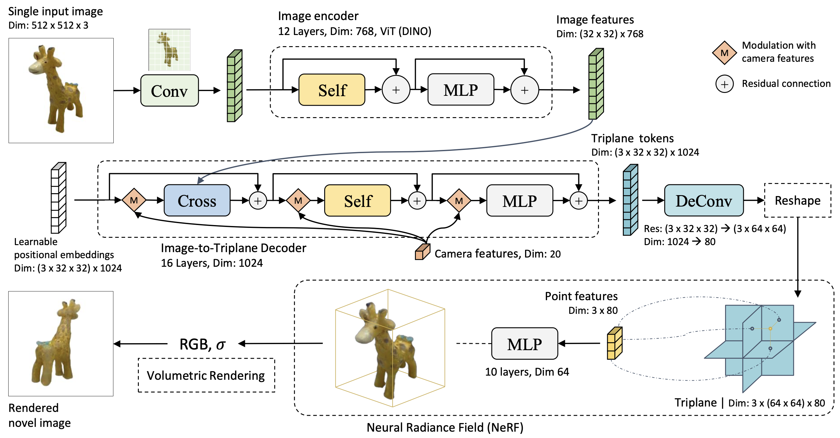
Reconstruct 3D from Single Image
Saito et al. PIFu, ICCV’19.
LRM: Regress NeRF tri-plane features from a RGB image
Notes:
Reconstruct NeRF from one image by regressing nerf triplane from single image.

Slide 4
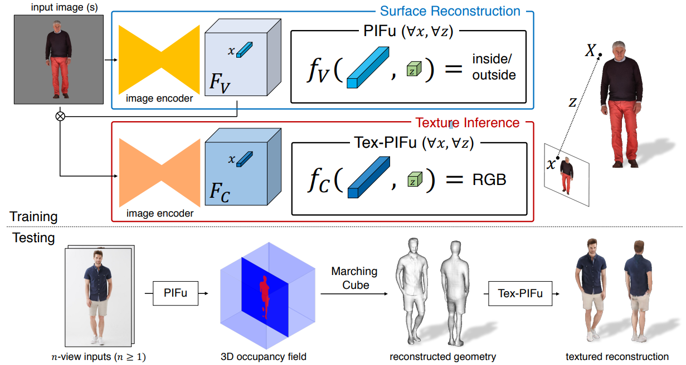
Reconstruct 3D from Single Image
Saito et al. PIFu, ICCV’19.
PiFU: regress occlusion field from a RGB image.
Notes:
Also, a pixel-aligned occupancy field can be used to model the volume.

Slide 5
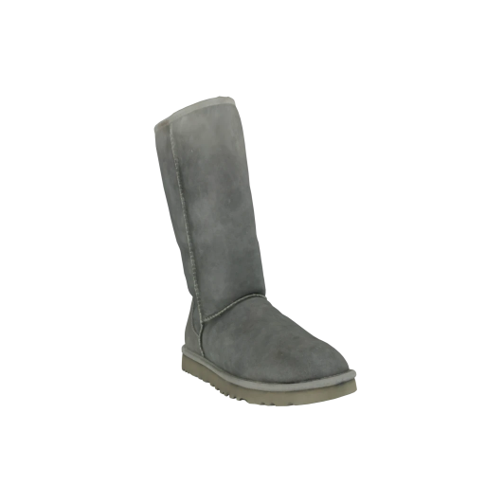
Reconstruct 3D from Single Image
Saito et al. PIFu, ICCV’19.
Limitation: no generative power, blurry occluded region.
Input Image
OpenLRM, He et al.
Notes:
This method, has limited modelling ability, especially in the occluded region, Because they are not generative model.

Slide 6
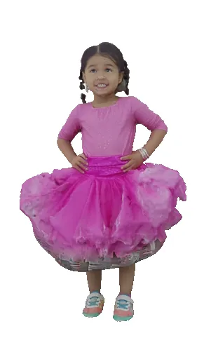
Reconstruct 3D from Single Image
Saito et al. PIFu, ICCV’19.
Limitation: no generative power, blurry occluded region.
Input Image
SiTH (CVPR 2024)
SiFU (CVPR 2024)

Slide 7
Motivation for generative model
Goal: single view reconstruction is ill-posed.
Deterministic model might collapse to average value.
We should learn a distribution of all possible configurations instead of simply regression.
Diffusion model for conditional generation!
Deterministic: learn an average
Generative model: learn a distribution
Notes:
If the reconstruction model is not generative, then it will try to model as avarage of training dataset. Thus, it will be blurry.
A solution will be training a conditional generative model to perform the single image reconstruction.

Slide 8
Main contents
3D Reconstruction from single Image
2D Diffusion Model for Novel-view Synthesis
Novel-view Diffusion Models
Multi-view Image Diffusion Models
Sync 2D Diffusion & 3D Reconstruction

Slide 9
Image Diffusion Model
Notes:
Diffusion model is very popular in image domain.

Slide 10
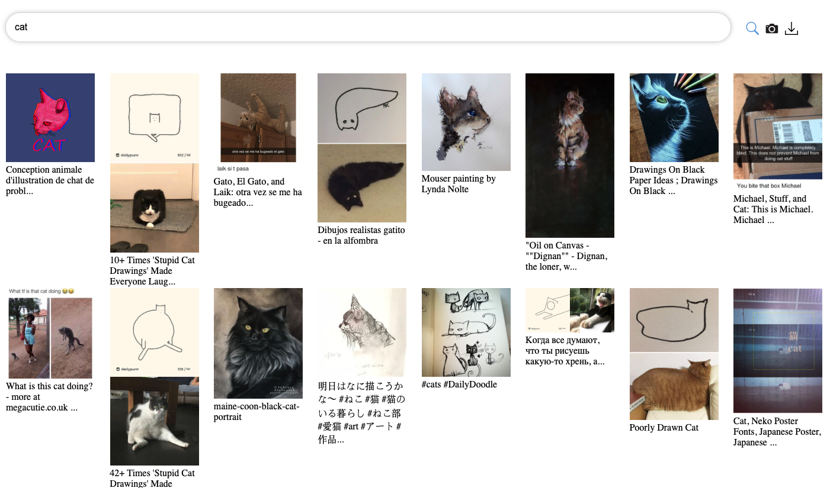
Large-scale Training
Laion5B:
5 Billion images
With Text annotations
Notes:
Thanks to the large-scale dataset, people train a very huge machine learning model for image generation (foundation models)

Slide 11
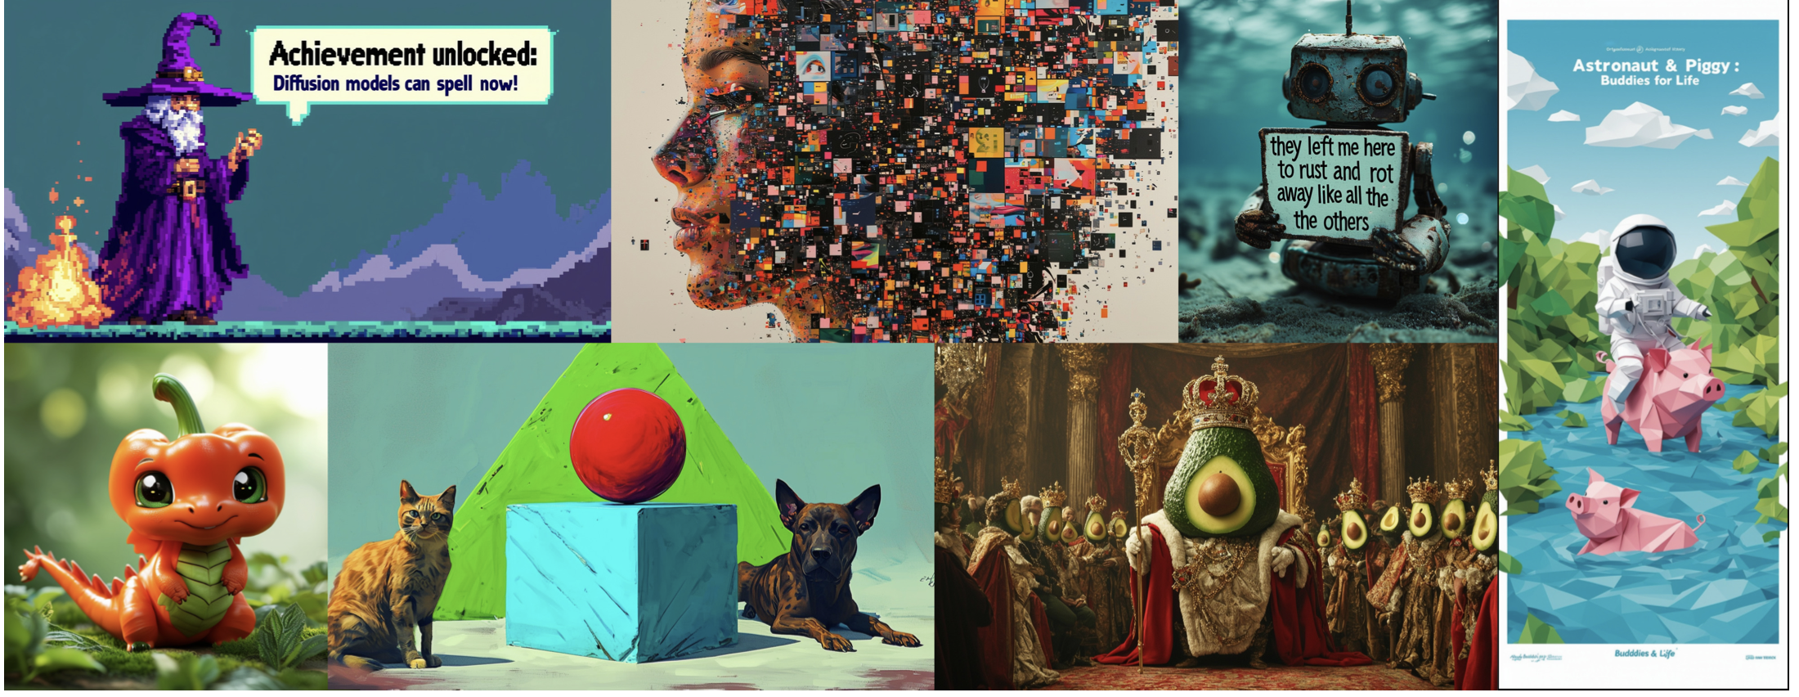
Superior image generation quality
Notes:
It allows those image diffusion models to achieve very high image generation quality.

Slide 12
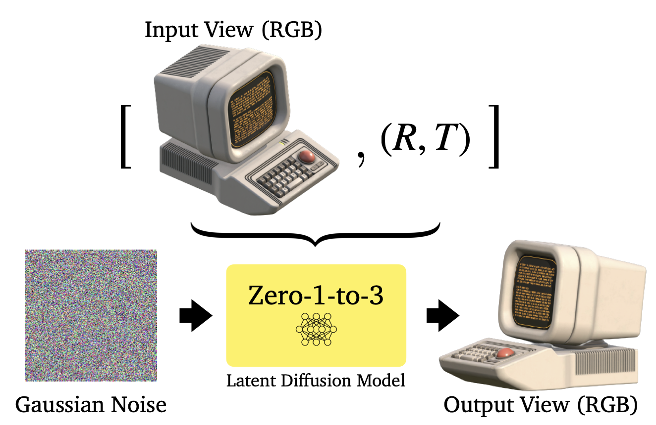
Novel-view Diffusion Model
Leverage Image diffusion prior, generate desired novel view image
Notes:
A diffusion model can be also trained to generate a image in a novel view. Given one image and desired camera view, the model can give the generated view as the corresponding view

Slide 13
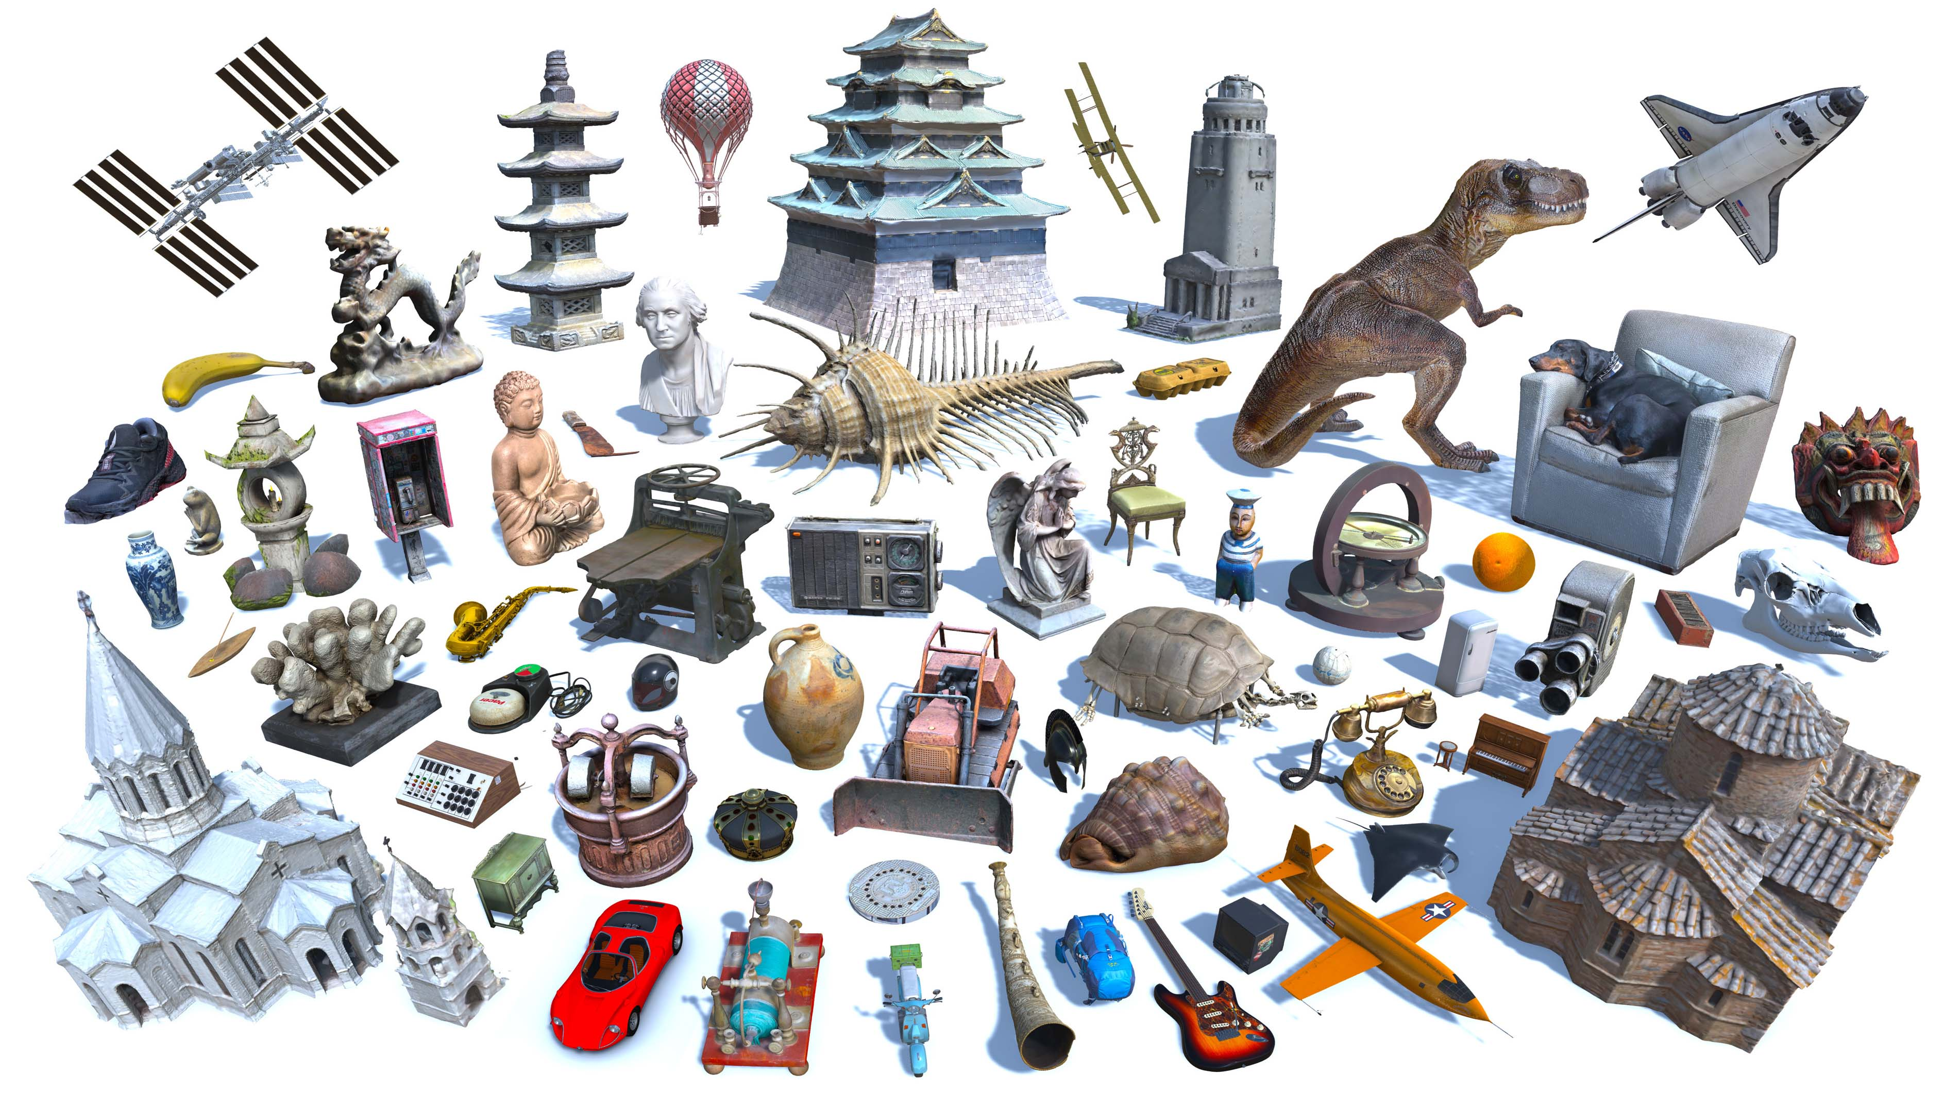
Large-scae Training
Objaverse:
800K 3D objects
Notes:
It also requires large-scale 3D dataset training, such as objaverse

Slide 14
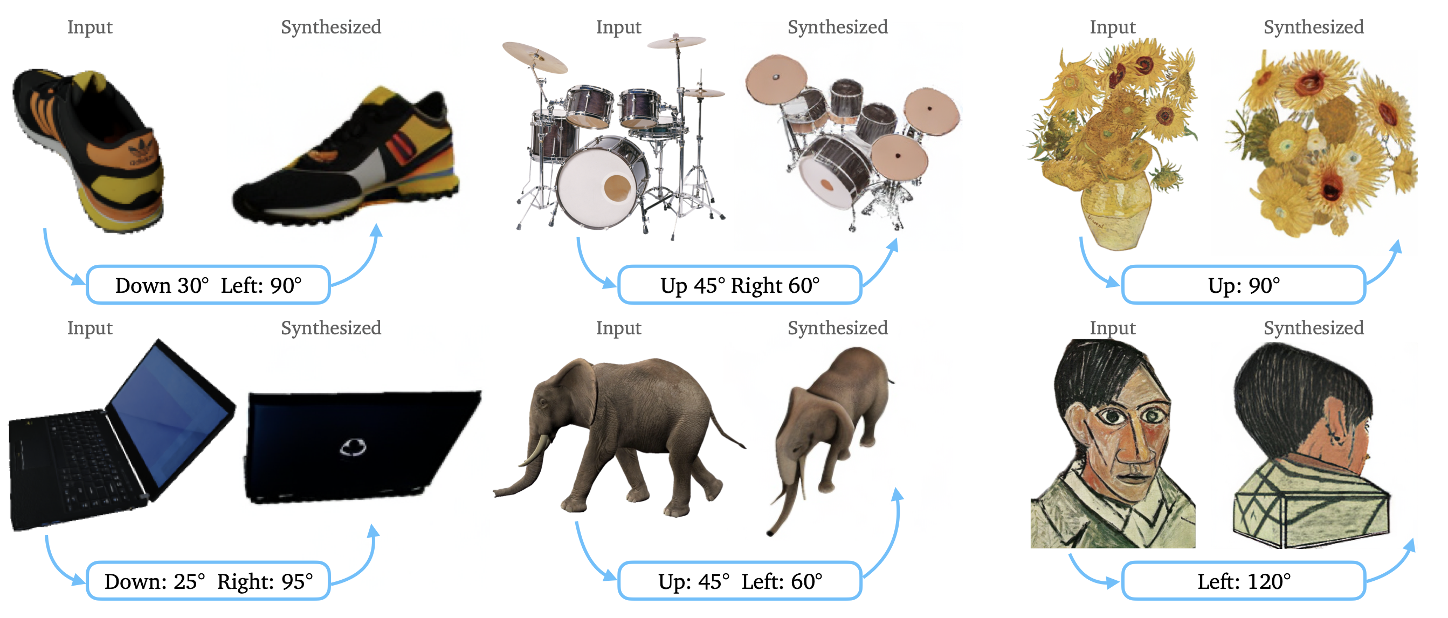
Novel-view Diffusion Model

Slide 15
Novel-view Diffusion Model
Limitation: each view generated individually, inconsistent across generation
Input Image
Zero123-XL, Liu et al.
Notes:
Although each view is realistic, They are not consistent across difference views.

Slide 16
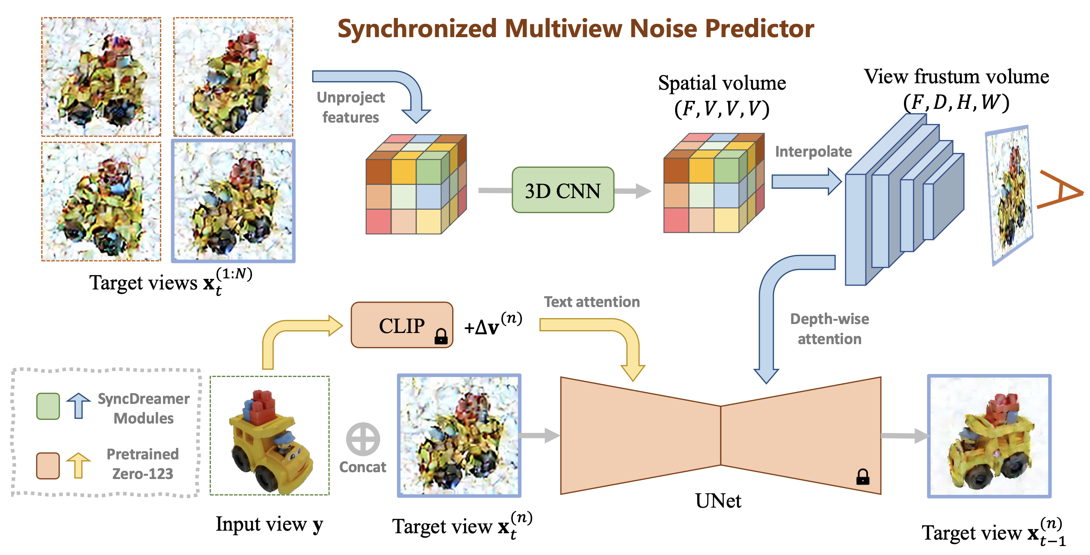
Multi-view Diffusion Model
Generate Multiple Views simultaneously, have more consistency
Notes:
People also modify the model, and allow it to generate multiple target views simultanously. These views will share some features, to exchange information.

Slide 17
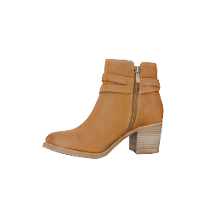
Multi-view Diffusion Model
Compared to Single-view Diffusion, the multi-view diffusion models are more consistent across generated novel views
Input Image
Single-view Diffusion
Multi-view Diffusion
Notes:
Multiview diffusion can generate much more consistent views than the single view diffusion.

Slide 18
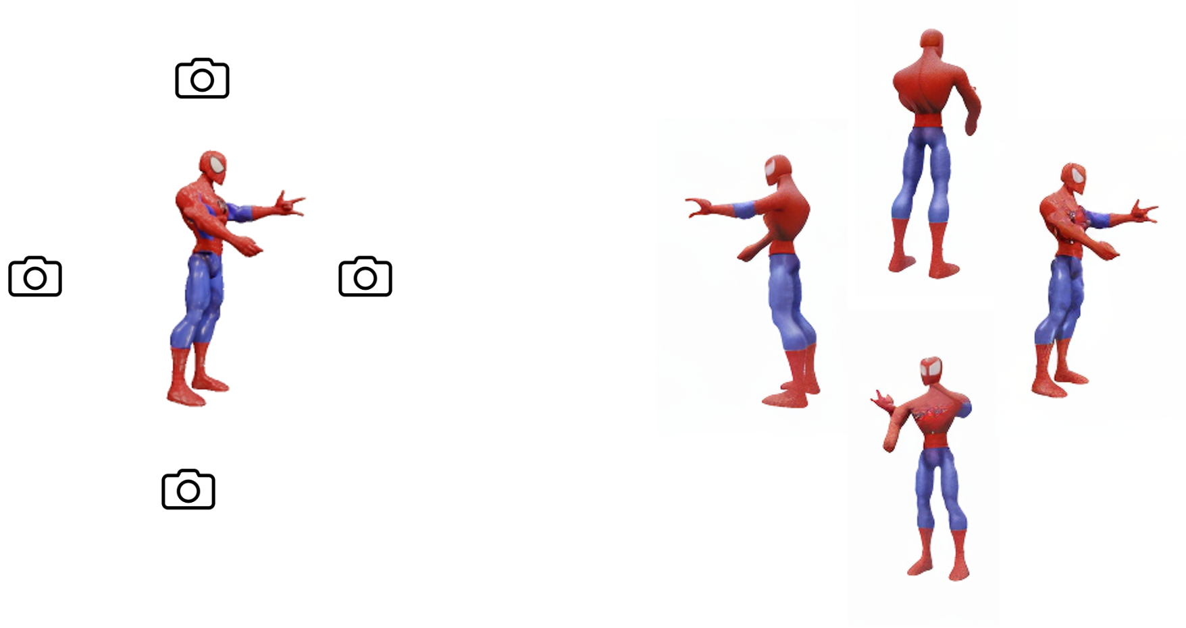
3D Consistency in 2D Multi-view Diffusion Model
2D Multi-view Diffusion has no explicit 3D representation (e.g. NeRF or 3D-GS). Thus, the 3D consistency of the generated images are not constrained.
Diffusion
Notes:
However, multiview diffusion can be 3D inconsistent

Slide 19
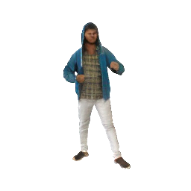
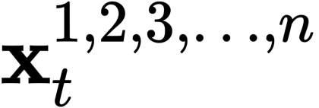
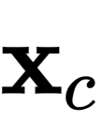
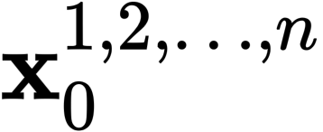
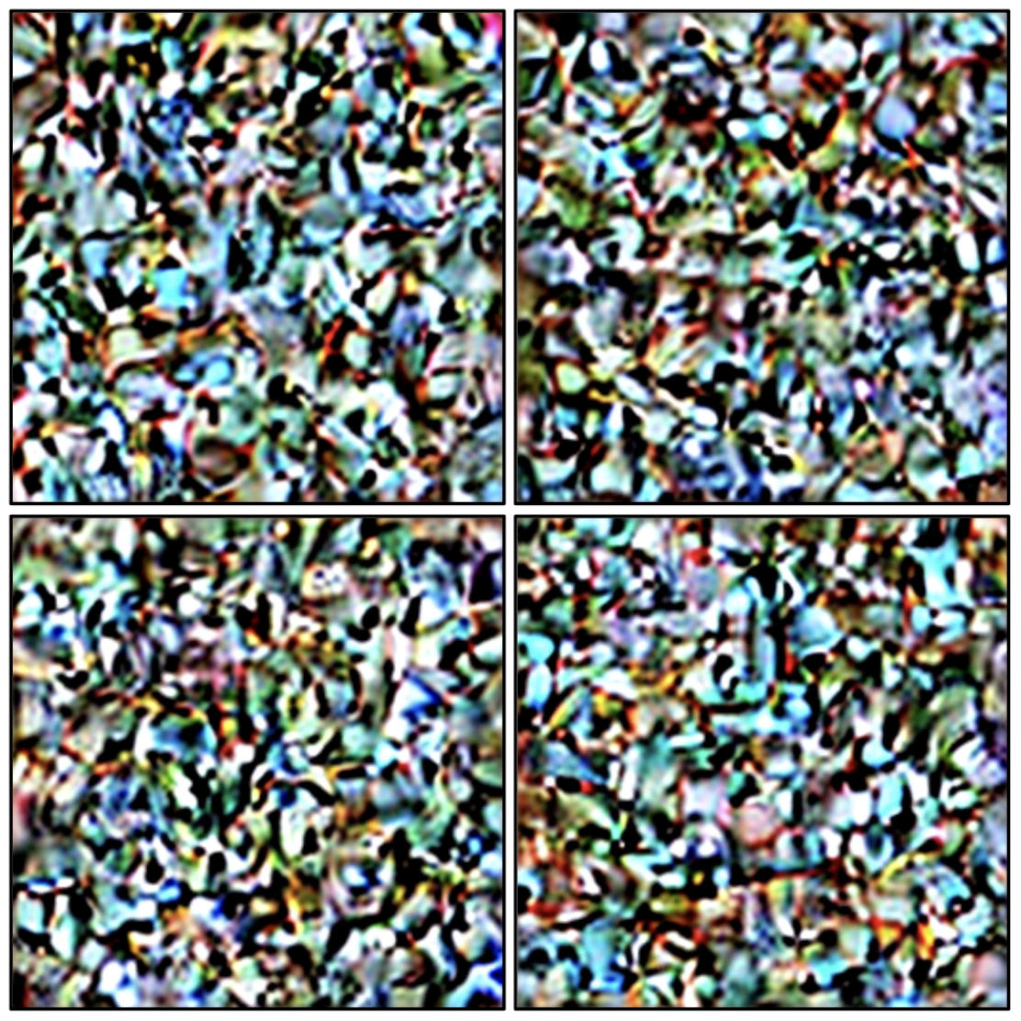
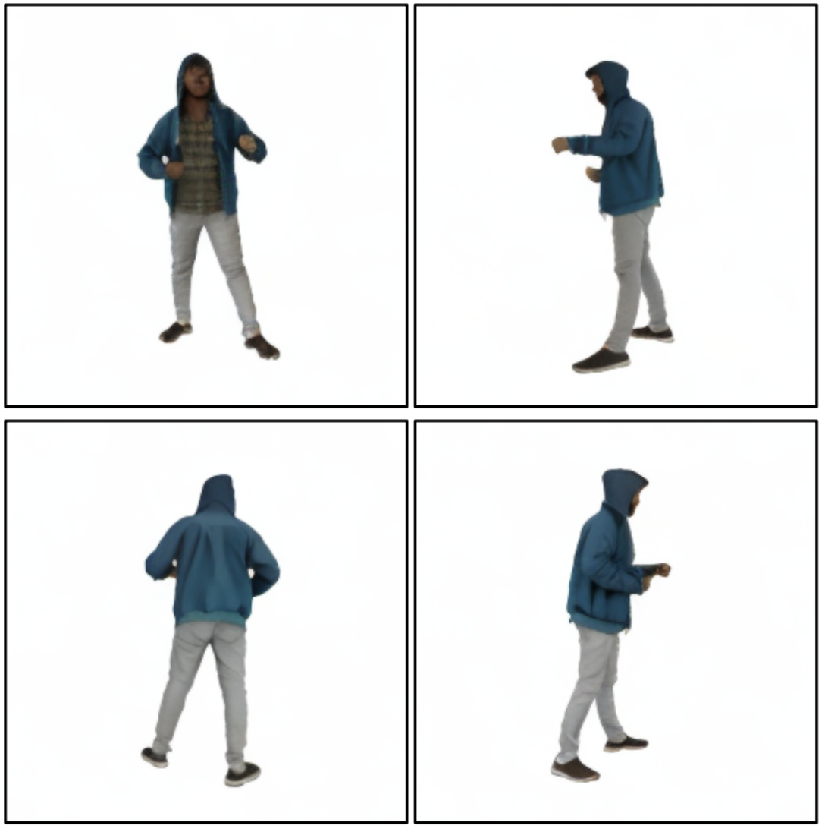
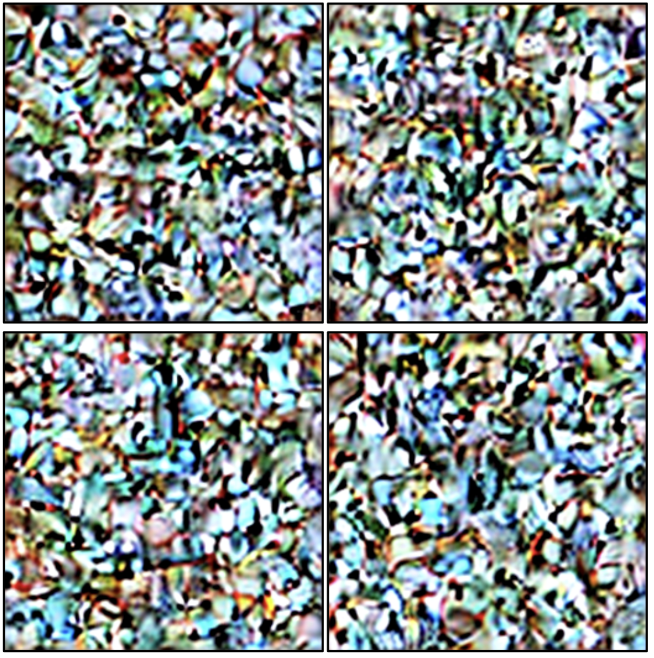
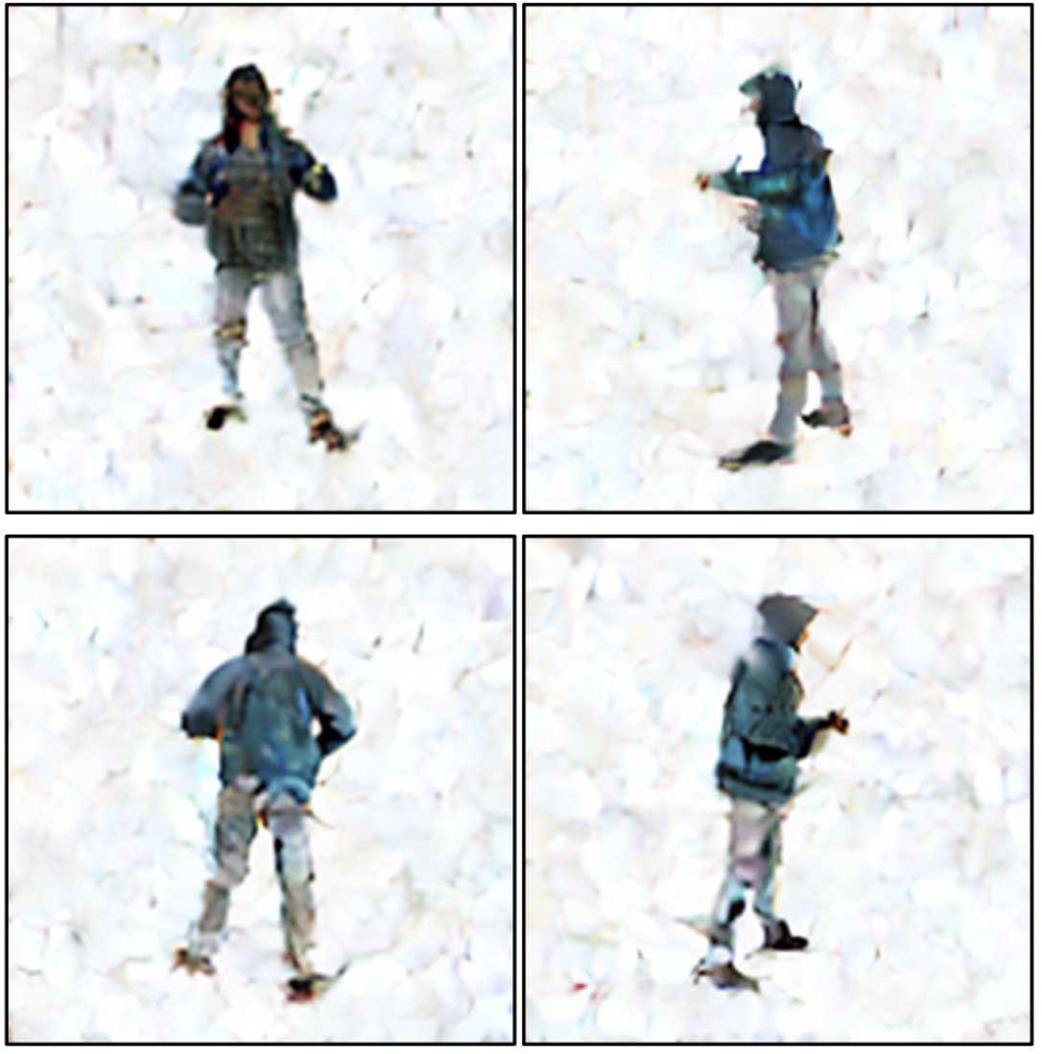
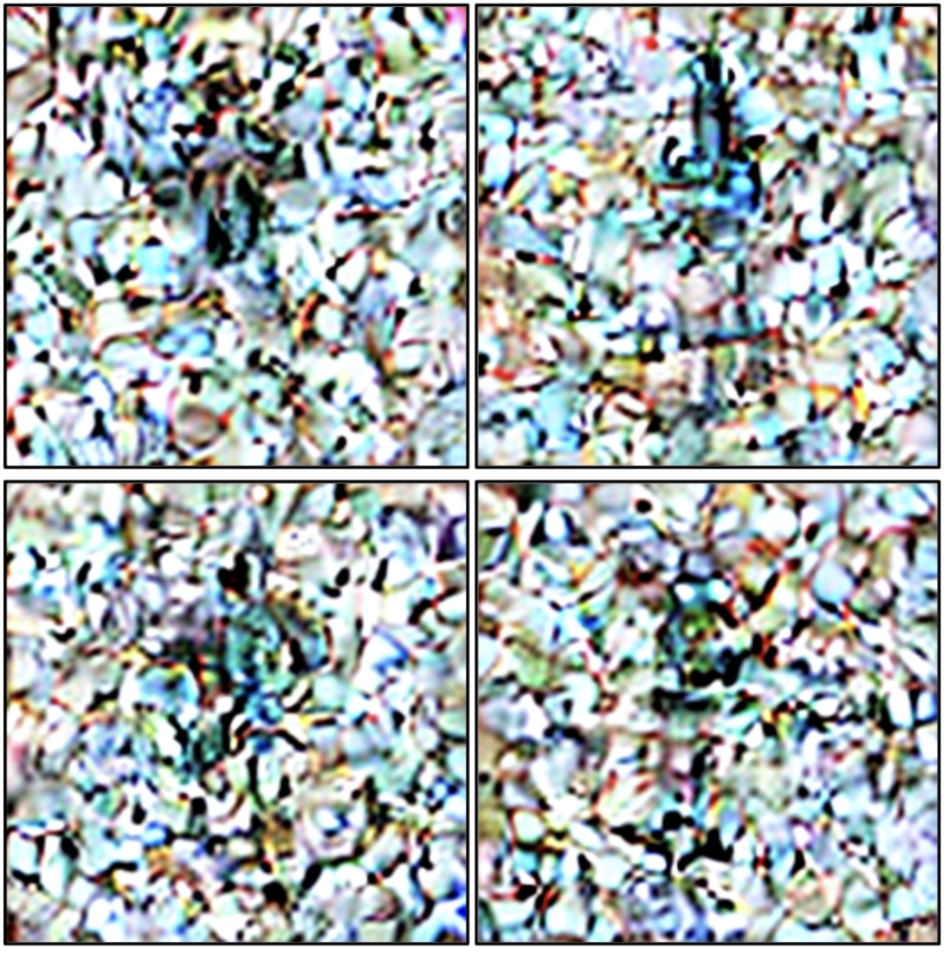
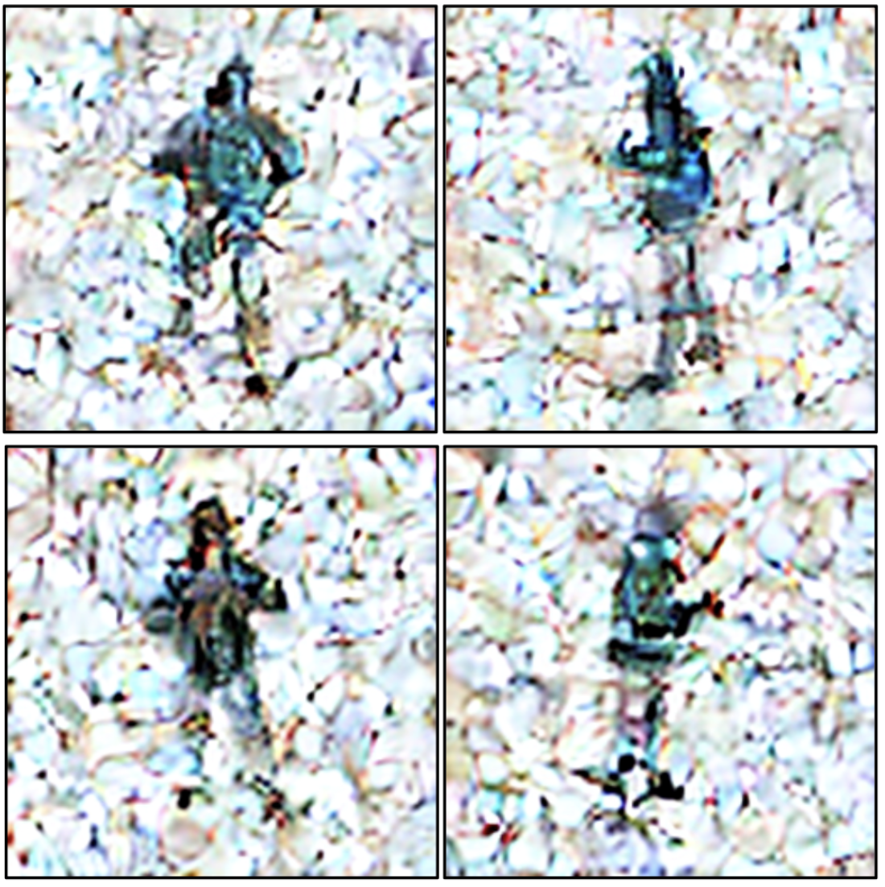
Multi-view Diffusion Model
Pre-trained on 5B 2D images and 800K 3D objects
Notes:
Technically, Multiview Diffusion models gradually denoise and finally generate the 4 views of the 3D objects of input view.

Slide 20
Multi-view Diffusion Model
Pre-trained on 5B 2D images and 800K 3D objects
Notes:
Technically, Multiview Diffusion models gradually denoise and finally generate the 4 views of the 3D objects of input view.

Slide 21
Multi-view Diffusion Model
Pre-trained on 5B 2D images and 800K 3D objects
Notes:
Technically, Multiview Diffusion models gradually denoise and finally generate the 4 views of the 3D objects of input view.

Slide 22
Multi-view Diffusion Model
Pre-trained on 5B 2D images and 800K 3D objects
Notes:
Technically, Multiview Diffusion models gradually denoise and finally generate the 4 views of the 3D objects of input view.
.

Slide 23
Multi-view Diffusion Model
Pre-trained on 5B 2D images and 800K 3D objects
Notes:
Technically, Multiview Diffusion models gradually denoise and finally generate the 4 views of the 3D objects of input view.

Slide 24
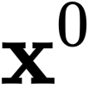
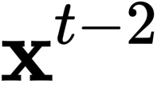
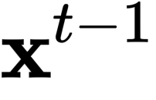
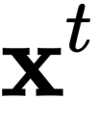
Inconsistency accumulates along trajectory
Groundtruth trajectory
Inconsistent trajectory

Slide 25
Main contents
3D Reconstruction from single Image
2D Diffusion Model for Novel-view Synthesis
Novel-view Diffusion Models
Multi-view Image Diffusion Models
Sync 2D Diffusion & 3D Reconstruction

Slide 26
Gen-3Diffusion: Sync 2D Diffusion & 3D Recon
2D Difffusion leverages Image Diffusion Prior
3D Reconstructor provides 3D representation
Explicit 3D representation ensures 2D multiview consistency
3D Gaussian Splats $\hat{𝒢}$
3D Gaussian Splats
Diffusion Model
2D Multi-view Diffusion Model
Synchronized at
each diffusion timestep t
Strong Multiview Shape Prior helps 3D generation

Slide 27
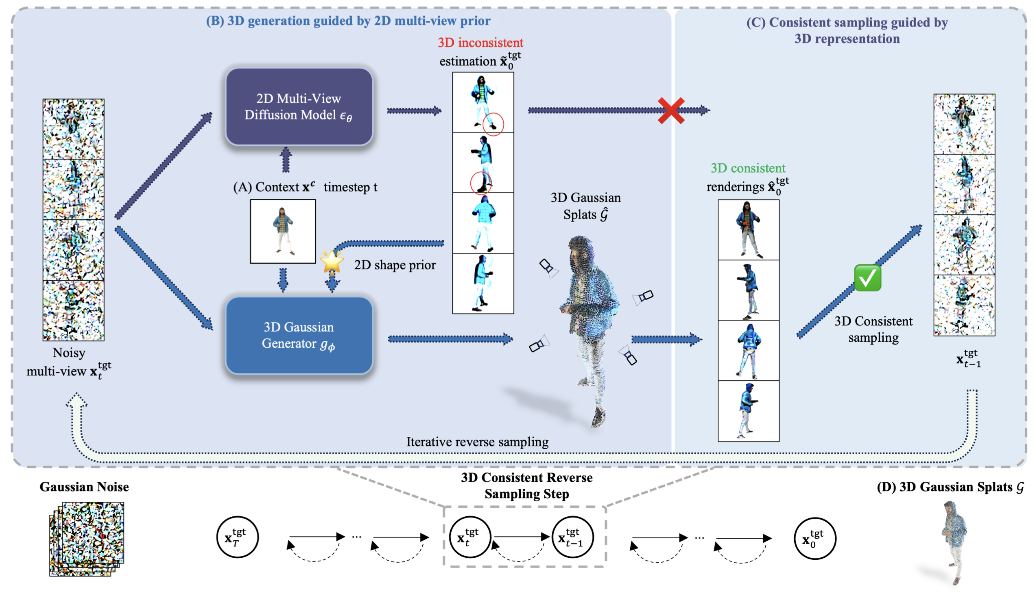

Slide 28
Algorithm

Slide 29
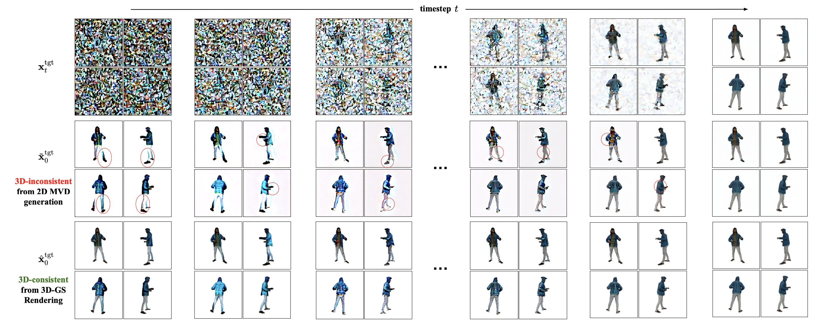
Explicit 3D-GS helps 2D Diffusion

Slide 30
Results: Object Reconstruction

Slide 31
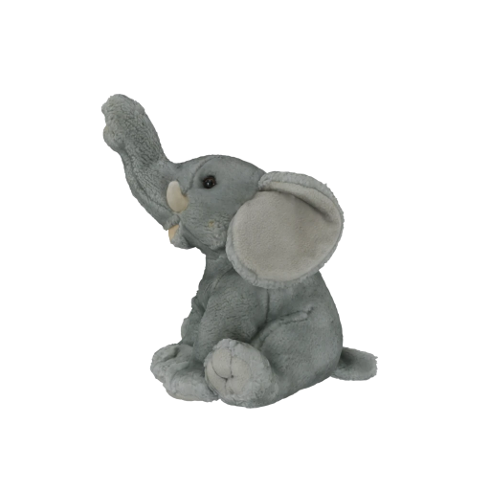
Reconstruction w/ novel view diffusion
Input Image
Gen-3Diffusion
Single-view Diffusion
Multi-view Diffusion
Notes:
We compare our Gen3Diffusion with novel view diffusion models, shows bettter performance especially in multi-view consistency of generated views.

Slide 32
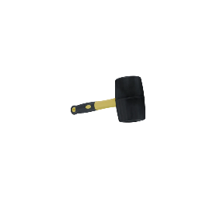
Reconstruction w/ novel view diffusion
Input Image
Gen-3Diffusion
Single-view Diffusion
Multi-view Diffusion

Slide 33
Reconstruction w/ novel view diffusion
Input Image
Gen-3Diffusion
Single-view Diffusion
Multi-view Diffusion

Slide 34
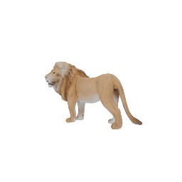
Reconstruction w/ novel view diffusion
Input Image
Gen-3Diffusion
Single-view Diffusion
Multi-view Diffusion

Slide 35
Reconstruction w/ direct 3d reconstruction
Input Image
Gen-3Diffusion
TripoSR
LGM
Notes:
We compare our Gen3Diffusion with 3D reconstruction methods, shows bettter performance especially in the unseen region from other views.

Slide 36
Reconstruction w/ direct 3d reconstruction
Input Image
Gen-3Diffusion
TripoSR
LGM

Slide 37
Reconstruction w/ direct 3d reconstruction
Input Image
Gen-3Diffusion
TripoSR
LGM

Slide 38
Reconstruction w/ direct 3d reconstruction
Input Image
Gen-3Diffusion
TripoSR
LGM

Slide 39
Results: Avatar Reconstruction

Slide 40
Reconstruction avatar appearance
Input Image
Gen-3Diffusion
SiTH
SiFU
Notes:
We compare Gen3Diffusion with two state-of-the-art avatar reconstruction works, show superior performance in both appearance and geometry.

Slide 41
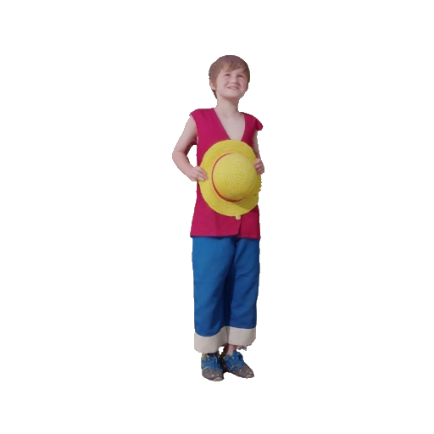
Reconstruction avatar appearance
Input Image
Gen-3Diffusion
SiTH
SiFU

Slide 42
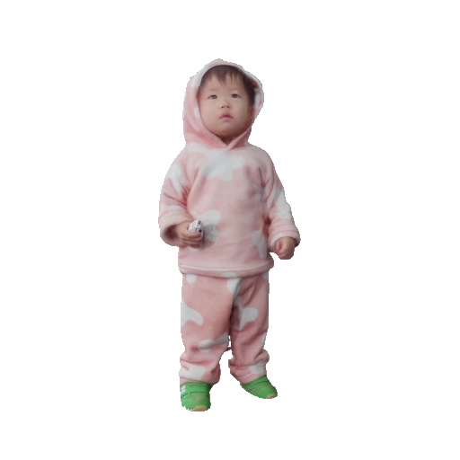
Children
Input Image
Gen-3Diffusion
SiTH
SiFU
Notes:
Previous works:
Rely on SMPL template
Limited in representing challenging scenarios

Slide 43
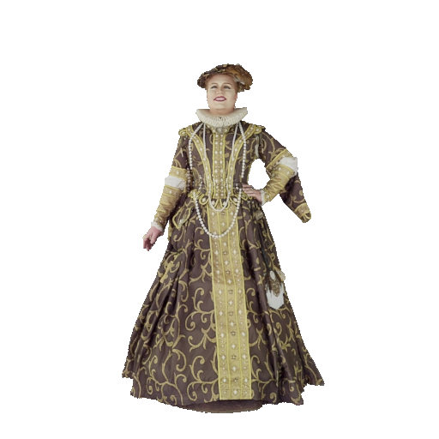
Reconstruction avatar geometry
Input Image
Gen-3Diffusion
ICON
ECON
Notes:
We compare Gen3Diffusion with two popular avatar reconstruction works, shows better reconstruction results in challenging subjects.

Slide 44
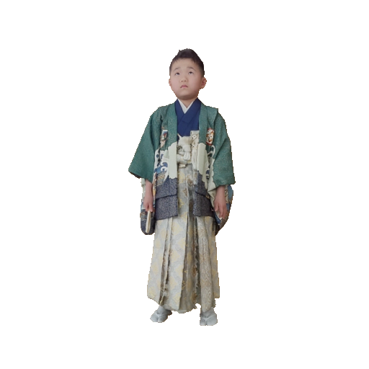
Reconstruction avatar geometry
Input Image
Gen-3Diffusion
ICON
ECON

Slide 45
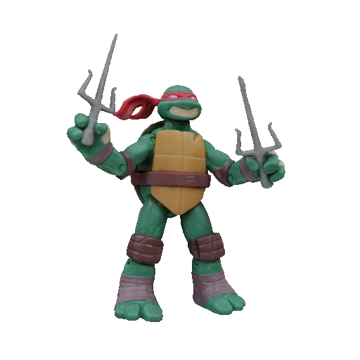
Strong generalization
Input Image
Gen-3Diffusion
SiTH
SiFU
ECON
Notes:
Although only trained on isolated human scans, Our Gen3Diffusion (avatar version) shows superior generalization ability.

Slide 46
Strong generalization
Notes:
This generaliation ability also shows on multi-human image reconstruction. This amazing generalizing ability is all thaks to the foundational power from the pre-trained 2D diffusion model.

Slide 47
Take away messages
With training on massive data, image diffusion models achieve superior image generation quality
The image diffusion prior can be applied to 3D tasks, e.g. generate novel views
Novel view diffusion models lack 3D consistency because they don’t have an explicit 3D representation
2D Diffusion Models and 3D Reconstruction Models can be combined to achieve excellent reconstruction capability

