Slide 1
Virtual Humans – Winter 24/25
Lecture 13_1 – Diffusion Models Theory
Prof. Dr.-Ing. Gerard Pons-Moll
University of Tübingen / MPI-Informatics

Slide 2
In this lecture…
Recap of deep generative models
Introduction of Diffusion Models
Applications of Diffusion Models
Notes:
List of contents

Slide 3
Goal: Generate Virtual Humans
Generate Appearance
Generate Motion
Notes:
Goal of diffusion model in VH: generate virtual human appearance, and generate virtual human behaviour

Slide 4
So far we have seen…
We can capture human appearance (NeRF, 3DGS)
We can capture human motion (MoCap, Registration)
We can capture human-object interaction (Behave, PHOSA, CHORE)
Can we also generate the appearance and motion of ”human”?
Why is "synthesis" of Virtual Human useful?
Notes:
We already see capture methods, which collects a lot of data
Can we literatelly also generate them from Gaussian noise?

Slide 5
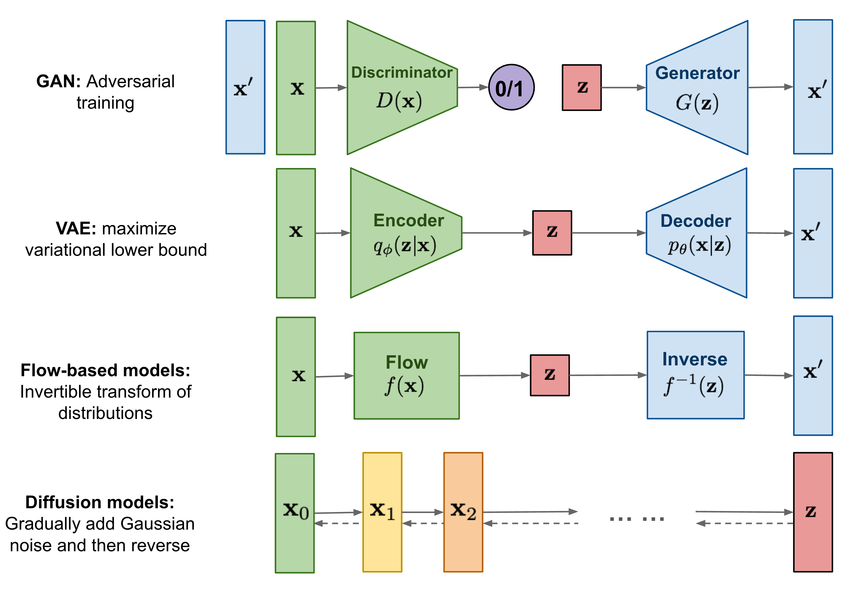
Generative Models
Notes:
In previous lectures, we already covered the VAE in motion synthesis. There are also other types of generative models, including GAN, Flow-based models, and our topic today, the diffusion model.
GAN: has a discriminator, to verify if generated data is realistic enough. Perform adversarial training
VAE: as last lecture introduced, it maximizes variational lower bound.
Diffusion models; try to estimate the trajectory from Gaussian distribution to the real data distribution. It adds noise on real data distribution and see how it approximates Gaussian. In reverse steps It can perform nosie removing from Gaussian noise.

Slide 6
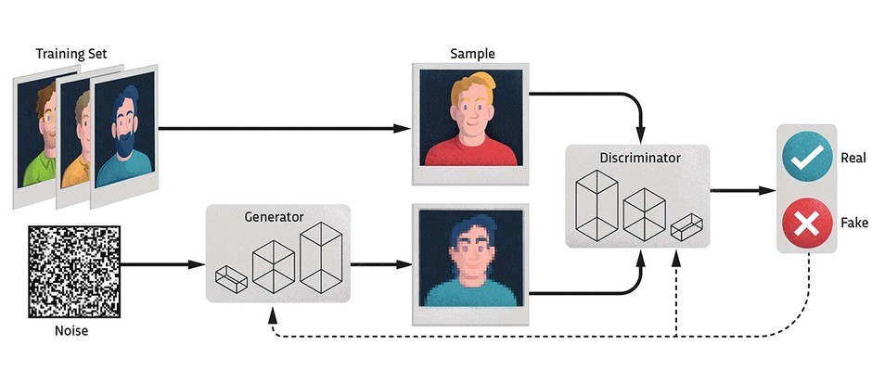
GAN
Notes:
Here indicates how GAN works.
Generator: generate from Gaussian noise
Discrminator decides if it is real nough.
If generated sample can already foul the discriminator, it means the generator is excellent and can synthesize realistic samples.

Slide 7
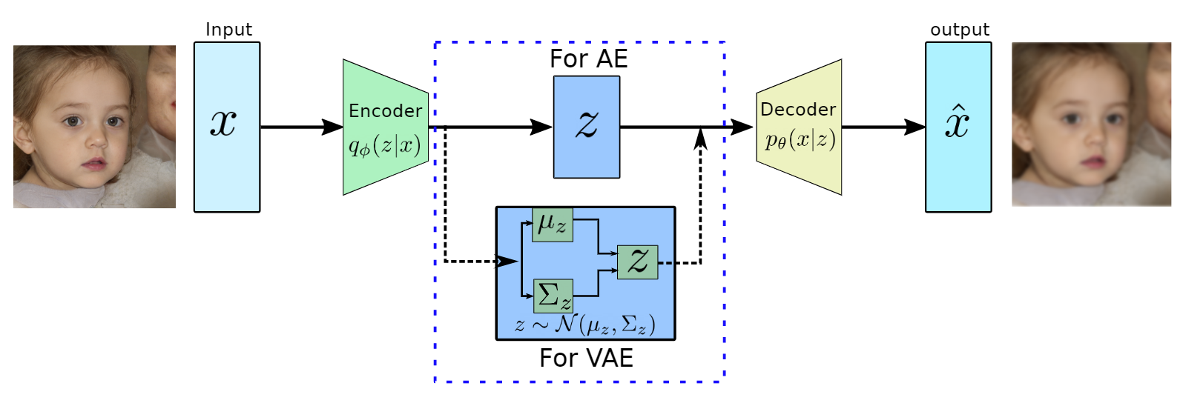
VAE
Notes:
VAE lean a latent space, which follows the Gaussian distribution.
The training maximizes the variational lower bound.
During inference time, people draw sample from Gaussian distribution, and decode them to the output.

Slide 8
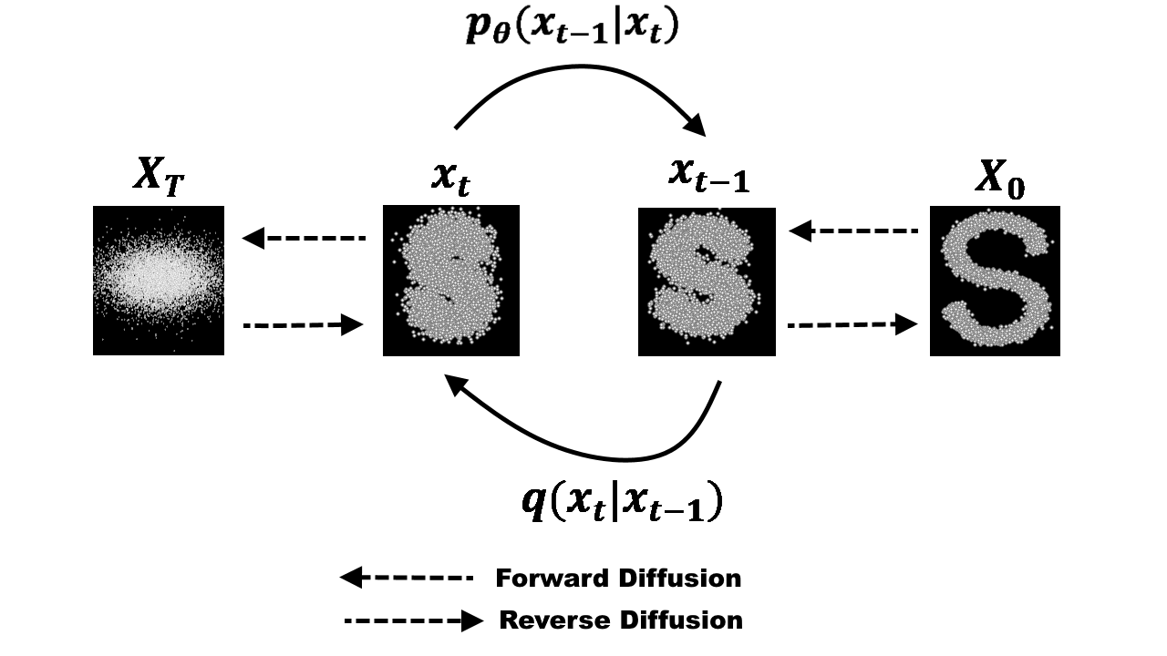
Diffusion Models
Notes:
Our focus in this lecture is about diffusion models.
We want to lean the true data distribution, and we decompose it to the problem of learning the step-wise trajectory from the Gaussian noise to the true data distribution.
In forward step: it add gaussian noise, until it is noisy enough and become gaussian noise
Then the model learns how much noise is added to each step
Then it will be used to predict amount of noise to remove -> can be used to iteratively approximate the clear sample x0

Slide 9
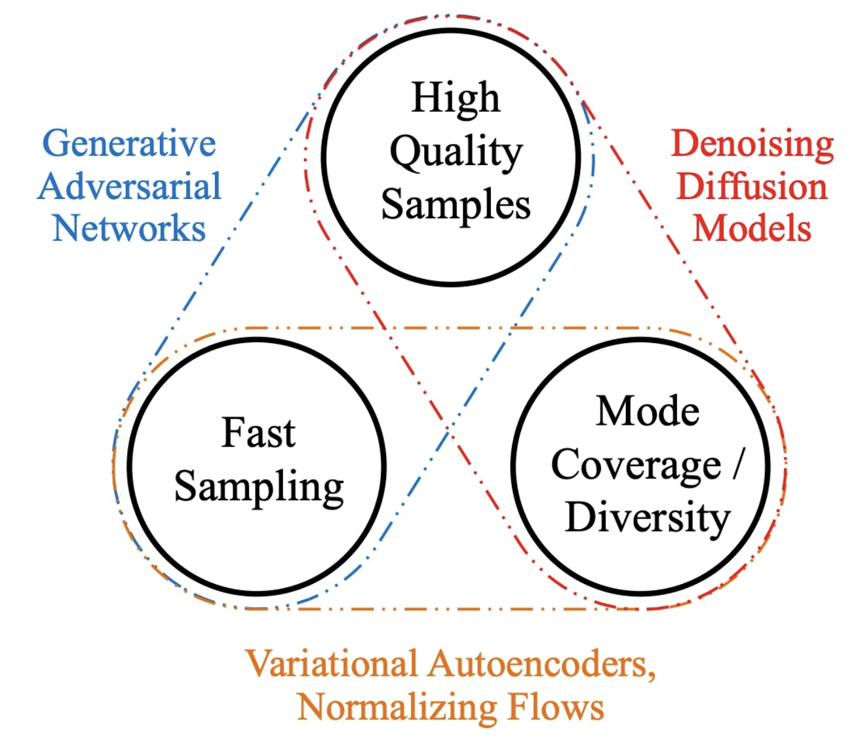
Trilemma: Quality, Diversity Speed
Notes:
Different generative models have different properties.
GAN and VAE only have one-step generator, thus they are very fast.
Diffusion models need to perform iterative noise prediction and substraction, thus it takes time.
However it can generate good samples and has strong generalization ability.
Also in practical the diffusion models are easier to train than the GAN. Thus it is so popular in recent years.

Slide 10
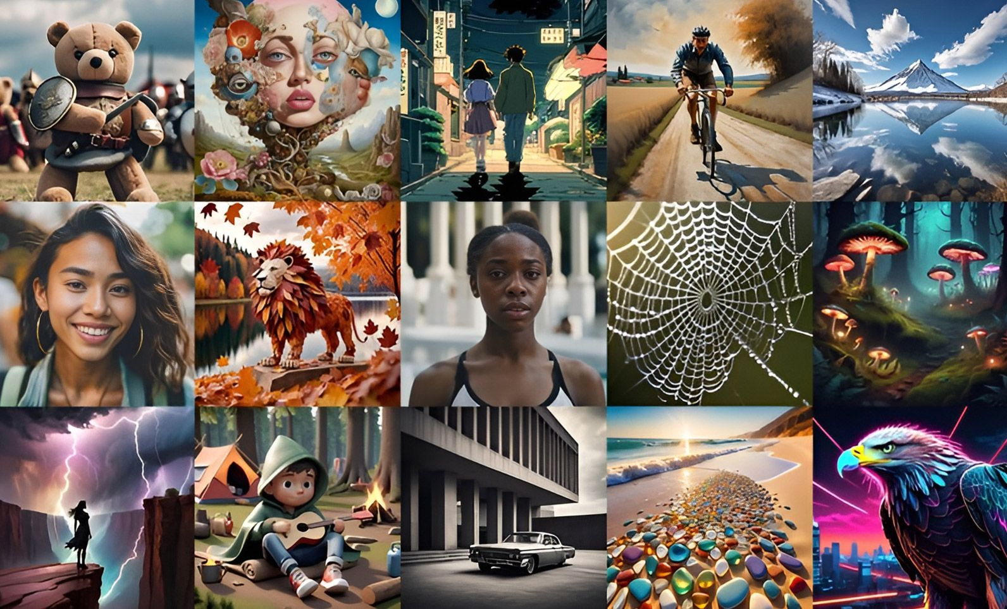
Diffusion Model for Image Generation
Diffusion model is SOTA on image generation
Stable Diffusion
Mid-Journey
Flux
…
Notes:
Diffusion models has been widely used in the image generation, such as text to image model. The most recent AI image generators are all using diffusion models.
It can greatly follow the text input and generate corresponding images with different styles.

Slide 11
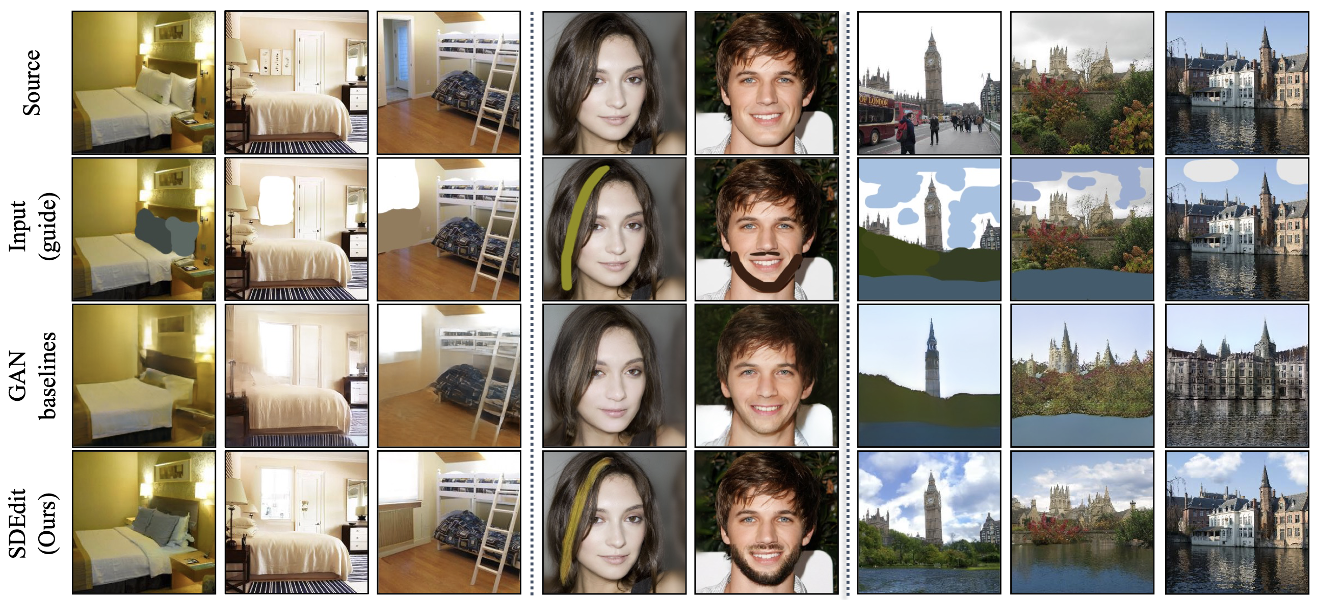
Diffusion Model for Image Generation
Diffusion model is useful for image editing
Notes:
Similar to text-to-image, it can be also used to edit existing image. Here, given an image, the diffusion model performs better than GAN in impainting the masked region.

Slide 12
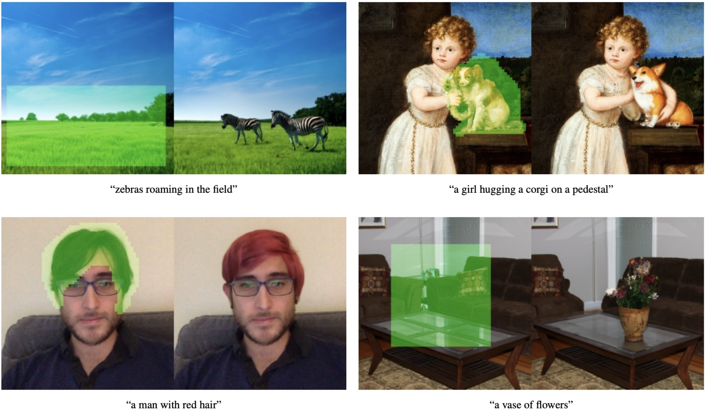
Diffusion Model for Image Generation
Diffusion model is useful for image editing
Notes:
Also, it can be combined with text prompt, so that it can be inpainted with desired features.

Slide 13
Diffusion Model for Image Generation
Diffusion model is applicable for other non-visual domains
Generate motion from text
Notes:
Apart from image domain, diffusion models are also widely applied in the motion generation.

Slide 14
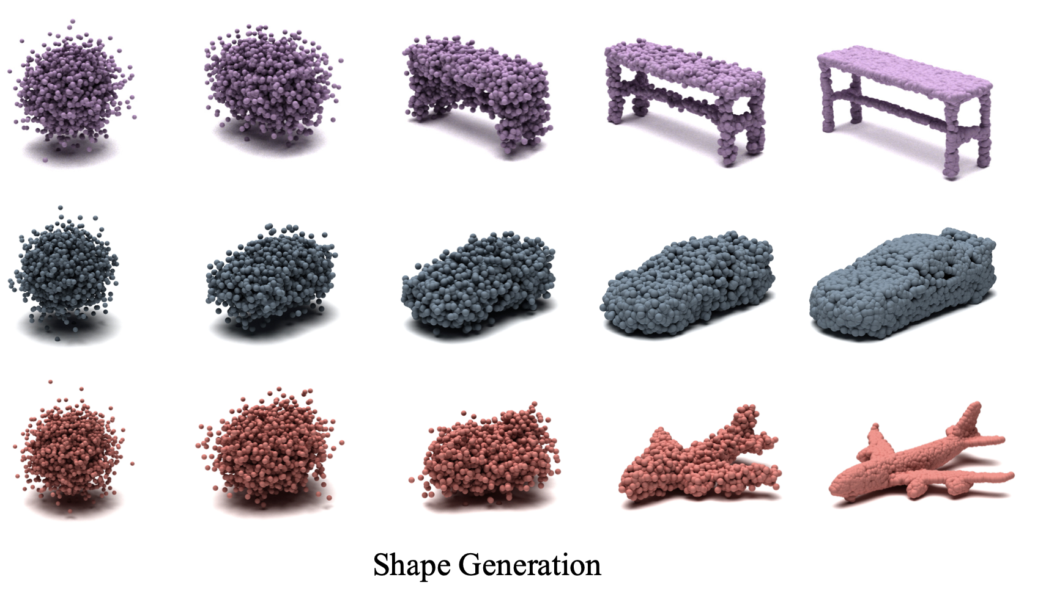
Diffusion Model for Image Generation
Diffusion model is applicable for other non-visual domains
Generate 3D point cloud
Notes:
Also, diffusion models are applied to the 3D point cloud generation. We will cover this and motion generation in following lectures.

Slide 15
Diffusion Probabilistic Models
Diffusion model aims to learn the reverse of noise generation procedure
Forward step: (Iteratively) Add noise to the original sample
→ The sample 𝑥! converges to the complete noise $xT$ (e.g., ∼ 𝒩(0, 𝐼))
Reverse step: Recover the original sample from the noise
→ Note that it is the “generation” procedure
Notes:
Diffusion probabilisitc models leans the trajectory between the gaussian distribution, and the desired distribution.
Training: forward step; Iteratively add Gausian noise on the sample, until it become Gaussian noise Xt.
Generation: reverse step: sample from gaussian distribution, and try to remove noise at each step. Until it arrives the clear sample x0.
Markov chain: only depends on the last step.

Slide 16
Diffusion Probabilistic Models
Diffusion model aims to learn the reverse of noise generation procedure
Forward step: (Iteratively) Add noise to the original sample
→ Technically, it is a product of conditional noise distributions 𝑞(𝐱_{t}|𝐱_{t-1})
Usually, the parameters 𝛽_{t} are fixed (one can jointly learn, but not beneficial)
• Noise annealing (i.e., reducing noise scale 𝛽_{t} < 𝛽_{t-1}) is crucial to the performance
Notes:
Beta is a scheduling parameter, used to anneal the noise level to add and remove at each timestep.
From t-1 to t, the noise scal beta is reduced, which is practically crucial to the performance.

Slide 17
Diffusion Probabilistic Models
Diffusion model aims to learn the reverse of noise generation procedure
Forward step: (Iteratively) Add noise to the original sample
→ Technically, it is a product of conditional noise distributions 𝑞(𝐱_{t}|𝐱_{t-1})
Reverse step: Recover the original sample from the noise
→ It is also a product of conditional (de)noise distributions 𝑝$θ$(𝐱_{t-1}|𝐱_{t})
• Use the learned parameters: denoiser 𝝁$θ$ (main part) and randomness 𝚺$θ$
Notes:
Important is tp predict the noise value to denoise. Given the current noise sample xt, a network parametrizes by theta is used to predict the noise to remove.

Slide 18
Diffusion Probabilistic Models
Diffusion model aims to learn the reverse of noise generation procedure
Forward step: (Iteratively) Add noise to the original sample
Reverse step: Recover the original sample from the noise
Training: Minimize variational lower bound of the model 𝑝$θ$(𝐱₀)
Notes:
Similar to vae, diffusion model also minimizes the variational lower bound at each diffusion timestep.

Slide 19
Diffusion Probabilistic Models
Diffusion model aims to learn the reverse of noise generation procedure
Training: Minimize variational lower bound of the model 𝑝$θ$(𝐱₀)
→ It can be decomposed to the step-wise losses (for each step 𝑡)

Slide 20
Diffusion Probabilistic Models
Diffusion model aims to learn the reverse of noise generation procedure
Training: Minimize variational lower bound of the model 𝑝$θ$(𝐱₀)
→ It can be decomposed to the step-wise losses (for each step 𝑡)
Here, the true reverse step 𝑞(𝐱_{t-1}|𝐱_{t}, 𝐱₀) can be computed as a closed form of 𝛽_{t}
Note that we only define the true forward step 𝑞(𝐱_{t}|𝐱_{t-1})
Notes:
The reverse step is computed from x0 and xt. It can be seen as sample from the Gaussian distribution, which the mean is sampled from the xt and x0.

Slide 21
Diffusion Probabilistic Models
Diffusion model aims to learn the reverse of noise generation procedure
Network: Use the image-to-image translation (e.g., U-Net) architectures
Recall that input is 𝐱t and output is 𝐱t-1, both are images
• It is expensive since both input and output are high-dimensional
• Note that the denoiser 𝜇$θ$(𝐱_{t}, t) conditioned by step 𝑡
Notes:
In practical, a network is used to predict the noise value at each timestep t. For image domain, people usually use a Unet to perform such a image-to-image translation (from xt to xt-1 value)

Slide 22
Diffusion Probabilistic Models
Diffusion model aims to learn the reverse of noise generation procedure
Sampling: Draw a random noise 𝒙_{T} then apply the reverse step 𝑝$θ$(𝐱_{t-1}|𝐱_{t})
It often requires the 1000 reverse steps (very slow)
Notes:
From pure gaussian noise, it perform 1000 steps reverse sampling, where gradually decome less noisy and clear.

Slide 23
Diffusion Probabilistic Models
Diffusion model aims to learn the reverse of noise generation procedure
Sampling: Draw a random noise 𝒙_{T} then apply the reverse step 𝑝$θ$(𝐱_{t-1}|𝐱_{t})
Early and late steps change the high- and low-level attributes, respectively
Notes:
At beginning of reverse sampling, it changes the high level attributes, While the less noisier input only has samll changes.

Slide 24
Denoising Diffusion Probabilistic Models
DDPM reparametrizes the reverse distributions of diffusion models
Key idea: The original reverse step fully creates the denoiser 𝜇$θ$(𝐱_{t}, t)
However, 𝐱_{t-1} and 𝐱_{t} share most information, and thus it is redundant
→ Instead, create the residual 𝜖$θ$(𝐱_{t}, t) and add to the original 𝐱_{t}
Formally, DDPM reparametrizes the learned reverse distribution as
and the step-wise objective 𝐿_{t-1} can be reformulated as
Notes:
Gerard: add or subtract?? -> Yuxuan: here is the training of DDPM. Thus, the predicted noise should be as close as the sampled gaussian noise during training.
DDPM: the network predicts noise, instead of xt-1.

Slide 25
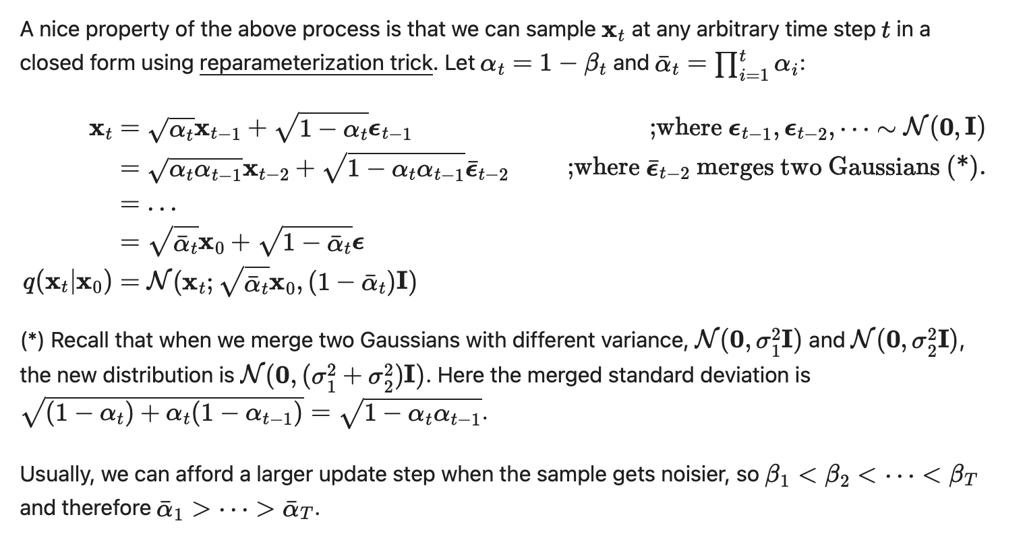
Reparametrization for forward
Unhide it if necessary

Slide 26
Denoising Diffusion Implicit Models
DDIM roughly sketches the final sample, then refine it with the reverse process
Motivation:
Diffusion model is slow due to the iterative procedure
GAN/VAE creates the sample by one-shot forward operation
⇒ Can we combine the advantages for fast sampling of diffusion models?
Technical spoiler:
Instead of naïvely applying diffusion model upon GAN/VAE,
DDIM proposes a principled approach of rough sketch + refinement
Notes:
DDPM requires a lot of steps. It is much slower than the GAN or VAE which only needs one step. Can we improve the efficiency of the DDPM? Yes, we can use DDIM, which can do the rough sketch + refinement.

Slide 27
Denoising Diffusion Implicit Models
DDIM roughly sketches the final sample, then refine it with the reverse process
Key Idea:
Given 𝐱_{t}, generate the rough sketch 𝐱₀ and refine 𝑝$θ$(𝐱_{t-1}|𝐱_{t})
Unlike original diffusion model, it is not a Markovian structure
Original Diffusion
Non-Markovian
Notes:
Compared to DDPM which performs at each individual step, the DDIM first roughly estimate x0, and then use it to refine the modelling of xt-1

Slide 28
Denoising Diffusion Implicit Models
DDIM roughly sketches the final sample, then refine it with the reverse process
Key Idea: Given 𝐱_{t}, generate the rough sketch 𝐱₀ and refine 𝑝$θ$(𝐱_{t-1}|𝐱_{t})
Formulation: Define the forward distribution 𝑞(𝐱_{t-1}|𝐱_{t}, 𝐱₀) as
then, the forward process is derived from Bayes’ rule
Notes:
The formulation can be seen as here

Slide 29
Denoising Diffusion Implicit Models
DDIM roughly sketches the final sample, then refine it with the reverse process
Key Idea: Given 𝐱_{t}, generate the rough sketch 𝐱₀ and refine 𝑝$θ$(𝐱_{t-1}|𝐱_{t})
Formulation: Forward process is
and reverse process is
Notes:
The reverse process is this.

Slide 30
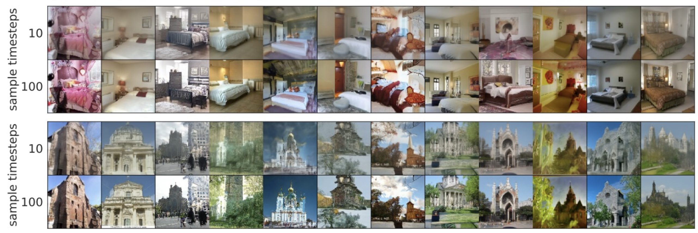
Denoising Diffusion Implicit Models
DDIM significantly reduces the sampling steps of diffusion model
Creates the outline of the sample after only 100 steps (DDPM needs thousands)
Notes:
With DDIM, people can dramatically improve the inference speed.

Slide 31
Takeaways
New golden era of generative models
Competition of various approaches: GAN, VAE, flow, diffusion model
Diffusion model seems to be a nice option for high-quality generation

