Slide 1
Virtual Humans – Winter 23/24
Lecture 4_1 – ICP: Iterative Closest Points
Prof. Dr.-Ing. Gerard Pons-Moll
University of Tübingen / MPI-Informatics

Slide 2
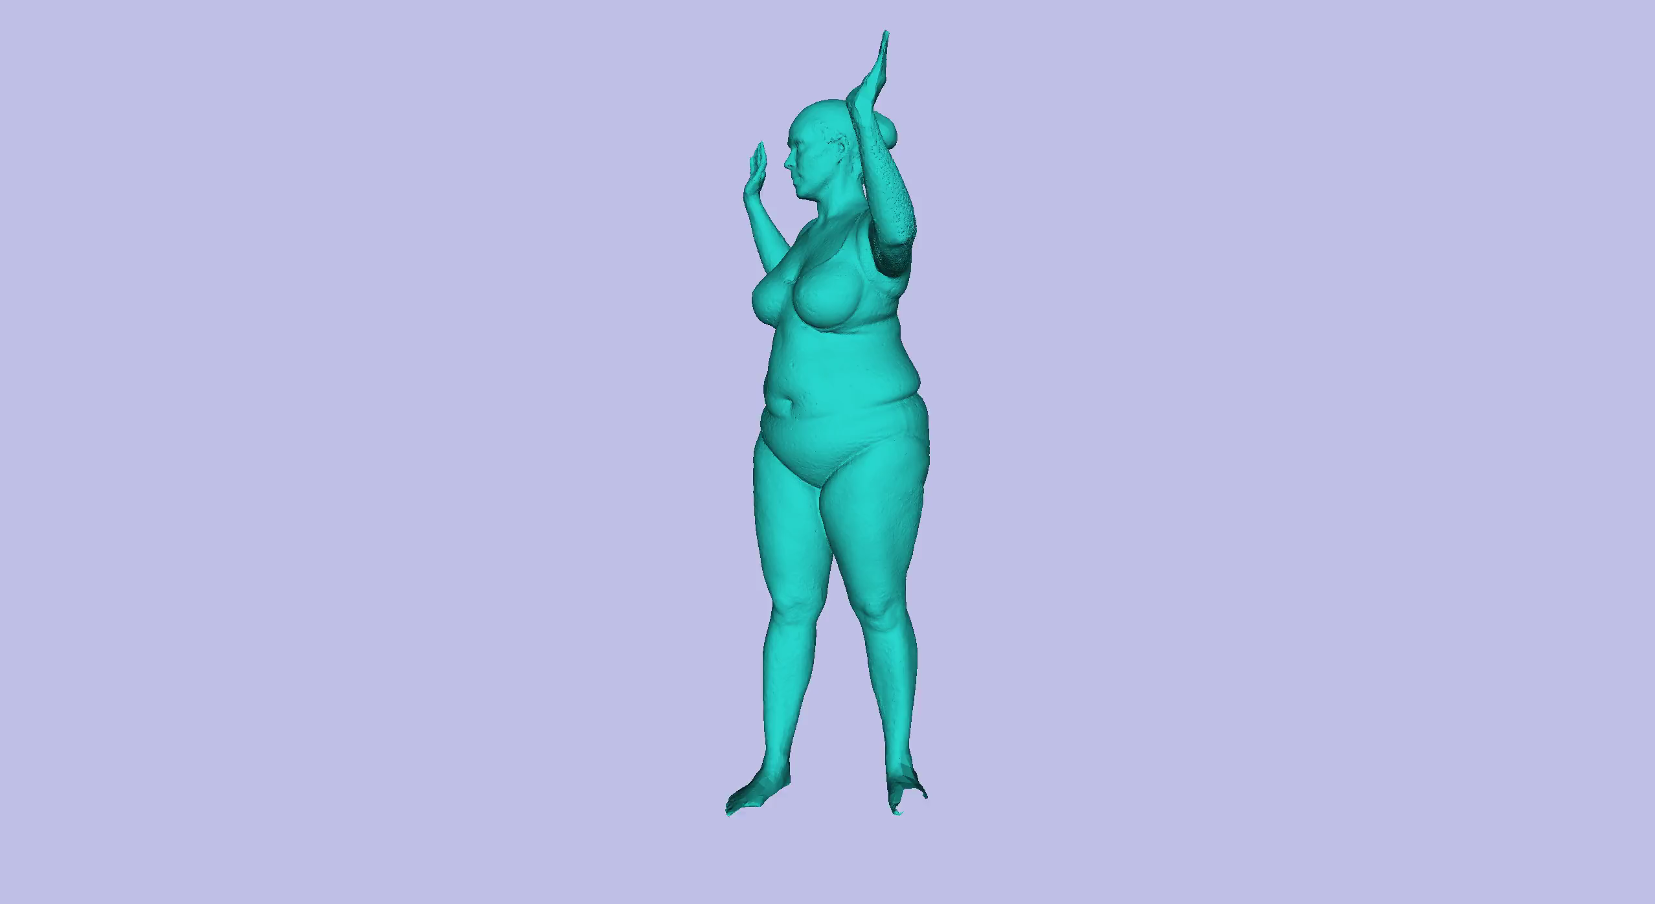
Non-rigid Articulated Registration
Notes:
In reality we need to non-rigidly align bodies. Not only rotation, translation and scale, but also articulation and non-rigid alignment

Slide 3
What is missing?
Given correspondences, we can find the optimal rigid alignment with Procrustes.
PROBLEMS:
How do we find the correspondences between shapes ?
How do we align shapes non-rigidly ?
Notes:
We have two remaining problems. How do we find the correspondences. How do we align non-rigidly

Slide 4
ICP and alignment based on optimisation
Optimising alignment and correspondences using Iterative Closest Point (ICP).
Alignment through continuous optimisation.

Slide 5
How do we find correspondences?

Slide 6
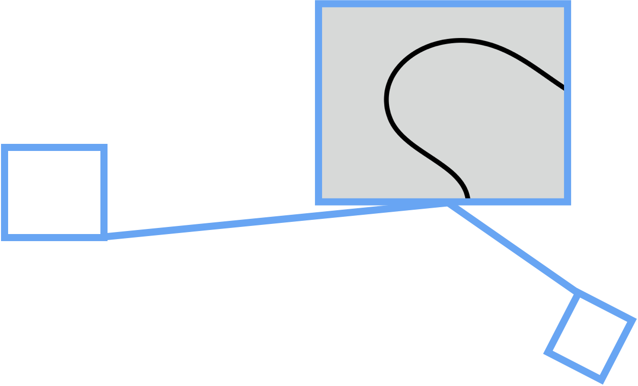
How do we find correspondences?

Slide 7
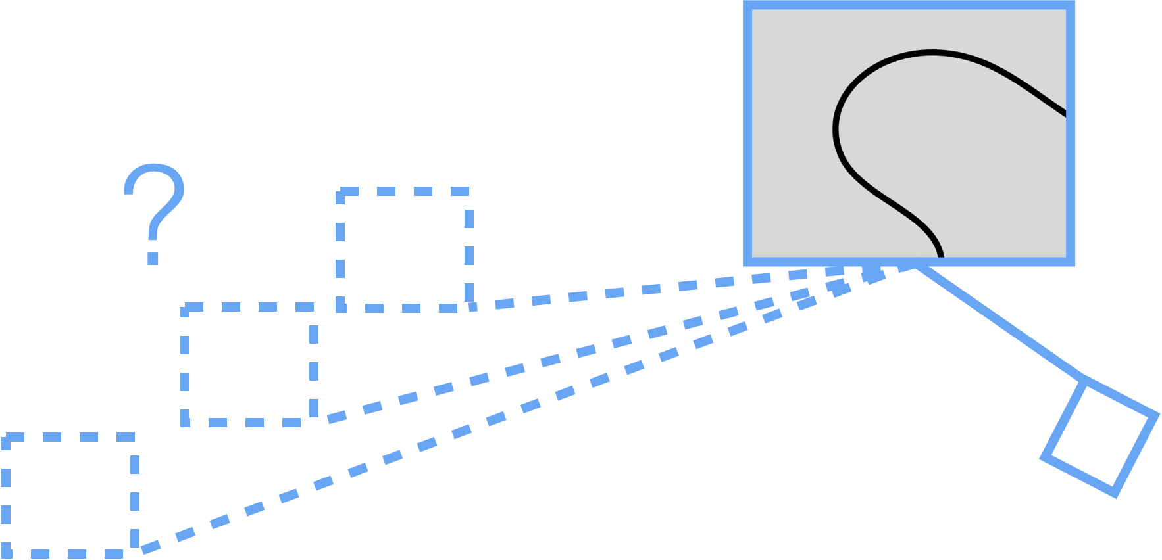
How do we find correspondences?
Notes:
Based on local features? This is often ambiguous! Local parts look the same

Slide 8
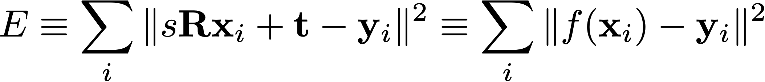




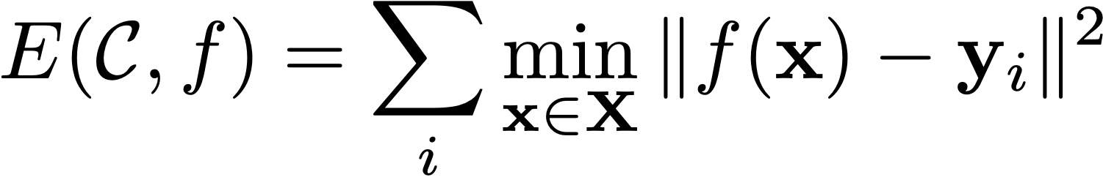
How do we find correspondences?
?
compact notation: f contains translation, rotation and isotropic scale
Closest point to target shape point
The optimisation is over:
  the transform
  the correspondences
Notes:
E(\mathcal{C},f) = \sum_i \min_{\mathbf{x}\in\mathbf{X}} \|f(\mathbf{x})-\mathbf{y}_i \|^2
\mathcal{C}=\{(\mathbf{x}_i,\mathbf{y}_i)\}_i^N

Slide 9
How do we find correspondences?
The idea was to minimise the sum of distances between the one set of points and the other set, transformed
?
compact notation: f contains translation, rotation and isotropic scale

Slide 10
Ideas
The idea was to minimise the sum of distances between the one set of points and the other set, transformed
What if we estimate the correspondences?
compact notation: f contains translation, rotation and isotropic scale

Slide 11
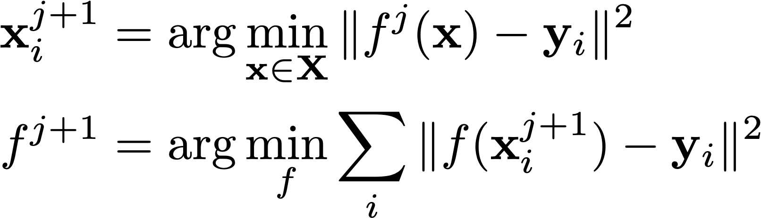
Solution: Iteratively find correspondences
The idea was to minimise the sum of distances between the one set of points and the other set, transformed
What if we estimate the correspondences?
compact notation: f contains translation, rotation and isotropic scale
iteration
Given current best transformation,
which are the closest correspondences?
original unsorted points
Given current best correspondences,
which is the best transformation?

Slide 12
Alternate between finding correspondences and finding the optimal transformation
The idea was to minimise the sum of distances between the one set of points and the other set, transformed
What if we estimate the correspondences?
compact notation: f contains translation, rotation and isotropic scale
iteration
Given current best transformation,
which are the closest correspondences?
original unsorted points
Given current best correspondences,
which is the best transformation?
Notes:
To what machine learning method does this remind you of? —> Expectation maximisation. In K-means and fitting mixture of Gaussians there is a similar type of alternation.

Slide 13


Make up reasonable correspondences
Notes:
\xwo_i = \arg\min_{\xwo}\|\Tt\xwo -\y \|^2
%\y
%\xwo_0
%\xwo_1

Slide 14

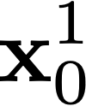

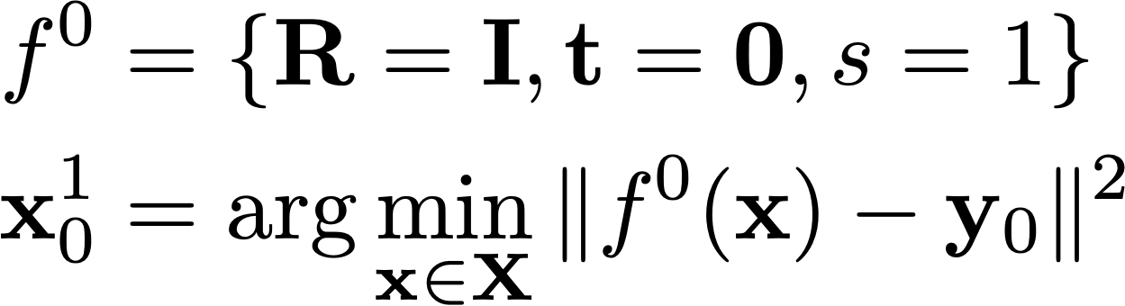
Make up reasonable correspondences
Neutral initialization.
Initializing t to align centroids should work better!
Notes:
\xwo_i = \arg\min_{\xwo}\|\Tt\xwo -\y \|^2
%\y
%\xwo_0
%\xwo_1

Slide 15


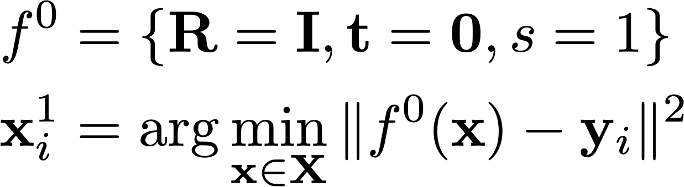
Make up reasonable correspondences

Slide 16
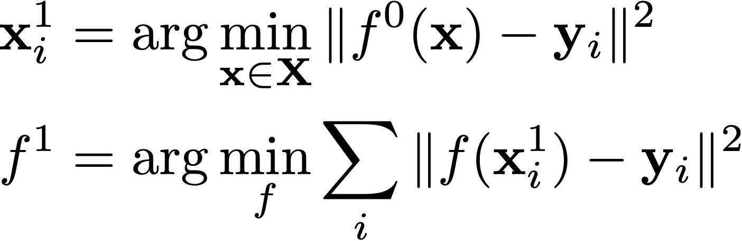
Solve for the best transformation
solve with procrustes

Slide 17
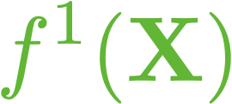
Apply it …

Slide 18
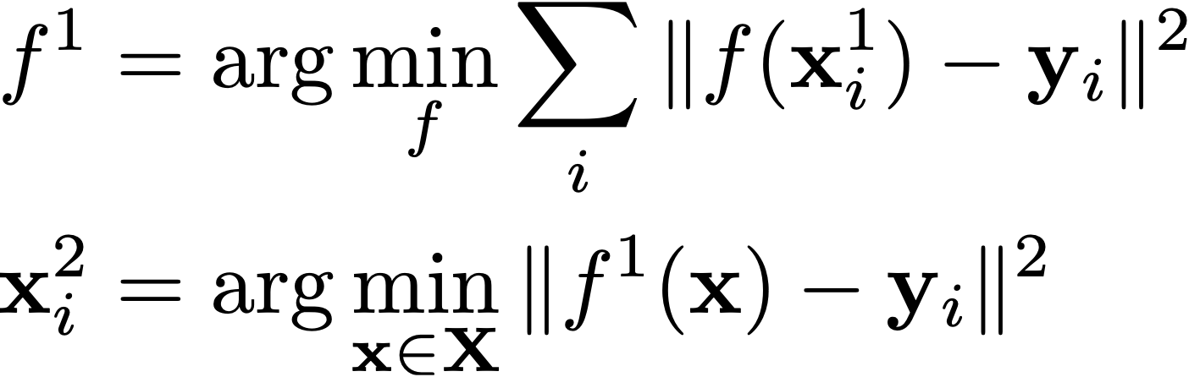
and iterate!

Slide 19
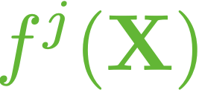
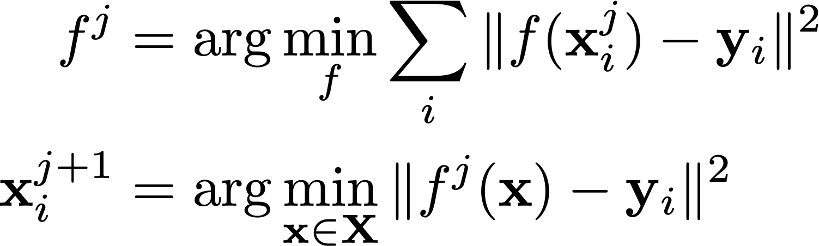
and iterate!

Slide 20
and iterate!

Slide 21
and iterate!

Slide 22
and iterate!

Slide 23
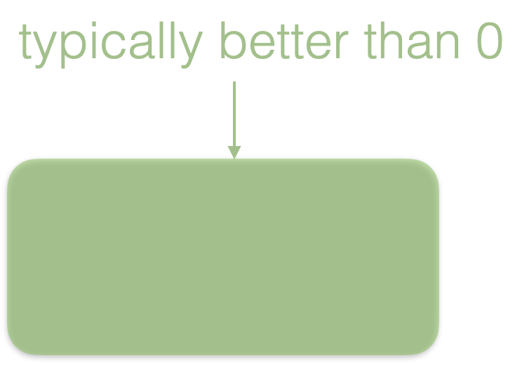
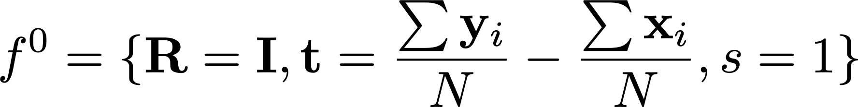
Iterative Closest Point (ICP)
Initialize

Slide 24
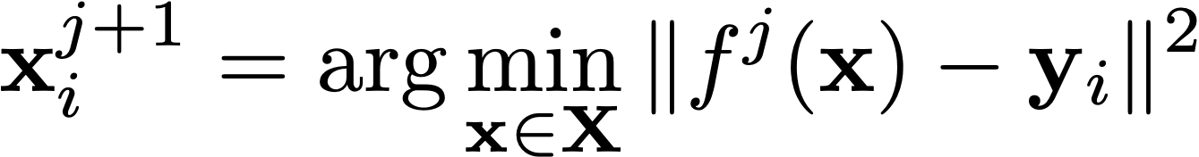
Iterative Closest Point (ICP)
Initialize
Compute correspondences according to current best transform

Slide 25

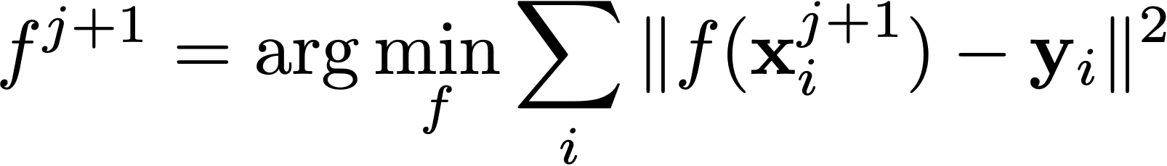
Iterative Closest Point (ICP)
Initialize
Compute correspondences according to current best transform
Compute optimal transformation ( )with Procrustes

Slide 26
Iterative Closest Point (ICP)
Initialize
Compute correspondences according to current best transform
Compute optimal transformation ( )with Procrustes
Terminate if converged (error below a threshold), otherwise iterate

Slide 27
Iterative Closest Point (ICP)
Initialize
Compute correspondences according to current best transform
Compute optimal transformation ( )with Procrustes
Terminate if converged (error below a threshold), otherwise iterate
Converges to local minima

Slide 28
Is ICP the best we can do?
Iteration j:
compute closest points
compute optimal transformation with Procrustes
apply transformation
terminate if converged, otherwise iterate

Slide 29
Closest points
Brute force is O(n²)
For every source point find a neighbor point on the source shape

Slide 30
Closest points
Tree based methods (e.g. kdtree) have avg. complexity log(n)
Random point sampling also reduces the running time

Slide 31
ICP: Tips to avoid local minima
Always find correspondences from target to source!
Proper data term
Outliers —> Robust cost functions
Use additional information (e.g. normals)
Compute transformation based on greedy subsets of points: RANSAC

Slide 32
A much better objective: Point-to-surface distance
Notes:
This results in a point-to-surface distance. If we zoom in a triangle with vertices v_0 to v_2
\mathbf{y}_0 \in \mathbf{Y}

Slide 33


Closest points: avoid local minima
Point-to-point distance
Notes:
and a query point s from the surface of the scan, a point-to-surface distance would find the closest vertex on the registration, in this case x1. This is not a good distance estimation, since

Slide 34

Closest points: avoid local minima
Point-to-surface distance
Notes:
the closest distance to the surface is the one to a point within the triangle. Although this seems rather obvious, it is rather common to find papers using the point to surface distance. The formulation of the derivatives of point-to-surface distance is more complicated, but results are substantially better.

Slide 35
Is ICP the best we can do?
Iteration j:
compute closest points
compute optimal transformation with Procrustes
apply transformation
terminate if converged, otherwise iterate

Slide 36
Best transformation?
Procrustes gives us the optimal rigid transformation and scale given correspondences
What if the deformation model is not rigid ?
Can we generalise ICP to non-rigid deformation ?

Slide 37
Iterative Closest Point (ICP)
Iteration j:
compute closest points ➔ Which direction to move?
compute optimal transformation with Procrustes
apply transformation
terminate if converged, otherwise iterate

Slide 38
Iterative Closest Point (ICP)
Iteration j:
compute closest points ➔ Which direction to move?
compute optimal transformation with Procrustes ➔
apply transformation
terminate if converged, otherwise iterate
Compute a transform that reduces the error
Notes:
The first step gives us correspondences. The direction I should move towards. In the second step we have to compute the optimal transformation.

Slide 39
Gradient-based ICP
Iteration j:
compute closest points ➔ Which direction to move?
compute optimal transformation with Procrustes ➔
apply transformation
terminate if converged, otherwise iterate
Compute descent step by linearising the energy
Jacobian of distance-based energy
Notes:
If we have a more complicated paramterization of shape deformation, we can linearlize the energy with respect to transformation f parameters

Slide 40
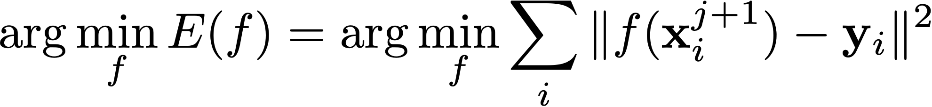
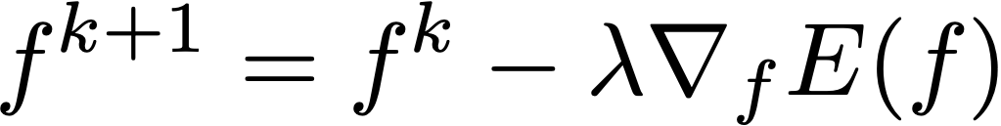
Gradient-based ICP
If f is a rigid transformation we can solve this minimisation using Procrustes
If f is a general non-linear function ?
Gradient descent:
For least squares, is there a better optimisation method ?
yes: Gauss-Newton based methods.
Notes:
Note the derivative is not with respect to the function. In practice the function is parameterised, and the derivative is with respect to those parameters.
\arg\min_f E(f) = \arg\min_f \sum_i\|f(\mathbf{x}_i^{j+1})-\mathbf{y}_i\|^2
f^{k+1} = f^k + \nabla_f E(f)

Slide 41
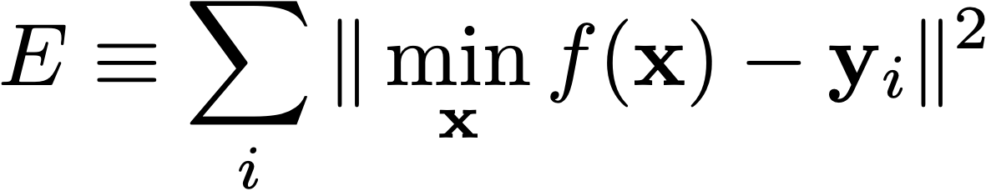
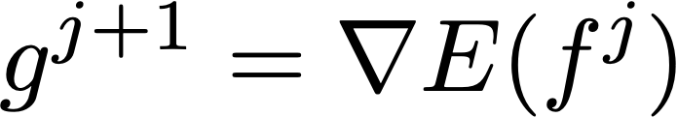
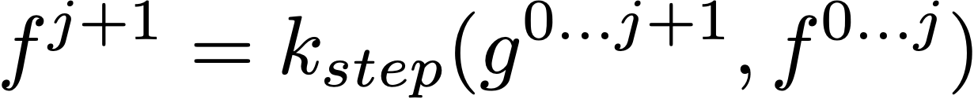

Gradient-based ICP
Energy:
Consider the correspondences fixed in each iteration j+1
Compute gradient of the energy around current estimation
Apply step (gradient descent, dogleg, LM, BFGS…)
terminate if converged, otherwise iterate (go to step 2)
(for example )

Slide 42
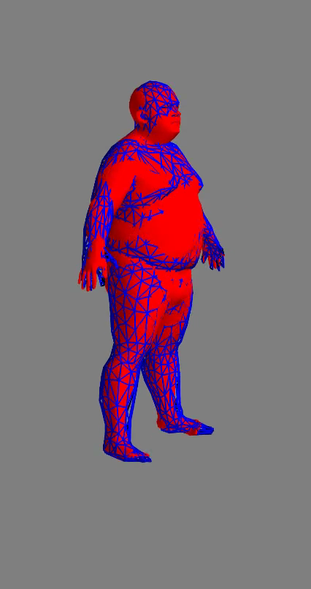
Gradient-based ICP

Slide 43
Why is convergence on the left less smooth?
Point to point objective
Point to surface objective

Slide 44
Gradient-based ICP
Energy:
Consider the correspondences fixed in each iteration j+1
Compute gradient of the energy around current estimation
Apply step (gradient descent, dogleg, LM, BFGS…)
terminate if converged, otherwise iterate

Slide 45
Gradient-based ICP
Gradient: derivative of the sum of squared distances with respect to transformation f parameters
Notes:
\documentclass[10pt]{article}
\usepackage[usenames]{color} %used for font color
\usepackage{amssymb} %maths
\usepackage{amsmath} %maths
\usepackage[utf8]{inputenc} %useful to type directly diacritic characters
\newcommand*{\tran}{^{\mkern-1.5mu\mathsf{T}}}
\newcommand{\Ss}{\mathbf{S}}
\newcommand{\X}{\mathbf{X}}
\newcommand{\Tt}{\mathbf{T}}
\newcommand{\mX}{\bar{\mathbf{X}}}
\newcommand{\x}{\mathbf{x}_i}
\newcommand{\xwoi}{\mathbf{x}}
\newcommand{\ywoi}{\mathbf{y}}
\newcommand{\hx}{\hat{\mathbf{x}}_i}
\newcommand{\xwo}{\mathbf{x}}
\newcommand{\hxwo}{\hat{\mathbf{x}}}
\newcommand{\mx}{\bar{\mathbf{x}}}
\newcommand{\mxi}{\bar{\mathbf{x}_i}}
\newcommand{\Pb}{\mathbf{P}}
\newcommand{\mPb}{\bar{\mathbf{P}}}
\newcommand{\pb}{\mathbf{p}_i}
\newcommand{\mpb}{\bar{\mathbf{p}}}
\newcommand{\mpbi}{\bar{\mathbf{p}_i}}
\newcommand{\Y}{\mathbf{Y}}
\newcommand{\mY}{\bar{\mathbf{Y}}}
\newcommand{\y}{\mathbf{y}_i}
\newcommand{\my}{\bar{\mathbf{y}}}
\newcommand{\myi}{\bar{\mathbf{y}_i}}
\newcommand{\U}{\mathbf{U}}
\newcommand{\V}{\mathbf{V}}
\newcommand{\R}{\mathbf{R}}
\newcommand{\A}{\mathbf{A}}
\newcommand{\trans}{\mathbf{t}}
%E &\equiv \sum_i \| s \R \x + \trans - \y \|^2 \equiv \sum_i \| f(\x) - \y \|^2\\
%E &\equiv \sum_i \min_\xwoi\|f(\xwoi) - \y \|^2%E &\equiv \sum_i \| s \R \x + \trans - \y \|^2 \equiv \sum_i \| \Tt \mxi - \myi \|^2\\
%\hx &= \arg\min_\xwoi \| f(\xwoi) - \y\|^2 \\
%f &= \arg\min_f \sum_i \| f(\hx) - \y \|^2\\
%f^0 &= \{\R=\mathbf{I}, \trans=\mathbf{0}, s=1\} \\
%f^0 &= \{\R=\mathbf{I}, \trans=\frac{\sum{\y}}{N} - \frac{\sum{\x}}{N}, s=1\} \\
%\xwoi_i^1 &= \arg\min_{\xwoi \in \X} \| f^0(\xwoi) - \y\|^2 \\
%f^{j} &= \arg\min_f \sum_i \| f(\x) - \y \|^2\\
%\x^{j+1} &= \arg\min_{\xwoi \in \X} \| f^j(\xwoi) - \y\|^2 \\
%f^{j+1} &= \arg\min_f \sum_i \| f(\x^{j+1}) - \y \|^2\\
%E^{j+1} &= \sum_i \| f^j(\x) - \y \|^2\\
%^\xwoi_0
%\xwoi_i^{j+1} &= \arg\min_{\xwoi \in \X} \| f^j(\xwoi) - \y\|^2 \\
%\X \equiv f^0(\X)
%E &\equiv \sum_i \| \min_\xwoi f(\xwoi) - \y \|^2\\
%J^{j+1} &= \frac{\delta E}{\delta f}(f^j)
%f^{j+1} = k_{\mathrm{step}}(J^{0\ldots j+1}, f^{0\ldots j})
f^{j+1} = f^{j} - \alpha J^{j+1}

Slide 46
Gradient-based ICP
Gradient: derivative of the sum of squared distances with respect to transformation f parameters
Each derivative is easy
  Who wants to writes it down?
Notes:
\documentclass[10pt]{article}
\usepackage[usenames]{color} %used for font color
\usepackage{amssymb} %maths
\usepackage{amsmath} %maths
\usepackage[utf8]{inputenc} %useful to type directly diacritic characters
\newcommand*{\tran}{^{\mkern-1.5mu\mathsf{T}}}
\newcommand{\Ss}{\mathbf{S}}
\newcommand{\X}{\mathbf{X}}
\newcommand{\Tt}{\mathbf{T}}
\newcommand{\mX}{\bar{\mathbf{X}}}
\newcommand{\x}{\mathbf{x}_i}
\newcommand{\xwoi}{\mathbf{x}}
\newcommand{\ywoi}{\mathbf{y}}
\newcommand{\hx}{\hat{\mathbf{x}}_i}
\newcommand{\xwo}{\mathbf{x}}
\newcommand{\hxwo}{\hat{\mathbf{x}}}
\newcommand{\mx}{\bar{\mathbf{x}}}
\newcommand{\mxi}{\bar{\mathbf{x}_i}}
\newcommand{\Pb}{\mathbf{P}}
\newcommand{\mPb}{\bar{\mathbf{P}}}
\newcommand{\pb}{\mathbf{p}_i}
\newcommand{\mpb}{\bar{\mathbf{p}}}
\newcommand{\mpbi}{\bar{\mathbf{p}_i}}
\newcommand{\Y}{\mathbf{Y}}
\newcommand{\mY}{\bar{\mathbf{Y}}}
\newcommand{\y}{\mathbf{y}_i}
\newcommand{\my}{\bar{\mathbf{y}}}
\newcommand{\myi}{\bar{\mathbf{y}_i}}
\newcommand{\U}{\mathbf{U}}
\newcommand{\V}{\mathbf{V}}
\newcommand{\R}{\mathbf{R}}
\newcommand{\A}{\mathbf{A}}
\newcommand{\trans}{\mathbf{t}}
%E &\equiv \sum_i \| s \R \x + \trans - \y \|^2 \equiv \sum_i \| f(\x) - \y \|^2\\
%E &\equiv \sum_i \min_\xwoi\|f(\xwoi) - \y \|^2%E &\equiv \sum_i \| s \R \x + \trans - \y \|^2 \equiv \sum_i \| \Tt \mxi - \myi \|^2\\
%\hx &= \arg\min_\xwoi \| f(\xwoi) - \y\|^2 \\
%f &= \arg\min_f \sum_i \| f(\hx) - \y \|^2\\
%f^0 &= \{\R=\mathbf{I}, \trans=\mathbf{0}, s=1\} \\
%f^0 &= \{\R=\mathbf{I}, \trans=\frac{\sum{\y}}{N} - \frac{\sum{\x}}{N}, s=1\} \\
%\xwoi_i^1 &= \arg\min_{\xwoi \in \X} \| f^0(\xwoi) - \y\|^2 \\
%f^{j} &= \arg\min_f \sum_i \| f(\x) - \y \|^2\\
%\x^{j+1} &= \arg\min_{\xwoi \in \X} \| f^j(\xwoi) - \y\|^2 \\
%f^{j+1} &= \arg\min_f \sum_i \| f(\x^{j+1}) - \y \|^2\\
%E^{j+1} &= \sum_i \| f^j(\x) - \y \|^2\\
%^\xwoi_0
%\xwoi_i^{j+1} &= \arg\min_{\xwoi \in \X} \| f^j(\xwoi) - \y\|^2 \\
%\X \equiv f^0(\X)
%E &\equiv \sum_i \| \min_\xwoi f(\xwoi) - \y \|^2\\
%J^{j+1} &= \frac{\delta E}{\delta f}(f^j)
%f^{j+1} = k_{\mathrm{step}}(J^{0\ldots j+1}, f^{0\ldots j})
f^{j+1} = f^{j} - \alpha J^{j+1}

Slide 47
Gradient-based ICP
Gradient: derivative of the sum of squared distances with respect to transformation f parameters
Each derivative is easy
  Who wants to writes it down?
Chain rule and automatic differentiation!
Notes:
\documentclass[10pt]{article}
\usepackage[usenames]{color} %used for font color
\usepackage{amssymb} %maths
\usepackage{amsmath} %maths
\usepackage[utf8]{inputenc} %useful to type directly diacritic characters
\newcommand*{\tran}{^{\mkern-1.5mu\mathsf{T}}}
\newcommand{\Ss}{\mathbf{S}}
\newcommand{\X}{\mathbf{X}}
\newcommand{\Tt}{\mathbf{T}}
\newcommand{\mX}{\bar{\mathbf{X}}}
\newcommand{\x}{\mathbf{x}_i}
\newcommand{\xwoi}{\mathbf{x}}
\newcommand{\ywoi}{\mathbf{y}}
\newcommand{\hx}{\hat{\mathbf{x}}_i}
\newcommand{\xwo}{\mathbf{x}}
\newcommand{\hxwo}{\hat{\mathbf{x}}}
\newcommand{\mx}{\bar{\mathbf{x}}}
\newcommand{\mxi}{\bar{\mathbf{x}_i}}
\newcommand{\Pb}{\mathbf{P}}
\newcommand{\mPb}{\bar{\mathbf{P}}}
\newcommand{\pb}{\mathbf{p}_i}
\newcommand{\mpb}{\bar{\mathbf{p}}}
\newcommand{\mpbi}{\bar{\mathbf{p}_i}}
\newcommand{\Y}{\mathbf{Y}}
\newcommand{\mY}{\bar{\mathbf{Y}}}
\newcommand{\y}{\mathbf{y}_i}
\newcommand{\my}{\bar{\mathbf{y}}}
\newcommand{\myi}{\bar{\mathbf{y}_i}}
\newcommand{\U}{\mathbf{U}}
\newcommand{\V}{\mathbf{V}}
\newcommand{\R}{\mathbf{R}}
\newcommand{\A}{\mathbf{A}}
\newcommand{\trans}{\mathbf{t}}
%E &\equiv \sum_i \| s \R \x + \trans - \y \|^2 \equiv \sum_i \| f(\x) - \y \|^2\\
%E &\equiv \sum_i \min_\xwoi\|f(\xwoi) - \y \|^2%E &\equiv \sum_i \| s \R \x + \trans - \y \|^2 \equiv \sum_i \| \Tt \mxi - \myi \|^2\\
%\hx &= \arg\min_\xwoi \| f(\xwoi) - \y\|^2 \\
%f &= \arg\min_f \sum_i \| f(\hx) - \y \|^2\\
%f^0 &= \{\R=\mathbf{I}, \trans=\mathbf{0}, s=1\} \\
%f^0 &= \{\R=\mathbf{I}, \trans=\frac{\sum{\y}}{N} - \frac{\sum{\x}}{N}, s=1\} \\
%\xwoi_i^1 &= \arg\min_{\xwoi \in \X} \| f^0(\xwoi) - \y\|^2 \\
%f^{j} &= \arg\min_f \sum_i \| f(\x) - \y \|^2\\
%\x^{j+1} &= \arg\min_{\xwoi \in \X} \| f^j(\xwoi) - \y\|^2 \\
%f^{j+1} &= \arg\min_f \sum_i \| f(\x^{j+1}) - \y \|^2\\
%E^{j+1} &= \sum_i \| f^j(\x) - \y \|^2\\
%^\xwoi_0
%\xwoi_i^{j+1} &= \arg\min_{\xwoi \in \X} \| f^j(\xwoi) - \y\|^2 \\
%\X \equiv f^0(\X)
%E &\equiv \sum_i \| \min_\xwoi f(\xwoi) - \y \|^2\\
%J^{j+1} &= \frac{\delta E}{\delta f}(f^j)
%f^{j+1} = k_{\mathrm{step}}(J^{0\ldots j+1}, f^{0\ldots j})
f^{j+1} = f^{j} - \alpha J^{j+1}

Slide 48
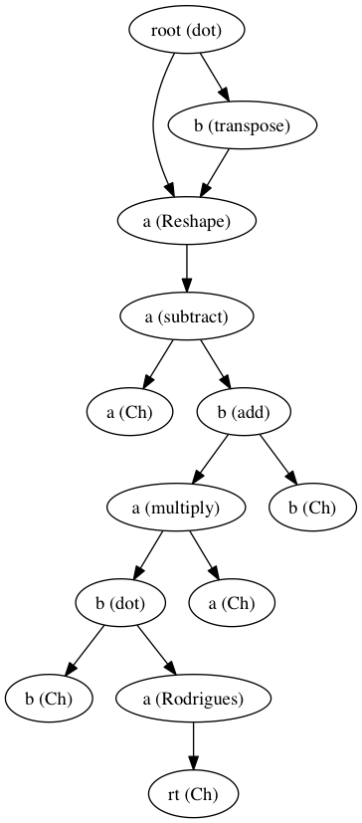
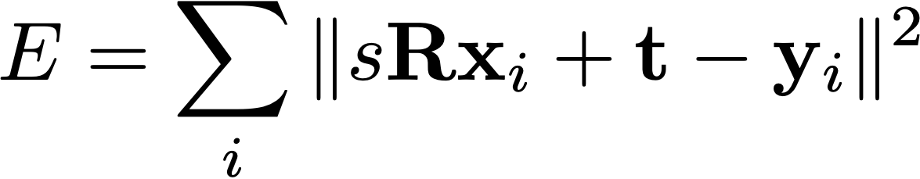
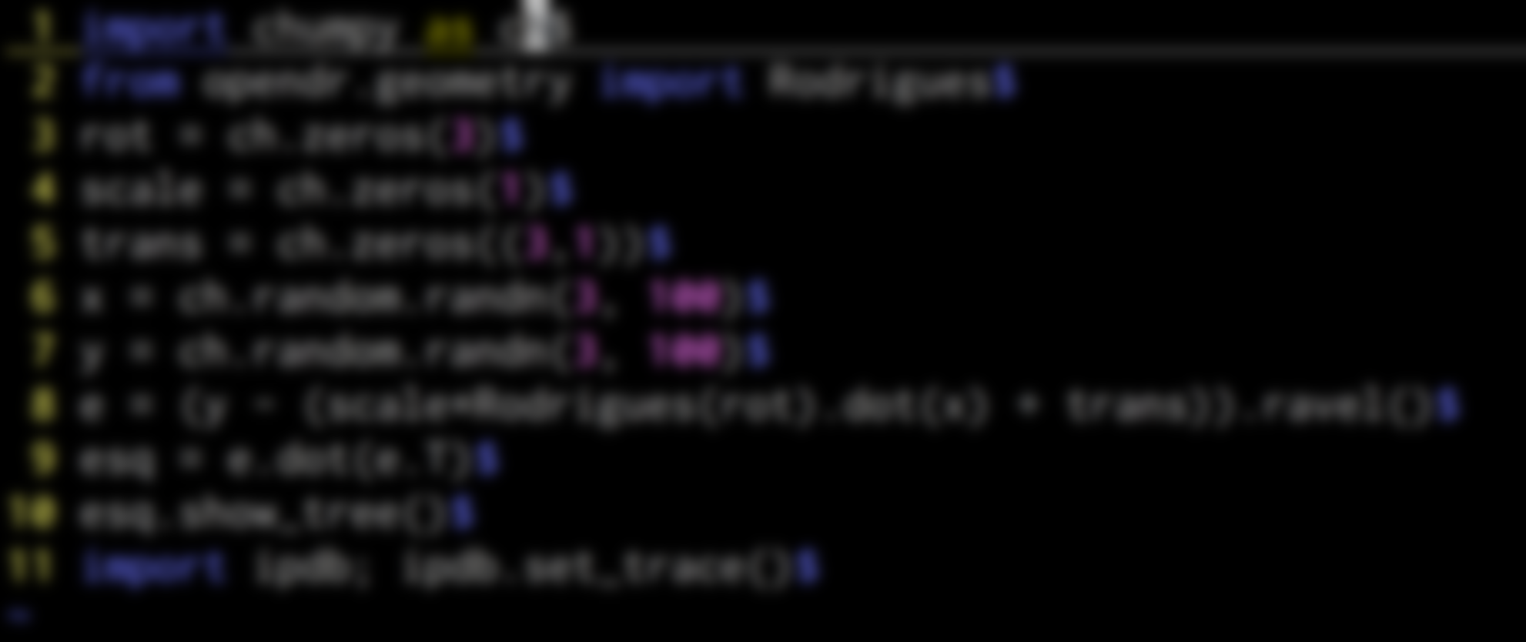
Automatic differentiation
write as if it was numpy code
results in expression tree
with jacobians available at each step

Slide 49
Gradient-based ICP
Energy:
Consider the correspondences fixed in each iteration j+1
Compute gradient of the energy around current estimation
Apply step (gradient descent, dogleg, LM, BFGS…)
terminate if converged, otherwise iterate

Slide 50
Why Gradient-based ICP?
Formulation is much more generic: the energy can incorporate other terms, more parameters, etc
A lot of available software for solving this least squares problem (cvx, ceres, …)
However, the resulting energy is non-convex for general deformation models. Optimisation can get trapped in local minima.

Slide 51
Take-home message
Procrustes is optimal for rigid alignment problems with known correspondences. For other problems:
We can compute correspondences and solve for the best transformation iteratively with Iterative Closest Point (ICP)

Slide 52
Slide credits
Javier Romero

Slide 53
Iterative Closest Point (ICP)
iteration j
compute closest points
compute optimal transformation with Procrustes
apply transformation
terminate if converged, otherwise iterate
In which direction should I move?
compute a transform that reduces the error
Notes:
The first step gives us correspondences. The direction I should move towards. In the second step we have to compute the optimal transformation.

Slide 54
Gradient-based ICP
iteration j
compute closest points
compute optimal transformation with Procrustes
apply transformation
terminate if converged, otherwise iterate
compute descent step by linearising the energy
Jacobian of distance-based energy
Notes:
If we have a more complicated paramterization of shape deformation, we can linearlize the energy with respect to transformation f parameters

