Slide 1
Virtual Humans – Winter 23/24
Lecture 2_2 – Rotations and Kinematic chains
Prof. Dr.-Ing. Gerard Pons-Moll
University of Tübingen / MPI-Informatics
Notes:
In today’s lecture we will learn how to parameterize human motion. We will deep dive into 3D rotations representations and kinematic chains

Slide 2
Ingredients to build a Virtual Human
Building a human model
Fitting model to observations
Kinematic parameterization
  Rotation Matrices
  Euler Angles
  Quaternions
  Twists and Exponential maps
  Kinematic chains
Subject shape model
  Geometric primitives
  Detailed Body Scans
  Human Shape models
Inference
  Observation likelihood
  Local optimization
  Particle Based optimization
  Directly regressing parameters
Notes:
As we saw in the first lecture, to build a virtual human, beyond the 3D shape, we need to specify how the 3D surface will move and deform with pose. By far the most common approach to this is to use a kinematic chain.

Slide 3
Kinematic Chains
Motivated from robotics:
The human motion can be expressed via a „kinematic chain“, a series of local rigid body motions (along the limbs).
The model parameters to optimize, correspond to rigid body motions (RBM).
How to model RBM ?
Bregler et.al. CVPR-98
Notes:
This is motivated from robotics. The idea is that human motion can be expressed as a series of local rigid body motions along the limbs. Essentially, every part can only rotate and perhaps slightly translate relative to the parent.
This model has been widely used in animation and computer vision, because it is a very good approximation.

Slide 4
Kinematic Parameterization
Pose configurations are represented with a minimum number of parameters
Singularities can be avoided during optimization
Easy computation of derivatives segment positions and orientations w.r.t parameters
Human motion contrains such as articulated motion are naturally described
Simple rules for concatenating motions
Notes:
When choosing. A parameterization we should consider the following things.
Sngularities are for example, degenerate cases such as a gimbal lock, in which we lose one degree of freedom.

Slide 5
Ingredients to build a Virtual Human
Building a human model
Fitting model to observations
Kinematic parameterization
  Rotation Matrices
  Euler Angles
  Quaternions
  Twists and Exponential maps
  Kinematic chains
Subject shape model
  Geometric primitives
  Detailed Body Scans
  Human Shape models
Inference
  Observation likelihood
  Local optimization
  Particle Based optimization
  Directly regressing parameters
Notes:
As we saw in the first lecture, to build a virtual human, beyond the 3D shape, we need to specify how the 3D surface will move and deform with pose. By far the most common approach to this is to use a kinematic chain.

Slide 6
Informally, what is a rotation?
It is useful to characterize a transformation by its invariances.
A rotation is a linear transformation which preserves angles and distances, and does not mirror the object

Slide 7
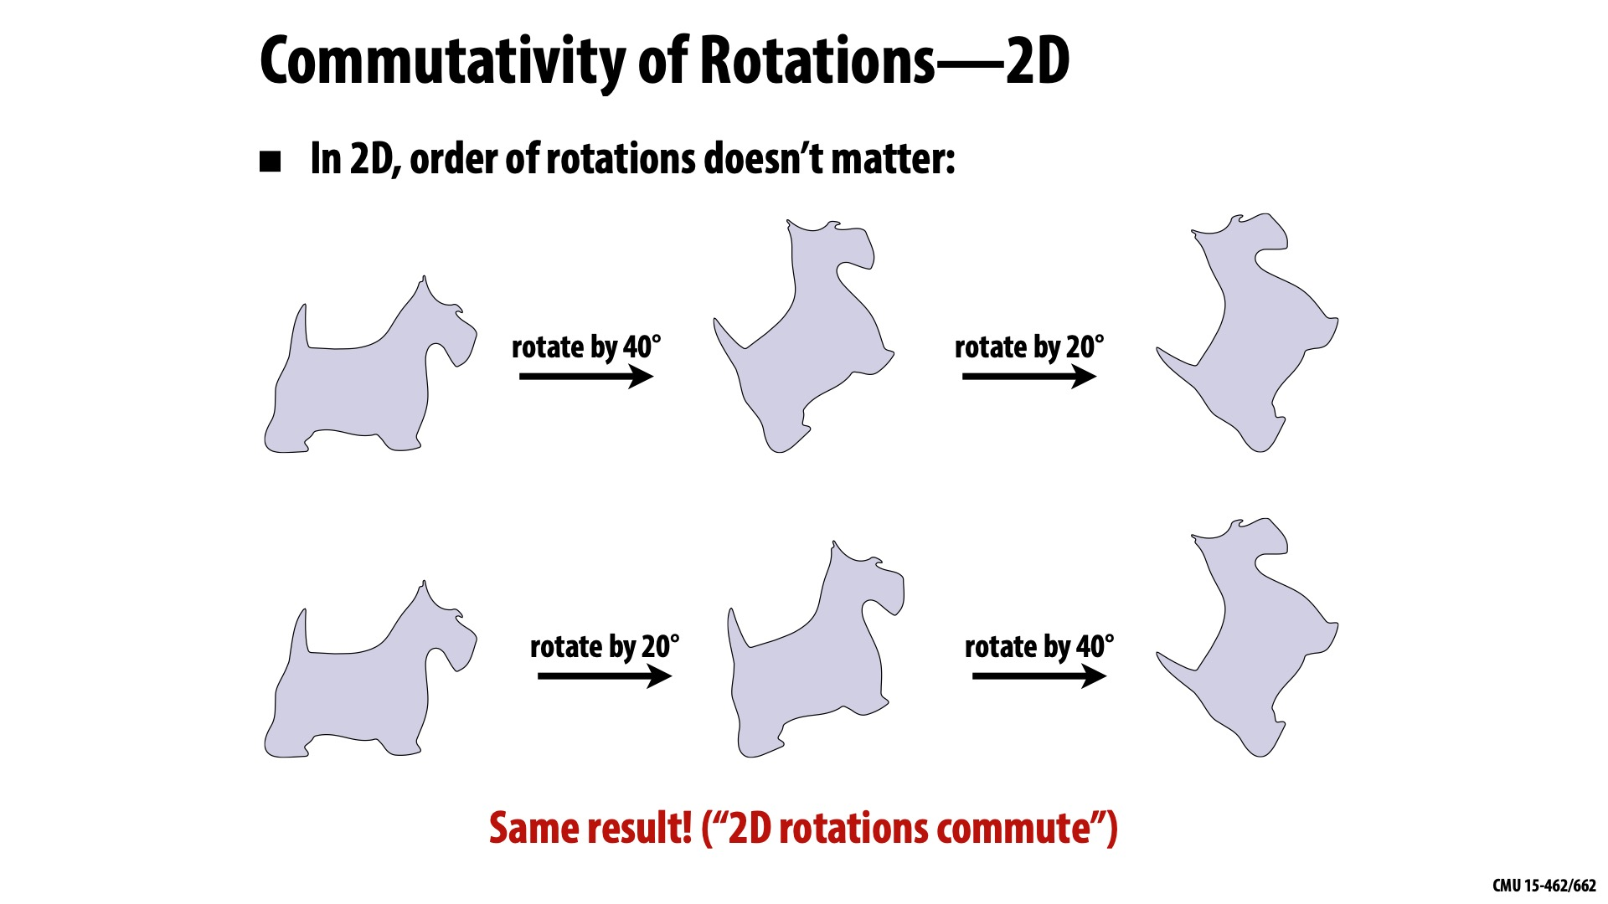
Commutativity of Rotations – 2D
Notes:
An important property of a transformation is whether it commutes. So, we can ask whether rotations commute. Let’s look first at rotations in 2D. Do they commute?

Slide 8
Commutativity of Rotations – 3D
Try it at home – grab a bottle!
  Rotate 90º around Y, then Z, then X
  Rotate 90º around Z, then Y, then X
  Was there any difference?

Slide 9
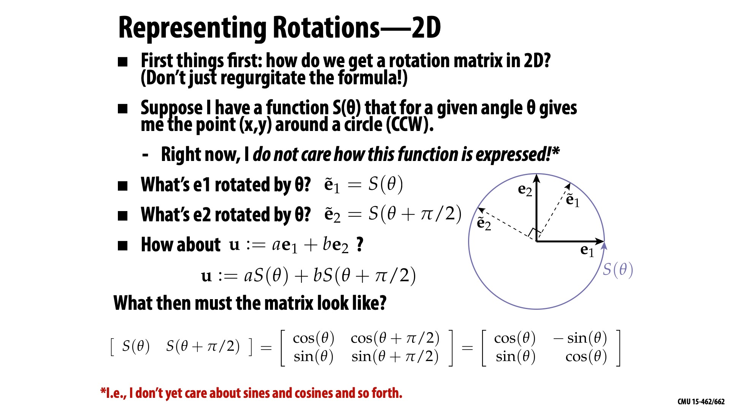
Representing rotations – 2D
How to get a rotation matrix in 2D?
Suppose we have a function S(θ), that for a given θ, gives me the point (x, y) around a circle.
What's e₁ rotated by θ?
What's e₂ rotated by θ?
How about u := a.e₁ + b.e₂?
What then must the matrix look like?

Slide 10
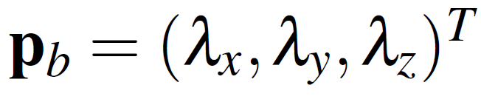
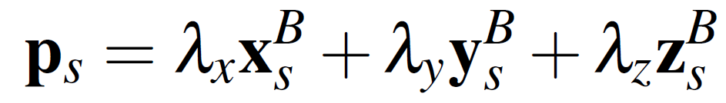
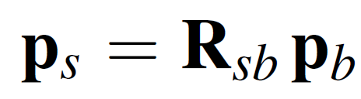
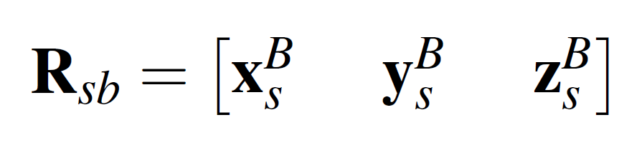
Rotation Matrices
S
B
The columns of a rotation matrix are the principal axis of one frame expressed relative to another
Notes:
Let’s look now at the most basic representation of a rotation, which are the 9 numbers of a matrix. First of all, a rotation is a linear mapping. Therefore, we can fully characterize it by a matrix, whose columns are the principal axis of one frame expressed relative to another frame.
Let’s look at the point p_b in body coordinates it is lambda_x,lambda_y,\lambda_z. The point in spatial coordinates can be written as, where x_s^B is the x axis of the B frame written in spatial coordinates,…
So the columns of a rotation matrix are the ppal axis of one frame expressed relative to antother

Slide 11
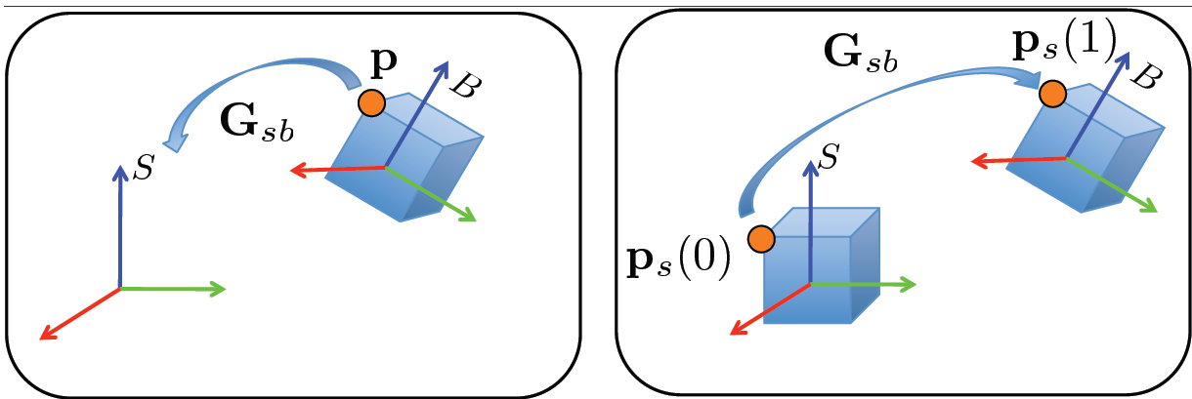
2 Views of Rotations
Rotations can be interpreted either as
Coordinate transformation
Relative motion in time
Notes:
Rotations can often lead to lots of confusions. Unlike say a translation, they can be interpreted in different ways. We can think of a rotation as a coordinate transformation or a relative motion in time
In the right, we imagine the object in the body coordinates is static, and applying a rotation simply writes the object in spatial frame coordinates. Nothing moves. Just coordinate transform
In the second case, we can imagine the body and spatial frames are originally aligned. When we apply a rotation, the object moves to a new location. So we can think of ps(0) moving to new location ps(1).
There is no coordinate transform. Ps is always in spatial coordinates.
The math is exactly the same, but interpretations are very different. Note: don’t be mislead. The fact that the math can be exactly the same, but interpretations can lead to completely new results and discoveries.

Slide 12
Rotation matrix drawbacks
Need for 9 numbers
6 additional constrains to ensure that the matrix is orthonormal and belongs to SO(3)
Suboptimal for numerical optimization
Notes:
So, are rotation matrices a good representation? We need 9 numbers. But how many degrees of freedom does a rotation have?
With the 9 numbers we need additional constraints to ensure orthonormality, and we need to enforce detR=1 to prevent mirroring.
This makes them unsuited for numerical optimization. For example, if we want to find the rotation that aligns to shapes.
A good thing of rotation matrices is that they are functions of sines and cosines, which makes its values bounded. Good for machine learning tasks/

Slide 13
Euler Angles
One of the most popular parameterizations
Rotation is encoded as the successive rotations about three principal axis
Only 3 parameters to encode a rotation
Derivatives easy to compute
Notes:
A very common representaiton are Euler Angles. The idea is to apply 3 consecutive planar rotations to the object to achieve a 3D rotation.
Very intuitive. And it is easy to accumulate motion

Slide 14
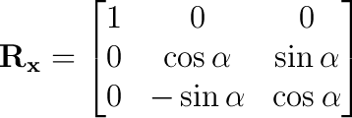
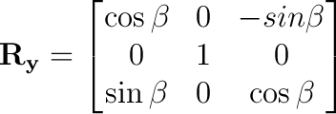
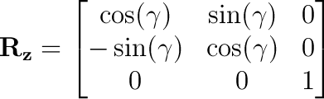
Euler Angles
S
Notes:
Taking rotation along fixed axis of the spatial frame, the 3rotation would be obtained with the following matrices.

Slide 15
Euler Angles: Confusion
Careful: Euler angles are a typical source of confusion!
When using Euler angles 2 things have to be specified:
  Convention: X-Y-Z, Z-Y-X, Z-Y-Z …
  Rotations about the static spatial frame or the moving body frame (intrinsic vs extrinsic rotation)
Notes:
Careful. Many conventions for Euler angles. This makes them a source of many confusions.
2 thngs need to be specified.
What do we mean by extrinsic versus intrinsic? Extrinisic rotates the object along fixed coordinate axis. Intrinsic rotates along the axes of the object itself, like the example here

Slide 16
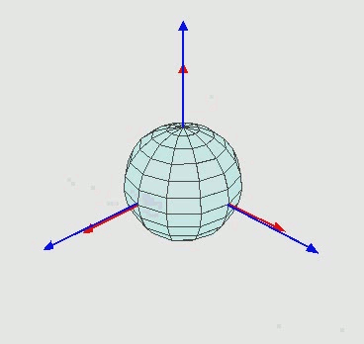
Example of intrinsic rotations (z,x’,z’’)
https://en.wikipedia.org/wiki/Euler_angles
Notes:
What do we mean by extrinsic versus intrinsic? Extrinisic rotates the object along fixed coordinate axis. Intrinsic rotates along the axes of the object itself, like the example here

Slide 17
Gimbal Lock
When using Euler angles θ_{x}, θ_{y}, θ_{z}, may reach a configuration where there is no way to rotate around one of the three axes!
Recall rotation matrices around the three axes:
The product of these represents rotation by the three Euler angles.
Notes:
A very annoying thing of euler angles is the Gimbal lock lock. This is a degenerate case where we lose one degree of freddom and we can not rotate the object along one axis.
If we look a the resulting rotation matrix, we obtain this.
Consider the case…
We are left with a planar rotation. Notice it depends only of thetax, tehtaz. Not on theta_y.

Slide 18
Gimbal Lock
Consider the special case where θ_{y}=$π$/2 (so, cos(θ_{y})=0, sin (θ_{y})=1)
We are left with a planar rotation. Notice it depends only of θ_{x}, θ_{z}. Not on θ_{y}.
Notes:
A very annoying thing of euler angles is the Gimbal lock lock. This is a degenerate case where we lose one degree of freddom and we can not rotate the object along one axis.
If we look a the resulting rotation matrix, we obtain this.
Consider the case…
We are left with a planar rotation. Notice it depends only of thetax, tehtaz. Not on theta_y.

Slide 19
Euler Angles: Drawbacks
Gimbal lock: When two of the axis align one degree of freedom is lost!
Parameterization is not unique
Lots of conventions
Notes:
Geometrically what is happening is that….

Slide 20
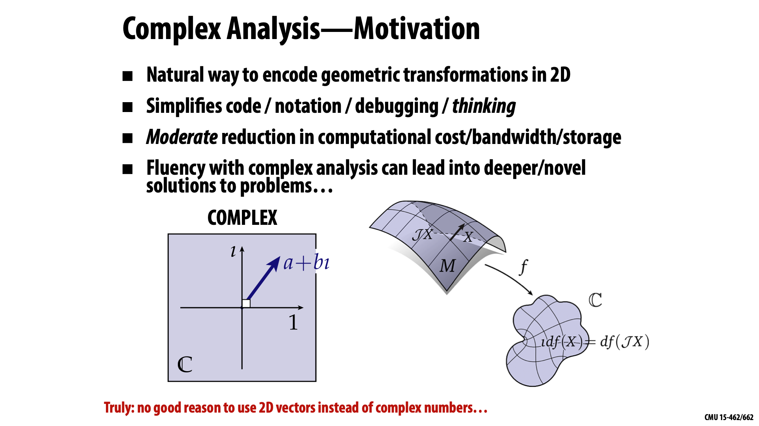
Complex Analysis - Motivation
Natural way to encode geometric transformations in 2D.
Simplifies code/notation/debugging/thinking.
Moderate reduction in computational cost/ bandwidth/storage.
Fluency in complex analysis can lead to deeper/novel solutions to problems…
Notes:
The gimbal lock is a real problem. Can we find a parameterization which does not suffer from a gimbal lock and is more compact than the 9 numbers of a rotation matrix?
Yes, the answer are quaternions. To understand quaternions we need to know where they come from. They come from complex numbers.

Slide 21
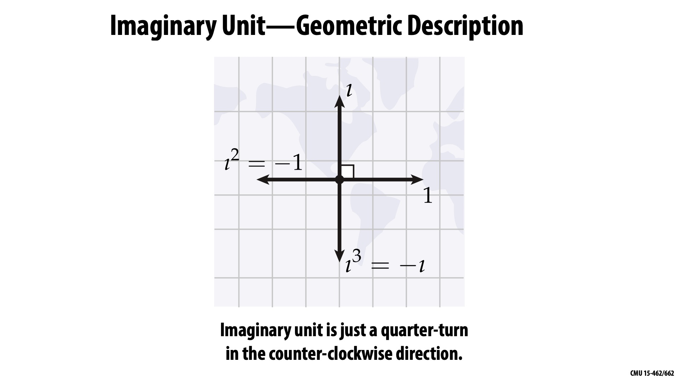
Imaginary units – Geometric description
Notes:
I want want you to think about complex numbers in a different way. In bachelor math, you have seen that the square root of -1 equals i.
But what is the geometrical interpretation? Forget about this for now.
We will think of I, simply as a quarter-turn in the ounter clockwise direction. Such that two turns lead map form 1 to -1.

Slide 22
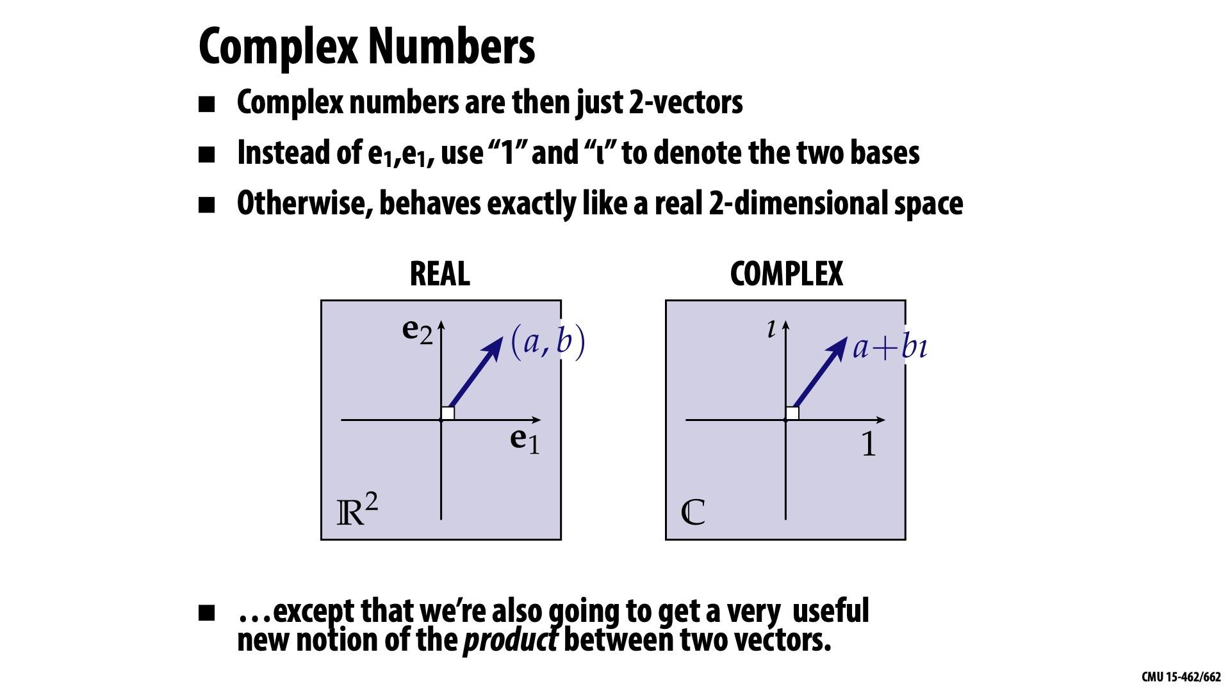
Complex Numbers
Complex numbers are then just two vectors
Instead of e₁, e₂ use "1" and "⍳" to denote two bases.
Otherwise behaves like a 2D space
… except that we are also going to get a very useful new notation of the product between the two vectors.
Notes:
Complex numbers are just 2 vectros, where we have just replaced the name of the basis vectors say e1,e2 by 1 and i. But nothing else changes.
Except that now we have a new notion of product between two vectors!

Slide 23
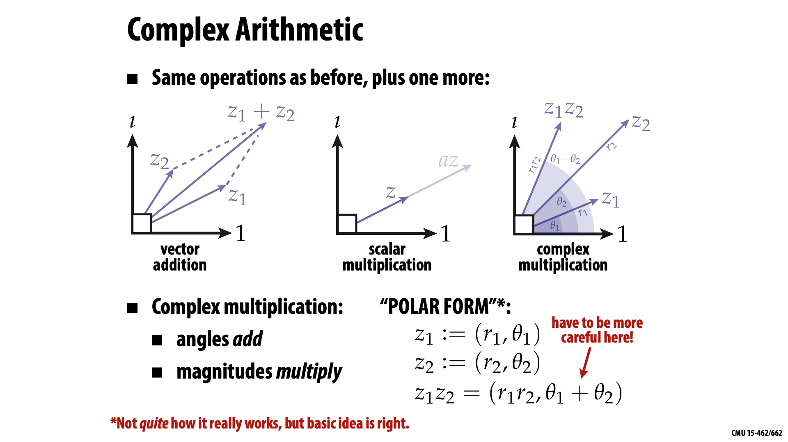
Complex Arithmetic
Same operations as before, plus one more
Complex multiplication:
  Angles add
  Magnitude multiplies
Notes:
Vector addition, scalar multiplaction, Evertyhing like a vector space. But we alos have complex multiplication. Angles will add and magnitudes ill multiply.
If we take the polar form, we can get r1r2 and theta1+theta2 → we just have to be careful if theta1+theta2 is larger than 2pi.

Slide 24
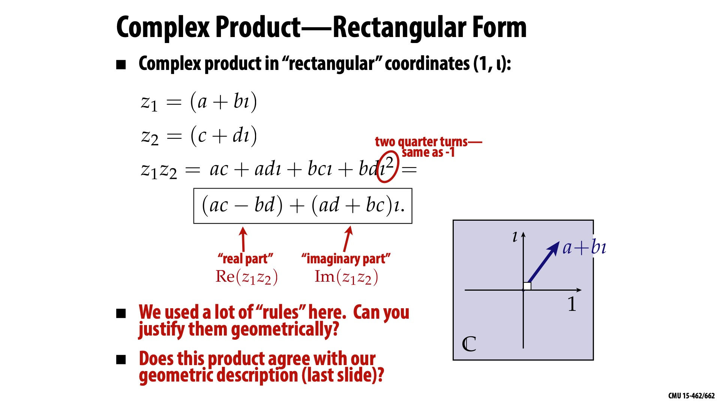
Complex product – Rectangular form (1, ⍳)
Notes:
Can we justify this geometrically?

Slide 25
Complex product – Polar form
Perhaps most beautiful identity in maths.
Specialization of Euler's formula.
Can use to implement complex product.
Notes:
Let’s look at this again in polar form. Perhaps the most beautiful formula in math. It involves a bunch of important constants e, pi, I,
This formula is a specialization of a more useful formula. E^\theta_i is a function that takes a \theta and returns a point on the circle.
Use this formulat to implement the complex product
You can represent rotations with complex numbers.
Why using complex numbers, they define an additional product operation over vectors which we can leverage to compose rotations.

Slide 26
2D rotations: Matrices vs. Complex
Suppose we want to rotate a vector u by an angle θ, then by an angle ɸ.
Notes:
Suppose I want to rotate.
Much easier formulae when using complex numbers

Slide 27
Quaternions generalize complex numbers
TLDR: Kinda like complex numbers but for 3D rotations
Weird situation: can't do 3D rotations w/ only 3 components!
Notes:
Hamilton spent many years trying to find a generalization of complex numbers to higher dimensions to higher spatial dimensions. In working with four dimensions, rather than three, he created quaternion algebra. According to Hamilton, on 16 October he was out walking along the Royal Canal in Dublin with his wife when the solution in the form of the equation
i² = j² = k² = ijk = −1 occurred to him; Hamilton then carved this equation using his penknife into the side of the nearby Broom Bridge.

Slide 28


Quaternions
A quaternion has 4 components:
They generalize complex numbers
with additional properties:
Unit length quaternions can be used to carry out rotations. The set they form is called

Slide 29

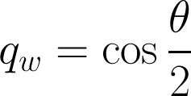
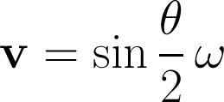
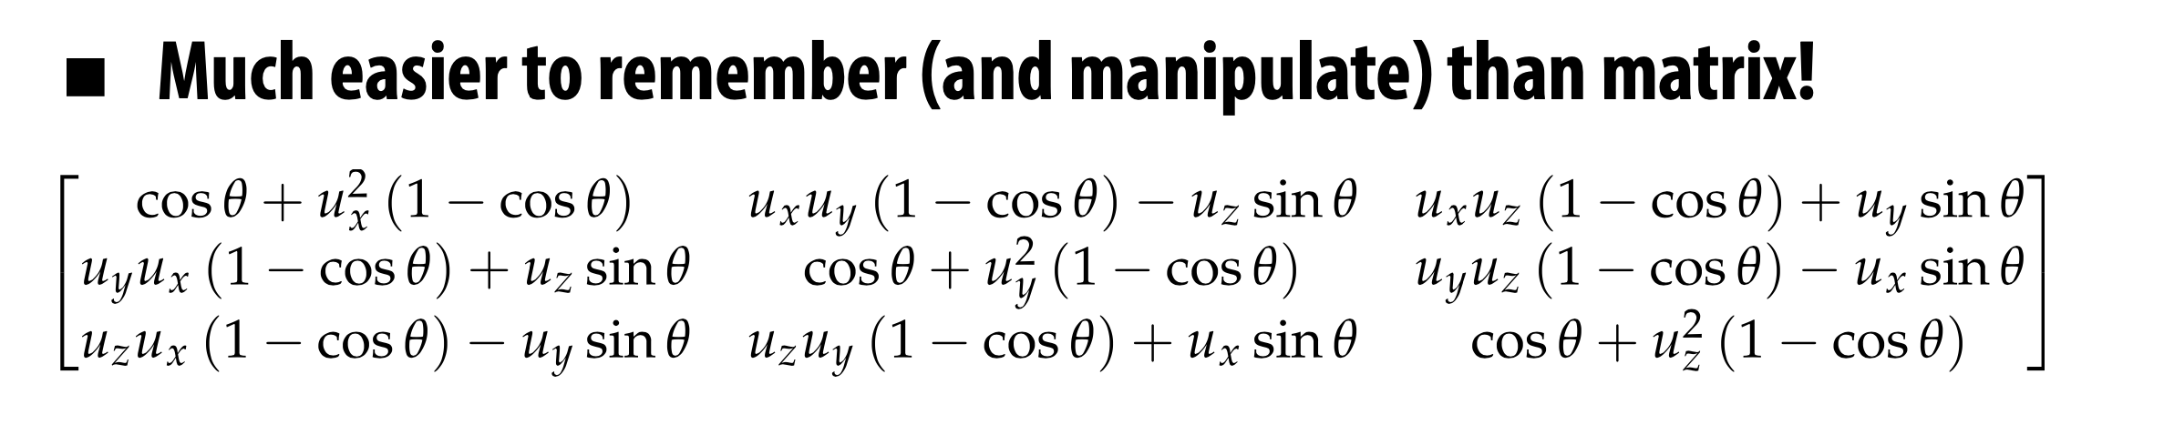
Quaternions
Quaternions can also be interpreted as a scalar plus a 3-vector
Where

Slide 30

Quaternions
Rotations can be carried away directly in parameter space via the quaternion product:
  Concatenation of rotations:
If we want to rotate a vector
where is the quat conjugate.

Slide 31
Quaternions are ideal for interpolation
Interpolating Euler angles can yield strange-looking paths, non-uniform rotation speed, …
Simple solution with quaternions: "SLERP" (spherical linear interpolation):
Notes:
Quaternions are specially useful for carrying out interpolation.

Slide 32



Quaternions
Quaternions have no singularities
Derivatives exist and are linearly independent
Quaternion product allows to perform rotations
Good for interpolation
But all this comes at the expense of using 4 numbers instead of 3
Enforce quadratic constraint
Notes:
Is there a representation that requires just 3 numbers and does not suffer from gimbla lock?

Slide 33

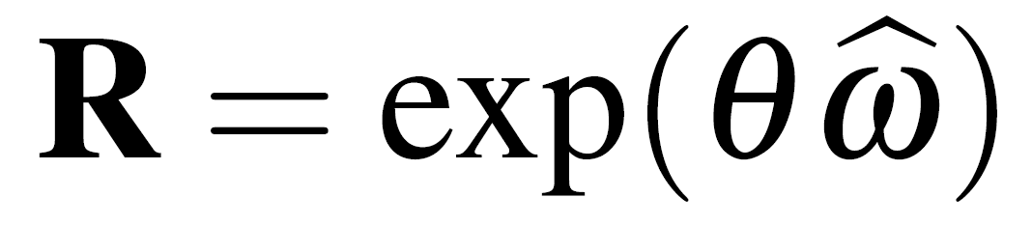
Axis-angle
For human motion modeling it is often needed to specify the axis of rotation of a joint
Any rotation about the origin can be expressed in terms of the axis of rotation and the angle of rotation with the exponential map
Notes:
specify the motion of the knee joint as a
rotation about an axis perpendicular to the leg and parallel to the hips

Slide 34
Lie Groups / Lie Algebras
Definition: A group is an n-dimensional Lie-group, if the set of its elements can be represented as a continuously differentiable manifold of dimension n, on which the group product and inverse are continuously differentiable functions as well
Lie Group
M
Lie algebra
Notes:
specify the motion of the knee joint as a
rotation about an axis perpendicular to the leg and parallel to the hips
34

Slide 35
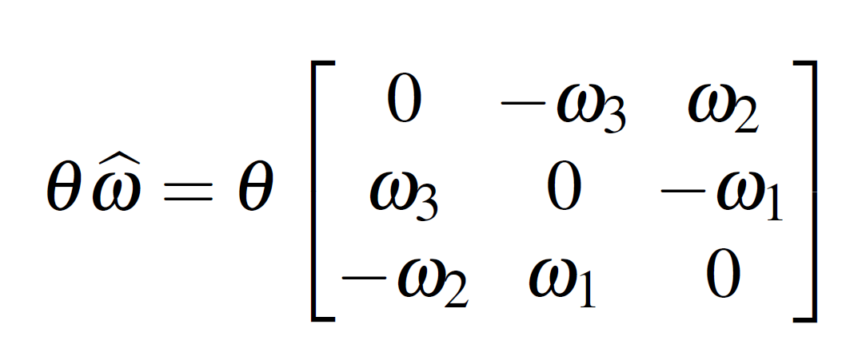


Axis-angle
Given a vector the skew symetric matrix is
It is the matrix form of the cross-product:
You will also find it as
Notes:
Coment on the hat

Slide 36

Exponential map
The exponential map recovers the rotation matrix from the axis-angle representation (Lie-algebra)

Slide 37
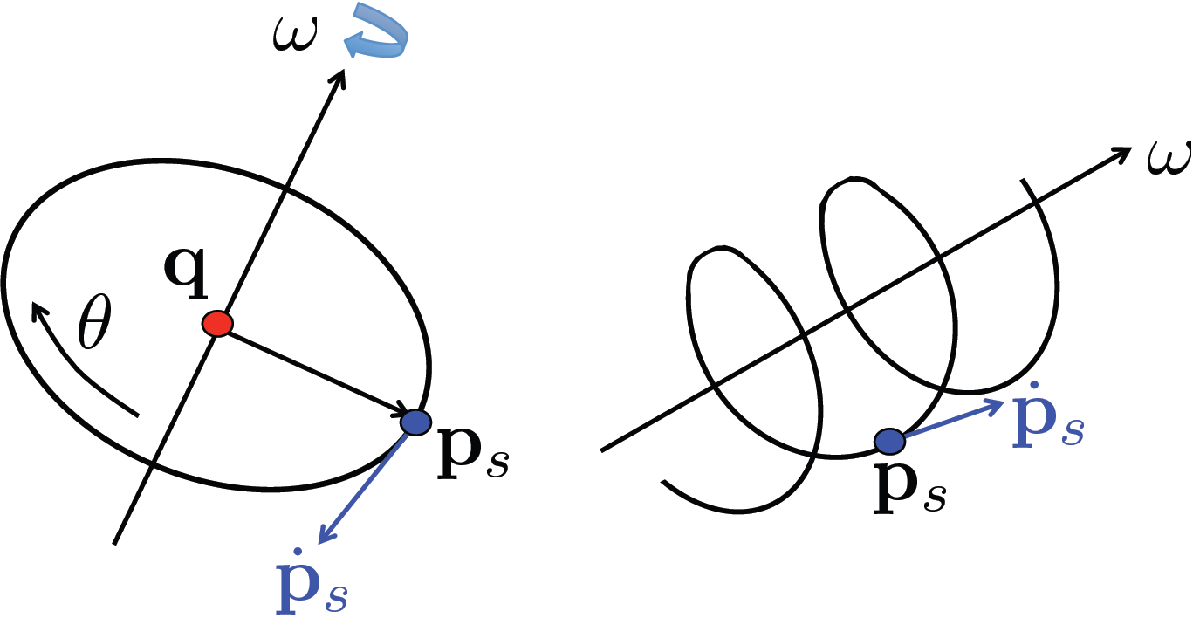
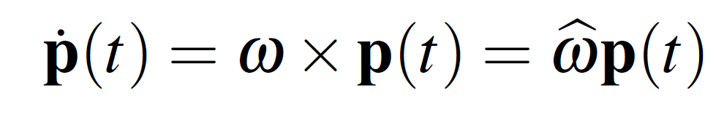
Exponential map
Proof: exponential map
?
Notes:
Consider a point rotating about an axis following a trajectory in time

Slide 38
Exponential map
Proof: exponential map
Notes:
Consider a point rotating about an axis following a trajectory in time

Slide 39
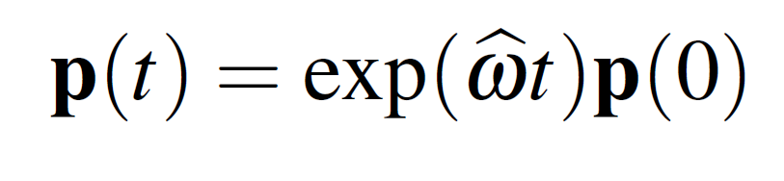
Exponential map
Proof: exponential map
Notes:
Consider a point rotating about an axis following a trajectory in time

Slide 40
Exponential map
Proof: exponential map
If we rotate θ units of time

Slide 41
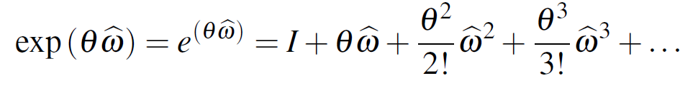
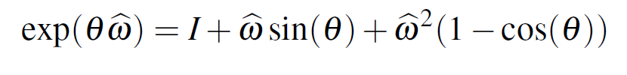
Exponential map
Exploiting the properties of skew symetric matrices
Rodriguez formula:
Closed form!

Slide 42
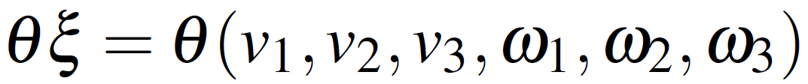
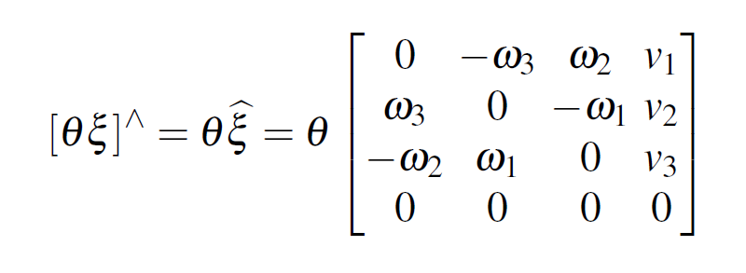

Twists
What about translation ?
The twist coordinates are defined as
And the twist is defined as

Slide 43
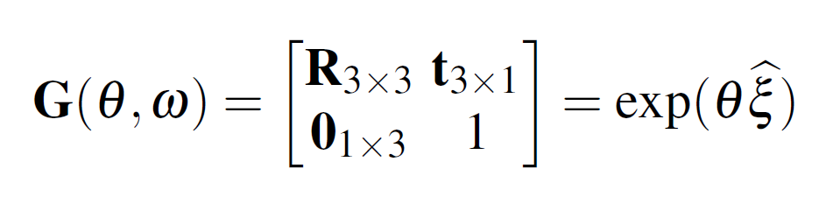
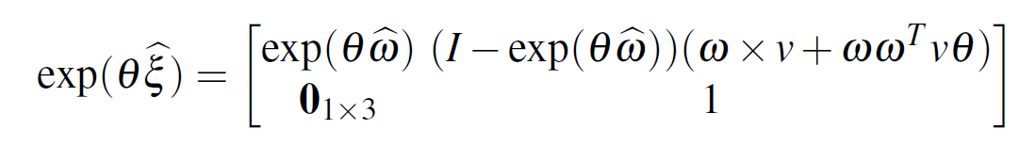
Exponential map
The rigid body motion can be computed in closed form as well
From the following formula

Slide 44
Which representation should I use?
Number of parameters | Singularities | Human constraints | Concatenate motion | Optimization (derivatives)
Twists | Quaternions | Twists | Quaternions | Twists
Euler Angles | Twists | Quaternions | Twists | Euler Angles
Quaternions | Euler Angles | Euler Angles | Euler Angles | Quaternions

Slide 45
Ingredients to build a Virtual Human
Building a human model
Fitting model to observations
Kinematic parameterization
  Rotation Matrices
  Euler Angles
  Quaternions
  Twists and Exponential maps
  Kinematic chains
Subject shape model
  Geometric primitives
  Detailed Body Scans
  Human Shape models
Inference
  Observation likelihood
  Local optimization
  Particle Based optimization
  Directly regressing parameters
Notes:
As we saw in the first lecture, to build a virtual human, beyond the 3D shape, we need to specify how the 3D surface will move and deform with pose. By far the most common approach to this is to use a kinematic chain.

Slide 46



Articulation
B
S
In a rest position we have

Slide 47
Articulation
B
S

Slide 48


Articulation
B
S

Slide 49
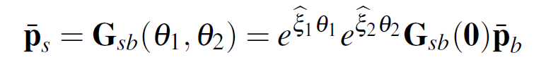
Articulation
B
S
The coordinates of the point in the spatial frame

Slide 50
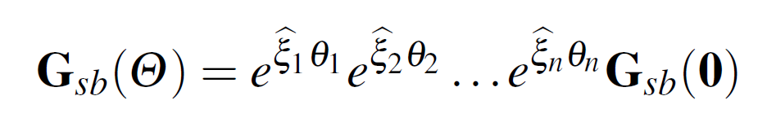

Product of exponentials
is the mapping from coordinate B to coordiante S
BUT IS NOT the mapping from segment i+1 to segment i.
Think of simply as the relative motion of that joint.

Slide 51




Inverse Kinematics
Supose we want to find the angles to reach a specific goal

Slide 52
Inverse Kinematics
Supose we want to find the angles to reach a specific goal
The problem is non-linear
Linearize with the articulated Jacobian

Slide 53
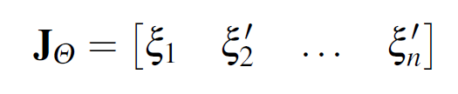

Articulated Jacobian
The Jacobian using twists is extremely simple and easy to compute
Every column corresponds to the contribution of i-th joint to the end-effector motion
Maps an increment of joint angles to the end-effector twist
Notes:
Comment that it is configuration dependent

Slide 54


Articulated Jacobian
Intuition: Linear combination of twists
B

Slide 55
Articulated Jacobian
Intuition: Linear combination of twists
B

Slide 56
Articulated Jacobian
Intuition: Linear combination of twists
B

Slide 57
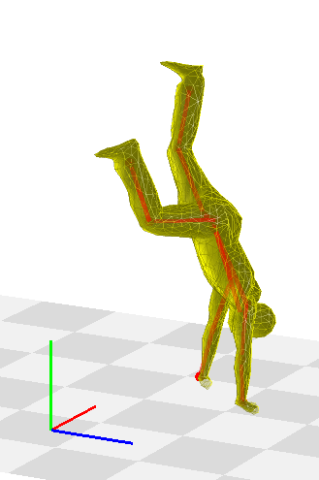

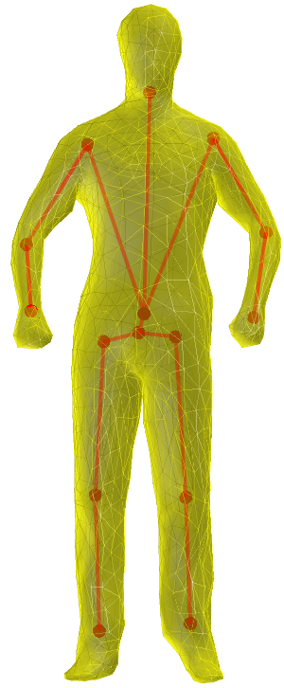
Pose Parameters
Pose parameters: root + joint angles
Notes:
Show video of moving paramteres

Slide 58

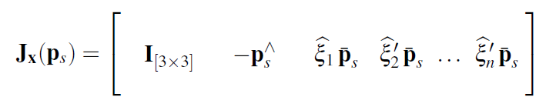
Pose Jacobian
Maps increments in the pose parameters to increments in end-effector position
6 columns of Root
N columns for one per joint
Notes:
Comment column is zero if the joint is not influencing the point

Slide 59
In SMPL (de-facto body model)
In SMPL rotations are local, from child to parent
C
B
A
In SMPL Twists are in the coordinates of the parent joint!

Slide 60
Slide credits and further reading
Keenan Crane – Computer Graphics (slides on quaternions). CMU computer graphics lecture
Pons-Moll & Rosehnan – ICCV’2011 Tutorial on Model Based Pose Estimation
  Book chapter: model based human pose estimation available on pdf on my website.
A Mathematical Introduction to Robotic Manipulation
  excellent rigorous treatment of twists and exponential maps for articulated bodies

Slide 61
Slides below are originals for heavy editing

Slide 62
Ingredients to build a Virtual Human
Kinematic parameterization
- Rotation Matrices
- Euler Angles
- Quaternions
- Twists and Exponential maps
- Kinematic chains
2) Subject model
- Geometric primitives
- Detailed Body Scans
- Human Shape models
3) Inference
- Observation likelihood
- Local optimization
- Particle Based optimization
Notes:
As we saw in the first lecture, to build a virtual human, beyond the 3D shape, we need to specify how the 3D surface will move and deform with pose. By far the most common approach to this is to use a kinematic chain.

Slide 63
Ingredients to build a Virtual Human
Kinematic parameterization
- Rotation Matrices
- Euler Angles
- Quaternions
- Twists and Exponential maps
- Kinematic chains
2) Subject model
- Geometric primitives
- Detailed Body Scans
- Human Shape models
3) Inference
- Observation likelihood
- Local optimization
- Particle Based optimization

Slide 64
Notes:
An important property of a transformation is whether it commutes. So, we can ask whether rotations commute. Let’s look first at rotations in 2D. Do they commute?

Slide 67
Notes:
A very annoying thing of euler angles is the Gimbal lock lock. This is a degenerate case where we lose one degree of freddom and we can not rotate the object along one axis.
If we look a the resulting rotation matrix, we obtain this.
Consider the case…
We are left with a planar rotation. Notice it depends only of thetax, tehtaz. Not on theta_y.

Slide 68
Product of exponentials
Product of exponentials formula
is the mapping from coordinate B to coordiante S
BUT IS NOT the mapping from segment i+1 to segment i.
Think of simply as the relative motion of that joint

Slide 69
Overview
Kinematic parameterization
- Rotation Matrices
- Euler Angles
- Quaternions
- Twists and Exponential maps
- Kinematic chains
2) Subject model
- Geometric primitives
- Detailed Body Scans
- Human Shape models
3) Inference
- Observation likelihood
- Local optimization
- Particle Based optimization

Slide 70
Notes:
The gimbal lock is a real problem. Can we find a parameterization which does not suffer from a gimbal lock and is more compact than the 9 numbers of a rotation matrix?
Yes, the answer are quaternions. To understand quaternions we need to know where they come from. They come from complex numbers.

Slide 71
Notes:
I want want you to think about complex numbers in a different way. In bachelor math, you have seen that the square root of -1 equals i.
But what is the geometrical interpretation? Forget about this for now.
We will think of I, simply as a quarter-turn in the ounter clockwise direction. Such that two turns lead map form 1 to -1.

Slide 72
Notes:
Complex numbers are just 2 vectros, where we have just replaced the name of the basis vectors say e1,e2 by 1 and i. But nothing else changes.
Except that now we have a new notion of product between two vectors!

Slide 73
Notes:
Vector addition, scalar multiplaction, Evertyhing like a vector space. But we alos have complex multiplication. Angles will add and magnitudes ill multiply.
If we take the polar form, we can get r1r2 and theta1+theta2 → we just have to be careful if theta1+theta2 is larger than 2pi.

Slide 74
Quaternions are ideal for interpolation
Notes:
Quaternions are specially useful for carrying out interpolation.

Slide 75
Quaternions: where they come from
Notes:
Can we justify this geometrically?

Slide 76
Quaternions
Rotations can be carried away directly in parameter space via the quaternion product:
  - Concatenation of rotations:
  - If we want to rotate a vector
  where is the quat conjugate

Slide 77
Quaternions: where they come from
Notes:
Suppose I want to rotate.
Much easier formulae when using complex numbers

Slide 78
Quaternions: where they come from
Notes:
Let’s look at this again in polar form. Perhaps the most beautiful formula in math. It involves a bunch of important constants e, pi, I,
This formula is a specialization of a more useful formula. E^\theta_i is a function that takes a \theta and returns a point on the circle.
Use this formulat to implement the complex product
You can represent rotations with complex numbers.
Why using complex numbers, they define an additional product operation over vectors which we can leverage to compose rotations.

