Slide 1
Virtual Humans – Winter 23/24
Lecture 10_2 – Humans and NeRF
Prof. Dr.-Ing. Gerard Pons-Moll
University of Tübingen / MPI-Informatics

Slide 2
Novel View Synthesis for Humans
Peng et al. CVPR 21
Notes:
Novel view synthesis for human means learning a dynamic nerf. One way as we have seen in D-NeRF is to learn time conditioned NeRF. But that doesn’t allow us control over human motion.
As we knoe that human motion depends on movement/articulation of individual joint, ideally we aim for learning a pose conditioned nerf for synthesis, where we can change both the pose and viewpoint of human.

Slide 3
Human models using NeRF
Peng et al. CVPR 21
Notes:
As we have already seen in previous part, we cannot model dynamic scene directly using NeRF. In D-NeRF we propose to learn a separate canonical shape of the deforming scene controlled by time
With this we cover NeuralBody, which is intial work doing NVS for humans using volume rendering.

Slide 4
Neural Body: Implicit Neural Representations with Structured Latent Codes for NVS of Dynamic Humans
Peng et al. CVPR 21
Notes:
NeuralBody, which is intial work doing NVS for humans using volume rendering and control over pose. The key idea to intergrate info across video frame using underying human model.

Slide 5
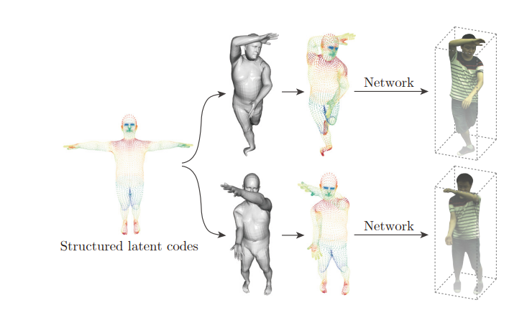
Neural Body: Key Idea
Peng et al. CVPR 21
Notes:
The over all idea to represent human with a structured latent code., specifically latent code z is anchored to vertices of a deformed mesh. When the pose of human changes, the anchor point changes.
For each frame, we transform the spatial locations of codes based on the human pose, and use a network to regress the density and color for any 3D location based on the structured latent codes. Then, images at any viewpoints can be synthesized by the volume rendering.

Slide 6
Neural Body: Key Idea
Sparse latent code, not defined for all points in 3D
Peng et al. CVPR 21
Notes:
In volume rendering setting, we need to query color and density values for all points along the ray, but as mentioned in the previous slide, the latent codes are only defined on the surface of deformed mesh, which is very sparse for a continuous model.

Slide 7
Neural Body: Method
Peng et al. CVPR 21
Notes:
In volume rendering setting, we need to query color and density values for all points along the ray, but as mentioned in the previous slide, the latent codes are only defined on the surface of deformed mesh, which is very sparse for a continuous model.
To solve this problem, latent codes are diffused to nearby 3D space and this is termed as Code diffusion
Based on posed SMPL, 3D bbox of human is estimated and devided in to small grids of a fixed size. . The latent code of a nonempty voxel is the mean of latent codes of SMPL vertices inside this voxel. SparseConvNet utilizes 3D sparse convolutions to process the input volume and output latent code volumes

Slide 8
Neural Body: Method
Peng et al. CVPR 21
Notes:
Using this diffused latent codes and trilinear interpolation, a latent code for any point x is obtained.

Slide 9
Neural Body: Method
Peng et al. CVPR 21
Notes:
Using this latent code as input, we predict view independent density and view dependent color value.
This values are used in volume rendering to yield the final color at any ray.

Slide 10
Neural Body: Results
Input Views NeuralBody 3D reconstruction
Peng et al. CVPR 21
Notes:
Compared to PiFU, Neural body recoverd human shapes with no missing/extra limbs or ghost artefacts. This is due the structed latent code used in method, which has strong information about humans shape.

Slide 11
Neural Body: Conclusion
Use SMPL mesh as structure:
Strong human prior and preserves human shape.
Peng et al. CVPR 21
Notes:
Since neuralbody uses SMPL mesh as the underlying strutuce. It has a strong prior of human body shape So it doesn’t have ghosting artfatcs or extra limbsetc, which method like pifu might have.

Slide 12
Neural Body: Conclusion
Use SMPL mesh as structure:
Strong human prior and preserves human shape.
Introduces artifacts in clothing and complex motions that are not captured by the SMPL model.
Input NeuralBody
Peng et al. CVPR 21
Notes:
But the downside it, it might generate artfacts for clothing which does not closely follow SMPL e.g. jackets

Slide 13
Neural Body: Conclusion
Use SMPL mesh as structure:
Strong human prior and preserves human shape.
Introduces artifacts in clothing and complex motions that are not captured by the SMPL model.
Only works for multi-view setup.
Input NeuralBody
Peng et al. CVPR 21
Notes:
Naturally having a monocular video setting is more natural, challenging.

Slide 14
HumanNeRF:Free-viewpoint Rendering of Moving People from Monocular Video
Given a monocular video(a) of a human performing complex movement, e.g., dancing (left), HumanNeRF creates a free-viewpoint rendering for any frame in the sequence(b).
Deformation and skinning formulation similar to NeuralGIF
Weng et al. CVPR 22

Slide 15
HumanNeRF: Key Idea
Split the deformation into:
Human articulation
Non-rigid pose dependent deformation
Similar to NerualGIF
Weng et al. CVPR 22
Notes:
Similar to neuralgif, they query points in posed space and transform it to cannical using inverse trasnforamtion, followed by predicting non rigid deformation in canocial shape.

Slide 16
HumanNeRF: Key Idea
Split the deformation into:
Human articulation
Non-rigid pose dependent deformation
Skinning weights using forward skinning.
Similar to NeuralGIF
Similar to SNARF
Weng et al. CVPR 22
Notes:
Following SNARF,Human NeRF solves for canonical skinning weight and hence results in better generalization.

Slide 17
HumanNeRF: Method
Observed to canonical
Skinning weight obtained using forward skinning
Weng et al. CVPR 22
Notes:
Given a body pose p , and MLP, pointsin observed(deformed space) is transformed to canonical space

Slide 18
HumanNeRF: Method
Positional encoding
Set of joint rotations
Weng et al. CVPR 22
Notes:
Then we predict non rigid deformation in the canonical space.

Slide 19
HumanNeRF: Method
Weng et al. CVPR 22
Notes:
Using volumetric rendering, we render the image and supervise using image loss

Slide 20
HumanNeRF: Method
Notes:
Add equations

Slide 21
More on Human and NeRFs
Animatable NeRF, Peng et al., ICCV2021
H-NeRF, Xu et al., NeurIPS 2021
NeuMan, Jian et al., ECCV 2022
DoubleField, Shao et al., CVPR 2022
……. And many more.
Notes:
Add equations

Slide 22
Limitation of NeRF/Implicit Representations
4. Expensive training:
Training is slow(10 hours-upto few days)
Inference is also not real time
Notes:
We have already discussed this limitaiton in frist part of lecture. And tried to solve this problem for static scene. We now focus on a novel representaition to efficiently model dynamic scenes with high fidelity.
The ideal representation should be memory efficient, can be rendered fast, is drivable, and has high rendering quality

Slide 23
Mixture of Volumetric Primitives
Combines the advantages of volumetric and primitive-based approaches for:
High performance decoding
Efficient rendering
• A novel motion model for voxel grids for scene motion, minimization of primitive overlap to increase the representational power.
Lombardi et al. SIGGRAPH 21
Notes:
We present Mixture of Volumetric Primitives (MVP), a representation for rendering dynamic 3D content that combines the completeness of volumetric representations with the efficiency of primitive-based rendering, e.g., point-based or mesh-based methods such that:
We explain the technical details of the work one by one

Slide 24
Mixture of Volumetric Primitives: Key Idea
Combining primitives and volumetric representation:
Lombardi et al. SIGGRAPH 21
Notes:
In case of traditional volumetric representation, we define a a single volume and make large number of queries in that volume to obtain the color values for a camera ray.

Slide 25
Mixture of Volumetric Primitives: Key Idea
Combining primitives and volumetric representation:
Lombardi et al. SIGGRAPH 21
Notes:
This might result in large of unnecessary samples in the empty space of the shape and hence resulting in unnescessary network queries and computation.

Slide 26
Mixture of Volumetric Primitives: Key Idea
Combining primitives and volumetric representation:
Translation, rotation and scale of grid/primtitves
Where each festure grid containes color and desnity and M is grid resolution
Lombardi et al. SIGGRAPH 21
Notes:
In MVP, the key idea is to increase the number of primitives(grids) based on the structure of coarse mesh/shape of the object of interest.
Then treat each of these grids like regular grid in volumetric rendering formulation. We define each grid with the centre and its rotation, scale and a feature grid.
The feature grid is learned, which we will explain later.
Given the coarse shape and associated grids with it, we now only make queries the region where probability of the space being empty is much lower.
\mathcal{V}_k = \{t_k, R_k, s_k,V_k \}
V_k \in \mathbb{R}^{4 \times M_x \times M_y \times M_z

Slide 27
Mixture of Volumetric Primitives: Key Idea
Combining primitives and volumetric representation:
Lombardi et al. SIGGRAPH 21
Notes:
As we increase the number of these primitives, the coarse shape is more refined and the probablityl of hitting empty regions decreases further.
This increase the quality of results and no. of unnecessary calls of network.
But there is tradeoff between speed/memory and high frequency details.

Slide 28
Mixture of Volumetric Primitives: Method
Lombardi et al. SIGGRAPH 21
Notes:
Now let us look how the model is learned from images using supervision only on images.

Slide 29
Mixture of Volumetric Primitives: Method
Lombardi et al. SIGGRAPH 21
Notes:
The first step is predict a coarse shape, which can be used to create primitives. Using vertex positions of a guide mesh we compute a base transformation for each primitive (ˆt𝑘 , Rˆ 𝑘 , sˆ𝑘 ) by computing a rotation matrix from the tangent, bitangent, normal vectors at points evenly distributed in the UV space of the mesh

Slide 30
Mixture of Volumetric Primitives: Method
Where each festure grid containes color and desnity and M is grid resolution
Lombardi et al. SIGGRAPH 21
Notes:
Using the latent code z a feature of volumetric primitives(V_k) if predicted

Slide 31
Mixture of Volumetric Primitives: Method
Lombardi et al. SIGGRAPH 21
Notes:
And composed together to obtained the whole feature grid.

Slide 32
Mixture of Volumetric Primitives: Method
Lombardi et al. SIGGRAPH 21
Notes:
a residual transformation (𝜹t𝑘 , 𝜹R𝑘 , 𝜹s𝑘 ) is also predicted to model deviation from initialized volume grid. Allowing the volumetric primitives to deviate from the guide mesh is important to account for deficiencies in the initialization strategy, low guide mesh quality, and insufficient coverage of objects in the scene
.

Slide 33
Mixture of Volumetric Primitives: Method
Lombardi et al. SIGGRAPH 21
Notes:
The composed slab is transformed into world space using the transformations.

Slide 34
Mixture of Volumetric Primitives: Method
Lombardi et al. SIGGRAPH 21
Notes:
We raymarch through the volumetric primitives, accumulating color and opacity, to form the reconstructed image. Both the reconstructed image and the mesh vertex positions are supervised during training from ground truth data.
We can train the network end-to-end using image based loss term.

Slide 35
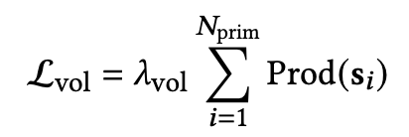
Mixture of Volumetric Primitives: Training
Difference between predicted and GT image
Volumetric primitive to be as small as possible
Difference regressed vertex position and GT vertex
Lombardi et al. SIGGRAPH 21
Notes:
We train the network using photometric loss and geometry super vision
We constrain the volumetric primitives to be as small as possible. The reasons for this are twofold: 1) We want to prevent them from overlapping too much, since this wastes model capacity in already well explained regions, and 2 We want to prevent loss of resolution by large primitives overlapping empty space. T
Last two terms:
a delta magnitude prior Ldel, and a Kullback–Leibler (KL) divergence prior Lkld to regularize the latent space of our Variational Autoencoder (VAE

Slide 36
Mixture of Volumetric Primitives: Results
Lombardi et al. SIGGRAPH 21
Notes:
We see that we increase the number of primitives, fine details complex details e.g. modeling inside of mouth and hair is improved.

Slide 37
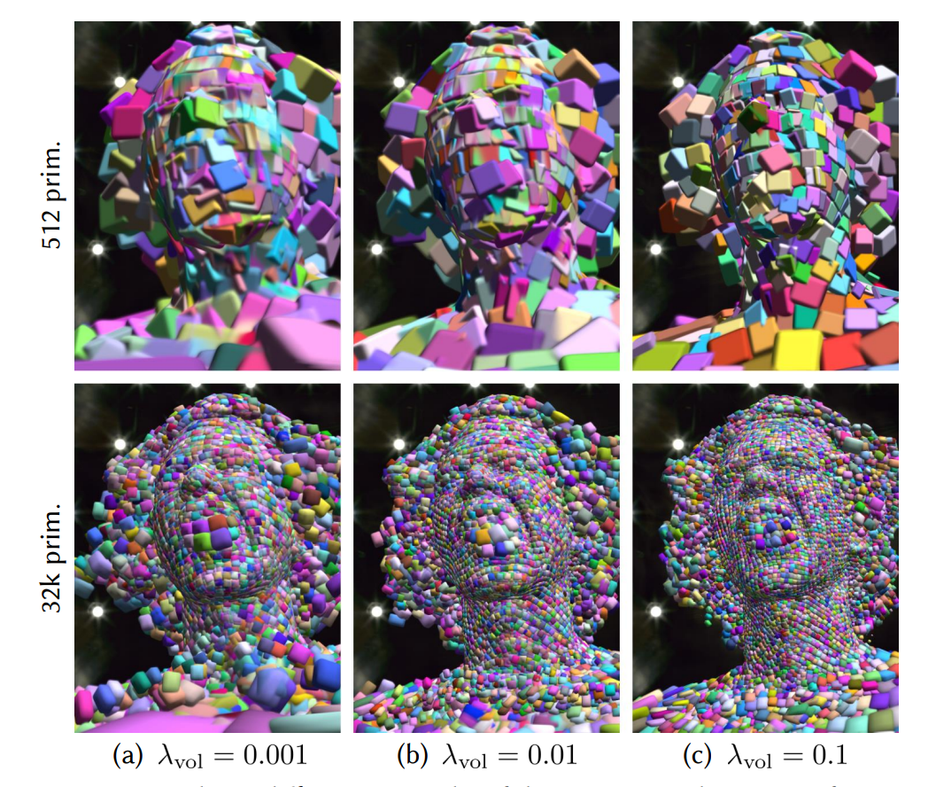
Mixture of Volumetric Primitives: Results
A stronger primitive volume prior leads to less overlap and thus speeds up raymarching
Lombardi et al. SIGGRAPH 21

Slide 38
Mixture of Volumetric Primitives
How much the result depends on initialization(or the guide coarse mesh)?
Lombardi et al. SIGGRAPH 21
Notes:
One question that arises, is that how much this method relies on the initialisation. What if the initialisation is not correct and doesn’t reflect the deforming geometry well.
a residual transformation (𝜹t𝑘 , 𝜹R𝑘 , 𝜹s𝑘 ) is also predicted to model deviation from initialized volume grid. Allowing the volumetric primitives to deviate from the guide mesh is important to account for deficiencies in the initialization strategy, low guide mesh quality, and insufficient coverage of objects in the scene
.

Slide 39
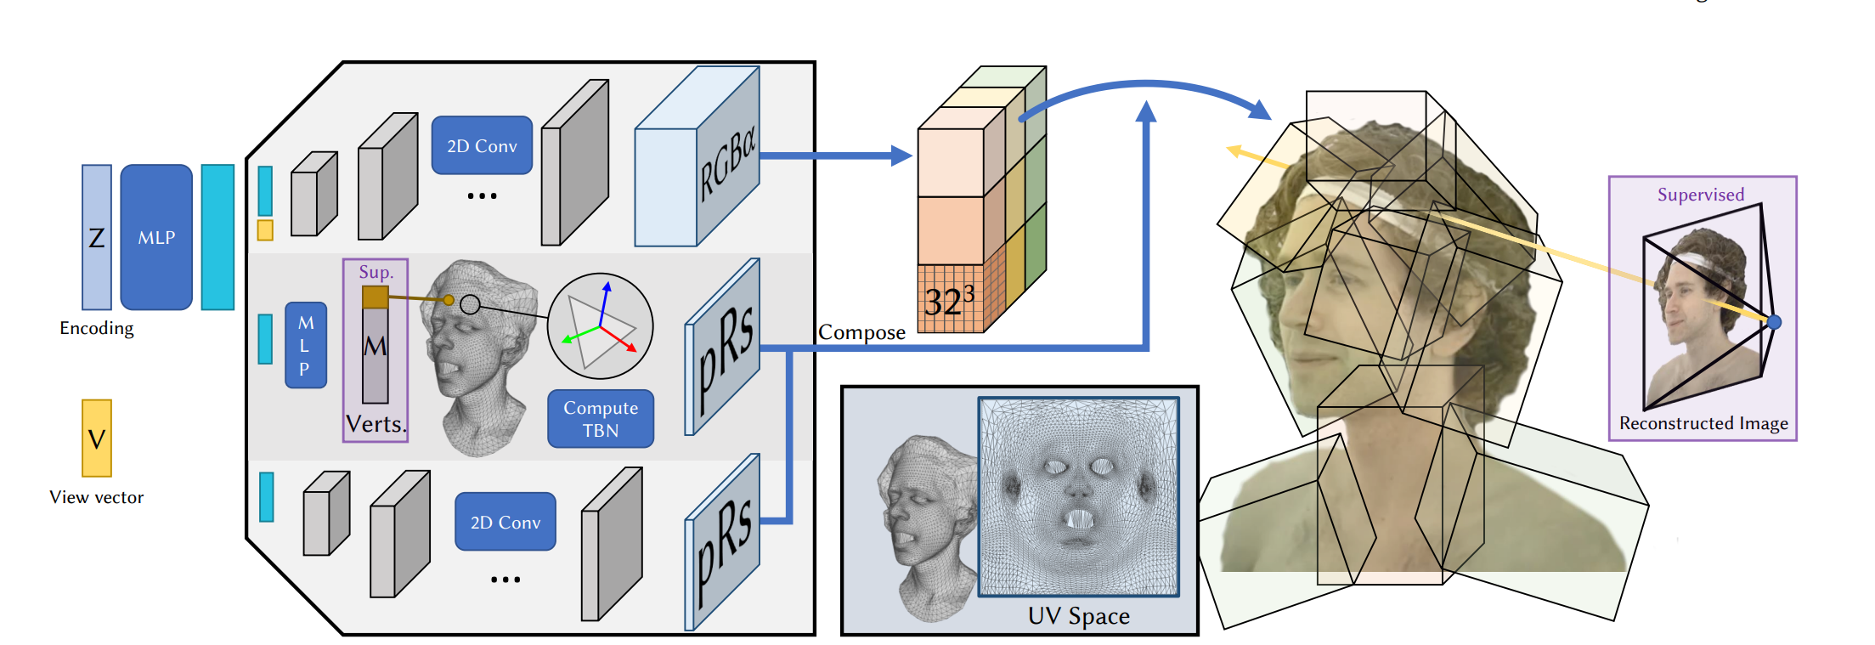
Mixture of Volumetric Primitives
How much the result depends on initialization(or the guide coarse mesh)?
Lombardi et al. SIGGRAPH 21
Notes:
As we have already seen, a residual transformation (𝜹t𝑘 , 𝜹R𝑘 , 𝜹s𝑘 ) is also predicted to model deviation from initialized volume grid. Allowing the volumetric primitives to deviate from the guide mesh is important to account for deficiencies in the initialization strategy, low guide mesh quality, and insufficient coverage of objects in the scene
.
However, allowing for motion is not enough; during training the model can only receive gradients from regions of space that the primitives cover, resulting in a limited ability to self assemble and expand to attain more coverage of the scene’s content. Furthermore, it is easier for the model to reduce opacity in empty regions than to move the primitives away. This wastes primitives that would be better-utilized in regions with higher occupancy

Slide 40
Mixture of Volumetric Primitives
How much the result depends on initialization(or the guide coarse mesh)?
Alpha Fade: Windowing function adds an inductive bias to explain the scene’s contents via motion instead of volumetric opacity.
Lombardi et al. SIGGRAPH 21
Notes:
To solve this problem, a windowing function W is applied to the opacity of the volumetric primitive
W(x,y,z) = \mathrm{exp \Big( -\alpha(x ^{\beta} + y ^{\beta} + z ^{\beta}) \Big)}
W(x,y,z) \in \mathbb{R}^{M^3}
where (𝑥, 𝑦, 𝑧) ∈ [−1, 1] 3 are normalized coordinates within the primitive’s payload volume. Here, 𝛼 and 𝛽 are hyperparameters that control the rate of opacity decay towards the edges of the volume.
This windowing function adds an inductive bias to explain the scene’s contents via motion instead of payload since the magnitude of gradients that are propagated through opacity values at the edges of the payload are downscaled

Slide 41
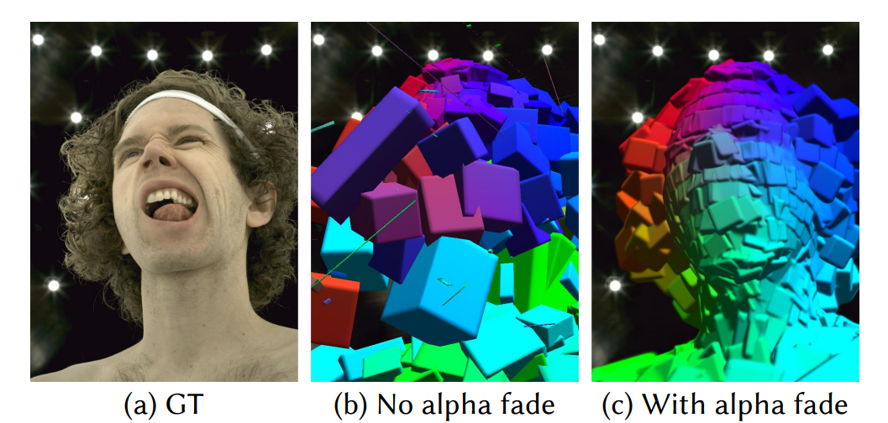
Mixture of Volumetric Primitives
How much the result depends on initialization(or the guide coarse mesh)?
Lombardi et al. SIGGRAPH 21
Notes:
The opacity fade factor enables proper learning of primitive positions. We evaluate with and without opacity fade factor applied to the primitives. No opacity fade factor causes poor primitive positioning, drifting very far from the initialization, to a bad configuration with large primitives and high overlap because of poor gradients

Slide 42
Mixture of Volumetric Primitives
Combine volumetric and primitive based approach for generizable representation of dynamic scenes.
Fast to render
Represent translucent parts, thing structures
Lombardi et al. SIGGRAPH 21

Slide 43
Mixture of Volumetric Primitives
Combine volumetric and primitive based approach for generizable representation of dynamic scenes.
Fast to render
Represent translucent parts, thing structures
Strong prior about structure of underlying shape via coarse shape and derived primitives
Lombardi et al. SIGGRAPH 21

Slide 44
Mixture of Volumetric Primitives
Combine volumetric and primitive based approach for generizable representation of dynamic scenes.
Fast to render
Represent translucent parts, thing structures
Strong prior about structure of underlying shape via coarse shape and derived primitives
No prior/information about the structure of motion of underlying object.
Difficulty to model human motion
Lombardi et al. SIGGRAPH 21

Slide 45
Drivable Volumetric Avatars
Remelli et al. SIGGRAPH 22
Notes:
With the idea that human body dynamics is highly structured deformation i.e controlled via a skeletion. We will see the work called drivable volumetric avatar, which buildson top of MVP and integrate human motion and structure information.

Slide 46
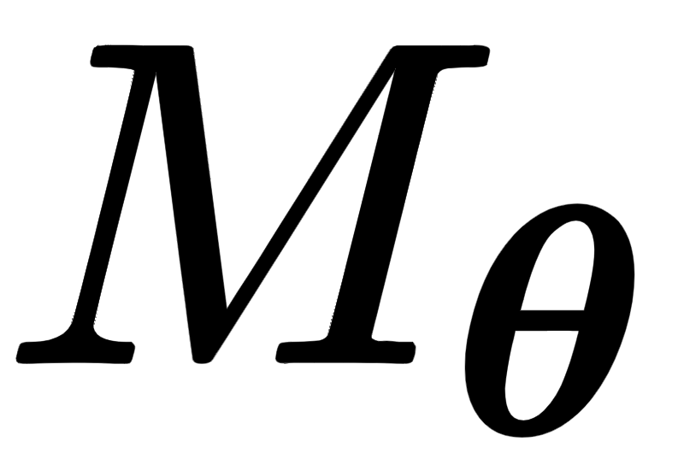
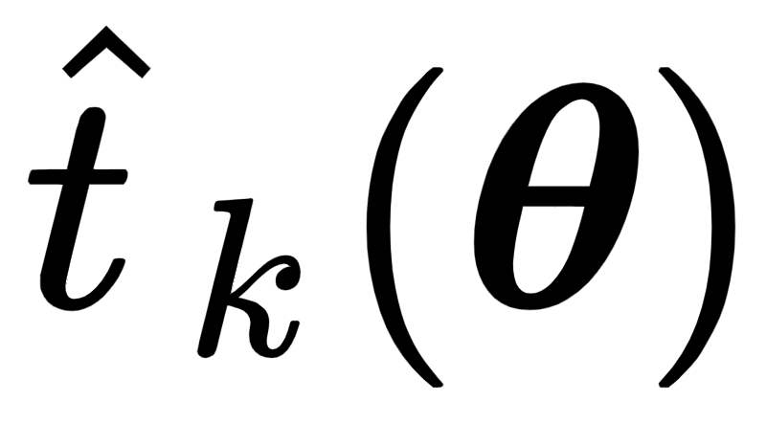
Drivable Volumetric Avatars
Key Idea: Articulated Primitives
Use SMPL posed mesh. as a guide mesh and define primitives using it.
Initialise primitive by uniformly sampling UV space and mapping each primitive to closest texel .
Transform primitives using transformation matrices of SMPL joints and skinning weights.
Remelli et al. SIGGRAPH 22
Notes:
We then initialize primitive locations by uniformly sampling UVspace, mapping each primitive to the closest texel, and positioning it at the corresponding surface point 𝑡ˆ 𝑘 (𝜽) ∈ M𝜽
\hat{t}_k(\boldsymbol{\theta})

Slide 47
Drivable Volumetric Avatars: Method
Remelli et al. SIGGRAPH 22
Notes:
The core of our full-body model is a encoder-decoder architecture, which takes as input raw images, body pose, facial expression and view direction, and outputs a mixture of volumetric primitives.
Specifcially we first take input images, camera parameters and SMPL params of images as input.
Given the body pose, we also have 3D SMPL mesh, and skinning weights.
We use the 3d smpl mesh, viewing direction to unwrap texture from images to UV space.

Slide 48
Drivable Volumetric Avatars: Method
Remelli et al. SIGGRAPH 22
Notes:
Given posed mesh, skinning and unwrapped UV, we learn texel aligned features which represent pose features for geometry , viewdependent features and image features for textures

Slide 49
Drivable Volumetric Avatars: Method
Remelli et al. SIGGRAPH 22
Notes:
Using these texel aligned features, we use a decoder to predict volumetric primitive features namely color, density and rotation/trans scale of grid.
This is analogous to MVP, where given z latent code, we predict RGB, density and rotation/trans etc of the volumetric grid.

Slide 50
Drivable Volumetric Avatars: Method
Remelli et al. SIGGRAPH 22
Notes:
We then compose all the features and transform them using predicted transformation to get the articulated primtives.
Which is then rendering using ray marching to obtain final image.

Slide 51
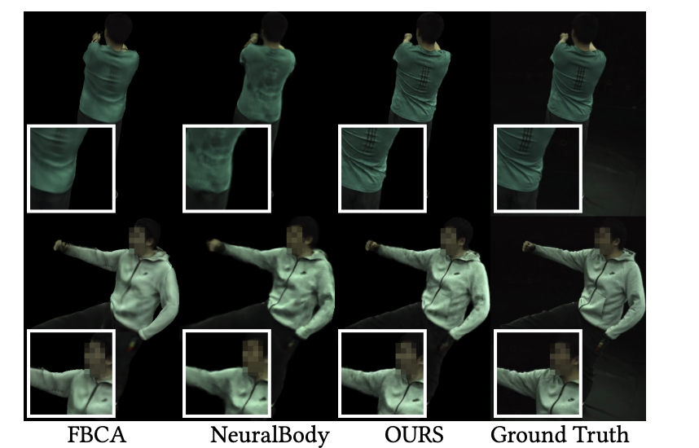
Drivable Volumetric Avatars: Results
Remelli et al. SIGGRAPH 22
Notes:
We compare our method to state-of-the-art for NVS on ZJU-MoCap. Despite not being explicitly tailored to be trained with sparse supervision, our method outperforms competitors. Real faces and their reconstructions are blurred for anonymity
o Full-Body Codec Avatars (FBCA)

Slide 52
Conclusion:
For NVS of humans, it helps to introduce human shape and structure prior in the method.
Provides controlabilty
Preserves human shape/structure
Mixture of volumetric primitives helps:
Efficient rendering
Preserving fine details and model translucent structres

Slide 53
More on Human and NeRFs
Animatable NeRF, Peng et al., ICCV2021
H-NeRF, Xu et al., NeurIPS 2021
NeuMan, Jian et al., ECCV 2022
DoubleField, Shao et al., CVPR 2022
……. And many more
53
Notes:
Add equations

