Slide 1
Virtual Humans – Winter 23/24
Lecture 6_1 – Fitting SMPL to Images with Optimization
Prof. Dr.-Ing. Gerard Pons-Moll
University of Tübingen / MPI-Informatics

Slide 2
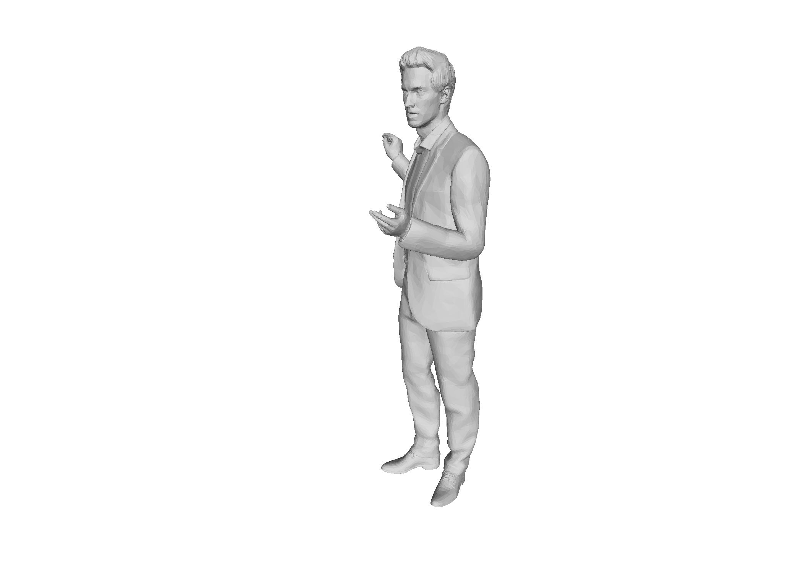
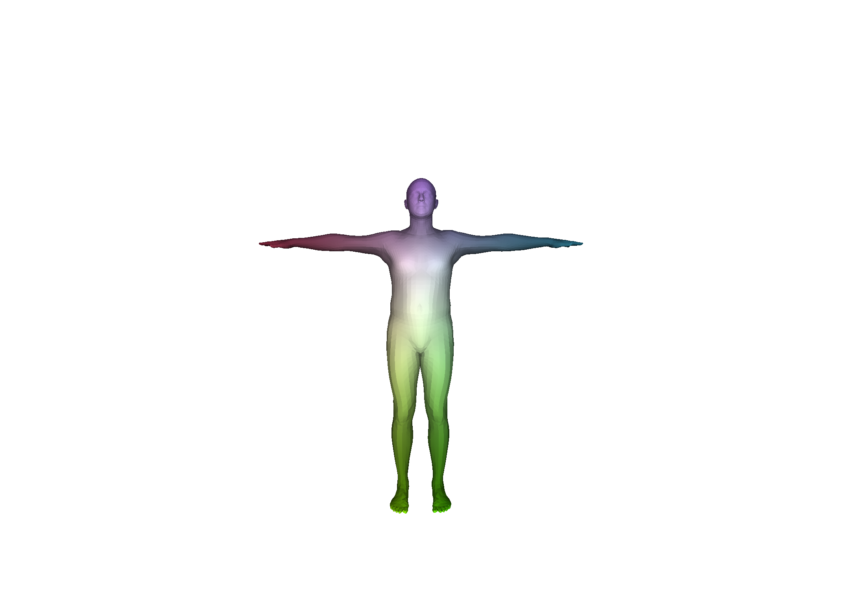
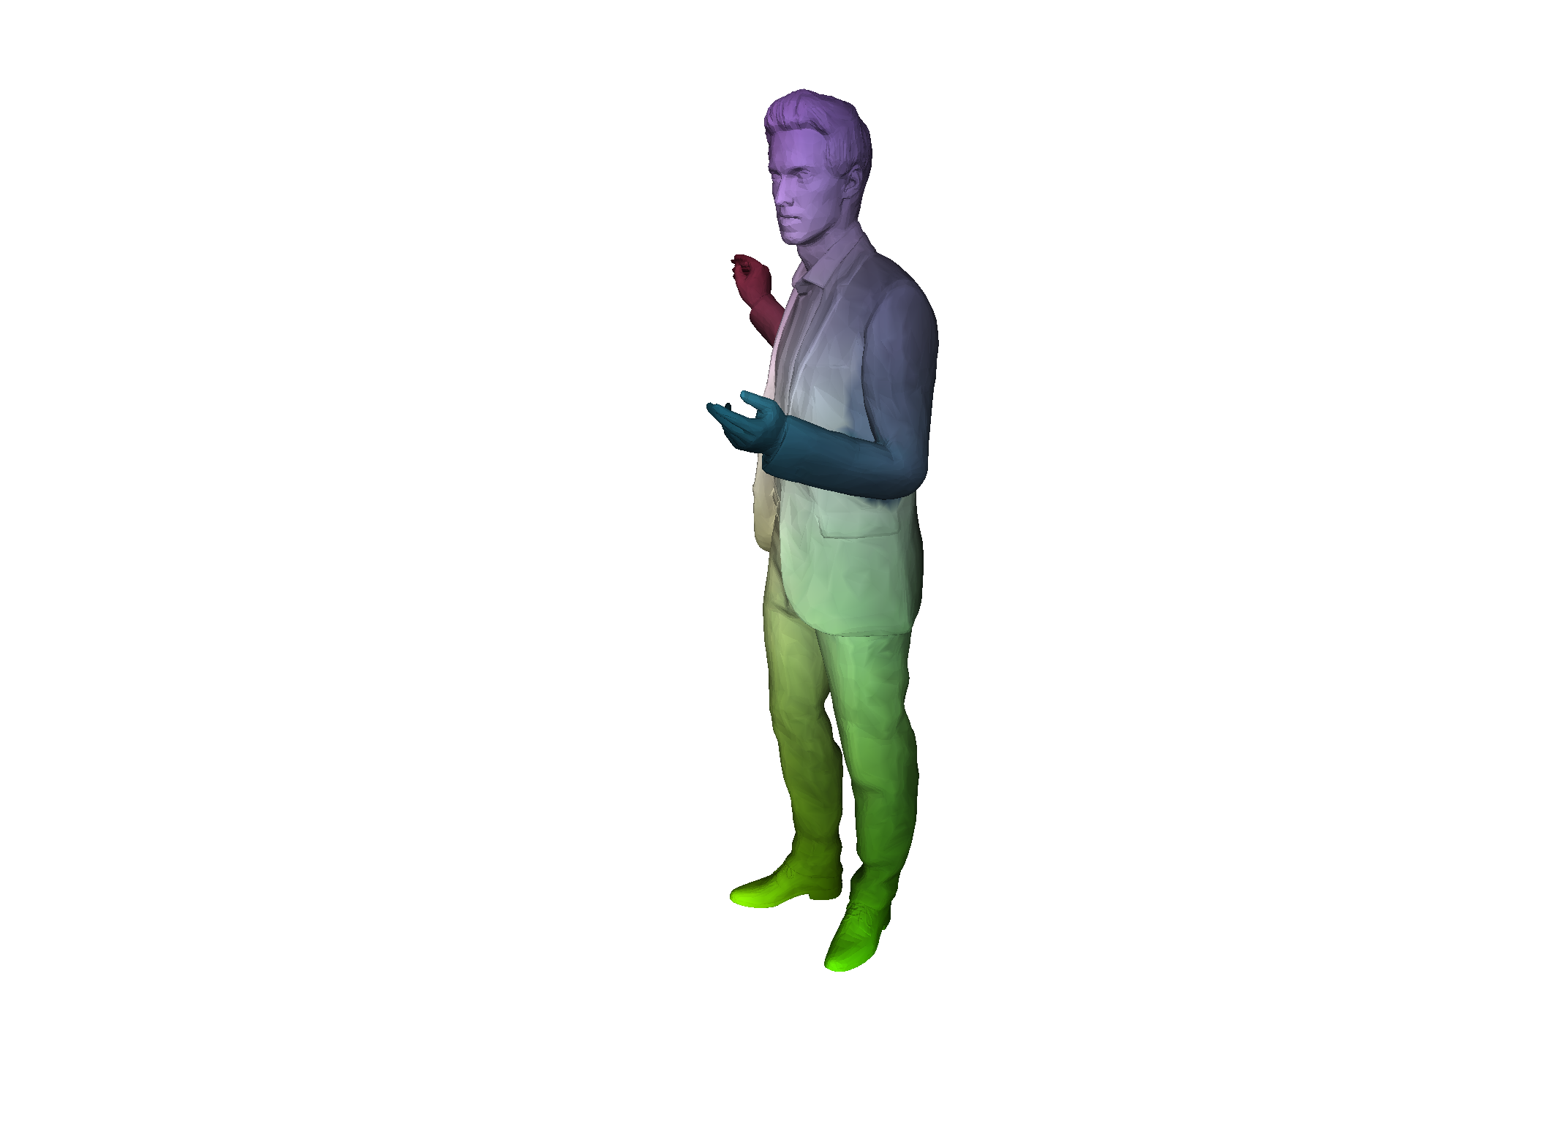
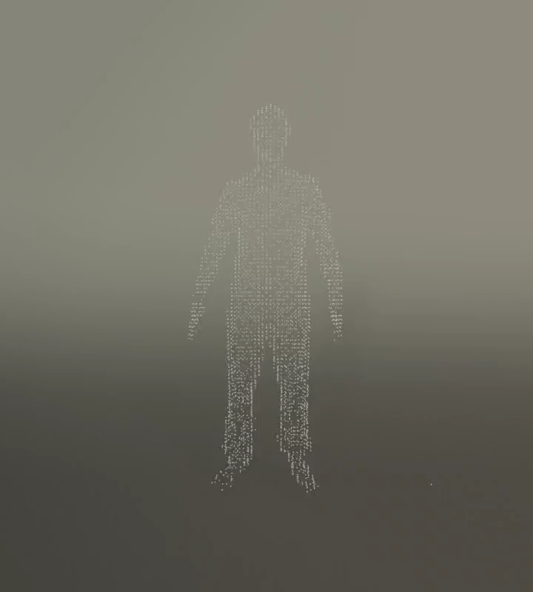
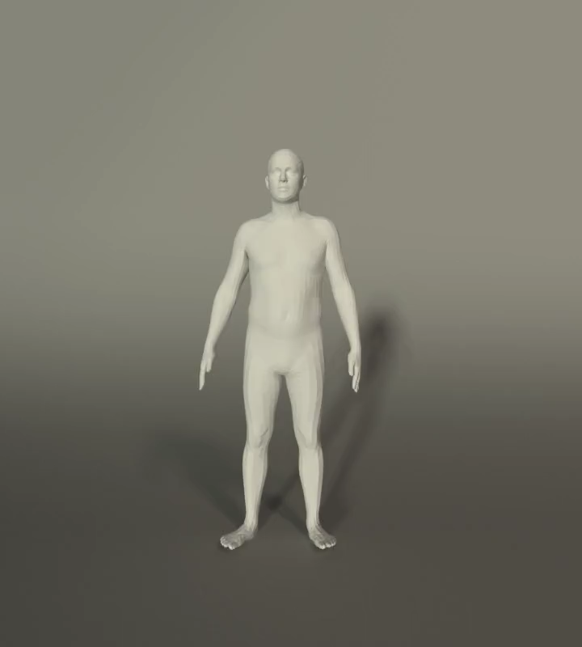
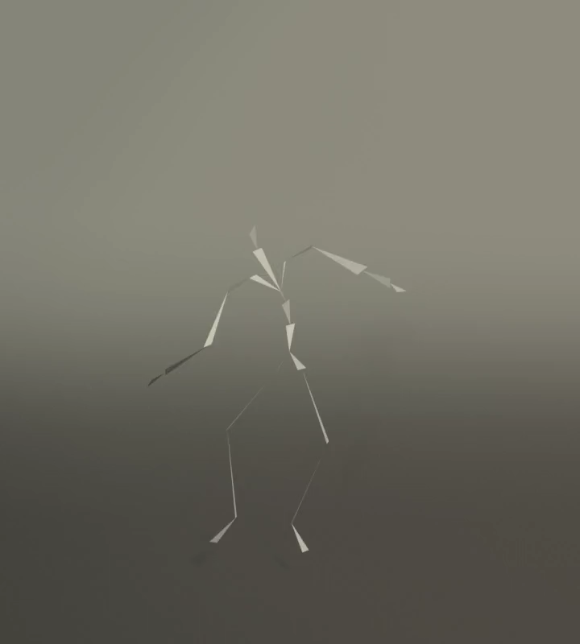
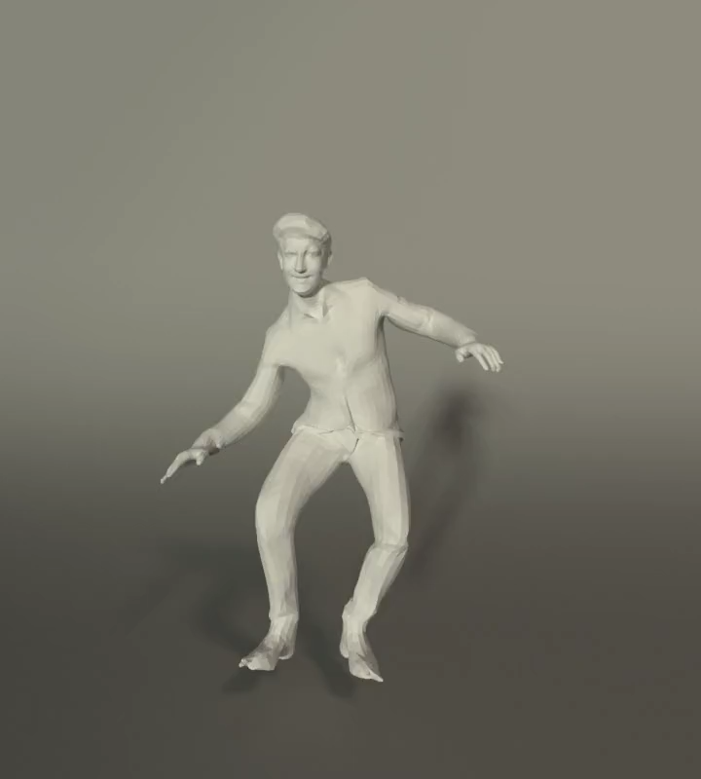
We have seen how to fit SMPL to scans
Correspondences
Tracking
Animation / Control
Notes:
We have seen how to useful.
Most content in the web are still 2D images. Robots and intelligent systems are foten quipped with just images.

Slide 3
How can we infer 3D human pose and shape from a single image?

Slide 4
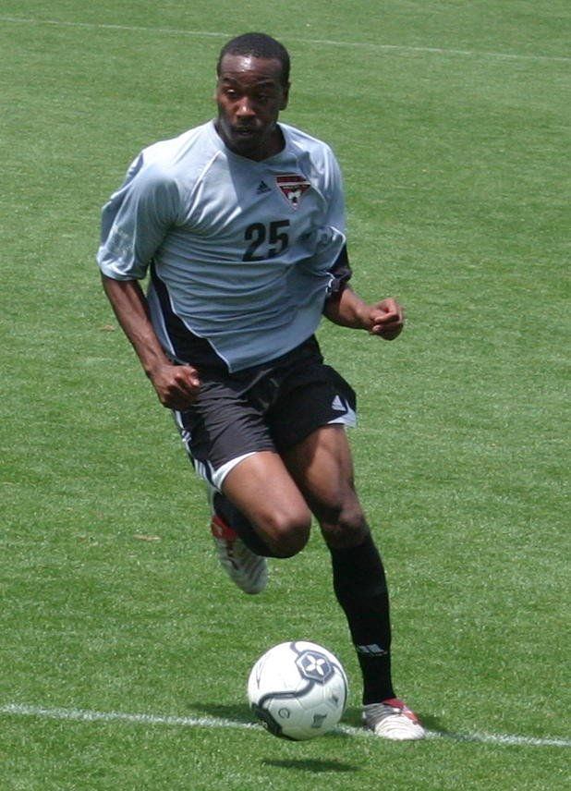
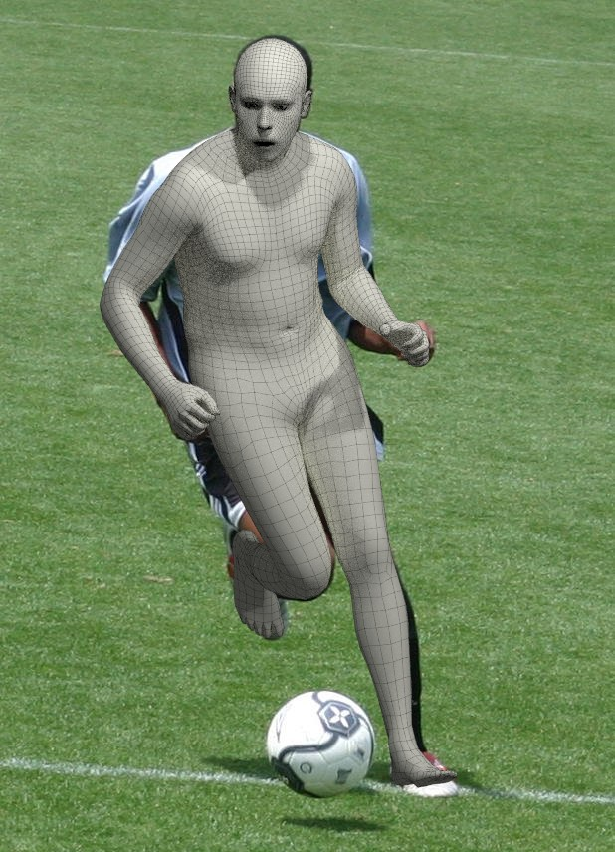
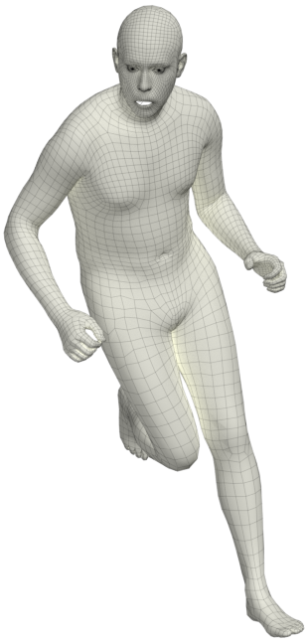
Understand people in images
Estimate 3D shape and pose
"See" the person in 3D
Notes:
To understand human actions, we need to estimate
the configuration of people - from camera images.
For this, we need to
<CLICK> estimate their 3D body shape and pose.
Specifically:
<CLICK> As input, we get a single RGB image of a human,
without any information about
- body pose,
- scene structure, or
- camera calibration.
. As output, we wish to obtain the body shape-and-pose in full 3D.

Slide 5
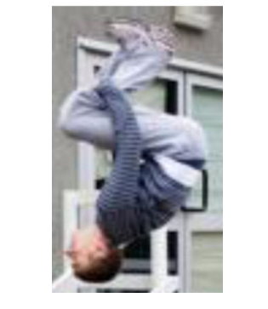
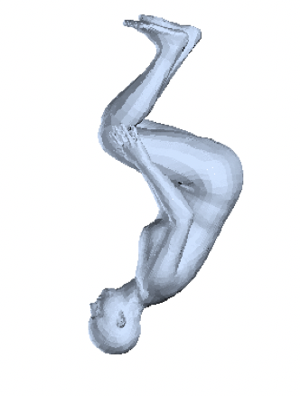
Two ways to estimate 3D humans
Discriminative Models
  "condition on the image"
Generative Models
  "explain the image"

Slide 6
Why is it Hard?

Slide 7
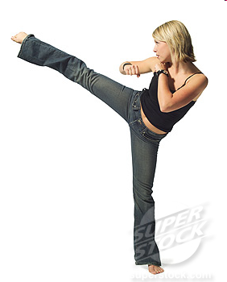

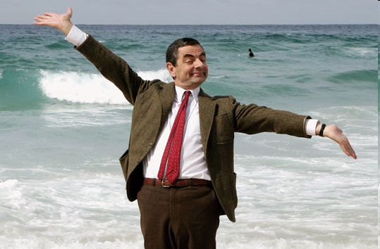
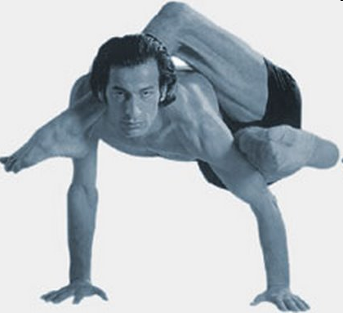
Why is it Hard?
Many degrees of freedom.
Highly Dynamic / Skinning/ Clothing / Outdoor.
Large variability and individuality of Motion patterns.
http://www.google.de/images

Slide 8
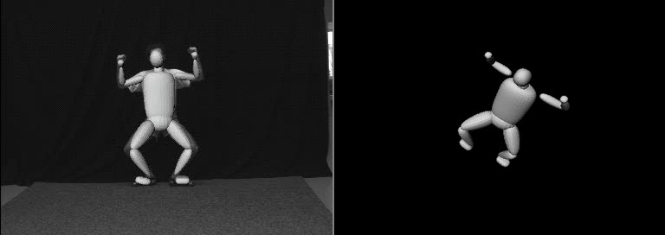
Why is it hard?
Depth ambiguity: many 3D poses produce the exact same projection!
Sminchisescu and Triggs. CVPR’01

Slide 9
Can we use prior information about humans?
We know humans have a fixed skeletal structure.
Motion is mostly articulated.
Human shape is roughly symmetric, and lives in a subspace.
Notes:
Q. Any ideas on how to leverage this information?

Slide 10
We need a body model

Slide 11
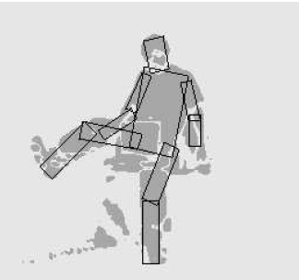
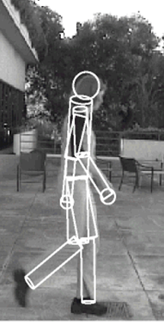
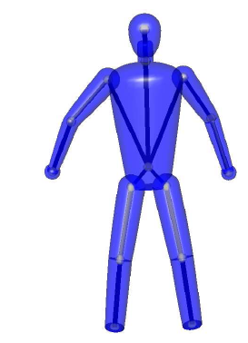
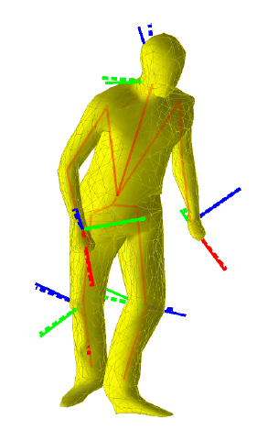
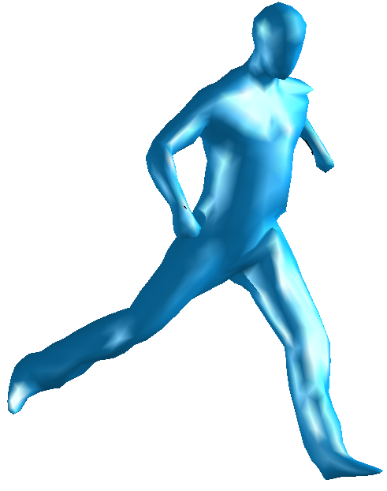
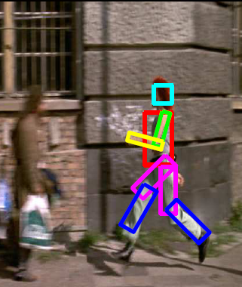
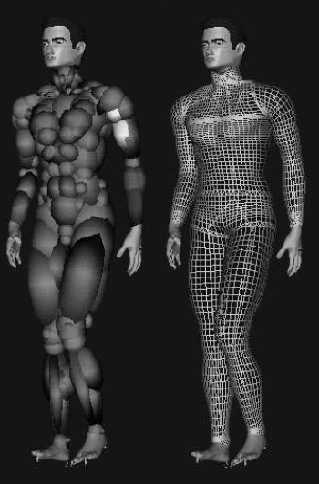
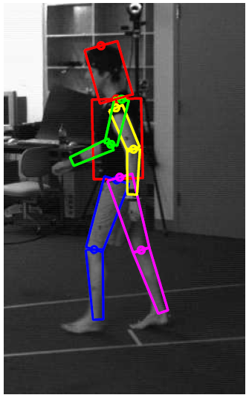
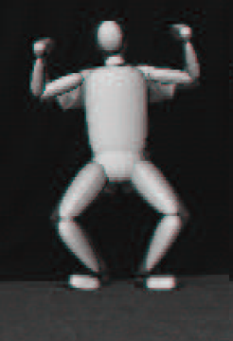
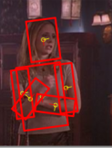
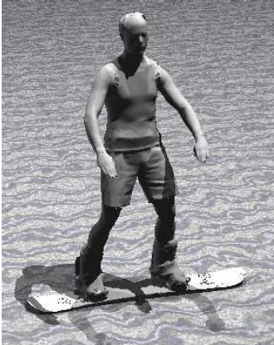
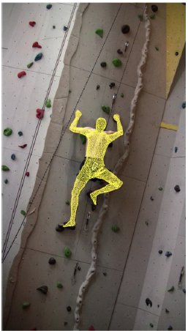
Body models in the past
2D
3D
Cylinders
Ellipsoids
Gaussian Blobs
Rigged scan
Felzenszwalb et.al
Ramanan et.al. Andriluka et.al.
Kjellström et.al.
Sigal et.al.
Kehl and Van Gool
Sminchisescu and Triggs
Plaenkers and Fua
Pons-Moll et.al.
Rosehnahn et.al.
Gall et.al.
Notes:
Geom. Primitives useful because easy to compute
3D: shape paramters usually inferred from image using antropometric data as constrains in an initilization stage
andrilucka

Slide 12
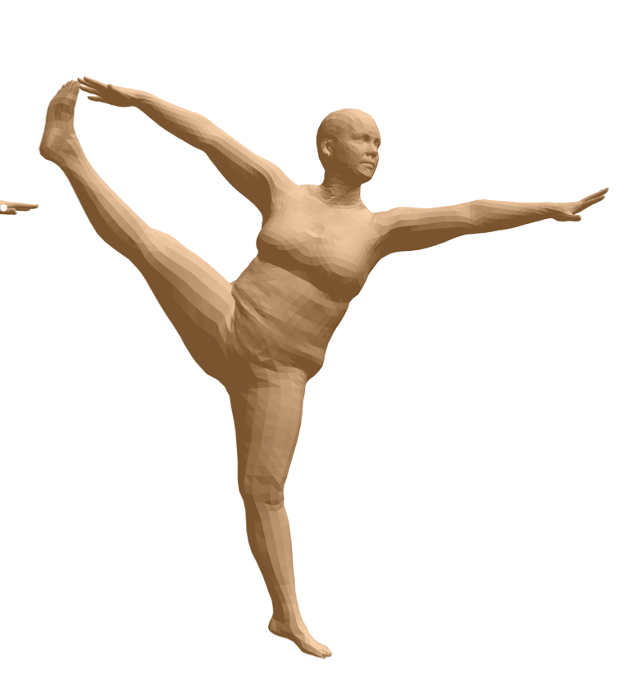
Nowadays
Nowadays SMPL is the de-facto model for human pose and shape estimation from images.

Slide 13
Problem formulation
Input: RGB image
Estimate: Model (SMPL) parameters
  Pose
  Shape
  Camera (optional)

Slide 14
Inference with a generative model eg. SMPL
Posterior
Likelihood
Prior
Model params. (eg. θ, β)
Input/ Observation
(eg. RGB image)

Slide 15
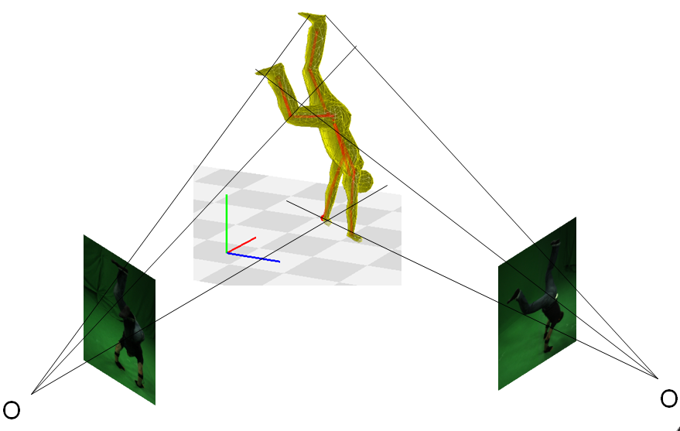
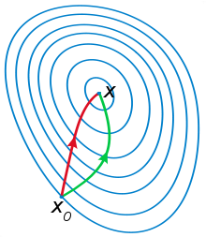
How to model ?
Optimization
Bayesian models
Map of
Approx. with weighted samples

Slide 16
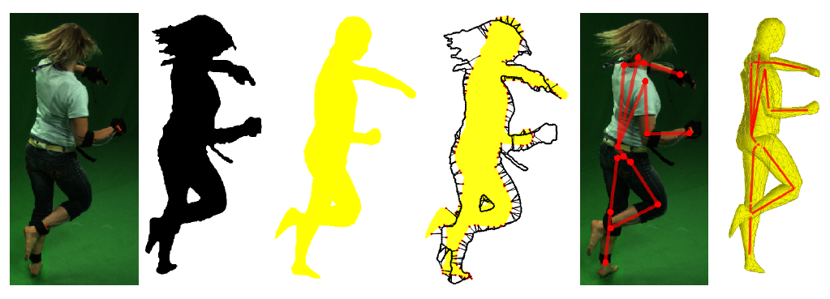
General framework for optimization
Extract features
Predict and match
Optimize

Slide 17
General framework for optimization
Extract features
Predict and match
Optimize
What are good features for fitting?
How to "match" 3D SMPL with 2D image?
What objective should we optimize?

Slide 18
General framework for optimization
Extract features
Predict and match
Optimize
What are good features for fitting?
How to "match" 3D SMPL with 2D image?
What objective should we optimize?

Slide 19
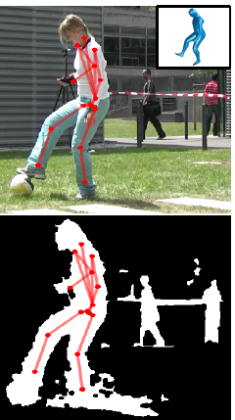
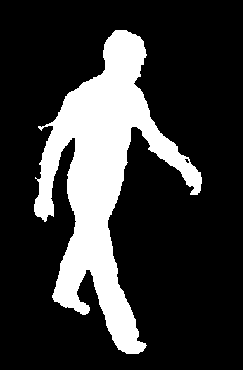
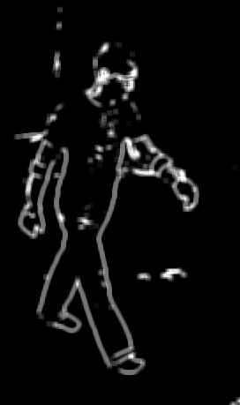
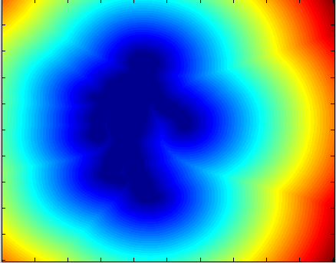
What are good features for fitting?
Silhouettes
Edges
Distance transforms
SIFT
Optic flow
Appearance
…
Any feature that can be predicted from the model and is fast to compute

Slide 20
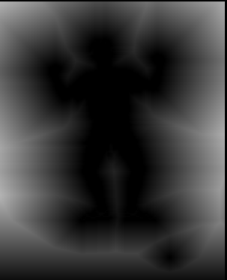
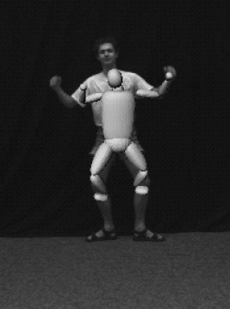
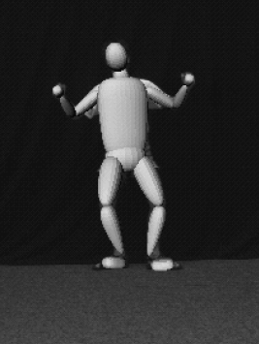
Let's look at Distance Transform for example
Only 1)
1) & 2)
Inconsistent
Consistent
Push model inside silhouette
Force the model to explain the image
Sminchisescu F & G 2001

Slide 21
General framework for optimization
Extract features
Predict and match
Optimize
What are good features for fitting?
How to "match" 3D SMPL with 2D image?
What objective should we optimize?

Slide 22
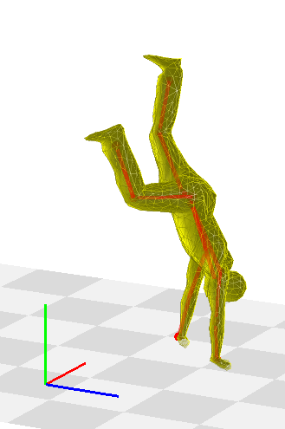
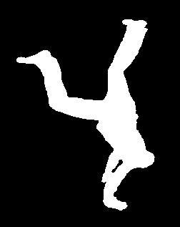
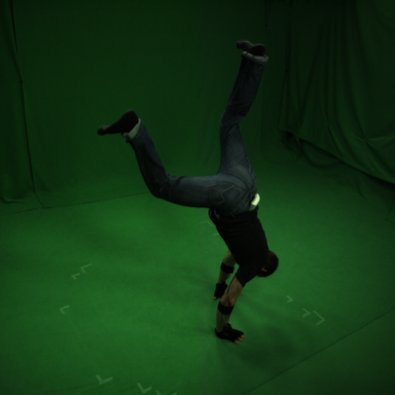
How to "match" a 3D Model with a 2D image?
Input Image
Current 3D model estimate
Project model features
O
Extract image features
Optimize
Pons-Moll et al. CVPR’10
Pons-Moll et al. 2011 Model Based Pose Estimation

Slide 23
How to "match" 3D SMPL with 2D image?
Check your understanding:
Should we match model to image or image to model?
  What if the images contain partial body?
What if our features contain outliers?
We saw in our assignments that optimization can be susceptible to outliers.

Slide 24
General framework for optimization
Extract features
Predict and match
Optimize
What are good features for fitting?
How to "match" 3D SMPL with 2D image?
What objective should we optimize?

Slide 25
What objective should we optimize?
A lot of problems can be formulated as Non-Linear Least Squares
SMPL params. for image t
2D image features predicted by the model
Observed 2D features
Sum over all N features
Notes:
e(\mathbf{x}_t)= \sum_{i=1}^N e_i(\mathbf{x}_t)=\sum_{i=1}^N \| \tilde{\mathbf{r}}_i(\mathbf{x}_t)-\mathbf{r}_i \|^2

Slide 26
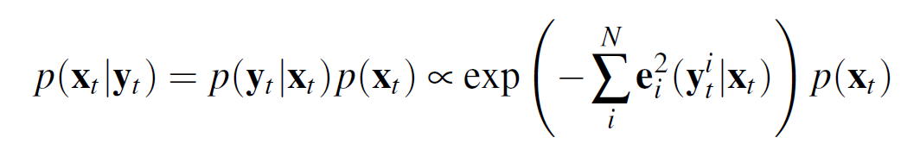
What objective should we optimize?
A lot of problems can be formulated as Non-Linear Least Squares
Assuming errors re independent and Gaussian distributed, least squares is equivalent to a MAP estimate
Observation (image)
Notes:
e(\mathbf{x}_t)= \sum_{i=1}^N e_i(\mathbf{x}_t)=\sum_{i=1}^N \| \tilde{\mathbf{r}}_i(\mathbf{x}_t)-\mathbf{r}_i \|^2

Slide 27
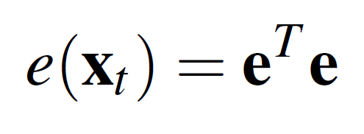


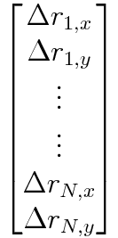
Optimization with Least Squares
Express the problem in vector form
Residual for match 1

Slide 28
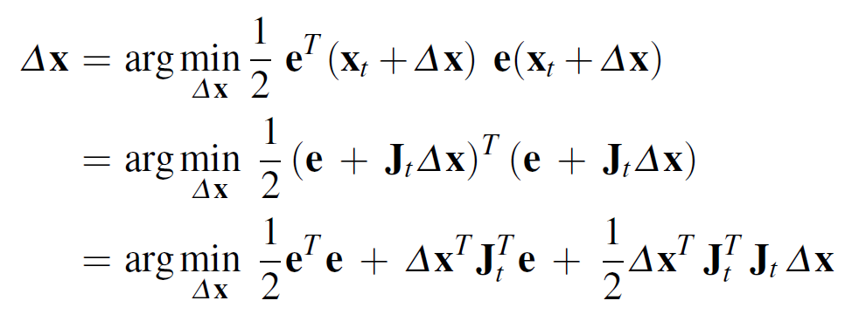
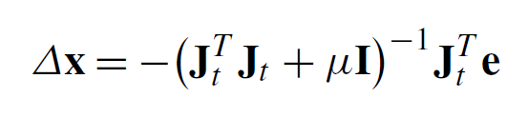

Optimization with Least Squares
Gradient
~Hessian
Take a step in that direction

Slide 29
The land of optimization if full of pitfalls
~Hessian
(approximation)
Gradient term of total error
Jacobian of the vector error
(entries often correspond to vertices in the model)

Slide 30
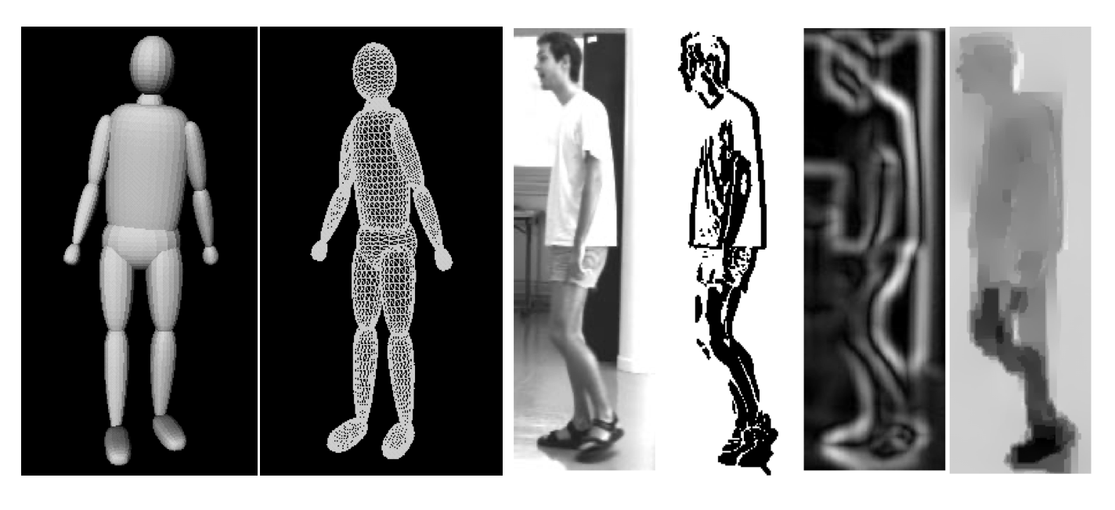
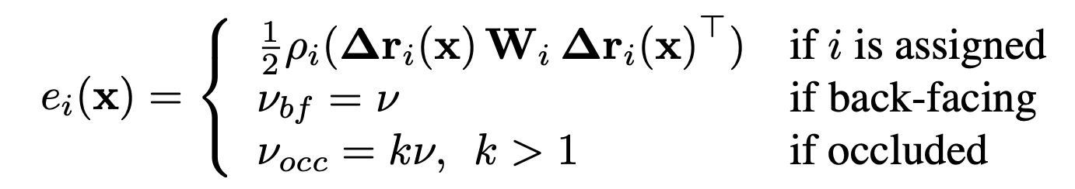
Example: Covariance scaled sampling for Monocular 3D body tracking
Features:
Motion boundaries
Edges
Optical Flow
Sminchisescu et al. CVPR’01

Slide 31
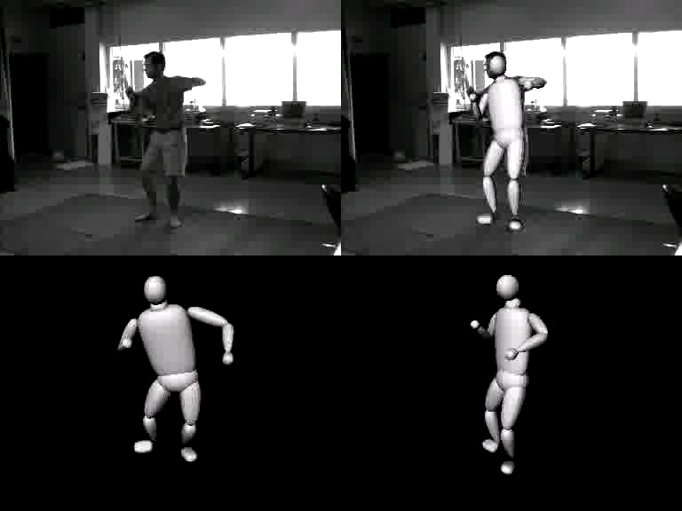
Example: Covariance scaled sampling for Monocular 3D body tracking
Remarkable for 2001!!
Constrained to lab settings
Not robust to difficult poses and backgrounds

Slide 32





So what has changed in almost 20 years
2D pose detection works very reliably!
A very good feature!! → why?
SMPL
Flexible and easy to use model which adapts to different shapes

Slide 33


How does SMPLify execute the general framework to fit SMPL to an image
Extract features
Predict and match
Optimize
2D joints are quite reliable
Match projection of 3D joints with 2D joints
Min. L₂ dist. b/w image and projected joints
Bogo et al., ECCV'16

Slide 34




Bottom up and top down should match
Apply pose and shape
Bottom Up
Top Down

Slide 35
Bottom up and top down should match
2D joints [1]
camera
shape
pose
Camera
Projection
Bottom-up
2D joints^{[1]}
Top-down
SMPL fit
[1] - Pishchulin et al., "DeepCut: Joint subset partition and labeling for multi person pose estimation", CVPR 2016

Slide 36



SMPLify Objective Function
camera
joints
Is this enough?
Data term
Notes:
To fit beta and theta parameters to the detected 2D joints, we minimize [show] an objective function,

Slide 37



Problem: Depth Ambiguity
Side view
SMPL aligns well with the image
Side view is incorrect
Input image
[Guan et al., Estimating human shape and pose from a single image. ICCV 2009.]
Notes:
However, this problem is fundamentally ambiguous, because many 3D poses and shapes can explain the same 2D image.
For example, given this image of a man standing, this model looks like a reasonable explanation, but if we see it from another side[show], we see that the knees are bent even though they shouldn’t be. To overcome this, we need a good prior.

Slide 38


Solution: Pose and Shape Priors
Pose Prior
Shape Prior
Notes:
So, we learn a multi-modal pose prior [show] from nearly 1 million poses in the CMU mocap dataset.
For the shape prior, [show] we use SMPL’s PCA space, which was obtained from thousands of scans. This captures the statistics of human body shapes very well and is much richer than a prior on 3D skeletons.
#We also encode a prior on joint angle limits.

Slide 39
Updated SMPLify Objective Function
camera
joints
Prior on unnatural joint bending
Data term
Prior on pose
Prior on shape
Notes:
To fit beta and theta parameters to the detected 2D joints, we minimize [show] an objective function, which is a sum of a data term and four priors.

Slide 40


Problem: Interpenetrations
Notes:
Here is a result without the interpenetration term where [show] there is a gross intersection of the left arm and the body. Adding the interpenetration term [show] resolves this problem and makes the results qualitatively natural.

Slide 41



Solution: Approx. surface with capsules and penalise intersections
Before
After

Slide 42
SMPLify Objective Function
pose and shape priors
Joint projection error
interpenetration
Notes:
Our final objective function is composed of the sum of all of the energy terms.

Slide 43







Results on Leeds Sports Poses (LSP)
Notes:
We demonstrate our approach on the Leeds Sport Poses, a highly unconstrained dataset with a wide variety of complex poses, clothing, background, and imaging conditions.
To our knowledge, no other previous approaches have demonstrated 3D mesh reconstruction on LSP images.

Slide 44



Datasets
Indoor, lab
Outdoor, unconstrained
Human-Eva
H3.6M
3DPW
CoCo, Leeds,etc
With reference pose and shape
Into the wild

Slide 45
SMPLify-X vs SMPLify
SMPLify-X improves on SMPLify.
Key changes:
  Upgrade SMPL to have detailed hands and face (SMPL-X).
  Update the pose priors from GMM to VAE.
  Train classifier to predict gender and select model accordingly.
The key ideas remain the same.
SMPLify-X. Pavlakos et al. CVPR'19

Slide 46




Add detailed hands and face to SMPL
FLAME
[Li et al. TOG’17]
MANO
[Romero et al. SiggA.'17]
SMPL
[Loper et al. TOG’15]
SMPLify-X. Pavlakos et al. CVPR'19

Slide 47

Use a VAE to learn the manifold of poses

Slide 48

SMPLify-X captures hands and faces better
Notes:
Please notice:
<CLICK> the gestures for the sign of victory
<CLICK> the surprise expression
<CLICK> the tension
<CLICK> and other expressive states

Slide 49
Limitations of Optimization

Slide 50









Failure modes: 2D CNN failure
Notes:
One of the failure modes are due to wrong detections in the 2D joints.

Slide 51









Failure modes: Depth Ambiguity
Notes:
Another failure mode is due to challenging cases of depth ambiguity. These cases maybe improved by using the appearance information in the image and occlusion reasoning.

Slide 52


Pros/ Cons of local optimization
It (can be) fast and accurate
Prone to local minima
Requires initialization
Matching cost is ambiguous
Can we use learning to solve these?

Slide 53
Thanks!
Can we use learning to address some of these limitations?
More in Part 2…

Slide 54



Expressive Body Capture: 3D Hands, Face, and Body from a Single Image
(SMPLify-X)
G. Pavlakos*, V. Choutas*, N. Ghorbani, T. Bolkart, A. A. A. Osman, D. Tzionas and M. J. Black, CVPR'19

Slide 55





Keep it SMPL: Automatic Estimation of 3D Human Pose and Shape from a Single Image
(SMPLify)
F. Bogo*, A. Kanazawa*, C. Lassner, P. Gehler, J. Romero, M. J. Black
ECCV'16

Slide 56
Learned Vertex Descent
Key idea: Instead of computing gradient per-vertex, can we train a NN to predict it based on image features (local and global)?
Corona et al. ECCV‘22
Notes:
e=\mathbf{e}(\mathbf{x})^T\mathbf{e}(\mathbf{x})
\mathbf{x}^* = \arg \min_\mathbf{x} \mathrm{dist} (f(I), f_m(M(\mathbf{x})))

Slide 57

Learned Vertex Descent

Slide 58






Slide 59


Slide 60
We'll learn more about LVD in our lecture on neural fields.
Lets use simple least squares optimization for fitting SMPL to images, for now.

