Slide 1
Virtual Humans – Winter 23/24
Lecture 5_2 – Learning based registration
Prof. Dr.-Ing. Gerard Pons-Moll
University of Tübingen / MPI-Informatics

Slide 2
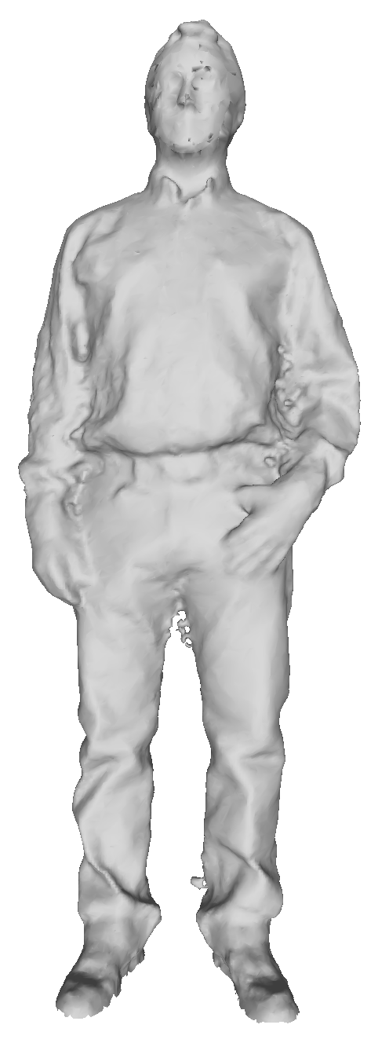
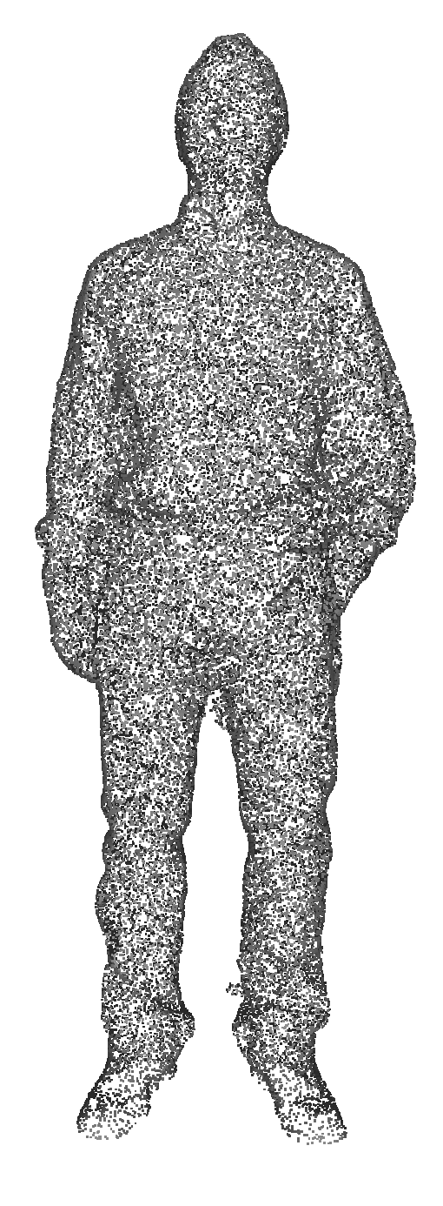
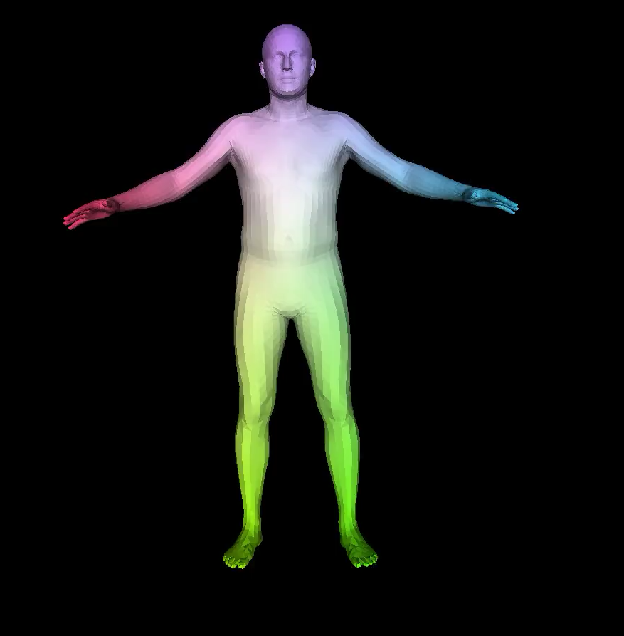
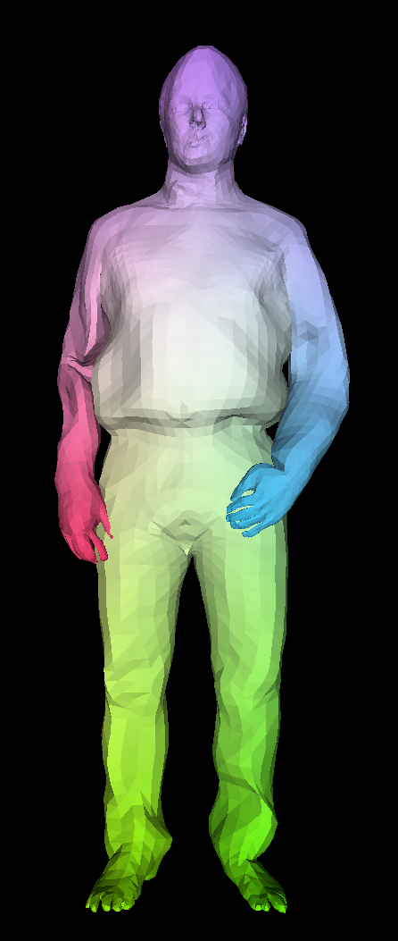
3D scan → Human Model
Input: 3D scan/ Pointcloud
Colour coded SMPL model
Output: Registered SMPL+D
Notes:
In previous lecture we saw how to solve this with ICP and optimization. In this lecture, we will see how to integrate learning to make fitting more robust.

Slide 3
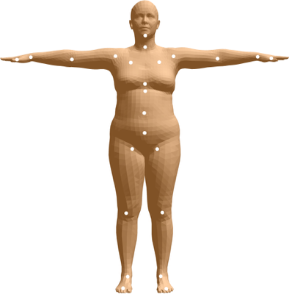
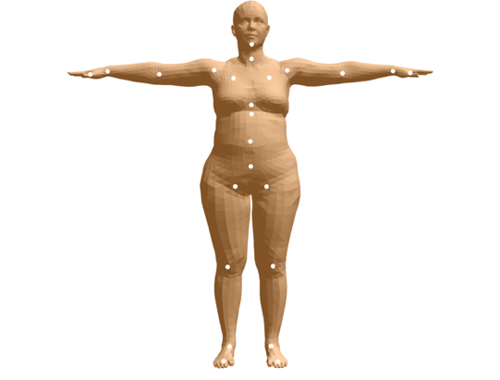
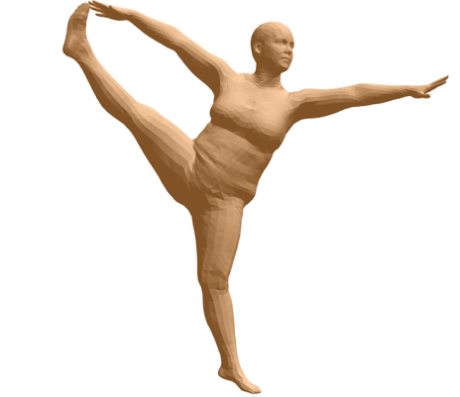
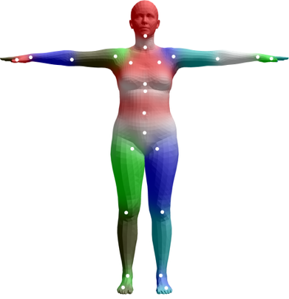
SMPL model
Vertices in a 0-pose
Notes:
For this lecture, let me introduce a modified SMPL model. So SMPL can not explain clothing. It lacks displacements.
T(\boldsymbol{\theta},\boldsymbol{\beta}) = \mathbf{T}_\mu+B_s(\boldsymbol{\beta})+B_p(\boldsymbol{\theta})

Slide 4
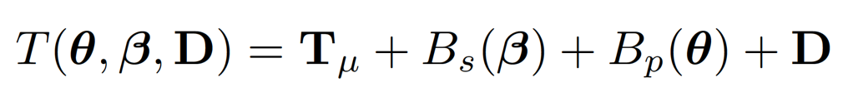
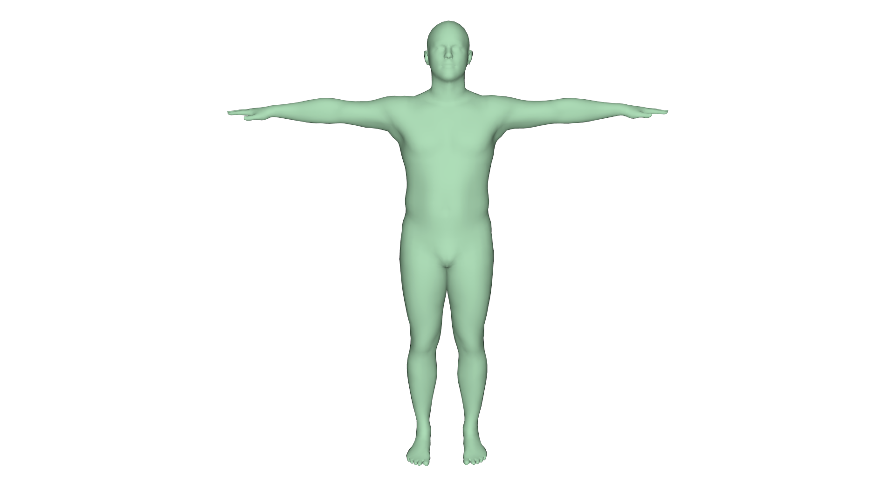
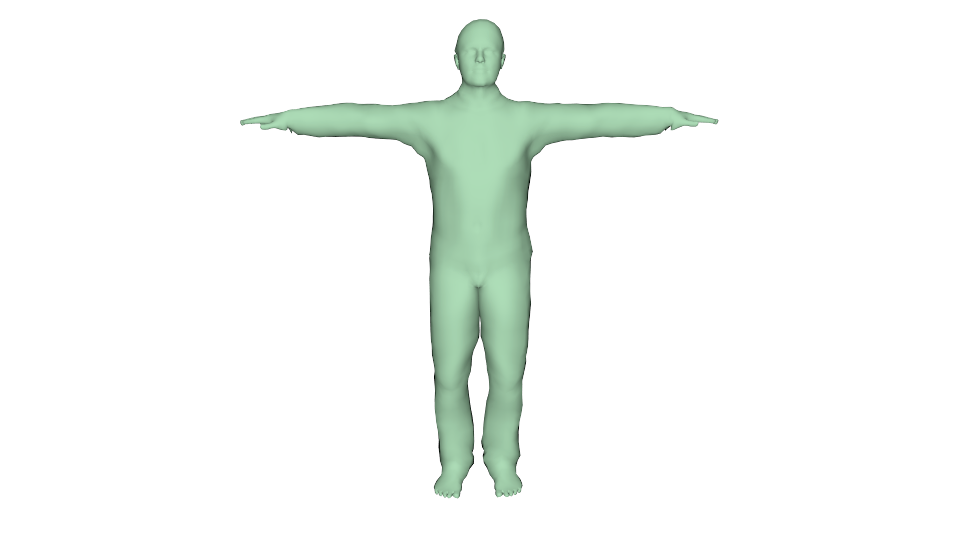
SMPL + Clothing
Vertices in a 0-pose
Pose parameters
Shape parameters
Personal details + clothing
Notes:
But explain detail you can add a layer D, and be able to go beyond SMPL

Slide 5
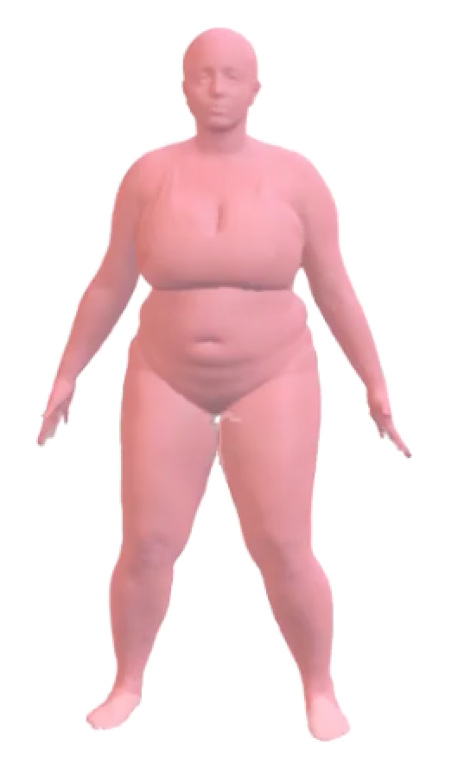
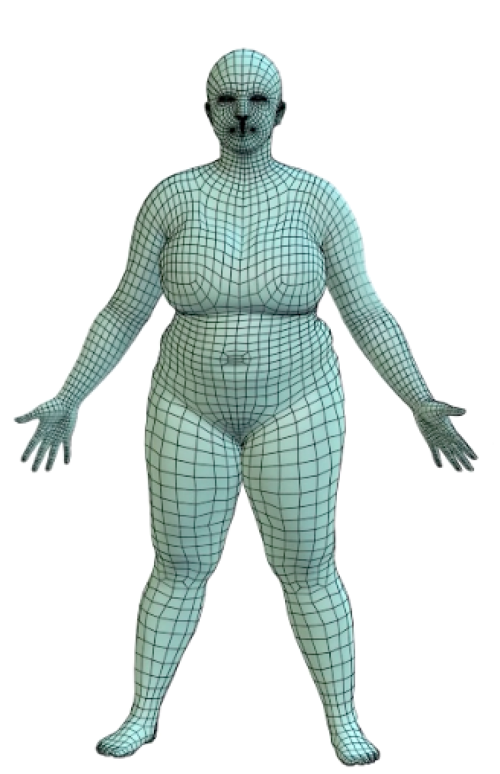
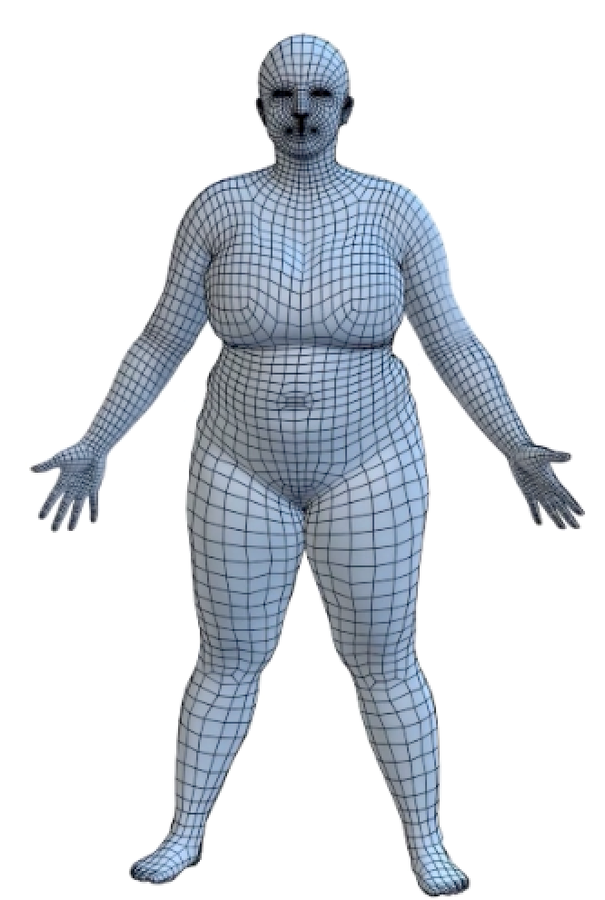
Scan
Registration
Model
Notes:
By the way, SMPL+D is almost identical to the formulation we saw before in which we couple free-form registration vertices to the model
E(\mathbf{V}) = \sum_{\mathbf{s}_i\in\mathcal{S}}\mathrm{dist}(\mathbf{s}_i,\mathcal{V}(\mathbf{V}))+E_\mathrm{prior}(\mathbf{v})
E(\theta, \beta,\mathbf{V})=\sum_{\mathbf{s}_i\in\mathcal{S}}\mathrm{dist}(\mathbf{s}_i,\mathcal{V}(\mathbf{V}))+\mathrm{dist}(\mathcal{V}(\mathbf{v}),\mathcal{M}(\theta, \beta))+E_\mathrm{prior}(\theta,\beta)

Slide 6
Why fit SMPL to scans?
We motivated finding registration as a key ingredient to train a body model
Notes:
Before, we motivated finding registration . But registration in itself is useful for several applications in itself

Slide 7
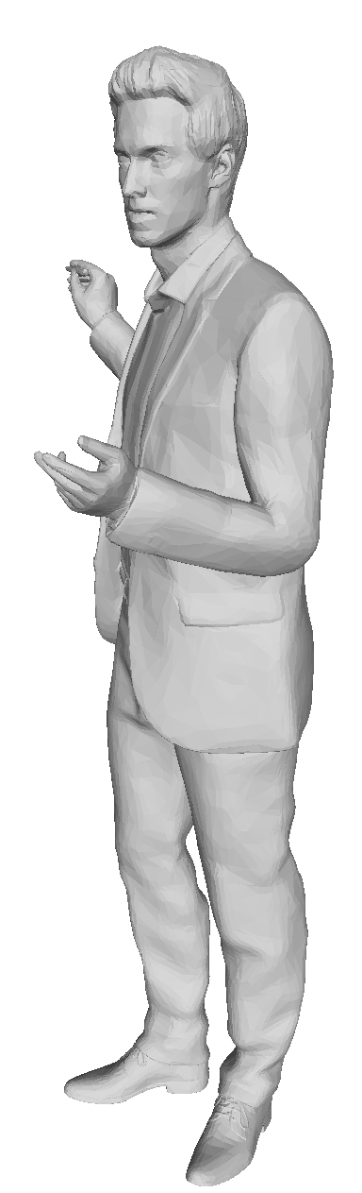
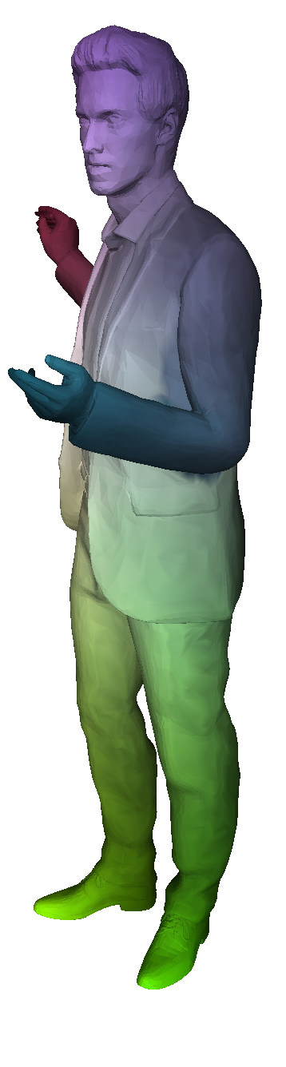
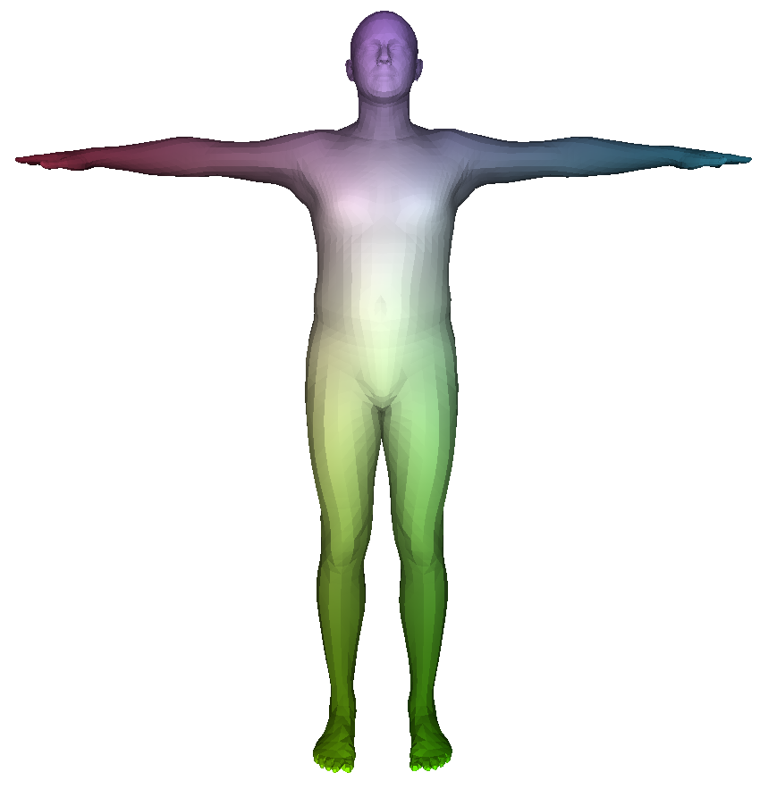
Find correspondences between meshes
Fit with SMPL

Slide 8
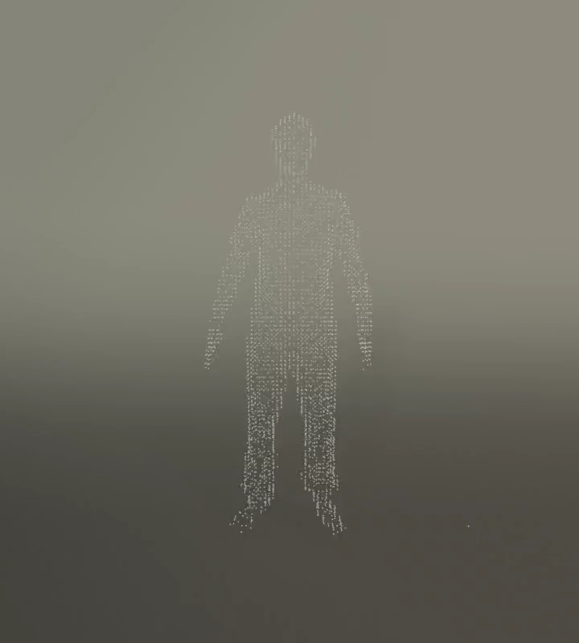
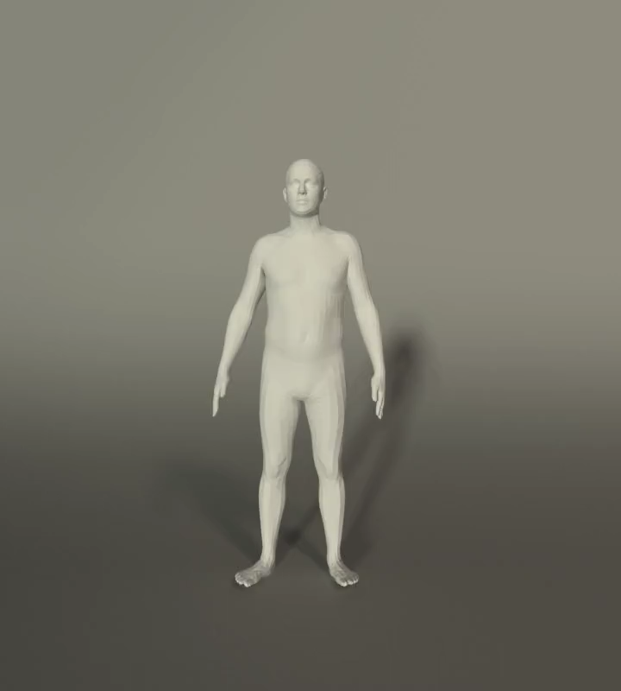
Tracking scans/ point clouds
Input PC seq.
Tracked SMPL model

Slide 9
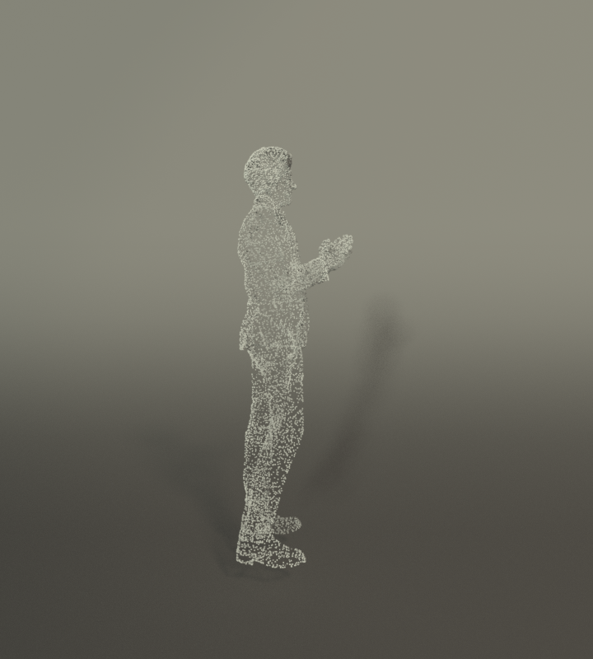
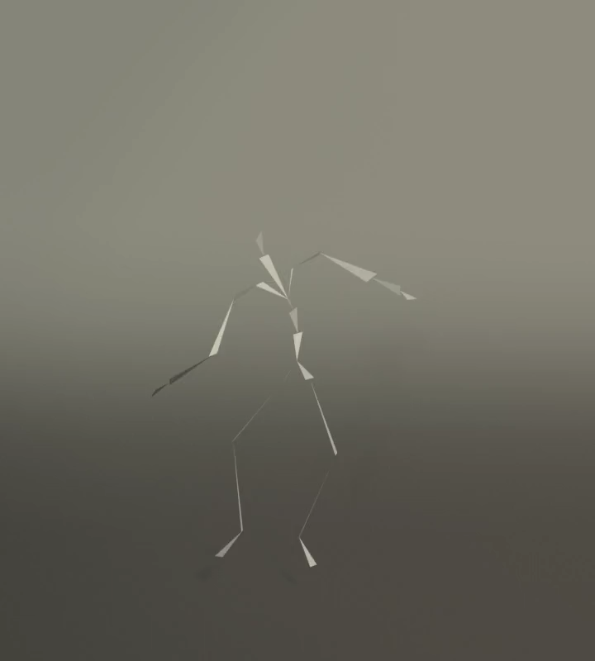
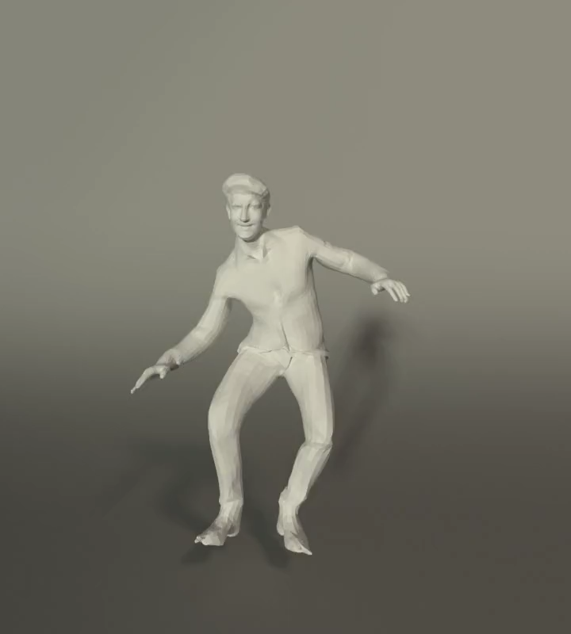
Controlling static shapes
Input PC
Input pose sequence
Animated SMPL+D

Slide 10
Controlling static shapes
Input PC
Input pose sequence
Animated SMPL+D
All these applications require fitting SMPL to scans/ point clouds.

Slide 11
Fit SMPL or SMPL+D to scans using ICP (compute registrations)

Slide 12
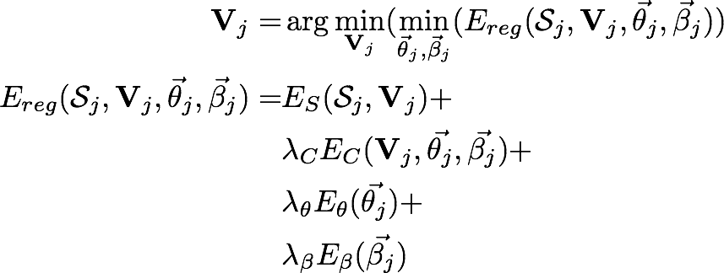
Objective
scan-to-mesh distance
coupling
pose prior
shape prior
relative weights
Notes:
where all the terms are relatively weighted through a set of weights lambda
\mathbf{V}_j = & \arg\min_{\mathbf{V}_j}(\min_{\vec{\theta}_j, \vec{\beta}_j} (E_{reg}(\mathcal{S}_j, \mathbf{V}_j, \vec{\theta}_j, \vec{\beta}_j)) \\
E_{reg}(\mathcal{S}_j, \mathbf{V}_j, \vec{\theta}_j, \vec{\beta}_j) = & E_S(\mathcal{S}_j, \mathbf{V}_j) + \\
& \lambda_C E_C(\mathbf{V}_j, \vec{\theta_j}, \vec{\beta_j}) + \\
& \lambda_\theta E_\theta(\vec{\theta_j}) + \\
& \lambda_\beta E_\beta(\vec{\beta_j})

Slide 13
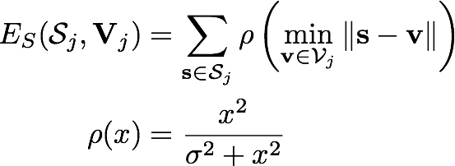
Scan-to-mesh distance
Notes:
and closer inspection reveals we require finding correspondences. So we require ICP to minimize the the objhective

Slide 14
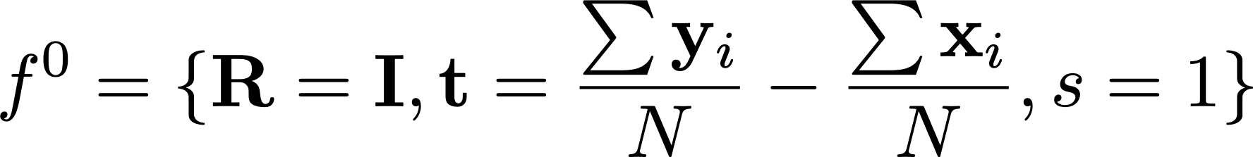
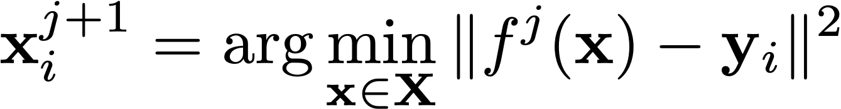

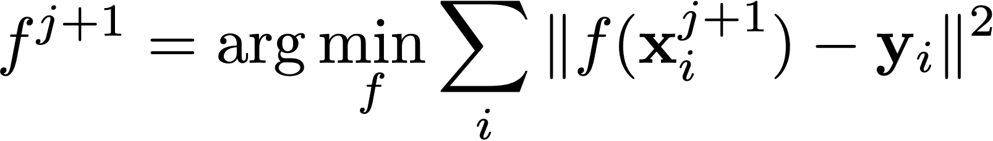
Refresher on ICP
Initialize
Compute correspondences according to current best transform
Compute optimal transformation ( )with Procrustes
Terminate if converged (error below a threshold), otherwise iterate

Slide 15
Limitations of ICP
Notes:
Q. Can you think about cases where ICP would fail?

Slide 16
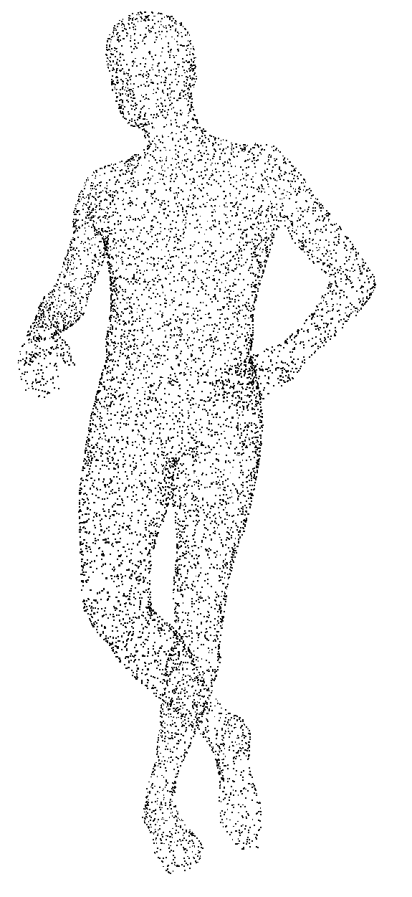
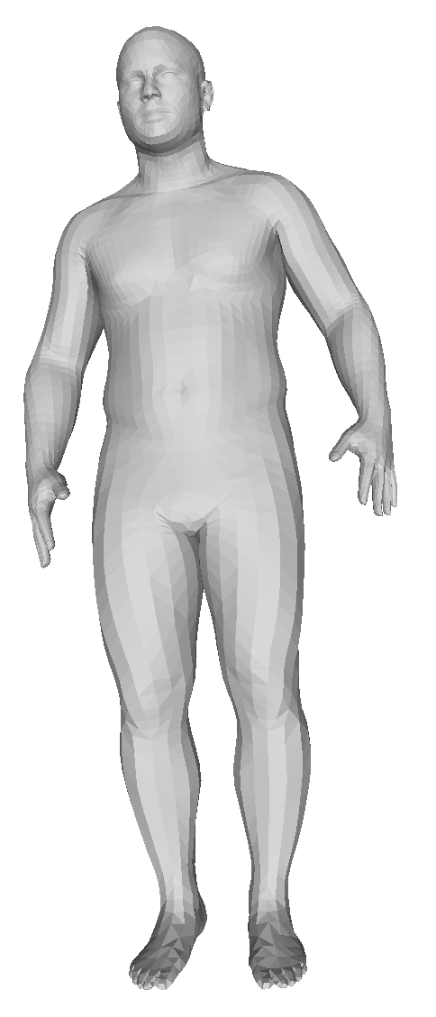
Limitations of ICP
ICP -> closest points can be wrong
Doesn't distinguish if the correspondence is semantically correct.
For example, pointcloud hand points are explained by the waist of the model
Input PC
SMPL fit - ICP
Notes:
By now, we already know that ICP is prone to local minima

Slide 17
Limitations of ICP
ICP cares about closest point.
Doesn't distinguish if the correspondence is semantically correct.
Points on waist, incorrectly considered as closest to hand.
Nearest point as correspondence gets stuck in local minimas!
Input PC
SMPL fit - ICP

Slide 18
Learning based fitting
Can we use data to learn how to fit a template mesh to scan/ point cloud?
Notes:
Q. Can you think about cases where ICP would fail?

Slide 19
Learning based fitting
Non-parametric: Fit a template mesh to data.
  3D-CODED, Groueix et al. ECCV‘18
Parametric: Fit a model to data.
  IPNet, Bhatnagar et al. ECCV'20
  LoopReg, Bhatnagar et al. NeurIPS’20
Hybrid:
  Learned Vertex Descent, Corona et al. ECCV’22
  (we will see later in the course)
Notes:
So far we've talked about registering SMPL to scans. But we could also use non-SMPL meshes … <groundwork for 3dcoded>

Slide 20
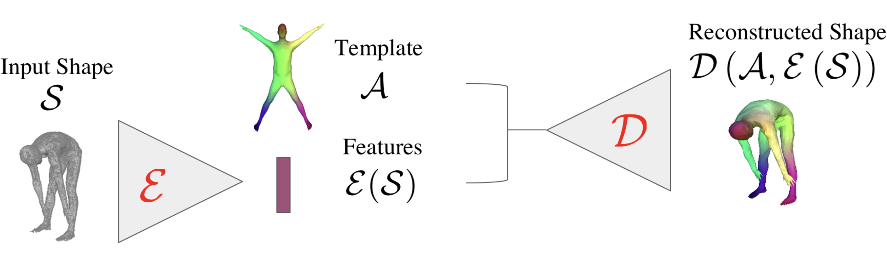
Learn to deform vertices of a template
Encode input shape into a feature vector.
Directly predict locations of vertices of template.
3D-CODED, Groueix et al. ECCV'18

Slide 21
Advantages/ Disadvantages
Learning based model, generalises better than ICP.
Gets stuck in local minima. Need to init. ~100 global rots.
No details.
Registered template is not controllable!
Can't pose and shape.
Bring back the parametric model!

Slide 22
Can we "learn" to fit SMPL model to data?
  Make scans controllable
Can we capture high frequency details?
  More realistic
Notes:
Can we make our registrations controllable and more realistic?

Slide 23
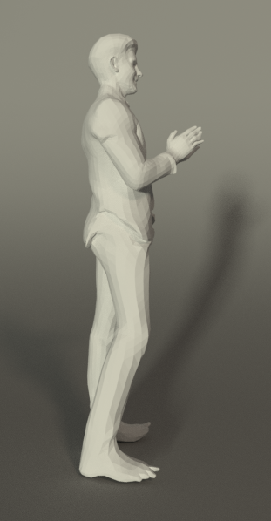
Get detailed and controllable reconstructions.
Input PC
Registration
Input Motion Sequence
Animated registration
IPNet. Bhatnagar et. al, ECCV'20
Notes:
So our goal in this work was to get detailed reconstructions that are controllable by combining IFs and parametric models.

Slide 24
IPNet: High level idea
Fit SMPL+D
Implicit Reconstruction
IPNet. Bhatnagar et. al, ECCV'20

Slide 25
Why combine implicit functions and parametric models?
Implicit Reconstruction
Parametric Modelling
Better details.
Can handle arbitrary poses.
Just static meshes;
Can't do much.
Lacks details.
Generalization to complex poses is difficult.
Can be re-shaped, re-posed etc.
Notes:
But the natural question is why do we want to combine implicit functions and parametric models? (click)
Well, over the last couple of years we have seen that implicit function based reconstruction approaches can produce detailed meshes and are also able to fill in the missing data. (click)
but these reconstructions cannot be controlled, ie. they cant be animated or re-shaped.
Parametric models on the other hand allow control over the meshes via explicit parameters for pose and shape.

Slide 26
IPNet: High level idea
Fit SMPL+D
Implicit Reconstruction

Slide 27
Challenge

Slide 28
How to fit SMPL+D? We saw ICP fail!
Lots of good works.
IFNets, NDFs…
How to fit SMPL+D ?
Fit SMPL+D
Implicit Reconstruction

Slide 29
Problem: ICP gets stuck due to bad correspondences and due to the fact that SMPL can not represent cloth, hair etc
Idea1: Predict SMPL as an implicit surface to make fitting easy
Idea2: Learn to predict correspondences rather than using nearest point.

Slide 30
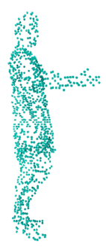
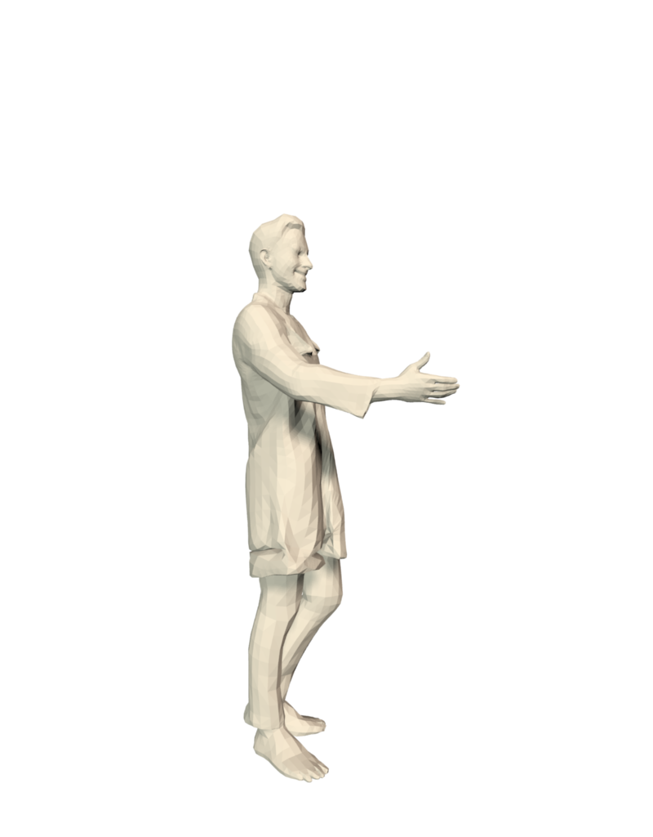
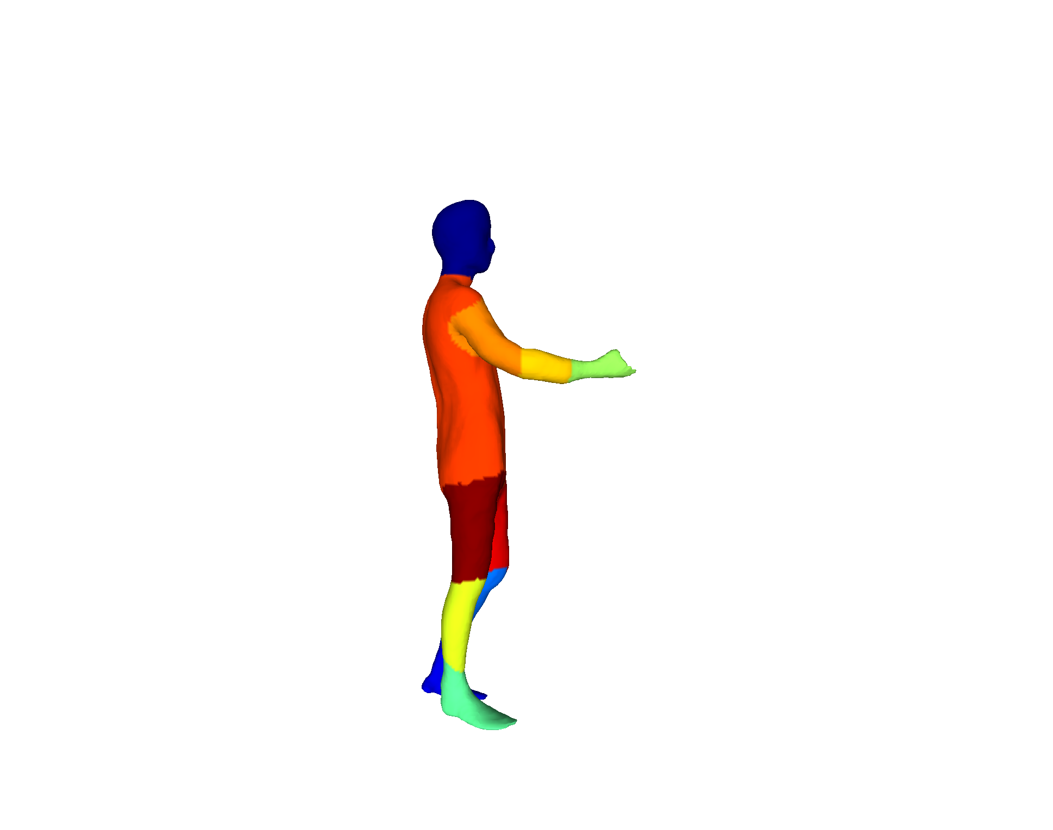
IPNet: Predictions
Double layer implicit function for outer and inner shape.
Part correspondences to parametric model
R0
R1
IP-Net
R2
IPNet. Bhatnagar et. al, ECCV'20
Notes:
Our key idea was to get detailed 3D reconstruction using IFs.
But instead of traditional inside-outside classification. We used 3 labels; inside the body, …. Outside the body.
This allowed us to reconstruct a detailed clothed surface and smooth body shape.
Finally, we used IFs to predict a correspondence field to SMPL model which allowed us to register the SMPL model to the smooth body shape.
This allowed us to rig the implicit reconstruction.

Slide 31
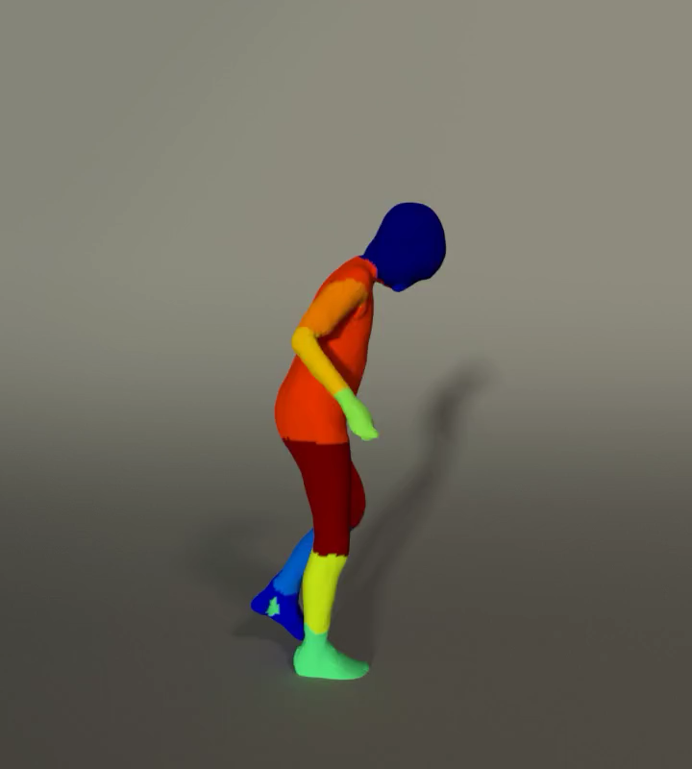
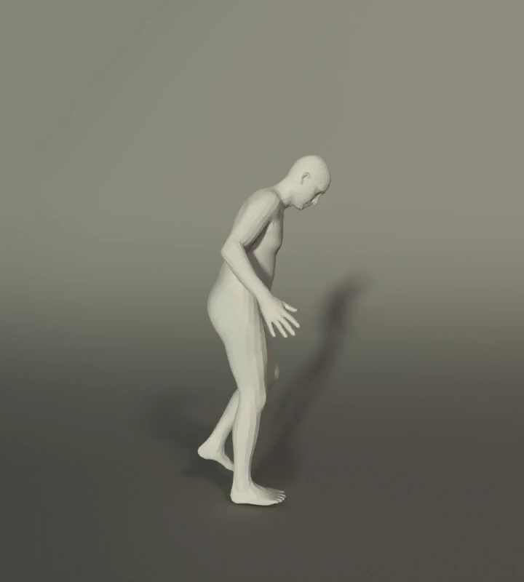
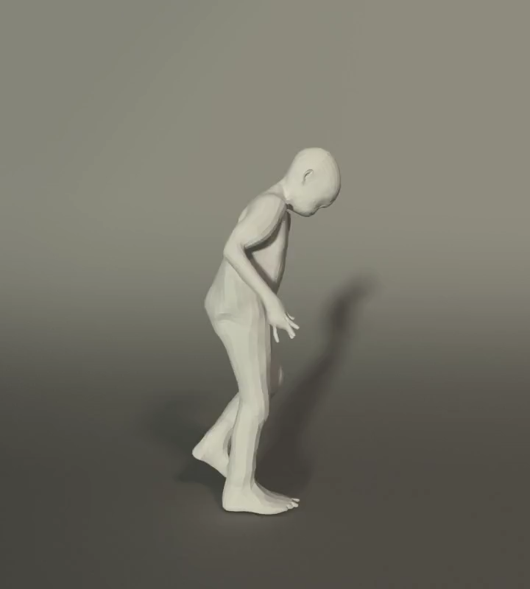
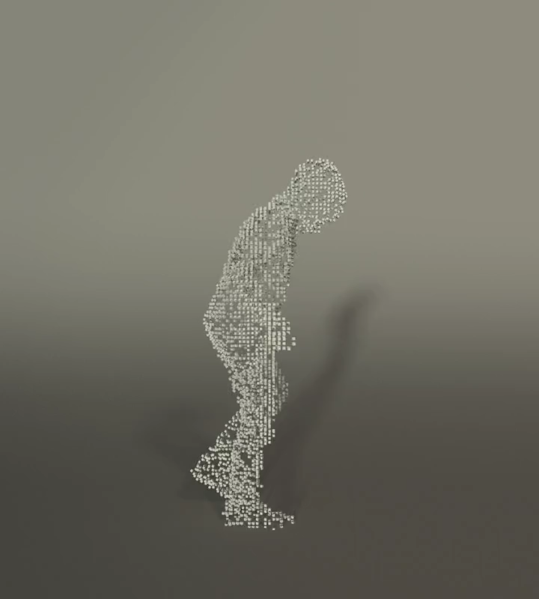
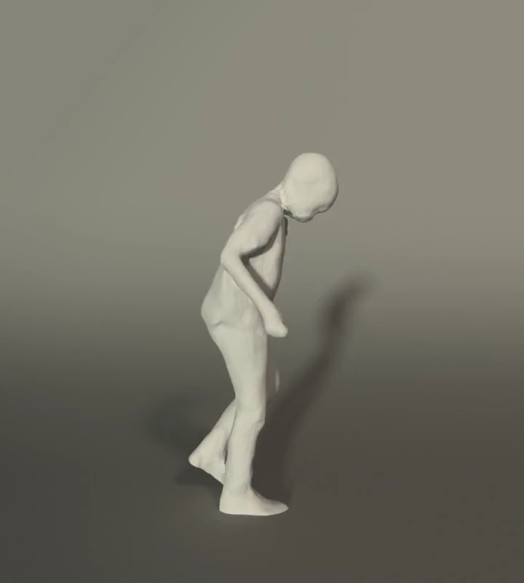
IPNet: Overview
Implicit Reconstruction
Parametric Mesh
IP-Net: Inner
surface + parts
Fit SMPL to inner surface
IP-Net
Input: Sparse point cloud
Non-rigidly register with SMPL+D to outer surface
SMPL+D registration
IP-Net: Outer surface
IPNet. Bhatnagar et. al, ECCV'20

Slide 32
Registering SMPL to IP-Net predictions

Slide 33
Registering SMPL to IP-Net predictions
SMPL parameters
Laplacian regularizer
Match SMPL surface to the body surface predicted by IP-Net
Match parts on the SMPL mesh to parts predicted by IP-Net
Notes:
Registering SMPL to the IP-Net predictions involves instance specific optimization and we minimize the objective shown here.
We end up with the following terms: (click)
1. Data term: to match SMPL surface to the body surface predicted by IP-Net (click)
2. Part matching term: to match parts on the SMPL mesh to parts predicted by IP-Net (click)
3. And finally a Laplacian regularizer.

Slide 34
Registering SMPL to IP-Net predictions
Dist. from body to SMPL
Dist. from SMPL to body
Notes:
Let's briefly look at the data term for the our SMPL fitting.
Recall that this terms must force SMPL surface to be close to the body surface predicted by IP-Net.
To this end, we minimize bi-directional vertex to surface distance between the two meshes.

Slide 35
Registering SMPL to IP-Net predictions
Select body vertices corresponding to part I
Summation over SMPL parts
Dist. from body vertex to SMPL sub-mesh corresponding to part I
Summation over predicted body vertices
Notes:
Next we ensure that correct parts on the SMPL mesh explain the corresponding predicted part. In our experiments we found this term to be vital for accurate registration.

Slide 36
Registering SMPL+D to IP-Net predictions
Dist. from dressed surface to SMPL+D
Dist. from SMPL+D to the dressed surface
Notes:
Once we have registered SMPL to the IP-Net predicted body shape under clothing, we non-rigidly deform the SMPL mesh to explain the deformations corresponding to the IP-Net outer dressed surface.
We use similar data term as before but now additionally optimise the per-vertex displacements on top of the SMPL mesh.

Slide 37
IPNet: Results

Slide 38
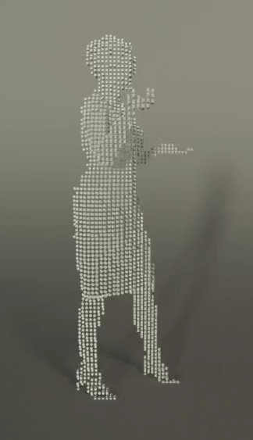
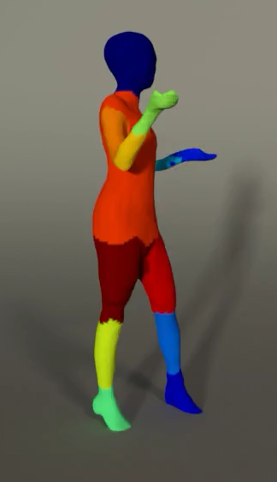
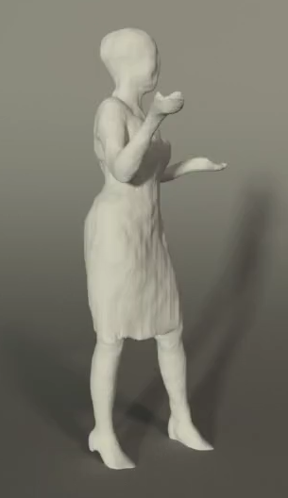
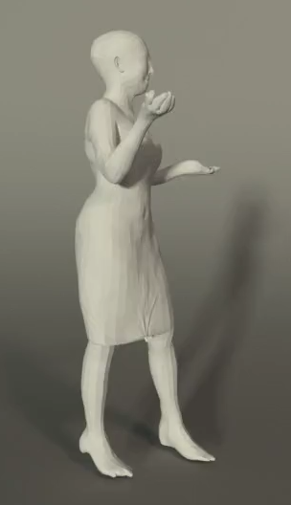
Single View Point Cloud Registration
Input: Single View PC
IP-Net inner surface & parts
IP-Net outer surface
Registration
Notes:
Single view point clouds are easily accessible from devices such as Kinect.
We show that IP-Net can be trained to fully reconstruct the missing shape and susequently register SMPL to it.

Slide 39
We can animate our reconstructions
Input: Dense PC
Registration
Input: Motion sequence
Animated registration
IPNet. Bhatnagar et. al, ECCV'20

Slide 40
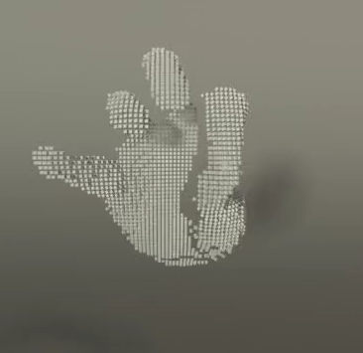
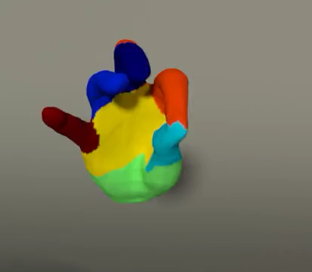
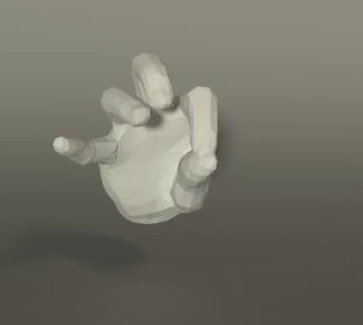
IPNet generalises to other domains.
Input: Single View PC
IP-Net surface & parts
Registration
IPNet. Bhatnagar et. al, ECCV'20

Slide 41
What does "learning" bring over ICP?
Learnt correspondences more reliable than just nearest point.
We can learn to complete/ denoise input shape.
ICP struggles with with partial data.

Slide 42
IPNet: Limitations
Implicit Reconstruction
Parametric Mesh
Marching cube to get surfaces.
Computationally expensive.
Non-differentiable.
IP-Net: Inner
surface + parts
Fit SMPL to inner surface
IP-Net
IPNet correspondences not differentiable wrt. SMPL fitting.
Input: Sparse point cloud
Non-rigidly register with SMPL+D to outer surface
SMPL+D registration
IP-Net: Outer surface

Slide 43
Q. Is ICP differentiable wrt. SMPL fitting?
Recall ICP formulation…
Is it differentiable?

Slide 44
Can we make correspondences differentiable?
→End-to-end differentiable registration?
Can we remove expensive marching cubes?
Notes:
Can we make our registrations controllable and more realistic?

Slide 45
3D scan → Human Model
Input: 3D scan/ Pointcloud
Colour coded SMPL model
Output: Registered SMPL+D
Notes:
The input to our method is a 3D scan or a PC and we output a registered body model explaining the geometry of the input scan.

Slide 46
Problem: Traditional registration
Get correspondences.
  Keypoints / Landmarks
  Closest point
  Pre-trained network
Minimize the distance.
  Optimize the model parameters.
Iterate over 1 & 2.
- Instance specific
- Prone to local minima
- Not End-to-end Differentiable wrt. Correspondences !!
Input Scan
SMPL model
LoopReg. Bhatnagar et. al, NeurIPS'20
Notes:
\arg\min_{\mathcal{C},\mathbf{x}} \sum_{\mathbf{s},\mathbf{m} \in \mathcal{C}} \| \mathbf{s}_i - M(\mathbf{m}_j,\mathbf{x})\|^2

Slide 47
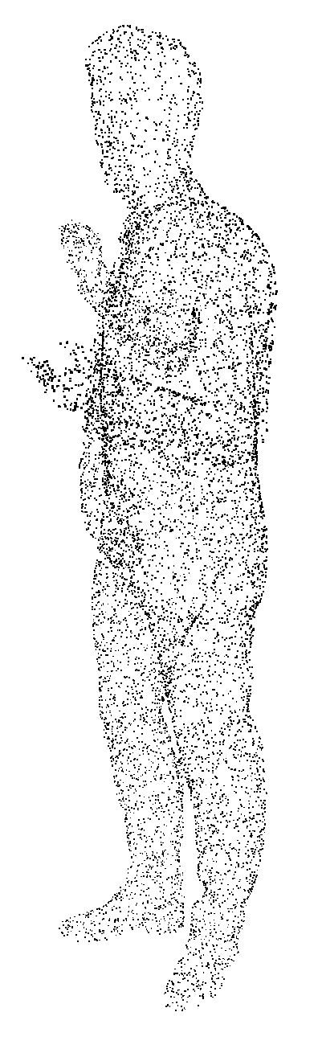
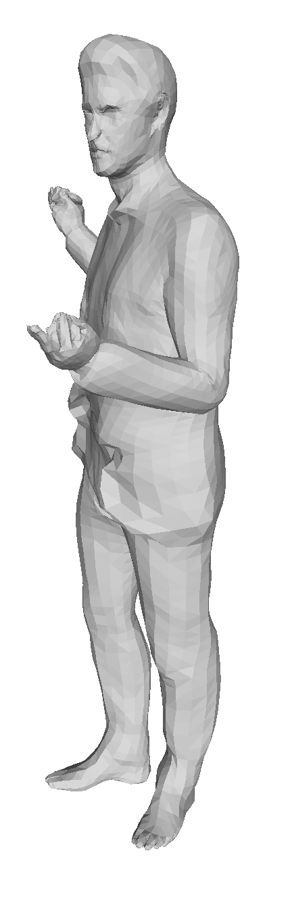
Can we jointly optimize over model and correspondences without supervision?
LoopReg. Bhatnagar et. al, NeurIPS'20
Notes:
Problem: difficult to force that NN predicts correspondences on the surface.
Outside surface the model is not defined.

Slide 48
Key challenges
Can we jointly train the network and optimize without supervision?
How to ensure that correspondence predictions lie on the model surface?
Integrate correspondence prediction with model fitting.
LoopReg. Bhatnagar et. al, NeurIPS'20

Slide 49
Can we jointly optimize over model and correspondences without supervision?
LoopReg. Bhatnagar et. al, NeurIPS'20
Notes:
L_\mathrm{self}(\phi,\mathcal{X}) = \sum_{j=1}^N \sum_{\mathbf{s}_i \in \mathcal{S}_j} \mathrm{dist}(\mathbf{s}_i,M(\mathbf{m},\mathbf{x}_j)
Problem: difficult to force that NN predicts correspondences on the surface.
Outside surface the model is not defined.

Slide 50
Let a Neural Network predict the correspondences.
LoopReg. Bhatnagar et. al, NeurIPS'20
Notes:
L_\mathrm{self}(\phi,\mathcal{X}) = \sum_{j=1}^N \sum_{\mathbf{s}_i \in \mathcal{S}_j} \mathrm{dist}(\mathbf{s}_i,M(f_\phi(\mathbf{s}),\mathbf{x}_j))
L_\mathrm{self}(\phi,\mathcal{X}) = \sum_{j=1}^N \sum_{\mathbf{s}_i \in \mathcal{S}_j} \mathrm{dist}(\mathbf{s}_i,M(\mathbf{m},\mathbf{x}_j)
Problem: difficult to force that NN predicts correspondences on the surface.
Outside surface the model is not defined.

Slide 51
NN predicted correspondences don't lie on the model surface.
Why not learn directly?
Deformation model (SMPL) only defined for surface points on the manifold
Not defined for off-manifold
LoopReg. Bhatnagar et. al, NeurIPS'20
Notes:
M(\mathbf{m},\mathbf{x}): \mathbf{m} \in \mathcal{M} \mapsto \mathbf{m}^\prime \in \mathbb{R}^3
f_\phi(\mathbf{s}) \notin \mathcal{M}

Slide 52
NN predicted correspondences don't lie on the model surface.
Not defined!!
LoopReg. Bhatnagar et. al, NeurIPS'20
Notes:
L_\mathrm{self}(\phi,\mathcal{X}) = \sum_{j=1}^N \sum_{\mathbf{s}_i \in \mathcal{S}_j} \mathrm{dist}(\mathbf{s}_i,M(f_\phi(\mathbf{s}),\mathbf{x}_j))
L_\mathrm{self}(\phi,\mathcal{X}) = \sum_{j=1}^N \sum_{\mathbf{s}_i \in \mathcal{S}_j} \mathrm{dist}(\mathbf{s}_i,M(\mathbf{m},\mathbf{x}_j)
Problem: difficult to force that NN predicts correspondences on the surface.
Outside surface the model is not defined.

Slide 53
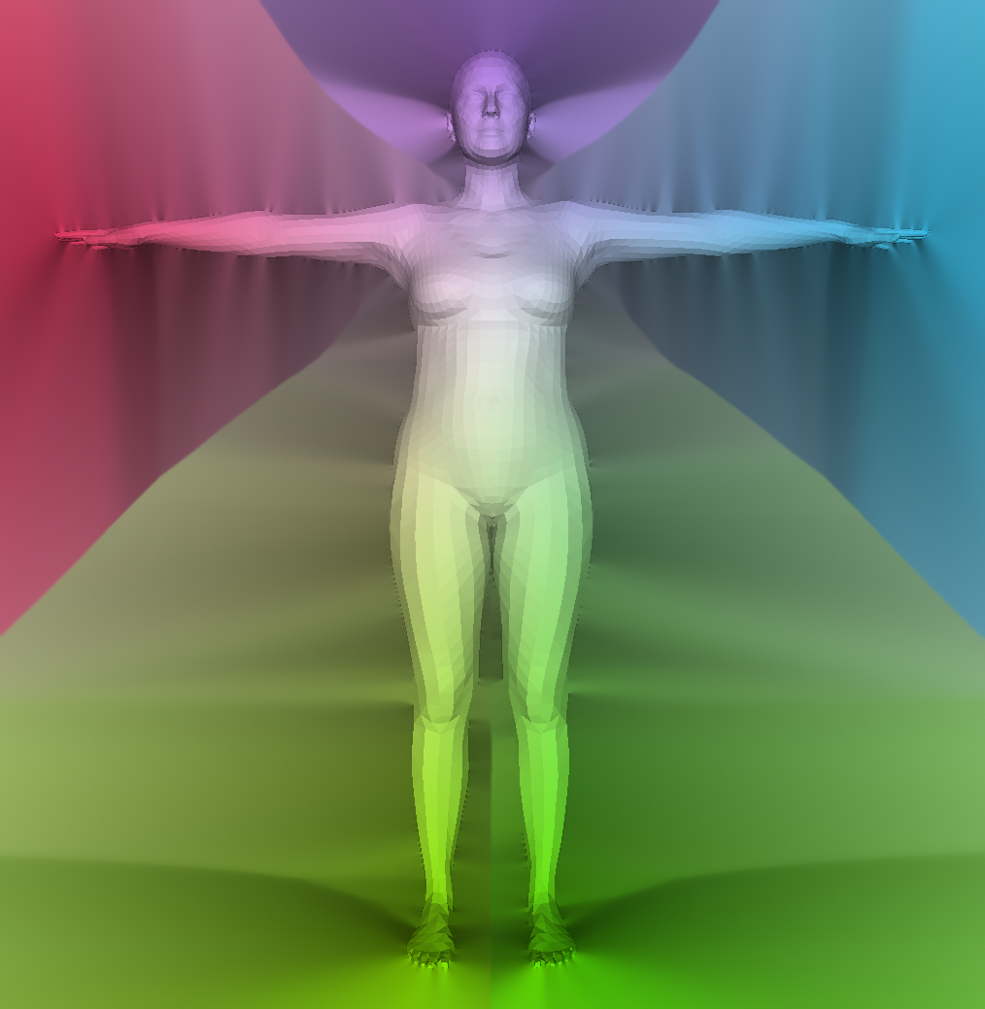
How to ensure that NN predicted correspondences lie on the model surface?
1) Diffuse the SMPL model beyond the surface
2) Add a Lagrangian constraint to force predictions to lie on the manifold
DISTANCE TRANSFORM
BASED DIFFUSION
LoopReg. Bhatnagar et. al, NeurIPS'20
Notes:
M(\mathbf{m},\mathbf{x}): \mathbf{m} \in \mathcal{M} \mapsto \mathbf{m}^\prime \in \mathbb{R}^3
g_\mathbf{x}(\mathbf{p}):\mathbf{p}\in \mathcal{H} \subset \mathbb{R}^3 \mapsto \mathbf{p}^\prime
f_\phi(\mathbf{s}) \notin \mathcal{M}

Slide 54
Use diffused SMPL to get valid function in ℝ³
LoopReg. Bhatnagar et. al, NeurIPS'20
Notes:
L_\mathrm{self}(\phi,\mathcal{X}) = \sum_{j=1}^N \sum_{\mathbf{s}_i \in \mathcal{S}_j} \mathrm{dist}(\mathbf{s}_i,M(\mathbf{m},\mathbf{x}_j)
Problem: difficult to force that NN predicts correspondences on the surface.
Outside surface the model is not defined.

Slide 55
We can jointly optimize over model and correspondences without supervision.
LoopReg. Bhatnagar et. al, NeurIPS'20
Notes:
L_\mathrm{self}(\phi,\mathcal{X}) = \sum_{j=1}^N \sum_{\mathbf{s}_i \in \mathcal{S}_j} \mathrm{dist}(\mathbf{s}_i,M(\mathbf{m},\mathbf{x}_j)
L_\mathrm{self}(\phi,\mathcal{X}) = \sum_{j=1}^N \sum_{\mathbf{s}_i \in \mathcal{S}_j} \mathrm{dist}(\mathbf{s}_i,g(f_\phi(\mathbf{s})),\mathbf{x}_j) + \lambda \cdot \mathrm{dist}_\mathcal{M}(f_\phi(\mathbf{s}))
Problem: difficult to force that NN predicts correspondences on the surface.
Outside surface the model is not defined.

Slide 56
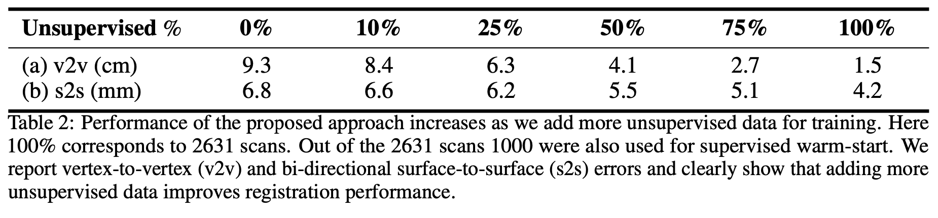
Performance improves with more unlabelled data
LoopReg. Bhatnagar et. al, NeurIPS'20

Slide 57


Comparison to competing approaches
A) Input, B) Alldieck et al. CVPR'19 C) Ours D) Ground Truth
Results on FAUST correspondence prediction challenge.

Slide 58
Summary
ICP is simple conceptually, but finding closest points is prone to local minima
IPNet combines learned implicit surface reconstruction and model fitting
  Predict double layer surface (inner and outer) with part correspondences
  Fit SMPL to inner layer and expand to outer layer
LoopReg makes registration differentiable wrt. correspondence prediction.

Slide 59



Combining Implicit Function Learning and Parametric Models for 3D Human Reconstruction
B L Bhatnagar¹
C Sminchisescu²
C Theobalt¹
G Pons-Moll¹
¹Max Planck Institute for Informatics, Saarland Informatics Campus; ²Google Research
https://virtualhumans.mpi-inf.mpg.de/ipnet

Slide 60
LoopReg: Self-supervised Learning of Implicit Surface Correspondences, Pose and Shape for 3D Human Mesh Registration
Bharat Lal Bhatnagar^{[1]}, Cristian Sminchisescu^{[2]}, Christian Theobalt^{[3]}, Gerard Pons-Moll^{[1]}
¹Max Planck Institute for Informatics, Saarland Informatics Campus; ²Google Research
https://virtualhumans.mpi-inf.mpg.de/loopreg
Notes:
Welcome all. This is Bharat and I'd like to talk about our work on Combining Implicit Function Learning and Parametric Models for 3D Human Reconstruction

