Slide 1
Virtual Humans – Winter 23/24
Lecture 5_1 – Training a Body Model and Fitting SMPL to Scans
Prof. Dr.-Ing. Gerard Pons-Moll
University of Tübingen / MPI-Informatics
Notes:
In this lecture, we will see how to design and build a body model that can be controlled with pose and shape.

Slide 2
Agenda
Body models based on triangle deformations (SCAPE, BlendSCAPE) – very briefly
Training a Body Model from registrations
How to obtain registrations (Fitting SMPL)
Jointly solve for registration and model training
Notes:
Articulation is very non-linear. How do we parameterize pose
\mathbf{R}_0,\mathbf{t}_0

Slide 3
Two deformation models
Local triangle deformations
3x3 transformations
Applied to vertex differences (edges)
-> BlendSCAPE
Global vertex deformations
4x4 transformations
Applied to vertices
-> SMPL
Notes:
Beyond SMPL, there are other formulations to parametrize pose and shape of virtual humans.
We have so far seen a vertex based model, like SMPL
One describes 3x3 transformations applied to edges, without an explicit centre of rotation.
The other one describes global vertex transformations.
Those two philosophies resulted in two body models from our group: BlendSCAPE and SMPL.

Slide 4
Two deformation models
Local triangle deformations
3x3 transformations
Applied to vertex differences (edges)
-> BlendSCAPE
Global vertex deformations
4x4 transformations
Applied to vertices
-> SMPL
Notes:
I’ll be talking about BlendSCAPE during the rest of this presentation, and Gerard will continue describing SMPL afterwards

Slide 5
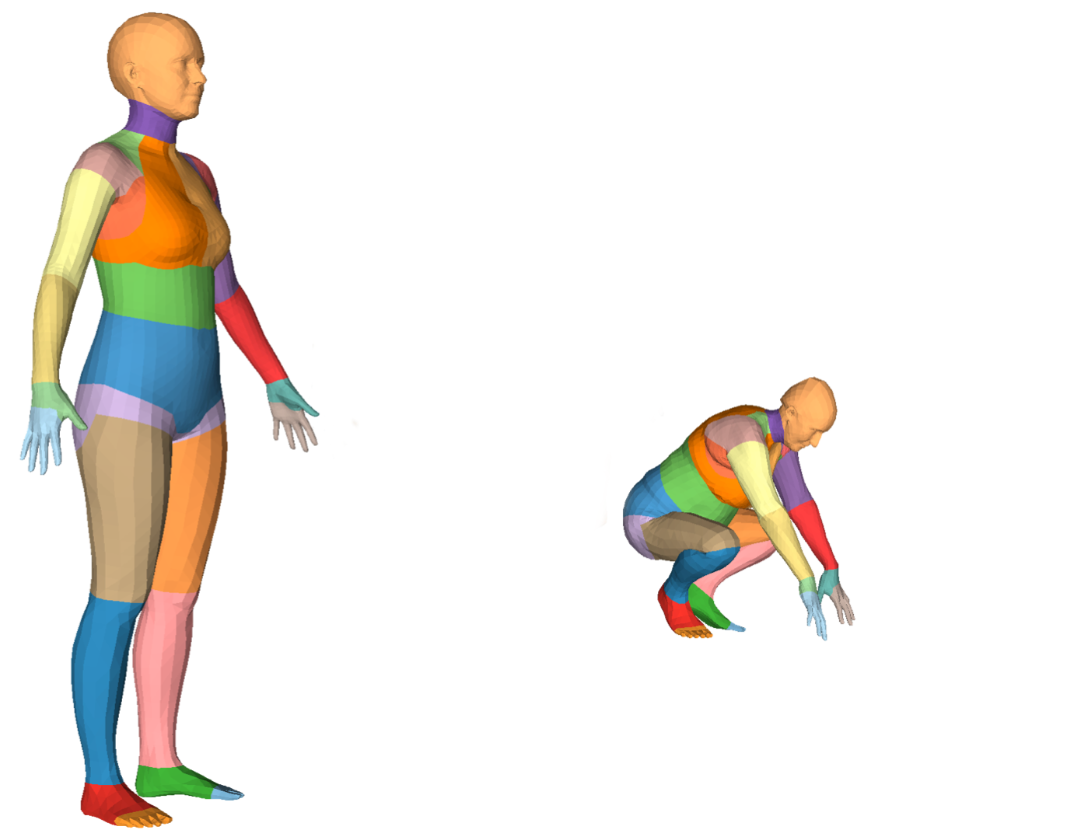
Modelling with local triangle deformations:
SCAPE and BlendSCAPE
Notes:
OK, So let’s start talking about how to deform a neutral body in a neutral pose to a specific one based on local deformations, and how to model those deformations compactly with BlendSCAPE.

Slide 6
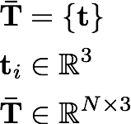
Notes:
In order to describe how to deform locally a template T, let’s zoom in to see what happens with two of its triangles, defined by vertices lower case t_0 to t_3
\mathbf{\bar{T}} &= \{\mathbf{t}\} \\
\mathbf{t}_i &\in \mathbb{R}^3 \\
\mathbf{\bar{T}} &\in \mathbb{R}^{N\times3}

Slide 7
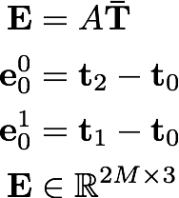
Notes:
As previously mentioned, we will work with edges defined by differences between vertices, as described by the matrix A. We consider two edges per triangle with superscripts 0 and 1, and subscripts iterating over triangles.
\mathbf{E} &= A\mathbf{\bar{T}}\\
\mathbf{e}_0^0 &= \mathbf{t}_2 - \mathbf{t}_0 \\
\mathbf{e}_0^1 &= \mathbf{t}_1 - \mathbf{t}_0 \\
\mathbf{E} &\in \mathbb{R}^{2M\times3}

Slide 8
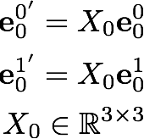


Notes:
We transform the edges by applying a 3x3 deformation X (six degrees of freedom) specific for each triangle.
\mathbf{e}_0^{0'} = X_0\mathbf{e}_0^0 \\
\mathbf{e}_0^{1'} = X_0\mathbf{e}_0^1 \\
X_0 \in \mathbb{R}^{3\times 3}

Slide 9

Notes:
The interesting part comes when we consider a second adjacent triangle
\mathbf{e}_2 &= \mathbf{t}_1 - \mathbf{t}_2 \\
\mathbf{e}_3 &= \mathbf{t}_3 - \mathbf{t}_2

Slide 10
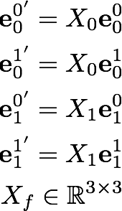


Notes:
Since the transformations X0 and X1 applied to each triangle are different, the previously coherent edges are not longer colinear. After applying different deformations to each of the triangles in a triangulated mesh, the resulting mesh would look like
\mathbf{e}_0^{0'} = X_0\mathbf{e}_0^0 \\
\mathbf{e}_0^{1'} = X_0\mathbf{e}_0^1 \\\mathbf{e}_1^{0'} = X_1\mathbf{e}_1^0 \\
\mathbf{e}_1^{1'} = X_1\mathbf{e}_1^1 \\
X_f \in \mathbb{R}^{3\times 3}

Slide 11
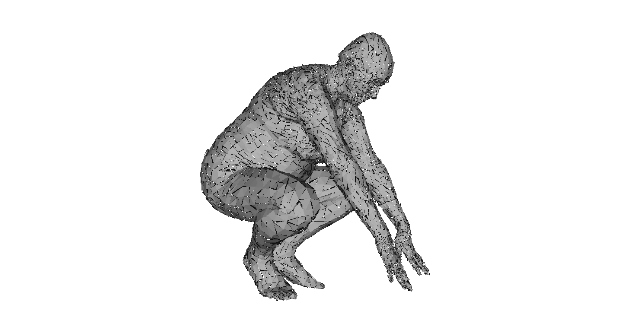
Notes:
this mesh. Triangles are disconnected from each other,

Slide 12
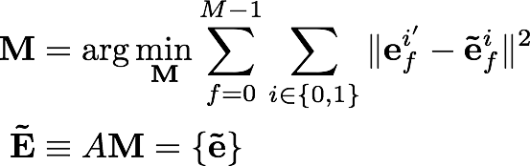
Notes:
so in order to obtain a coherent mesh, one has to solve for the vertices m
\mathbf{M} &= \arg\min_{\mathbf{M}} \sum_{f=0}^{M-1} \sum_{i\in\{0,1\}} \| \mathbf{e}_f^{i'} - \mathbf{\tilde{e}}_f^i\|^2 \\
\mathbf{\tilde{E}} &\equiv A\mathbf{M} = \{\mathbf{\tilde{e}}\}

Slide 13
Notes:
whose edges e tilde
\mathbf{M} &= \arg\min_{\mathbf{M}} \sum_{f=0}^{M-1} \sum_{i\in\{0,1\}} \| \mathbf{e}_f^{i'} - \mathbf{\tilde{e}}_f^i\|^2 \\
\mathbf{\tilde{E}} &\equiv A\mathbf{M} = \{\mathbf{\tilde{e}}\}

Slide 14
Notes:
are most similar to the transformed edges e’.
\mathbf{M} &= \arg\min_{\mathbf{M}} \sum_{f=0}^{M-1} \sum_{i\in\{0,1\}} \| \mathbf{e}_f^{i'} - \mathbf{\tilde{e}}_f^i\|^2 \\
\mathbf{\tilde{E}} &\equiv A\mathbf{M} = \{\mathbf{\tilde{e}}\}

Slide 15
Notes:
This stitching process implicitly solves for the actual location of the vertices, at the cost of a gap between what the model tries to express and what actually can be achieved with a coherent mesh.

Slide 16

Modeling deformations
Notes:
. Now the question is, how do we actually model those triangle deformations X?

Slide 17
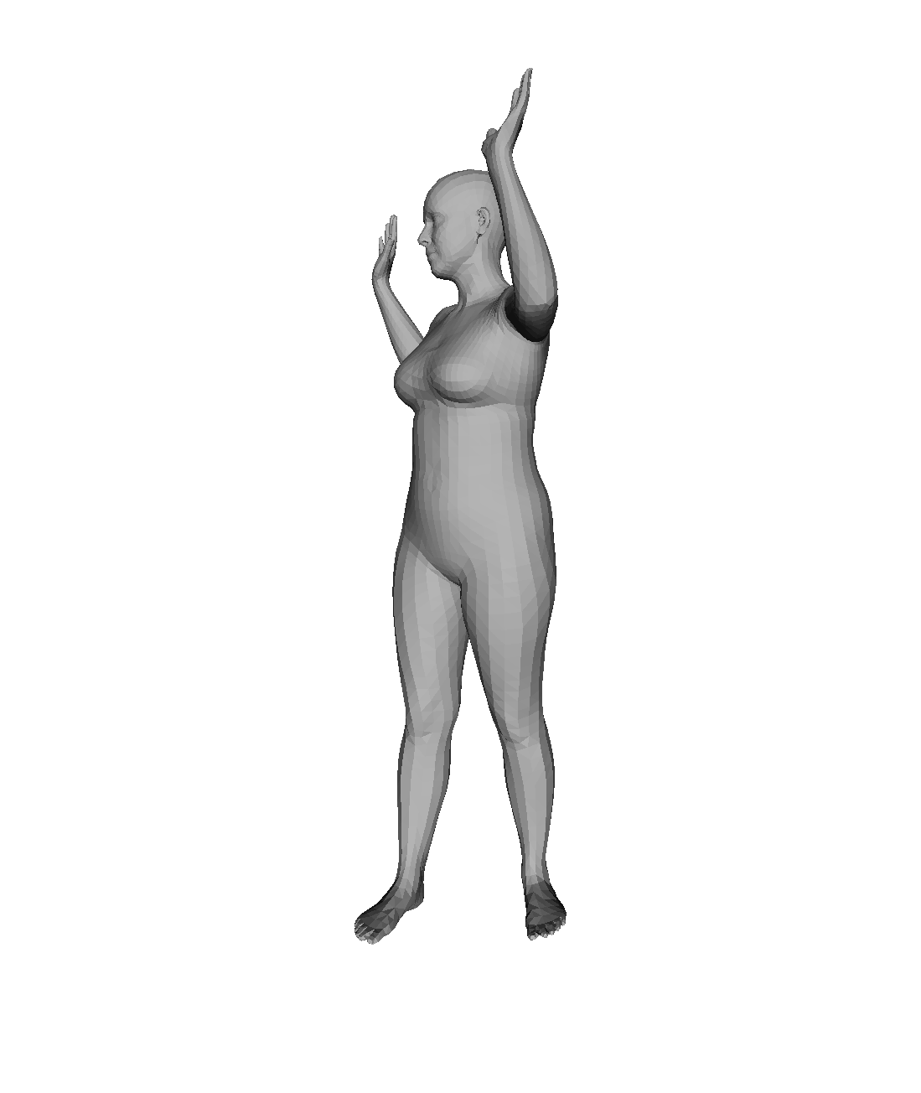
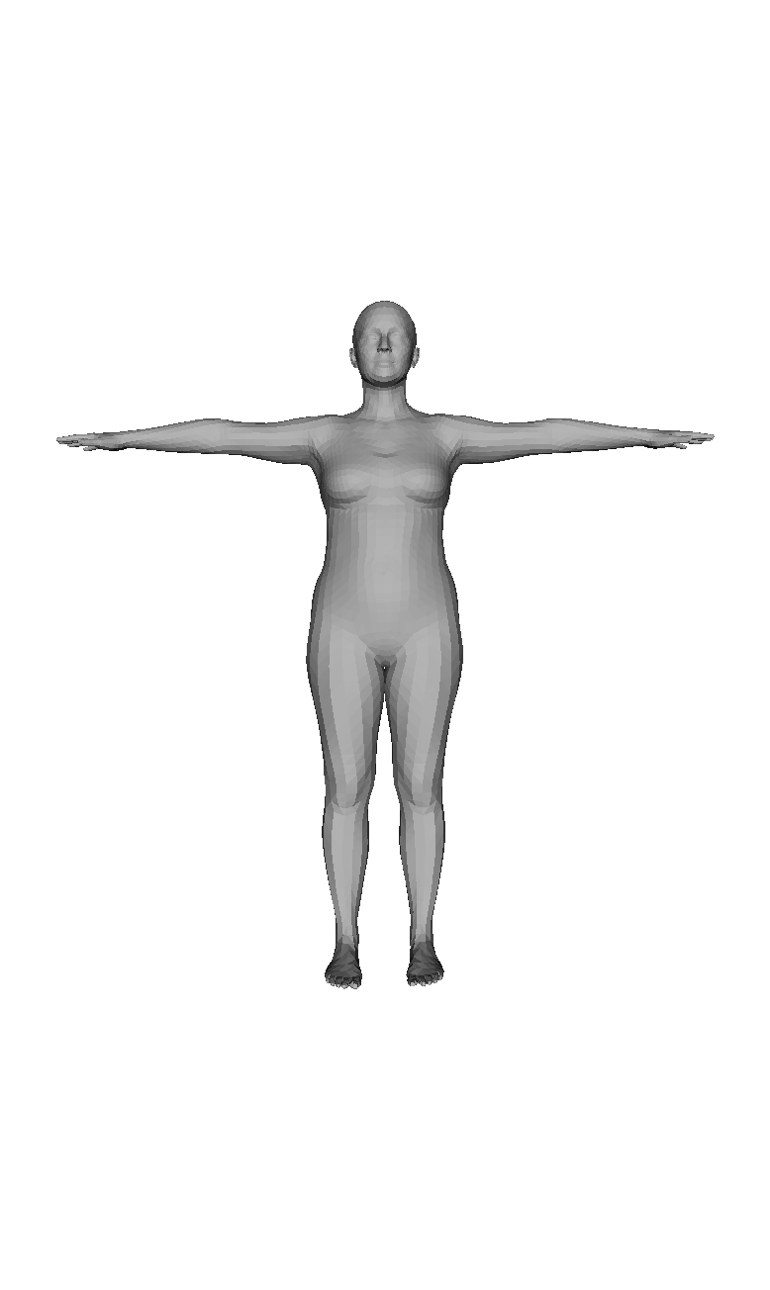
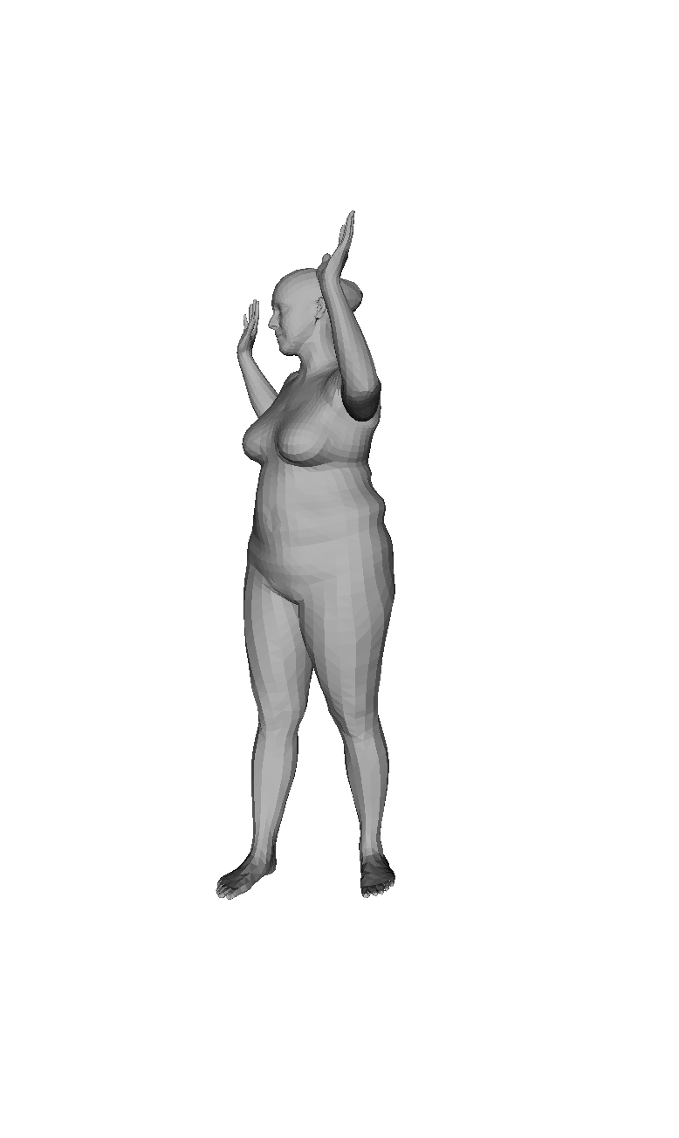
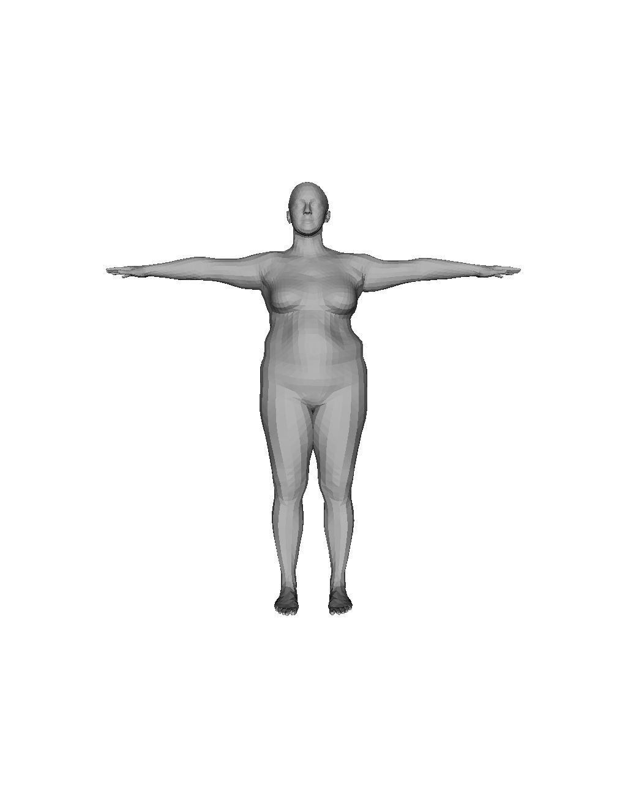
SCAPE. Angelov et al. 2005
BlendSCAPE, Hirshberg 2012
pose
pose and shape
shape
Notes:
SCAPE, and its variant BlendSCAPE, factorise those deformations into different independent components that relate either to the intrinsic shape of a particular subject, or its kinematic configuration.

Slide 18
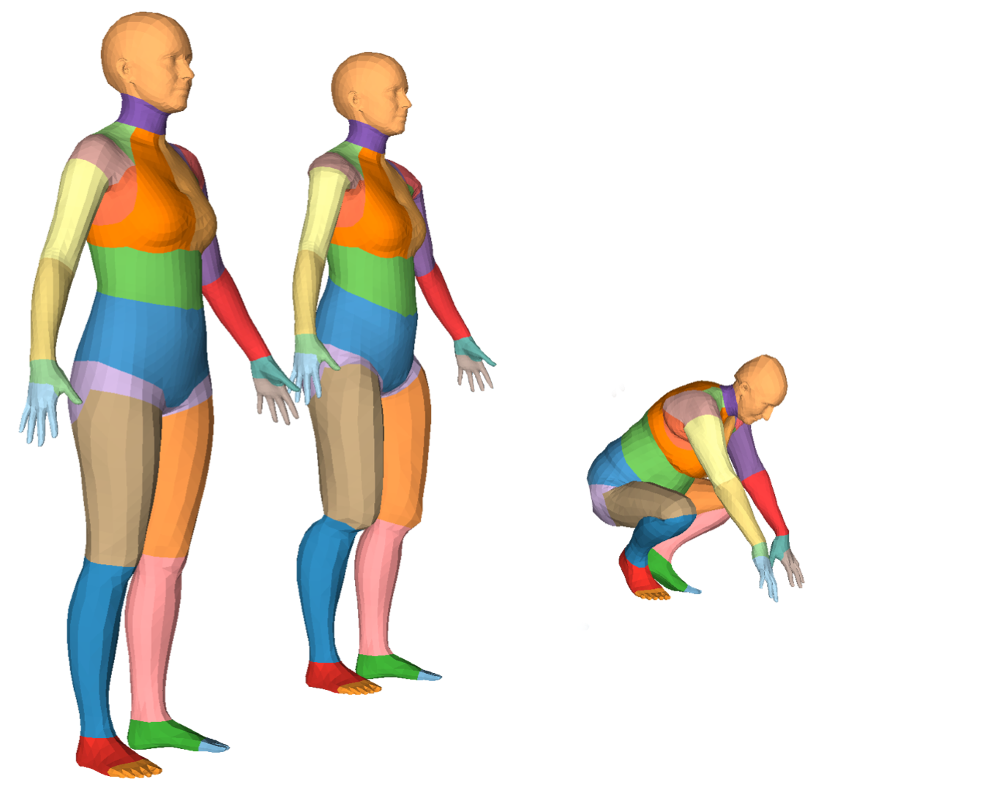

SCAPE and BlendSCAPE
Notes:
BlendSCAPE first performs some pose-dependent corrections related to muscle bulging or skinning imperfections called Q, independent of body shape,

Slide 19
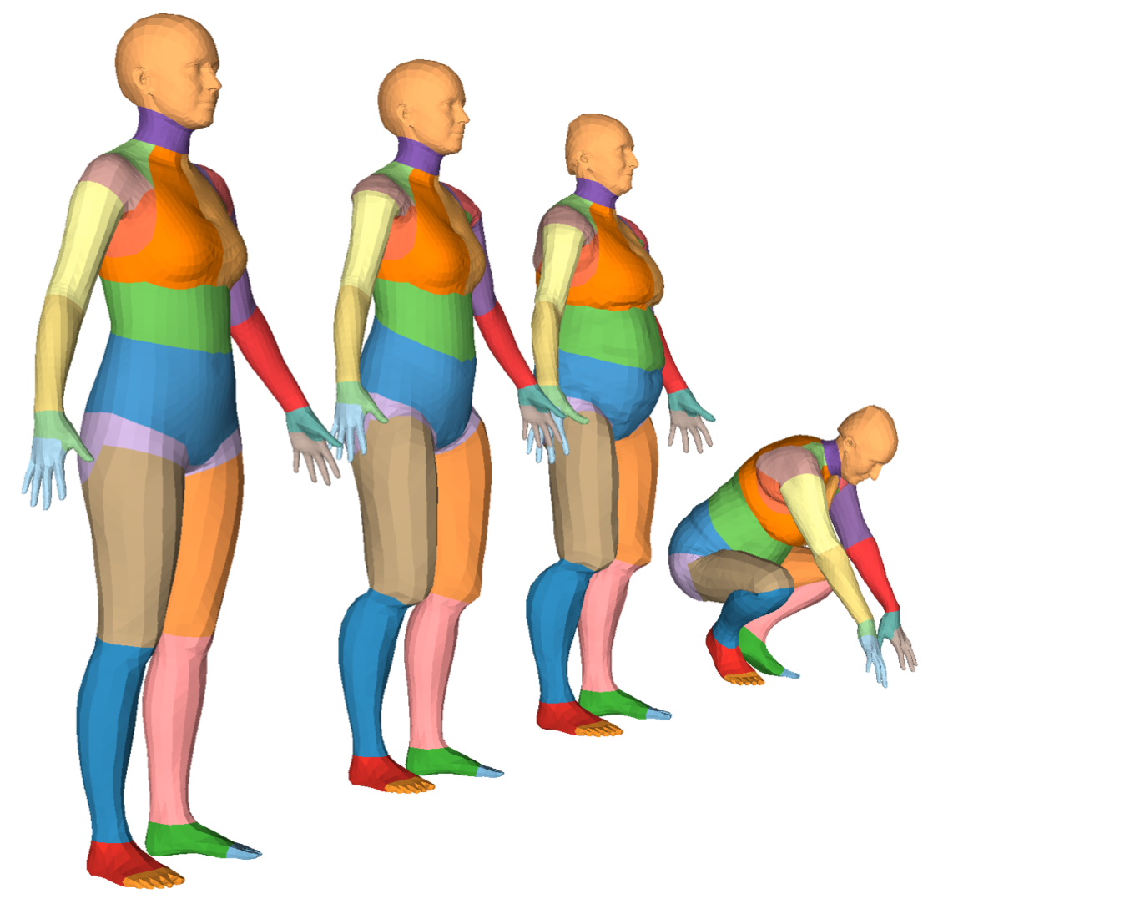

SCAPE and BlendSCAPE
Notes:
Then, it adapts the template to obtain the intrinsic shape related to the identity of the subject, with a deformation matrix called S.

Slide 20

SCAPE and BlendSCAPE
Notes:
Finally, it rotates each triangle with a weighted average of rotations called B.

Slide 21
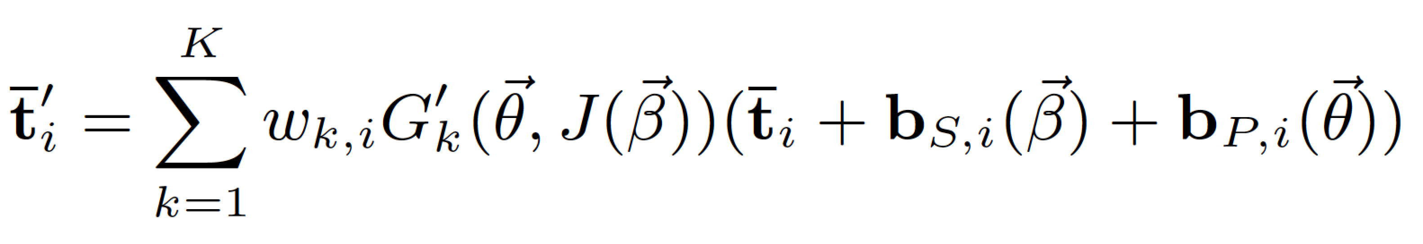
SMPL
Additive Model
Joint locations
Vertices
BlendSCAPE
Multiplicative Model
No joints
Edges
Notes:
Let’s have a look how SMPL model form compares to BlendSCAPE:
Muliplicative vs additive
Analogy
\mathbf{e}^\prime=B(\vec{\theta})S(\vec{\beta})Q(\vec{\theta})\mathbf{e}
dimensionality higher, harder to train. degrees of freedom are not used

Slide 22
Two deformation models
Local triangle deformations
3x3 transformations
Applied to vertex differences (edges)
-> BlendSCAPE
Global vertex deformations
4x4 transformations
Applied to vertices
-> SMPL
Notes:
I’ll be talking about BlendSCAPE during the rest of this presentation, and Gerard will continue describing SMPL afterwards

Slide 23
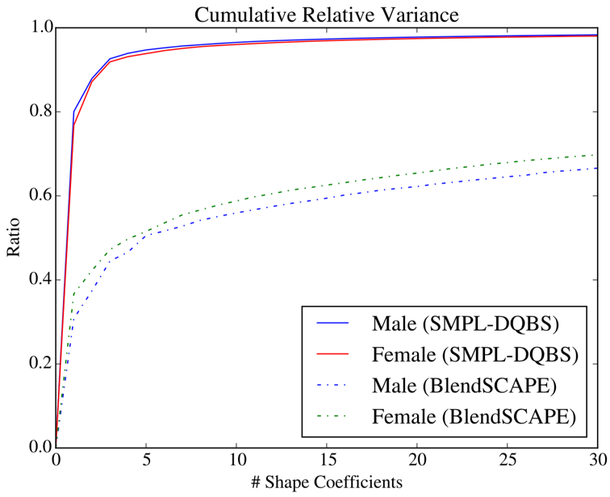
SMPL vs SCAPE

Slide 24
How do we train a body model ?
Notes:
regardless of SCAPE or SMPL

Slide 25
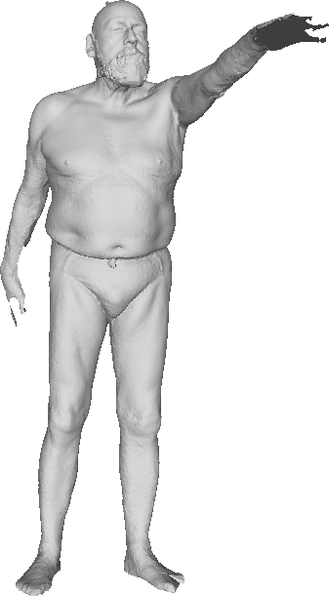
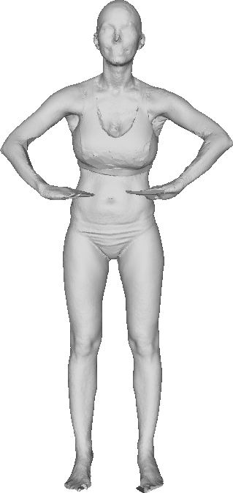
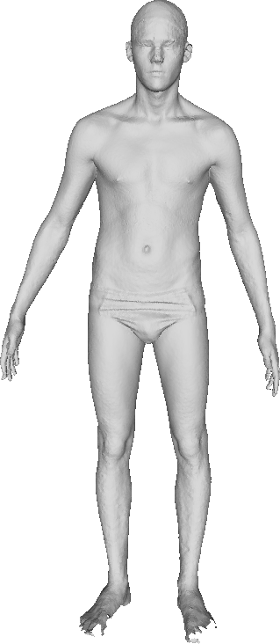
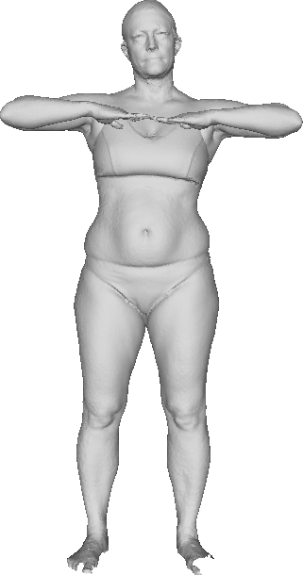
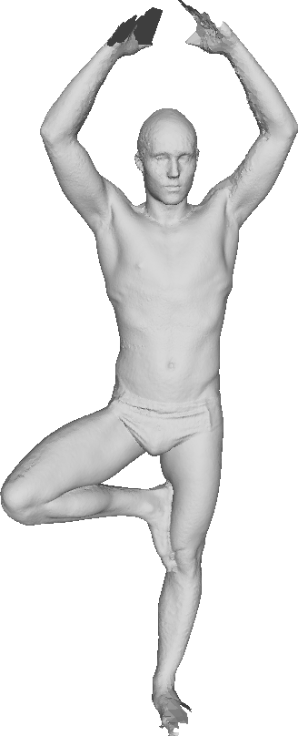
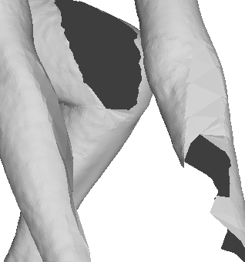
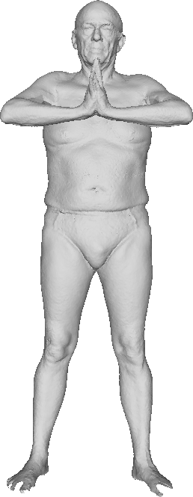
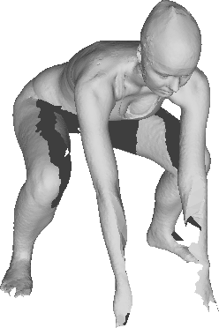
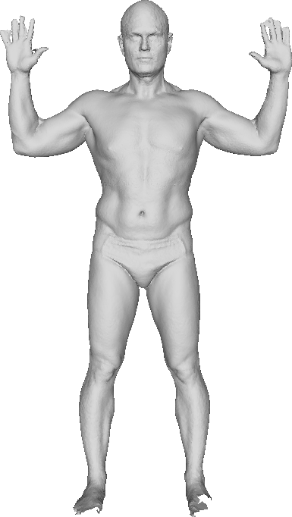
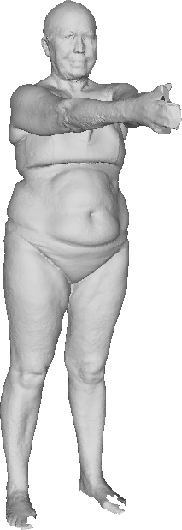
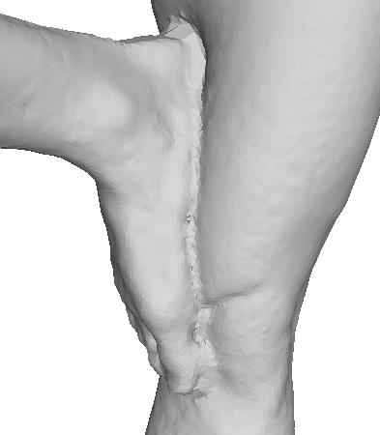
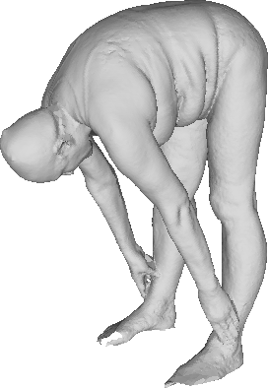
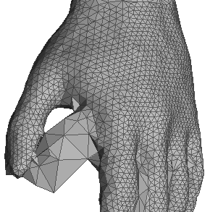
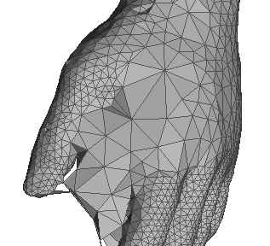
Scans
missing data
self contacts
varying
topology
Notes:
Note that both CAESAR and our triangulated meshes have missing data, self contacts and varying topology, which means scans should be first registered to a common template in order to compute statistics on them.

Slide 26

Training
Notes:
Those learned parameters
\Phi = \arg\min_\Phi\sum_j \min_{\vec{\theta_j}, \vec{\beta_j}} \|M(\vec{\theta_j}, \vec{\beta_j}; \Phi) - \mathbf{V}_j\|^2

Slide 27
Training
Parameters to be learned
Notes:
Phi

Slide 28
Training
Parameters to be learned
Model
Notes:
are learned by minimising the sum of the distance between the model, in this case BlendSCAPE

Slide 29
Training
Parameters to be learned
Model
Set of registrations
Notes:
and a set of registrations from the datasets that I’ve mentioned before.

Slide 30
Training
Parameters to be learned
Model
Set of registrations
Shape parameters of registration j
Notes:
The shape

Slide 31
Training
Parameters to be learned
Model
Set of registrations
Shape parameters of registration j
Pose parameters of registration j
Notes:
and pose parameters corresponding to registration j should be optimised to minimise that distance as well.
The elements in Phi (pose-dependent regressor, shape directions and blendweights) are optimised one at a time while keeping the rest of the elements fixed.

Slide 32
Training
Set of registrations
Notes:
But, what are those registrations to start with?

Slide 33



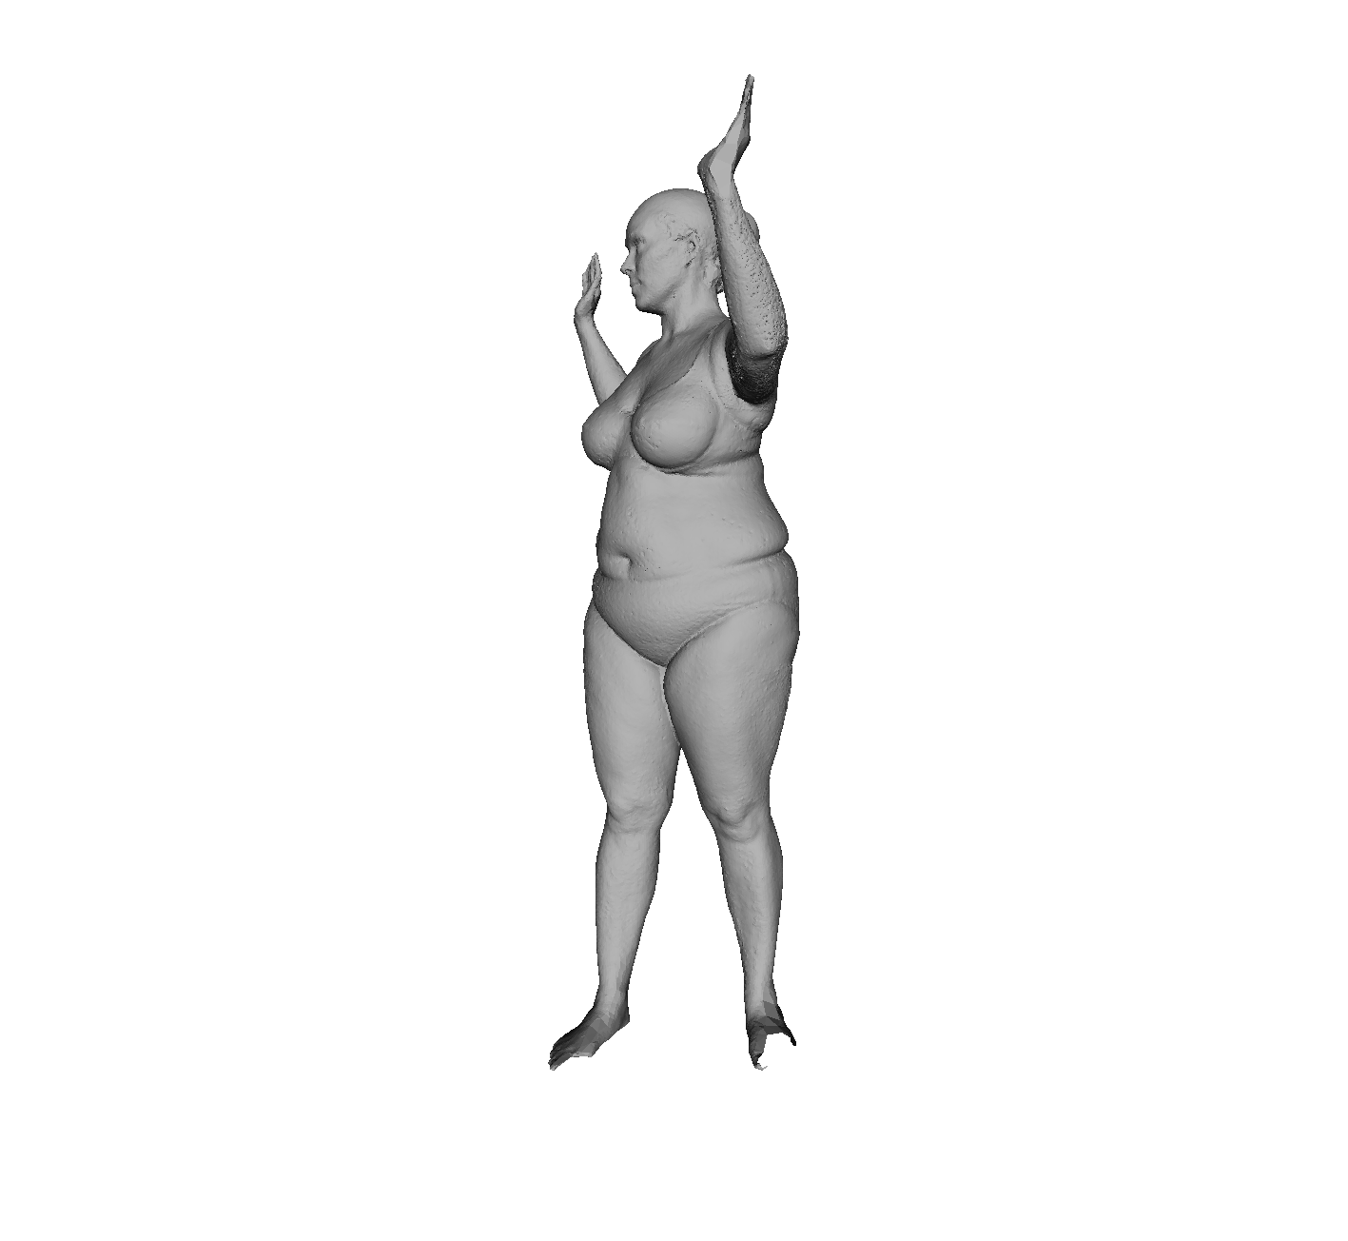


Data
Registration
Model
Notes:
Registrations are a middle representation that decouples the problem of learning a model from unstructured data into

Slide 34
Data
Registration
Model
Notes:
registering raw data into surfaces that share a common topology (therefore identifying specific points of the body),

Slide 35
Data
Registration
Model
Notes:
and creating a model from those coherent registered meshes. We have briefly mentioned how to optimise the model learned parameters Phi given registrations,

Slide 36
Data
Registration
Model
Notes:
Now we will talk about the other side of the coin, how to obtain the registrations from real 3D scans.
\mathbf{V}_j = \arg\min_{\mathbf{V}_j} (d(\mathcal{S}_j, \mathbf{V}_j))
%\textcolor[rgb]{0.35,0.35,0.35}{\{S^k\}}
%\textcolor[rgb]{0.35,0.35,0.35}{M(P)}
%\textcolor[rgb]{0.35,0.35,0.35}{\{T^k\}}
%\textcolor[rgb]{0.35,0.35,0.35}{P = \arg\min_{P}(d(M(P), \{T^k\}))}
%\textcolor[rgb]{0.35,0.35,0.35}{T^k = \arg\min_{T^k}(d(S^k, T^k) + d(T^k, P))}
%\textcolor[rgb]{0.35,0.35,0.35}{\{M(P) - T^k\} = }

Slide 37
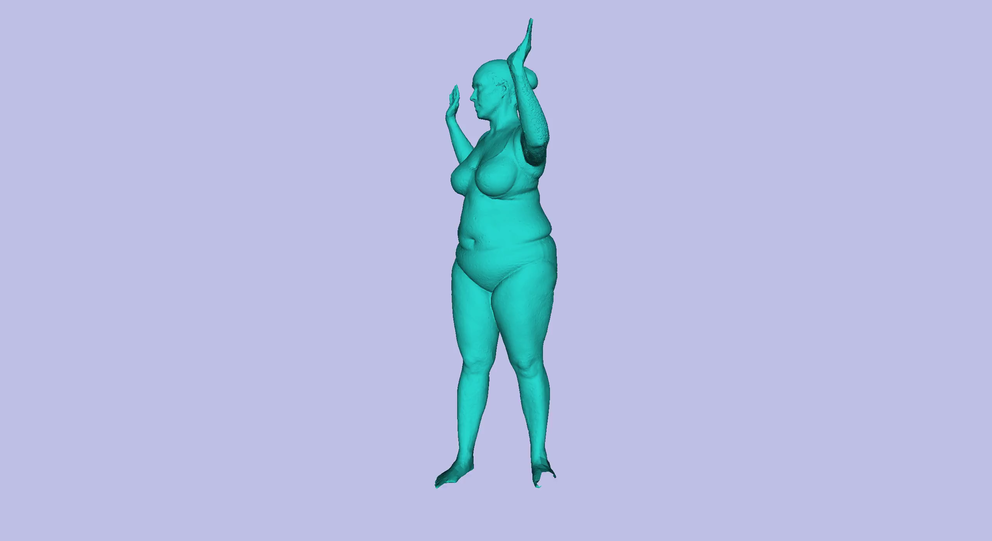

Data
pose + shape
Registration
Notes:
A registration is the solution to a minimisation problem of a distance between the scan surface Sj and the registration surface calligraphic Vj, elicited by vertices bold Vj.
\mathbf{V}_j = \arg\min_{\mathbf{V}_j} ( d(\mathcal{S}_j, \mathcal{V}_j))

Slide 38
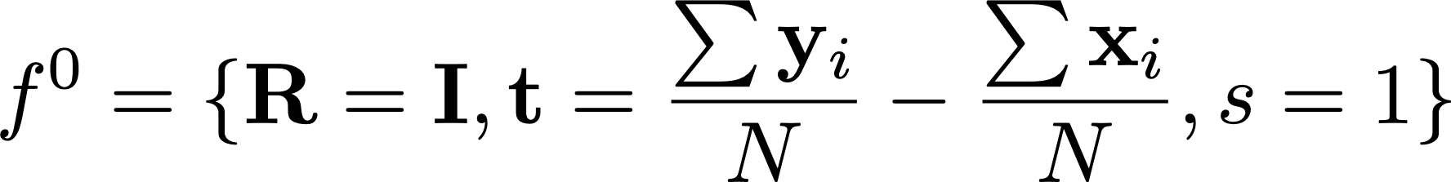
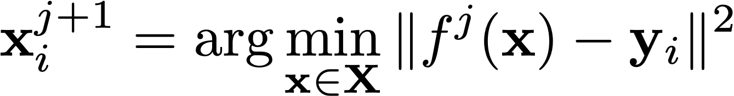

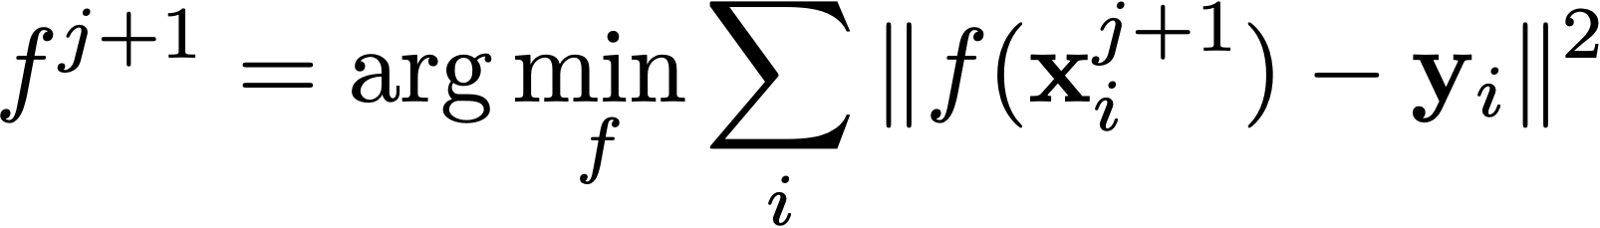
Refresher on ICP
Initialize
Compute correspondences according to current best transform
Compute optimal transformation ( )with Procrustes
Terminate if converged (error below a threshold), otherwise iterate

Slide 39
Refresher on ICP
need not just be a rigid transformation .
can be any deformation model for the vertices V.

Slide 40
What should f() be?
should it be all the degrees of freedom in V?
should it be the SMPL function, parameterised by ?

Slide 41
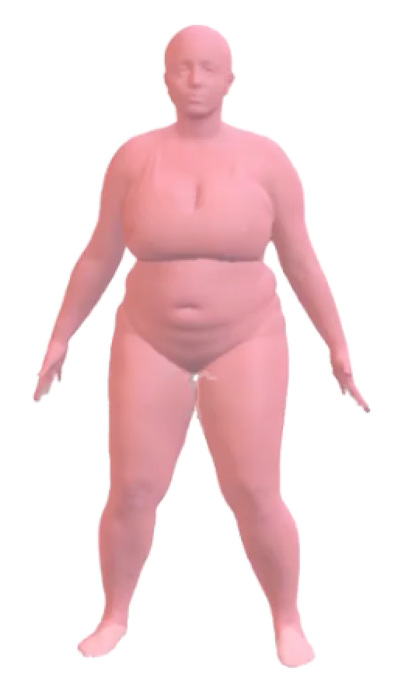
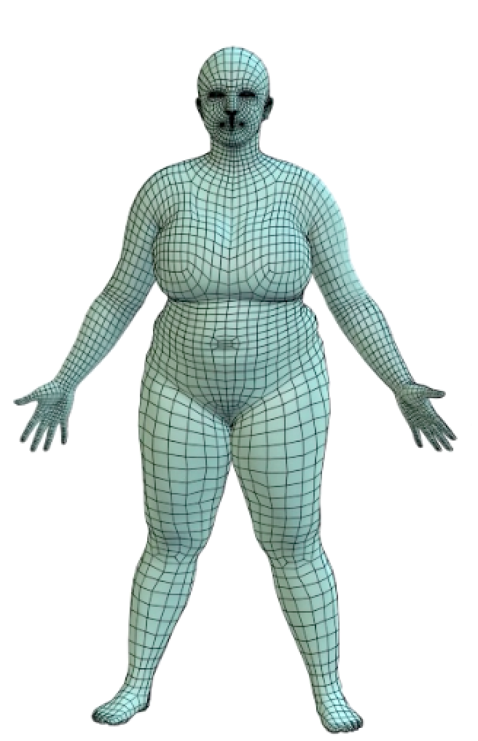
Optimizing vertices directly is unstable
Scan
Registration
Notes:
E(\mathbf{V}) = \sum_{\mathbf{s}_i\in\mathcal{S}}\mathrm{dist}(\mathbf{s}_i,\mathcal{V}(\mathbf{V}))+E_\mathrm{prior}(\mathbf{V})
E(\theta, \beta,\mathbf{v})=\sum_{\mathbf{s}_i\in\mathcal{S}}\mathrm{dist}(\mathbf{s}_i,\mathcal{A}(\mathbf{v}))+\mathrm{dist}(\mathcal{A}(\mathbf{v}),\mathcal{M}(\theta, \beta))+E_\mathrm{prior}(\theta,\beta)

Slide 42
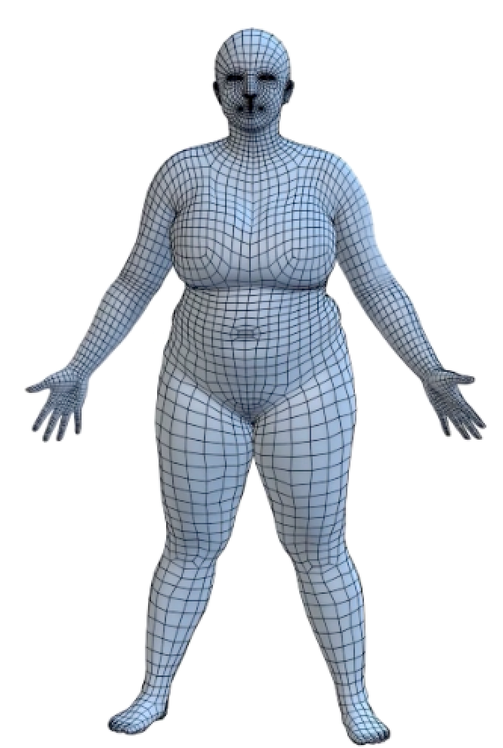
Optimizing just the model does not capture detail.
We do not learn anything new from the scan
Scan
Model
Notes:
E(\mathbf{v}) = \sum_{\mathbf{s}_i\in\mathcal{S}}\mathrm{dist}(\mathbf{s}_i,\mathcal{A}(\mathbf{v}))+E_\mathrm{prior}(\mathbf{v})
E(\theta, \beta,\mathbf{v})=\sum_{\mathbf{s}_i\in\mathcal{S}}\mathrm{dist}(\mathbf{s}_i,\mathcal{A}(\mathbf{v}))+\mathrm{dist}(\mathcal{A}(\mathbf{v}),\mathcal{M}(\theta, \beta))+E_\mathrm{prior}(\theta,\beta)

Slide 43
Scan
Registration
Model
Notes:
E(\mathbf{V}) = \sum_{\mathbf{s}_i\in\mathcal{S}}\mathrm{dist}(\mathbf{s}_i,\mathcal{V}(\mathbf{V}))+E_\mathrm{prior}(\mathbf{v})
E(\theta, \beta,\mathbf{V})=\sum_{\mathbf{s}_i\in\mathcal{S}}\mathrm{dist}(\mathbf{s}_i,\mathcal{V}(\mathbf{V}))+\mathrm{dist}(\mathcal{V}(\mathbf{v}),\mathcal{M}(\theta, \beta))+E_\mathrm{prior}(\theta,\beta)

Slide 44
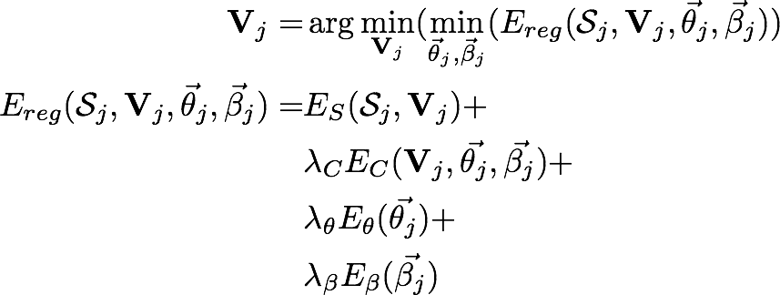
Objective
Notes:
The “distance”, or energy to be minimised is composed

Slide 45
Objective
scan-to-mesh distance
Notes:
a data term measures the distance from the scan to the registration

Slide 46
Objective
scan-to-mesh distance
coupling
Notes:
a coupling term that regularises the registration to be close to the body model

Slide 47
Objective
scan-to-mesh distance
coupling
pose prior
Notes:
A pose prior

Slide 48
Objective
scan-to-mesh distance
coupling
pose prior
shape prior
Notes:
And a shape prior

Slide 49
Objective
scan-to-mesh distance
coupling
pose prior
shape prior
relative weights
Notes:
where all the terms are relatively weighted through a set of weights lambda
\mathbf{V}_j = & \arg\min_{\mathbf{V}_j}(\min_{\vec{\theta}_j, \vec{\beta}_j} (E_{reg}(\mathcal{S}_j, \mathbf{V}_j, \vec{\theta}_j, \vec{\beta}_j)) \\
E_{reg}(\mathcal{S}_j, \mathbf{V}_j, \vec{\theta}_j, \vec{\beta}_j) = & E_S(\mathcal{S}_j, \mathbf{V}_j) + \\
& \lambda_C E_C(\mathbf{V}_j, \vec{\theta_j}, \vec{\beta_j}) + \\
& \lambda_\theta E_\theta(\vec{\theta_j}) + \\
& \lambda_\beta E_\beta(\vec{\beta_j})

Slide 50
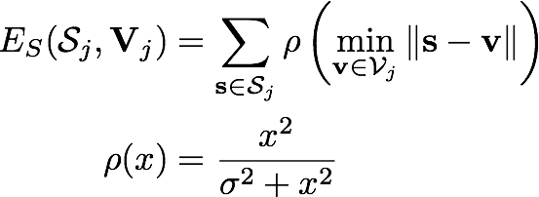
Scan-to-mesh distance
Notes:
The scan-to-mesh distance measures

Slide 51
Scan-to-mesh distance
Notes:
the distance from

Slide 52
Scan-to-mesh distance
Notes:
points on the scan

Slide 53
Scan-to-mesh distance
Notes:
to the surface of the registration

Slide 54
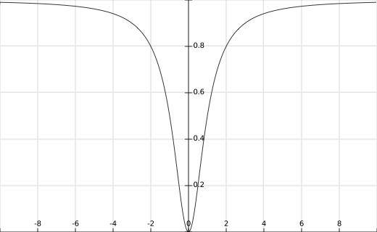

Scan-to-mesh distance
Notes:
robustified with a Geman-Mcclure estimator

Slide 55
Scan-to-mesh distance
point-to-surface distance!
Notes:
There is a important detail not to miss though; the distance is measure between points on the scan to points on the SURFACE of the registration.
E_S(\mathcal{S}_j, \mathbf{V}_j) &= \sum_{\mathbf{s} \in \mathcal{S}_j} \rho \left( \min_{\mathbf{v} \in \mathcal{V}_j} \| \mathbf{s} - \mathbf{v} \|\right) \\
\rho(x) &= \frac{x^2}{\sigma^2 + x^2} \\

Slide 56
A much better objective: Point-to-surface distance
Notes:
This results in a point-to-surface distance. If we zoom in a triangle with vertices v_0 to v_2
\mathbf{y}_0 \in \mathbf{Y}

Slide 57


Closest points: avoid local minima
Point-to-point distance
Notes:
and a query point s from the surface of the scan, a point-to-surface distance would find the closest vertex on the registration, in this case x1. This is not a good distance estimation, since

Slide 58

Closest points: avoid local minima
Point-to-surface distance
Notes:
the closest distance to the surface is the one to a point within the triangle. Although this seems rather obvious, it is rather common to find papers using the point to surface distance. The formulation of the derivatives of point-to-surface distance is more complicated, but results are substantially better.

Slide 59
Coupling
Notes:
The second term in the energy was the coupling term. Instead of enforcing that the registration Vj is completely contained in the model space, registrations are softly coupled through this energy term. We use two different coupling terms
E_C(\mathbf{V}_j, \vec{\theta}_j, \vec{\beta}_j) &\equiv \mathrm{dist}(\mathbf{V}_j, M(\vec{\theta}_j, \vec{\beta}_j))

Slide 60
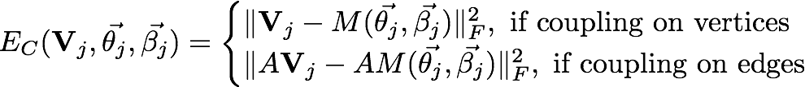
Coupling
Notes:
The first kind of distance is just the frobenius norm of the difference between registration and model.

Slide 61
Coupling
Notes:
The second one is the norm of the difference between the EDGES of the registration and the edges of the model. This second term effectively couples registration and model locally instead of globally, which can be particularly useful when the model does not model successfully the shape to be registered.
COUPLING ON EDGES ONLY

Slide 62
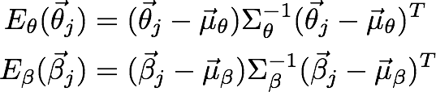
Priors
Priors are based on Mahalanobis distance
Assumes a Gaussian Distribution
Notes:
Finally, there are two priors, on shape and pose, designed as the Mahalanobis distance between the pose and shape and their distributions from training datasets, respectively. Under this notation, mu and uppercase sigma represent the mean and covariance matrix respectively.
INCLUDE A PICTURE OF GAUSSIAN AND BODIES!
E_\theta(\vec{\theta}_j) &= (\vec{\theta}_j - \vec{\mu}_\theta) \Sigma_\theta^{-1}(\vec{\theta}_j - \vec{\mu}_\theta)^T \\
E_\beta(\vec{\beta}_j) &= (\vec{\beta}_j - \vec{\mu}_\beta) \Sigma_\beta^{-1}(\vec{\beta}_j - \vec{\mu}_\beta)^T

Slide 63
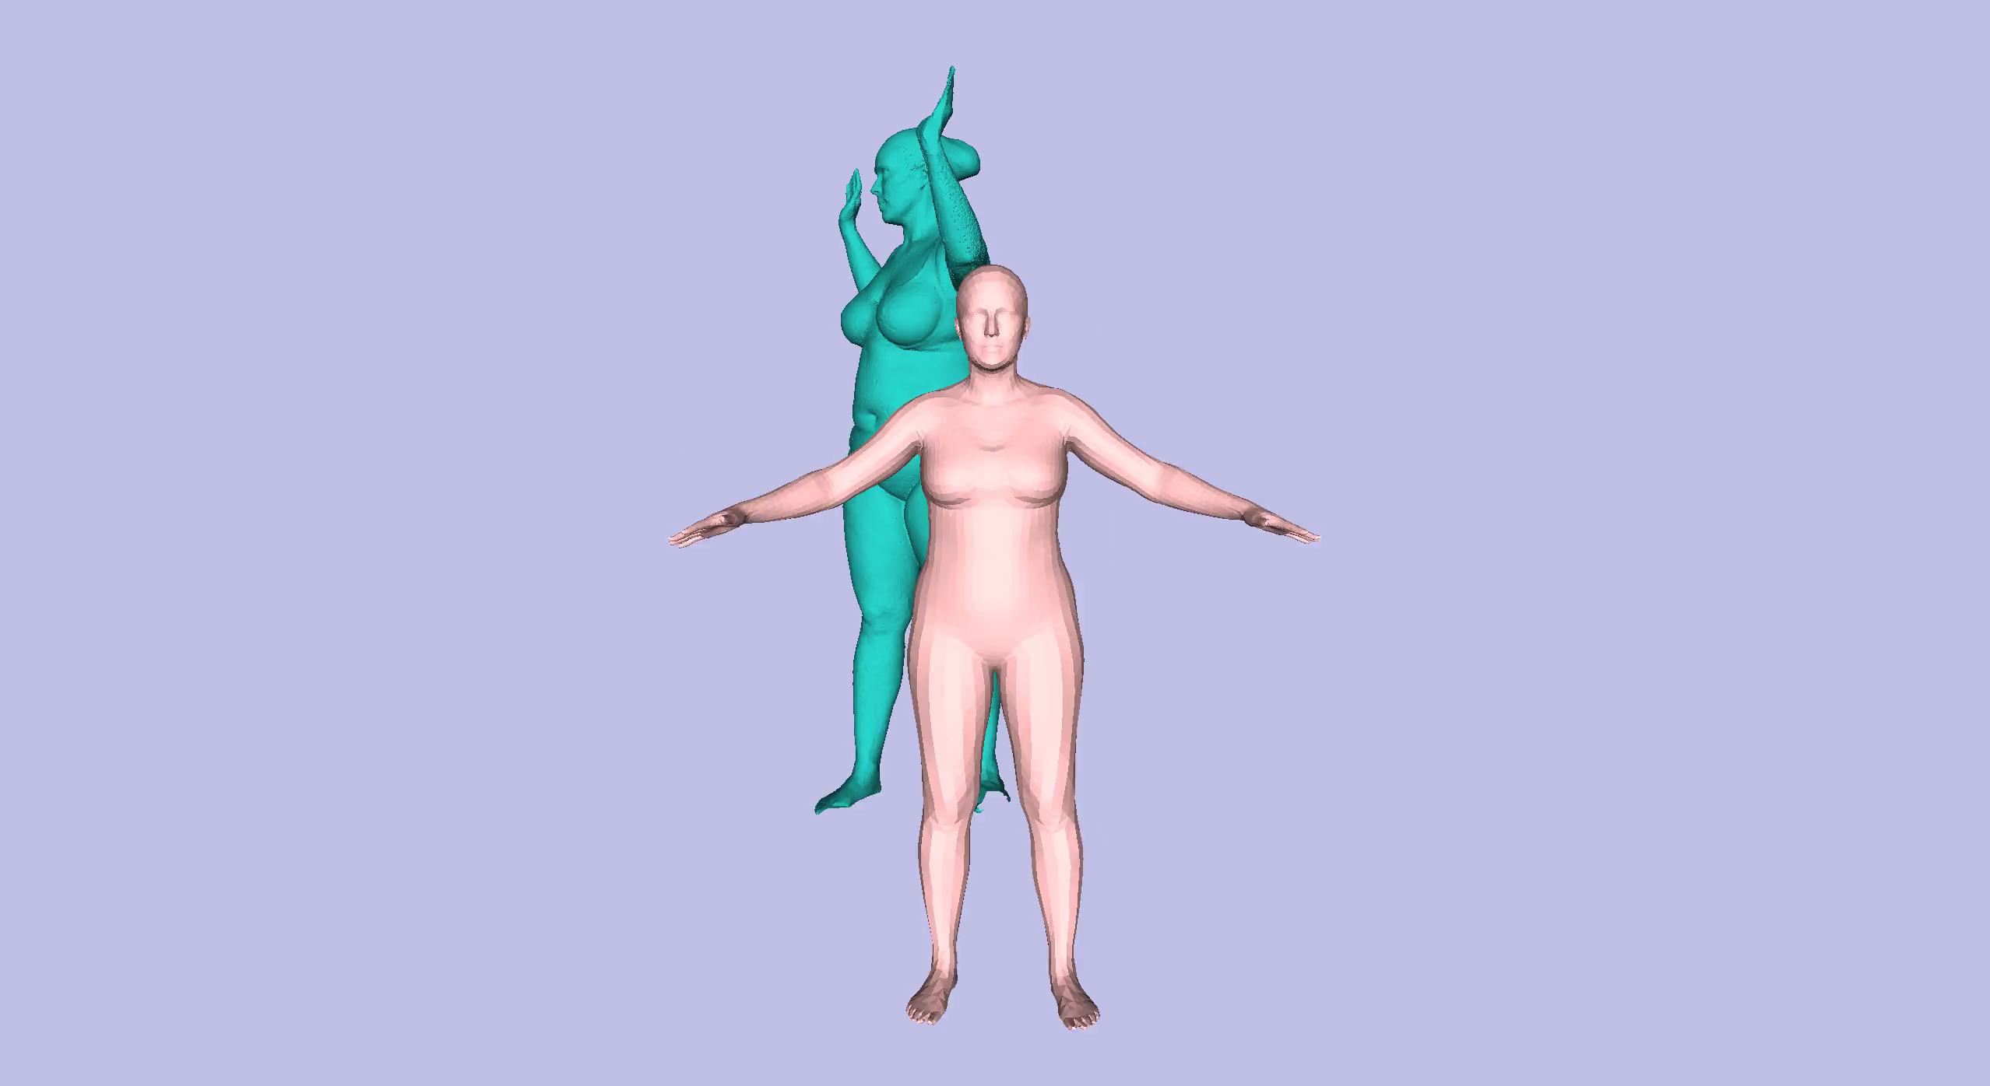
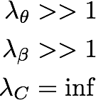
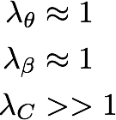
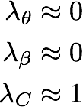
Data
pose + shape
Registration
Stage 1
Stage 2
Stage 3
Notes:
Here we see the registration optimisation in action. Since the problem is highly non-convex, the optimisation is performed in a staged manner to help avoiding local minima. The first stage is very conservative: the registration cannot deviate from the model because of its infinite coupling weight, and the penalty for deviating from known poses and shapes is very high.
DON’T BREAK INTO STEPS

Slide 64
Given Registrations I can train a Model
Registration
Model
Notes:
I’ve covered briefly how to train a model given registrations

Slide 65

Given a Model I can obtain registrations
pose + shape
Data
Data
Registration
Registration
Model
Model
pose + shape
COREGISTRATION
Notes:
But…
I need registrations for
Interestingly, this two components of the model creation (registration and modelling) can be expressed as two sides of the same objective function which minimises the distance between scans and the model.

Slide 66
But, how can I solve both problems at once?
pose + shape
Data
Data
Registration
Registration
Model
Model
pose + shape
COREGISTRATION
Notes:
But…
I need registrations for
Interestingly, this two components of the model creation (registration and modelling) can be expressed as two sides of the same objective function which minimises the distance between scans and the model.

Slide 67
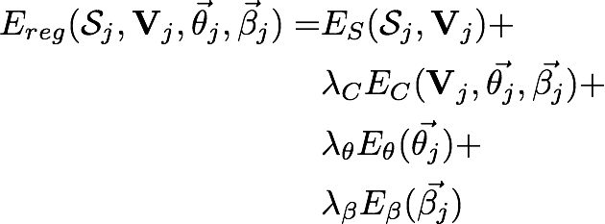
Joint registration and model learning
The key idea is to minimize the registration objective (loss function)
Notes:
Due to lack of time, I’ll just briefly say that, if we take the registration objective
E_{reg}(\mathcal{S}_j, \mathbf{V}_j, \vec{\theta}_j, \vec{\beta}_j) = & E_S(\mathcal{S}_j, \mathbf{V}_j) + \\
& \lambda_C E_C(\mathbf{V}_j, \vec{\theta_j}, \vec{\beta_j}) + \\
& \lambda_\theta E_\theta(\vec{\theta_j}) + \\
& \lambda_\beta E_\beta(\vec{\beta_j})

Slide 68
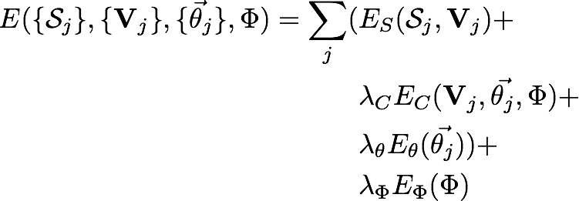
pose + shape
Data
Data
Registration
Registration
Model
Model
pose + shape
COREGISTRATION
The key idea is to minimize the registration objective across the dataset of scans
Sums over dataset scans!
model regularisation
Hirshberg et al., Coregistration: Simultaneous alignment
and modeling of articulated 3D shape, ECCV’12
Notes:
the registration and training problems become specific instances of this objective, where

Slide 69

pose + shape
Data
Data
Registration
Registration
Model
Model
pose + shape
COREGISTRATION
Hirshberg et al., Coregistration: Simultaneous alignment
and modeling of articulated 3D shape, ECCV’12
Notes:
minimising the energy with respect to the learned parameters, given fixed registrations, becomes the training problem
\Phi = \arg\min_\Phi(E(\{\mathcal{S}_j\}, \{\mathbf{V}_j\}, \{\vec{\theta}_j\}, \Phi)) \textnormal{ with } \{\mathbf{V}_j\} \textnormal{ fixed}

Slide 70
Summary
SCAPE based models are based on triangle deformations and stitching triangles
Training a model requires solving for model hyper-parameters and shape and pose for each registration
Obtaining registrations requires a model. Obtaining a model requires registrations.
This chicken and egg problem can be addressed with co-registration (similar to EM)
Notes:
And finally briefly talked about how registration and model-training are two sides of a single objective in co-registration.

Slide 71
Summary
SCAPE based models are based on triangle deformations and stitching triangles
Training a model requires solving for model hyper-parameters and shape and pose for each registration
Obtaining registrations requires a model. Obtaining a model requires registrations.
This chicken and egg problem can be addressed with co-registration (similar to EM)
Notes:
And finally briefly talked about how registration and model-training are two sides of a single objective in co-registration.

Slide 72
Summary
SCAPE based models are based on triangle deformations and stitching triangles
Training a model requires solving for model hyper-parameters and shape and pose for each registration
Obtaining registrations requires a model. Obtaining a model requires registrations.
This chicken and egg problem can be addressed with co-registration (similar to EM)
Notes:
And finally briefly talked about how registration and model-training are two sides of a single objective in co-registration.

Slide 73
Summary
SCAPE based models are based on triangle deformations and stitching triangles
Training a model requires solving for model hyper-parameters and shape and pose for each registration
Obtaining registrations requires a model. Obtaining a model requires registrations.
This chicken and egg problem can be addressed with co-registration (similar to EM)
Notes:
And finally briefly talked about how registration and model-training are two sides of a single objective in co-registration.

Slide 74
Slide Credits and resources
Slides adapted from Learning Human Shapes in Motion. Siggraph tutorial 2016. Special thanks to Javier Romero

