Slide 1
Virtual Humans – Winter 23/24
Lecture 3_2 – Procrustes Alignment
Prof. Dr.-Ing. Gerard Pons-Moll
University of Tübingen / MPI-Informatics

Slide 2
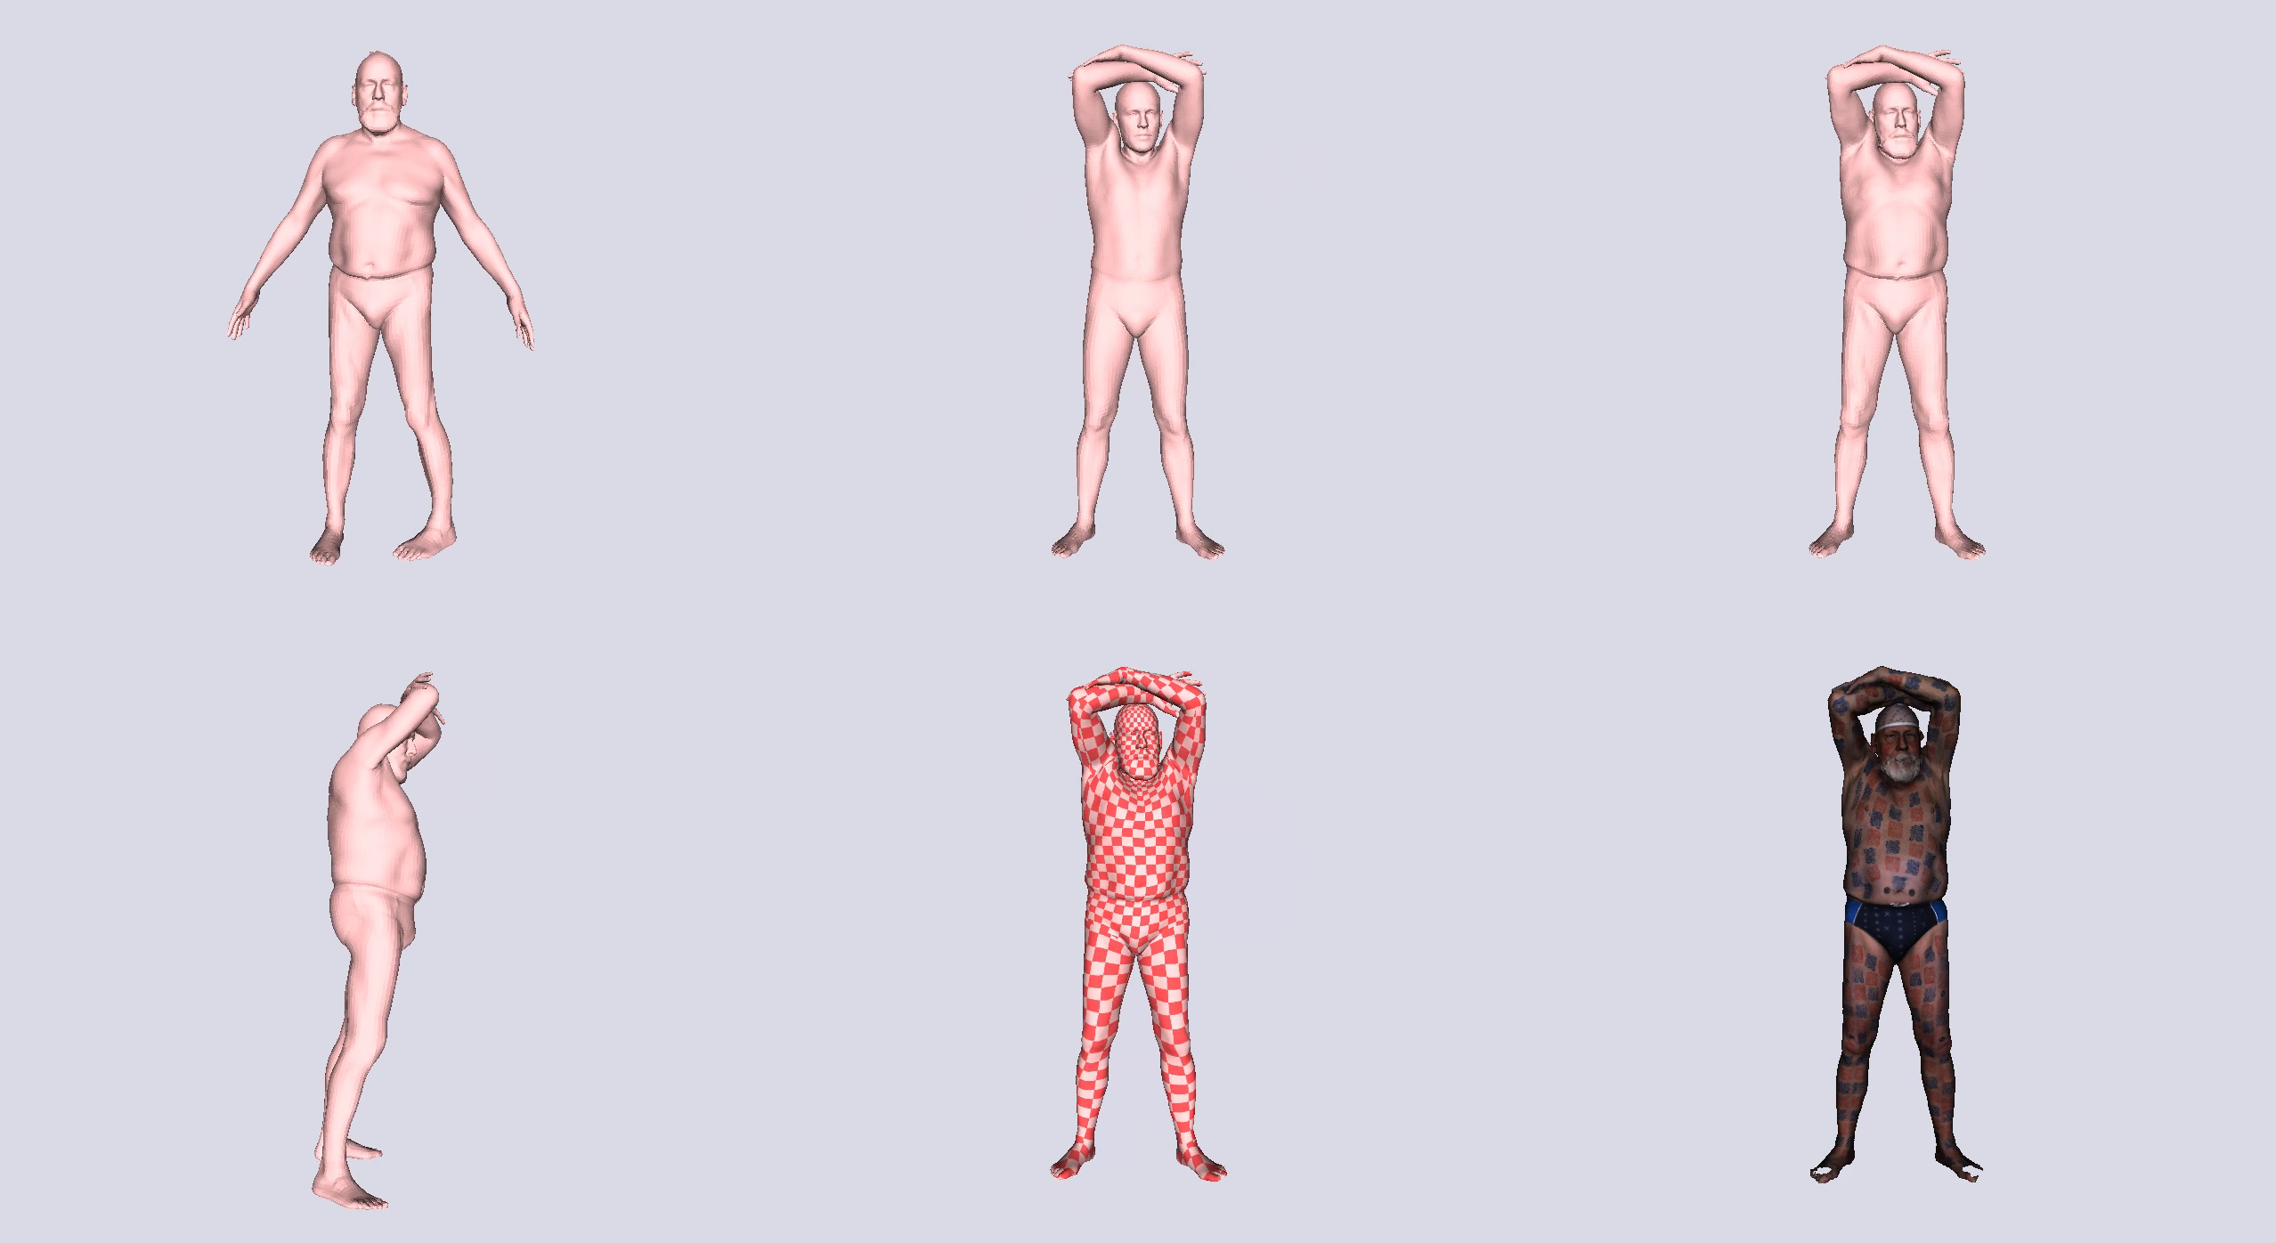
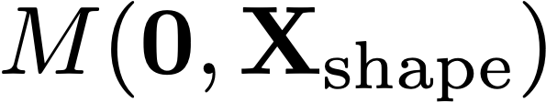
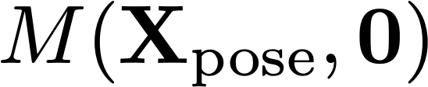
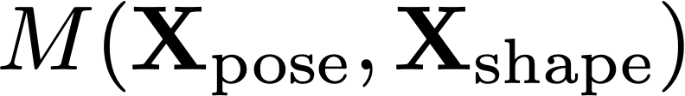
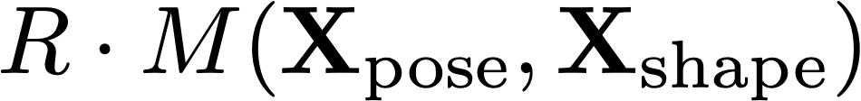


Goal: learn a model of pose and shape

Slide 3
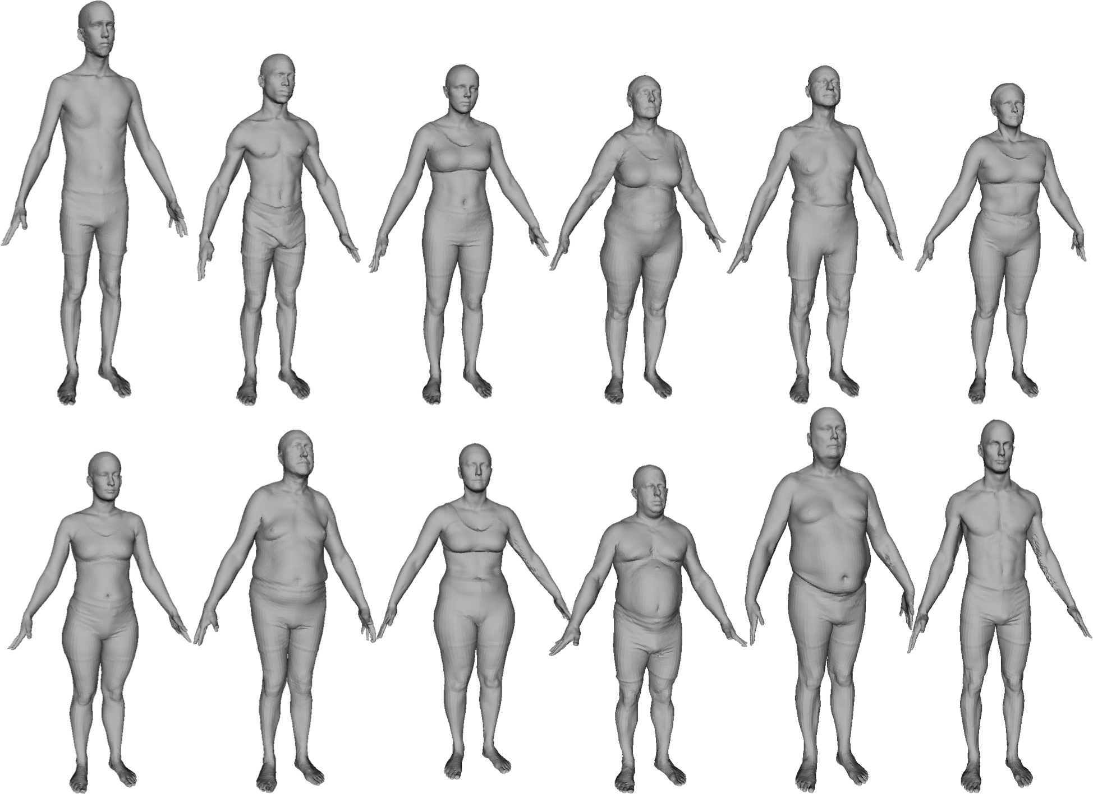
Scan a Lot of People
Notes:
The key idea is to scan lots of people

Slide 4
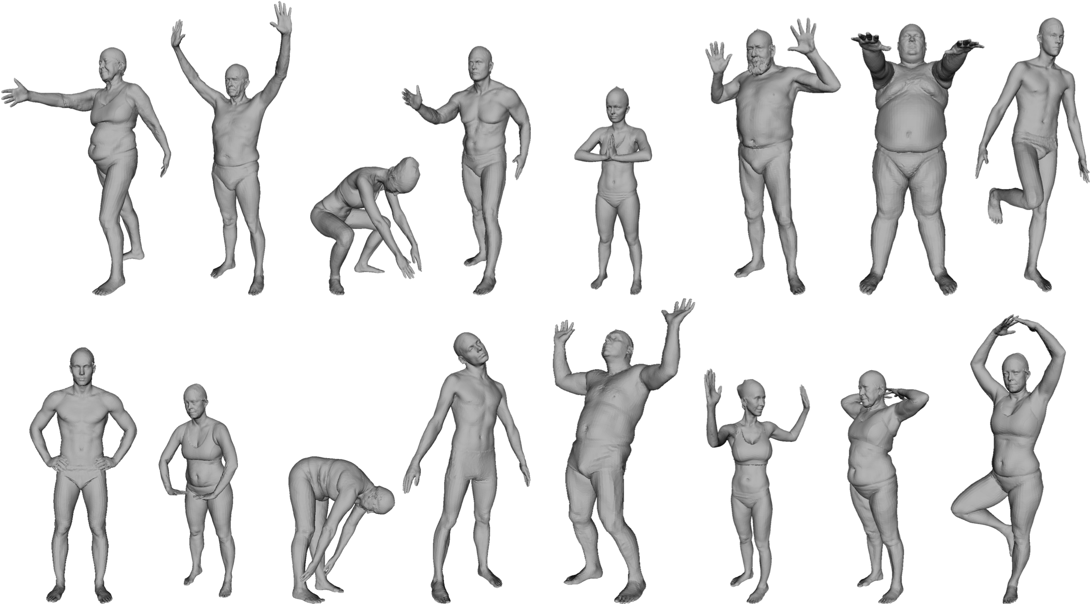
In lots of poses
Notes:
Idea scan lots of people

Slide 5
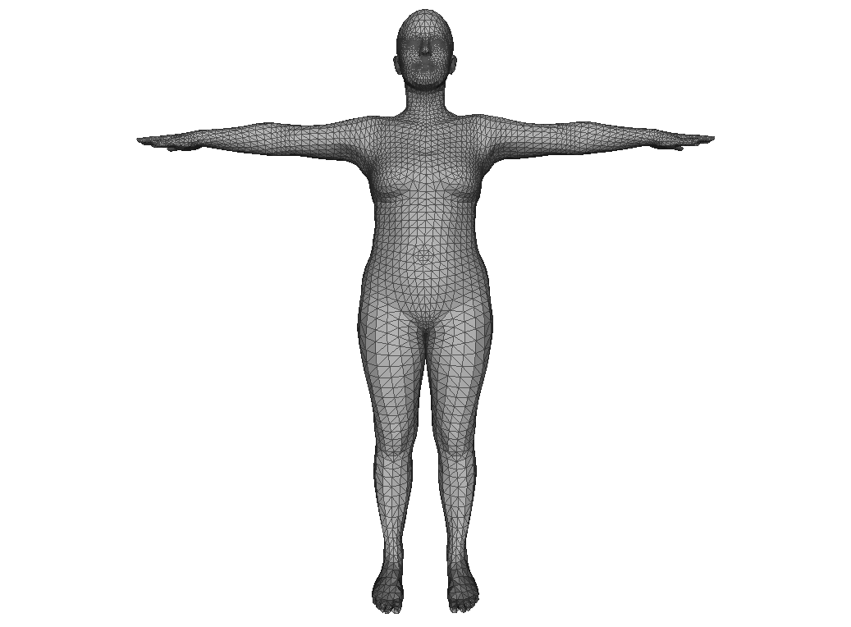
To learn a model we need correspondence
Notes:
And bring them into correspondence

Slide 6
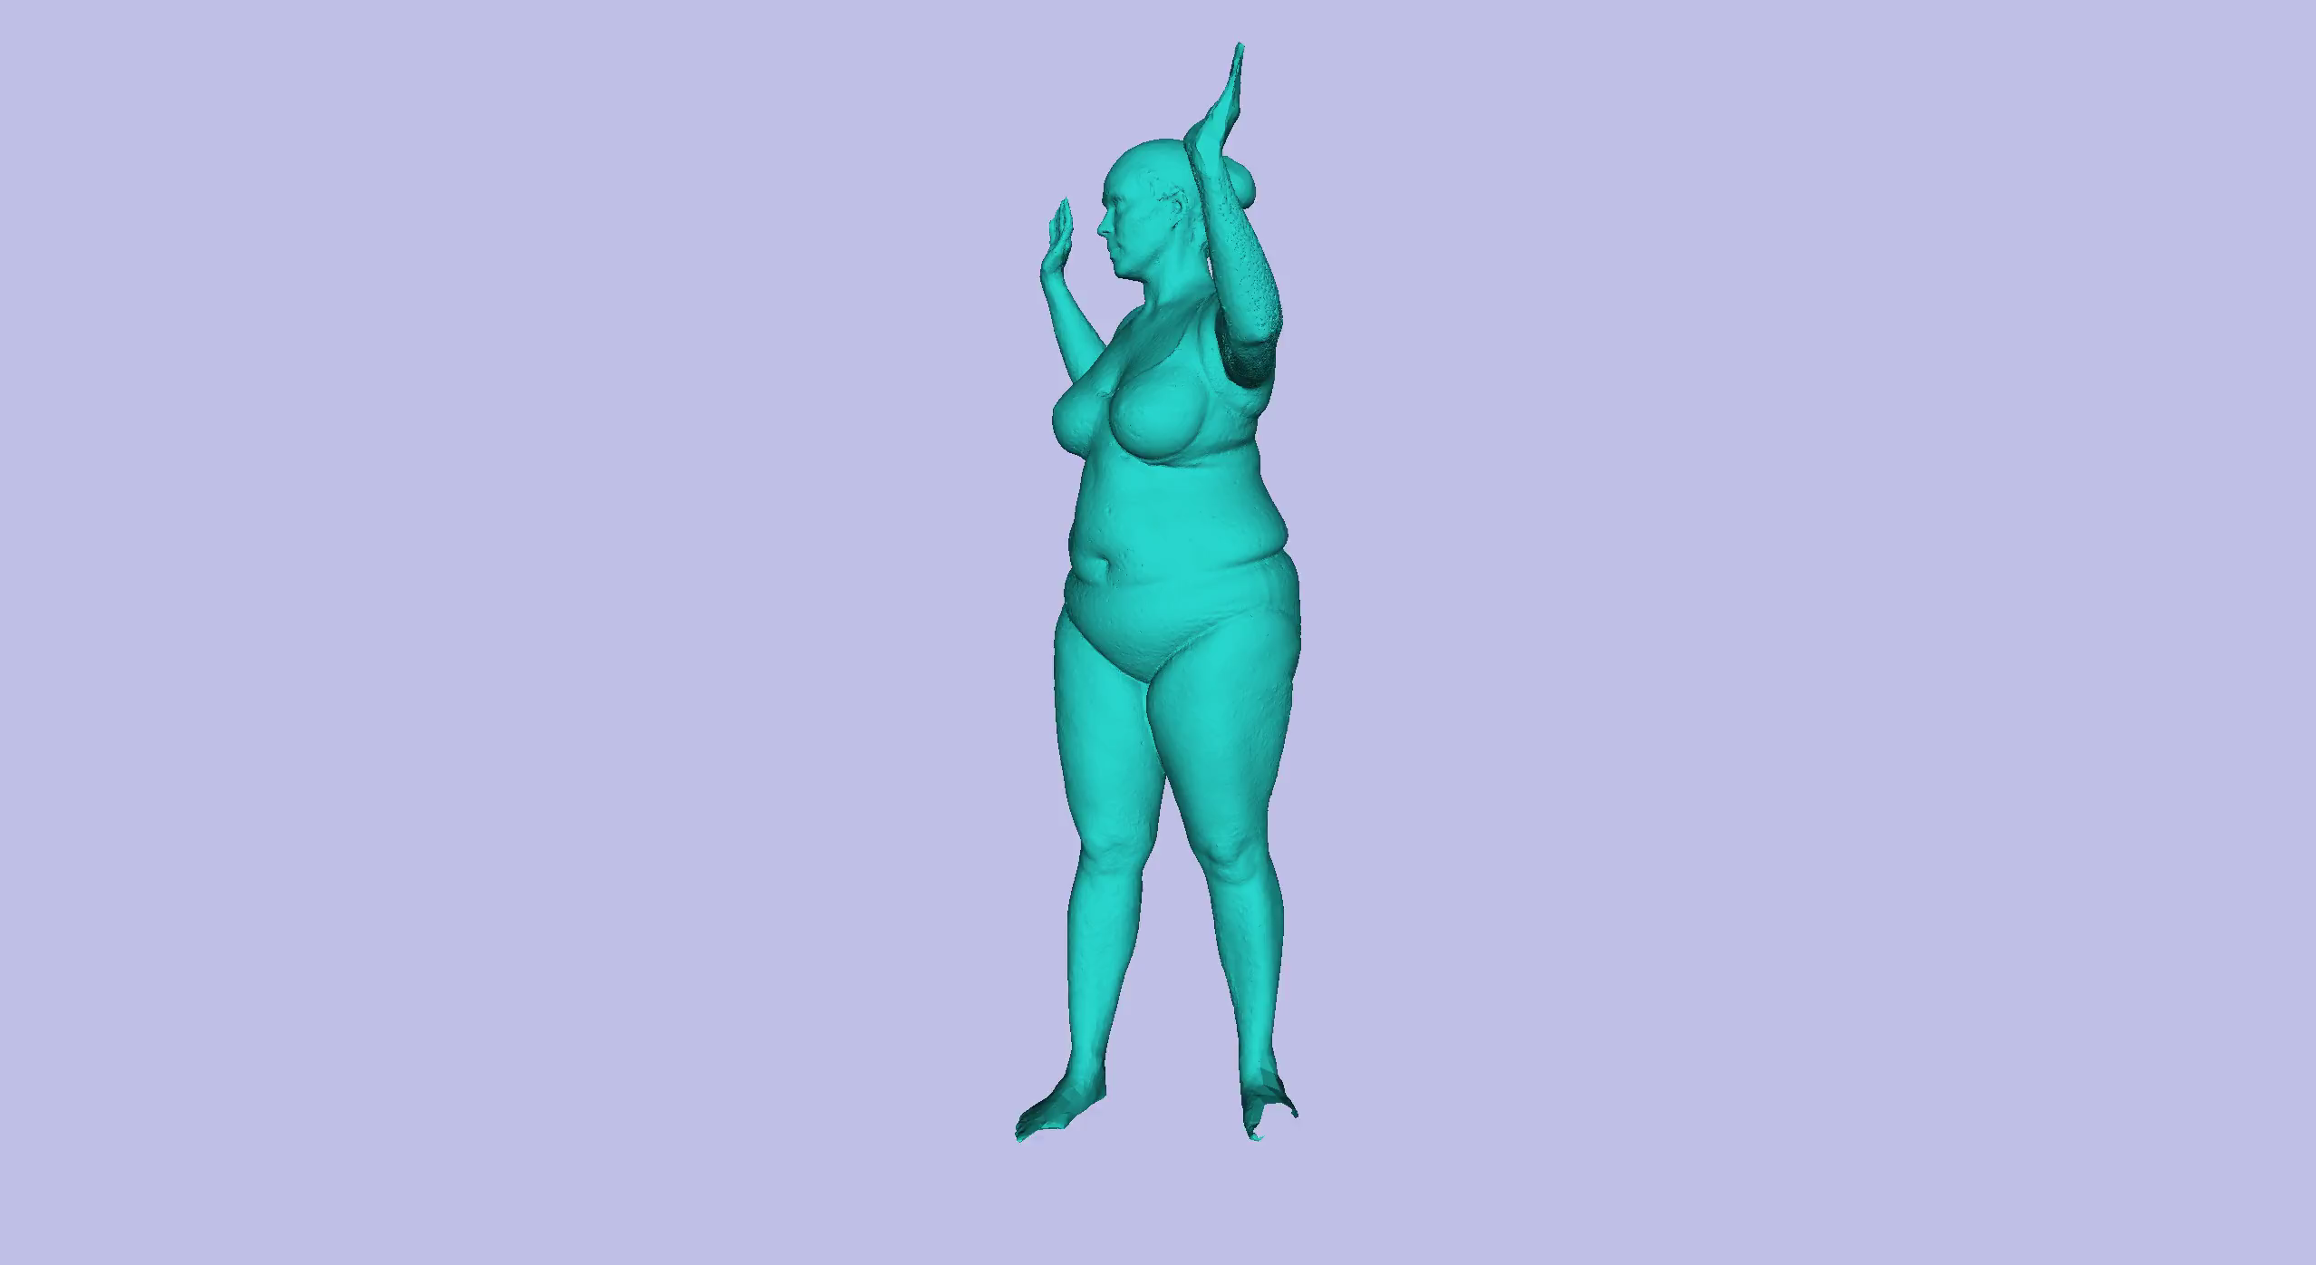
Non-rigid Articulated Registration
How?
Notes:
We need non-rigid articulated registration

Slide 7
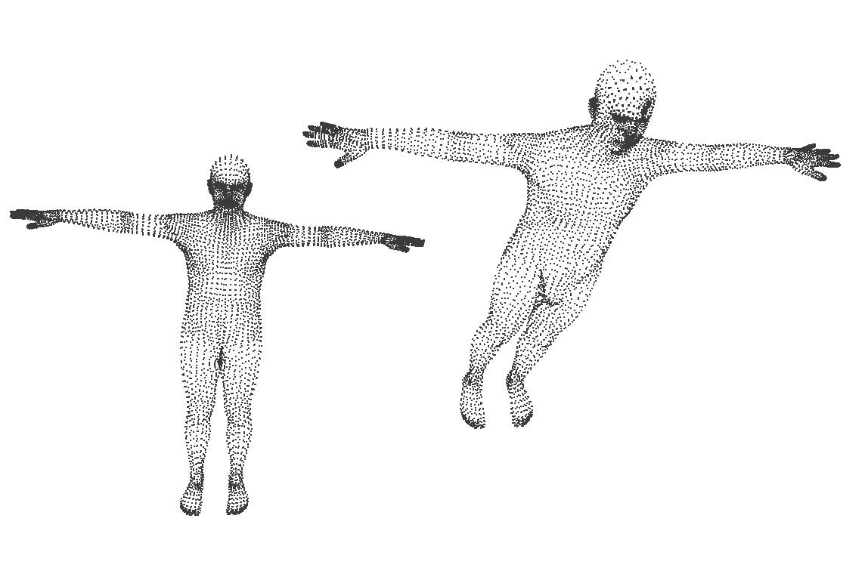


Today: Rigid Alignment (Procrustes)
?
Notes:
Topic of today. Rigid alignment.
\underset{S}{\text{arg min}} || (s\mathbf{R} \cdot \mathbf{X}^T + \mathbf{t}) - \mathbf{X}^{'T}||

Slide 8
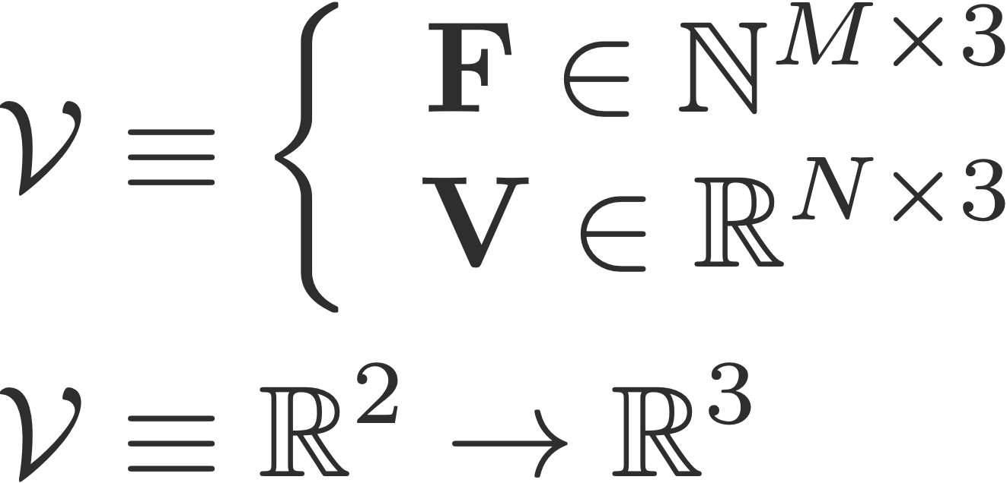
Surface representation: Mesh
Notes:
and their corresponding N vertices V define a triangulated mesh, which is a piecewise-linear 2D surface embedded in 3D. We denote those 2D spaces embedded in 3D with calligraphic notation

Slide 9
Surface representation: Mesh
Notes:
A set of M triangles F
\mathcal{V} &\equiv \left\{
\begin{array}{rl}
\mathbf{F} \in \mathbb{N}^{M\times3} \\
\mathbf{V} \in \mathbb{R}^{N\times3}
\end{array} \right. \\
\mathcal{V} &\equiv \mathbb{R}^2 \rightarrow \mathbb{R}^3

Slide 10
Surface representation: Mesh
How can we rigidly transform a set of points ?
Translate it
Rotate it
Today we’ll consider also
Scale it
Notes:
\mathbf{X}{'} = \mathbf{X} + \mathbf{t}, \mathbf{t} \in \mathbb{R}^3
{\mathbf{X}'}^{T} = \mathbf{R} \cdot \mathbf{X}^T , \mathbf{R} \in \mathbf{SO}(3)
{\mathbf{X}'} = s \mathbf{X} , s \in \mathbb{R}

Slide 11
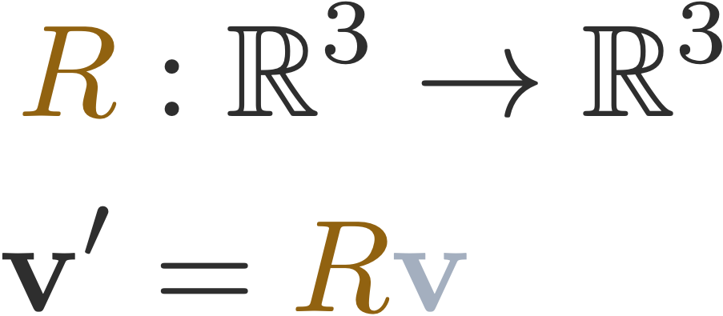
Rigid transformation + scale
Notes:
Algebraically, rotations can be represented by a 3x3 matrix. A column vector v gets pre-multiplied by the rotation matrix R to obtain the rotated point v’ as a column vector. This representation of rotations requires 9 numbers, although there are only 3 degrees of freedom.

Slide 12
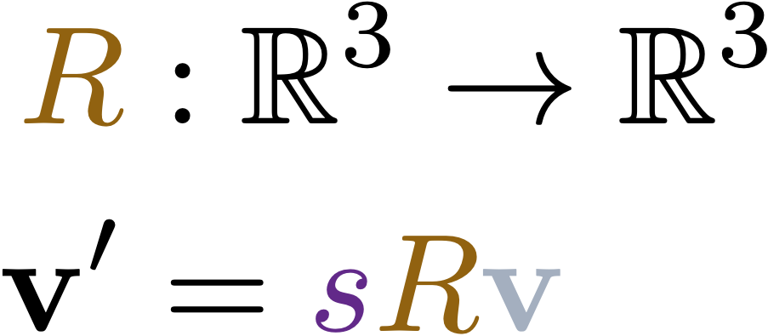

Rigid transformation + scale
Notes:
Algebraically, rotations can be represented by a 3x3 matrix. A column vector v gets pre-multiplied by the rotation matrix R to obtain the rotated point v’ as a column vector. This representation of rotations requires 9 numbers, although there are only 3 degrees of freedom.
{\color[rgb]{0.568627,0.384314,0.062745} R }&: \mathbb{R}^3 \rightarrow \mathbb{R}^3\\
\mathbf{v}' &= {\color[rgb]{0.568627,0.384314,0.062745} R }{\color[rgb]{0.643137,0.686275,0.749020} \mathbf{v}} \\
{\color[rgb]{0.568627,0.384314,0.062745} R }& \equiv \left[ \mathbf{r}_x~\mathbf{r}_y~\mathbf{r}_z\right]

Slide 13
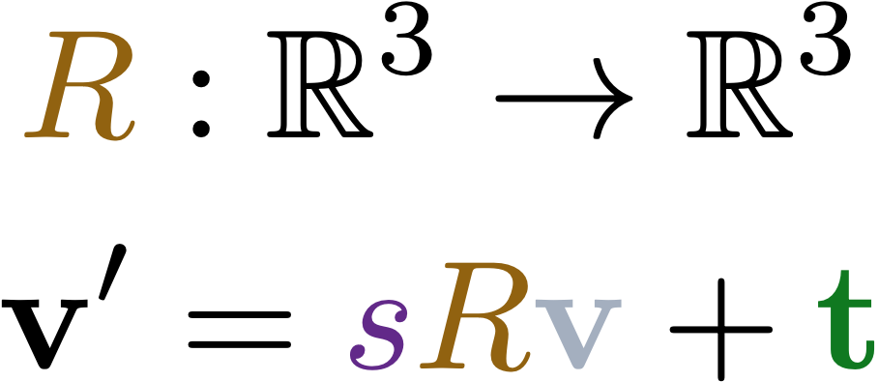
Rigid transformation + scale
Notes:
Algebraically, rotations can be represented by a 3x3 matrix. A column vector v gets pre-multiplied by the rotation matrix R to obtain the rotated point v’ as a column vector. This representation of rotations requires 9 numbers, although there are only 3 degrees of freedom.
{\color[rgb]{0.568627,0.384314,0.062745} R }&: \mathbb{R}^3 \rightarrow \mathbb{R}^3\\
\mathbf{v}' &= {\color[rgb]{0.568627,0.384314,0.062745} R }{\color[rgb]{0.643137,0.686275,0.749020} \mathbf{v}} \\
{\color[rgb]{0.568627,0.384314,0.062745} R }& \equiv \left[ \mathbf{r}_x~\mathbf{r}_y~\mathbf{r}_z\right]

Slide 14
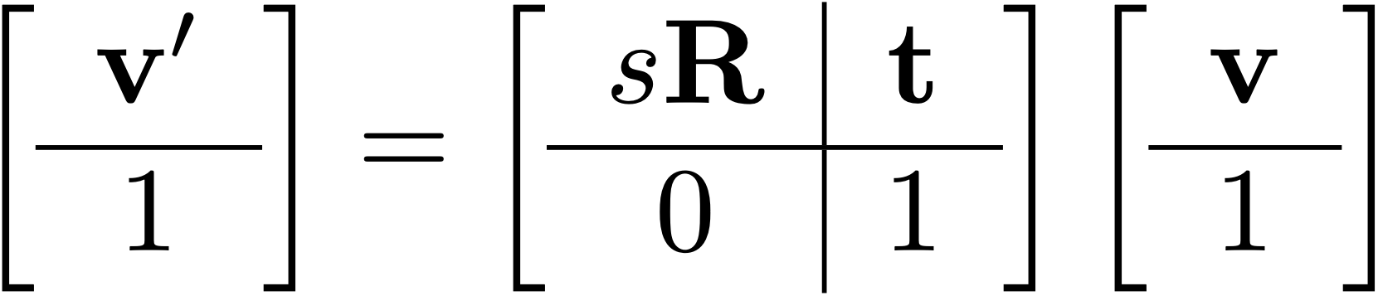
Rigid transformation + scale
Notes:
Algebraically, rotations can be represented by a 3x3 matrix. A column vector v gets pre-multiplied by the rotation matrix R to obtain the rotated point v’ as a column vector. This representation of rotations requires 9 numbers, although there are only 3 degrees of freedom.
{\color[rgb]{0.568627,0.384314,0.062745} R }&: \mathbb{R}^3 \rightarrow \mathbb{R}^3\\
\mathbf{v}' &= {\color[rgb]{0.568627,0.384314,0.062745} R }{\color[rgb]{0.643137,0.686275,0.749020} \mathbf{v}} \\
{\color[rgb]{0.568627,0.384314,0.062745} R }& \equiv \left[ \mathbf{r}_x~\mathbf{r}_y~\mathbf{r}_z\right]

Slide 15

Procrustes alignment problem definition
?

Slide 16
Procrustes alignment problem definition
Notes:
\mathbf{X}' = S(\mathbf{X}) = (s\mathbf{R} \cdot \mathbf{X}^T + \mathbf{t})^T

Slide 17
Procrustes alignment problem definition
?
Notes:
\arg \min_{s,\mathbf{R},\mathbf{t}} \| (s\mathbf{R}\mathbf{V}^T+\mathbf{t})-\mathbf{V}^{\prime T}\|^2_F

Slide 18
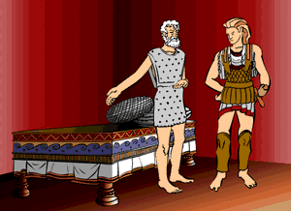
Why Procrustes?
The name Procrustes (Greek: Προκρούστης) refers to a bandit from Greek mythology who made his victims fit his bed either by stretching their limbs or cutting them off.
Prcrustes means “he who stretches”
Notes:
Procrustes, which means "he who stretches", offered hospitality to people who passed his home. He gave them a room and a nice bed to sleep in, and he explained to his guests that the bed had a unique quality, in which it would fit whoever laid on it perfectly. He neglected to explain, though, that the reason people fit the bed was due to the fact that he stretched out people who were too short for the bed, and he cut off limbs of people who were too tall for it.
Eventually, a hero in Greek mythology, Theseus, beat Procrustes by adjusting him to fit his own bed.

Slide 19
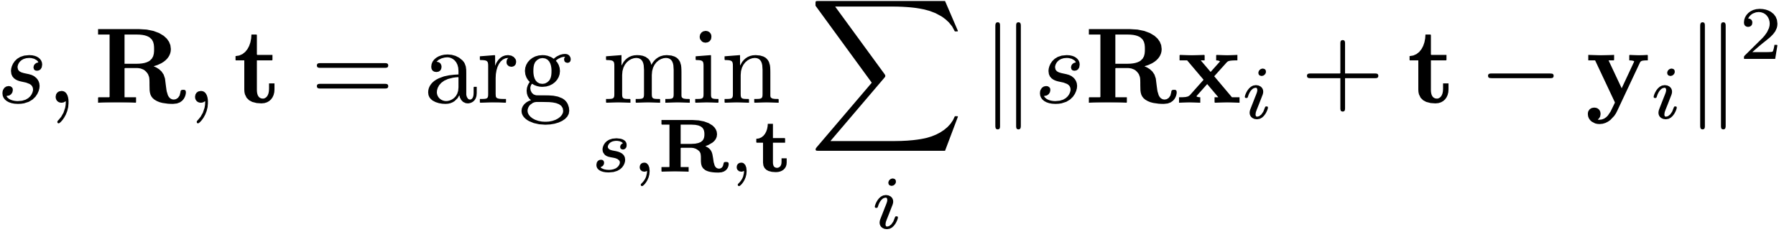
Optimisation Problem
Notes:
Ideas to solve the problem?
Is it linear, quadratic in the parameters?

Slide 20
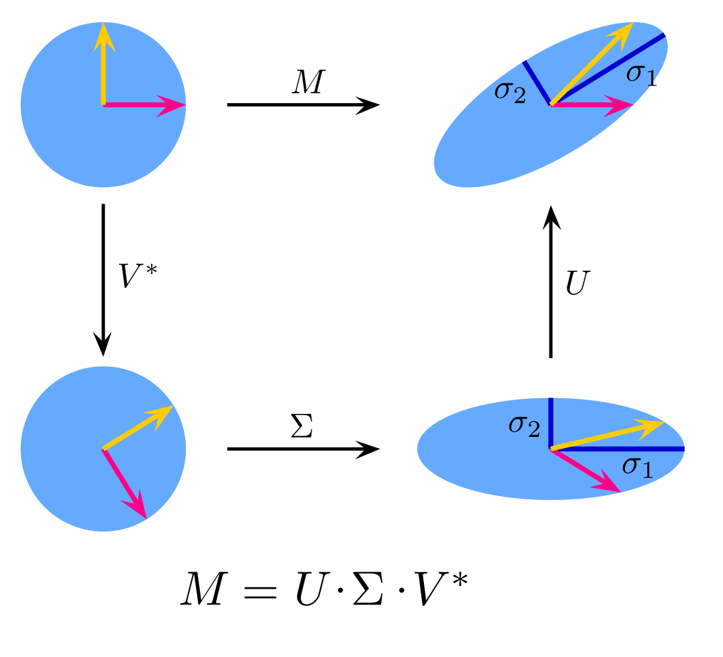

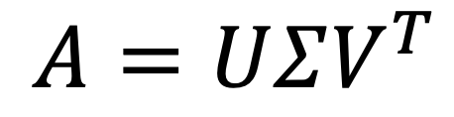
Quick recap of SVD
T
$$A=UΣV^{T}$$
Notes:
To understand how procrustes works, we need to understand what SVD does. I assume you are familiar with SVD, but here is a quick recap.
SVD states that every matrix, can be factorized into 3 matrices. Where V and U are orthogonal matrices and sigma is diagonal.
Geometrically it is telling us, a linear mapping can always be decomposed into a rotation, a scaling along principal axis by Sigma, followed by another rotation.

Slide 21
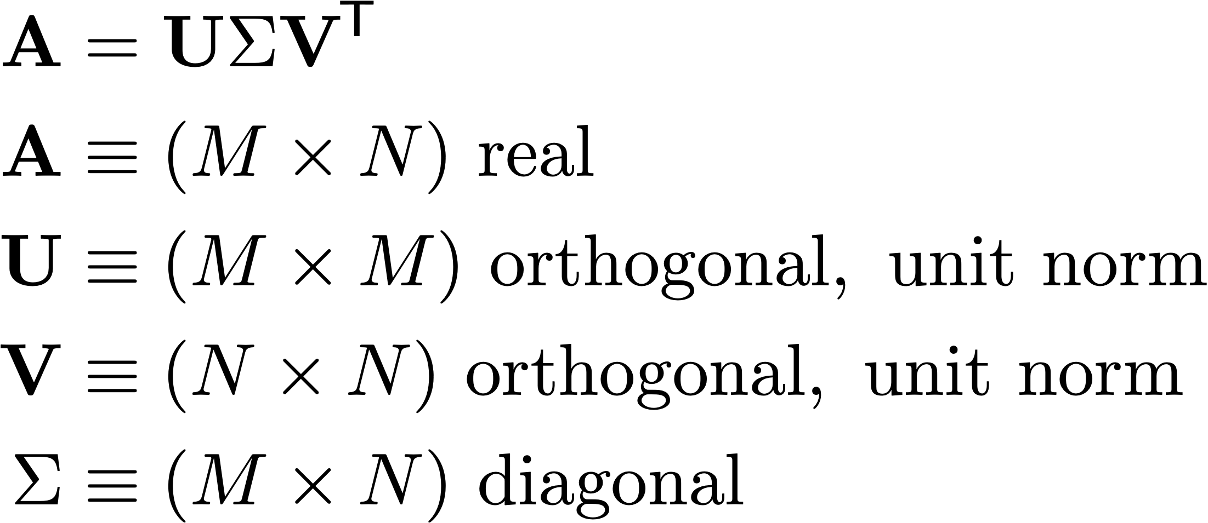
Quick recap of SVD
in general, applied to a real matrix:
warning: this is not the vertex matrix!
Notes:
\A &= \U\Sigma \V\tran \\
\A &\equiv (M \times N) \mathrm{\ real\ } \\
\U &\equiv (M\times M) \mathrm{\ orthogonal,\ unit\ norm} \\
\V &\equiv (N\times N) \mathrm{\ orthogonal,\ unit\ norm} \\
\Sigma &\equiv (M\times N) \mathrm{\ diagonal} \\

Slide 22
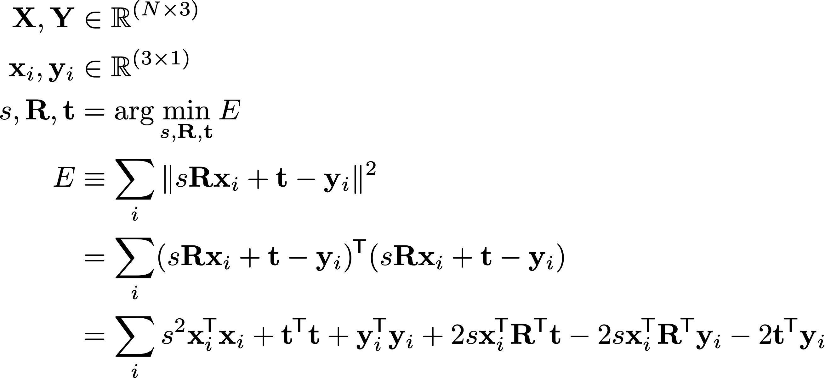
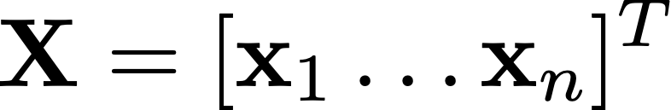
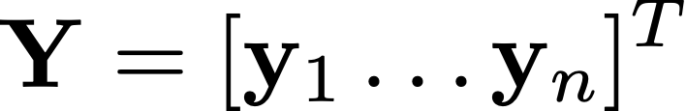


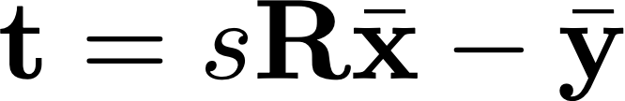

Procrustes alignment steps
* See also clarification slide 1 at the end of slide deck
Matrices of points
Optimal rotation obtained by computing SVD on the point cross-covariance
Translation is the centroid difference
Scale is a quotient of eigenvalue sums
Notes:
\mathbf{X}= [\mathbf{x}_1 \hdots \mathbf{x}_n]^T
\mathbf{Y}= [\mathbf{y}_1 \hdots \mathbf{y}_n]^T
\mathbf{R} = \mathbf{U}\mathbf{V}^T
\mathbf{t} = \sum \mathbf{R}\bar{\mathbf{x}} - \bar{\mathbf{y}}
\mathbf{t} = \sum \mathbf{R}\bar{\mathbf{x}} - \bar{\mathbf{y}}
\bar{\mathbf{X}}^T\bar{\mathbf{Y}} = \mathbf{U}\Sigma\mathbf{V}^T
\mathbf{s} = \frac{\mathrm{tr}(\Sigma)}{\|\bar{\mathbf{X}}\|_F^2}
clarify what the \bar{X} is

Slide 23
Proof

Slide 24
Procrustes derivation: translation
Minimize the L2 distance between
transformed source points and target points

Slide 25
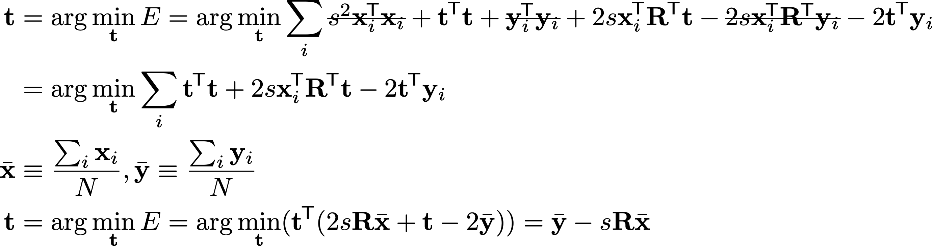
Procrustes derivation: translation
We remove the elements that do not depend on the translation and solve for t.
Compute the centroid of the point clouds
So given s and R, we can compute the translation t
Notes:
The summation is replaced by the centroids. The rotation and scale comes out of the summation.
Take derivative equate to zero and find result
\documentclass[10pt]{article}
\usepackage[usenames]{color} %used for font color
\usepackage{amssymb} %maths
\usepackage{amsmath} %maths
\usepackage[utf8]{inputenc} %useful to type directly diacritic characters
\newcommand*{\tran}{^{\mkern-1.5mu\mathsf{T}}}
\newcommand{\X}{\mathbf{X}}
\newcommand{\mX}{\bar{\mathbf{X}}}
\newcommand{\x}{\mathbf{x}_i}
\newcommand{\mx}{\bar{\mathbf{x}}}
\newcommand{\mxi}{\bar{\mathbf{x}_i}}
\newcommand{\Y}{\mathbf{Y}}
\newcommand{\mY}{\bar{\mathbf{Y}}}
\newcommand{\y}{\mathbf{y}_i}
\newcommand{\my}{\bar{\mathbf{y}}}
\newcommand{\myi}{\bar{\mathbf{y}_i}}
\newcommand{\U}{\mathbf{U}}
\newcommand{\V}{\mathbf{V}}
\newcommand{\R}{\mathbf{R}}
\newcommand{\A}{\mathbf{A}}
\newcommand{\trans}{\mathbf{t}}
\usepackage[normalem]{ulem}
\usepackage{amsmath}
\newcommand{\stkout}[1]{\ifmmode\text{\sout{\ensuremath{#1}}}\else\sout{#1}\fi}
%%%%%%%%%%%%%%%%%%%%%%%%%%%
\X, \Y &\in \mathbb{R}^{(N\times 3)} \\
\x, \y &\in \mathbb{R}^{(3\times 1)} \\
%\mu_\X &= \mathop{}\mathbb{E}(\X), \mu_\Y = \mathop{}\mathbb{E}(\Y) \\
%\bar{\X} &= \X - \mu_\X, \bar{\Y} = \Y - \mu_\Y \\
%\tilde{\X} &= \frac{\bar{\X}}{\|\bar{\X}\|}, \tilde{\Y} = \frac{\bar{\Y}}{\|\bar{\Y}\|} \\
%\A &= \tilde{\X}\tran \tilde{\Y} \\
%\A &= \U \Sigma \V\tran \\
%\R &= \V\U\tran \\
%s &= \mathrm{tr}(\Sigma) \frac{\|\bar{\X}\|}{\|\bar{\Y}\|} \\
%\trans &= \mu\X - s(\mu\Y \cdot \R)
{s, \R, \trans} &= \arg\min_{s, \R, \trans} E \\
E &\equiv \sum_i \| s \R \x + \trans - \y \|^2 \\
&= \sum_i (s \R \x + \trans - \y)\tran (s \R \x + \trans - \y) \\
&= \sum_i s^2 \x\tran \x + \trans\tran \trans + \y\tran \y + 2s\x\tran \R\tran \trans - 2s\x\tran\R\tran \y -2\trans \tran \y \\
{\trans} &= \arg\min_{\trans} E = \arg\min_{\trans}\sum_i \stkout{s^2 \x\tran \x} + \trans\tran \trans + \stkout{\y\tran \y} + 2s\x\tran \R\tran \trans - \stkout{2s\x\tran\R\tran \y} -2\trans \tran \y \\
&= \arg\min_{\trans}\sum_i \trans\tran \trans + 2s\x\tran \R\tran \trans -2\trans \tran \y \\
\mx &\equiv \frac{\sum_i \x}{N}, \my \equiv \frac{\sum_i \y}{N} \\
{\trans} &= \arg\min_{\trans} E = \arg\min_{\trans}(\trans\tran (2s\R \mx + \trans - 2\my)) = \my - s \R \mx \\
\mxi &\equiv \x - \mx, \myi \equiv \y - \my \\
E &= \sum_i \| s \R \x + \trans - \y \|^2 = \sum_i \| s \R \mxi - \myi \|^2 = \sum_i s^2 \mxi\tran \mxi + \myi\tran \myi - 2s\mxi\tran\R\tran \myi \\
\A &\equiv \mX\tran \mY = \sum_i \mx\my\tran\\
{\R} &= \arg\min_{\R} E = \arg\min_{\R}(\sum_i \stkout{s^2 \mxi\tran \mxi + \myi\tran \myi} - 2s\mxi\tran\R\tran \myi)\\
&= \arg\max_{\R}(\sum_i \mxi\tran\R\tran \myi) = \arg\max_{\R}(\sum_i \mathrm{tr}(\mxi\myi\tran \R)) = \mathrm{tr}(\A \R) \\
\A &= \U\Sigma\V\tran \mathrm{,\ through\ SVD}\\
\R &= \V\U\tran \mathrm{\ because\ } \\
\A\R &= (\U\Sigma\V\tran)(\V\U\tran) = \U\Sigma\U\tran \mathrm{\ symmetric\ positive\ semidefinite,\ so\ } \R \mathrm{\ maximizes\ } \mathrm{tr}(\A\R) \\
s &= \arg\min_{s} E = \arg\min_{s}(\sum_i s^2 \mxi\tran \mxi + \stkout{\myi\tran \myi} - 2s\mxi\tran\R\tran \myi) \\
&= \arg\min_{s}(s^2 \sum_i(\mxi\tran \mxi) -2s \sum_i(\mxi\tran\R\tran \myi)) \\
&= \arg\min_s(s^2a -2sb) = \frac{b}{a} = \frac{\mxi\tran\R\tran \myi}{\mxi\tran \mxi} \\
&= \frac{\mathrm{tr}(\A\R)}{\|\X\|^2} = \frac{\mathrm{tr}(\Sigma)}{\|\X\|^2}

Slide 26

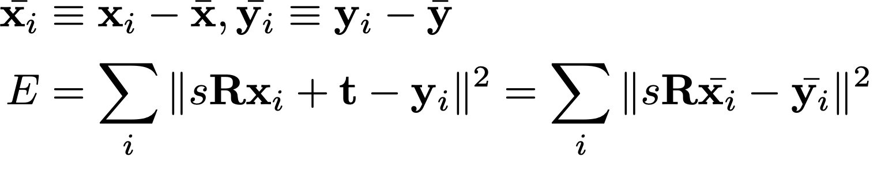
Procrustes derivation: Rotation
Subtract the centroid from the points to obtain a simpler expression for E
Optimal rotation does not depend on scale
Notes:
Let’s look at the rotation part
\mathbf{R} &= \arg\min_\mathbf{R} ||\mathbf{R} \bar{\mathbf{X}}^T-\bar{\mathbf{Y}}^T\|_F^2 \\
&= \arg\min_\mathbf{R} \langle \mathbf{R} \bar{\mathbf{X}}^T-\bar{\mathbf{Y}}^T, \mathbf{R} \bar{\mathbf{X}}^T-\bar{\mathbf{Y}}^T \rangle_F \\
&= \arg\min_\mathbf{R} \|\mathbf{R} \bar{\mathbf{X}}^T\|_F^2 + \|\bar{\mathbf{Y}}^T\|_F^2 - 2 \langle \mathbf{R} \bar{\mathbf{X}}^T , \bar{\mathbf{Y}}^T \rangle_F \\
&= \arg\min_\mathbf{R} \|\bar{\mathbf{X}}^T\|_F^2 + \|\bar{\mathbf{Y}}^T\|_F^2 - 2 \langle \mathbf{R} \bar{\mathbf{X}}^T , \bar{\mathbf{Y}}^T \rangle_F \\
&= \arg\max_\mathbf{R} \langle \mathbf{R} , \bar{\mathbf{Y}}^T \bar{\mathbf{X}} \rangle_F \\
&= \arg\max_\mathbf{R} \langle \mathbf{R}, U\Sigma V^T \rangle_F \\
&= \arg\max_\mathbf{R} \langle U^T \mathbf{R} V , \Sigma \rangle_F \\
&= \arg\max_\mathbf{R} \langle S , \Sigma \rangle_F \quad \text{where } S = U^T \mathbf{R} V \\

Slide 27
Procrustes derivation: Rotation
Subtract the centroid from the points to obtain a simpler expression for E
Optimal rotation does not depend on scale
Rotation does not change norm!
Inner product should be maximum!

Slide 28
Procrustes derivation: Rotation
Subtract the centroid from the points to obtain a simpler expression for E
Optimal rotation does not depend on scale
Rotation does not change norm!
Inner product should be maximum!
Cross-covariance matrix
SVD decomposition
Notes:
\mathbf{R} &= \arg\min_\mathbf{R} ||\mathbf{R} \bar{\mathbf{X}}^T-\bar{\mathbf{Y}}^T\|_F^2 \\
&= \arg\min_\mathbf{R} \langle \mathbf{R} \bar{\mathbf{X}}^T-\bar{\mathbf{Y}}^T, \mathbf{R} \bar{\mathbf{X}}^T-\bar{\mathbf{Y}}^T \rangle_F \\
&= \arg\min_\mathbf{R} \|\mathbf{R} \bar{\mathbf{X}}^T\|_F^2 + \|\bar{\mathbf{Y}}^T\|_F^2 - 2 \langle \mathbf{R} \bar{\mathbf{X}}^T , \bar{\mathbf{Y}}^T \rangle_F \\
&= \arg\min_\mathbf{R} \|\bar{\mathbf{X}}^T\|_F^2 + \|\bar{\mathbf{Y}}^T\|_F^2 - 2 \langle \mathbf{R} \bar{\mathbf{X}}^T , \bar{\mathbf{Y}}^T \rangle_F \\
&= \arg\max_\mathbf{R} \langle \mathbf{R} , \bar{\mathbf{Y}}^T \bar{\mathbf{X}} \rangle_F \\
&= \arg\max_\mathbf{R} \langle \mathbf{R}, U\Sigma V^T \rangle_F \\
&= \arg\max_\mathbf{R} \langle U^T \mathbf{R} V , \Sigma \rangle_F \\
&= \arg\max_\mathbf{R} \langle S , \Sigma \rangle_F \quad \text{where } S = U^T \mathbf{R} V \\

Slide 29
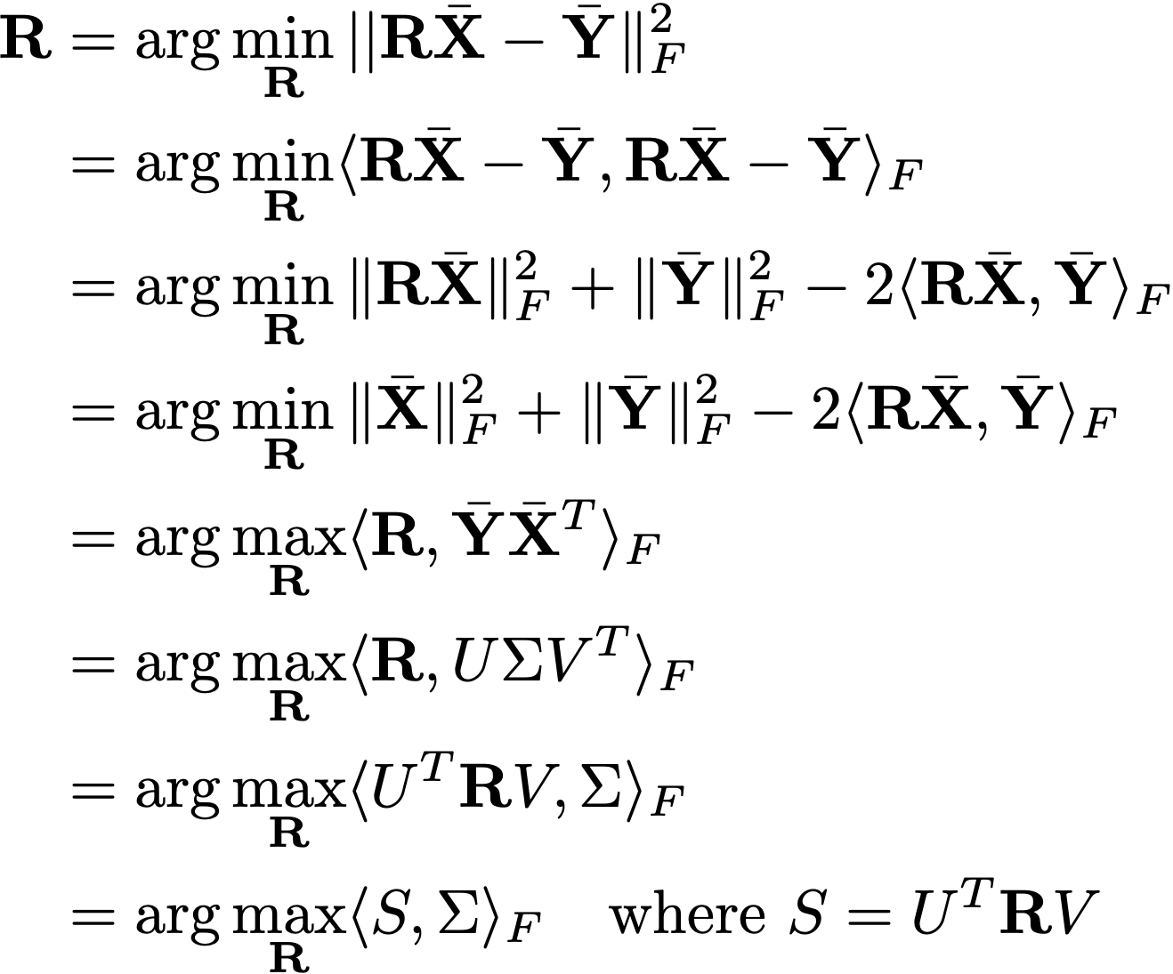


Procrustes derivation: Rotation
What kind of matrix is ?
Orthogonal
What kind of matrix is ?
Diagonal
Notes:
\mathbf{R} &= \arg\min_\mathbf{R} ||\mathbf{R} \bar{\mathbf{X}}-\bar{\mathbf{Y}}\|_F^2 \\
&= \arg\min_\mathbf{R} \langle \mathbf{R} \bar{\mathbf{X}}-\bar{\mathbf{Y}}, \mathbf{R} \bar{\mathbf{X}}-\bar{\mathbf{Y}} \rangle_F \\
&= \arg\min_\mathbf{R} \|\mathbf{R} \bar{\mathbf{X}}\|_F^2 + \|\bar{\mathbf{Y}}\|_F^2 - 2 \langle \mathbf{R} \bar{\mathbf{X}} , \bar{\mathbf{Y}} \rangle_F \\
&= \arg\min_\mathbf{R} \|\bar{\mathbf{X}}\|_F^2 + \|\bar{\mathbf{Y}}\|_F^2 - 2 \langle \mathbf{R} \bar{\mathbf{X}} , \bar{\mathbf{Y}} \rangle_F \\
&= \arg\max_\mathbf{R} \langle \mathbf{R} , \bar{\mathbf{Y}} \bar{\mathbf{X}}^T \rangle_F \\
&= \arg\max_\mathbf{R} \langle \mathbf{R}, U\Sigma V^T \rangle_F \\
&= \arg\max_\mathbf{R} \langle U^T \mathbf{R} V , \Sigma \rangle_F \\
&= \arg\max_\mathbf{R} \langle S , \Sigma \rangle_F \quad \text{where } S = U^T \mathbf{R} V \\

Slide 30
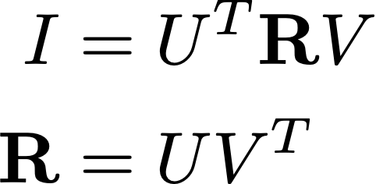
Procrustes derivation: Rotation
What kind of matrix is ?
Orthogonal
What kind of matrix is ?
Diagonal
Hence the quantity above is maximised when equals the identity, hence:
SVD of cross-covariance of pointsclouds
Notes:
\mathbf{R} &= \arg\min_\mathbf{R} ||\mathbf{R} \bar{\mathbf{X}}-\bar{\mathbf{Y}}\|_F^2 \\
&= \arg\min_\mathbf{R} \langle \mathbf{R} \bar{\mathbf{X}}-\bar{\mathbf{Y}}, \mathbf{R} \bar{\mathbf{X}}-\bar{\mathbf{Y}} \rangle_F \\
&= \arg\min_\mathbf{R} \|\mathbf{R} \bar{\mathbf{X}}\|_F^2 + \|\bar{\mathbf{Y}}\|_F^2 - 2 \langle \mathbf{R} \bar{\mathbf{X}} , \bar{\mathbf{Y}} \rangle_F \\
&= \arg\min_\mathbf{R} \|\bar{\mathbf{X}}\|_F^2 + \|\bar{\mathbf{Y}}\|_F^2 - 2 \langle \mathbf{R} \bar{\mathbf{X}} , \bar{\mathbf{Y}} \rangle_F \\
&= \arg\max_\mathbf{R} \langle \mathbf{R} , \bar{\mathbf{Y}} \bar{\mathbf{X}}^T \rangle_F \\
&= \arg\max_\mathbf{R} \langle \mathbf{R}, U\Sigma V^T \rangle_F \\
&= \arg\max_\mathbf{R} \langle U^T \mathbf{R} V , \Sigma \rangle_F \\
&= \arg\max_\mathbf{R} \langle S , \Sigma \rangle_F \quad \text{where } S = U^T \mathbf{R} V \\
\bar{\mathbf {Y}}^T\mathbf{X} = \mathbf{{U}}\Sigma\mathbf{{V}}^T

Slide 31
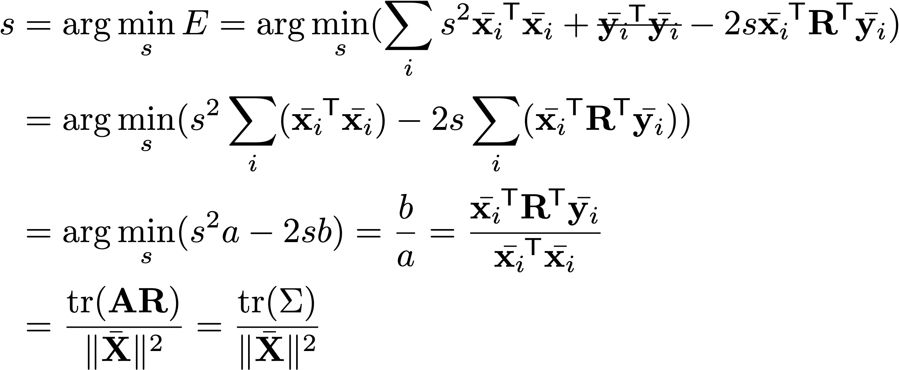
Procrustes derivation: scale
Optimize scale given the rotation
We used:
Trace invariance with shifts
Trace equals sum of eigenvals for square matrices
Notes:
Correction: summation missing
Theorem 1: The trace of a square matrix is smaller than the sum of its eigenvalues, equal if an only if the matrix is symmetric and positive semi-definite
Theorem 2: For a square matrix $\mathbf{B}$, there is an orthogonal matrix $\mathbf{C}$ such that $\mathbf{B}\mathbf{C}$ is symmetric and positive semi-definite. If $\mathbf{D}$ is any other orthogonal matrix, $\mathrm{tr}(\m
athbf{B}\mathbf{D}) \leq \mathrm{tr}(\mathbf{B}\mathbf{C})$, equal if and only if $\mathbf{B}\mathbf{D}$ is symmetric and positive semi-definite
change A by Sigma
\mathrm{tr}\{ \mathbf{X} \mathbf{R}^T \mathbf{Y} \}
=\frac{\mathrm{tr}(\bar{\mathbf{X}} \mathbf{R}^T \bar{\mathbf{Y}}^T)}{\|\bar{\mathbf{X}}\|_F^2} = \frac{\mathrm{tr}(\mathbf{R}^T\bar{\mathbf{Y}}^T\bar{\mathbf{X}})}{\| \bar{\mathbf{X}}\|_F^2}=\frac{\mathrm{tr}(\mathbf{V}\mathbf{U}^T\mathbf{U}\Sigma\mathbf{
V}^T)}{\| \bar{\mathbf{X}}\|_F^2}=\frac{\mathrm{tr}(\Sigma)}{\| \bar{\mathbf{X}}\|_F^2}
\bar{\mathbf{Y}}^T\bar{\mathbf{X}} = \mathbf{U} \Sigma \mathbf{V}^T, \, \mathbf{R} = \mathbf{U}\mathbf{V}^T

Slide 32
Clarification slides
(not included in the video recordings)
Notes:
\bar{\mathbf{X}}= [\mathbf{x}_1 -\bar{\mathbf{x}}, \hdots ,\mathbf{x}_n-\bar{\mathbf{x}}]^T
\bar{\mathbf{x}} = \frac{1}{N}\sum_i^N \mathbf{x}_i

Slide 33
Clarification slide 1 (not in the video)
Normalized pointcloud. The centroid is subtracted to all points to center the pointcloud at the origin
Centroid
Notes:
\bar{\mathbf{X}}= [\mathbf{x}_1 -\bar{\mathbf{x}}, \hdots ,\mathbf{x}_n-\bar{\mathbf{x}}]^T
\bar{\mathbf{x}} = \frac{1}{N}\sum_i^N \mathbf{x}_i

Slide 34
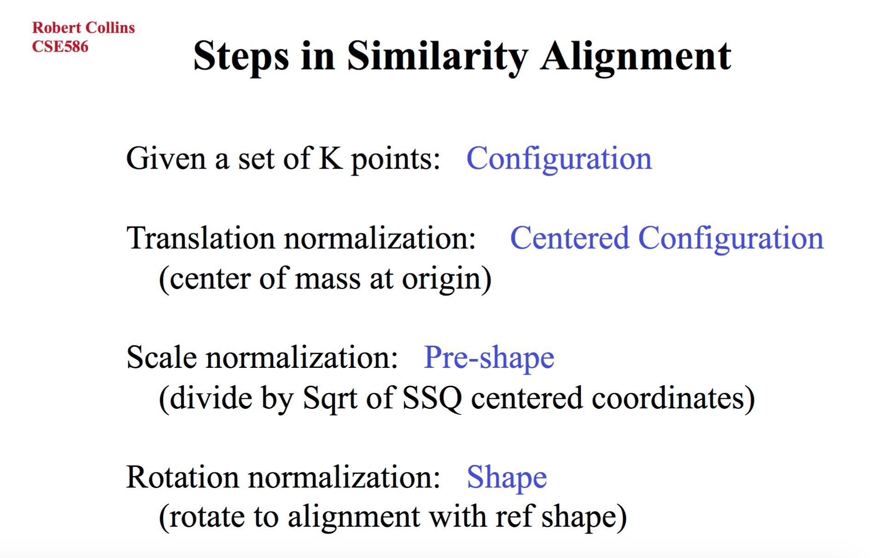
Notes:
Root mean square distance

Slide 35
Note: I will not expect you to be able to derive the procrustes algorithm, but it is good to look at the derivation to gain a deeper understanding of the method

Slide 36
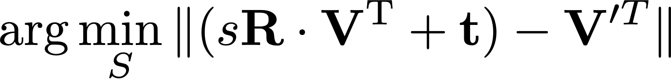
Today: Rigid Alignment (Procrustes)
?
Notes:
Topic of today. Rigid alignment.

Slide 37
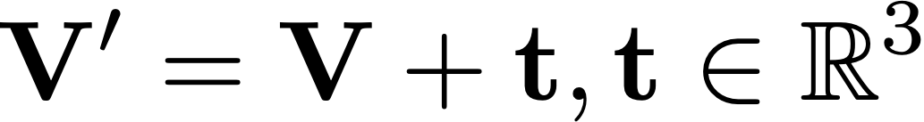
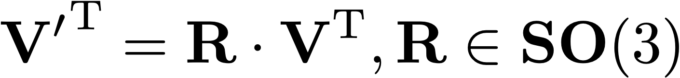
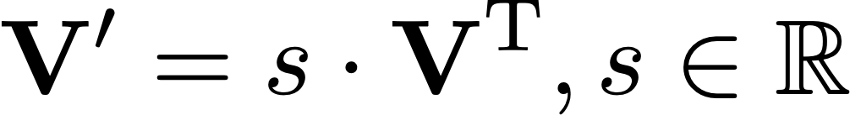
Surface representation: Mesh
How can we rigidly transform a set of points ?
Translate it
Rotate it
Today we’ll consider also
Scale it

