Slide 1

Hands-on AI based 3D Vision
Summer Semester 26
Lecture 10_0 – Diffusion Models
Prof. Dr.-Ing Gerard Pons-Moll
University of Tübingen / MPI-Informatics
Notes:
Intro

Slide 2
Motivations for Generative Models

Slide 3
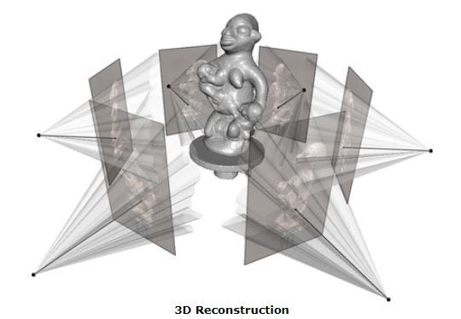
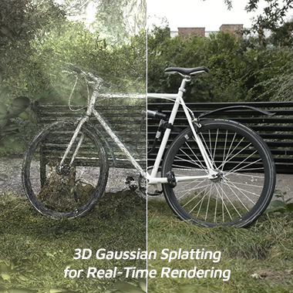
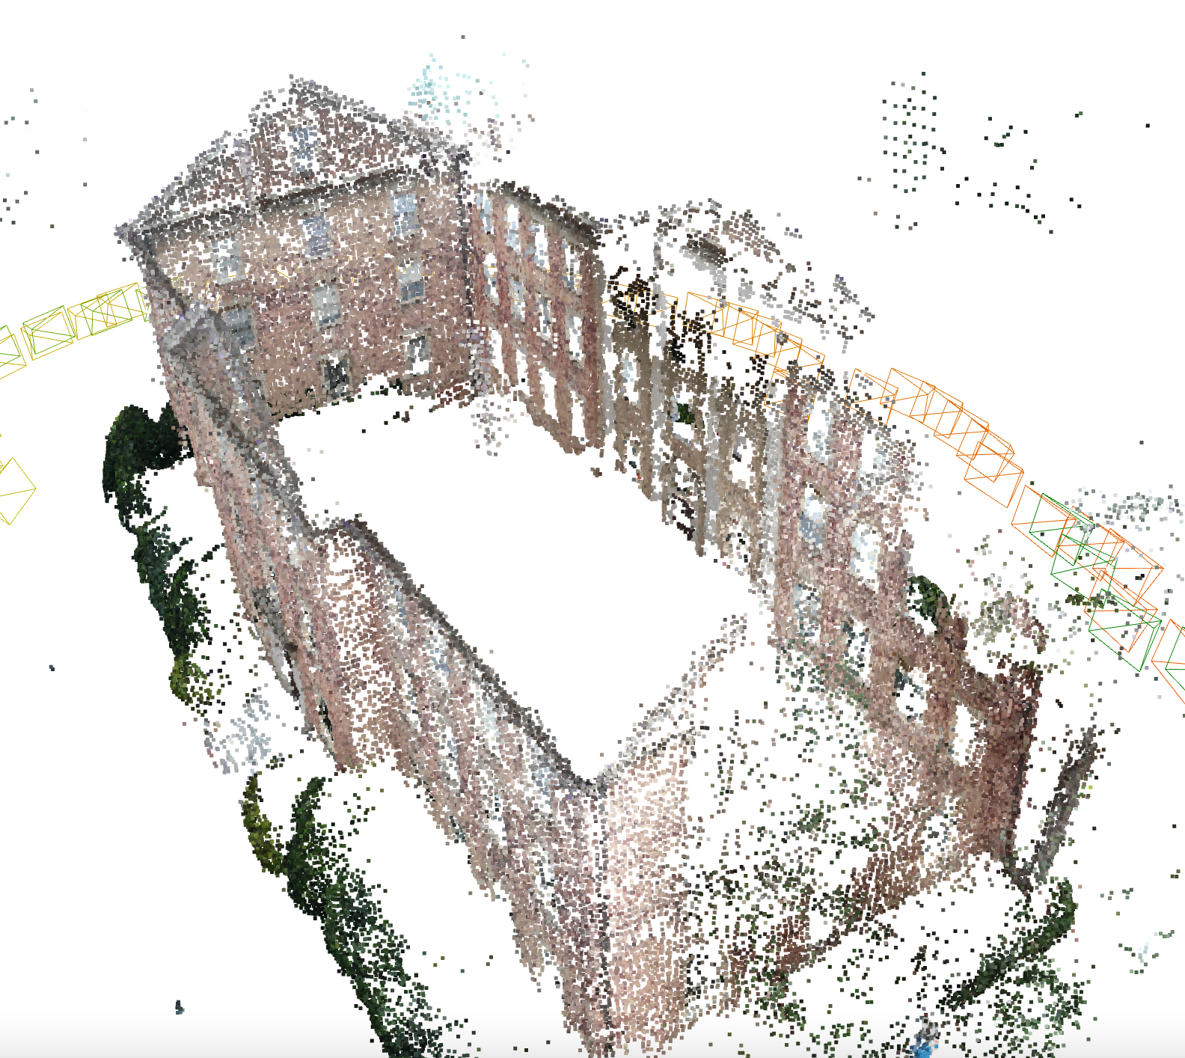
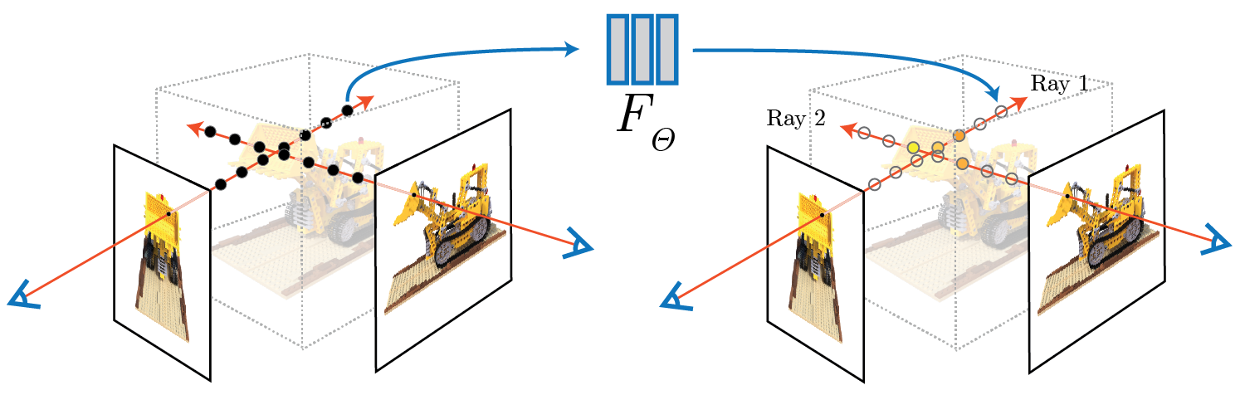
Motivations for Generative Models
Until now we saw methods that can reconstruct scene and objects from multiple images (SFM, Multiview Stereo, NeRF, Gaussian Splatting...)
Notes:
Overview of 3D Reconstruction Models
Until now, we've looked at various models that aim to reconstruct 3D structures from images.
For example:
Structure from Motion (SfM) tries to recover 3D points and camera positions from many images.
Multi-View Stereo (MVS) reconstructs objects by using shared features and geometry across multiple views.
NeRF and Gaussian Splatting, on the other hand, reconstruct a scene by overfitting to the set of training images.

Slide 4
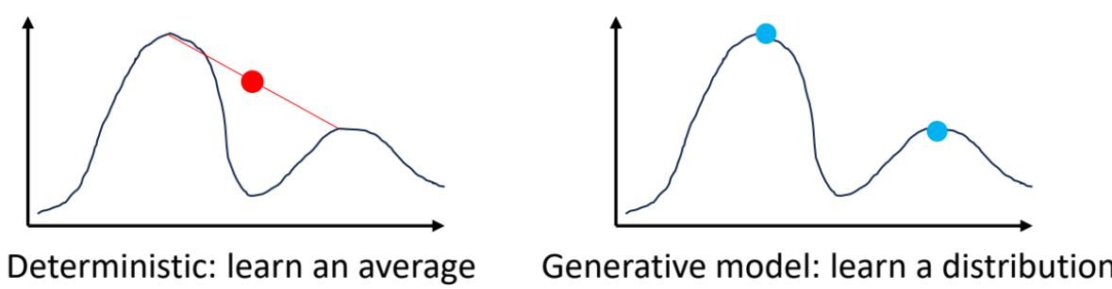
Motivation for generative models
However, tasks like single view reconstruction are ill-posed.
Deterministic model might collapse to average value.
We should learn a distribution of all possible configurations instead of simply regression or fitting to observations
Today we will explore diffusion model for conditional generation!
Notes:
The Challenge of Single View Reconstruction
However, for tasks like Single View Reconstruction, this is not enough.
When we only have a single image of an object, we can't see what's behind it - this makes the problem ill-posed.
To fully reconstruct such an object, we need generative capabilities.
Deterministic models often collapse to average shapes.
Generative models, instead, learn a probability distribution and can generate diverse plausible outputs.
Today, we’ll look at one powerful generative paradigm: diffusion models.

Slide 5
Generative Models in 3D

Slide 6
Generative Models in 3D
Being able to generate content is a very powerful capability, and has many applications.
Notes:
Generative modeling is the ability to generate new content.
It’s a very powerful capability with many applications.
Although it's become mainstream recently, research in this area has been ongoing for several years.

Slide 7
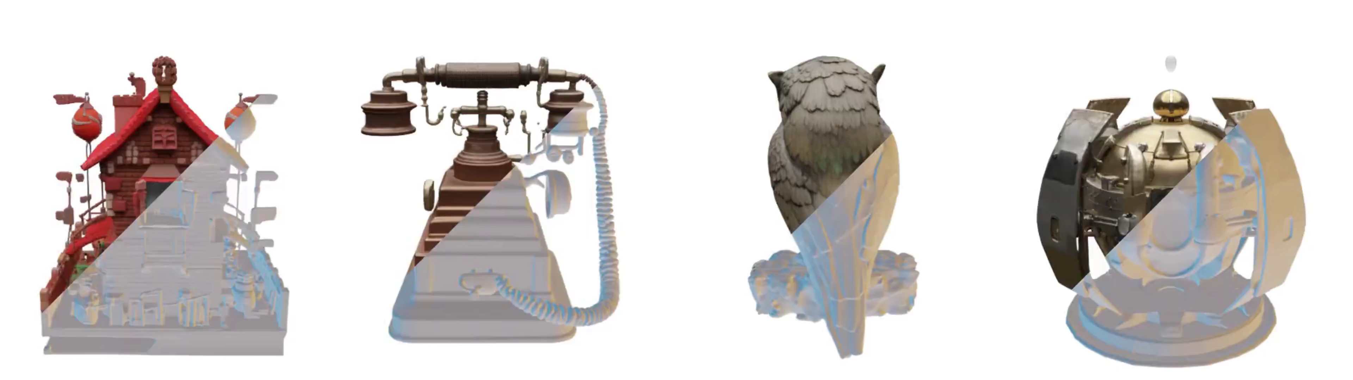
Text to 3D object
Two-story brick house with red roof and fence.
Vintage copper rotary telephone with intricate detailing.
Bronze owl sculpture perched on a branch.
Bronze owl sculpture perched on a branch.
Trellis: Structured 3D Latents
for Scalable and Versatile 3D Generation. Xiang et al. CVPR 2025
Notes:
Text-to-3D Object
With generative models, we can go from text descriptions to 3D object creation.
This allows us to generate highly detailed objects from just a textual prompt.
Here you can see a video showing rotating 3D objects generated from text descriptions, using the Trellis model.
The generated objects are:
Highly detailed
Visually realistic
Showcasing the model’s ability to produce compelling geometry and texture This demonstrates how far text-to-3D generation has come in terms of visual fidelity and detail.

Slide 8
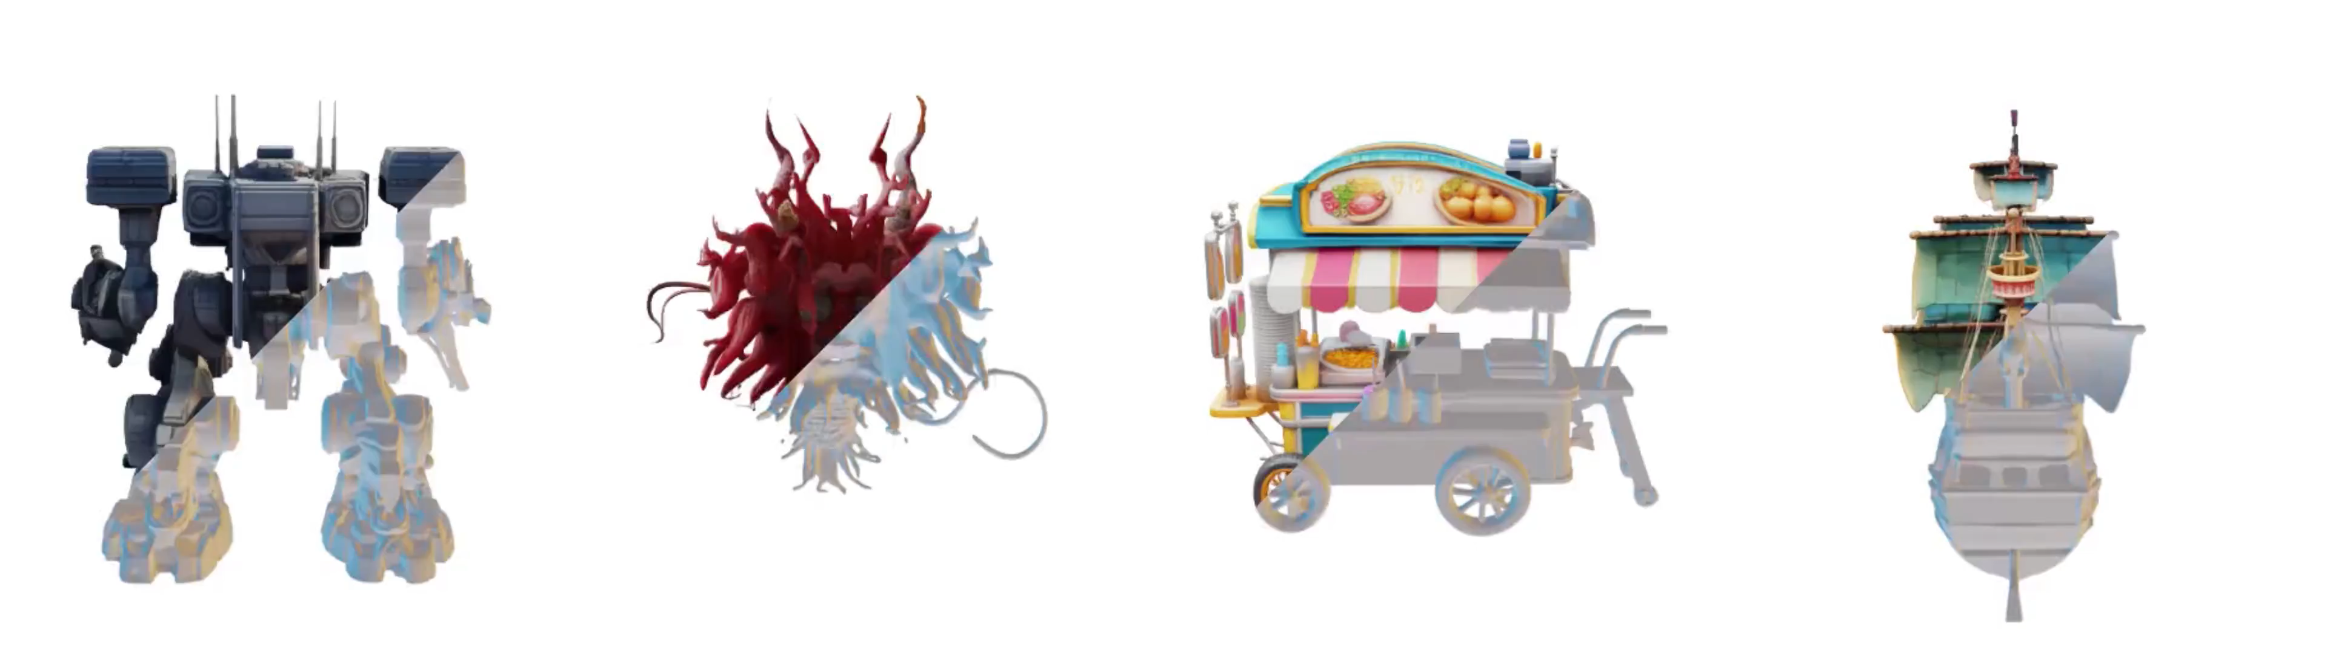
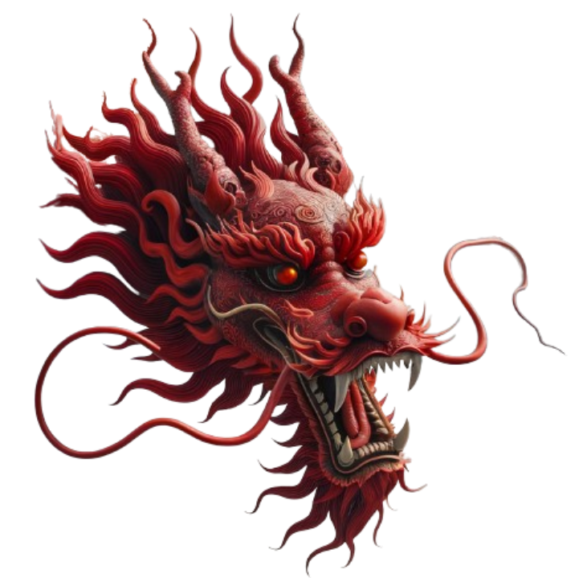

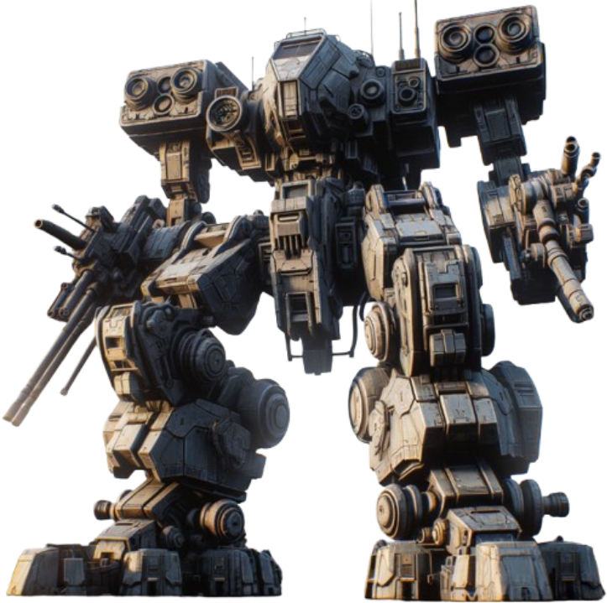
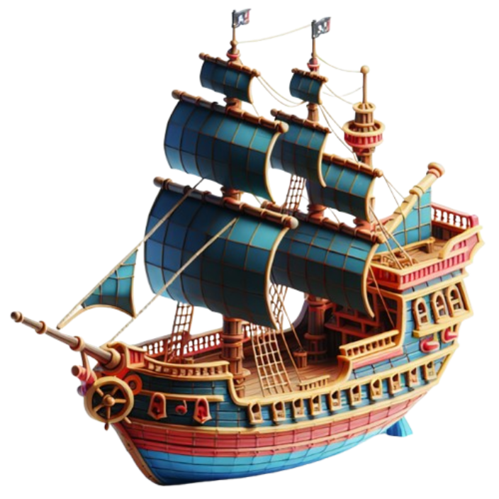
Image to 3D object
Trellis: Structured 3D Latents
for Scalable and Versatile 3D Generation. Xiang et al. CVPR 2025
Notes:
The same generative models can also reconstruct 3D shapes from single images.3D shapes from single images
Here we show more results from Trellis, this time focusing on single-image 3D reconstruction.
The input is just a single image of the object, and the model generates a full 3D reconstruction.
While the quality is generally very high, there are still some minor artifacts:
For instance, the robot's arms appear disconnected from its body.
Still, compared to just a year ago, this represents a major improvement, and the field has progressed rapidly in a short time

Slide 9
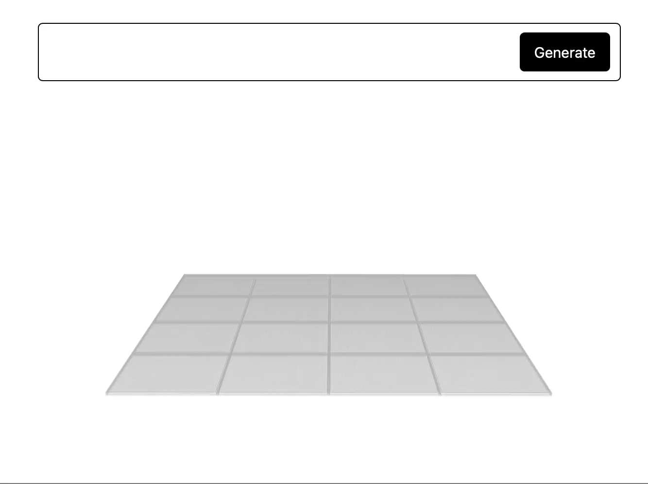
Generate 3D Scenes
SynCity. Engstler et al. CVPR 2025
Notes:
It’s also possible to try generating entire 3D scenes from text or images.
This slide shows results from the SynCity model, which generates 3D scenes.
The approach:
Divides the scene into tiles
Generates one tile at a time
Visually, the results can be appealing, but there are still important limitations.
For example:
The model cannot generate buildings larger than a single tile, since it doesn’t merge or coordinate across tiles.
This limits the scale and coherence of the generated scenes.
Ongoing research is actively trying to address these limitations and improve scene-level 3D generation.

Slide 10

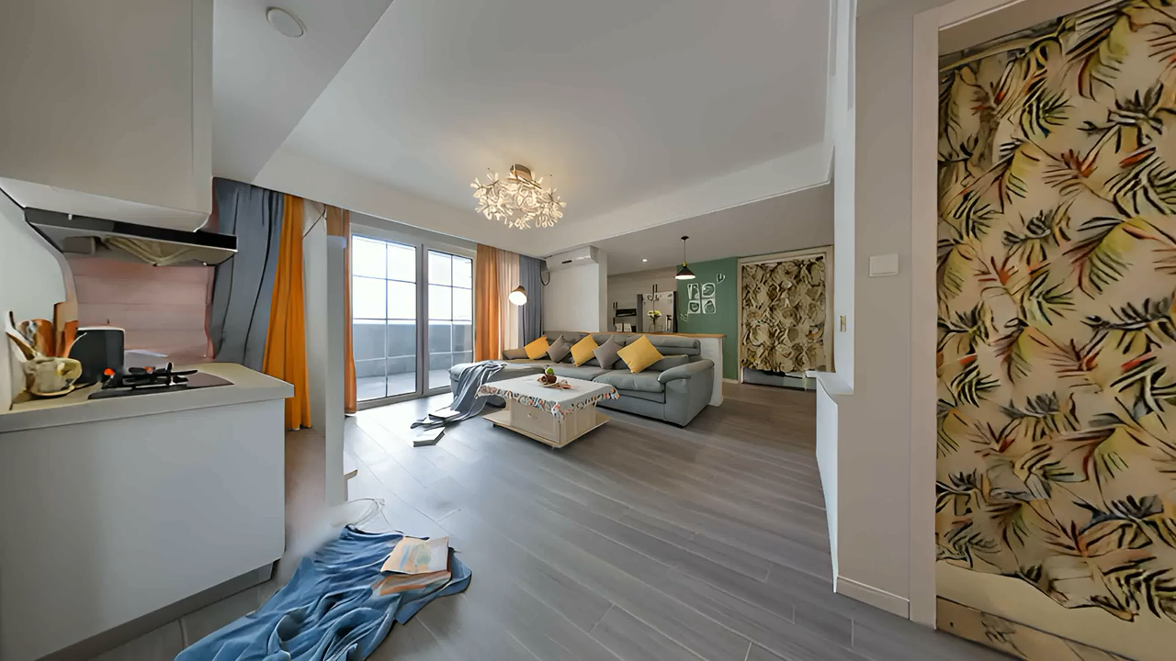
Generate 3D Worlds
Lyra 2.0 (Nvidia)
HY-World 2.0 (Tencent Hunyuan)

Slide 11
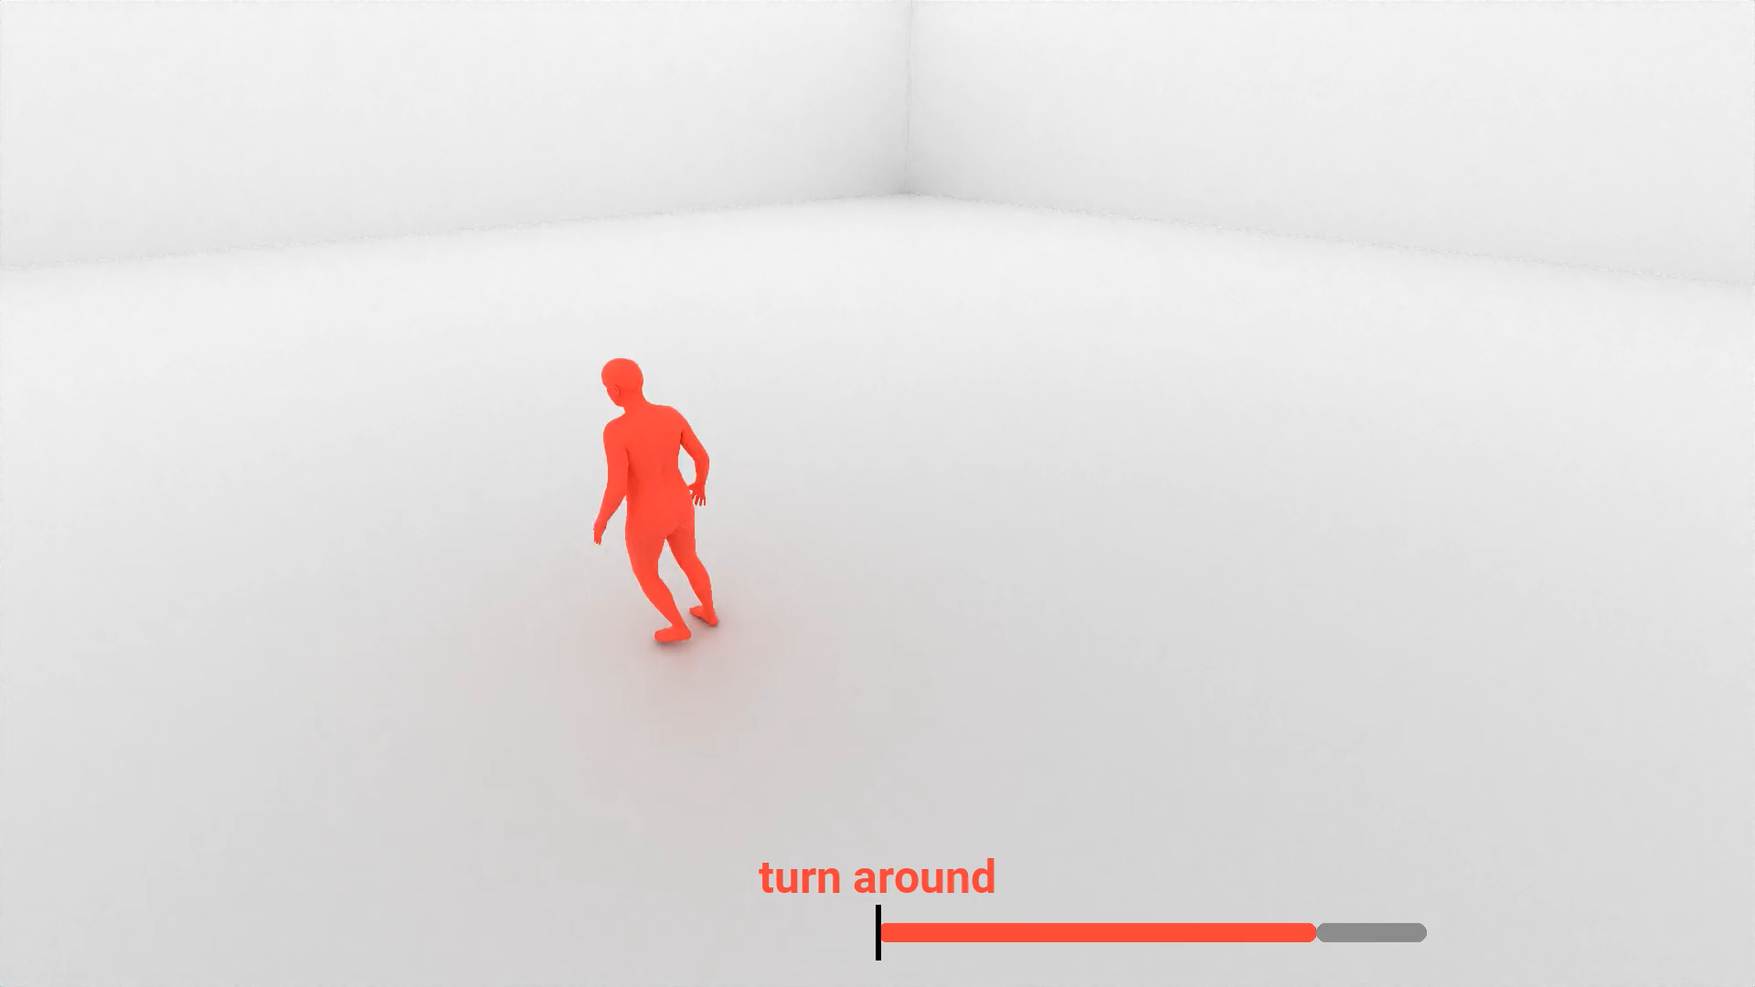
Motion Generation
UniMotion. Li et al. 3DV 2025
Notes:
Generative models aren’t limited to visual content.
For example, in motion generation, models can create motion sequences based on text descriptions.

Slide 12
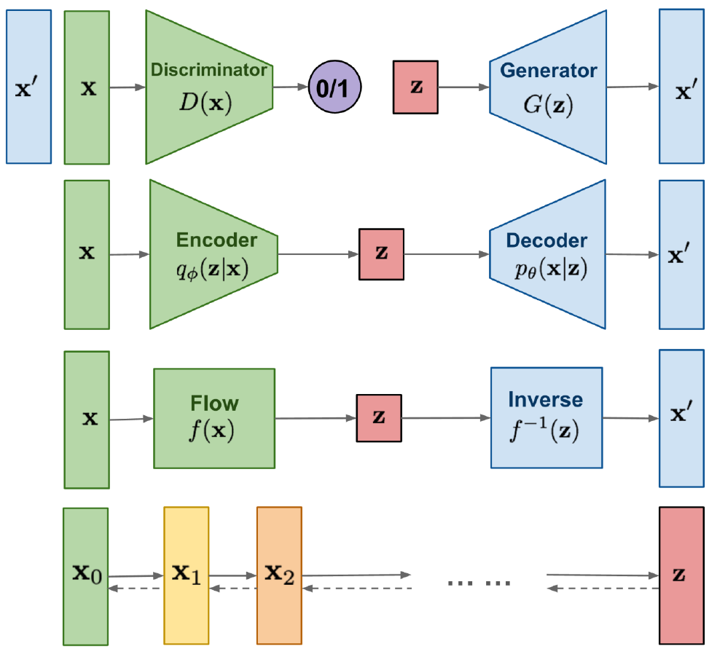
Generative Models – Main Architectures
GAN: Adversarial training
VAE: Maximize variational lower bound
Flow-based models: Invertible transform to distribution
Diffusion Models: Gradually add Gaussian noise and then reverse
Notes:
Generative Model Architectures
There are four main families of generative models:
GANs (Generative Adversarial Networks) – use adversarial training to learn data distributions.
VAEs (Variational Autoencoders) – learn a latent space to compress and sample data.
Normalizing Flows – learn invertible functions and solve ODEs to generate samples.
Diffusion Models – progressively add Gaussian noise to data and learn to reverse the process to generate new samples.

Slide 13
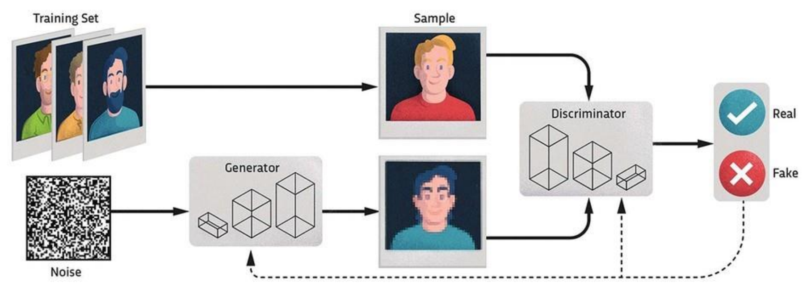
GAN
Notes:
Generative Adversarial Networks (GANs)
There are two main components:
Generator (G):
Takes in random noise (or some structured input)
Tries to generate realistic samples that resemble the training data
Discriminator (D):
Takes in samples
Tries to distinguish whether they come from the real training data or were generated by G
The training is based on game theory:
The generator tries to fool the discriminator
The discriminator tries to correctly classify samples as real or fake
This leads to a min-max optimization problem where:
G minimizes the probability of D detecting fake samples
D maximizes its ability to distinguish them
The goal is for G to eventually generate samples so realistic that D can no longer tell the difference.

Slide 14
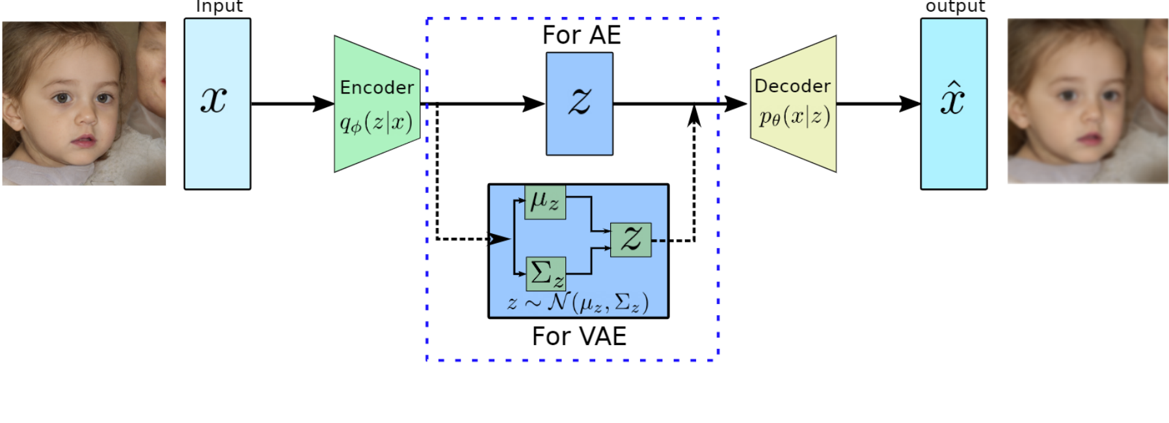
VAE
Notes:
Variational Autoencoders (VAEs)
The second architecture from the previous overview is the Variational Autoencoder (VAE).
A VAE is an autoencoder that learns to encode data into a latent space and then decode it back to reconstruct the input.
The encoder doesn't just output a single point, but rather the parameters of a distribution:
It predicts a mean (μ) and a standard deviation (σ)
This defines a Gaussian distribution in the latent space
To sample from this distribution and make it trainable, VAEs use the reparameterization trick:
A latent vector is sampled as:
z = μ + σ ⊙ ε, where ε ~ N(0, I)
This makes it possible to backpropagate through the sampling process.
The decoder then reconstructs the input from this latent vector
Training is self-supervised, with a loss that combines:
Reconstruction loss (how well the input is reconstructed)
KL divergence (to keep the latent distribution close to a standard Gaussian)

Slide 15

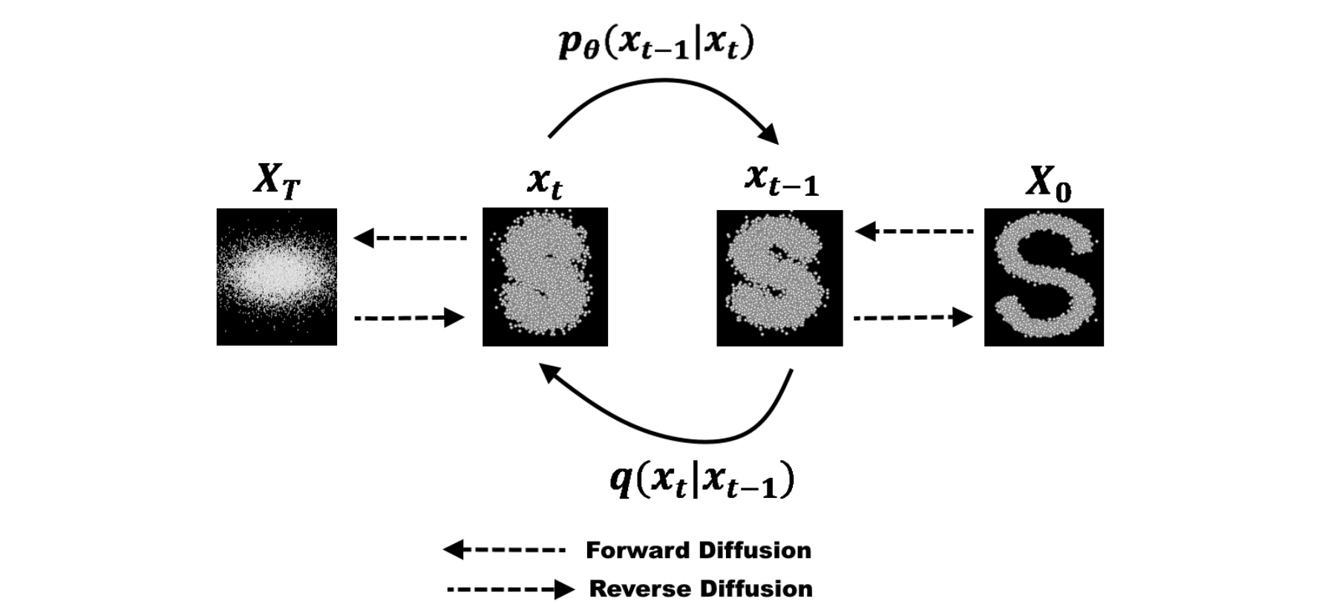
Diffusion Models
Notes:
Diffusion models work in two stages:
Forward Process (q):
Starting from a clean sample (e.g., an image), the model adds Gaussian noise step by step
After many steps, the sample becomes pure noise
Reverse Process (p):
The diffusion model is trained to reverse this process, step by step
The goal is to denoise the input gradually, going from noise back to a clean image
Notation:
q(xₜ | xₜ₋₁): Forward process – adds noise
p(xₜ₋₁ | xₜ): Reverse process – removes noise
During training, the model learns the reverse transitions, often by predicting the noise that was added, and then subtracting it to obtain a cleaner sample.
This leads to high-quality generative results, and diffusion models are currently state-of-the-art in many domains.

Slide 16
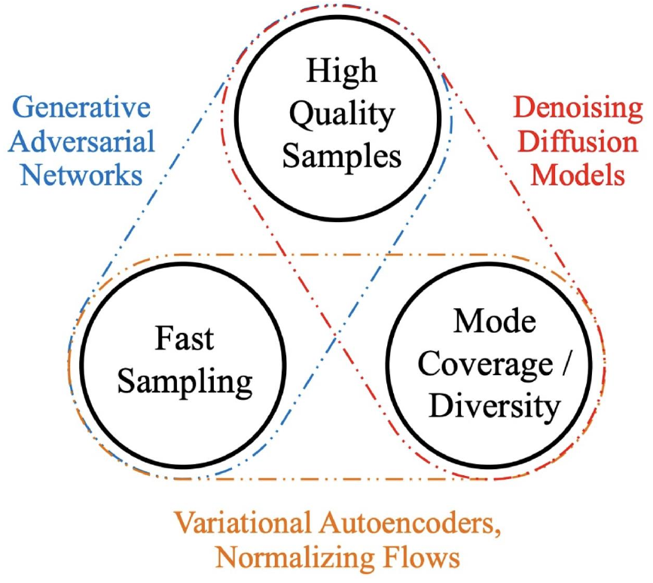
Trilemma: Quality, Diversity Speed
Notes:
The Generative Modeling Trilemma – Quality, Diversity, Speed
This slide illustrates what is often referred to as the Generative Modeling Trilemma, consisting of:
Quality of the generated samples
Diversity or mode coverage
Speed of sampling
Each architecture tends to prioritize different aspects:
GANs:
High quality outputs
Fast sampling
But low diversity – they often suffer from mode collapse
VAEs:
High diversity and good mode coverage
Fast to sample
But lower quality of the generated outputs
Denoising Diffusion Models:
High quality and high diversity
But slow sampling – due to the need for many iterative denoising steps

Slide 17
Diffusion Models
Notes:
In this lecture, we will focus specifically on diffusion models,
We will understand how they work
And explore how they can be applied to 3D tasks

Slide 18
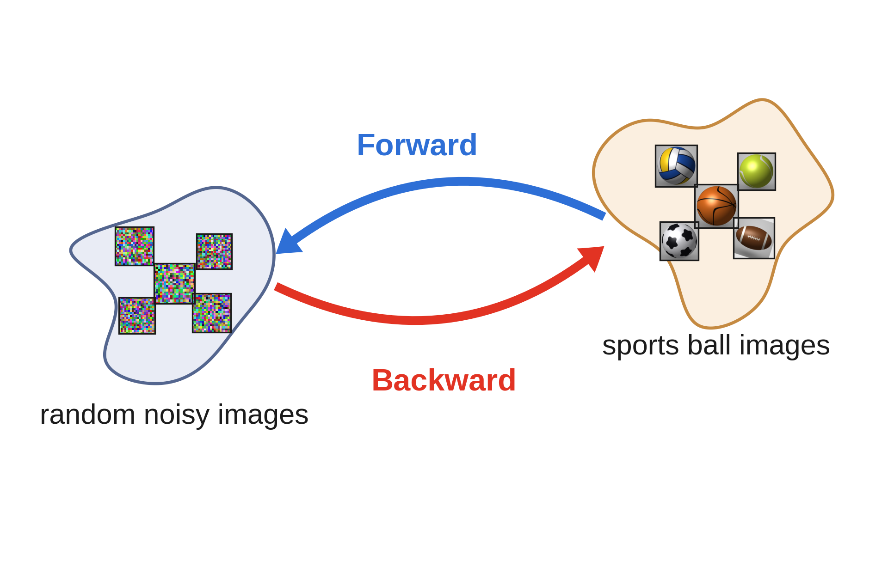
Idea
Notes:
Diffusion models bridge the gap between two distributions:
Gaussian Distribution, and data distribution we want to learn / sample from.
In this example:
Gaussian Noise Images and Images of sports balls
Clearly this is a nontrivial problem, as sport balls differ in shape, texture, size etc. So we are somehow trying to find a mapping between a simple unimodal distribution (Gaussian noise) and a very complex distribution (
The goal is to learn how to transform (samples from) one into (samples from) the other
One direction is easy. Which one and why?
Answer: From data distribution to Noise. Just add noise. We can do this incrementally (see next slide), which is called the forward process.

Slide 19
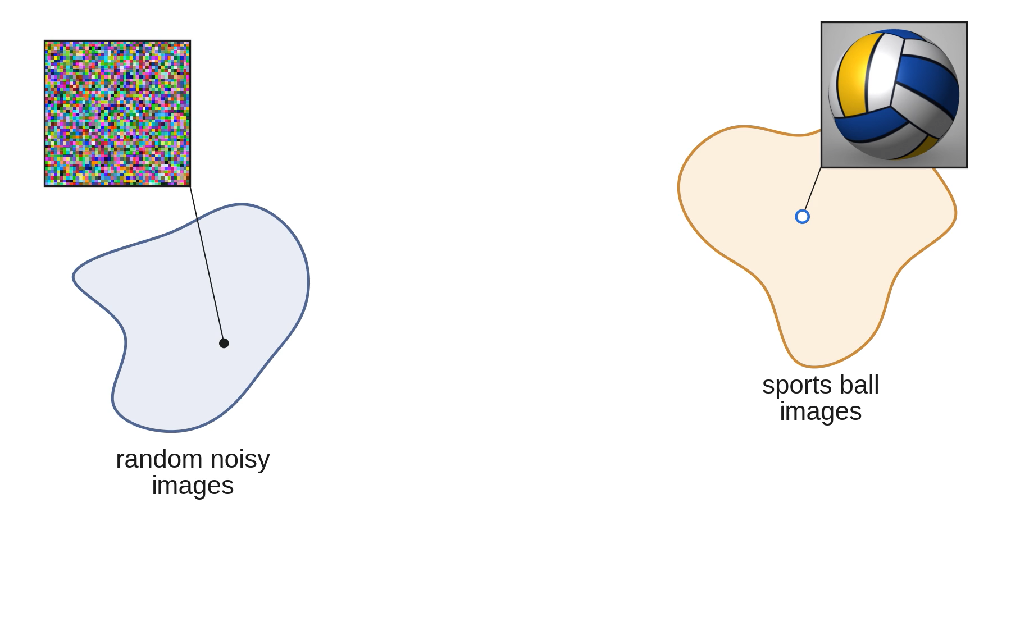
Idea: Forward Process
Notes:
The goal is to learn how to transform (samples from) one into (samples from) the other
One direction is easy. Which one and why?
Answer: From data distribution to Noise. Just add noise. We can do this incrementally, which is called the forward process.
So far there is no magic here. Nothing is learned. This just means: if we incrementally add noise to an image, it will converge to noise.
The idea of diffusion models is now to learn the backward process i.e. the denoising

Slide 20
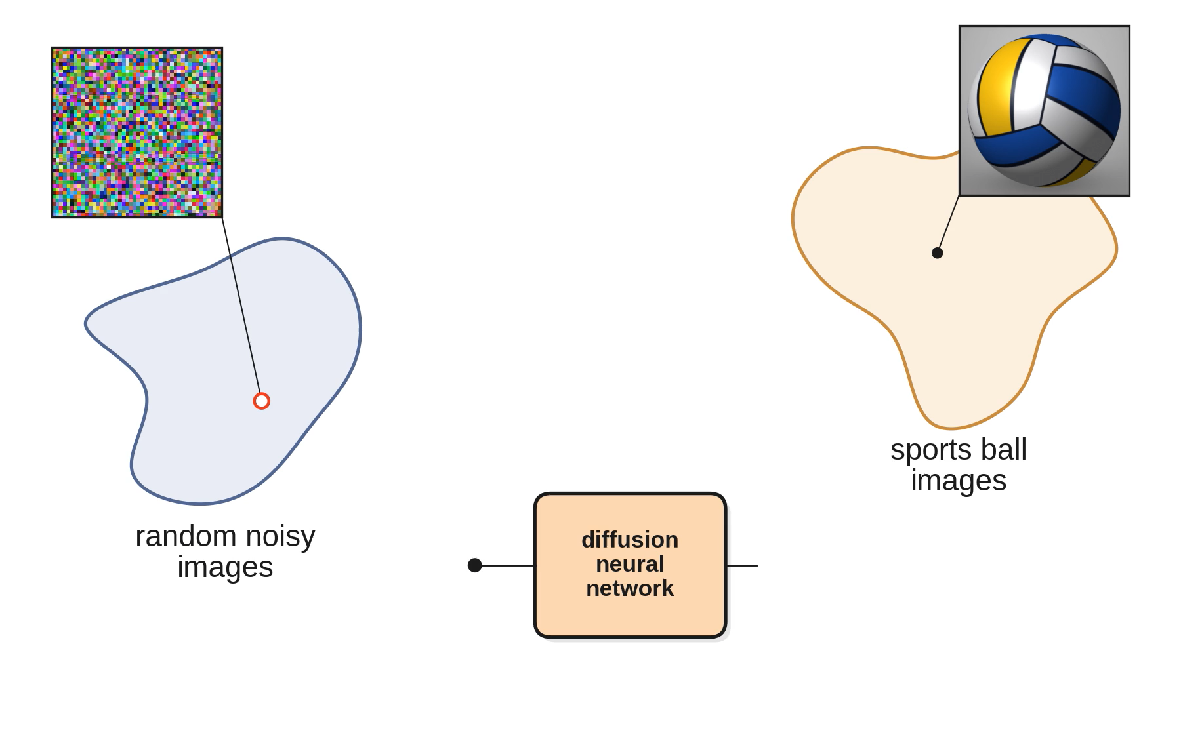
Idea: Learn to undo the incremental noising
Notes:
The idea of diffusion models is now to learn the backward process i.e. the incremental denoising.
We aim to learn a network that takes the current noisy image and tells us how to denoise it.
We use the same network to repeat multiple steps of denoising, to end up with an image of the volleyball.

Slide 21
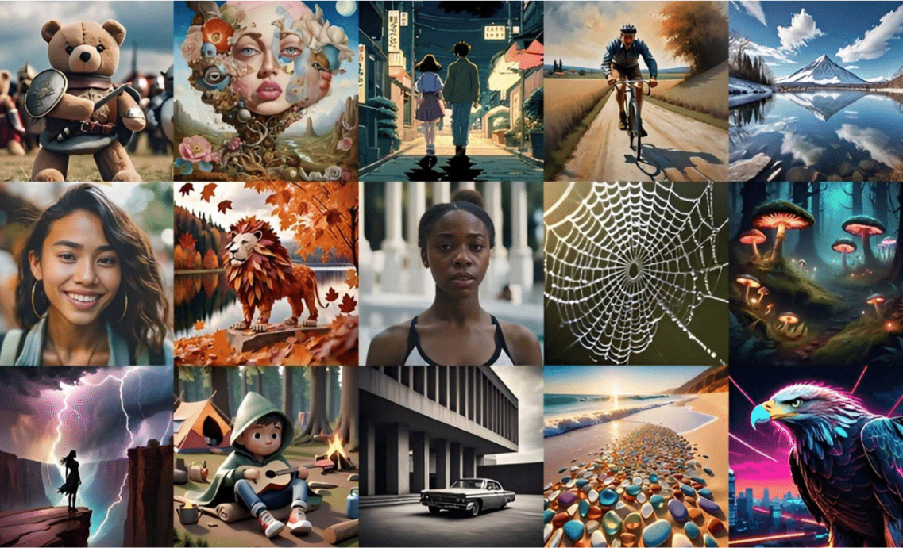
Diffusion Models for Image Generation
Diffusion model is SOTA on image generation
Stable Diffusion
Flux
Mid-Journey
Dall-E
...
Notes:
Diffusion models are currently state of the art for image generation. They gained widespread popularity with models like:
Stable Diffusion
Imagen
MidJourney
These models have become the backbone of modern generative pipelines.
Although Flow-based models are now emerging and sometimes outperforming diffusion models, the core architecture of these new models is still often based on diffusion.
So diffusion models remain central and widely used in the field.

Slide 22
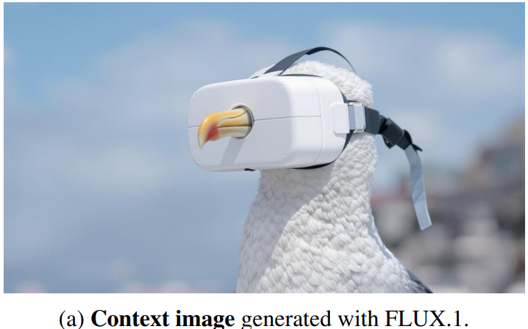
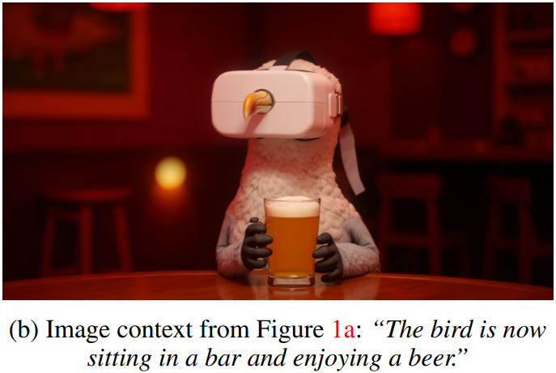
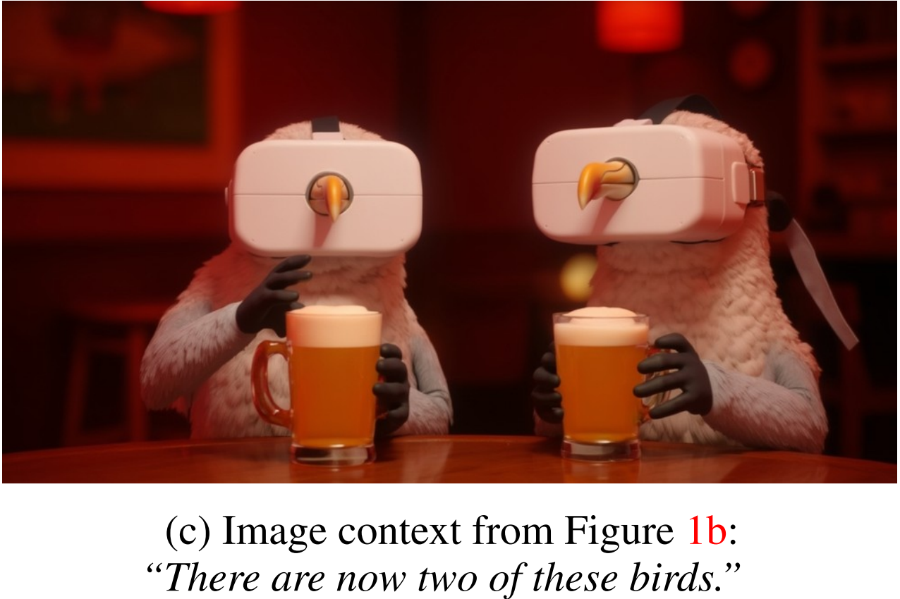
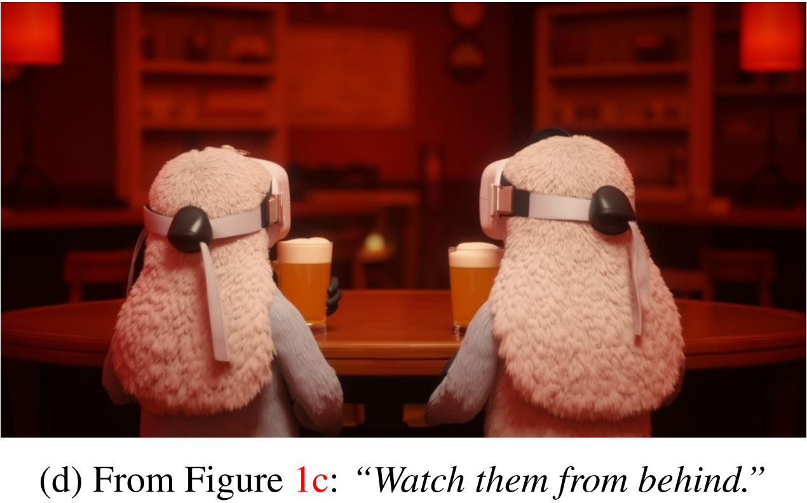
Diffusion Models for Image Editing
Flux.1 Kontext
Notes:
Recent Advances – Flux 1 Context
Just a few days ago, a new model called Flux 1 Context was released.
It builds upon Flux 1 and introduces image editing capabilities.
Unlike previous models, it can:
Edit existing images
Iterate over a generated sample
Create realistic and coherent variations

Slide 23
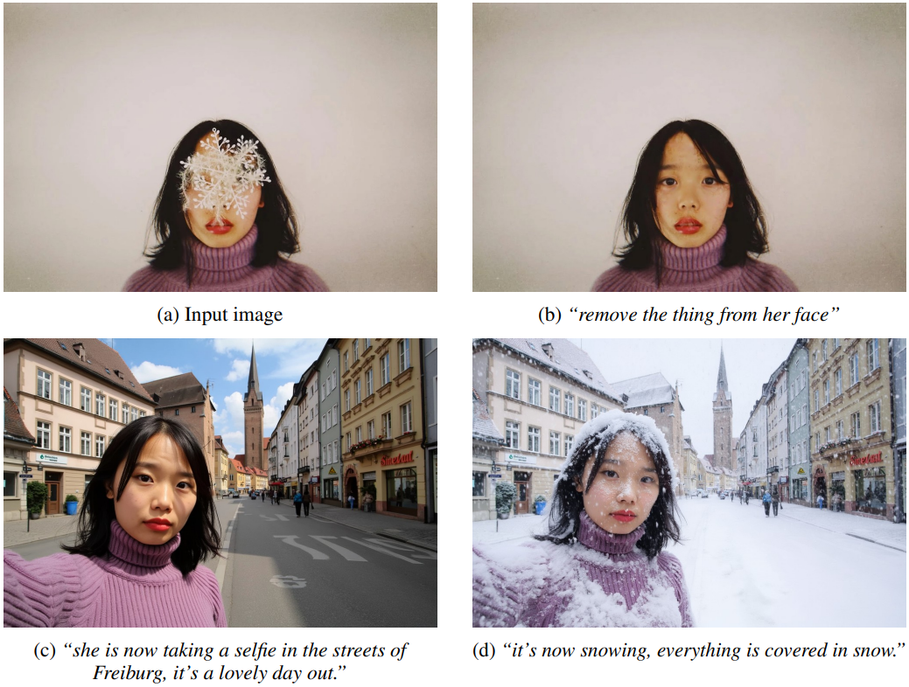
Diffusion Models for Image Editing
Flux.1 Kontext
Notes:
You can see here how Flux 1 Context:
Removes objects
Changes the scene
Maintains high visual quality
This highlights the power and flexibility of diffusion-based methods.

Slide 24
Diffusion - Theory
Notes:
Theoretical Foundations – Diffusion Probabilistic Models
Now let’s dive into the theoretical foundations of diffusion models.

Slide 25



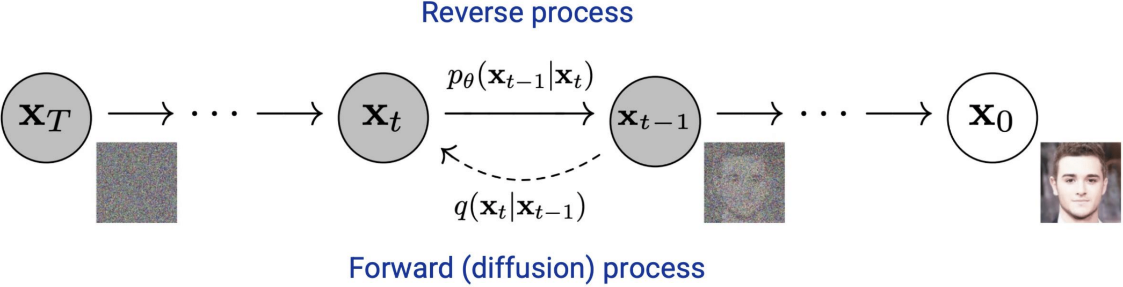
Diffusion Probabilistic Models
Diffusion model aims to learn the reverse of noise generation procedure
  Forward step: (Iteratively) Add noise to the original sample
    → The sample converges to the complete noise (e.g., )
  Reverse step: Recover the original sample from the noise
    → Note that it is the “generation” procedure
Notes:
Diffusion Probabilistic Models
The idea is simple:
Start from a clean image x_0
Gradually add Gaussian noise through a forward process, until the image becomes pure noise (x_T)
Then, learn the reverse process to recover the original image from noise
This reverse process is what enables the model to generate new data – by starting from noise and progressively denoising it into a realistic sample.

Slide 26

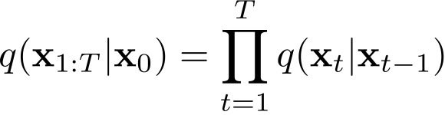


Forward Step
Iteratively add noise to the original sample
Modelled as product of conditional noise distributions
where each is a Gaussian with noise schedule
Put differently:
Variance
Preserving
Factor
Notes:
Forward Process – Mathematical Formulation
In the forward process, we define a Markov chain that adds Gaussian noise at each step:
The probability of a noisy sample at time t, given the previous step t−1, is denoted as q(x_t | x_{t-1})
The full forward process can be written as this product
Here:
βt are the variance schedule parameters that control how much noise is added at each step
They are typically fixed beforehand, though in theory they could be learned
To ensure that the added noise doesn’t overwhelm the data too early, βt values are gradually increased across timesteps.
The forward process is Gaussian, making the math tractable and differentiable.

Slide 27

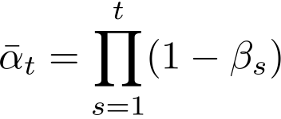



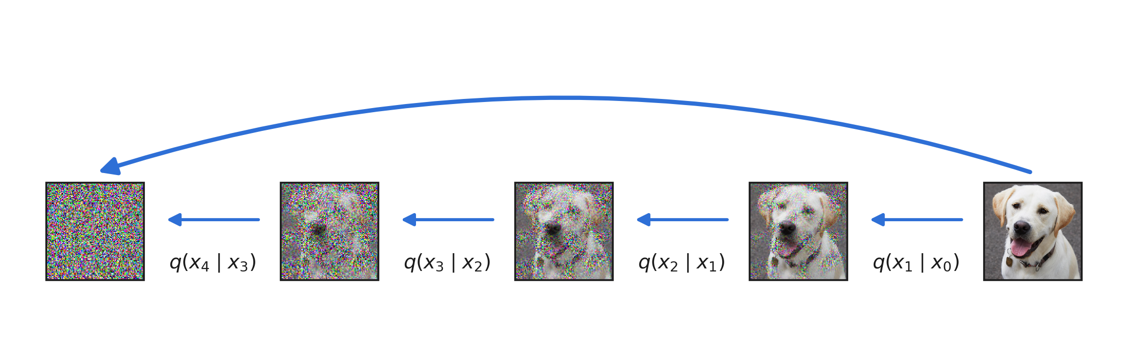
Forward Step: Skipping Intermediate Steps
This allows a simpler way to directly sample for any t via
In the limit we want to converge to pure noise, i.e.
What does this mean for ?
Notes:
With this formulation, it turns out we do not have to do the noising incrementally. Instead, there is a closed form representation for the sample after t noising steps, i.e. can skip the t noising steps and just do one single noise addition, now expressed in terms of bar (alpah_t)
In the limit, we want to end up in pure Gaussian noise, i.e. we want q(x_T | x_0) = N(0, I). How can we achieve this?
We need sqrt(alpha_t) -> 0 or equivalently alpha_t -> 0.

Slide 28

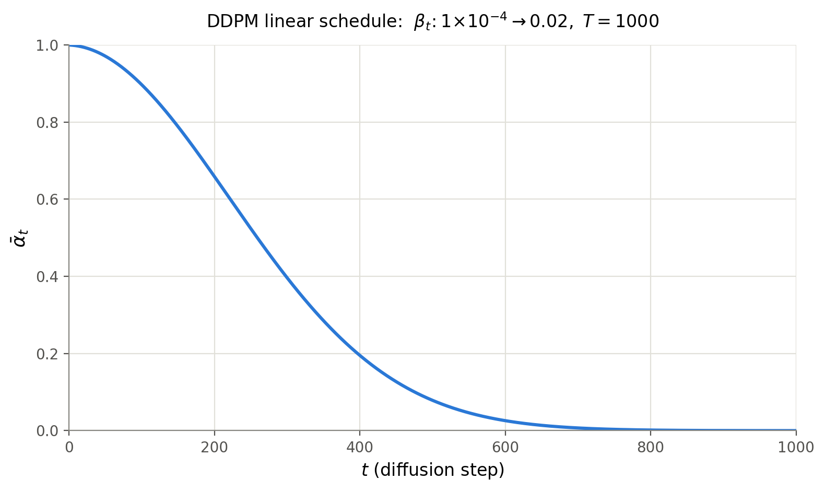

Forward Step: Skipping Intermediate Steps
This allows a simpler way to directly sample for any t via
In the limit we want to converge to pure noise, i.e.
We achieve this by
Original DDPM paper:
  T=1000
  Linear schedule
Notes:
Question: Why not just choose beta_t = 1? Then trivially alpha_t = 0
Answer: Then the SNR (signal to noise ratio) would be too high. Beta_t = 1 essentially discards all information from the image and is pure noise (see math on last slide).
Thus, we want to keep beta small, at least in the initial timesteps where there is still some information in the image.
Intuitively this also makes sense: We want to learn to undo this stepwise noising process. If in a step we add too much noise, then this will be too hard to undo, if there was lots of information was in x_{t-1}.
In later steps (higher T) we can afford to add more noise per step, as the

Slide 29



Backward Step / Sampling
By design we have
In theory, we can generate samples:
  Sample initial random noise
  Iteratively denoise
If is small, we can approximate with a Gaussian
unknown true denoising distribution
Trainable network!

Slide 30
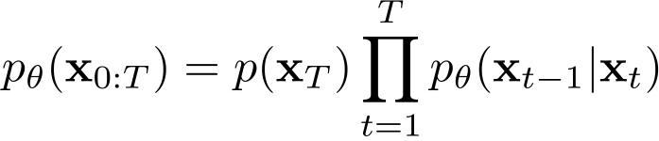



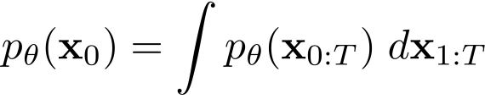
Backward Step / Sampling
The generative model is:
Goal maximum likelihood:
This would require marginalization over all possible paths ending in
Infeasible!

Slide 31
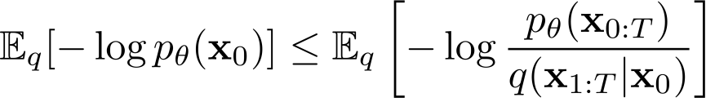
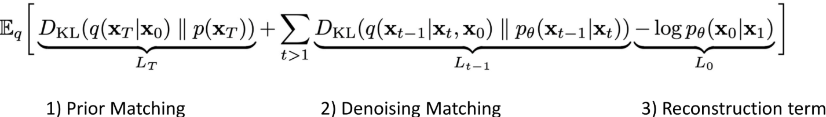
Derivation of Diffusion Loss
Instead, one can use Jensen's inequality to derive a negative ELBO:
Recall, we aim to minimize
which can be rewritten as
Notes:
We are skipping the derivation of this 3-term loss function here!

Slide 32
Derivation of Diffusion Loss
Instead, one can use Jensen's inequality to derive a negative ELBO:
Recall, we aim to minimize
which can be rewritten as
Notes:
L_T is independent of network parameters, i.e. it is constant and can therefore be dropped
Denoising matching terms are intuitive: We want to match the true denoising distribution.
Reconstruction term is the decoder term, where the model is scored against an actual data value rather than agains another noisy latent
Now we will see that because we modelled everything as Gaussians, all these KL losses reduce to simple L2 losses

Slide 33




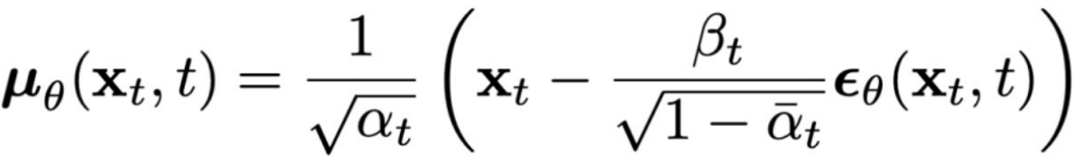


Denoising Diffusion Probabilistic Models (DDPM)
Key idea: Predict the noise instead of the denoised signal
  Since and share most information, it is redundant
  → Instead, predict the residual and add to the original
Formally, DDPM reparametrizes the learned reverse distribution as
and the stepwise objective becomes
Predicted noise
Normalization term (not important now)
Notes:
Noise Prediction Instead of Image Prediction
Originally, DPMs try to directly predict the denoised image x_{t-1} , given the noisy input x_t.
But an important improvement is the idea of predicting the noise instead.
This leads to the Denoising Diffusion Probabilistic Model (DDPM) formulation.
The key insight:
Instead of predicting the denoised signal x_{t-1} , the network predicts the noise that was added at step t .
This is more efficient because:
The noise is the only changing component between x_t and x_{t-1};
The rest of the image content is shared, so predicting it again is redundant.
This change affects the training objective:
Instead of minimizing the variational lower bound, the model minimizes a simple L2 loss between (Bottom Formula):
The true noise ϵ that was added during the forward process;
And the predicted noise ϵθ(x_t,t) output by the model.
This formulation is now standard in most diffusion models and improves both training stability and generation quality.

Slide 34





Simplified Training Objective
Ho et al. propose the following simplified training objective with randomly sampled t and dropped weights
where
Sidenote: The reconstruction term is also approximately included in this simplified loss ( )
Notes:
Now the full loss function would be quite involved, hence Ho et al (DDPM paper) propse a simplified training objective
Details for the L0 term are a bit technical. They don’t matter too much here.

Slide 35
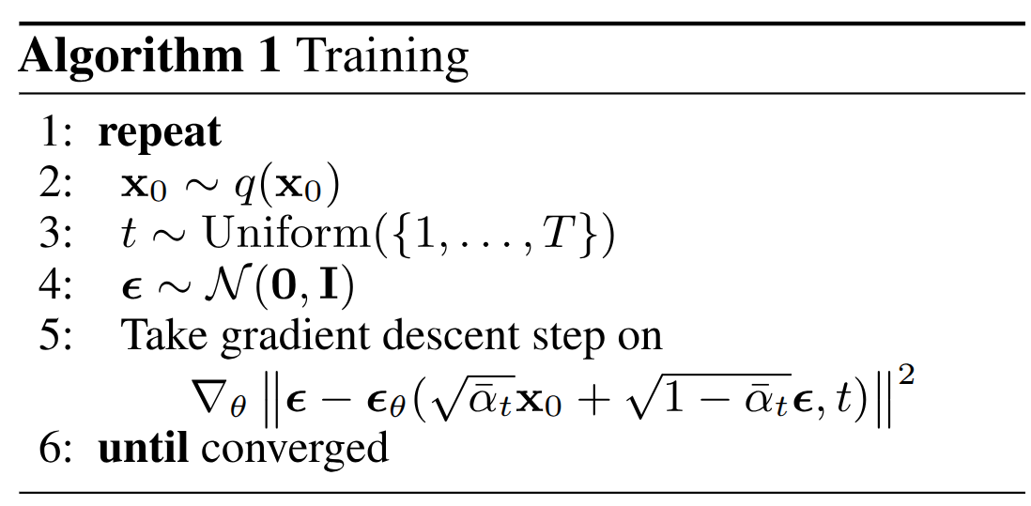
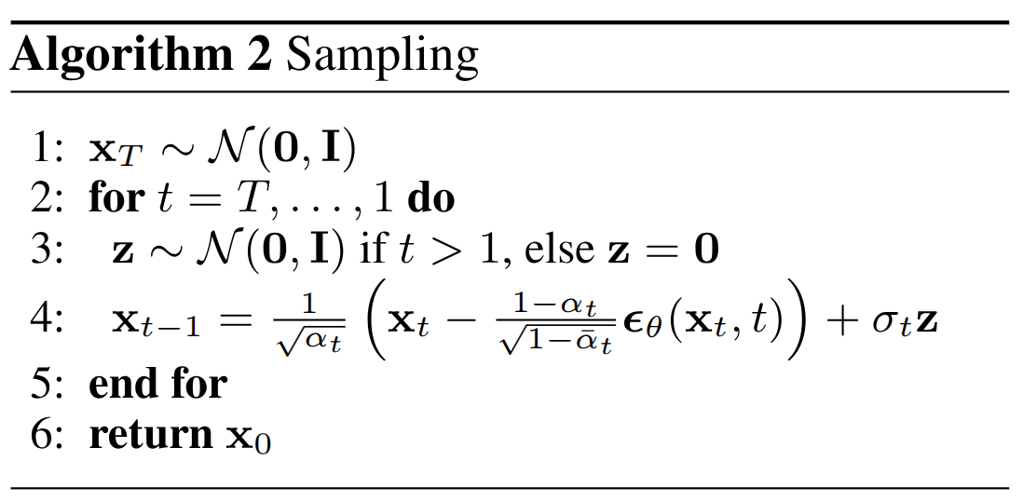
Training and Sampling
Sample image from training set
Sample random time step uniformly
Sample Gaussian noise
Apply noise, let model predict noise, calculate loss and apply gradient descent step
Sample pure Gaussian noise
Sample noise to apply to initial denoised image
Predict noise applied to image, then remove it, and finally add a little other noise
Notes:
To summarize:
Here is how we train a diffusion model, and how we sample from it

Slide 36


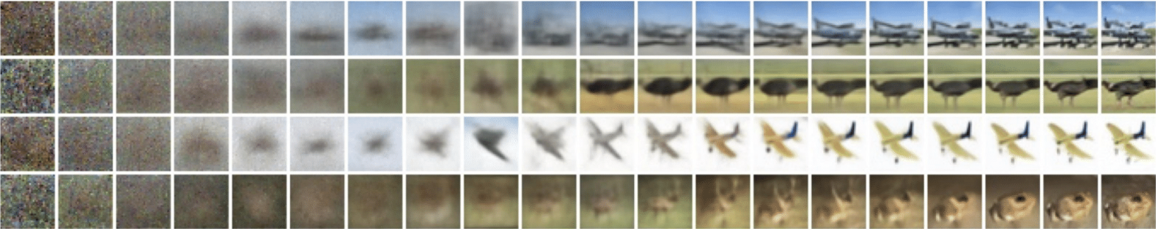
Diffusion Probabilistic Models
Diffusion model aims to learn the reverse of noise generation procedure
  Sampling: Draw a random noise then apply the reverse step
  It often requires the 1000 reverse steps (very slow)
Notes:
Once the model is trained, generation is done by starting from pure noise x_T , and progressively denoising it step by step until reaching a clean image x_0
This reverse process is slow: a typical Denoising Probabilistic Model (DPM) may require hundreds or even 1000 steps, making sampling quite computationally expensive.
Question: What happens if, instead of starting N generations from pure noise, we start from an image that is partially denoised?

Slide 37
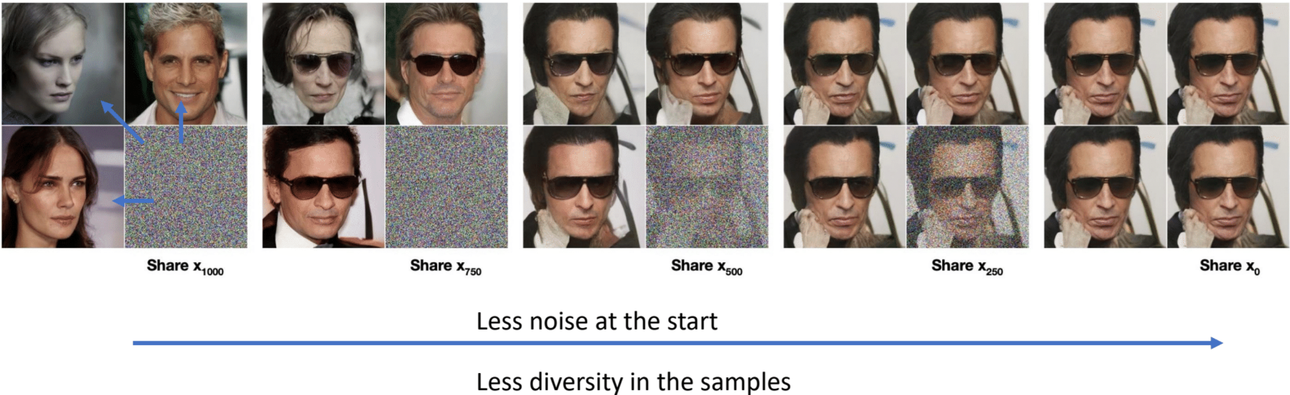
Diffusion Probabilistic Models
Diffusion model aims to learn the reverse of noise generation procedure
  Sampling: Draw a random noise then apply the reverse step
  It often requires the 1000 reverse steps (very slow)
Notes:
The less noise we add at the beginning, the closer the final generated images will be to each other.
Starting from pure noise leads to more diverse outputs.
Starting from slightly less noise leads to similar images.
If no noise is added at all, the output is always the same (deterministic).

Slide 38
Denoising Diffusion Implicit Models (DDIM)
DDIM roughly sketches the final sample, then refine it with the reverse process
  Motivation:
    Diffusion model is slow due to the iterative procedure
    GAN/VAE creates the sample by one-shot forward operation
    ⇒ Can we combine the advantages for fast sampling of diffusion models?
  Technical spoiler:
    Instead of naïvely applying diffusion model upon GAN/VAE, DDIM proposes a principled approach of rough sketch + refinement
Notes:
A key improvement to classic diffusion models is the Denoising Diffusion Implicit Model (DDIM).
The motivation:
Diffusion models are slow due to their iterative nature, requiring many steps for high-quality generation.
On the other hand, GANs and VAEs can generate samples in one forward pass.
The idea of DDIM is to combine the best of both worlds:
Keep the sample quality and diversity of diffusion;
Reduce the generation time closer to GAN/VAE speed.
Technical spoiler:
Instead of directly applying diffusion on a GAN or VAE, DDIM introduces a sketch-refinement approach.

Slide 39

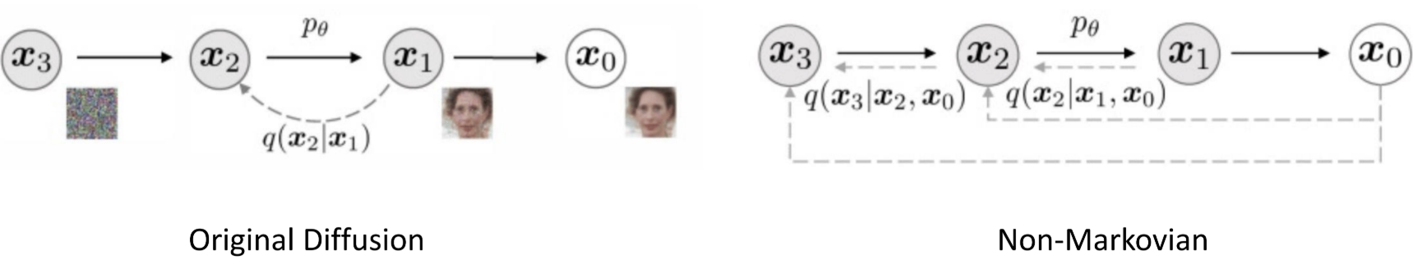
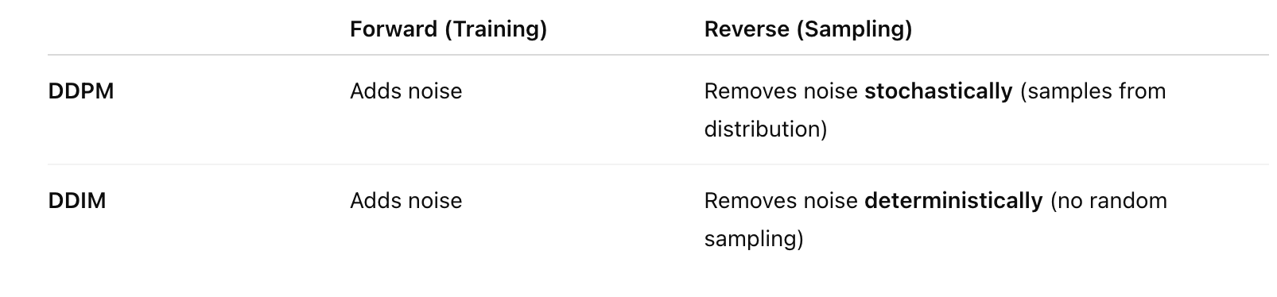
Denoising Diffusion Implicit Models (DDIM)
DDIM roughly sketches the final sample, then refine it with the reverse process
  Key Idea:
    Given , generate the rough sketch and predict deterministically
    Unlike original diffusion model, it is not a Markovian structure
Notes:
Sketch + Refinement Process
In DDIM, generation is divided into two steps:
Given a noisy sample x_T , the model first generates a rough sketch x0 , an initial estimate of the final sample.
Then, the reverse denoising process is conditioned not only on x_t , but also on the initial sketch x0 .
This means the reverse distribution becomes:
pθ (x_t−1 ∣x_t , x0)
This conditioning on the final sketch makes the generation more directed and efficient, and reduces the number of denoising steps needed.
Unlike the original diffusion models, DDIM is not modeled as a strict Markov chain anymore
The dependency on x0 breaks the Markov assumption.

Slide 40

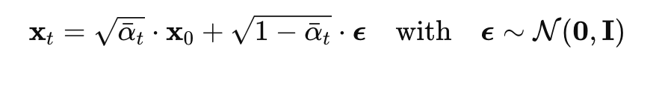
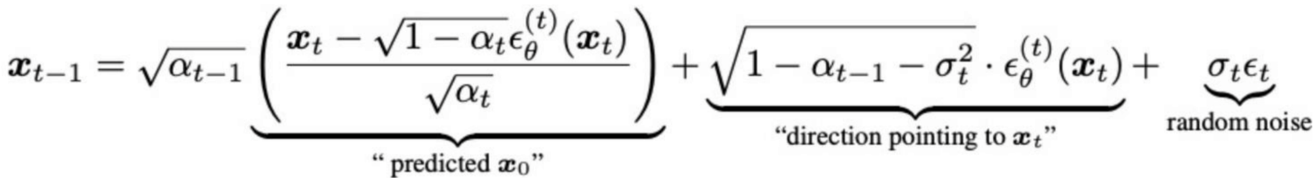
Denoising Diffusion Implicit Models (DDIM)
DDIM roughly sketches the final sample, then refine it with the reverse process
  Key Idea:
    Given , generate the rough sketch and refine
  Formulation: Forward process is
    And the reverse process is
Notes:
In the reverse step of DDIM, the goal is to sample x_{t-1} given the current noisy sample x_t .
The sampling is done as a weighted combination of: (Bottom Formula)
The predicted clean image x0 - the rough sketch of the final output;
The direction of the noise, as predicted by the network;
A random noise term, depending on whether we're doing stochastic or deterministic sampling.
This formulation allows DDIM to efficiently reconstruct a clean image by iteratively removing noise, while also giving control over the level of stochasticity in generation.

Slide 41
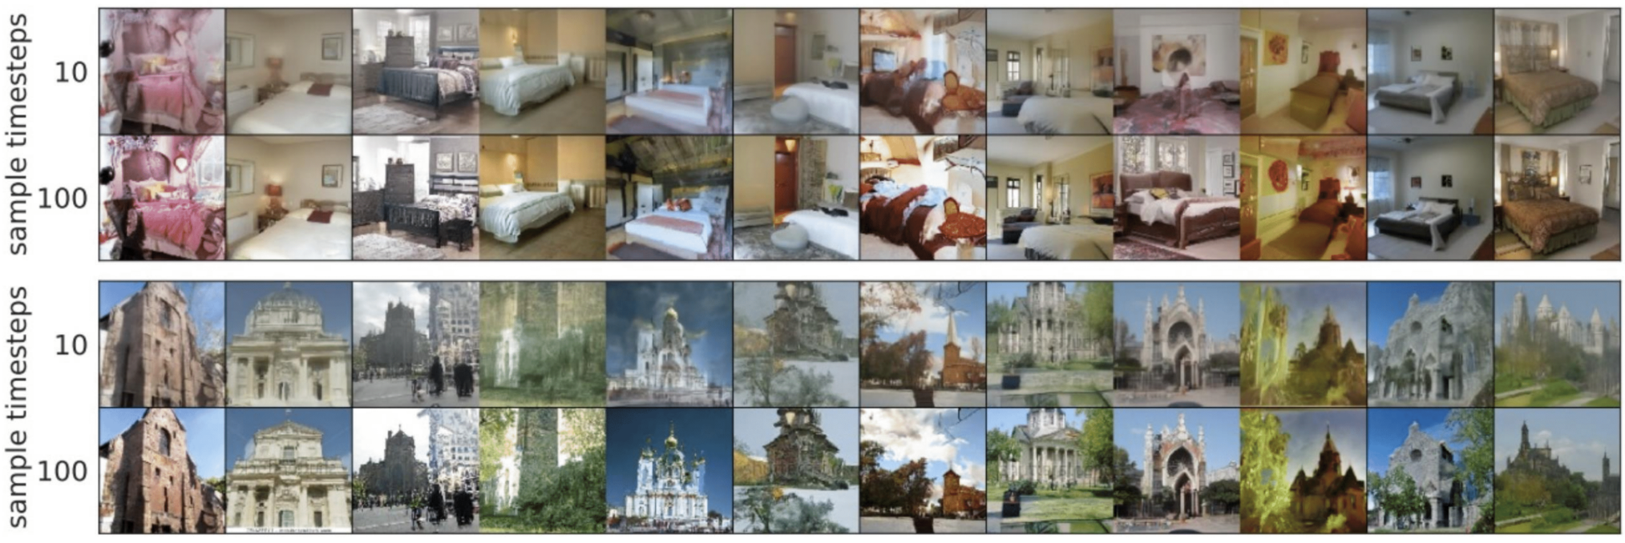
Denoising Diffusion Implicit Models (DDIM)
DDIM significantly reduces the sampling steps of diffusion model
  Creates the outline of the sample after only 100 steps (DDPM needs thousands)

Slide 42
Problems with Standard Diffusion
Standard diffusion models (like DDPM) operate directly on images, which are high-dimensional — e.g., a 512×512 RGB image has 786,432 values!
This makes them:
  Slow to train
  Expensive to sample from
  Memory-intensive

Slide 43
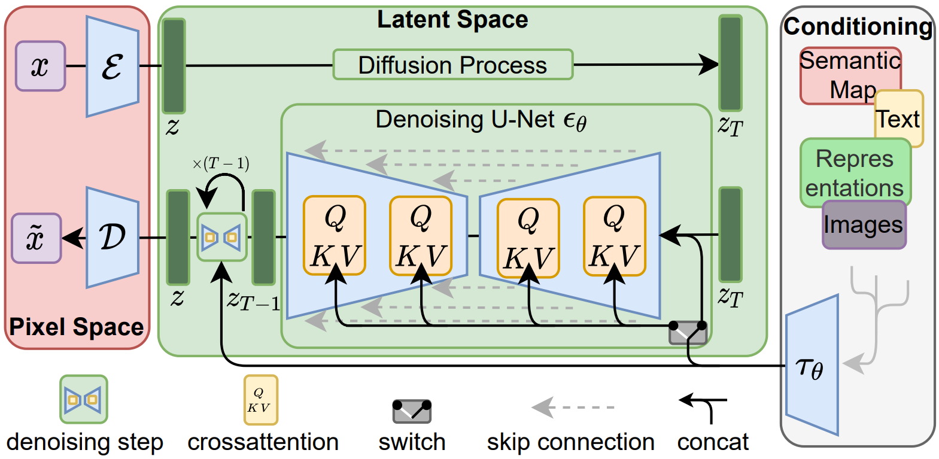
Stable Diffusion
Stable Diffusion, Rombach et al. 2022
  Key Idea: Run the Diffusion Process in a latent space.
Notes:
Building on this, in 2022 Stable Diffusion was released — one of the most popular open-source models for image generation.
It is based on a DDPM architecture, but instead of performing diffusion directly in pixel space, Stable Diffusion applies diffusion in a latent space.
An encoder (denoted as E) first maps the input image into a latent space;
The diffusion process (both forward and reverse) is applied in this compact space;
Finally, a decoder reconstructs the image back into pixel space from the denoised latent representation.
This latent formulation allows the model to generate high-resolution images more efficiently.
In addition, Stable Diffusion supports conditioning on various inputs — such as text, images, or other modalities — using techniques that were already established at the time.
Attention: self-attention understand image globally. Cross-attention to condition on text or an external image

Slide 44
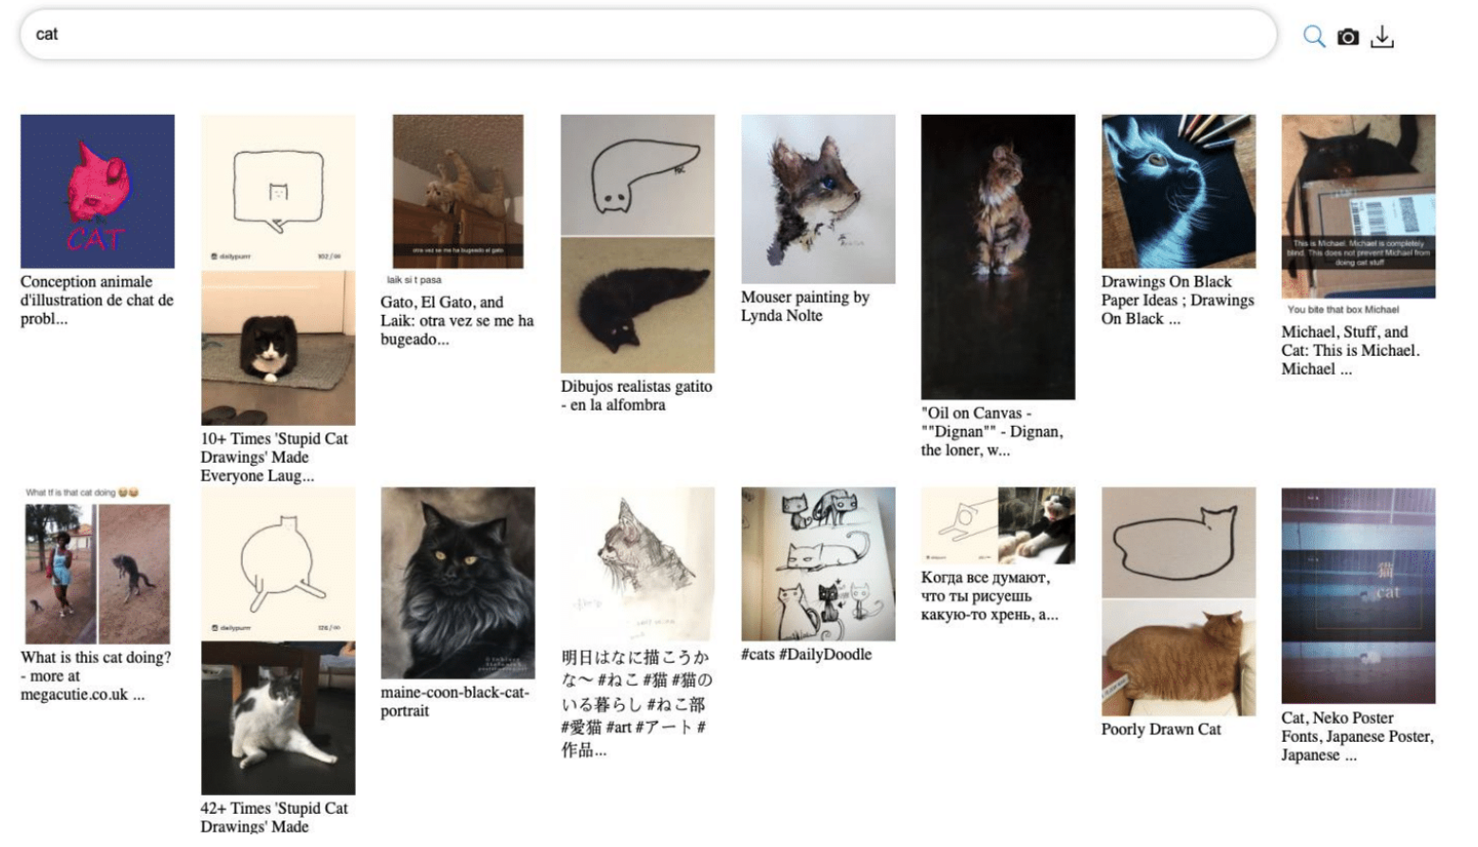
Stable Diffusion
Stable Diffusion, Rombach et al. 2022
  Large-Scale Training: Laion 5B, containing 5 Billion Images with text annotations
Notes:
Scaling with Data
A crucial ingredient for training such large models is large-scale data.
In the case of Stable Diffusion, training was done on LAION, a dataset of 5 billion image–text pairs.
This scale of data is key to achieving generalization and training powerful, open generative models.

Slide 45
Multiview Image Diffusion
Do 2D Diffusion Models have knowledge on 3D domain?
How can we leverage image diffusion for 3D?
Notes:
Transition to 3D
This brings us to the next part of the lecture:
There are two fundamental questions we’ll explore:
Do diffusion models understand 3D?
Can they reason about 3D geometry, structure, or depth?
How can we use them for 3D generation and reconstruction?

Slide 46
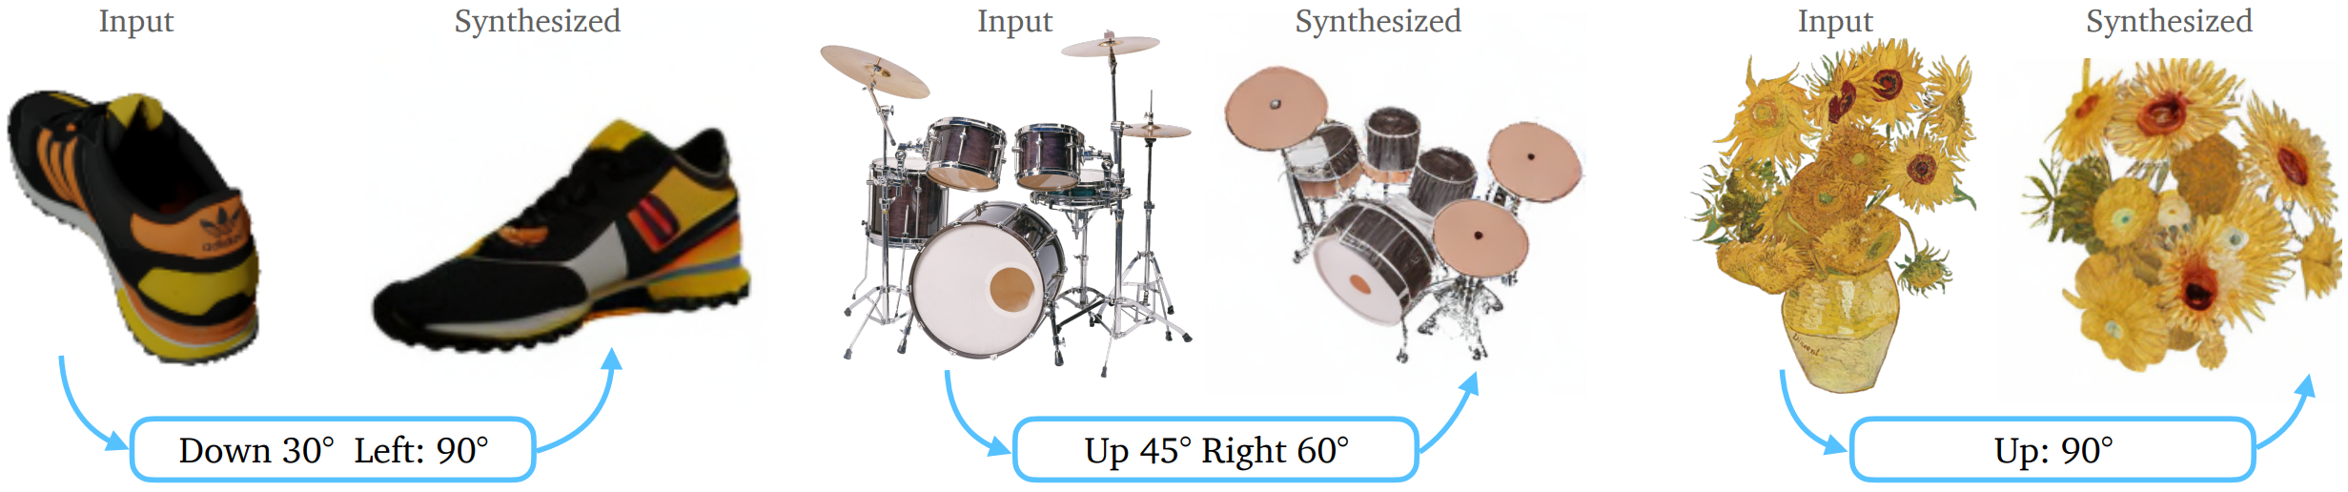
Multiview Image Generation
Multiview Diffusion
  Goal: to produce multiple views of the same object or scene in a way that’s geometrically consistent.
Notes:
Multi-view Diffusion
A prominent direction in this space is multi-view image diffusion, where the goal is to generate multiple views of the same object or scene, ensuring both geometric and texture consistency.

Slide 47

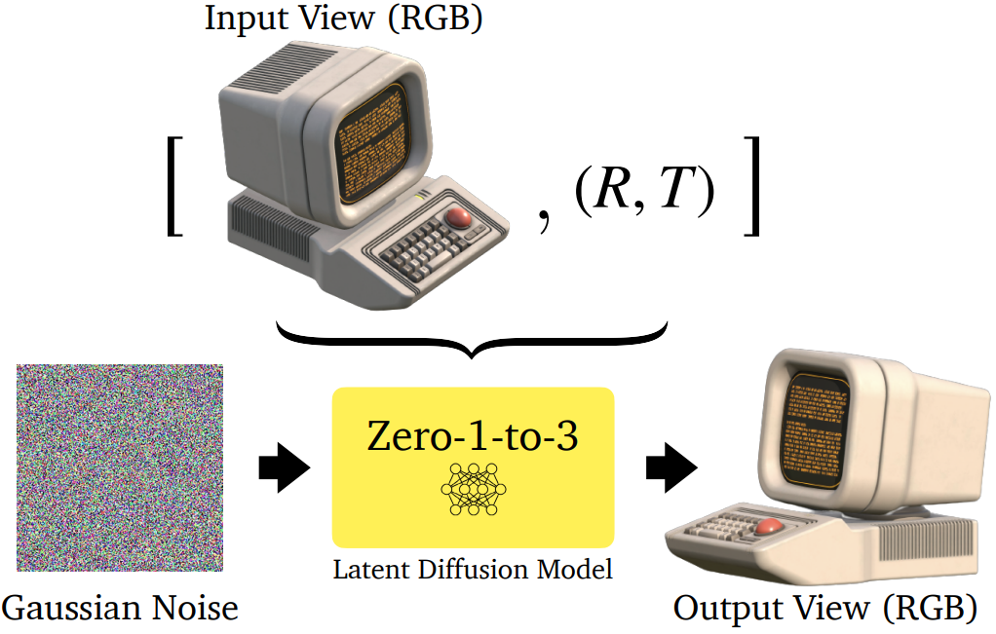
Zero-1-to-3
Zero-1-to-3: Train a diffusion model to generate novel views of an object.
  Key Idea: Condition the generation on an image of the object and rotation angles .
  Trained on Objaverse
Notes:
One of the first models tackling this was Zero-1-to-3.
It builds on top of Stable Diffusion to generate novel views of an object;
The model is conditioned on:
a single image of the object,
and a target rotation angle;
It was trained at scale on Objaverse, one of the largest datasets for 3D-aware image generation.

Slide 48


Zero-1-to-3
Zero-1-to-3: Train a diffusion model to generate novel views of an object.
  Input:
    Image of the object and rotation angles .
  Training Objective:
Where is the embedding of the input view and relative camera extrinsics
Notes:
Given an input image and a target viewpoint, Zero-1-to-3 uses a latent diffusion model to generate a novel image of the object from that viewpoint.
The training objective is the same as standard LDMs;
The key difference: the denoising network is conditioned not just on the noisy latent, but also on the input image and the rotation.
Once trained, the model can generate multiple views of an object, enabling 3D reconstruction from a single photo — a powerful and scalable solution for 3D generation.

Slide 49

Zero-1-to-3
Zero-1-to-3: Train a diffusion model to generate novel views of an object.
  Reconstruction:

Slide 50

Zero-1-to-3
Zero-1-to-3: Train a diffusion model to generate novel views of an object.
Notes:
Results Zero-1-to-3

Slide 51

Zero-1-to-3
Zero-1-to-3: Train a diffusion model to generate novel views of an object.
  Problem: consistency
Notes:
While the results from Zero-1-to-3 look quite impressive, there are clear limitations.
The most critical issue is inconsistency:
If we sample the same view multiple times, the generated images are often different.

Slide 52

Zero-1-to-3
2D Multi View Diffusion has no explicit 3D representation (e.g. NeRF or 3DGS). Thus, the 3D consistency of the generated images are not constrained.
Notes:
This happens because:
The model generates each view independently;
There is no explicit 3D representation or memory of previous views;
So there's no enforced 3D consistency across generated images.

Slide 53
Limitations of Multiview Diffusion
Notes:
Limitations of Multi-View Diffusion Models
Let’s now move to the final part of this talk — the limitations of current multi-view diffusion models.

Slide 54



Multiview Image Generation
Problems:
Independently generaing novel views leads to 3D inconsistencies!
Synchronized denoising with crosstalk (Zero123++, SyncDreamer, etc.) helps but cannot ensure accurate consistency!
Zero123++, Shi et al. '23
Key Questions:
How can we get rid of 3D inconsistencies? (Gen-3Diffusion)
How can we quantify inconsistencies and performance? (MVGBench)
Notes:
Improving 3D Consistency
In recent years, there has been a strong research focus on improving 3D consistency across novel views generated by diffusion models.
It is clear that if we generate the novel views independently without crosstalk, then we will surely end up with contradicting views and 3D inconsistencies!
Then people tried to synchronize the denoising with techniques like cross-attention between different views. This does help with creating more consistent views, but it still does not fully resolve the problem (horse is looking to the left vs right)
So key questions we want to adress in the remainder of this lecture are the following:
Can we create a model that by design creates 3d consistent multi view images?
How can we quantify inconsistencies? And can we create a benchmark to fairly compare different multiview image generation methods?
These two works were actually done in our group!

Slide 55









MV Diffusion + Sparse Reconstruction
Sparse
Reconstructor
(Regressor)
NeRF / SDF / 3D-GS
Xue et al. NeurIPS’24 [Human 3Diffusion]

Slide 56



MV Diffusion + Sparse Reconstruction
3D inconsistent multi-view images lead to unplausible 3D reconstruction
For example, floating 3D Gaussian Splats
LGM [Tang et al., 2024]
Xue et al. NeurIPS’24 [Human 3Diffusion]
Notes:
The inconsistency of generated images is suboptimal for downstream tasks, such as sparse view reconstructor. For example, Large Gaussian Model takes output from imagedream, and the inconsistency leads to the floating 3D Gaussian Splats, results in undesired rendering effect.

Slide 57




Problem
Multiview Diffusion Process lacks explicit 3D representation
Multiview-inconsistent
Multiview-consistent
Xue et al. NeurIPS’24 [Human 3Diffusion]

Slide 58
Solution
Introduce explicit 3D representation to refine multiview consistency at each diffusion timestep!
Multiview-inconsistent
Multiview-consistent
Reverse Sampling
Consistency Refinement
Xue et al. NeurIPS’24 [Human 3Diffusion]

Slide 59

Gen-3Diffusion: Sync 2D Diffusion & 3D Recon
Key Idea: Synchronizing 2D Multiview Diffusion and 3D diffusion-based Generative models
Notes:
Gen3D Fusion – 3D as a Consistency Backbone
The final direction we look at is to explicitly integrate 3D structure as a guiding backbone for the diffusion process.
A representative method here is Gen3D Fusion.
This method combines:
A 3D generative model that provides strong geometric priors,
With a multi-view 2D diffusion model, which benefits from rich image data and view diversity.
By fusing these two components, the model achieves the generalization power of 2D with the explicit geometry of 3D.

Slide 60
Xue et al. NeurIPS’24 [Human 3Diffusion]
Notes:
Our model is based on diffusion. We combine multi-view generation and 3D reconstruting using a gaussian splat representation.
Et each iteration the 3D generation model takes as input: the input view x^x and the current nosiy multi-view x^tgt which are rendered from the representation.
It also takes the predicted Multiview images as input, which might be 3D inconsistent, but they constitute a shape prior.
Then we generate the 3D representation based on Gaussian splats, render muklti-view and backpropagate throught he 3D generative model and the diffusion model

Slide 61

Algorithm

Slide 62

Explicit 3DGS helps 2D Diffusion

Slide 63




Reconstruction avatar appearance
Input Image
Gen-3Diffusion
SiTH
SiFU
Notes:
Here is a comparation of Gen3Diffusion with two state-of-the-art avatar reconstruction works, show superior performance in both appearance and geometry.

Slide 64




Reconstruction avatar geometry
Input Image
Gen-3Diffusion
ICON
ECON
Notes:
Gen3Diffusion shows better reconstruction results in challenging subjects.

Slide 65




Reconstruction w/ novel view diffusion
Zero123-XL
(ICCV 2023)
SV3D
(ECCV 2024)
Input Image
Our
Xue et al. Gen3Difussion PAMI’25

Slide 66




Reconstruction w/ novel view diffusion
Zero123-XL
(ICCV 2023)
SV3D
(ECCV 2024)
Input Image
Our
Xue et al. Gen3Difussion PAMI’25

Slide 67


Strong generalization
Notes:
This generaliation ability also shows on multi-human image reconstruction. This amazing generalizing ability is all thaks to the foundational power from the pre-trained 2D diffusion model.

Slide 68
Multiview Diffusion and Ground Truth
As we said at the beginning of the lecture, reconstructing an object from a single image is an ill-posed problem.
One of the main limitations of multiview diffusion is that benchmarks are based on Ground Truth data
  Problem: What is Ground Truth in a Generative task?
Notes:
A good starting point is to remember that reconstructing 3D from a single image is an inverse problem.
That means: for a single 2D view, there are many valid 3D interpretations.
Multiple 3D shapes can explain the same image equally well.
So there is inherent ambiguity in this task.
A major issue in current literature is how we evaluate these models.
Most works benchmark their performance using some kind of ground truth 3D data — like object meshes or multi-view renderings.
However, in a generative task, this doesn’t always make sense.
Why?
Because the model might generate a shape that is plausible and consistent, even if it’s not the same as the ground truth.
Penalizing such outputs could be misleading.

Slide 69


Let's play a game. Which is the GT?
Input View
180° Generated Views
Notes:
So, let’s play a quick game.
In the top right, you see the input view — a front-facing image of the object.
At the bottom, we have four possible back views, all showing the object rotated by 180°.
And the question is:
Which one is correct?
The truth is — we don’t know. Since the back side is occluded in the input view, it’s actually very hard to say which of these is the real one, unless some generation has obvious artifacts.

Slide 70
Let's play a game. Which is the GT?
Input View
Generated Views
GT
Notes:
Ground Truth Revealed
Here is the actual ground truth back view.
As you can see, it was not at all obvious.
And this leads to a key insight:
When we ask a model to generate the back of an object from a single input image, we’re essentially asking for a plausible guess, not an exact reconstruction.
So comparing the generated image directly to the ground truth — pixel by pixel or geometry by geometry — often doesn’t make much sense.
What does make sense is evaluating:
consistency across views,
3D geometry consistency,
and texture coherence.

Slide 71
Let's play a game. Which is the GT?
Hidden in the front view
Mirrored
Input View
180° GT
It does not make sense to compare a generated view to a fixed GT view.
Notes:
Example – Back View Discrepancy
Here's a concrete example:
On the left is the front view,
On the right is the actual back view.
Notice two things:
There's a yellow triangle on the back that’s completely invisible from the front.
The back side has slight asymmetries — for example, the staircase is shifted slightly to the right.
So again, if a model predicts a perfectly symmetric version of the object’s back, should we penalize it just because the real object was slightly asymmetric?
Probably not.

Slide 72

MVGBench, Xie et al.
Comprehensive benchmark that evaluates
  3D geometric consistency
  3D texture consistency
  Image Quality
  Semantic Consistency
Notes:
A New Benchmark
This is exactly the motivation behind a recent ICCV 2025 paper from our group.
The goal is to introduce a comprehensive benchmark that goes beyond simple GT comparison and evaluates:
3D geometry consistency,
texture consistency,
visual quality,
and semantic correctness.

Slide 73

MVGBench, Xie et al.
3D geometric and texture consistency
Notes:
How the Benchmark Works
Here's how it works:
Take any multi-view generation system.
Generate two independent sets of views from the same input.
Reconstruct the scene from both sets using 3D methods.
Apply 3D consistency metrics between the reconstructions.
The key idea is:
if the generated views are internally consistent, then their 3D reconstructions should also be structurally consistent.

Slide 74
MVGBench, Xie et al.
Semantic Metrics
  FID score
  Pretrained VLM for question answering on the overall quality of the generated view
Image Quality Metrics
  Pretrained VLM to assess
    Class consistency
    Color consistency
    Style consistency
Notes:
Semantic and Image Quality Metrics
In addition to geometric consistency, the benchmark also measures:
FID score, which compares the distribution of generated images with the training distribution — so it's not just comparing to a specific GT image.
A pre-trained Vision-Language Model (VLM) is used to evaluate:
Semantic consistency through tasks like question answering,
Image quality via class, color, and style consistency.

Slide 75

MVGBench, Xie et al.
Notes:
Trade-off: Image Quality vs 3D Consistency
Finally, one of the most interesting findings:
There’s a clear trade-off between image quality and 3D consistency.
This plot shows that methods like Zero-1-to-3, SV3D and SyncDreamer fall on different parts of the spectrum.
No existing method achieves both high image fidelity and high 3D consistency — at least not yet.
This suggests there's still a lot of room for improvement, especially toward building systems that are both photorealistic and geometrically consistent.

Slide 76
Conclusion
In this lecture we saw
  How Diffusion Models work
  How can we leverage diffusion models to generate multiview images
  We saw some limitations of Multiview Diffusion.
Next Lecture:
  Multiview Diffusion is not the only way to exploit Diffusion for 3D
    Score Distillation Sampling
  Methods that do not leverage on Image Diffusion
    PointDiffusion
    Hunyuan3D 2.0
    Trellis

Slide 77
Multiview Image Generation
Problem: novel views are generated independently.​
Recent works that improve consistency:​
    Synchronized Multiview Noise Prediction​
      SyncDreamer, Liu et al. ICLR 24
    Epipolar Geometry
      EpiDiff, Huang et al. CVPR 24
    Temporal Consistency
      SV3D, Voleti et al. ECCV 24
    Leverage 3D Consistency
      Gen-3dffusion, Xue et al.
Notes:
Improving 3D Consistency
In recent years, there has been a strong research focus on improving 3D consistency across novel views generated by diffusion models.
The goal is to make the generated views dependent on each other, rather than producing them independently, which often leads to inconsistencies.
We can identify four main research directions that are currently the most promising:
Synchronized multi-view noise prediction,
Epipolar geometry constraints,
Temporal consistency from video diffusion models,
And finally, explicit 3D consistency supervision to guide 2D diffusion for consistent multi-view generation.
We’ll now look at one representative method for each of these four directions.

Slide 78



SyncDreamer, Liu et al. ICLR 24
Goal: Given an image , we want to generate novel views by learning the joint distribution
Key Idea: Condition a novel view with images generated from other views.
Notes:
Let’s start with the first: SyncDreamer.
Motivation
The goal of SyncDreamer is to generate all novel views from a single image y , by learning a joint distribution over the full set of views.
The key idea is to condition the generation of each view not just on the initial image, but also on all the other generated views.

Slide 79

SyncDreamer, Liu et al. ICLR 24
Forward Process: is a direct extension of the vanilla DDPM, where noises are added to every view independently.
Notes:
Forward Process
The forward process in SyncDreamer is a direct extension of the vanilla DDPM:
Gaussian noise is added independently to each view;
Each view has its own noisy version.
So, this part is essentially the same as in standard diffusion models.

Slide 80


SyncDreamer, Liu et al. ICLR 24
Backward Process: Similarly, it is constructed as
Notes:
Reverse Process – Key Idea
The reverse process is where things change:
Instead of conditioning only on the current noisy view at time step t, each view is now generated by conditioning on multiple other views at the same time step.
This is the core idea behind SyncDreamer: synchronizing the denoising across all views.

Slide 81

SyncDreamer, Liu et al. ICLR 24
Backward Process:
    To condition the generation of a view on all the other N views at the same time, they project features in 3D, apply convolutions, and then construct a view frustum by interpolating features.
Notes:
Cross-View Conditioning
To enable this synchronized conditioning, SyncDreamer:
Projects features from each view into a shared 3D space;
Applies 3D convolutions to aggregate features across views;
Then interpolates the 3D features to generate a "view frustum" representation for the target view.
This view frustum acts as a strong multi-view conditioning signal for the generation of each novel view.

Slide 82



SyncDreamer, Liu et al. ICLR 24
Loss:
Notes:
The loss remains standard noise prediction:
The model predicts the added noise for each view,
Then computes the difference between the true and predicted noise.
The key difference is that this is now done jointly across multiple views, ensuring synchronized and consistent predictions.
As we can see in the qualitative results:
SyncDreamer produces significantly more consistent outputs compared to Zero-1-to-3 ;
Sampling the same view multiple times now leads to nearly identical results, unlike in earlier models.

Slide 83


SyncDreamer, Liu et al. ICLR 24
Better 3D
reconstructions
Notes:
Geometry Extraction – Cleaner Meshes
This consistency also improves geometry extraction:
The recovered meshes are much cleaner, with less noise,
Because the underlying multi-view images are geometrically consistent.
In contrast, methods like Zero-1-to-3 generate noisy and inconsistent meshes due to the lack of cross-view dependency.

Slide 84

EpiDiff, Huang et al. CVPR 24
Key Idea: Exploit Depth-aware 3D attention and Epipolar constraints to ensure depth consistency across different novel views
Notes:
There are, of course, several other approaches that aim to improve view consistency in multi-view diffusion.
One particularly interesting method is EpiDiff, presented at CVPR 2024.
EpiDiff takes a geometric approach to the problem, leveraging epipolar constraints to enforce consistency across views.
The core idea is conceptually similar to other joint multi-view diffusion methods:
We start from a single input view y and generate multiple new views simultaneously.
But instead of conditioning on a 3D volume or implicit representation, EpiDiff conditions each generated view by projecting features from neighboring views onto it, using epipolar geometry.

Slide 85

EpiDiff, Huang et al. CVPR 24
Cross attention with
neighboring epipolar lines
2) Self attention for spatial
consistency
Notes:
Epipolar Projection for Feature Conditioning
Here’s how it works in more detail:
When generating a new view, EpiDiff first identifies N neighboring views that are geometrically close.
Then, for each neighboring view, it traces epipolar lines, and uses features on the epipolar lines in a cross attention mechanism
This gives the model a geometrically meaningful guess about where the neighboring features should appear in the target view,
essentially aligning the context across views in a physically grounded way.

Slide 86

EpiDiff, Huang et al. CVPR 24
Notes:
This approach allows EpiDiff to strongly encode geometric priors into the generation process, leading to significantly improved multi-view consistency without the need for explicit 3D supervision.

Slide 87

SV3D, Voleti et al. CVPR 24
Key Idea: Finetune Stable Video Diffusion on videos of rotating object. Condition on elevation and azimuth angles to control the camera movement.
Notes:
SV3D – Leveraging Video Diffusion for 3D
Another interesting approach is SV3D, which stands for Stable Video Diffusion for 3D.
The idea is to generate synthetic videos of objects rotating from a single image, using camera pose conditioning — specifically, the elevation and azimuth of the camera.
This allows the model to create 360° object views, and the resulting video frames can later be used with methods like Gaussian Splatting or NeRF to reconstruct the full 3D mesh.

Slide 88

SV3D, Voleti et al. CVPR 24
Conditioning: to control the camera movement, they condition on camera positions.
Notes:
Dynamic Camera Conditioning
A key aspect of SV3D is its dynamic camera conditioning:
It doesn’t just teach the model to rotate around the object,
It also allows for camera trajectories that move closer or farther from the object,
This improves the generalization capabilities of the model.

Slide 89
SV3D, Voleti et al. CVPR 24
Consistency: SV3D is based on Stable Video Diffusion (SVD), which already implements some techniques to improve consistency across the generated video.
    SVD is a variant of Stable Diffusion adapted for video generation.
    It reaches temporal coherence by adding temporal attention and 3D convolutions to Stable Diffusion's U-Net.
Notes:
Built on Stable Video Diffusion
SV3D builds on Stable Video Diffusion, which itself is based on Stable Diffusion but extended for video generation.
Stable Video Diffusion introduces:
Temporal attention and
3D convolutions across frames,
to ensure temporal coherence in the video — meaning that frames remain geometrically and visually consistent over time.
So, by building on top of this video architecture, SV3D inherits temporal and geometric consistency in the generated object rotations.

Slide 90

SV3D, Voleti et al. CVPR 24
Notes:
Here we can see qualitative results from SV3D.
The model generates smooth and coherent object rotations.
Compared to earlier models like Zero-1-to-3 and its improved version Zero-1-to-3 XL, SV3D achieves higher consistency and realism across frames.

Slide 91
Diffusion Probabilistic Models
Diffusion model aims to learn the reverse of noise generation procedure
  Forward step: (Iteratively) Add noise to the original sample
    → The sample converges to the complete noise (e.g., )
  Reverse step: Recover the original sample from the noise
    → Note that it is the “generation” procedure
Notes:
Diffusion Probabilistic Models
The idea is simple:
Start from a clean image x_0
Gradually add Gaussian noise through a forward process, until the image becomes pure noise (x_T)
Then, learn the reverse process to recover the original image from noise
This reverse process is what enables the model to generate new data – by starting from noise and progressively denoising it into a realistic sample.

Slide 92




Diffusion Probabilistic Models
Diffusion model aims to learn the reverse of noise generation procedure
  Forward step: (Iteratively) Add noise to the original sample
    → Technically, it is a product of conditional noise distribution
  Usually, the parameters are fixed (one can jointly learn them, but it is not beneficial)
  Noise annealing (i.e., reducing noise scale ) is crucial to the performance
Notes:
Forward Process – Mathematical Formulation
In the forward process, we define a Markov chain that adds Gaussian noise at each step:
The probability of a noisy sample at time t, given the previous step t−1, is denoted as (Formula on the right)
The full forward process can be written as (formula on the left)
Here:
βt are the variance schedule parameters that control how much noise is added at each step
They are typically fixed beforehand, though in theory they could be learned
To ensure that the added noise doesn’t overwhelm the data too early, βt values are gradually increased across timesteps.
The forward process is Gaussian, making the math tractable and differentiable.

Slide 93


Diffusion Probabilistic Models
Diffusion model aims to learn the reverse of noise generation procedure
  Forward step: (Iteratively) Add noise to the original sample
    → Technically, it is a product of conditional noise distribution
  Reverse step: Recover the original sample from the noise
    → It is also a product of conditional (de)noise distribution
  Use the learned parameters: denoiser (main part) and randomness
Notes:
In the reverse process, the goal is to recover the original sample x_0 starting from pure noise x_T.
This process is learned by training a neural network to denoise progressively:
The model learns to approximate the reverse conditional distribution pθ (x_t−1 ∣x_t )
This is modeled as a Gaussian distribution with:
Mean μθ(x_t, t)
Variance Σθ(x_t , t)
These are both parameterized by neural networks with parameters θ.
So the reverse step predicts a cleaner sample x_{t-1} given a noisier one x_t , using the predicted μ and Σ.
The full reverse process is defined as a product of these conditional distributions (Formula bottom left)
This is what allows the model to generate realistic data from random Gaussian noise.

Slide 94


Diffusion Probabilistic Models
Diffusion model aims to learn the reverse of noise generation procedure
  Forward step: (Iteratively) Add noise to the original sample
  Reverse step: Recover the original sample from the noise
  Training: Minimize variational lower bound of the model
Notes:
To train the model, we use a variational approach.
We aim to minimize the negative log-likelihood of the data under the model,
but directly computing this is intractable.
Instead, we optimize a Variational Lower Bound (VLB) on the log-likelihood (Formula)
Why do we do this?
Because this ratio measures how well the model’s reverse process matches the forward process.
If they are the same, the ratio becomes 1, and the log becomes 0 — meaning perfect generation.

Slide 95
Diffusion Probabilistic Models
Diffusion model aims to learn the reverse of noise generation procedure
  Training: Minimize variational lower bound of the model
    It can be decomposed to step-wise losses (for each step t)
Notes:
In practice, this loss is further decomposed into simpler terms (KL divergences and reconstruction losses) that are easier to compute and optimize.
Denoising matching is matching the distribution at each time step
So, the core idea is:
We simulate how noise is added (forward process), and train the model to undo that noise in a way that matches the data distribution.

Slide 96




Diffusion Probabilistic Models
Diffusion model aims to learn the reverse of noise generation procedure
  Training: Minimize variational lower bound of the model
    Here, the true reverse step can be computed as a closed form of
    Note that we only define the true forward step

