Slide 1

Hands-on AI based 3D Vision Summer 26
Lecture 1_0 – Organization
Prof. Dr.-Ing Gerard Pons-Moll
University of Tübingen / MPI-Informatics
Notes:
Wellcome to virtual humans lecture!
In this first lecture I want to talk a bit about the organization of the lecture, and how it is going to be evaluated.

Slide 2
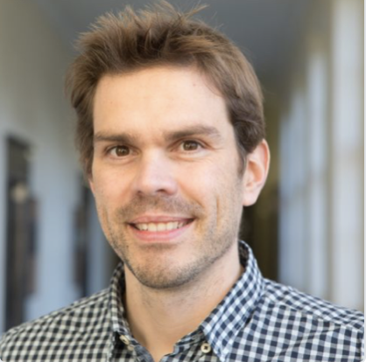
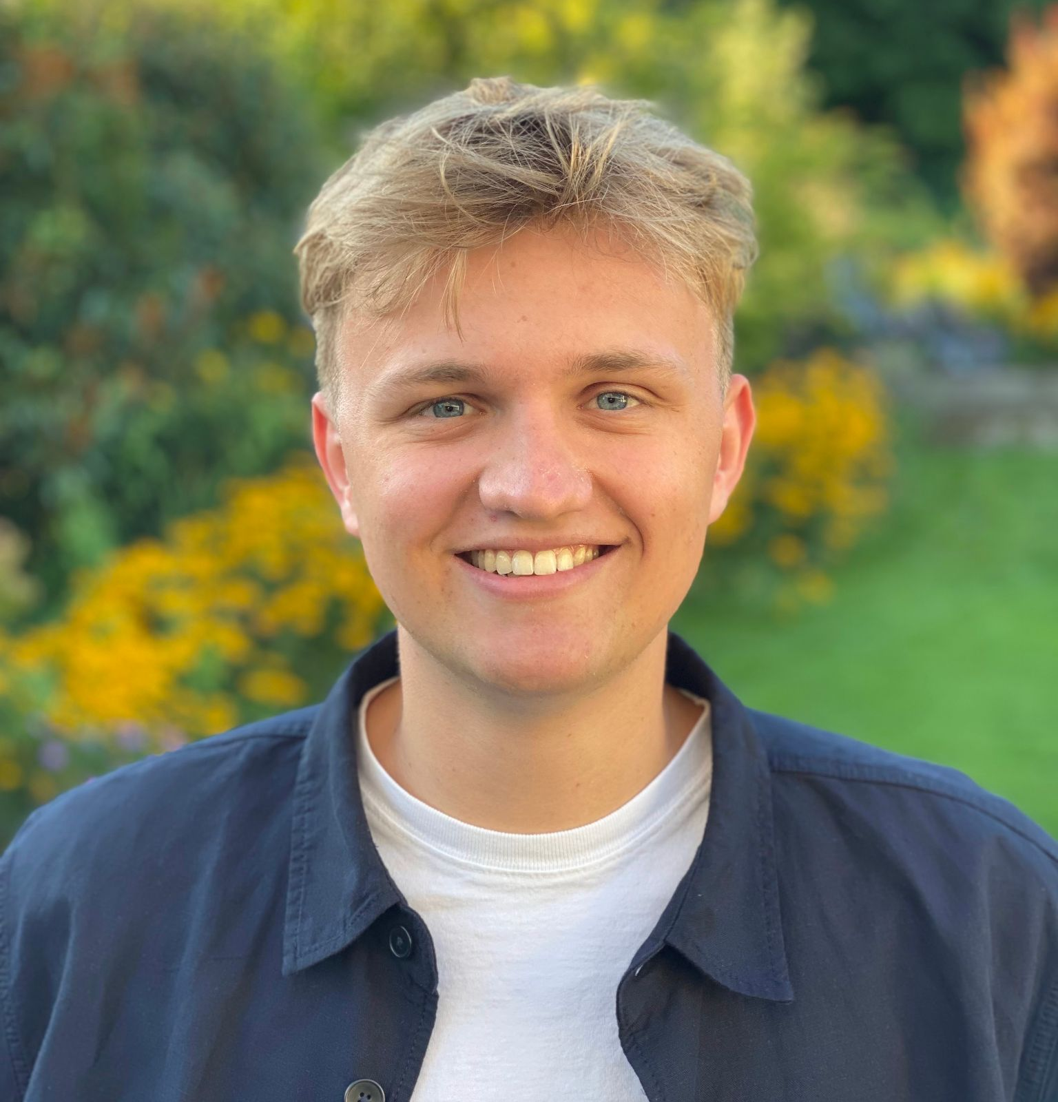
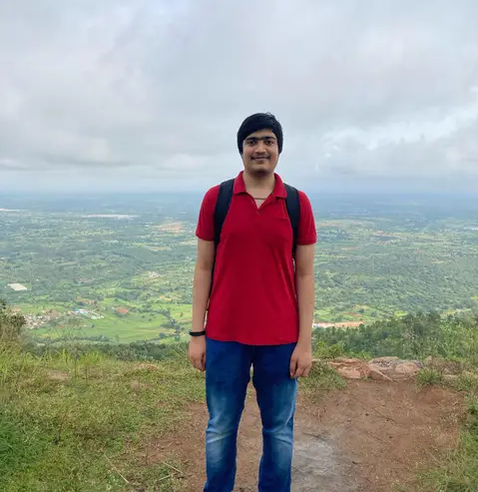

Team
Lecturer
Teaching assistants
Niklas Berndt
MvL 1, room A514
Pradyumna YM
MvL 1, room A514
Yannan He
Mvl 1, room A516
Prof. Dr.-Ing. Gerard Pons-Moll
Mvl 1, room A507
Notes:
I am Gerard Pons-Moll. I am professor in computer science....
MVL6 building second floor.
Teaching assistants PhD studetns in my group

Slide 3
Team
Lecturer
I am a Professor in Computer Science at the University of Tübingen and the Tübingen AI center
My group focuses on 3D computer vision and graphics
Special focus on Virtual Humans – making machines human-like
I want to teach machines to see, perceive and act on the 3D world like humans do
Prof. Dr.-Ing. Gerard Pons-Moll
5th floor Mvl 1
Notes:
I am Gerard Pons-Moll. I am professor in computer science....
MVL1 building fifth floor.
Teaching assistants PhD studetns in my group

Slide 4
Team
Teaching assistant
I am a first year PhD student supervised by Prof. Dr. Pons-Moll
Studied computer science and mathematics at RWTH Aachen
Interested in analysis and synthesis of realistic and plausible human-object interactions
Working on physics-based character animation
Niklas Berndt
5th floor MvL 1, room A514
Notes:
I am Gerard Pons-Moll. I am professor in computer science....
MVL6 building second floor.
Teaching assistants PhD studetns in my group

Slide 5
Team
Teaching assistant
I am a first year PhD student @ RVH group.
Studied machine learning @ Tübingen
Currently interested in human-scene interaction.
Pradyumna YM
5th floor MvL 1, room A514
Notes:
I am Gerard Pons-Moll. I am professor in computer science....
MVL6 building second floor.
Teaching assistants PhD studetns in my group

Slide 6
Team
Teaching assistant
I am a fourth year PhD student @ RVH group supervised by Prof. Dr. Pons-Moll.
Currently interested in human motion generation and deep generative models.
Yannan He
5th floor MvL 1, room A516
Notes:
I am Gerard Pons-Moll. I am professor in computer science....
MVL6 building second floor.
Teaching assistants PhD studetns in my group

Slide 7
Organization
Course webpage:
  https://virtualhumans.mpi-inf.mpg.de/3DVision26/
Lecture
  Wednesday 10-12, MVL1
  Tutorials on Tuesday 14-16, MVL6
  The course is 6 ECTS
Grade:
  50% exam, 20% exercises, 30% project
ILIAS and Website
  Announcements, discussion forum on ILIAS
  Exercises will be made available on ILIAS
  Slides will be available from the course webpage
Work in teams
  Form teams up to 3 people
    Add your team names on google docs (link)
    Deadline: April 24th 23:59PM CET.
  Exercises: Only 1 report per team

Slide 8
About Lectures and Tutorials
Lectures and Tutorials will be in presence.
It is really important that you participate in class. Any question is welcome. For example, ‘’I didn’t understand slide XX” or “I’d like to know more about these type of models” etc.
Classes will not be recorded.

Slide 9
Tutorial / Exercises
The exercises will consist of theoretical questions and also programming exercises
The final exercise (project) will consist of a mini research project
You can complete the exercises in teams of 2/3 people (depending on #of participants)
  Form a “team” until next week Apr 24 23:59PM CET.
  Add your team names on this google doc.
  We will remove you from the course if your name is not there to leave slots for waiting list students.

Slide 10
Evaluation criteria
Exam (Oral or written) 50 %:
  Depending on the number of students exam will be oral or written
  You need to pass the exam to pass the course
Exercises (20%) + project (30%):
  Exercises:
    Evaluation of theoretical exercises is based on correctness and clarity
  Project (mini-research project ~6 weeks) – we will evaluate
    Completeness of the report, including motivation, prior work, methodology, evaluation, and limitations/discussion.
    Whether the developed methods are substantial (not a small addition).
    Robustness of the final result in the scale and scope it was developed.
    We will have different TAs read the reports so that grading is unbiased.
    Presentation will also be graded
To pass the course, you need to pass the exercises, project and exam

Slide 11
Goal
After this course, students should be able to:
  Understand research papers related to 3D vision and be able to assess how they fit within the state of the art
  Develop classical and modern algorithms
    camera parameters estimation, Structure-from-Motion, pointcloud processing, Neural Rendering techniques, Generative models
Requirements:
  Master course. Knowledge of linear algebra, probability theory and programming skills are required.

Slide 12
Lectures Schedule
Location:
Lectures: MVL1, 10-12
Tutorials: MVL6, 14-16
Lecture | Lecture Date & Time |  | Lecture Title
Lecture 01 | April 15 |  | Introduction to 3D Computer Vision
Lecture 02 | April 22 |  | Camera Models and Coordinate Systems + First exercise
Lecture 03 | April 29 |  | Classical 3D Reconstruction Techniques
Lecture 04 | May 6 |  | Stereo Vision and Depth Estimation + Second exercise
Lecture 05 | May 13 |  | Surface reconstruction and Procrustes alignment
Lecture 06 | May 20 |  | Neural Fields and Point Based Representations + Third exercise
Lecture 07 | June 10 |  | Neural Radiance Fields (NeRF)
Lecture 08 | June 17 |  | Gaussian Splatting and Point Clouds + project proposal
Lecture 09 | June 24 |  | Advanced Methods in Learning-Based 3D Reconstruction
Lecture 10 | July 01 |  | Generative models
Lecture 11 | July 08 |  | Generative models continued
Lecture 12 | July 15 |  | Recap of concepts
Lecture 13 | July 22 |  | Project DEADLINE July 22 00:00 CET

