Slide 1

Hands-on AI based 3D Vision
Summer Semester 25
Lecture 4_0 – From Classical to Modern Stereo Vision and Depth Estimation
Prof. Dr.-Ing Gerard Pons-Moll
University of Tübingen / MPI-Informatics
Notes:
Intro

Slide 2
Overview
Intro
Recap of Epipolar Geometry
Stereo Matching and Depth Estimation
Multiview Stereo Matching
Monocular Depth Estimation
Notes:
Overview of the lecture

Slide 3
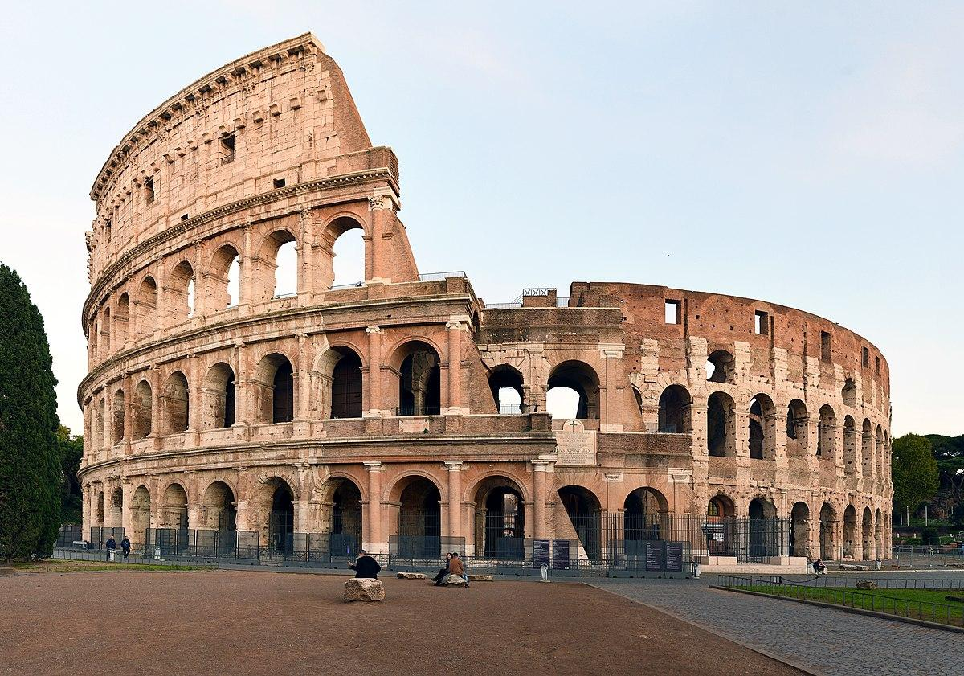
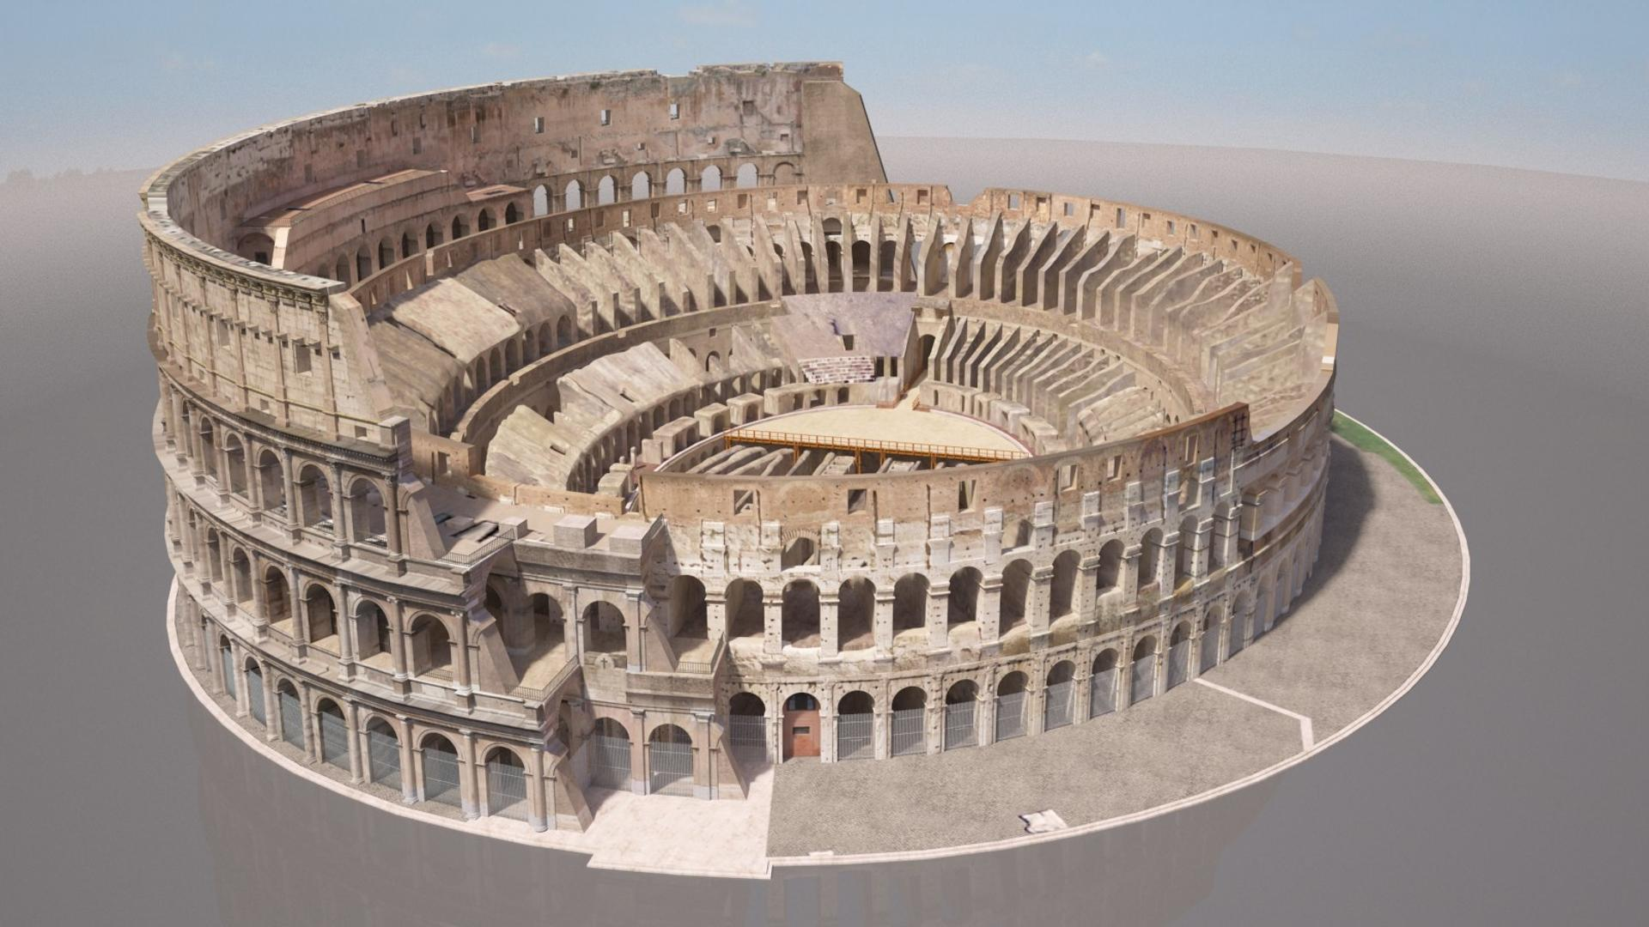
Recovering 3D from an Image
One of the main goals of 3D Vision is the reconstruction of 3D from images
Notes:
One of the most important goals of 3D vision is to reconstruct the shape of objects or entire scenes from images.
This has many practical applications.

Slide 4
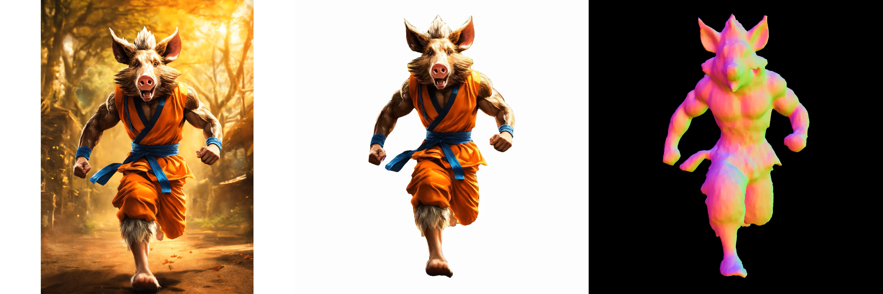
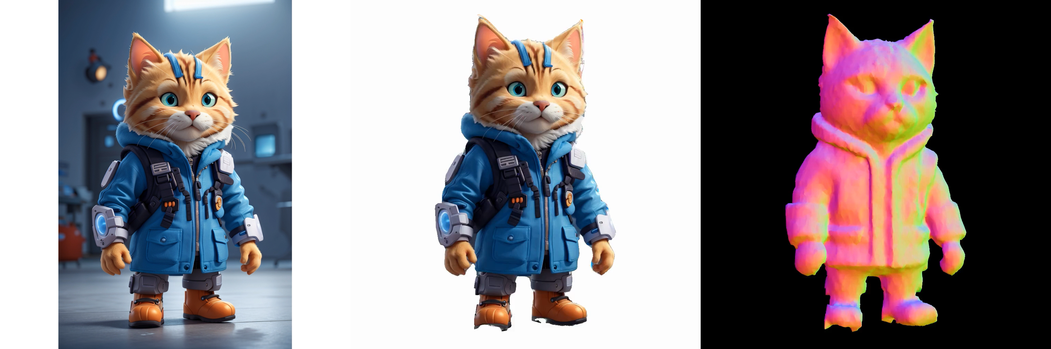
Help artists to speed-up their workflow
DreamCraft3D, Sun et al. ICLR 2024
Notes:
For example, it can help speed up the work of artists and 3D designers by automatically generating 3D models from photos.
This is crucial for fields like virtual reality, gaming, and digital twins.

Slide 5
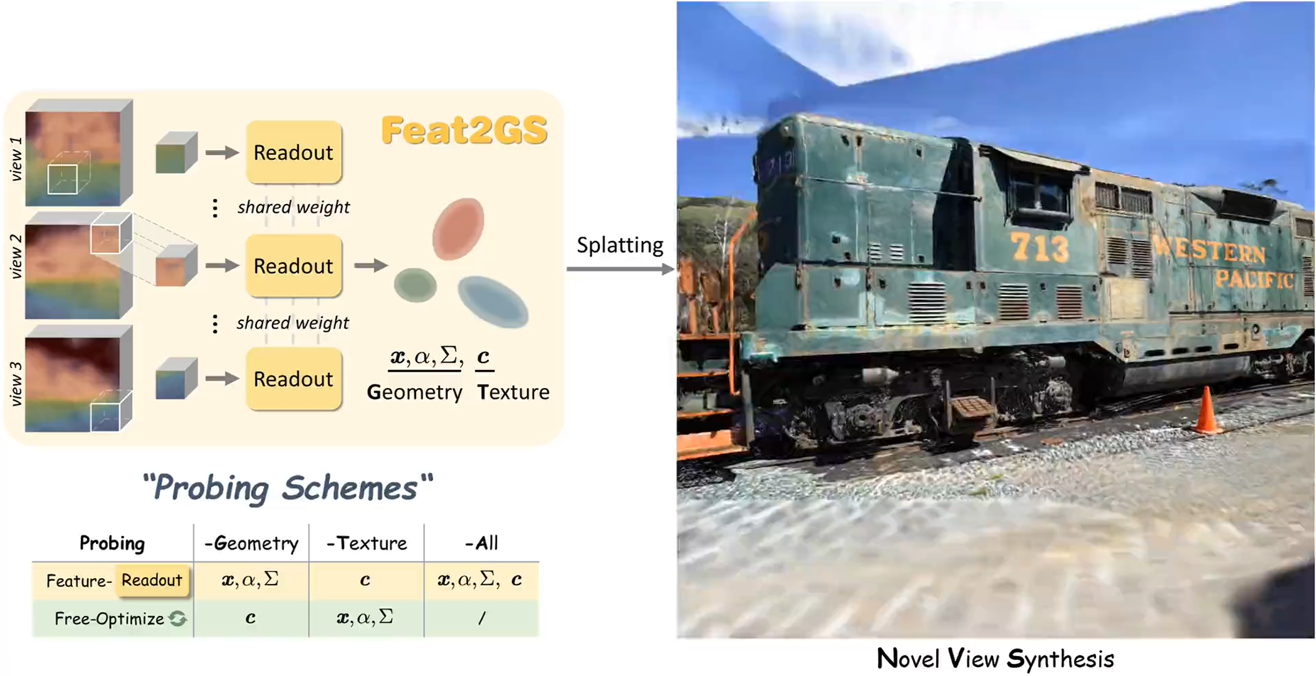
Democratize 3D asset creation
Feat2GS, Chen et al. CVPR 2025
Notes:
But more importantly, it can democratize 3D content creation—enabling people who have no modeling experience to create 3D assets simply by taking a photo.

Slide 6
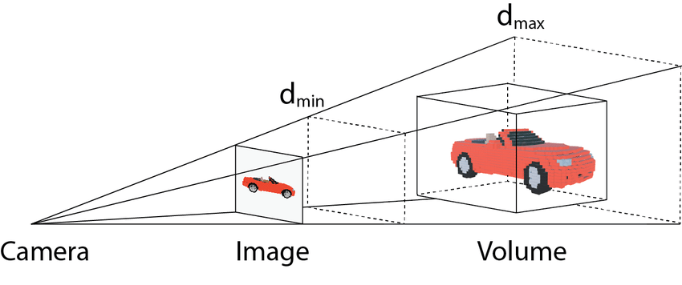
Recovering 3D from an Image
However 3D from an image is an ill-posed problem
During image formation, we lose depth information
Notes:
However, reconstructing 3D from a single image is an ill-posed problem.
That’s because when we take a photo, we’re projecting a 3D scene onto a 2D image plane, and in the process, we lose depth information.
The world has three dimensions, but the image only has two—and from a single viewpoint, we just don’t have enough information to fully recover the missing dimension.

Slide 7
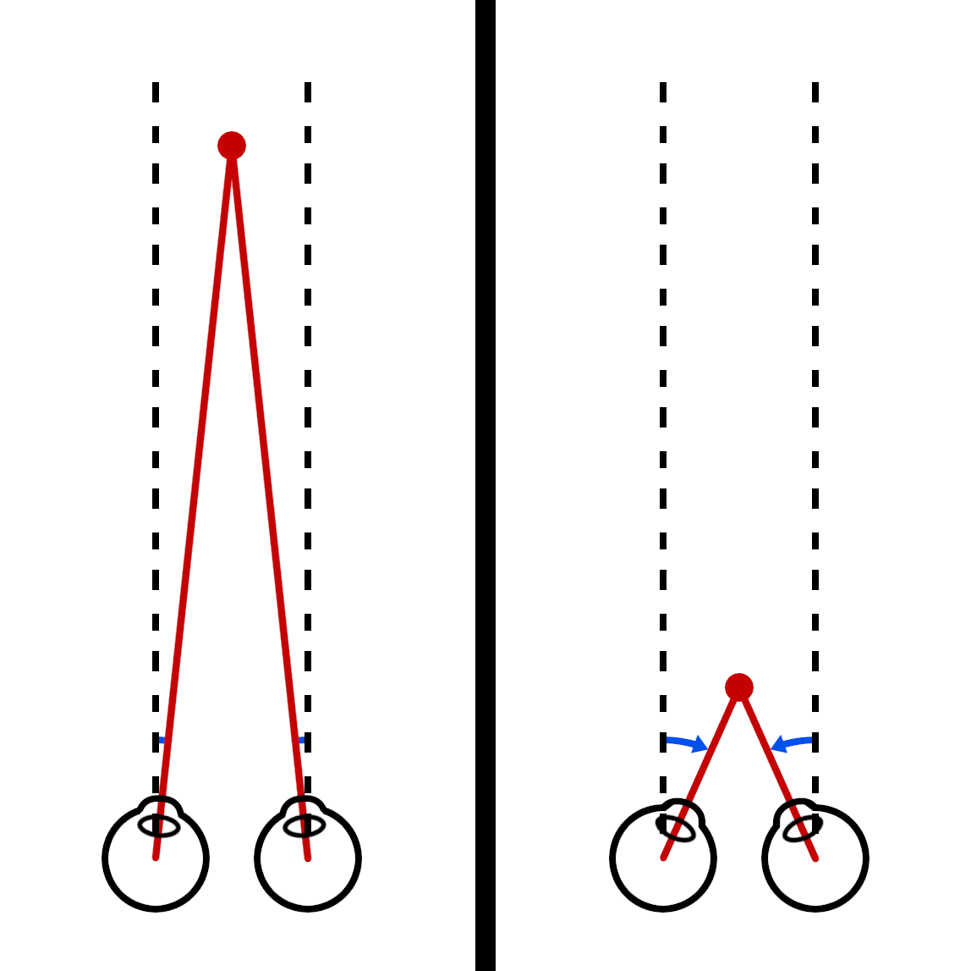
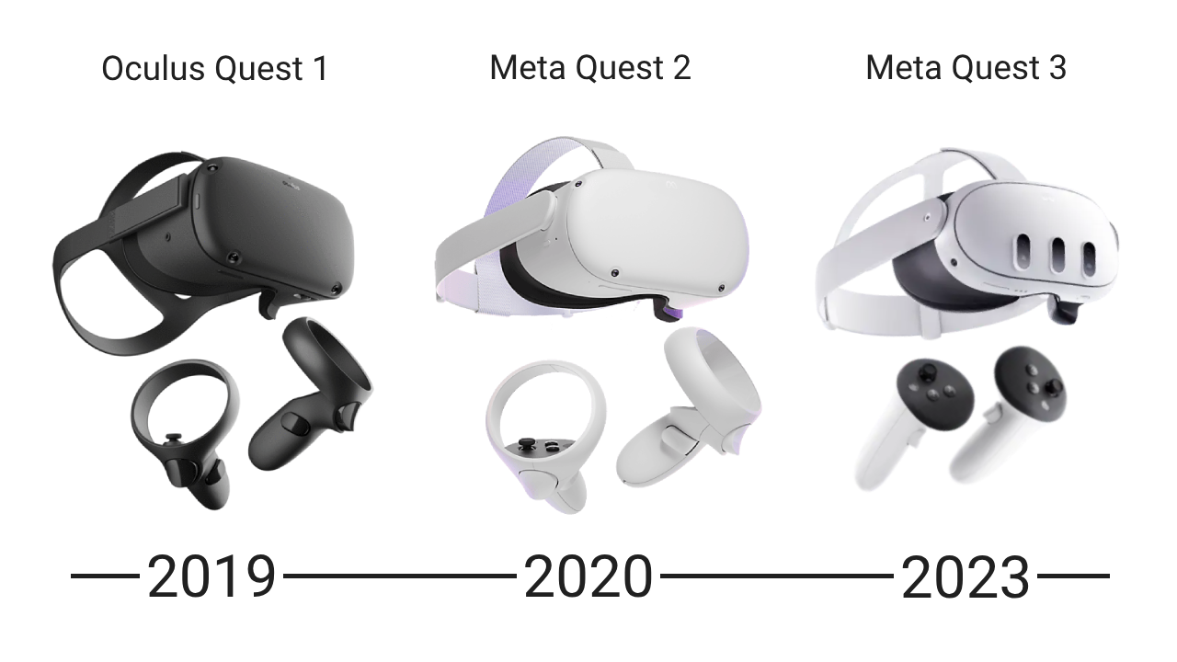
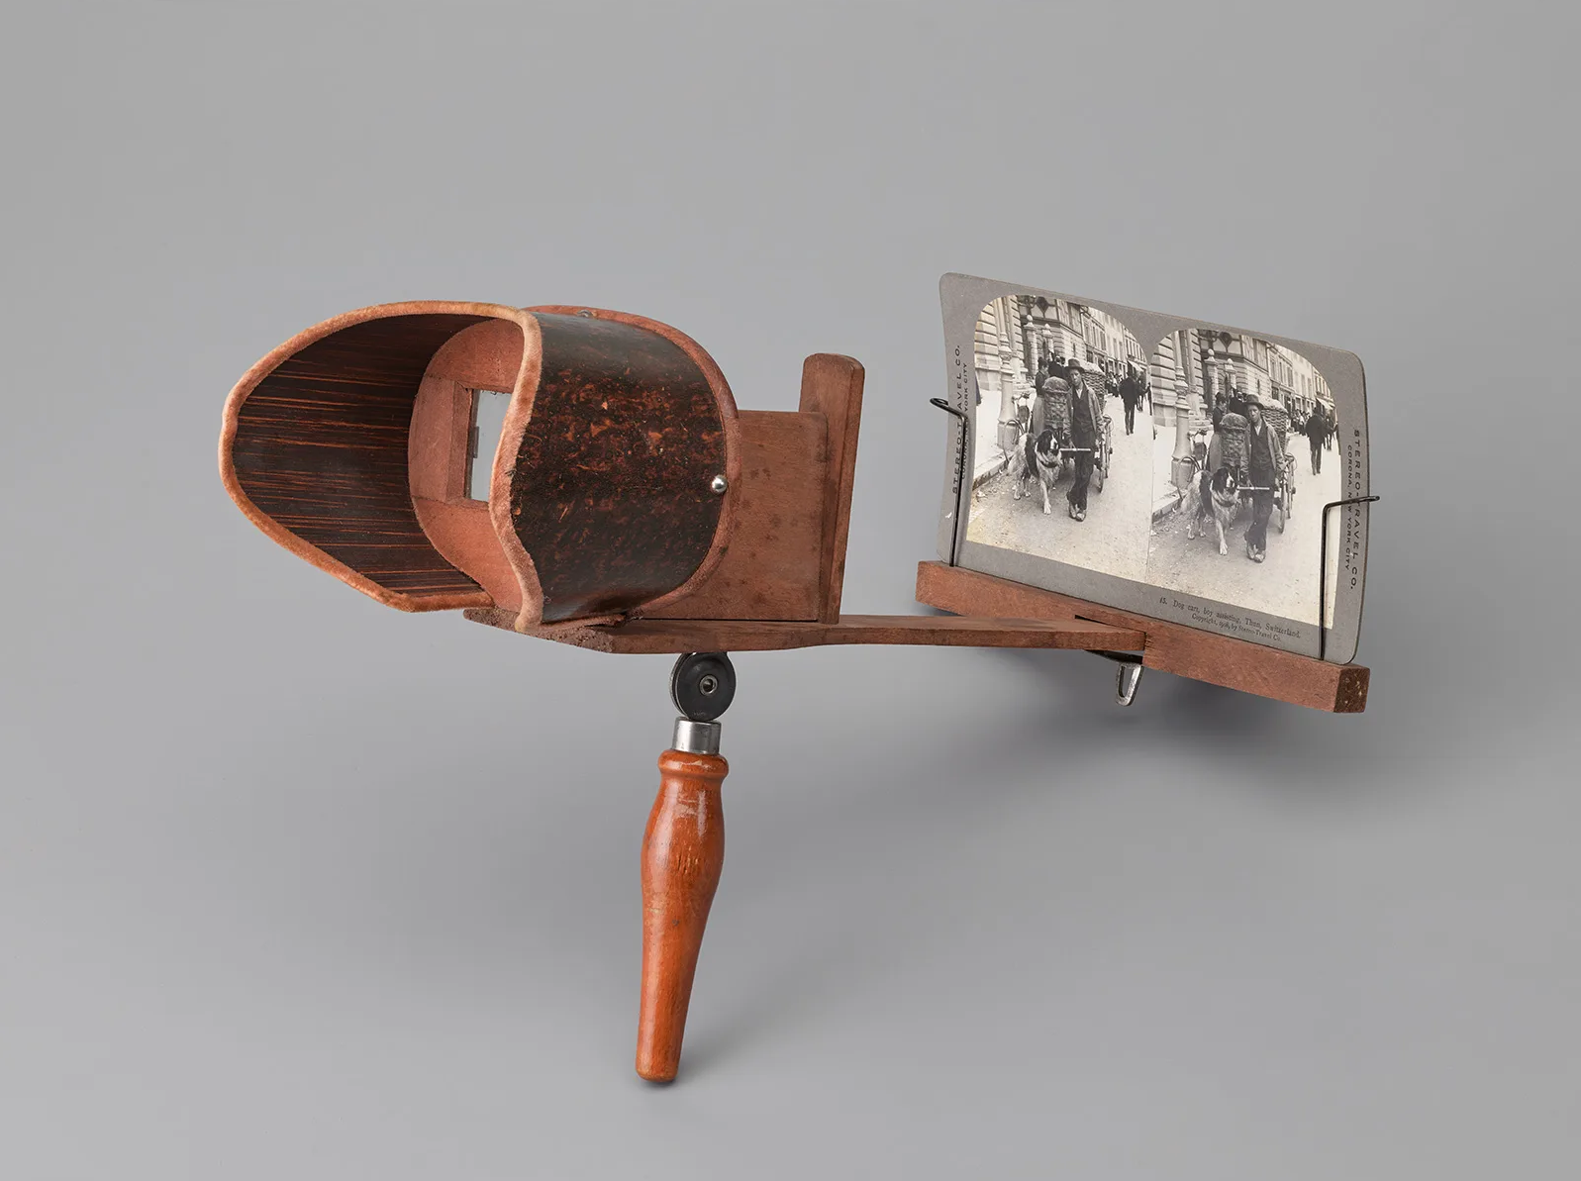
Recovering 3D from an Image
Luckily, we have more than one point of view on the word that surrounds us.
We can infer depth from our two-eye system
Wooden stereo viewing device, late 19th century. Swiss National Museum
Oculus/Meta Quest visors.
Notes:
Luckily, humans don’t face this limitation. We have two eyes, which give us two slightly different views of the world.
Our brain uses this difference—called disparity—to perceive depth effortlessly.
This ability has fascinated people for over a century. In fact, stereo viewing devices were already popular in the late 19th century to experience 3D photos.
Today, the interest in depth perception is rising again thanks to the advancement of technology—especially with the rise of VR and AR headsets, like the one shown here from Meta.
Thanks to our visual system and our two eyes, we’re able to infer depth based on the differences between the images perceived by each eye.
This binocular vision gives us a natural sense of how far or close objects are in our environment.
One of the main goals of 3D vision is to replicate this ability in machines.

Slide 8
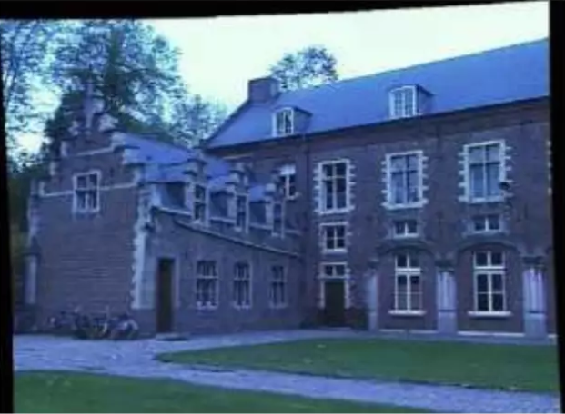
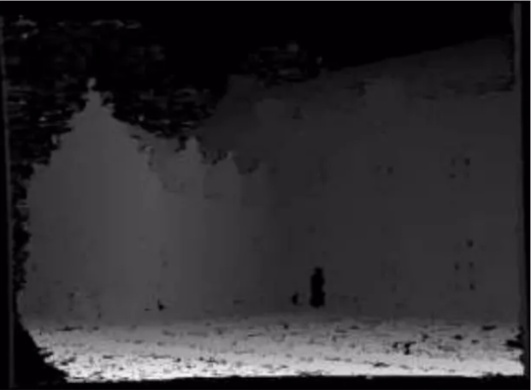
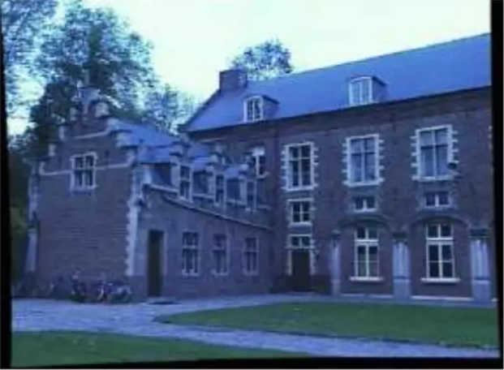
Recovering 3D from an Image
We would like to replicate the same behaviour, for computers
Depth image
Left image
Right image
Notes:
We want computers to estimate depth from two images—just like humans do.
By comparing a left and a right image, we aim to reconstruct a depth map that represents the distance of each pixel in the scene.
To do that effectively, we first need to understand epipolar geometry, which we briefly reviewed in the last lecture. Let’s quickly recap it here.

Slide 9
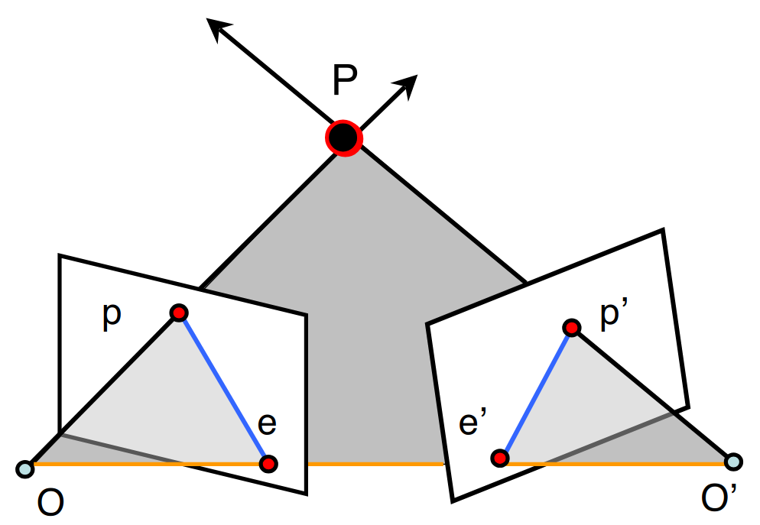



Epipolar Geometry
Recalls of epipolar geometry:
Cameras with center O and O’
The line that connects them: baseline
The intersections between the
image planes and the baseline
are called epipoles (e, e’)
If a point p is observed in image
, the corresponding point p’
must lie along the corresponding
epipolar line in image
baseline
Notes:
Now, if we observe a 3D point in one image, the corresponding point in the other image must lie along a specific line—called the epipolar line.
This constraint drastically reduces the search space for matching points between images.

Slide 10

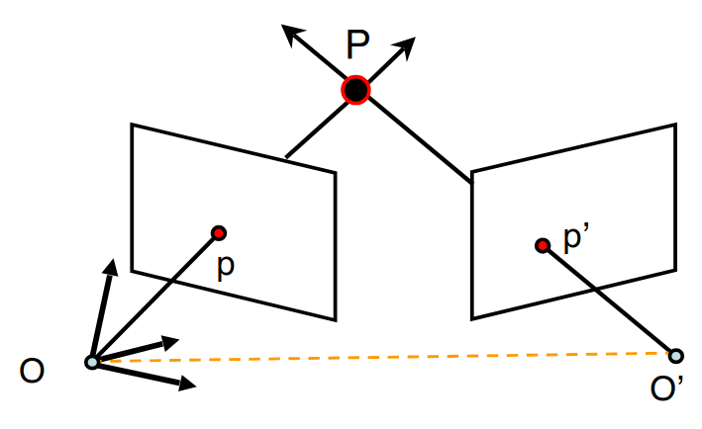




Epipolar Geometry
Mapping points of image to lines of image for canonical cameras:
Essential Matrix
is the matrix representation of the
cross product with translation (skew)
is the Rotation Matrix
Notes:
To map a point from one image to the corresponding epipolar line in the second image, we use the Essential Matrix, usually denoted by E.
This matrix encodes the rotation (R) and the translation (t) between the two camera views.

Slide 11





Epipolar Geometry
Mapping points of image to lines of image :
Fundamental Matrix
with intrinsic camera parameters
and respectively
Notes:
When we also account for the intrinsic parameters of the cameras, we get the Fundamental Matrix, F.
F is computed as F=K^{−T} EK'^{−1}, where K and K' are the intrinsic matrices of the two cameras.

Slide 12
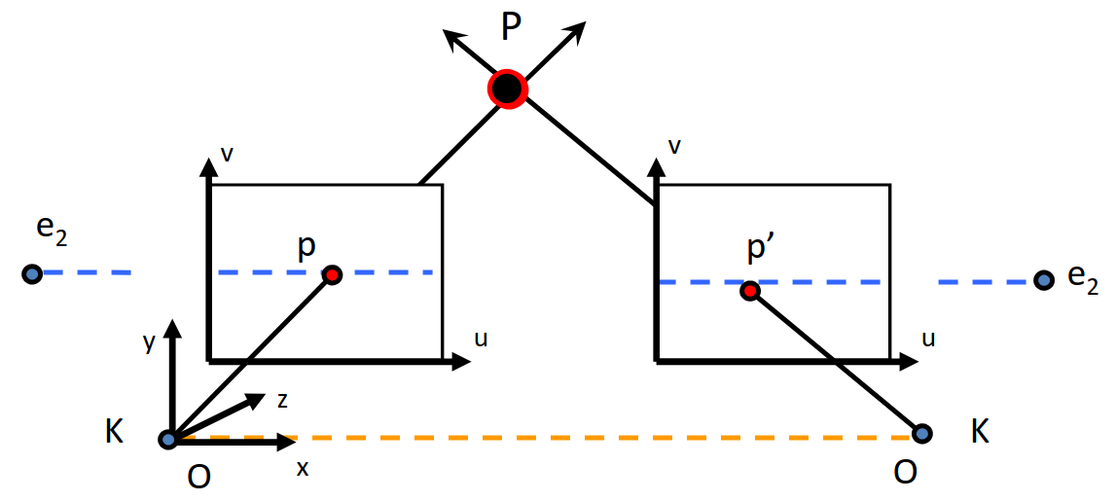
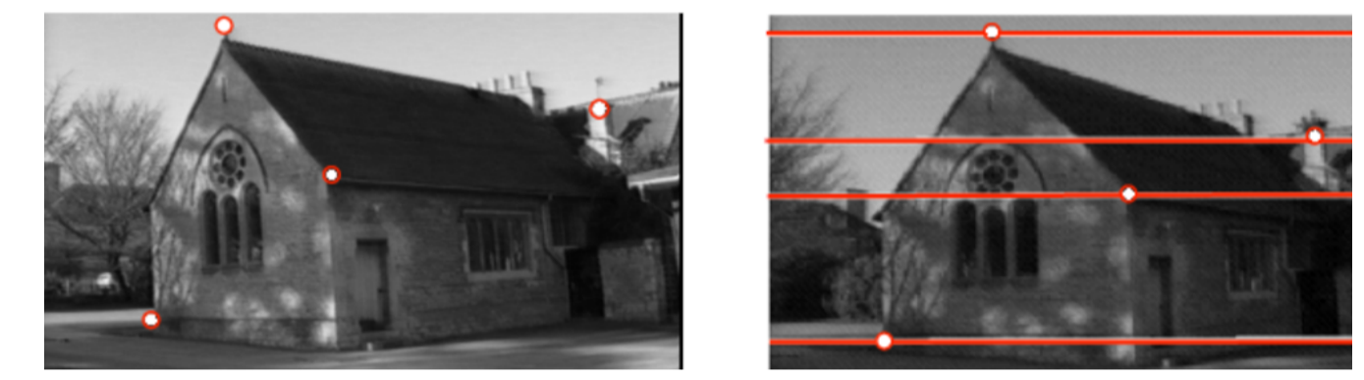
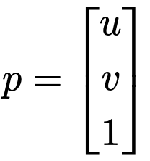
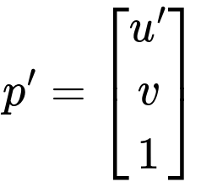
Epipolar Geometry
If we have parallel image planes:
Epipolar Lines are
horizontal and Epipoles
go to infinity
y-coordinates are
equal
v’
u
u’
Notes:
Now, in a special case where the cameras are aligned—meaning they are parallel and share the same image plane—something interesting happens.
The epipolar lines become horizontal and aligned with the scanlines of the image.
In this configuration, the Y-coordinates of corresponding points in both images are equal.
This simplifies the stereo matching problem significantly, since we only need to search along horizontal lines.

Slide 13
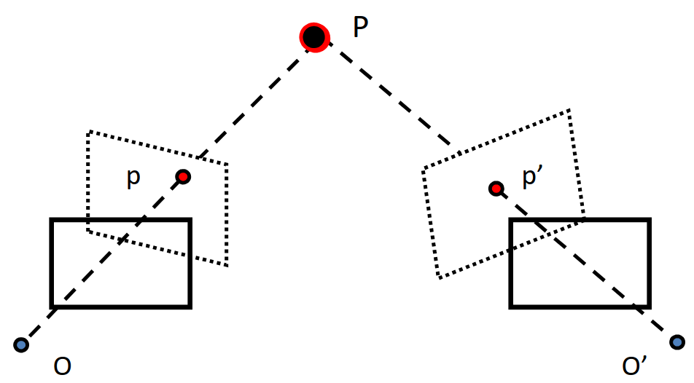
Image Rectification
The problem of warping camera planes to make them parallel is called
rectification
Existing algorithms solve
rectification by reprojecting
image planes onto a
common plane parallel to
the line between optical
centers
Notes:
To make this happen in practice, we often apply a process called rectification.
Rectification transforms the images—through warping—so that the two cameras appear as if they were parallel.
Several algorithms exist to perform this transformation by projecting both images onto a common plane.

Slide 14
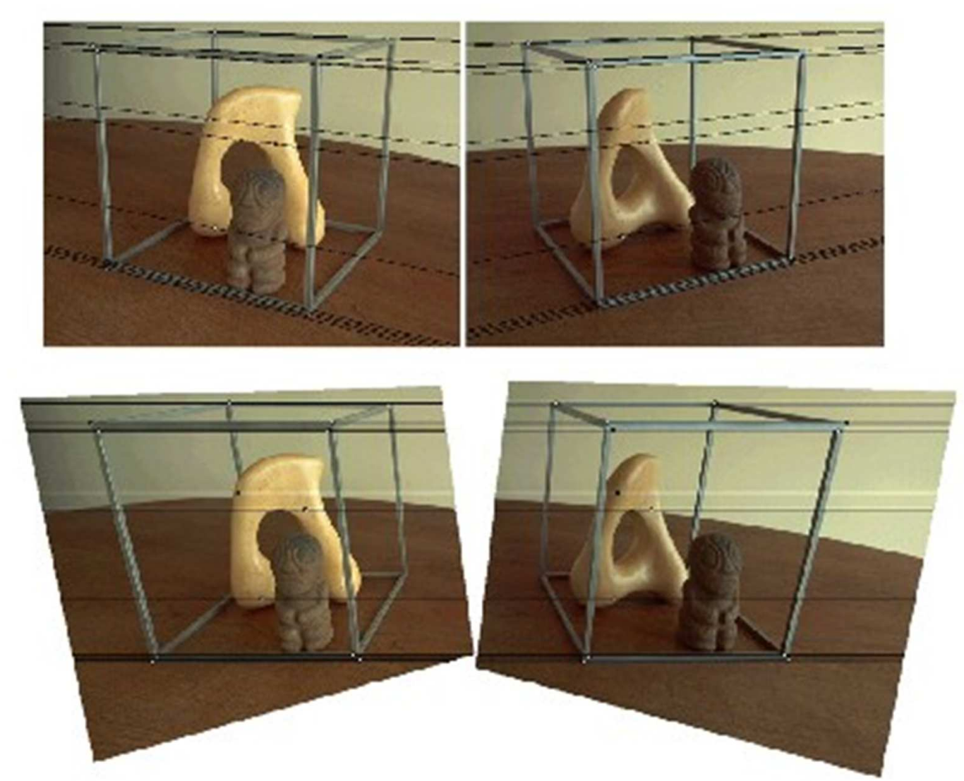
Image Rectification
A point in the right image corresponds to a set of candidate points along the same row in the left image
Computing rectifying homographies for stereo vision, Loop and Zhang, 1999
Notes:
This slide shows a concrete example of image rectification.
At the top, we see the original images.
At the bottom, the same images after rectification: now the epipolar lines are horizontal, and the epipoles have moved to infinity.
In this setup, each point in the right image corresponds to a set of candidate points along the same row in the left image.
This greatly simplifies matching, because we no longer need to search in two dimensions.
And this is exactly why rectification is such an important preprocessing step in stereo matching.

Slide 15



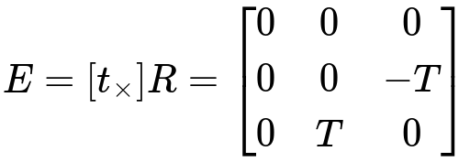
Image Rectification
After rectification, finding the essential matrix becomes trivial.
Image planes only differ by a translation:
Notes:
Once the images have been rectified, the Essential Matrix becomes trivial.
That’s because there’s no rotation involved anymore—only a translation along the horizontal axis.
In this case, the rotation matrix becomes the identity, and we’re left with just a simple translation to consider.
This greatly simplifies the computation of the correspondence between the two views and sets the stage for accurate and efficient depth estimation.

Slide 16
Stereo Matching

Slide 17
Stereo Matching
Given a pair of rectified stereo images, the goal of Stereo Matching is to compute the disparity for each pixel in the reference image, where disparity is defined as the horizontal displacement between a pair of corresponding pixels in the left and right images.
Notes:
Stereo matching is the process of estimating the disparity for each pixel given a rectified pair of stereo images.
Disparity is defined as the horizontal displacement between a pair of matching pixels—one from the left image and one from the right.
This displacement tells us how much an object shifts between the two views, and it’s key to estimating depth.

Slide 18
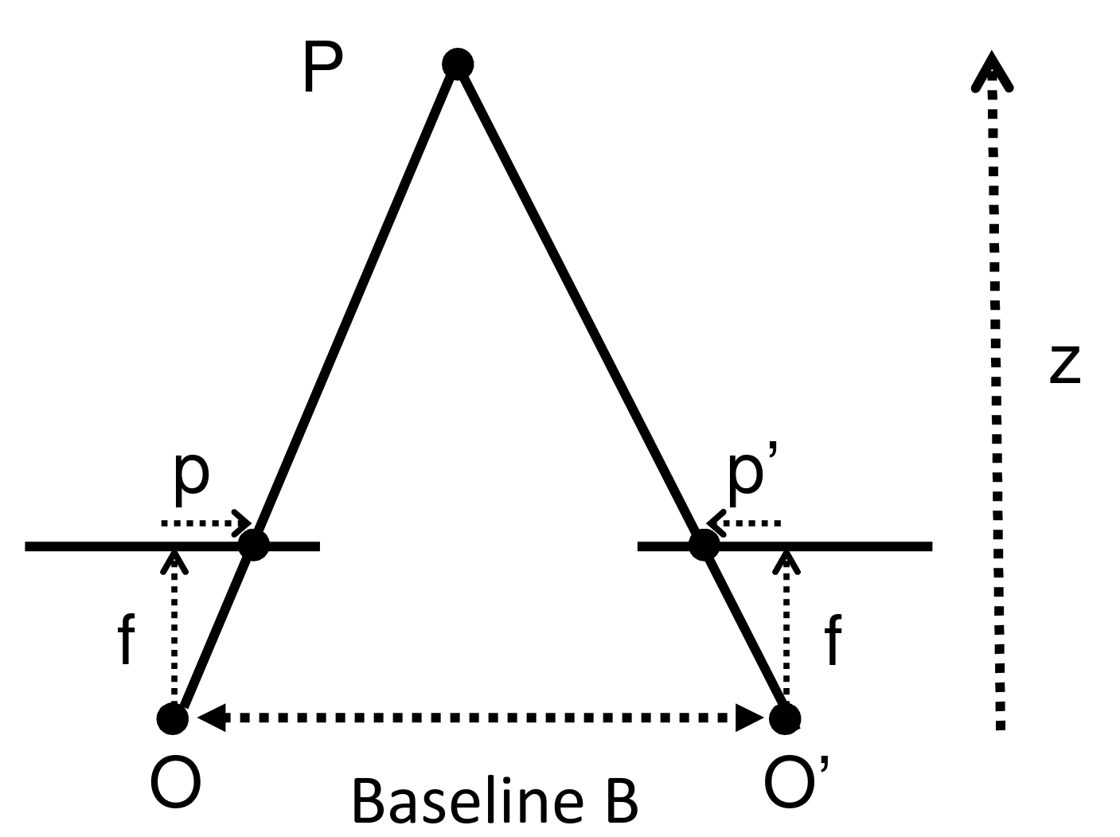

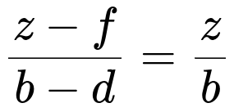




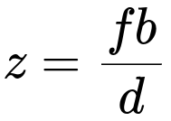
Disparity
Disparity can be used to calculate depth:
disparity:
Triangle Proportionality Theorem:
This reduces depth estimation to
finding matches between
points of two rectified images
to calculate the disparity
Notes:
Let’s look at how disparity relates to depth.
Mathematically, disparity is computed as the horizontal difference between matching pixel positions:
disparity=x1−x2
where x1 is the pixel position in the left image and x2 in the right.
Using similar triangles, we can derive a formula for depth.
Imagine two triangles: one formed by the point P and its projections x1 and x2, and another formed by the camera centers O and O′.
Thanks to triangle similarity, we can write:
baseline/disparity =depth /f
Solving for depth, we get:
depth = f ⋅ baseline / disparity
So with known focal length and baseline, disparity directly gives us depth.
This equation is powerful because it reduces the entire problem of depth estimation to finding correspondences between pixels in the two rectified images.

Slide 19
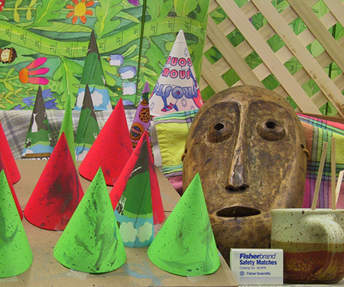
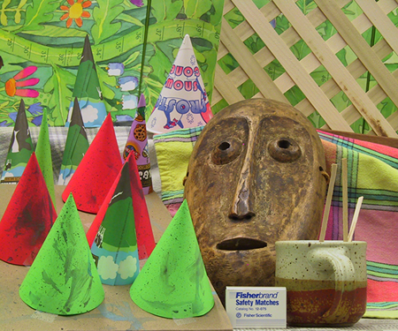
Finding Matches between Images
Left Image
Right Image
High-accuracy stereo depth maps using structured light,. Scharstein et al. 2003 IEEE Computer Society Conference on Computer Vision and Pattern Recognition
Notes:
Take these two example images.
They look very similar, but the objects appear slightly shifted due to the difference in perspective between the two cameras.
Even if it’s hard to see with the naked eye, there is a measurable offset—this is the disparity.
Because the images are rectified, we know the corresponding pixels lie on the same scanline, and we only need to search horizontally to find the match.

Slide 20
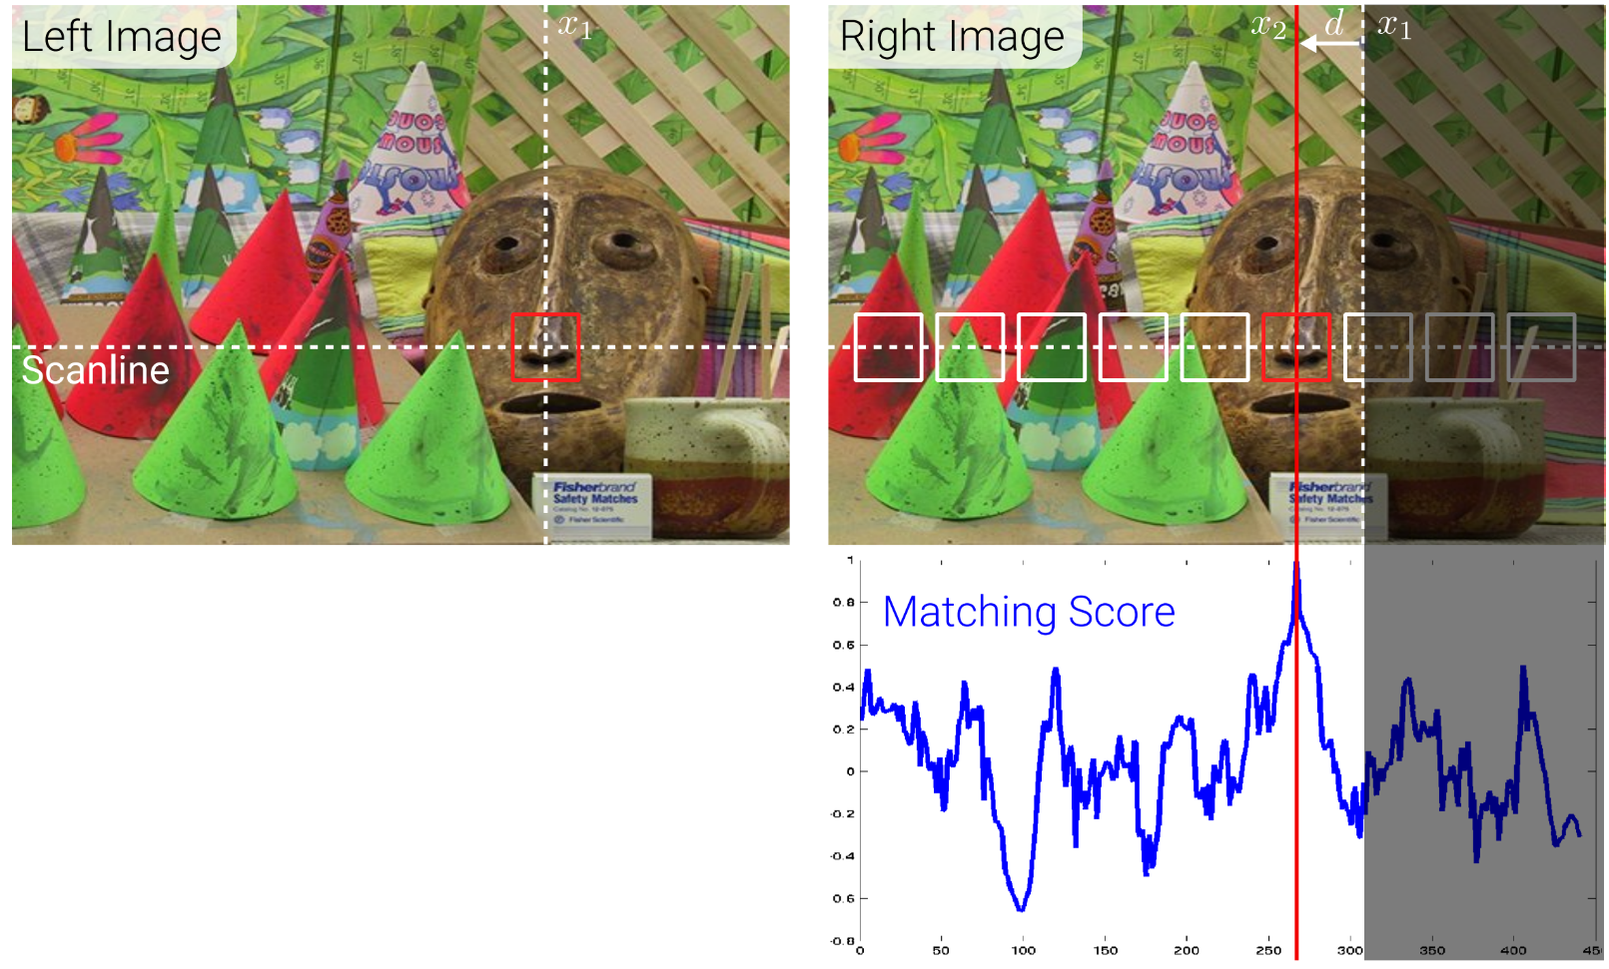
Stereo Matching and Similarity Metrics
Similarity Metric Approaches
Consist of sliding a
window along the epipolar
lines and compute a cost
through a Matching/Score
Function
Evaluation of Stereo Matching Costs on Images with Radiometric Differences. Hirschmuller and Scharstein, TPAMI, 2009.
Notes:
This brings us to the similarity matrix approach for stereo matching.
The idea is to slide a window along the epipolar line in the second image to find the best match for a patch selected in the first image.
We use a similarity score between patches to find which one is the best match.

Slide 21
Choose a patch on the left image (red square on the left image)
Look for a corresponding patch on the right image, along the epipolar line (or scanline)
  Use a sliding a window (squares on the right image) on the right image, and evaluating the score function.
Then, select the patch with the highest score as a match (red square on the right image)
Evaluation of Stereo Matching Costs on Images with Radiometric Differences. Hirschmuller and Scharstein, TPAMI, 2009.
Notes:
We begin with a red square—a patch—on the left image.
Then we scan along the same row in the right image using a sliding window, computing a similarity score between patches.
This score tells us how well the two patches match, and we choose the one with the highest score.
You can see the results of running a similarity metric on these two images on the bottom right.
Higher matching scores gives better patch matches.

Slide 22


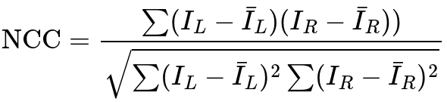
Stereo Matching
Many similarity metrics were proposed:
Sum of Absolute Differences (SAD)
Sum of Squared Differences (SSD)
Normalized Cross-Correlation (NCC)
Notes:
There are several well-known functions used to compute similarity between image patches.
Here are the most common ones:
Sum of Absolute Differences (SAD):
This function simply sums up the absolute difference between each pixel in the two patches.
It’s fast and easy to compute, but not very robust to lighting changes.
Sum of Squared Differences (SSD):
Similar to SAD, but instead of absolute values, it sums the squares of the differences.
This penalizes larger errors more heavily and gives smoother results, but it's also more sensitive to noise.
Normalized Cross-Correlation (NCC):
This function compares how well the intensity patterns of the two patches match, normalized by their variances.
It's more robust to global illumination changes and contrast differences, though it’s computationally more expensive.”

Slide 23
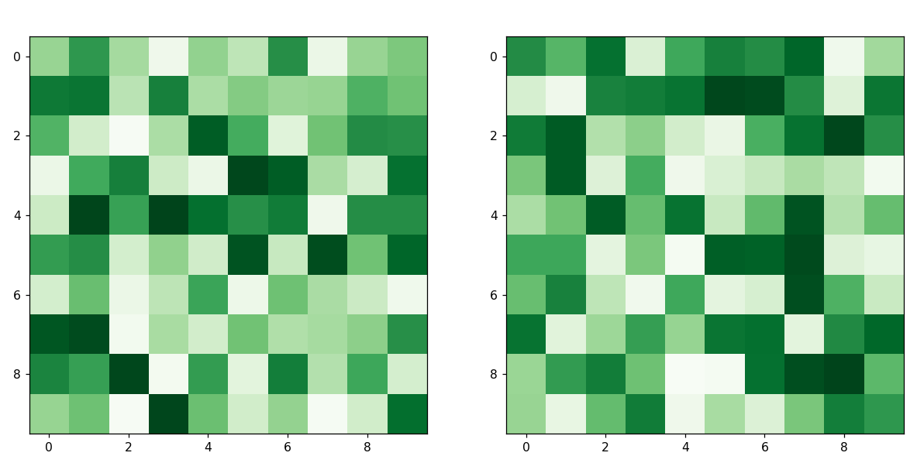
Cost Volume
Let's visualize the process:
Left Image
Right Image
Notes:
Let’s now visualize how this process works with two rectified cameras and their corresponding images.

Slide 24
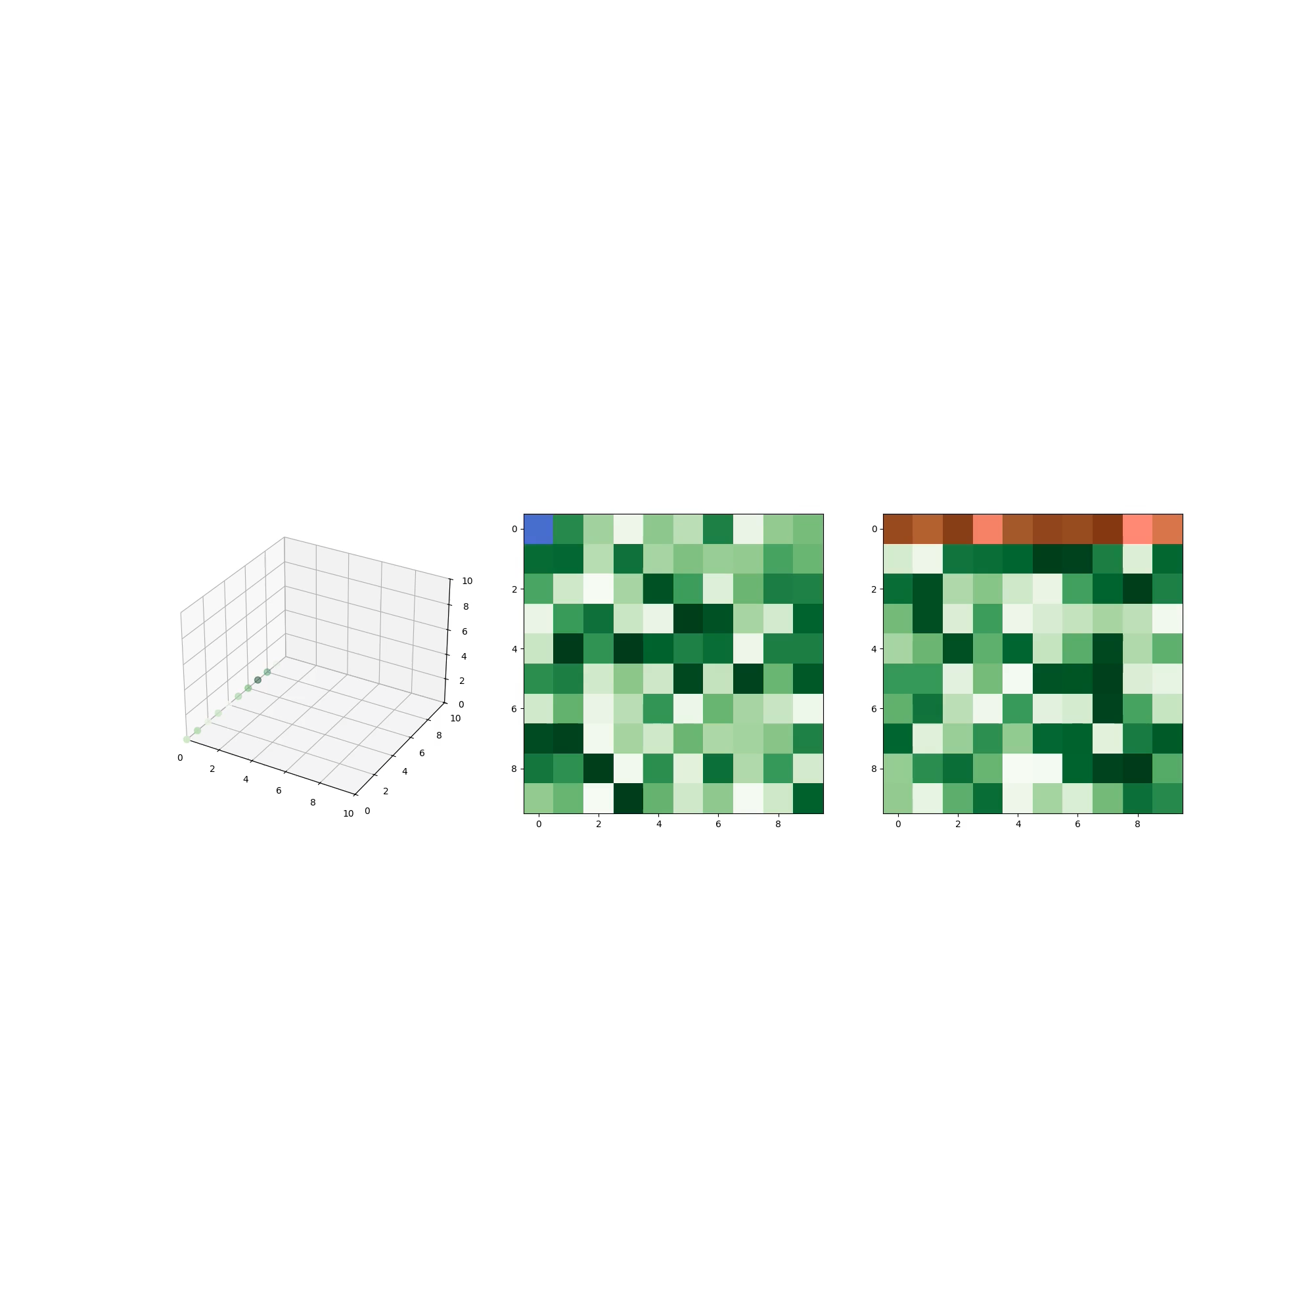
Cost Volume
Let's visualize the process:
Choose a metric, and use the sliding window to compute the cost.
Notes:
(video)
What we do is, foreach patch of the left image (blue), we compute the distace metric wrt the corresponding epipolar line in the right image (red patches).
These matching scores form what we call the cost values. For each patch in the right image (i, j), we get multiple cost values (equal to the number of red patches in the epipolar line of the right image)

Slide 25
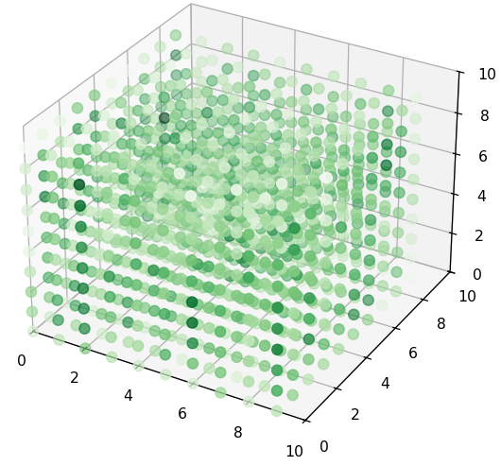
Cost Volume
Let's visualize the process:
Choose a metric, and use the sliding
window to compute the cost.
The resulting 3D volume is
called cost volume, and
contains the result of
running the cost function
between each patch on the
left image, and each patch
on the corresponding
epipolar line of the right
image
Left Image Height
Right Image Width
Left Image Width
Notes:
The final result is a 3D volume of values.
Its dimensions are:
- Height × Width (number of pixels)
- Times the number of disparities we evaluate (which can be up to the width of the image in the simplest case)
Each entry represents a cost or score between two patches. In some methods, instead of
raw similarity scores, we extract feature descriptors, so each entry becomes a feature vector instead of a single number.
This structure is called the cost volume, and it’s fundamental in many stereo matching pipelines.

Slide 26
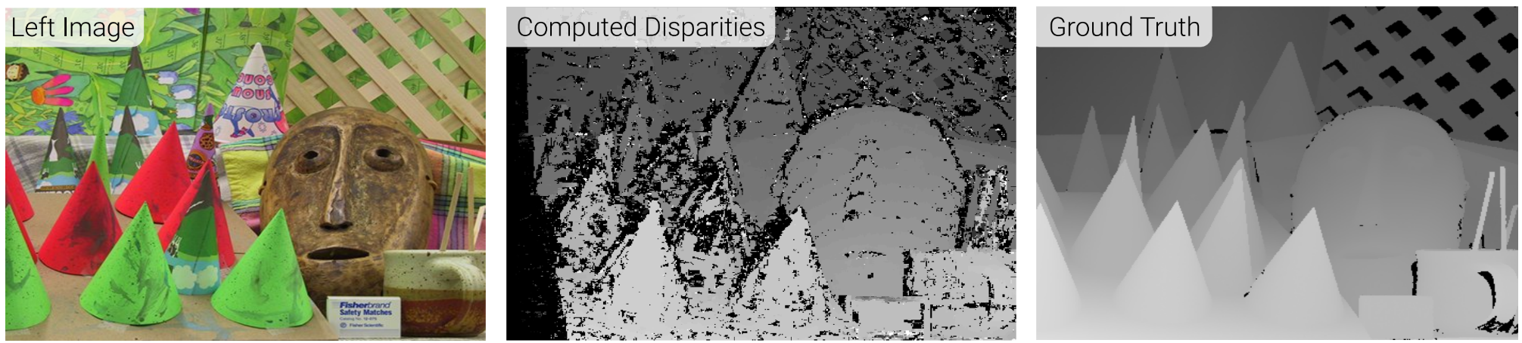
Evaluation of Stereo Matching Costs on Images with Radiometric Differences. Hirschmuller and Scharstein, TPAMI, 2009.
Notes:
This is an example of result. On the left we see the input left image, while on the right we see the output disparities and the GT disparities.

Slide 27
Limitations
Notes:
However, classical stereo matching methods have many limitations.
Handcrafted similarity functions often lack flexibility and robustness.

Slide 28
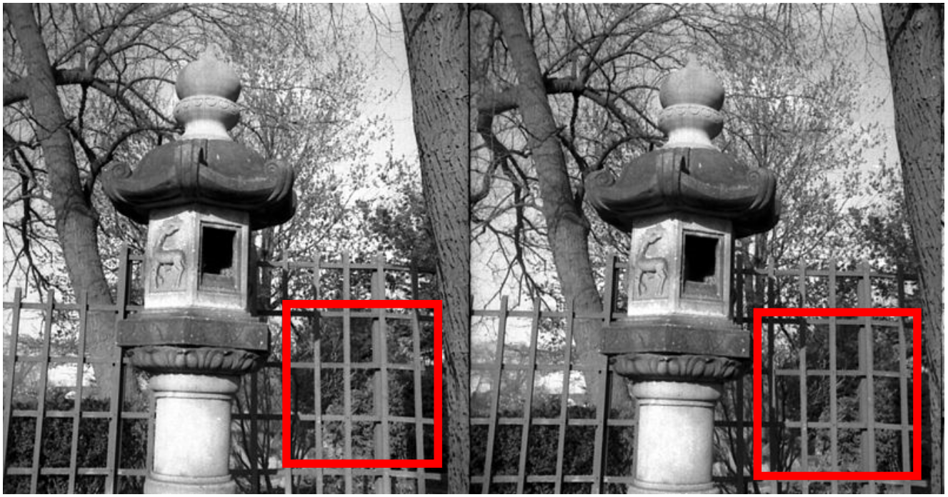
Limitations – Repeated Patterns
Notes:
For instance, when images contain repeated patterns, a point in the left image may match multiple points in the right image, confusing the matching algorithm.

Slide 29
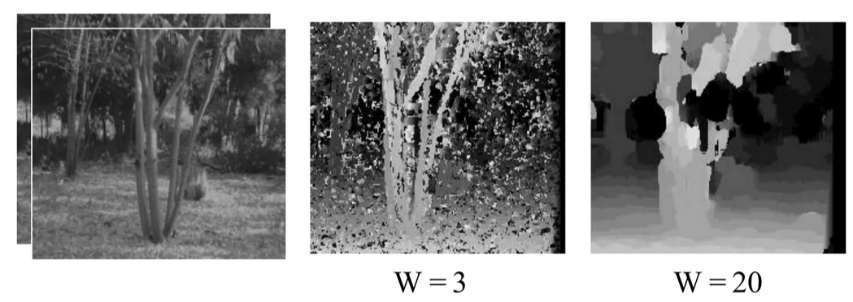
Limitations – Window Size
Notes:
The size of the comparison window also introduces trade-offs.
A window that is too small becomes highly sensitive to image noise, while a window that is too large can smooth out meaningful features, hurting accuracy.

Slide 30
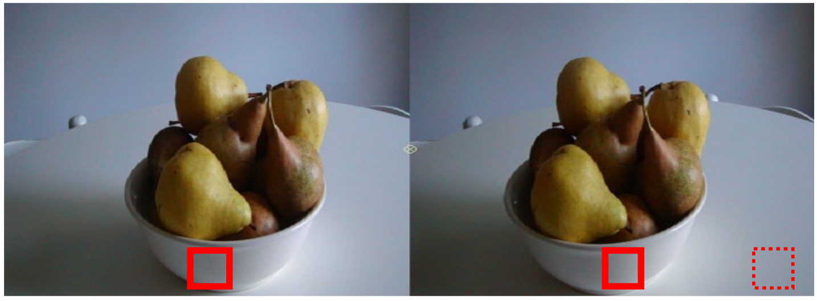
Limitations – Textureless Surfaces
Mismatch
Notes:
Textureless surfaces present another challenge: since all patches look the same, the cost function cannot determine the correct match.

Slide 31
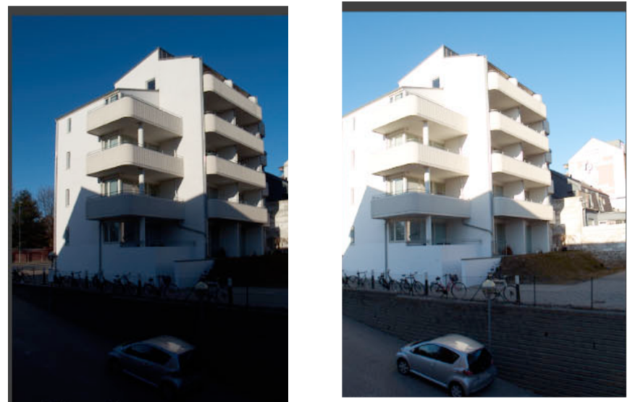
Limitations – Illumination Change
Notes:
Changes in lighting can affect the appearance of patches between views, leading to poor matching results.

Slide 32
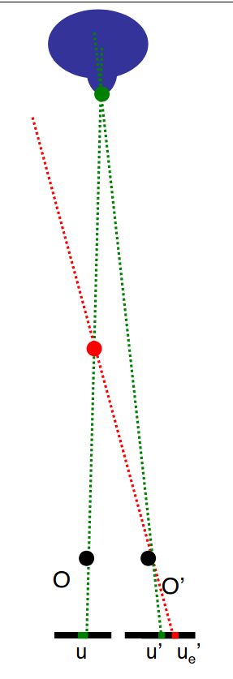
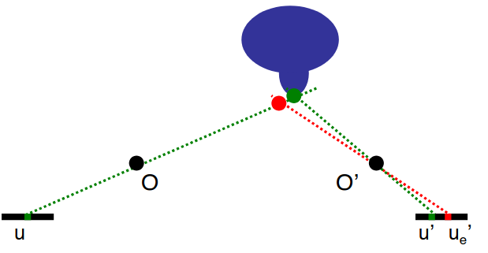
Limitations – Foreshortening
Large Error
Small Error
Large Baseline
Small Baseline
With a short baseline, small errors in estimating disparities result in larger depth estimation errors
Notes:
Another important limitation is related to foreshortening.
If we use a large baseline and make a small error in disparity estimation, the resulting depth error remains tolerable.
But with a narrow baseline, the same disparity error results in a much larger depth error (this is due to the geometry of projection).

Slide 33
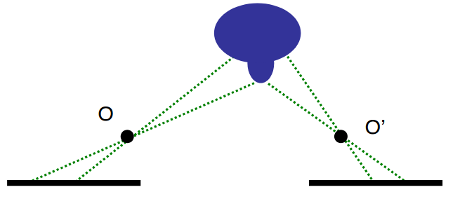
Limitations – Occlusions
Occluded from O'
Occluded from O
Notes:
Let’s not forget occlusions. Parts of the scene visible in one image may be completely hidden in the other.
This naturally occurs in any 3D scene viewed from two different viewpoints.

Slide 34
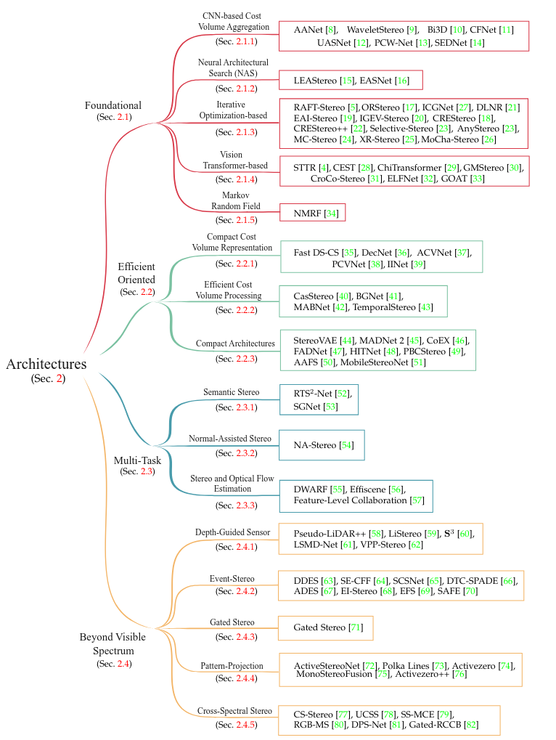
Modern Stereo Matching
Nowadays, directly evaluating cost functions
on hand-crafted features is not considered a
good approach.
Modern approaches use advanced
deep learning techniques to solve
Stereo Matching, by learning to extract features
from images.
A Survey on Deep Stereo Matching in the Twenties, Tosi et al. 2024
https://github.com/fabiotosi92/Awesome-Deep-Stereo-Matching
Notes:
Today, directly defining a cost function manually is no longer considered state of the art.
Modern stereo matching methods rely heavily on deep learning, allowing us to learn how to extract and compare features automatically.

Slide 35
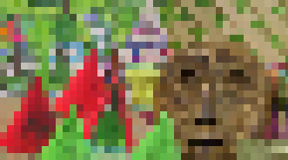
Modern Stereo Matching
Learning to match windows
Left Image
Reference Example (taken from left image)
Positive Example (taken from right image). The central pixels is the same as the central 3D point of the reference image.
Right Image
Negative Window (taken from right image). The central pixels is different from the central 3D point of the reference image.
Stereo Matching by Training a Convolutional Neural Network to Compare Image Patches. Zbontar and LeCun, JMLR, 2016.
Notes:
One intuitive idea is: instead of handcrafting a matching function, let’s learn one using neural networks.
This was explored early in the rise of deep learning.
In this work, the authors built a dataset of triplets:
a reference patch from the left image,
a positive patch, taken from the corresponding 3D location in the right image,
and a negative patch, from a different 3D location.

Slide 36
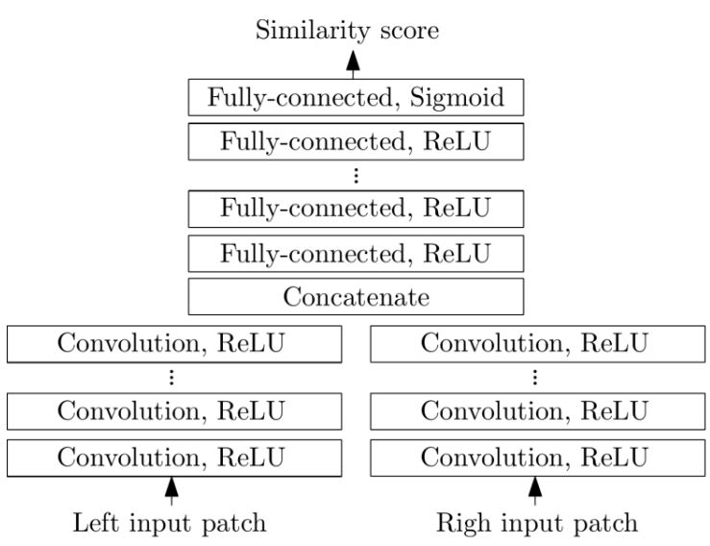
Modern Stereo Matching
CNN + Siamese networks
  Extract features with a network, and predict
  the matching cost [0, 1].
  For each patch, find the best match
  Training: triplets of reference,
  positive and negative patches. BCELoss.
Reference
Positive
Negative
Stereo Matching by Training a Convolutional Neural Network to Compare Image Patches. Zbontar and LeCun, JMLR, 2016.
Notes:
To learn the matching function, the authors used a Siamese Neural Network.
This architecture takes two patches (left and right) as input, and processes both using the same shared convolutional layers.
It then produces a matching score, ideally close to 1 if the patches correspond, and 0 if they don’t.
The network is trained using a binary classification loss:

Slide 37
Modern Stereo Matching
Label: 1
Stereo Matching by Training a Convolutional Neural Network to Compare Image Patches. Zbontar and LeCun, JMLR, 2016.
Reference
Positive
Notes:
If we feed it a reference and a positive patch, we want the score to be 1

Slide 38
Modern Stereo Matching
Label: 0
Stereo Matching by Training a Convolutional Neural Network to Compare Image Patches. Zbontar and LeCun, JMLR, 2016.
Reference
Negative
Notes:
If we feed it a reference and a negative patch, the score should be 0.
This learning-based method offers several advantages.
First, it’s much more robust to noise, textureless regions, repeated patterns, and even illumination changes.
Since the matching function is learned directly from data, it can adapt to many types of visual patterns and complexities that handcrafted functions struggle with.
Moreover, it opens the door to end-to-end learning pipelines, which are more powerful and generalizable.

Slide 39
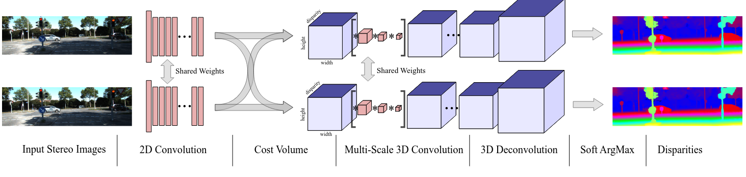
Modern Stereo Matching
GC-Net:
End-to-End architecture, trained with L1 loss (GT disparity vs predicted disparity)
Key idea: calculate disparity cost volume and apply 3D convolutions on it
1) extracts features with 2D convolutions 2) Cost volume contruction 3) 3D convolutions 4) Disparity map prediction
End-to-End Learning of Geometry and Context for Deep Stereo Regression. Kendall et al. ICCV, 2017.
Notes:
The following year, a very influential work called GCNet was introduced.
This architecture is trained end-to-end using the L1 loss between the predicted disparity map and the ground truth disparity.
Instead of directly learning the cost function , the key idea is to compute the full disparity cost volume and apply 3D convolutions directly on it.
Pipeline Description:
First, the network extracts features from the left and right images using 2D convolutions.
Then, it constructs a cost volume by comparing features across disparity levels. This results in a 4D tensor of shape: height × width × max_disparity × feature_dimension.
On this volume, 3D convolutions are applied to aggregate matching evidence across space and disparity.
The final output of the network is a full-resolution disparity map

Slide 40
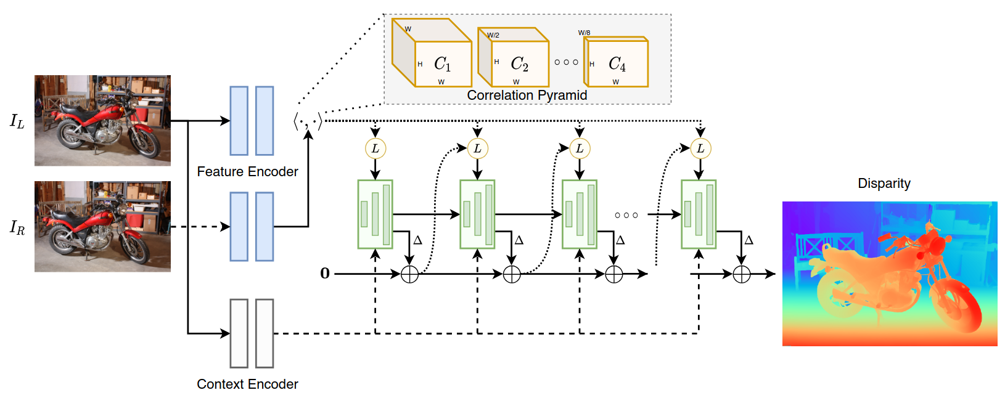
Modern Stereo Matching
RAFT-Stereo:
Key idea: Use a recursive architecture (GRU, green blocks) to iteratively refine a disparity map
Dot Product + Average Pooling
Gated Recurrent Unit (GRU [1]) to iteratively predict the disparity map
Backbones for feature extraction
RAFT-Stereo: Multilevel Recurrent Field Transforms for Stereo Matching. Lipson et al. 3DV, 2021.
Notes:
Another significant approach is RAFT-Stereo, an extension of the RAFT architecture originally used for optical flow.
Here, the idea is to refine the disparity map iteratively, using a Gated Recurrent Unit (GRU) (shown as green blocks in the diagram
The pipeline is as follows:
First, extract features from both stereo images.
2) Then compute the correlation between features at multiple resolutions using dot products between feature maps and average pooling.
3) The recurrent GRU module then updates the disparity map step by step, gradually refining it toward the correct solution.
This recursive refinement is highly effective for challenging scenes with occlusions, textureless regions, or fine details

Slide 41
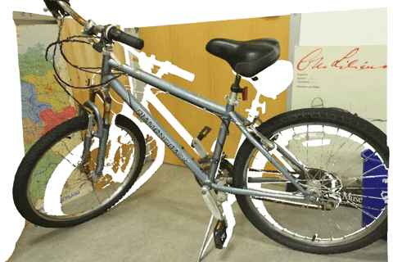
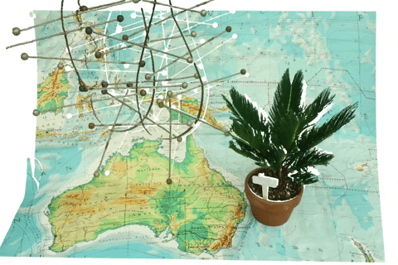
RAFT-Stereo Resutls
RAFT-Stereo: Multilevel Recurrent Field Transforms for Stereo Matching. Lipson et al. 3DV, 2021.
Notes:
Here we can see example outputs of RAFT-Stereo.
The predicted disparity maps are quite dense and smooth, capturing fine geometric details.
This model has become a strong backbone for downstream applications, and was extended
in many works to lower the error

Slide 42
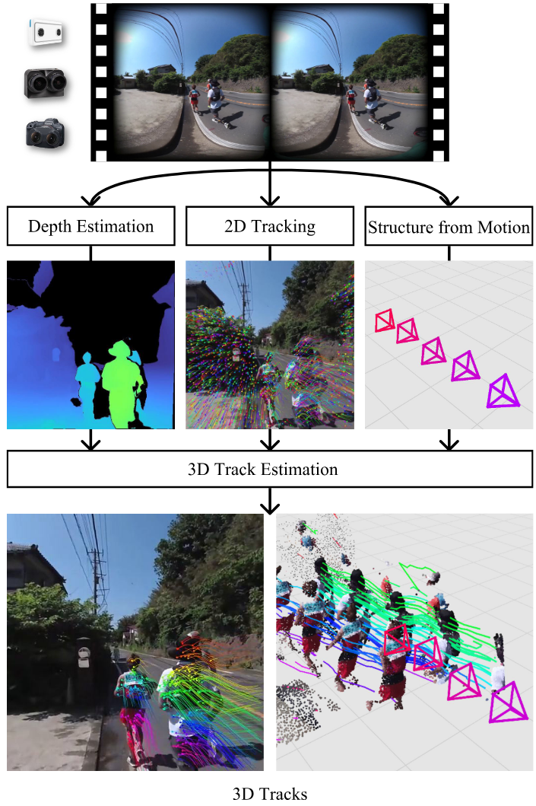
Downstream Task
Stereo4D: Learning How Things
Move in 3D from Internet Stereo Videos. Jin et al.
CVPR 25
  Input:
    Stereo Video
  Output:
    Movement of points in 3D (tracks)
  Key idea:
    Extract:
      Depth with Stereo Matching (RAFT[1])
      Camera Trajectory (SfM / COLMAP)
      2D point tracking (BootsTAP [2])
[1] RAFT: Recurrent all-pairs field transforms for optical flow. Teed et al. ECCV, 2020
[2] BootsTAP: Bootstrapped Training for Tracking-Any-Point. Doersch et al. ICCV,
2024
Notes:
Building on RAFT-Stereo, a very recent work presented at CVPR 2025 called Stereo4D aims to estimate 3D motion from stereo videos.
Their pipeline combines several powerful components:
First, depth estimation from RAFT-Stereo,
Then, camera trajectory estimation using COLMAP and structure-from-motion,
And finally, 2D point tracking, which is lifted to 3D trajectories using the previous depth and pose.

Slide 43
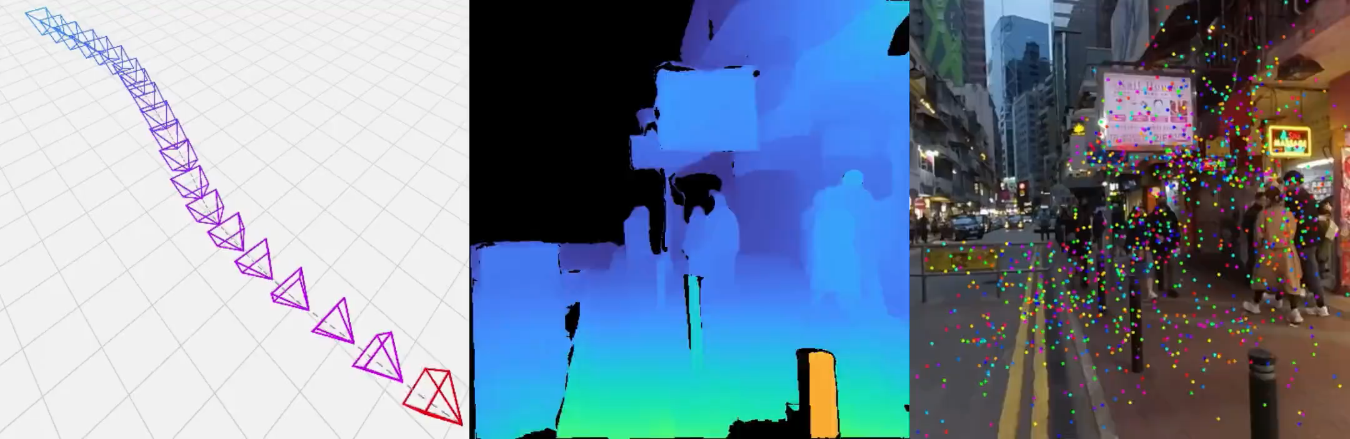
Downstream Task
Camera Position
Disparity Map (from RAFT)
Point Tracking
Stereo4D: Learning How Things Move in 3D from Internet Stereo Videos
Notes:
Here we can see visualizations of the estimated camera path, disparity maps, and point tracks in 3D.

Slide 44
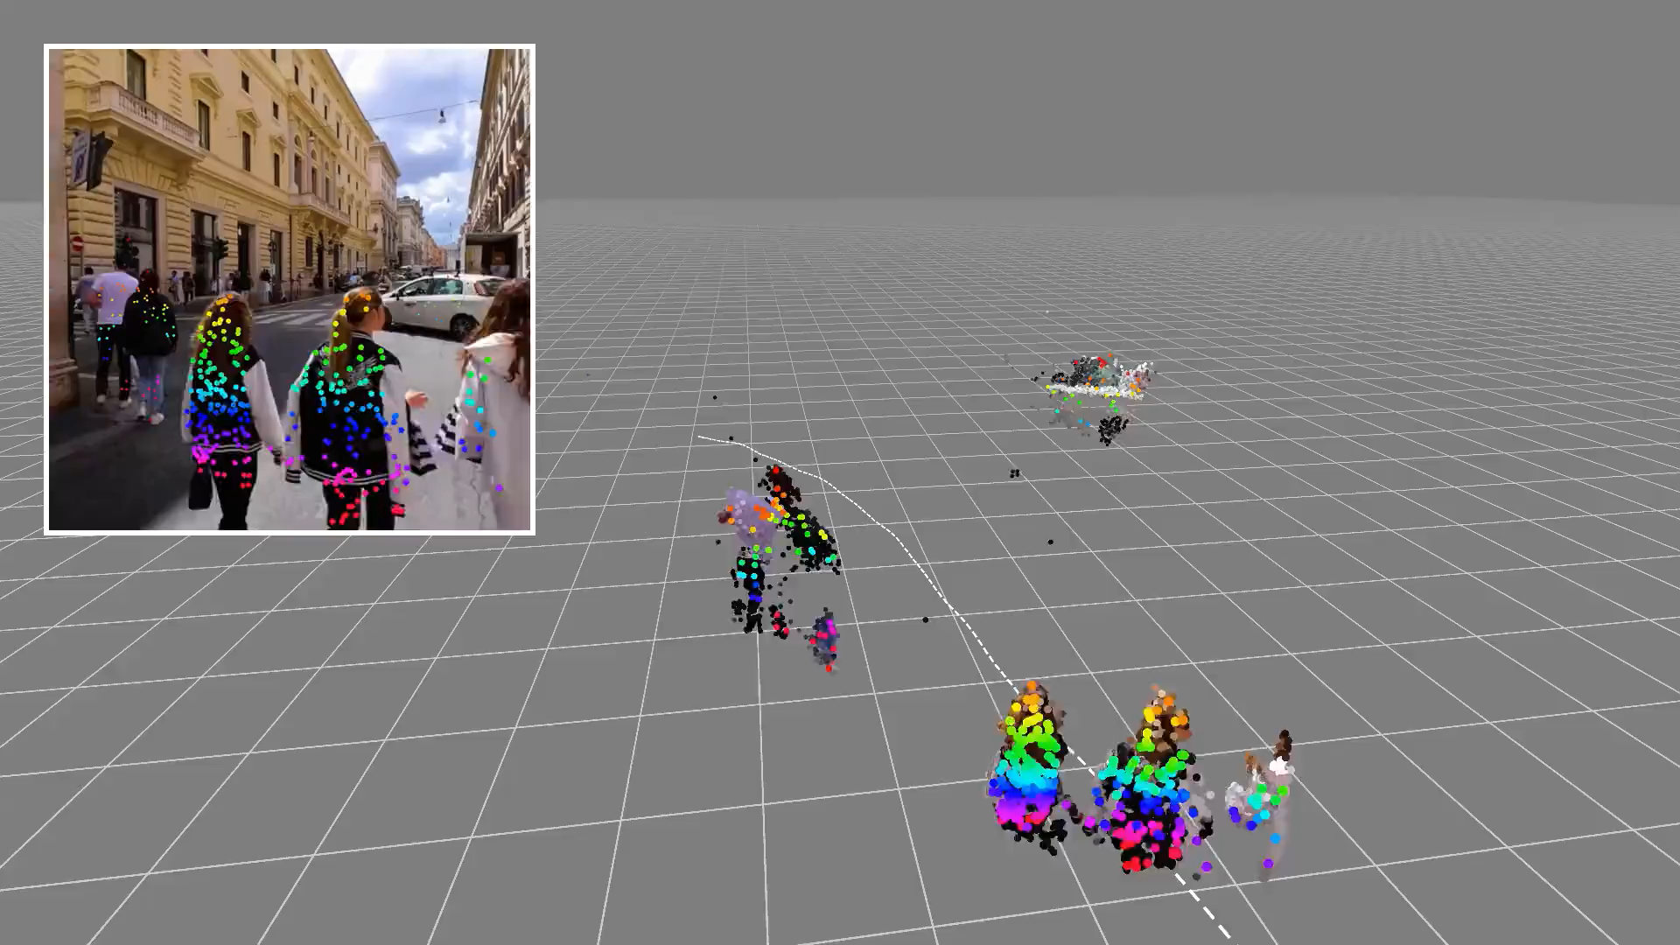
Stereo4D: Learning How Things Move in 3D from Internet Stereo Videos
Notes:
In the final output, the authors reconstruct dynamic 3D point clouds, where we can visualize the motion of points in the scene over time.
This is a compelling demonstration of how stereo matching serves as a foundation for full scene reconstruction and 4D motion understanding.

Slide 45
Other Applications of Rectified Images
Notes:
Stereoscopic matching has a wide range of applications beyond just depth estimation.
Let’s go through a few of them.

Slide 46
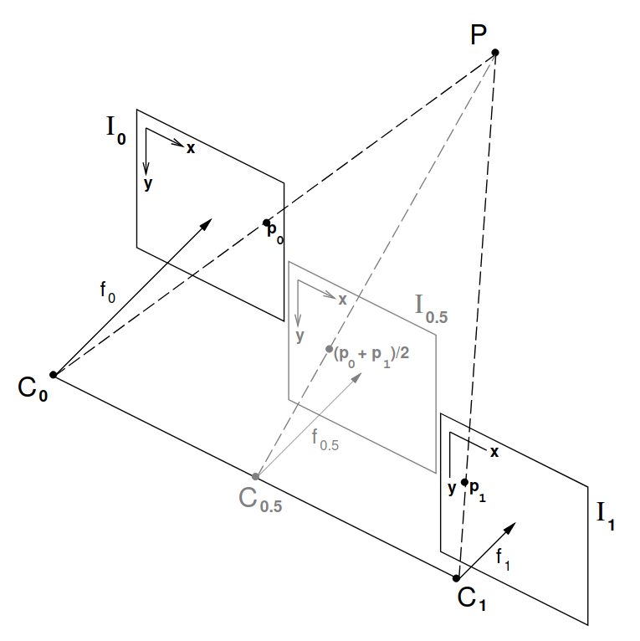

View Morphing
Rectified images can be used for
view morphing
View morphing, Seitz and Dyer, 1996
Notes:
One interesting application is view morphing. Given two stereo images, the idea is to synthesize a novel view
as if a virtual camera was placed between the original viewpoints.
By interpolating the geometry and appearance between the two views,
we can generate realistic intermediate frames.

Slide 47

View Morphing
View morphing, Seitz and Dyer, 1996
Notes:
This technique has been used for face interpolation, where the virtual view produces smooth transitions between expressions or poses.

Slide 48

Active Stereo
Some methods replace one of the two cameras with a projector:
A Volumetric Method for Building Complex Models from Range Images, Curless and Levoy, SIGGRAPH ’96
Notes:
Another variation is called active stereo matching.
In this case, one of the stereo cameras is replaced with a structured light source, such as a laser.
The laser actively illuminates the scene, projecting a known pattern, and the camera captures how this pattern is distorted by the geometry of the surface.

Slide 49

Active Stereo
Some methods replace one of the two cameras with a projector:
A Volumetric Method for Building Complex Models from Range Images, Curless and Levoy, SIGGRAPH ’96
Notes:
With proper calibration, this allows for very accurate 3D reconstructions.
Because of this, it has often been employed to create benchmark datasets in the field of computer vision.
With a well-calibrated setup involving a camera and an active light source (such as a laser or structured light)
it's possible to capture very precise depth maps that serve as ground truth for training or evaluating depth estimation algorithms.

Slide 50


Active Stereo
Some methods replace one of the two cameras with a projector
https://graphics.stanford.edu/papers/digmich_falletti/
Notes:
A well-known example is the Stanford "David" scan, where a red laser was swept over the statue while a camera captured the deformation of the light, enabling the reconstruction of a highly accurate 3D model.

Slide 51
Multiview Stereo Matching
Notes:
Now let’s move on to multi-view stereo, or MVS.
This is a natural extension of stereo matching to more than two cameras.

Slide 52

Multiview Stereo Matching
We can extend the problem of Stereo Matching to multiple cameras
Notes:
Having multiple views allows us to see the scene from many perspectives,
which provides more information for reconstruction, but also introduces additional challenges.
We no longer have to match features between just two images,
but across several views simultaneously

Slide 53






Multiview Stereo Matching
Multiple-baseline Stereo:
Problem: we have images ( for the example), and we
want to reconstruct a 3D depth map
A Multiple-Baseline Stereo. Okutomi et al. 1993in IEEE Transactions on Pattern Analysis and Machine Intelligence
Notes:
In the Multi-View Stereo (MVS) problem, we are given as input a set of n
images of the same scene, captured from different viewpoints.
The goal is to estimate a dense depth map for at least one of the images, typically referred to as the reference view.
In our example, we assume we have 9 input images, and our objective is to reconstruct
the depth map corresponding to one of them by exploiting the geometric and photometric consistency across the different views.

Slide 54










Multiview Stereo Matching
Multiple-baseline Stereo:
Choose a view as reference, and slide a window across epipolar lines of other images. Store the inverse depth relative to the
reference image
Combine multiple
baseline stereo pairs
A Multiple-Baseline Stereo. Okutomi et al. 1993in IEEE Transactions on Pattern Analysis and Machine Intelligence
Notes:
One of the simplest strategies for MVS is to extend traditional matching function based approach.
We choose one view as the reference image, then match image patches across all other views.
For each pixel in the reference, we hypothesize inverse depth values by matching it with patches in the other views.
We then aggregate the matching scores to find the best-fitting depth.

Slide 55
Multiview Stereo Matching
Multiple-baseline Stereo:
Pros
  Simple
Cons
  Computationally
  expensive
  Sensible to light change
  and noise
A Multiple-Baseline Stereo. Okutomi et al. 1993in IEEE Transactions on Pattern Analysis and Machine Intelligence
Notes:
This approach works, but it comes with drawbacks.
It’s computationally expensive, since we must compute cost volumes for multiple views.
It’s also sensitive to illumination changes, occlusions, and image noise.

Slide 56

Multiview Stereo Matching
Voxel Coloring:
Key idea:
  Given a set of basis images
  and a grid of voxels, we
  wish to assign color values to
  voxels in a way that is
  consistent with all of the
  images.
  By carving out inconsistent
  voxels, we retrieve a 3D
  reconstruction of the scene
Photorealistic Scene Reconstruction by Voxel Coloring. Seitz et al. 1999 International Journal of Computer Vision
Notes:
Another method that was proposed in the past is voxel coloring.
The core idea is: given a set of calibrated images, we divide the 3D space into a voxel grid,
and the goal is to assign a color to each voxel in a way that is consistent across all views.

Slide 57


Multiview Stereo Matching
Input Images
Voxel Coloring:
Algorithm:
  Initialize a 3D volume that
  encloses the scene.
  For each voxel:
    Project it into all images
    where it is visible.
    Extract color values
    from those projections.
    Compute
    photo-consistency
    (e.g., color variance).
  If photo-consistent → keep, else → remove ("carve").
  Proceed in visibility order (back-to-front w.r.t cameras).
Reconstruction
Photorealistic Scene Reconstruction by Voxel Coloring. Seitz et al. 1999 International Journal of Computer Vision
Notes:
The algorithm works as follows:
First, we initialize the 3D volume that encloses the scene.
Then, for each voxel, we project it onto all input images and collect the color that each image sees at that location, So, for a given voxel, we get n colors from n images.
Next, we compute the color consistency, for example using the variance.
If the colors are consistent — meaning most views agree — we assign the average color to the voxel.
If not, we consider the voxel to be inconsistent and remove it.
This process is done in order of visibility, starting from the furthest voxels and moving forward to the closest ones.

Slide 58

Multiview Stereo Matching
Input Images
Voxel Coloring:
Pros:
  Simple and intuitive
  Naturally handles occlusions via visibility
  reasoning.
  No explicit feature matching needed.
Cons:
  Low resolution due to voxel size.
  Computationally expensive (especially
  in dense grids).
  Sensitive to calibration and lighting
  variation.
Reconstruction
Photorealistic Scene Reconstruction by Voxel Coloring. Seitz et al. 1999 International Journal of Computer Vision
Notes:
This method is simple and intuitive.
It also handles occlusions quite naturally thanks to the visibility ordering.
And we don’t need to extract any explicit features.
However, the output resolution is limited by the voxel size.
If we want a finer reconstruction, we need to use more voxels, which makes the method computationally expensive.
It’s also sensitive to calibration errors and lighting changes.

Slide 59

Multiview Stereo Matching
Plane-Sweep Stereo
Imagine taking a 3D scene and slicing it into a series of fronto-parallel planes at different depths.
Projects all views onto these planes using known camera poses
Notes:
Another method proposed in the past is Plane Sweep.
The main idea is to take the 3D scene and slice it into a set of fronto-parallel planes, that is, planes parallel to the image plane, each corresponding to a different depth.
Then, for each of these planes, we project all the input images onto it.
So each plane collects the projections of all the views, assuming the plane lies at a specific depth.

Slide 60

Multiview Stereo Matching
Plane-Sweep Stereo
For each pixel, measures
photoconsistency (or feature
consistency) for each plane, and
choose the depth that gives the
lowest (or highest) variance
Notes:
The result is what you see in the top-right image:
If the depth of the plane is incorrect, the projections will not align, and the image patches will be misaligned or blurred when overlaid.
But if the depth is correct, the projections will match well and align neatly.
So the idea is to evaluate this alignment for each pixel across the planes, measuring photo-consistency (or feature consistency) at each depth.
Then, for each pixel, we choose the depth that gives the best match (for example, the one with the lowest variance).

Slide 61

Multiview Stereo Matching
Multi-View Stereopsis
Accurate, Dense, and Robust Multi-View Stereopsis. Furukawa et al. CVPR ‘07
Notes:
Another method that has been proposed for 3D reconstruction is Multiview Stereopsis.
Here we see an example result: on the left, we have the input views taken from different camera positions.
From these views, sparse feature matching is first performed to identify keypoints across the images.
Then, using depth estimation and triangulation, a sparse point cloud is reconstructed by matching these features across multiple views.
The final result, shown on the right, is a 3D reconstruction of the object.

Slide 62

Multiview Stereo Matching
Multi-View Stereopsis
Overall approach:
  Divide the input images
  in patches, and find
  feature correspondence
  along epipolar lines
  Triangulate 3D points
  based on feature matches
  Reconstruct the surface
  from the pointcloud
Accurate, Dense, and Robust Multi-View Stereopsis. Furukawa et al. CVPR ‘07
Notes:
The approach divides the input images into small patches and tries to find correspondences across the views.
To reduce the search space, it uses epipolar geometry:
Instead of searching across the whole image, the algorithm searches along the epipolar lines in the other views for potential matches.
Once feature matches are found, the 3D points are computed by triangulation.
Finally, a surface reconstruction algorithm is applied to convert the resulting point cloud into a full 3D surface.

Slide 63
Modern Multiview Stereo Matching
Notes:
Now we move on to the second-to-last part of this lecture: Modern Multiview Stereo Matching.
So far, we've looked at classical methods — now let's turn to modern approaches.

Slide 64
Modern Multiview Stereo Matching
Modern Multiview Stereo Matching exploits data-driven deep learning techniques.
Notes:
As you might expect, modern MVS approaches are based on deep learning.
Instead of hand-designing similarity measures or cost functions, the idea is to learn feature representations and matching functions directly from data.

Slide 65

Modern Multiview Stereo Matching
MVSNet proposes Cost Volume aggregation:
Extract features, calculate cost volume and aggregate them with a cost metric,
predict the depth map
MVSNet. Yao et al. ECCV 18
Notes:
A recent example is MVSNet, which proposes a deep learning pipeline to aggregate cost volumes for depth estimation.
The method first extracts features from each input image, and then — using a plane sweep strategy — builds a cost volume aligned with the reference image.
From this cost volume, it predicts an initial depth map, which is then refined in later stages.

Slide 66

Modern Multiview Stereo Matching
R-MVSNet (CVPR2019) extends MVSNet by adding a recurrent neural network
Notes:
MVSNet has inspired many follow-ups, including R-MVSNet (2019), which extends the original method with a recurrent architecture.
Instead of predicting the full cost volume at once, R-MVSNet processes it one depth slice at a time — from near to far.
A softmax over depth values is used to regress the final depth map, guided by ground truth supervision.

Slide 67
Modern Multiview Stereo Matching
Additional Readings:
MVSAnywhere: Zero-Shot Multi-View Stereo, Izquierdo et al. CVPR 2025
Stereo Anywhere: Robust Zero-Shot Deep Stereo Matching Even Where Either
Stereo or Mono Fail. Bartolomei et al. CVPR 2025
Selective-Stereo: Adaptive Frequency Information Selection for Stereo Matching. Wang et al. CVPR 2024
Cross-spectral Gated-RGB Stereo Depth Estimation. Brucker et al. CVPR 2024
MoCha-Stereo: Motif Channel Attention Network for Stereo Matching. Chen et al. CVPR 2024
Notes:
There are also many additional readings from the past couple of years that explore new ways to improve depth prediction in MVS — we recommend checking them out if you're interested in the latest research.

Slide 68

Modern Multiview Stereo Matching
What we saw until ​
now
What we will see in ​
future lectures
Learning-based Multi-View Stereo: A Survey. Wang et al, preprint 2024
Notes:
Let’s take a moment to recap what we’ve seen so far.
We looked at classical stereo and multiview stereo methods.
We’ve explored deep learning approaches for Stereo Matching and Multiview Stereo Matching, such as MVSNet and R-MVSNet.
In the last part of the course, we’ll explore learning-based methods for 3D reconstruction that go beyond depth estimation.
These methods don’t rely on explicitly predicting depth maps — but we won’t spoil that now. Stay tuned!

Slide 69
Monocular Depth Estimation
Notes:
Let’s move on to the final part of today’s lecture: Monocular Depth Estimation.
This part focuses on estimating depth from a single RGB image.

Slide 70

Monocular Depth Estimation
Monocular Depth Estimation is the task of estimating the depth value (distance relative to the camera) of each pixel given a single (monocular) RGB image.
Notes:
Monocular Depth Estimation is the task of predicting the depth - that is, the distance from the camera - for each pixel in a single monocular RGB image.

Slide 71

Monocular Depth Estimation
Recent Deep Learning advancements made Monocular Depth Estimation possible
Notes:
As you can see in the Google Trends graph, recent advances in deep learning have made this task increasingly feasible.
Why is that?

Slide 72

Monocular Depth Estimation
Learning from direct supervision:
Data
Architecture
Training Objective
Error
Input Image
Predicted Depth
Ground Truth
Notes:
Because we now train deep networks directly from supervision - that is, we learn depth from data.
There are three main factors that made this possible:
The availability of large-scale datasets,
The development of powerful network architectures,
And the design of new training objectives.
We’ll explore each of these points one at a time.

Slide 73


Monocular Depth Estimation
Collecting Real World
Data
Kinect from Microsoft.
Cheap sensors made Monocular Depth Estimation possible.
(stereo sensors, Time-of-Flight (ToF) sensors, Structured Light sensors…)
NYU Depth Dataset V2, Silberman et al. ECCV 12
Notes:
The growth of publicly available ground truth depth data started when low-cost depth sensors became available - for example, the Microsoft Kinect.
These sensors, including stereo systems, time-of-flight sensors, and structured light or IR-based devices, allow us to capture real-world depth with high accuracy.
They’re essential for creating large-scale real-world datasets.

Slide 74

Monocular Depth Estimation
Synthetic Data
High-Resolution Synthetic RGB-D Datasets for Monocular Depth Estimation. Rajpal et al. CVPR 23
Notes:
At the same time, synthetic datasets have become increasingly popular.
Thanks to realistic video game engines and synthetic scenes, we can now generate massive amounts of labeled training data in a controlled way.

Slide 75



Monocular Depth Estimation
Architecture
  CNNs, GANs, Diffusion Models…
Generative Adversal Networks
Convolutional Neural Networks
Diffusion Models
Notes:
Next up: architectures.
Thanks to advances in neural networks — especially CNNs, GANs, and more recently diffusion models — we now have models that can learn complex visual representations from large datasets.

Slide 76

Monocular Depth Estimation
Sobczak et al. 2021
Notes:
Architectures have evolved dramatically, enabling deeper, more accurate predictions.
Just look at the growth in the past years, and think at today's models, where we talk about billions of parameters

Slide 77


Monocular Depth Estimation
Training Objective
  A simple training objective could be to lower the error between prediction and ground truth
Error
Input Image
Predicted Depth
Ground Truth
Notes:
Finally, let’s talk about training objectives.
This is one of the core elements of monocular depth estimation.
A basic training loss might look like this: given an image X and the predicted depth Y = F(X), we minimize the mean squared error (MSE) between Y and the ground truth.
It’s a simple and intuitive objective - but that doesn’t mean the problem is easy.

Slide 78

Monocular Depth Estimation
Ill-posed problem
Notes:
In fact, monocular depth estimation is an ill-posed problem.
When we capture a real-world scene in a single image, we lose all depth information.
This leads to depth ambiguity - for instance, a small object close to the camera can look exactly like a large object farther away.
From a single image alone, we often can’t tell the difference.

Slide 79


Monocular Depth Estimation
Sometimes we can fight back…
Scale-invariant mean square error:
Use mean depth to measure relationship between points instead of their absolute value
Depth Map Prediction from a Single Image using a Multi-scale Deep Network. Puhrsch et al. NeurIPS 2014
Notes:
One way to deal with this is to design losses that are invariant to global scale.
For example, we can use a scale-invariant MSE, which penalizes the relative error between points, not their absolute distance.
This type of loss uses the mean depth to focus on depth relationships between pixels.

Slide 80


Monocular Depth Estimation
Sometimes we can fight back…
Scale-invariant mean square error:
Why log-space?
If your output is off by a multiplicative constant , by applying the loss in log-space we have , which is constant across all pixels so the loss ignores it, hence the scale invariance.
Notes:
And, importantly, this loss is often applied in log space.
Why? Because if the entire prediction is off by a constant scaling factor, applying the log will turn that into a constant — and the loss will ignore it.
This makes the model more robust to global scale errors.

Slide 81


Monocular Depth Estimation
Sometimes we can fight back… but we cannot do magic
Testing sota method “Depth Anything V2” (Yang et al. NeurIPS 2024) on Ames room illusion.
Demo: https://huggingface.co/spaces/depth-anything/Depth-Anything-V2
Notes:
But sometimes, there’s nothing we can do.
There are cases where even the best models can’t resolve depth ambiguity - simply because the visual evidence isn’t enough.
For example, on the right you see the result of a state-of-the-art method - Depth Anything 2 - applied to the famous Ames Room illusion.
From a single image, it’s impossible for the model to understand the illusion - and the depth prediction completely fails.

Slide 82
Monocular Depth Estimation
Improve Monocular Depth Estimation:
Acquire more data
Improve network architecture
Formulate better training objectives
Notes:
Now that we’ve seen the three key components of Monocular Depth Estimation,
we can easily understand how to improve it.
There are three fundamental directions:
Collecting high-quality data - both in terms of quantity and accuracy.
Designing better architectures - networks that can extract more meaningful features and improve predictions.
Developing stronger training objectives - losses that guide the model to learn depth more effectively.

Slide 83

Monocular Depth Estimation
Today, Monocular Depth Estimation is a very active field
Survey on Monocular Metric Depth Estimation. Zhang, ArXiv preprint 2025
Notes:
Today, monocular depth estimation is a very active research field.
It’s actually hard to keep up - every month, new methods are published.
In this lecture, we’ll go through a few recent ideas that can give you a sense of where the field is heading.

Slide 84

Monocular Depth Estimation
Depth Anything proposes a semi-supervised self-learning approach to enhance generalization
Notes:
One recent method is Depth Anything,
which focuses on a specific challenge: how can we train depth models on images that don’t come with ground truth depth?
This is useful, because most images available online are unlabeled - but still valuable for training.

Slide 85


Monocular Depth Estimation
Depth Anything proposes a semi-supervised self-learning approach to enhance generalization
  First, a teacher model learns monocular depth estimation (supervised).
Teacher model
Notes:
The idea is to first train a large teacher model, which consists of an encoder and a decoder.
This teacher model is trained in a supervised way on labeled datasets - so for each input image, it learns to predict depth from ground truth.

Slide 86

Monocular Depth Estimation
Depth Anything proposes a semi-supervised self-learning approach to enhance generalization
  First, a teacher model learns monocular depth estimation (supervised).
  Then, a student model learns to mimic teacher’s predictions on unlabeled images under input perturbation (color distortions, and CutMix [1])
Student model
[1] Cutmix: Regularization strategy to train strong classifiers with localizable features. Yun et al. ICCV 2019
Notes:
Then, a second, smaller student model is trained to mimic the predictions of the teacher.
This is done using both labeled and unlabeled images.
To make training more robust, the unlabeled images are augmented with perturbations - for example,
color distortions or CutMix, which randomly cuts and mixes patches from different images.
These augmentations force the student to learn the most essential and invariant features from the image.
In summary, the student is trained not only to imitate the teacher on clean images, but also to generalize under
perturbations - and that, according to the authors, is the key to improving generalization performance of their student model.

Slide 87



Monocular Depth Estimation
Exploiting Feature Extraction Backbones
Notes:
Another recent trend in monocular depth estimation is the use of large pre-trained backbone models.
These models were not specifically trained for depth estimation, but they are excellent at extracting image features - and can be effectively adapted for the task.
For example, a recent architecture that has gained attention is DINOv2 by Meta.
It was originally trained for general-purpose image understanding, but in their paper, the authors show that DINOv2 can be adapted for depth estimation - achieving results comparable to state-of-the-art methods.

Slide 88

Monocular Depth Estimation
Exploiting Feature Extraction Backbones
Vision Transformers for Dense Prediction. Ranftl et al. ICCV 2021
Notes:
And of course, DINOv2 is not the only one.
Other backbones have been used too - for instance, this paper uses ViT, the Vision Transformer, which was the first architecture to successfully apply Transformer models to image data.
In this work, ViT is used to perform dense prediction, showing again that strong feature extractors can be repurposed for accurate depth estimation.

Slide 89

Monocular Depth Estimation
Depth Pro (ICLR 2025)
  Key idea: 1) Extract patches at multiple scales 2) Extract features with ViT[1] encoder 3) decode the output inverse depth and focal length.
[1] An Image is Worth 16x16 Words: Transformers for Image Recognition at Scale. Dosovitskiy et al. ICLR 2021
Notes:
Here’s another recent paper from 2025. Their key idea is to extract features at multiple scales using ViT as a backbone.
Their model consists of downsampling the image, and then divide into patches.
Then ,each patch is encoded using ViT, and features are grouped in a set of 6 groups with different size. An upsample operation is run on these features.
Finally, the resulting inverse depth and focal length are predicted.

Slide 90
Conclusions
Notes:
To wrap up this lecture, let’s quickly summarize what we’ve covered today.

Slide 91
Conclusions
In this lecture we saw Stereo Matching, which consists of computing disparity maps given two reference image.
We saw how it is possible to compute depth from disparity maps, and reviewed both classical and recent methods for disparity map computation.
We then extended the problem formulation to Multiview Stereo Matching, and saw how to reconstruct a geometry from multiview images, and how to predict the depth from MVS.
We reviewed the problem of Monocular Depth Estimation, and analyzed some of the current state-of-the-art methods.
Notes:
We started by looking at Stereo Matching, the task of computing disparity maps from a pair of reference images.
We then saw how these disparity maps can be converted into depth information, and we explored both classical and modern methods for computing disparity.
Next, we extended the problem to Multiview Stereo Matching, looking at how to reconstruct 3D geometry from multiple views and how to predict depth using a multiview setup.
Finally, we reviewed the challenge of Monocular Depth Estimation, and we discussed several state-of-the-art approaches that tackle this task using large models, smart training objectives, and novel data strategies.

Slide 92
References
http://vision.stanford.edu/teaching/cs131_fall1415/lectures/lecture9_10_stereo_cs131.pdf, Fei-Fei Li
https://cvgl.stanford.edu/teaching/cs231a_winter1415/lecture/lecture6_affine_SFM_notes.pdf, Silvio Savarese
https://www.slideshare.net/slideshow/lec14-multiview-stereo/251201912, Bali Thorat
https://www.slideshare.net/slideshow/lec13-stereo-converted/251201880, Bali Thorat
https://drive.google.com/file/d/1QCDEM5l-wi7VLi4b8cw_ErmCAyJOxb10/view, Andreas Geiger
https://learning3d.github.io/, Gkioulekas and Tulsiani

Slide 93
The End

