Slide 1
Hands-On AI Based 3D Vision
Summer 25
Lecture 08 – 3D Gaussian Splatting (3DGS)
Prof. Dr. Gerard Pons-Moll
University of Tübingen / MPI-Informatics
Notes:
Welcome to virtual humans lecture 10_3.

Slide 2
In this lecture, we will learn …
Problems of NERF
Point-Based Rendering
3D Gaussian Splatting (3DGS) [Kerbl & Kopanas ‘23]
Applications of 3DGS and addressing its limitations (i.e., dynamic scene, compression, surface reconstruction…)
Notes:
---
Slide includes animation
---
We first take a look at the problems of nerf and revisit the alternative approaches, namely point based rendering.
After that we will talk about the latest point based rendering approach, 3D Gaussian Splatting, and explain how the method works.
Second part of the lecture, we will talk about how future works address the limitations of 3D gaussian splatting including extending into the dynamic scenes, obtaining surface reconstruction from gaussian representation etc ..
The last part of this lecture will be about synthesizing photorealistic virtual humans using 3DGS and animating them with different poses.

Slide 3
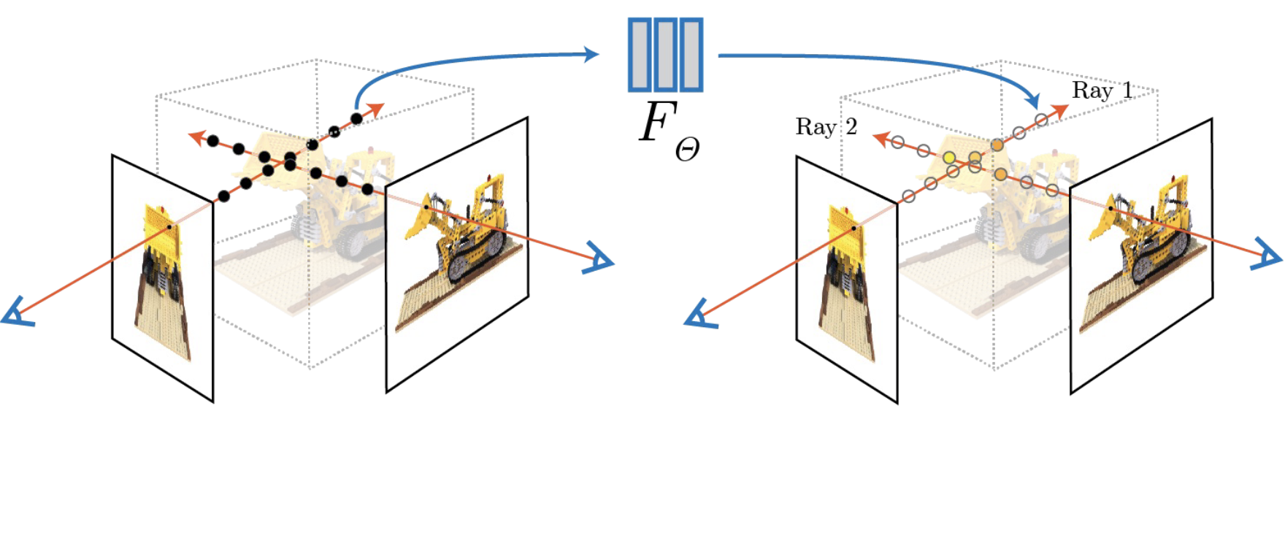
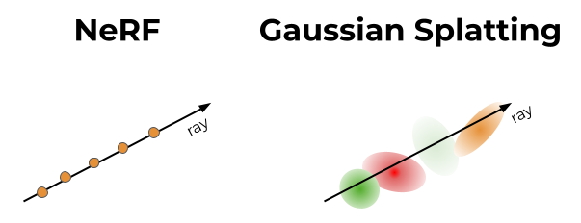
Problems of Nerf
NeRF suffers from slow training and rendering.
We have to query a neural network to obtain color and density values for each point.

Slide 4
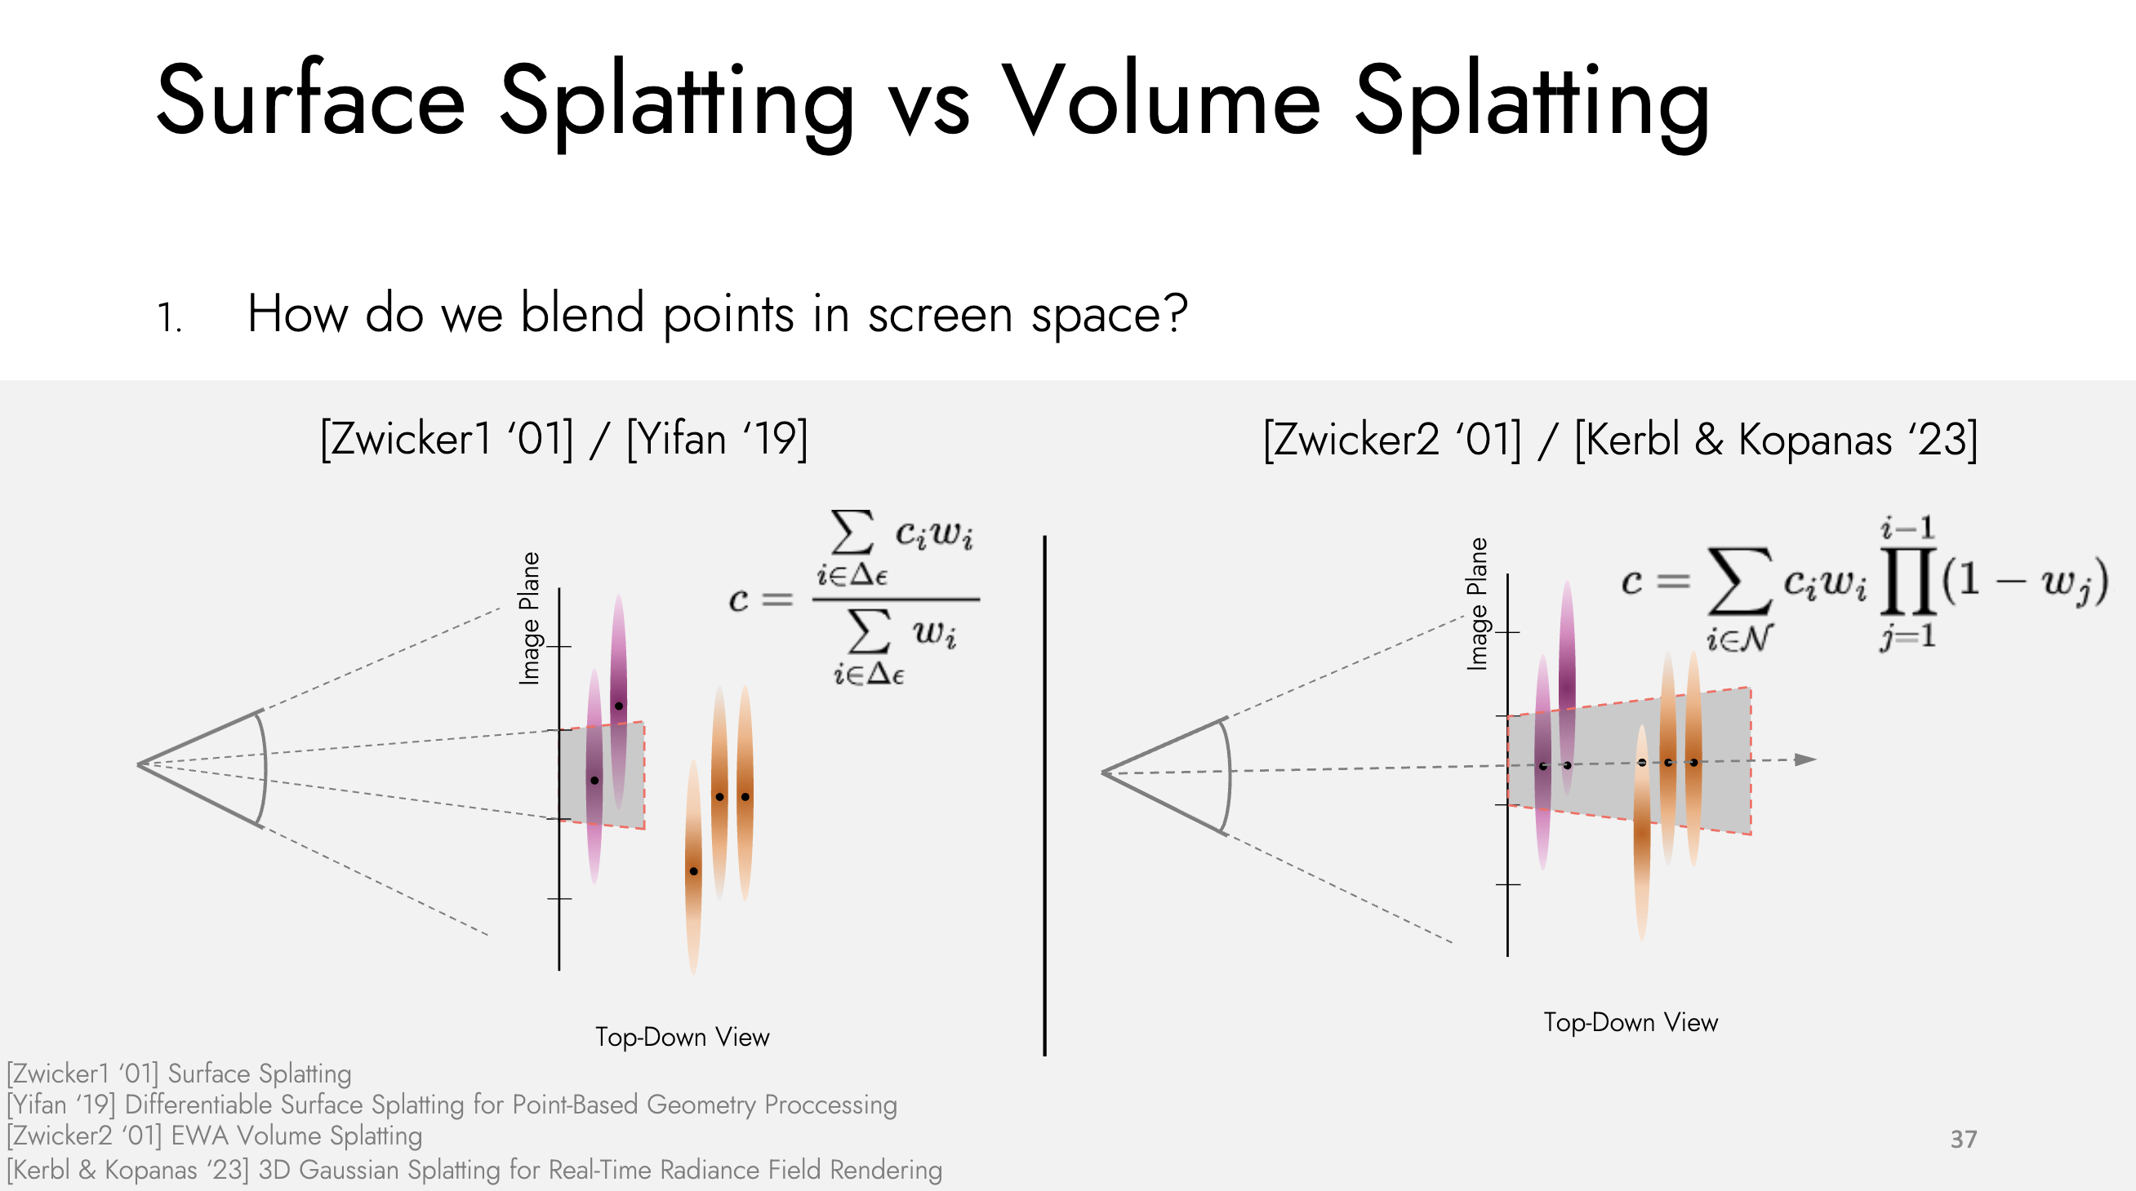
Point-Based Rendering
Notes:
One potential solution to NERF is to revisit point based rendering techniques. Those are based on alpha blending. Essentially the color of a pixel is composed of a blended combination of colors of points that fall into that pixel.

Slide 5
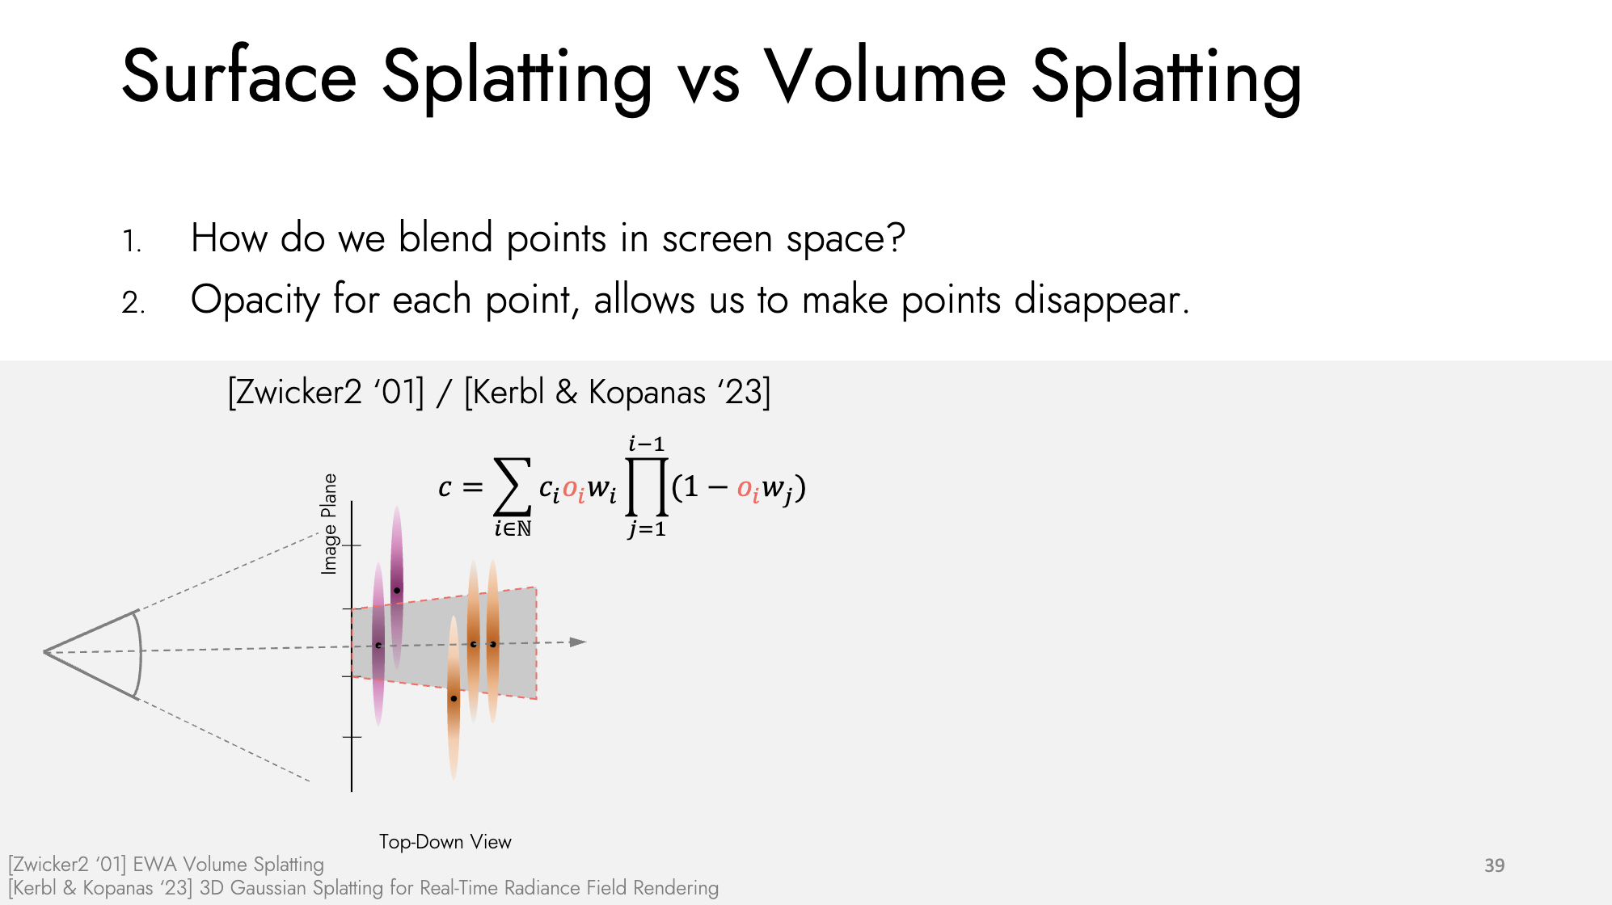

Slide 6
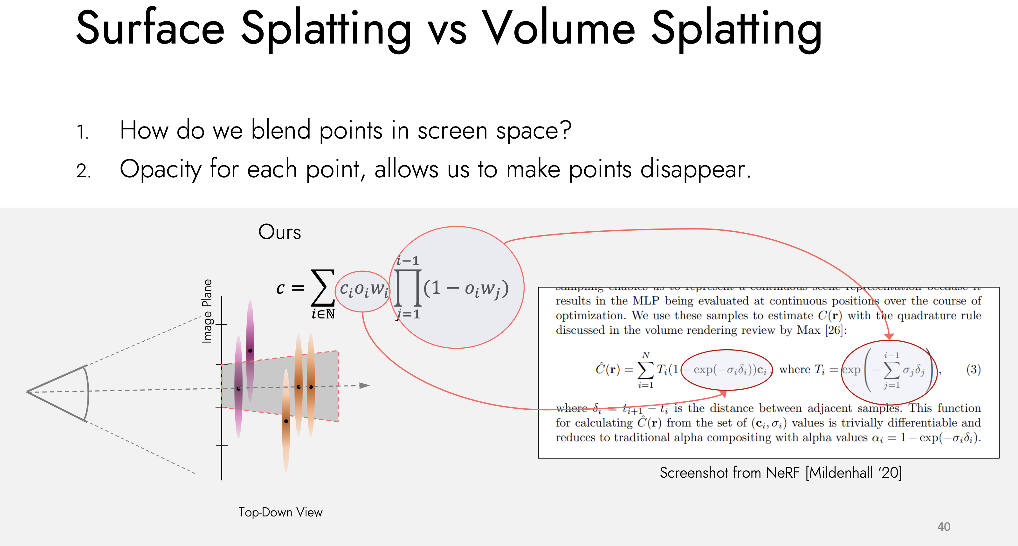
Notes:
the product can be interpreted as probability of voxel not being pre-occupied

Slide 7
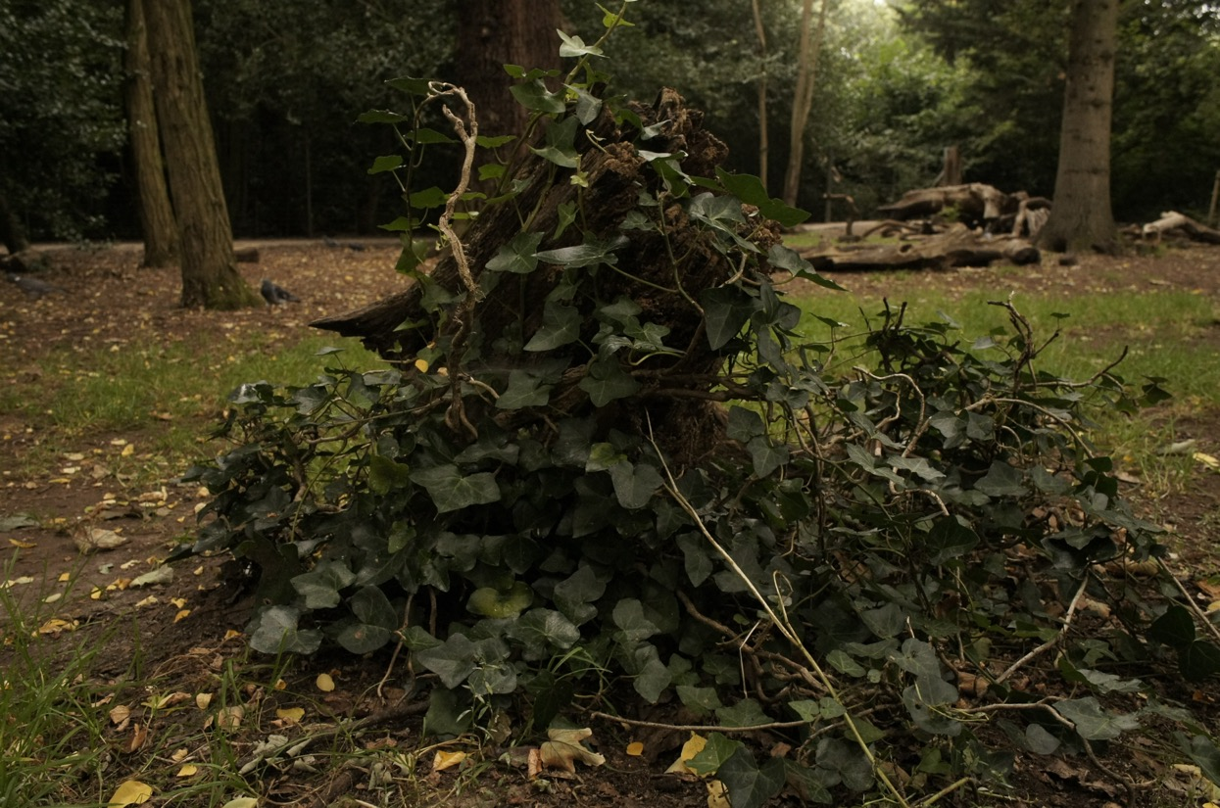
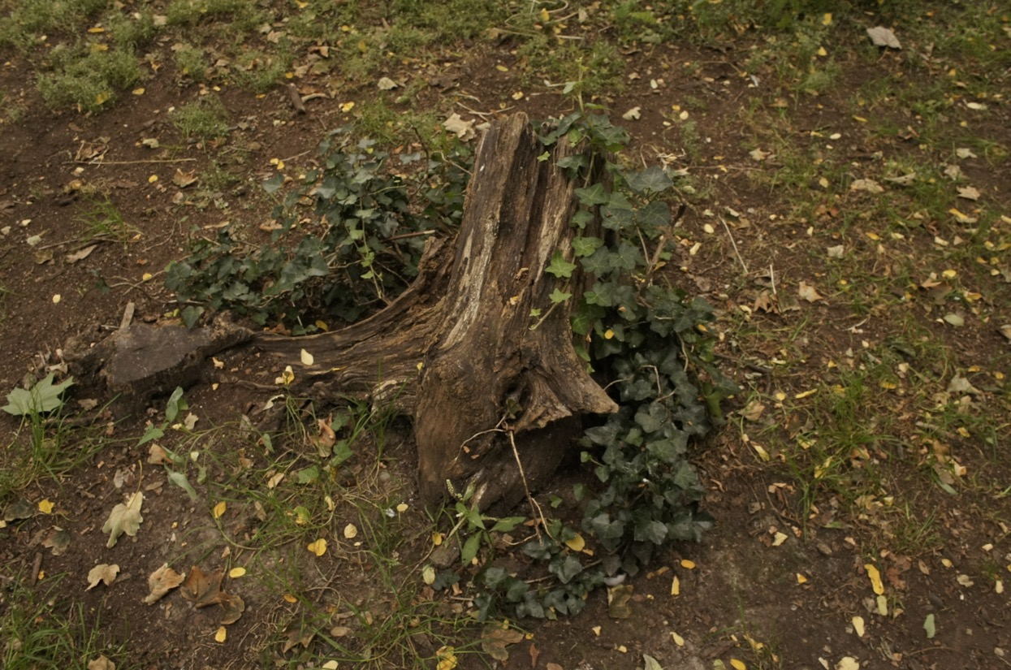
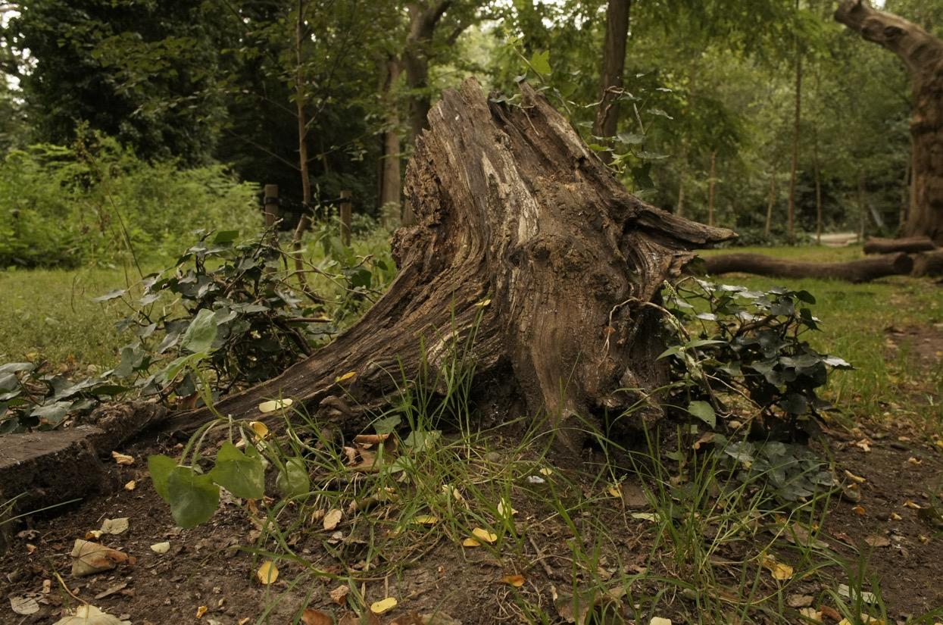
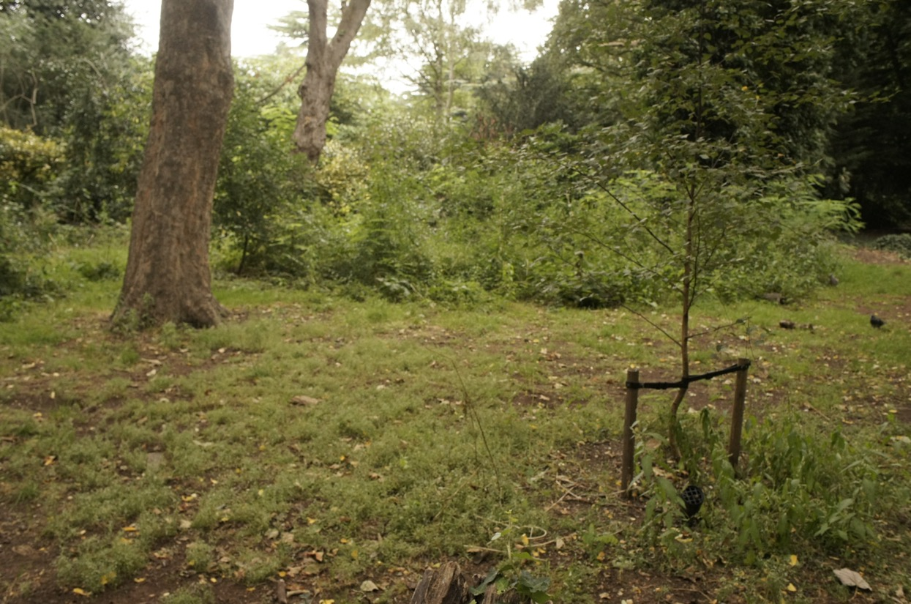
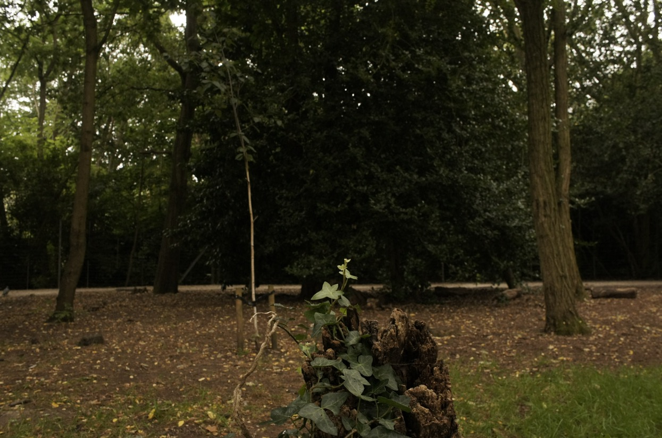
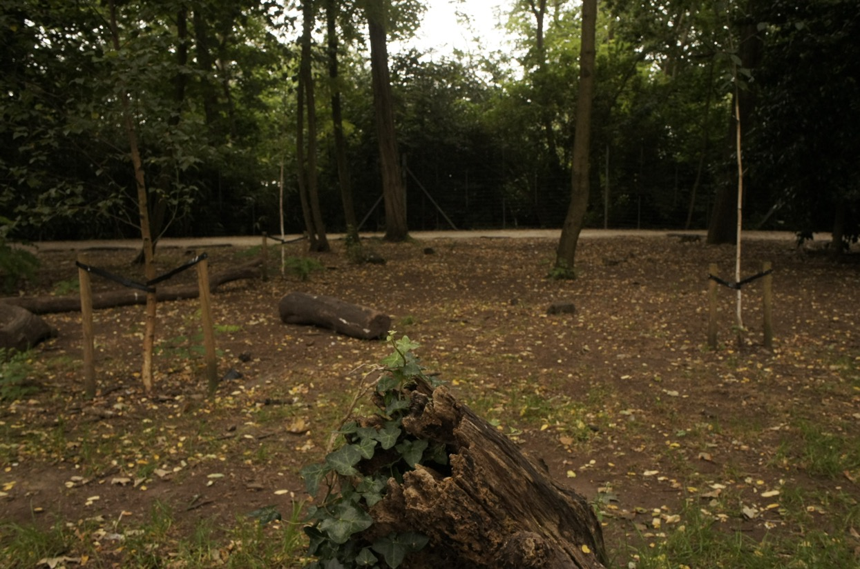
Goal: Reconstructing 3D world from images and videos
[...]
Input images
https://3dgstutorial.github.io/
Notes:
Given videos or images and their corresponding camera poses or videos, the goal of the 3D Gaussian splatting is to reconstruct the 3D world around us.

Slide 8
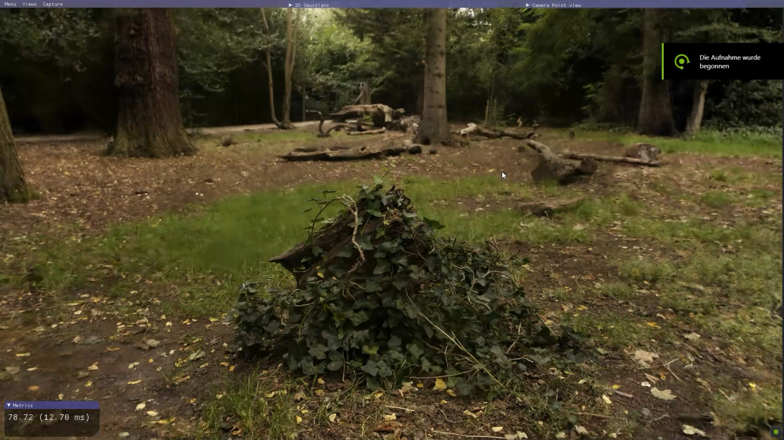
Notes:
---
Play video
---
In this video you see the reconstructed scene from the input images using 3D Gaussian Splatting.
After reconstruction, we can explore the scene from different camera views, ideally from unseen camera views in high rendering speed.
This task is called novel view synthesis.

Slide 9
3D Gaussian Splatting (3DGS) [Kerbl & Kopanas ‘23]
Splat-based representation
Use 3D Gaussians instead of points or a mesh.
It does not include any neural network.
Notes:
- The 3DGS is a splat-based representation.
- It uses small 3D gaussian primitives to represent the scene instead of points or meshes. Unlike points, 3D gaussians has volume.
- It does not include any neural network at all.

Slide 10
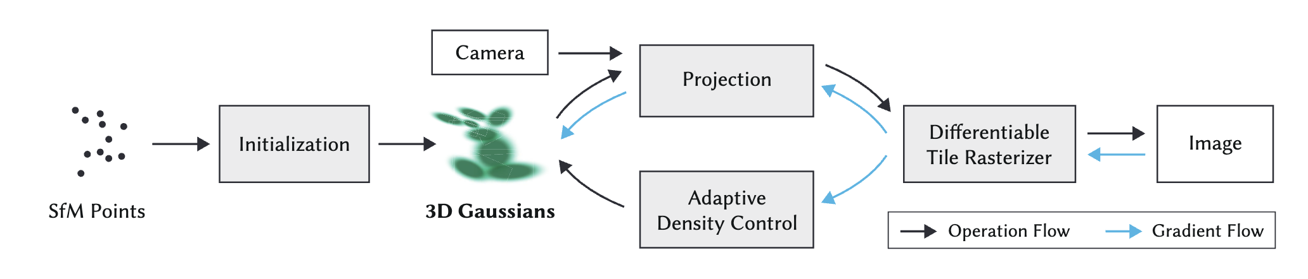
3D Gaussian Splatting (3DGS) [Kerbl & Kopanas ‘23]
Splat-based representation
Use 3D Gaussians instead of points or a mesh.
It does not include any neural network.
Method Overview
Notes:
Here you see the method overview.
Now we will look at the method in detail.
First step is the initialization of the scene.
To do so, given images, we can use SfM method (such as colmap) for initialization.
SfM points carry 3d positions. We can also initialize the 3d points with a color if needed.

Slide 11
Parametrization of 3D Gaussian
How to parametrize 3D Gaussian?
Notes:
As I mentioned, in Gaussian splatting a 3D world is represented with a set of 3D gaussian primitives.
Let’s take a look at how we could parametrize a 3D gaussian:

Slide 12
Parametrization of 3D Gaussian
How to parametrize 3D Gaussian?
3D Gaussian parametrized by:
Covariance Σ
Mean) μ
Opacity o
Color c – RGB values or spherical harmonics (SH) coefficients.
Notes:
Each 3D Gaussian is parametrized by:
Mean μ interpretable as location x, y, z;
Covariance Σ;
Opacity σ(𝛼), a sigmoid function is applied to map the parameter to the [0, 1] interval;
Color parameters, either 3 values for (R, G, B) or spherical harmonics (SH) coefficients.

Slide 13
How to optimize a covariance matrix Σ?
Not all symmetric matrices are covariance matrices and gradient updates can easily make them invalid.
The covariance matrix Σ of a 3D Gaussian is analogous to describing the configuration of an ellipsoid.
Σ has a physical meaning if its a positive-semi definite matrix. So factorize as follows:
Notes:
a 3D point can be an ellipsoid rotated and stretched along any direction in space.
So, it could have required 9 parameters for anisotropic 3D Gaussians. However we can not optimize directly. Why?
- Because: Not all symmetric matrices are covariance matrices and gradient updates can easily make them invalid.
- Σ has a physical meaning if its a positive-semi definite matrix.
Using gradient descent for optimization makes it hard to pose such constraints on a matrix directly. Instead we factorize as follows:
Such factorization is known as eigendecomposition of a covariance matrix and It’s a configuration of an ellipsoid where
S is a diagonal scaling matrix with 3 parameters for scale;
R is a 3x3 rotation matrix analytically expressed with 4 quaternions.

Slide 14
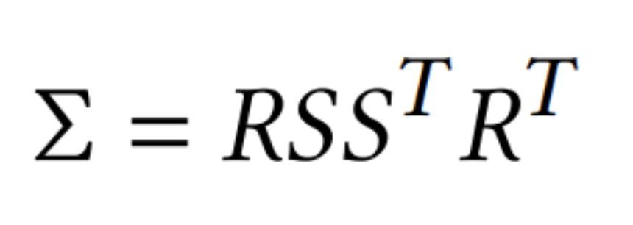
How to optimize a covariance matrix Σ?
Not all symmetric matrices are covariance matrices and gradient updates can easily make them invalid.
The covariance matrix Σ of a 3D Gaussian is analogous to describing the configuration of an ellipsoid.
Σ has a physical meaning if its a positive-semi definite matrix. So factorize as follows:
3x3
Covariance Matrix
3x3 Rotation matrix
Diagonal scaling matrix (3 parameters for scale)
Notes:
This factorization is known as eigendecomposition of a covariance matrix and It’s a configuration of an ellipsoid where
S is a diagonal scaling matrix with 3 parameters for scale
R is a 3x3 rotation matrix analytically expressed with 4 quaternions.

Slide 15
Projection of a covariance matrix Σ into 2D
3x3
Covariance Matrix
3x3 Rotation matrix
Diagonal scaling matrix (3 parameters for scale)

Slide 16
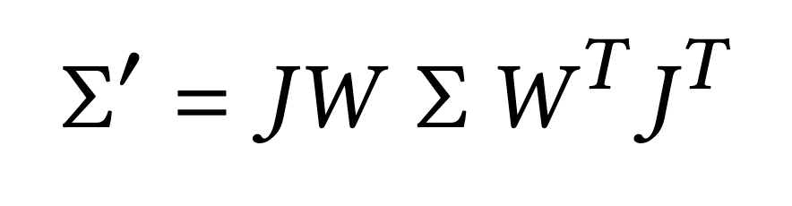
Projection of a covariance matrix Σ into 2D
3x3
Covariance Matrix
3x3 Rotation matrix
Diagonal scaling matrix (3 parameters for scale)
2x2 variance matrix
Projected 2D Gaussian
Jacobian of the affine approximation of the projective
transformation
Viewing Transformation
Notes:
G_{2D}=\mathcal{N}(\mathbf{x}_{2D};\mathbf{\mu}_{2D},\Sigma^\prime)

Slide 17
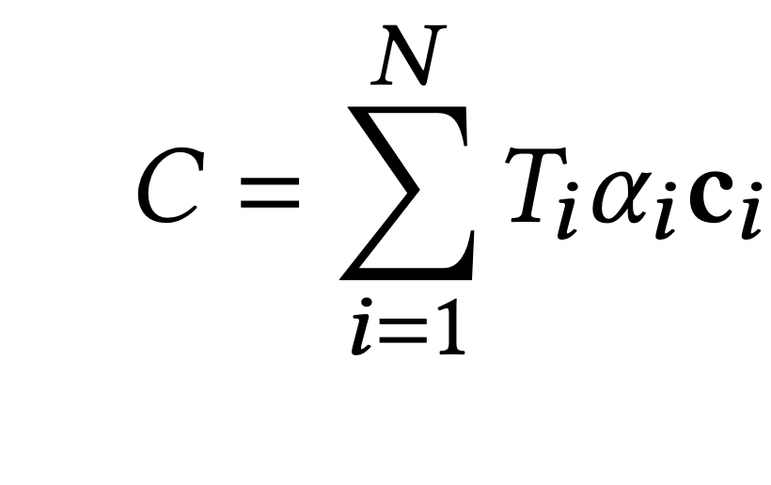
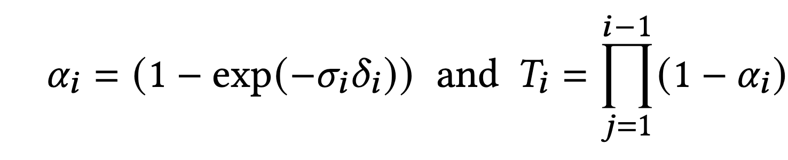
Image Formation Model of NeRF
Color of a pixel
Transmittance
Color of each point
Notes:
Now we will look into image formation.
Given a set of 3D points, how can we use them for rendering and form an image?
To see this, let’s take a little detour and re-visit the volumetric rendering formula given in NeRF²
Point-based 𝛼-blending and NeRF-style volumetric rendering share essentially the same image formation model.
Specifically, the color 𝐶 is given by volumetric rendering along a ray where samples of density 𝜎, transmittance 𝑇 , and color c are taken
along the ray with intervals 𝛿𝑖
in NeRF, color in an image pixel p is approximated by integrating over samples (MLP predictions) along the ray going through this pixel. The final color is a weighted sum of colors of 3D points sampled along this ray, down-weighted by transmittance.

Slide 18
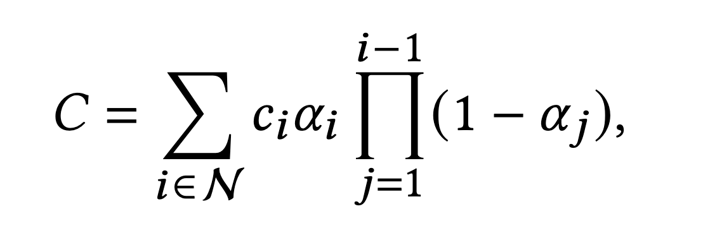
Image Formation Model of 3D Gaussian Splatting
Color of a pixel
Color of each point
Transmittance
Notes:
Now let’s look at the image formation model of 3GDS.
A typical neural point-based approach computes the color 𝐶 of a pixel by blending N ordered points overlapping the pixel:
Where c_i is the color of each point 𝛼_𝑖 is given by evaluating a 2D Gaussian with covariance Σ multiplied with a
learned per-point opacity.
\alpha = \mathbf{o}G_{2D}(\mathbf{x})

Slide 19
NeRF vs Gaussian Splatting
Nerf
Gaussian Splatting
Color of a pixel
Transmittance
Color of each point
Notes:
From the equations, we can clearly see that the image formation
model is the same.
If you look at these equations, the only difference is how 𝛼 is computed between the two.
This small discrepancy turns out extremely significant in practice and results in drastically different rendering speeds.
In fact, it is the foundation of the real-time performance of Gaussian splatting.
the rendering algorithm of Nerf and gausssian splatting is very different.
NeRFs are a continuous representation implicitly representing empty/occupied space; expensive random sampling is required to
find the samples in nerf volume rendering equation with consequent noise and computational
expense.
In contrast, points are an unstructured, discrete representation that is flexible enough to allow creation,
destruction, and displacement of geometry similar to NeRF.
In Gaussian Splatting, the aggregation for each pixel is conducted over the contribution of an ordered list of projected 2D Gaussians.

Slide 20
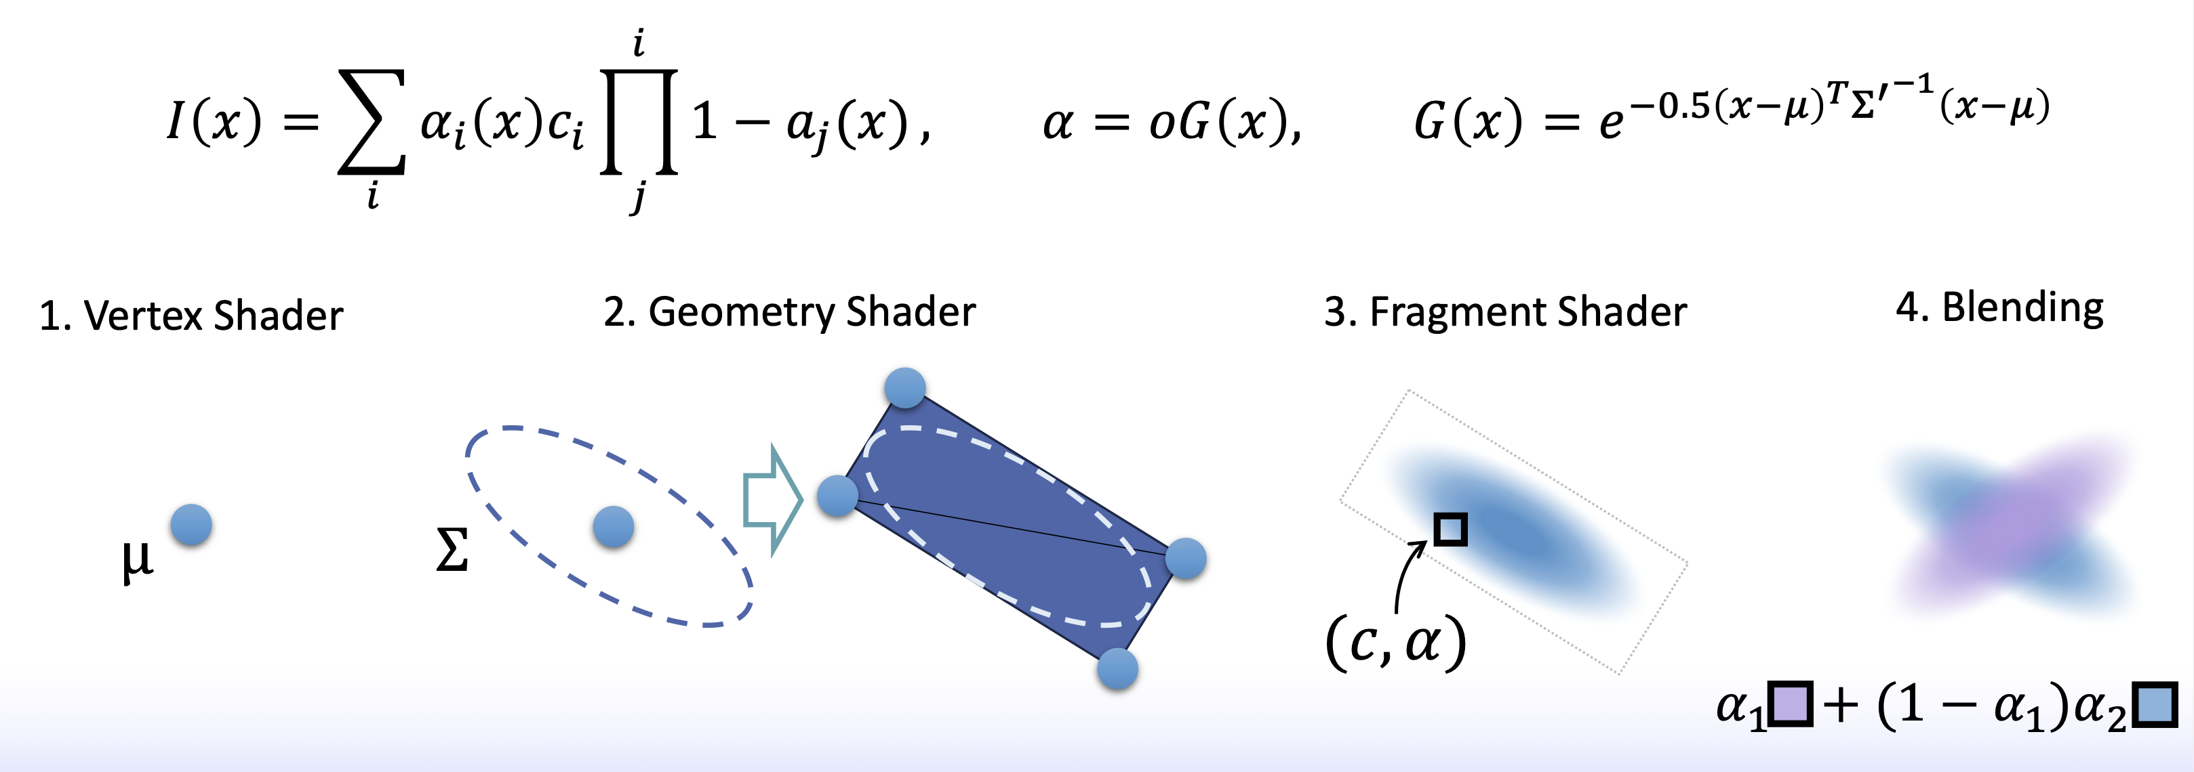
Gaussian Splatting: Why is it fast? A special case of alpha blending
Notes:
Vertex Shader Transforms vertices to screen space Per vertex
Geometry Shader(Optional) Modifies shape or adds geometry Per primitive
Rasterization Breaks triangles into pixel-sized fragments GPU fixed unit
Fragment Shader Colors the fragments (lighting, textures) Per fragment
Output Merger Writes final color to the screen Per pixel
All of these steps happen massively in parallel:
Vertex shaders are run on hundreds of vertices at the same time.
Fragment shaders are run on thousands of fragments simultaneously.

Slide 21
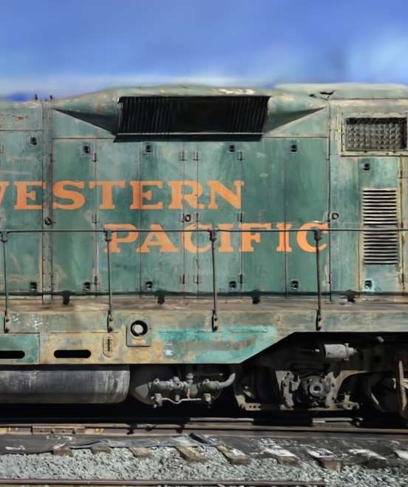
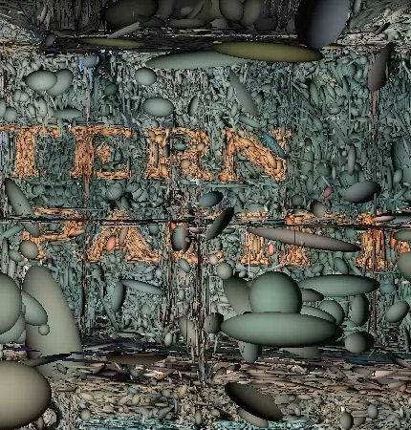
https://blog.42yeah.is/rendering/opengl/2023/12/20/rasterizing-splats.html
Notes:
The left image shows the rendering of gaussians. The right image shows the actual 3D gaussian primitives.
The sfm point init only gives us sparse pointclouds. However the scenes are dense and we need to create new gaussians.
To mitigate this problem, 3GGS also has adaptive strategy to adaptively control the number of gaussians.

Slide 22
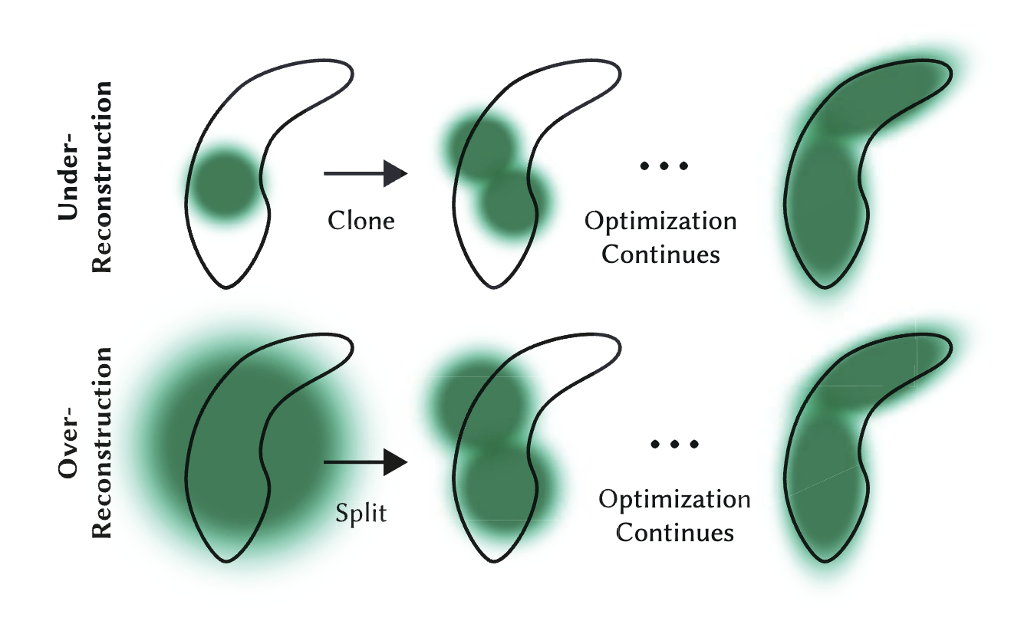
Adaptive Control of the Gaussians
Notes:
So we have to adaptively control the number of the gaussians.
When small-scale geometry (black outline) is insufficiently
covered, we clone the respective Gaussian.

Slide 23
Adaptive Control of the Gaussians
Notes:
Ib the Bottom row (over-reconstruction):
If small-scale geometry is represented by one large splat, we split it in two.

Slide 24
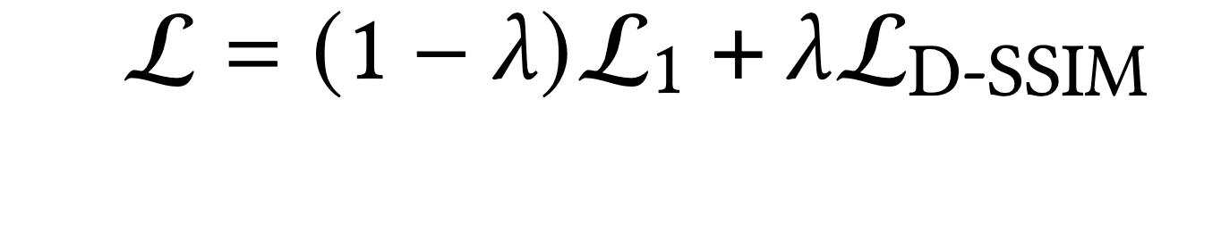
Optimization
Notes:
We optimize the 3G gaussians using L1 loss between ground truth images and rendered image from the rasterizer such that renders of the scene matche closely to the known dataset images.

Slide 25
Optimization
https://3dgstutorial.github.io/
How to go from 5 FPS to 100+ FPS?
(Using the GPU efficiently)

Slide 26
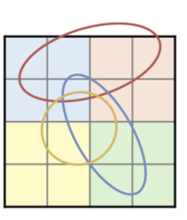
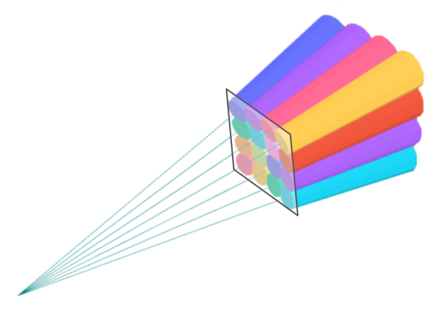
Optimization
https://3dgstutorial.github.io/
How to go from 5 FPS to 100+ FPS?
(Using the GPU efficiently)
1. Tiling
  Split the image in 16x16 Tiles – helps threads to work collaboratively.
2. Single global sort
  GPU sorts millions of primitives fast.

Slide 27
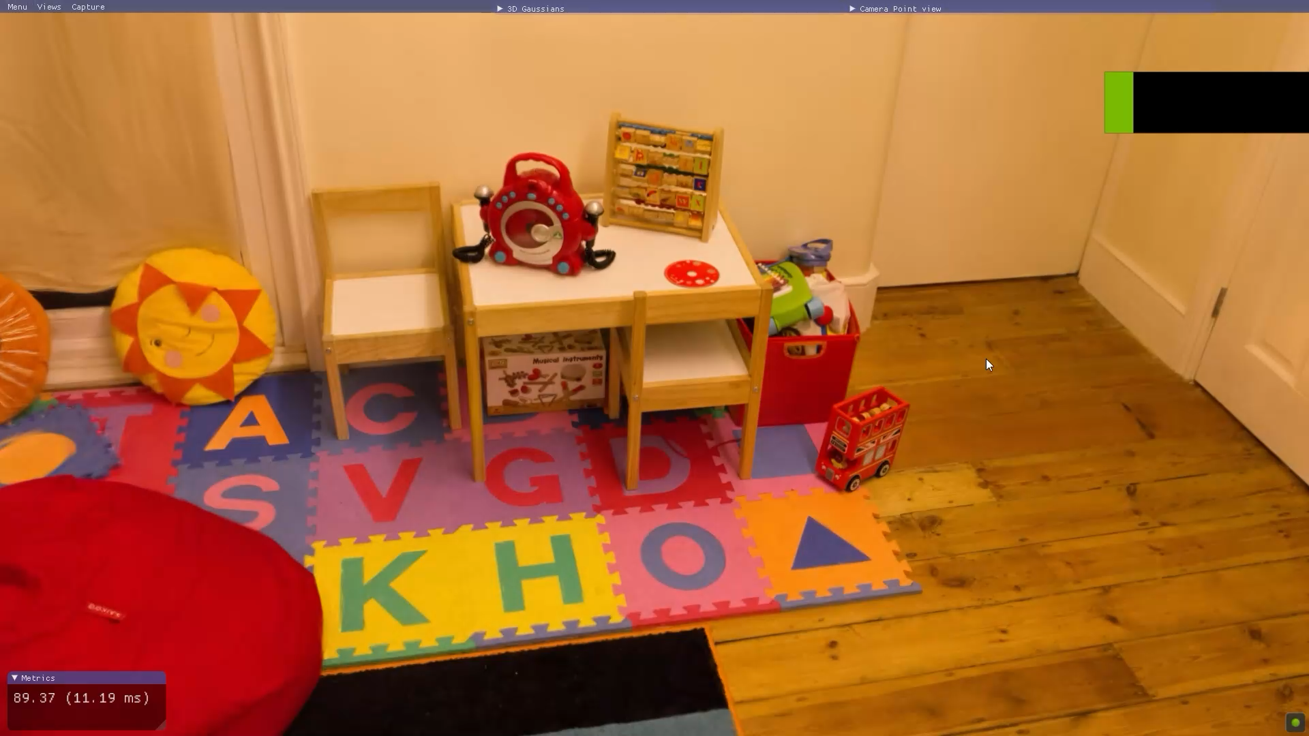
Notes:
Lets look at the results
Play video.

Slide 28
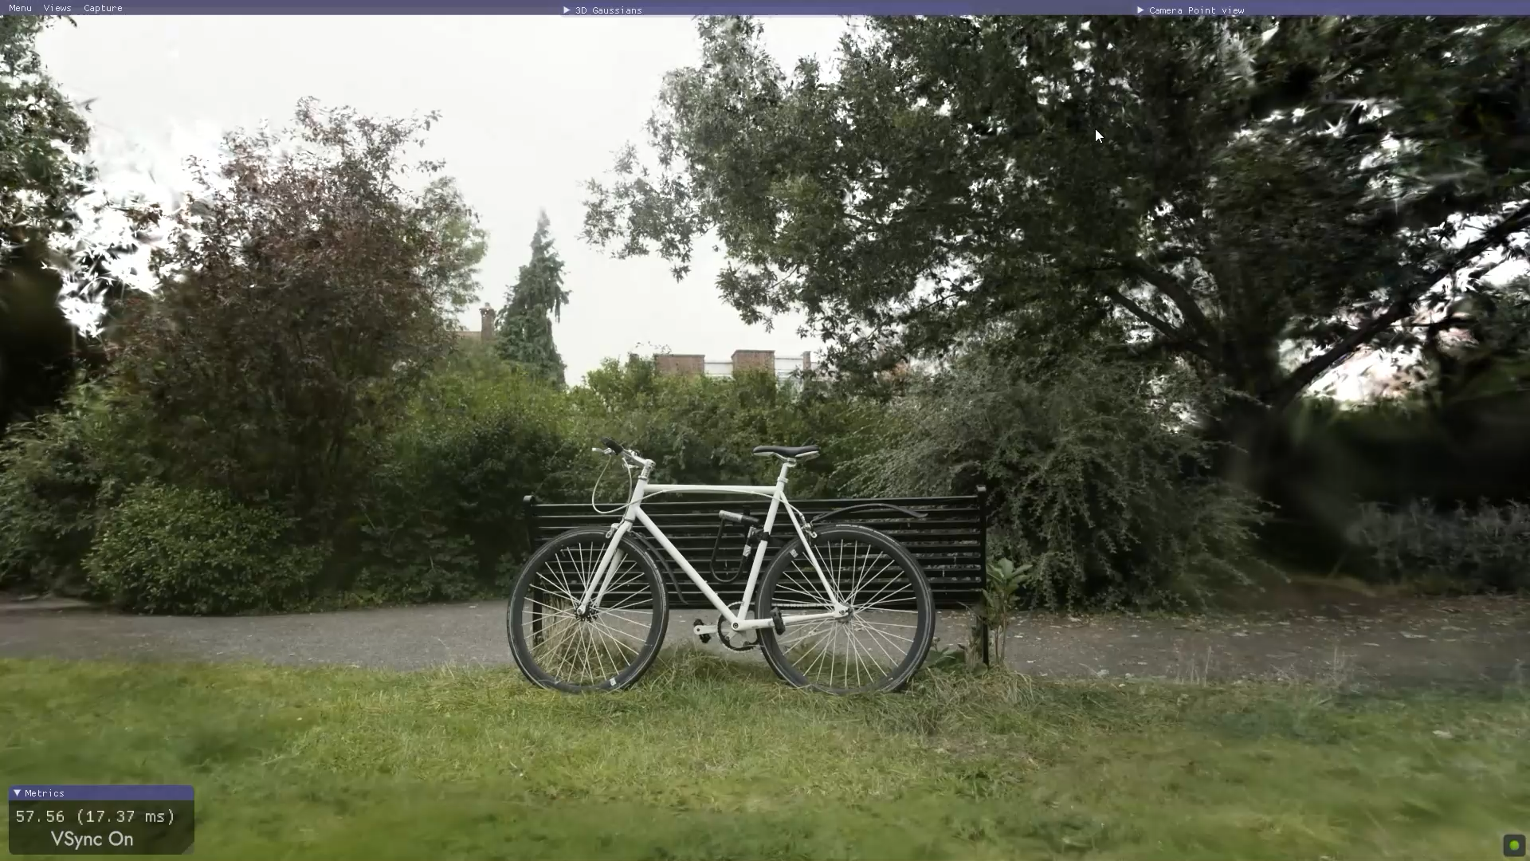
Notes:
Lets look at the results
Play video.

Slide 29
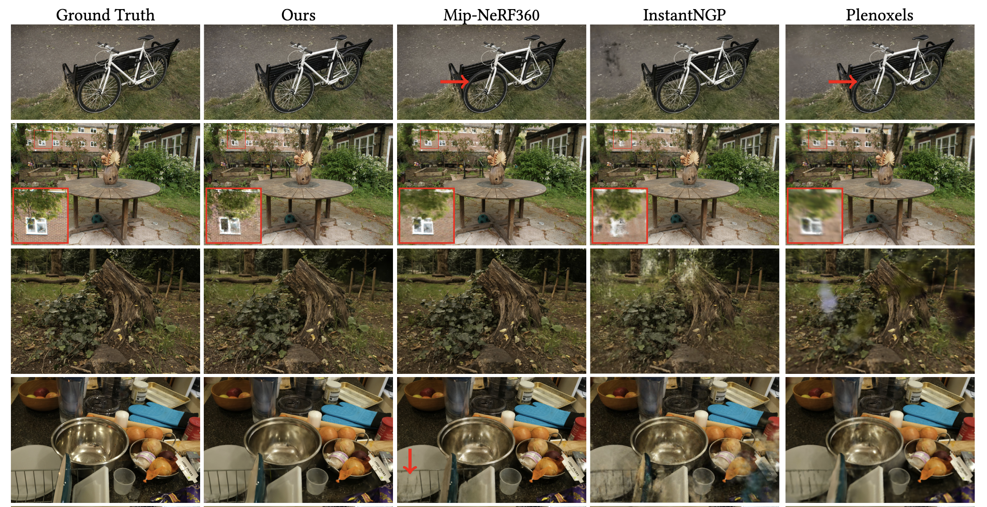
Notes:
Here is the comparison is shown of 3DGS to previous methods and the corresponding ground truth images from held-out test views.

Slide 30
In this lecture, we will learn …
3D Gaussian Splatting (3DGS) [Kerbl & Kopanas ‘23]
Applications of 3DGS and addressing its limitations (i.e., dynamic scene, compression, surface reconstruction…)
Notes:
---
---
So far, we talked about 3D Gaussian Splatting and explained how the method works. We went through the image formation model of 3DGS.

Slide 31
In this lecture, we will learn …
3D Gaussian Splatting (3DGS) [Kerbl & Kopanas ‘23]
Applications of 3DGS and addressing its limitations (i.e., dynamic scene, compression, surface reconstruction…)
Notes:
Second part of the lecture, we will talk about how future works address the limitations of 3D gaussian splatting including extending into the dynamic scenes, obtaining surface reconstruction from gaussian representation etc ..

Slide 32
Limitations and its follow-up works
  3DGS has a high storage cost.
    Compression
  3DGS is a novel view synthesis method (mostly static scenes).
    Extending into dynamic scenes - Dynamic 3DGS
  Unlike meshes, 3DGS does not provide a clean/compact surface.
    Surface Reconstruction (How to obtain surface from gaussian primitives?)
Notes:
Let’s first look at the limitations.

Slide 33
Limitations and its follow-up works
  3DGS has a high storage cost.
    Compression
  3DGS is a novel view synthesis method (mostly static scenes).
    Extending into dynamic scenes - Dynamic 3DGS
  Unlike meshes, 3DGS does not provide a clean/compact surface.
    Surface Reconstruction (How to obtain surface from gaussian primitives?)

Slide 34
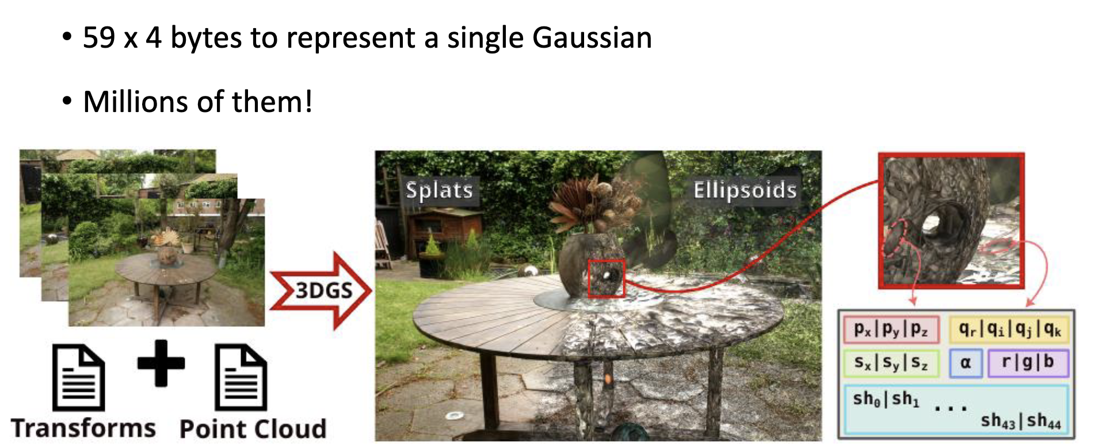
Storage cost of a 3DGS Scene
https://3dgstutorial.github.io/
Notes:
3DGS has a high storage cost.
To represent a single gaussian we need 59 x 4 bytes:
- Mean 3
- Scale 3
- Rotation 4
SH 16 x 3
Opacity 1
To represent a scene, we might need millions of them.

Slide 35
3DGS Compression – Follow-up works
Compact3D: Smaller and Faster Gaussian Splatting with Vector Quantization
EAGLES: Efficient Accelerated 3D Gaussians with Lightweight Encodings (ECCV 2024)
LightGaussian: Unbounded 3D Gaussian Compression with 15x Reduction and 200+ FPS (NeurIPS 2024)
Compact 3D Gaussian Representation for Radiance Field (CVPR 2024)
Compressed 3D Gaussian Splatting for Accelerated Novel View Synthesis (CVPR 2024)
Reducing the Memory Footprint of 3D Gaussian Splatting (I3D ’24)
Notes:
There are follow up works that address storage cost of a 3DGS scene. Here are some of them.

Slide 36
3DGS Compression – Follow-up works
Compact3D: Smaller and Faster Gaussian Splatting with Vector Quantization
EAGLES: Efficient Accelerated 3D Gaussians with Lightweight Encodings (ECCV 2024)
LightGaussian: Unbounded 3D Gaussian Compression with 15x Reduction and 200+ FPS (NeurIPS 2024)
Compact 3D Gaussian Representation for Radiance Field (CVPR 2024)
Compressed 3D Gaussian Splatting for Accelerated Novel View Synthesis (CVPR 2024)
Reducing the Memory Footprint of 3D Gaussian Splatting (I3D ’24)
Notes:
We will look at EAGLES: Efficient Accelerated 3D Gaussians with Lightweight Encodings.

Slide 37
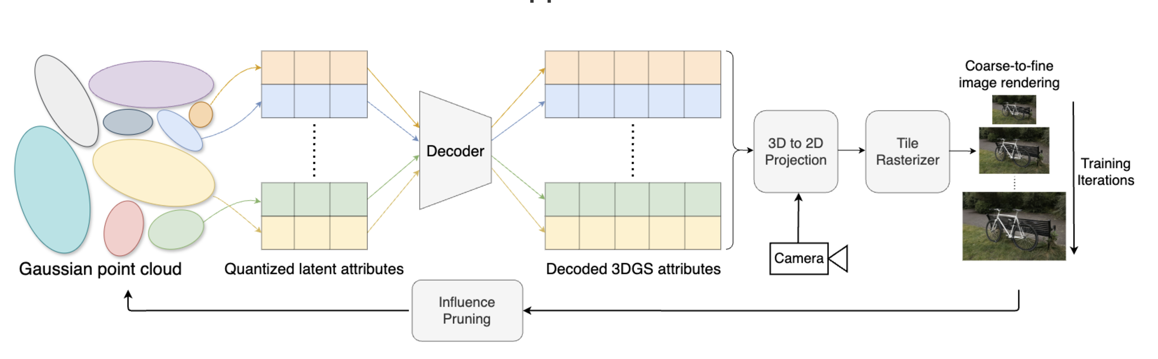
EAGLES: Efficient Accelerated 3D Gaussians with Lightweight Encodings (ECCV 2024)
https://efficientgaussian.github.io/
Key components:
  Quantized embeddings
  Coarse-to-fine training
  Influence pruning
Notes:
Lets look at one of the methods in detail.
three key components of the method are:
(1) quantized embeddings
(2) coarse-to-fine training and
(3) influence pruning.
Given a gaussian pointcloud, quantized embedings are computed.
Through a learned decoder 3DGS attibutes are decoded, projected and rasterized into images.

Slide 38
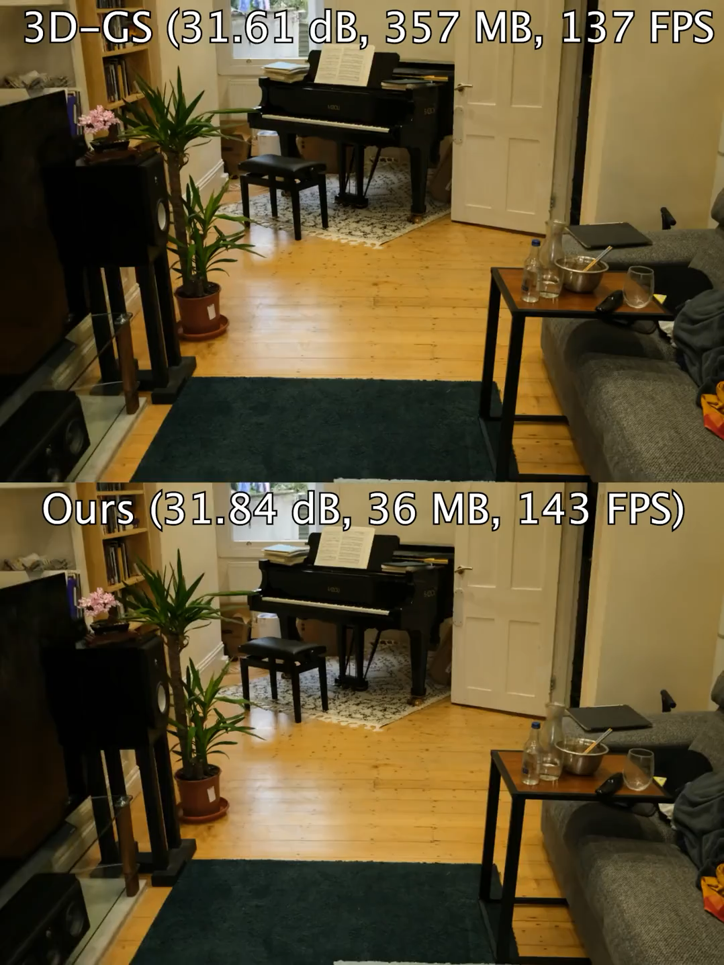
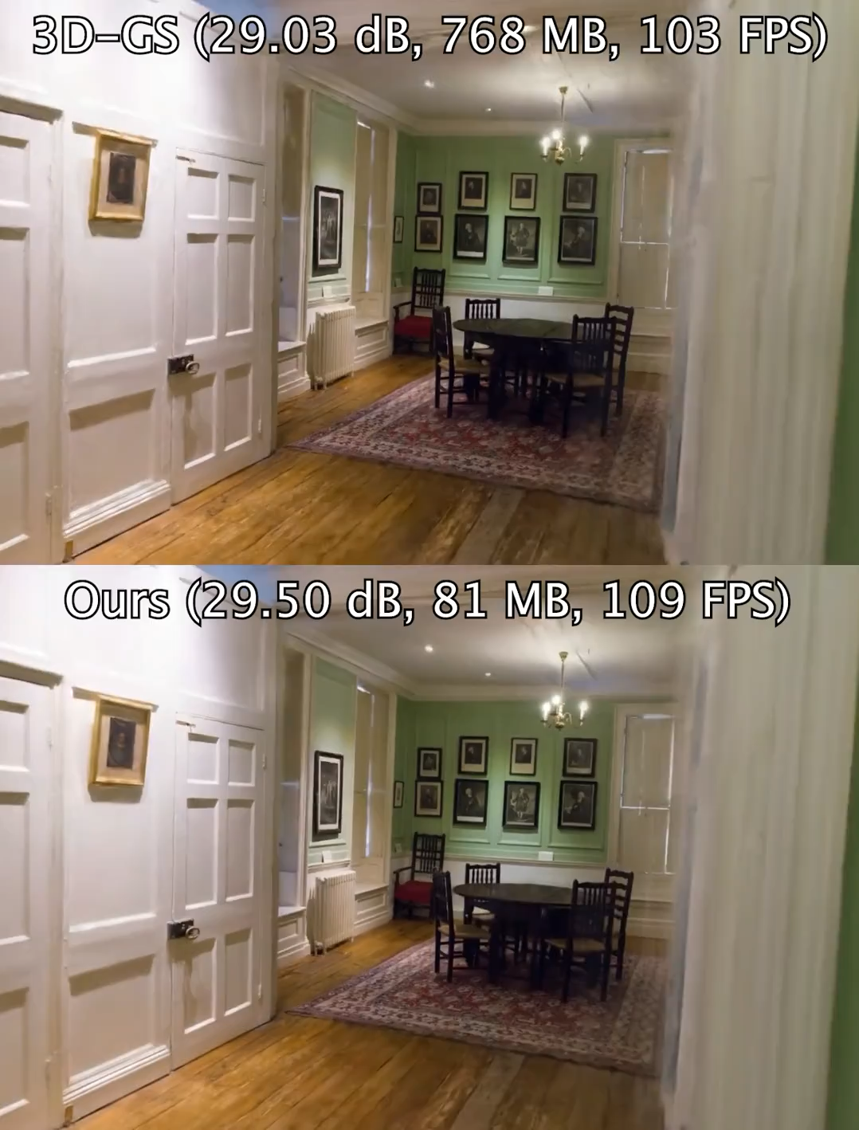
Compression results
Notes:
36mb instead of 357mb
81mb instead of 768 mb

Slide 39
Limitations and its follow-up works
  3DGS has a high storage cost.
    Compression
  3DGS is a novel view synthesis method (mostly static scenes).
    Extending into dynamic scenes - Dynamic 3DGS
  Unlike meshes, 3DGS does not provide a clean/compact surface.
    Surface Reconstruction (How to obtain surface from gaussian primitives?)

Slide 40
Limitations and its follow-up works
  3DGS has a high storage cost.
    Compression
  3DGS is a novel view synthesis method (mostly static scenes).
    Extending into dynamic scenes - Dynamic 3DGS
  Unlike meshes, 3DGS does not provide a clean/compact surface.
    Surface Reconstruction (How to obtain surface from gaussian primitives?)
Notes:
Second limitation of the original paper:
3DGS is a novel view synthesis method (mostly static scenes).

Slide 41
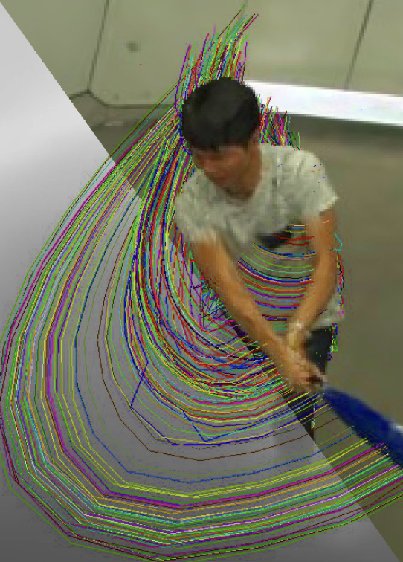
Dynamic 3D Gaussians: Tracking by Persistent Dynamic View Synthesis (3DV 2024)
https://dynamic3dgaussians.github.io/
Fixed / Consistent over time:
  3D Size
  Color
  Opacity
Changing over time (per timestep):
  3D Center
  3D Rotation

Slide 42
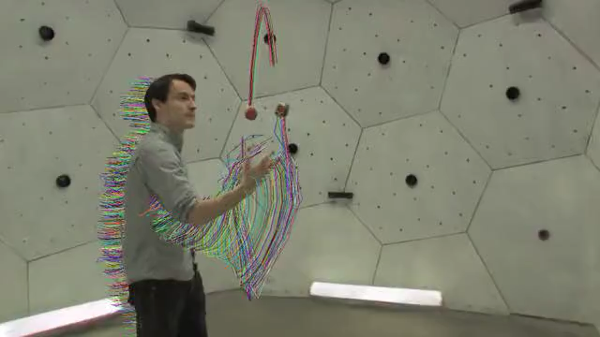
Tracking 3D Gaussians over time
Notes:
Play video

Slide 43
Limitations and its follow-up works
  3DGS has a high storage cost.
    Compression
  3DGS is a novel view synthesis method (mostly static scenes).
    Extending into dynamic scenes - Dynamic 3DGS
  Unlike meshes, 3DGS does not provide a clean/compact surface.
    Surface Reconstruction (How to obtain surface from gaussian primitives?)
Notes:
3DGS has a high storage cost.
3DGS is a novel view synthesis method (mostly static scenes).
Unlike meshes, 3DGS does not provide a clean/compact surface.

Slide 44
Limitations and its follow-up works
  3DGS has a high storage cost.
    Compression
  3DGS is a novel view synthesis method (mostly static scenes).
    Extending into dynamic scenes - Dynamic 3DGS
  Unlike meshes, 3DGS does not provide a clean/compact surface.
    Surface Reconstruction (How to obtain surface from gaussian primitives?)
Notes:
Unlike meshes, 3DGS does not provide a clean/compact surface.

Slide 45
Mesh Extraction
  The naive way of extracting meshes from gaussian splatting is usually done by running TSDF or Marchign Cubes
  Problem!
    Reconstructed surfaces are not smooth. Hence extracted meshes are very noisy.
Notes:
Unlike meshes, 3DGS does not provide a clean/compact surface.

Slide 46
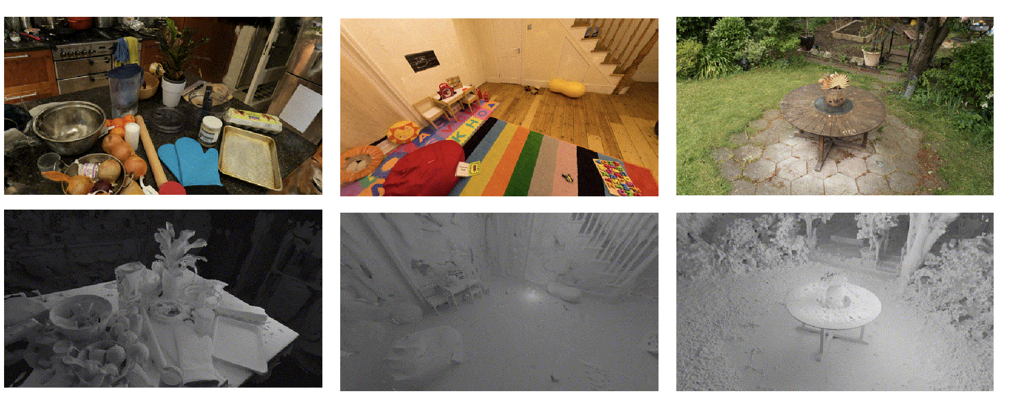
SuGaR: Surface-Aligned Gaussian Splatting for Efficient 3D Mesh Reconstruction and High-Quality Mesh Rendering (CVPR 2024)
Notes:
Gaussian Splatting does not provide the mesh, unlike meshes.
How can be obtain a surface from gaussian representation?
SuGaR paper proposes a method to obtain mesh representation from gaussians.

Slide 47
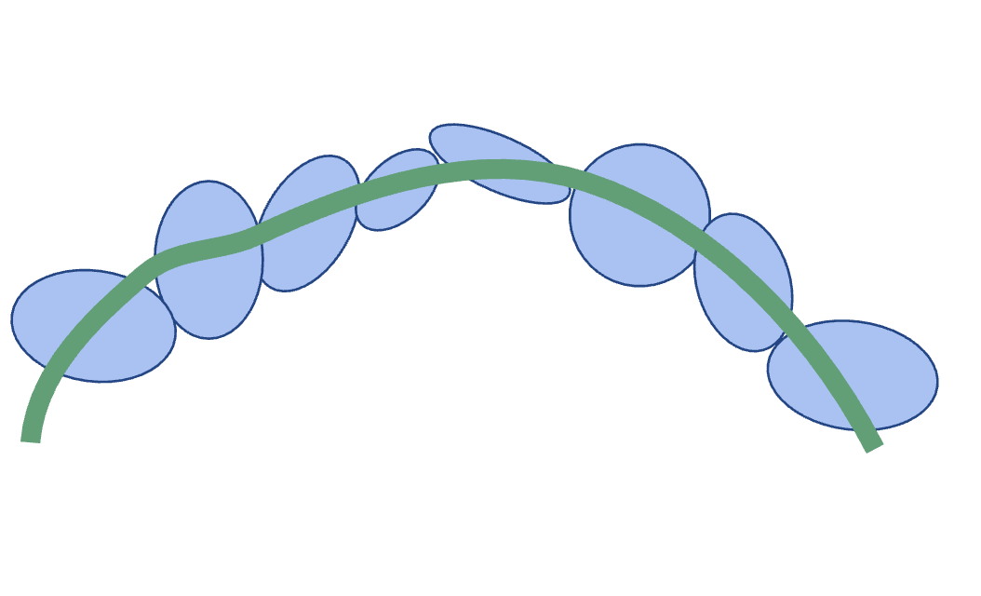
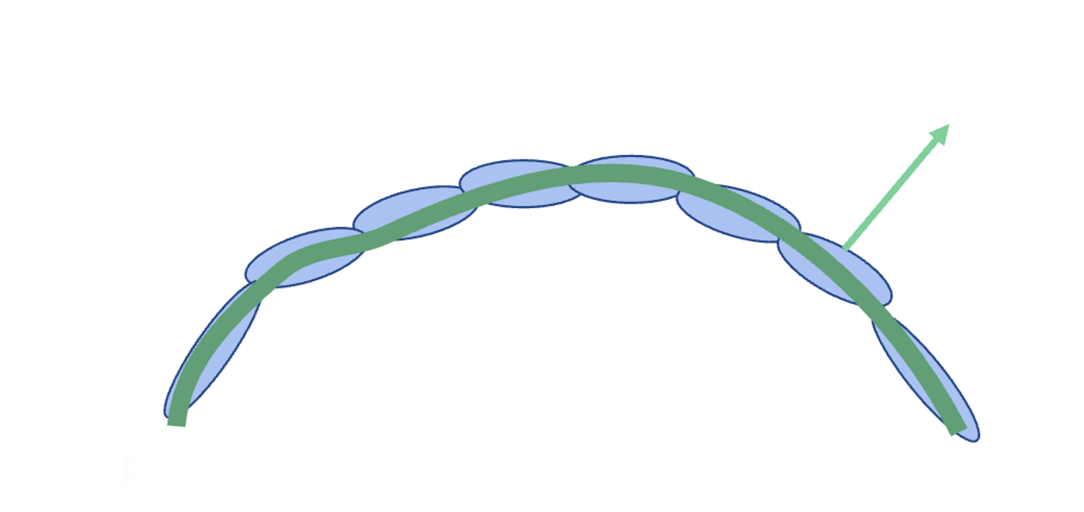
Density constraint: aligning gaussians with the true surface
  Gaussians should have limited overlap and be well-spread on the surface.
  Gaussians should be fully opaque or transparent (otherwise iso surfaces are meaningless)
  Gaussians should be as flat as possible. (One of the three scaling factors should be close to zero.)
Notes:
To align gaussians with the true surface:
Gaussians should have limited overlap and be well-spread on the surface
Gaussians should be fully opaque or transparent.
Gaussians should be as flat as possible. (One of the three scaling factors should be close to zero.)

Slide 48
In this lecture, we covered …
3D Gaussian Splatting (3DGS) [Kerbl & Kopanas ‘23]
Applications of 3DGS and addressing its limitations (i.e., dynamic scene, compression, surface reconstruction…)

