Slide 1
Hands on AI based 3D Vision
Summer Semester 25
Lecture 3 – Classical Reconstruction Methods
Prof. Dr.-Ing. Gerard Pons-Moll
University of Tübingen / MPI-Informatics

Slide 2
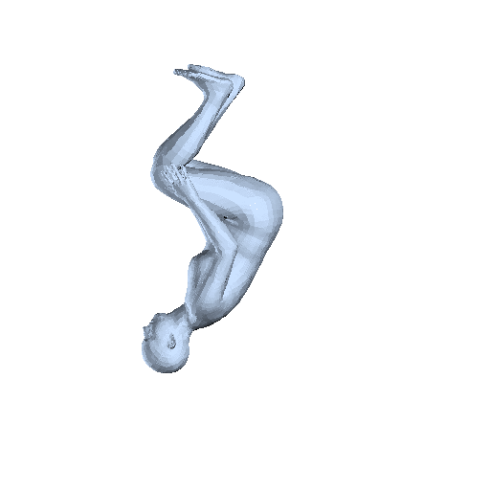
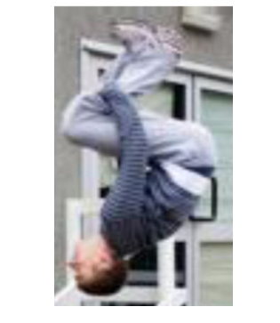
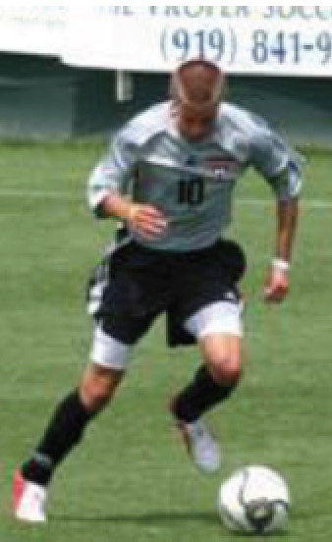
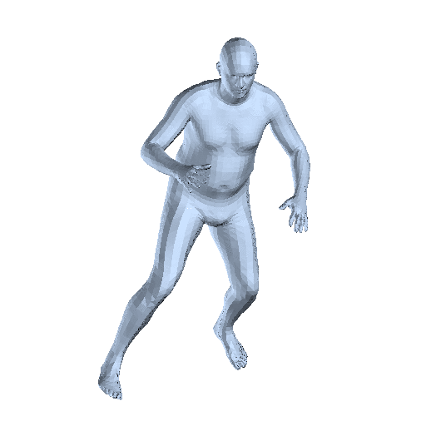
"Inverting" the Image Formation Process
Input (2D)
Output (3D)
Notes:
In the previous lecture we have seen how images are formed. This means how 3D points in the world are mapped to 2D pixels on a screen. What we are actually interested in is the inverse of this operation. Given 2D pictures, we want to reconstruct the underlying 3D structure. In this lecture we will be looking at some traditional methods for this task.
Classical 3D Reconstruction Methods usually require at least two images to handle depth ambiguities. This is typical for us humans, who can infer the 3D structure of a scene by moving around it and viewing it from different angles. This problem of reconstructing a scene from different viewing angles is known as "structure from motion.

Slide 3
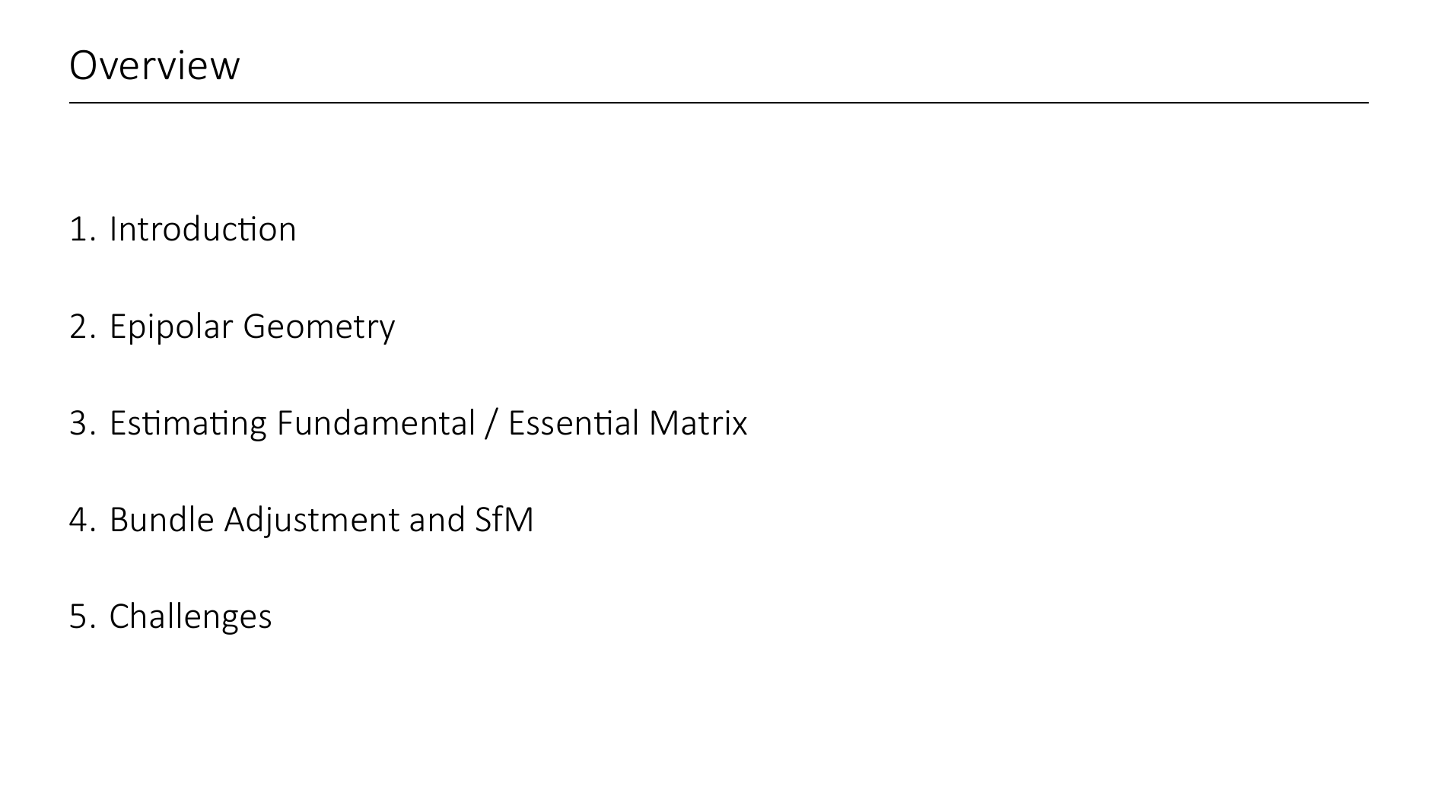

Slide 4


Slide 5
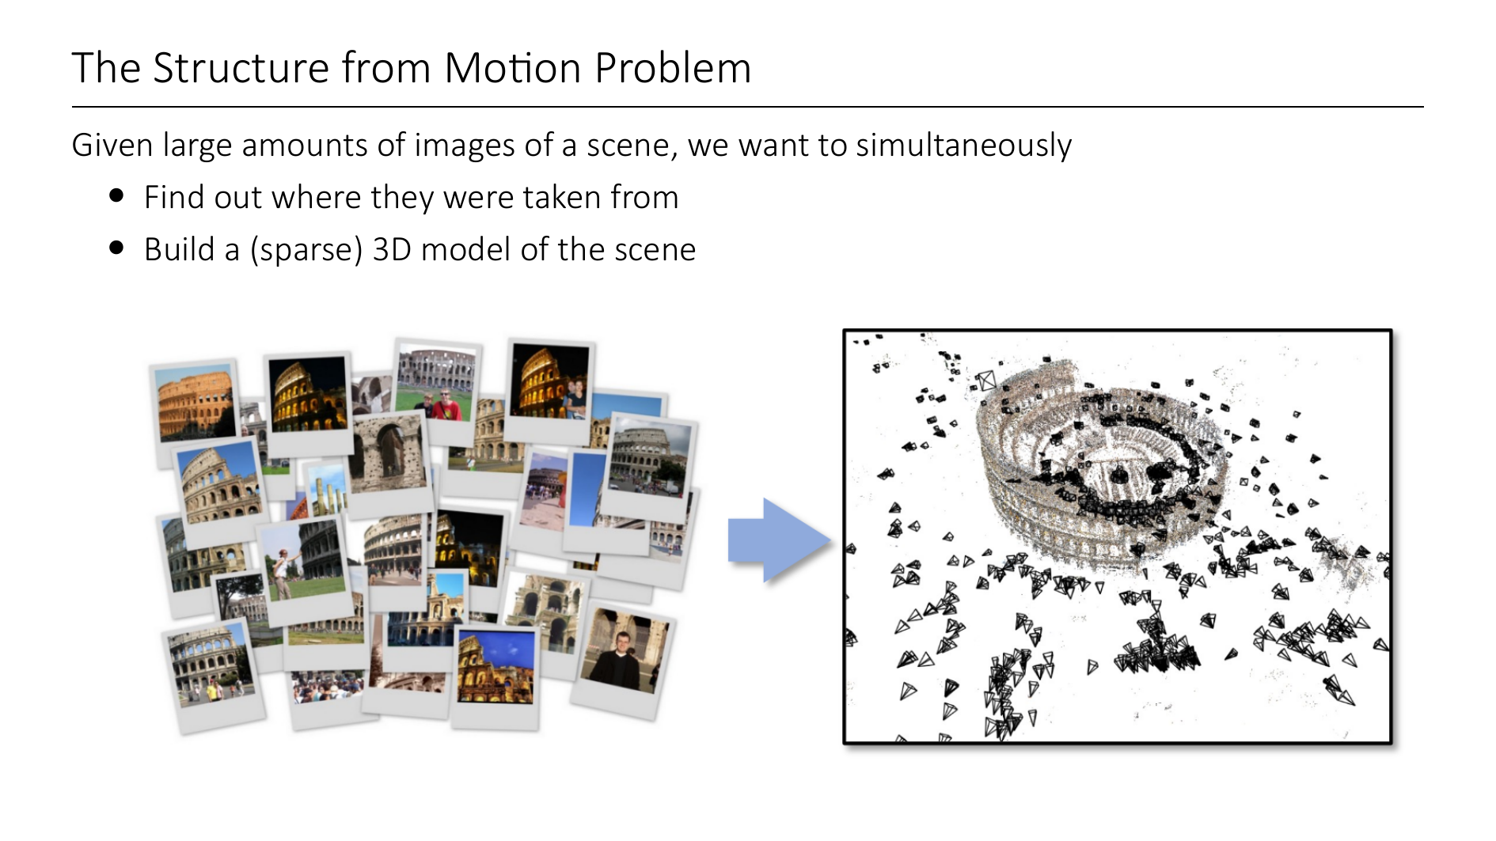
Notes:
Topic this lecture: The structure from motion problem
Overall goal is to make a 3D reconstruction of a scene. Because of depth ambiguity, we need at least 2 images from slightly different viewpoints for this.
The structure from motion problem is the following: We are given a collection of images that all show the same object/scene, but from different viewpoints.
The pictures will be slightly different, but many of them will share keypoints between each other, so we have some sort of 2D-2D correspendes between the images.
The task is to simultaneously estimate the camera information (intrinsics and poses), as well as building a sparse 3D reconstruction of the scene.
Example Use-Case: Many tourists take photos of the same monument (like the colloseum here), and post them on the internet. All of these pictures are taken with different cameras, from different poses, and show different parts of the colloseum, but most of them will have some overlap. What you see on the right is a scene reconstruction with estimated camera poses. All of this only comes from a collection of 2D images!

Slide 6


Slide 7

Notes:
An early work that leveraged large scale photo collections is "Photo Tourism" by Snavely et al from 06.
They present an interactive system where you can browse and explore large and unstructured collections of photographs. They estimate camera poses, and create a sparse 3D reconstruction of the scene, so that you can smoothly transition between photographs.
Demo / Video

Slide 8
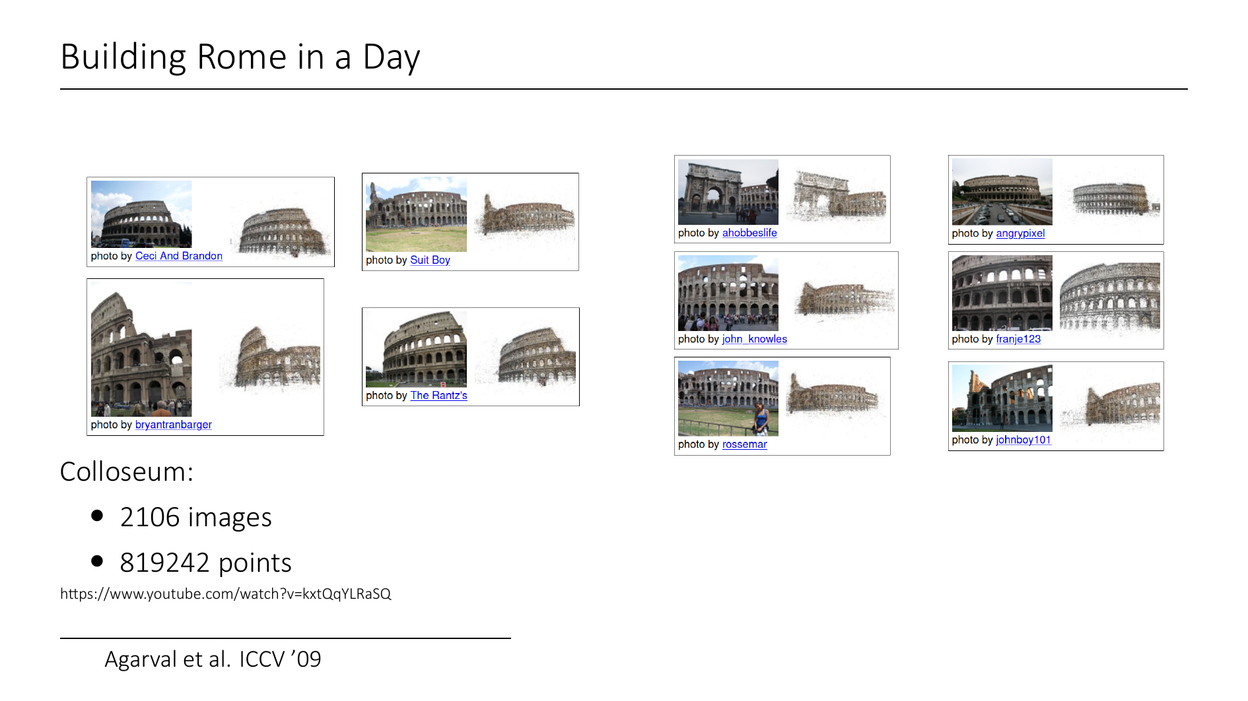

Slide 9
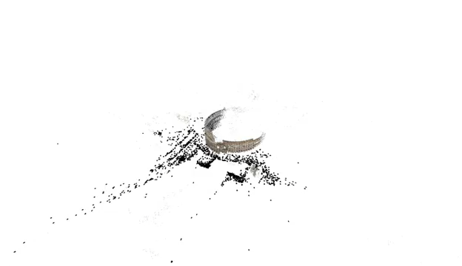
Notes:
Over time the scale of these methods increased from smaller scenes and single monuments to entire cities. "Building Rome in a Day" is a project where entire cities are reconstructed from web-images. (In 09, there were apparently more than 2M photographs when you looked for "Rome" in "Flickr"). The "in a day" part refers to the runtime of the entire pipeline. The sheer scale of the problem introduces new challenges:
- robustness: methods rely on keypoint matchings without 3D spatial awareness. There will certainly be outliers / mismatches
- involves large scale nonlinear problems that require designing efficient algorithms (like for Bundle Adjustment)
- a lot of effort has been put into parallel distributed systems

Slide 10
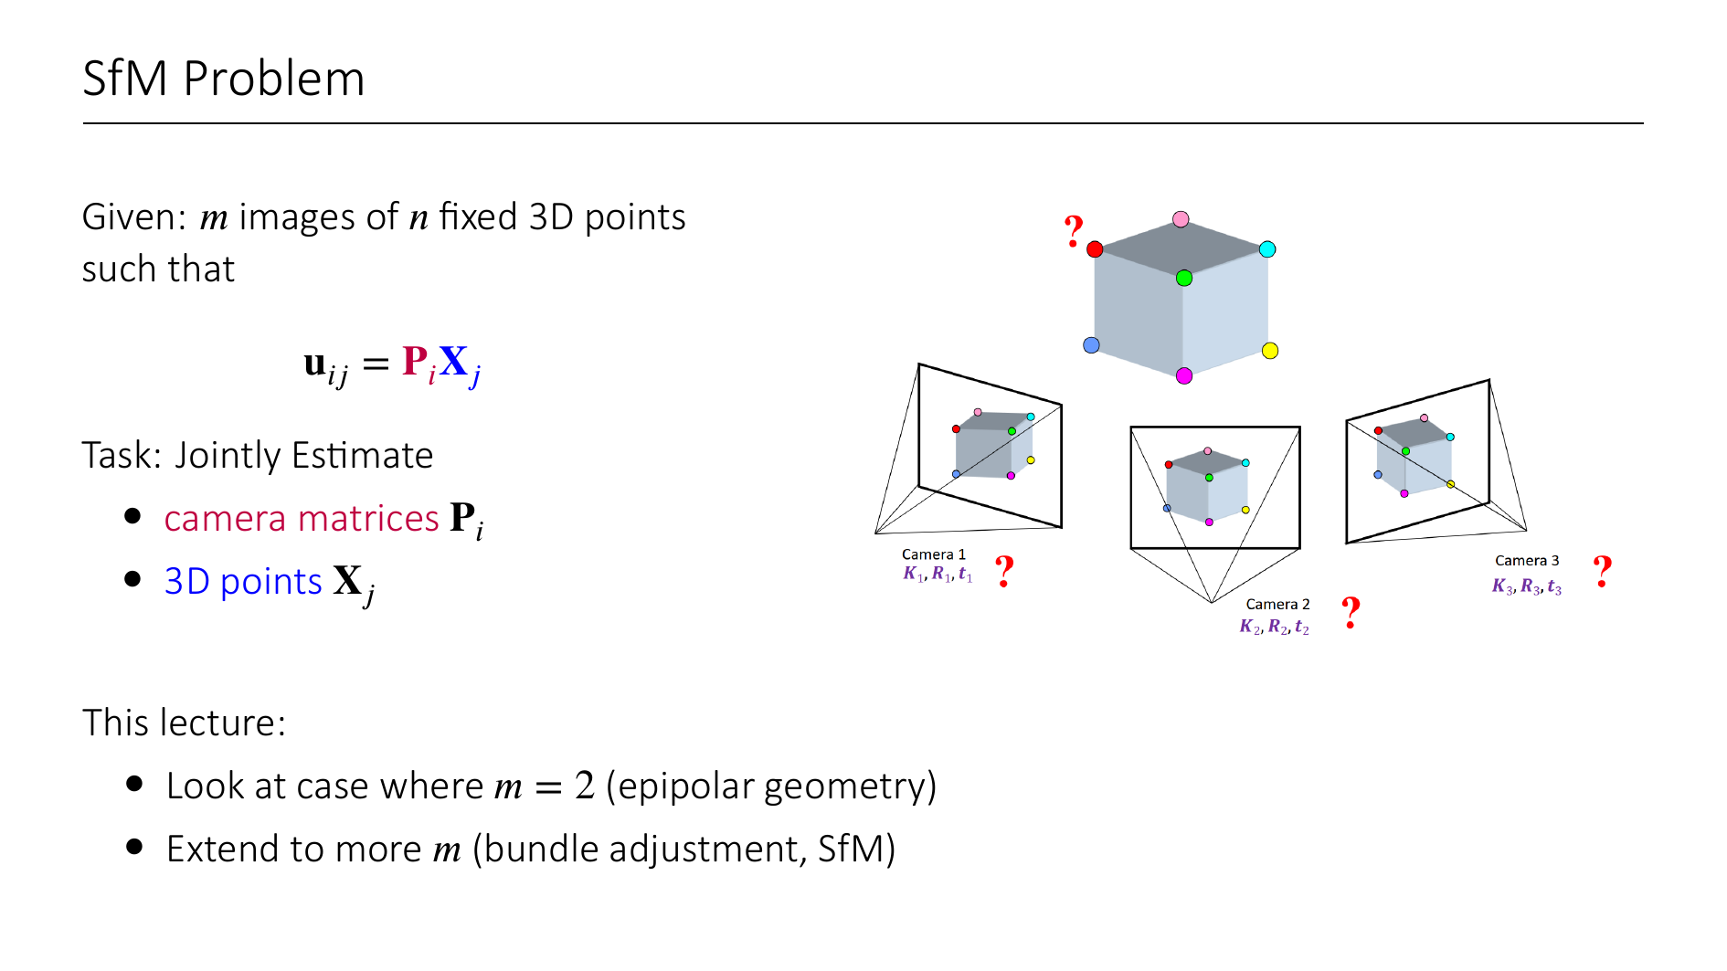
Notes:
Let's formalize the structure from motion problem.
We are given a collection of images, that show the projections of a scene of 3D points.
u_{ij} is the projection of point j onto image plane i.
Here i is the camera index, j is the point index.
We know that these image points are the results of projections to the images planes, i.e. u_{ij} = P_i X_j (of course everything in homog coords)
Here P_i is the i^th camera matrix, and X_j is the 3D position (in homogeneous coords) of the j^th point.
WE ONLY KNOW u_{ij}!!!!! Our task is to estimate the camera matrices P_i and 3D points X_j.
Camera matrix = Intrinsics * [ Rotation, translation], so we have to estimate the global pose of the cameras
3D points = points in world coordinates.
This lecture is structured as follows:
- First Part: Epipolar geometry. How can we estimate relative camera orientation between only two images?
- Second Part: BA + SfM pipelines. How can we integrate many different views?

Slide 11
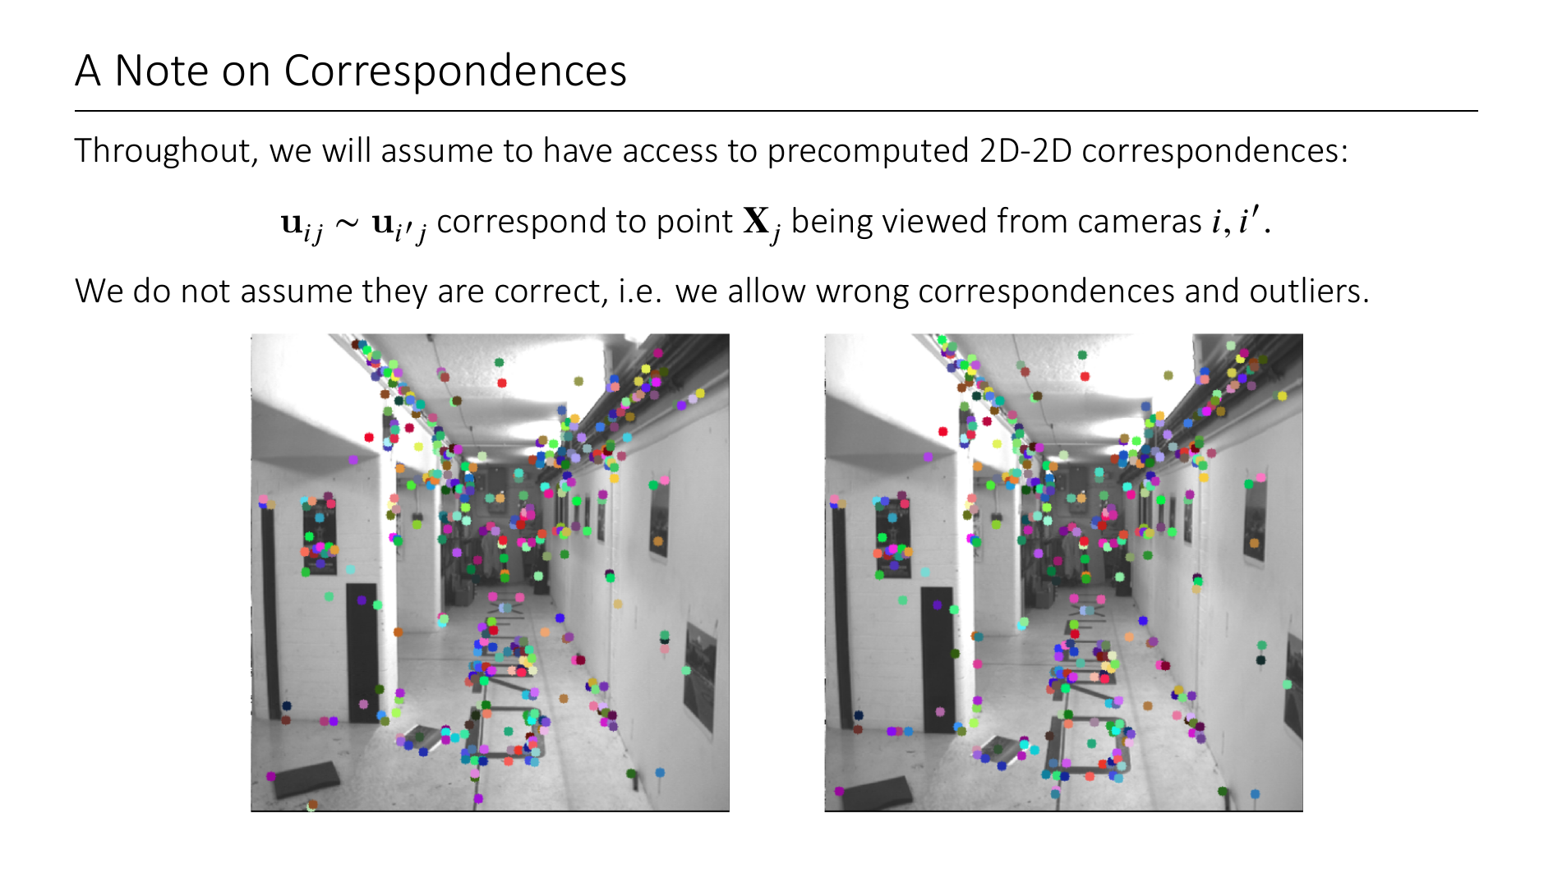
Notes:
Note that we implicitly assume known correspondences, i.e. which 2D points correspond to which 3D point, and therefore also which 2D points correspond between two views.
We can estimate correspondences using feature detection algorithms. They take as input images and find keypoints, and attach features to them, based on what is around the keypoint. You can then match the features between different views, to get 2D-2D correspondences.
We assume that we have access to such estimated 2D-2D correspondences, but we do NOT assume that they are correct.
Dealing with outliers and wrong correspondences is a huge challenge in any SfM pipeline, but we will later see one general method (RANSAC) to deal with those.

Slide 12
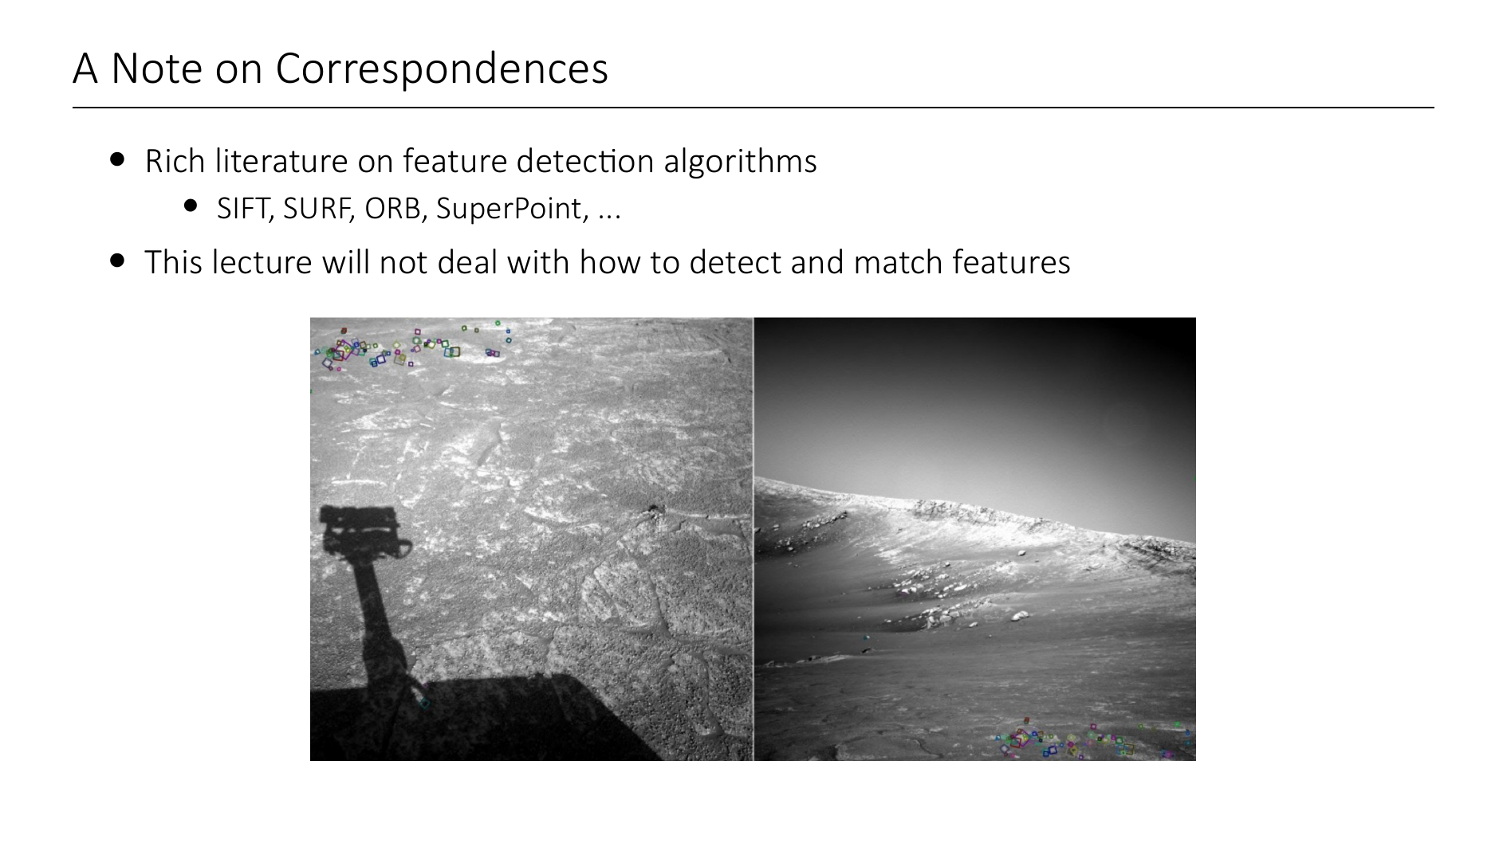
Notes:
If you are interested, you can find a rich literature on feature detection algorithms like SIFT, SURF, ORB, SuperPoints, etc.
We will not cover these methods in this course.
They are actually remarkably strong, as you can see in the image, (I think this was SIFT) could match the ground of Mars from two different views.

Slide 13
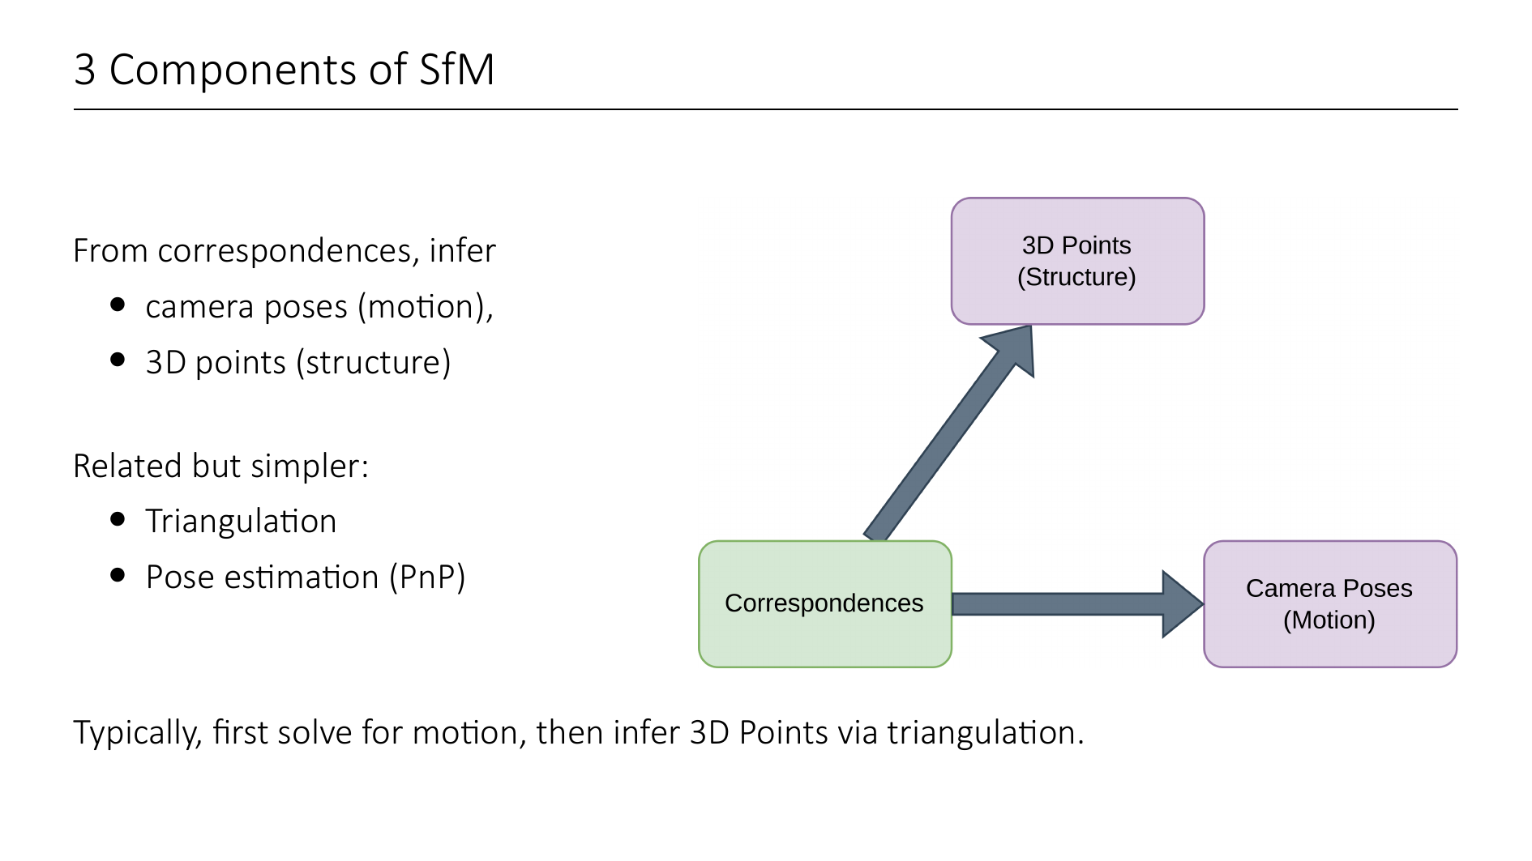
Notes:
So remember that the whole idea of SfM is to go from 2D-2D correspondences to 3D points and camera poses.
Typically this is done by first estimating camera poses (the motion) and then using the estimated poses to build a sparse reconstruction (structure).

Slide 14
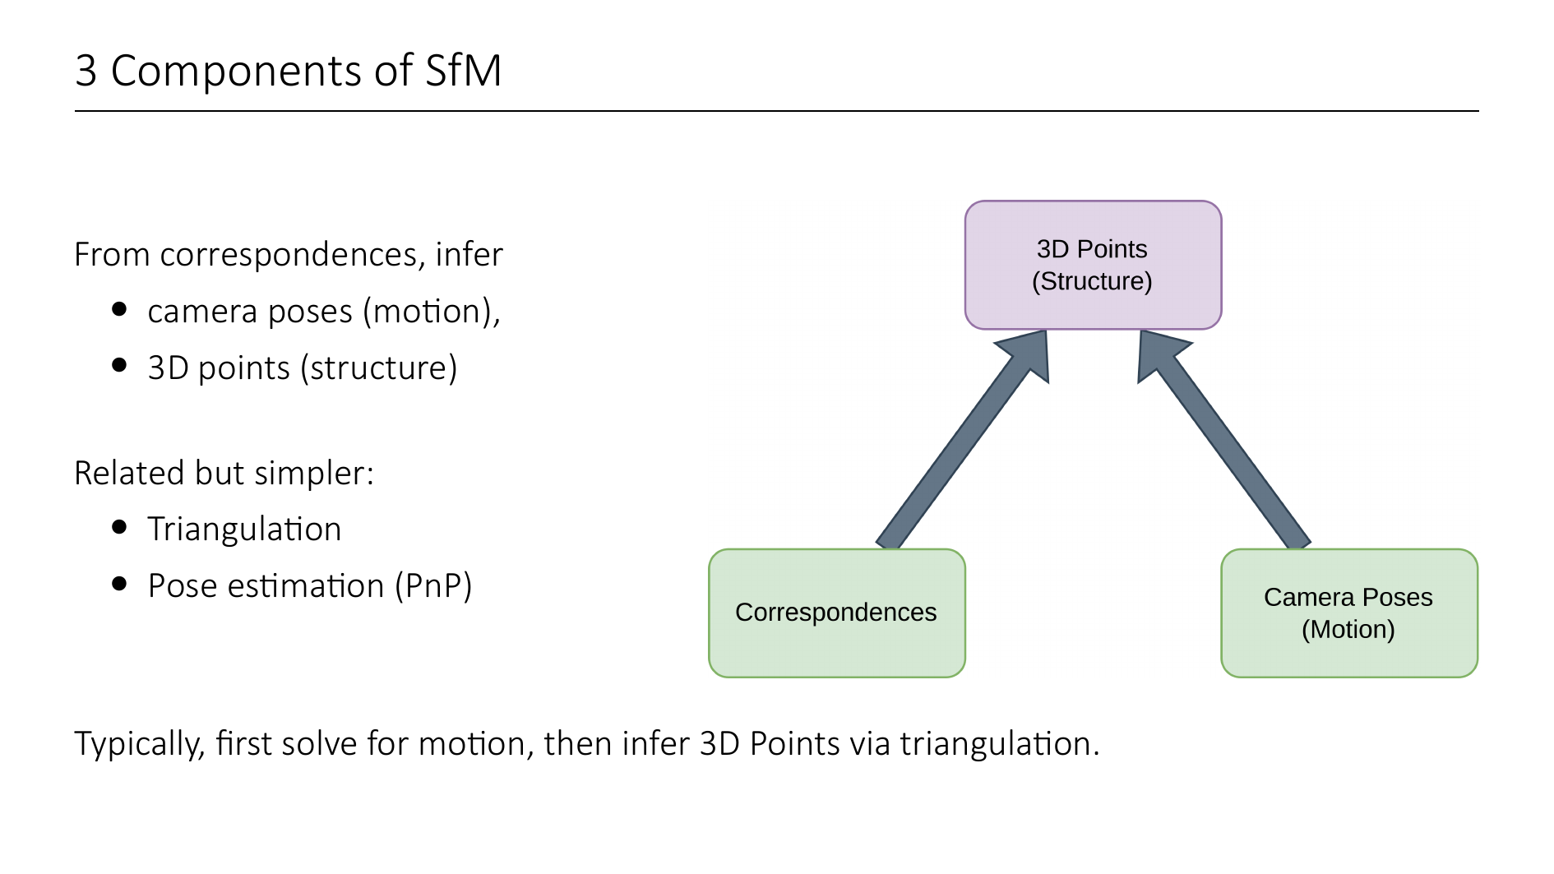
Notes:
A very related problem is triangulation, where you have correspondences, and know the camera poses, and you want to infer the structure of the scene.
Triangulation is a crucial part in most SfM pipelines, but it is a "simpler" problem, because we already know camera poses.

Slide 15
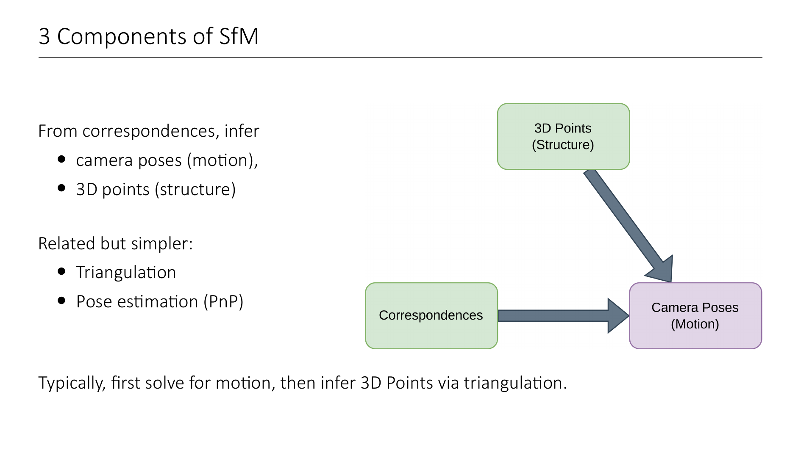
Notes:
The pose estimation problem (also known as the Perspective n Points Problem) is kind of like the inverse problem to triangulation. Here you know 2D-3D correspondences and also the 3D points, but you want to find out the camera poses.
This can be solved using the direct linear transform, which you see / have seen in the exercise.
Pose estimation is also a very important step in so-called "incremental" SfM pipelines, where you start building your scene from just a few images, and incrementally add new images. For each new image, we must find out where it was taken from, and integrate it into the already existing reconstruction.
We will talk about incremental SfM later. First, we need to cover some basics

Slide 16
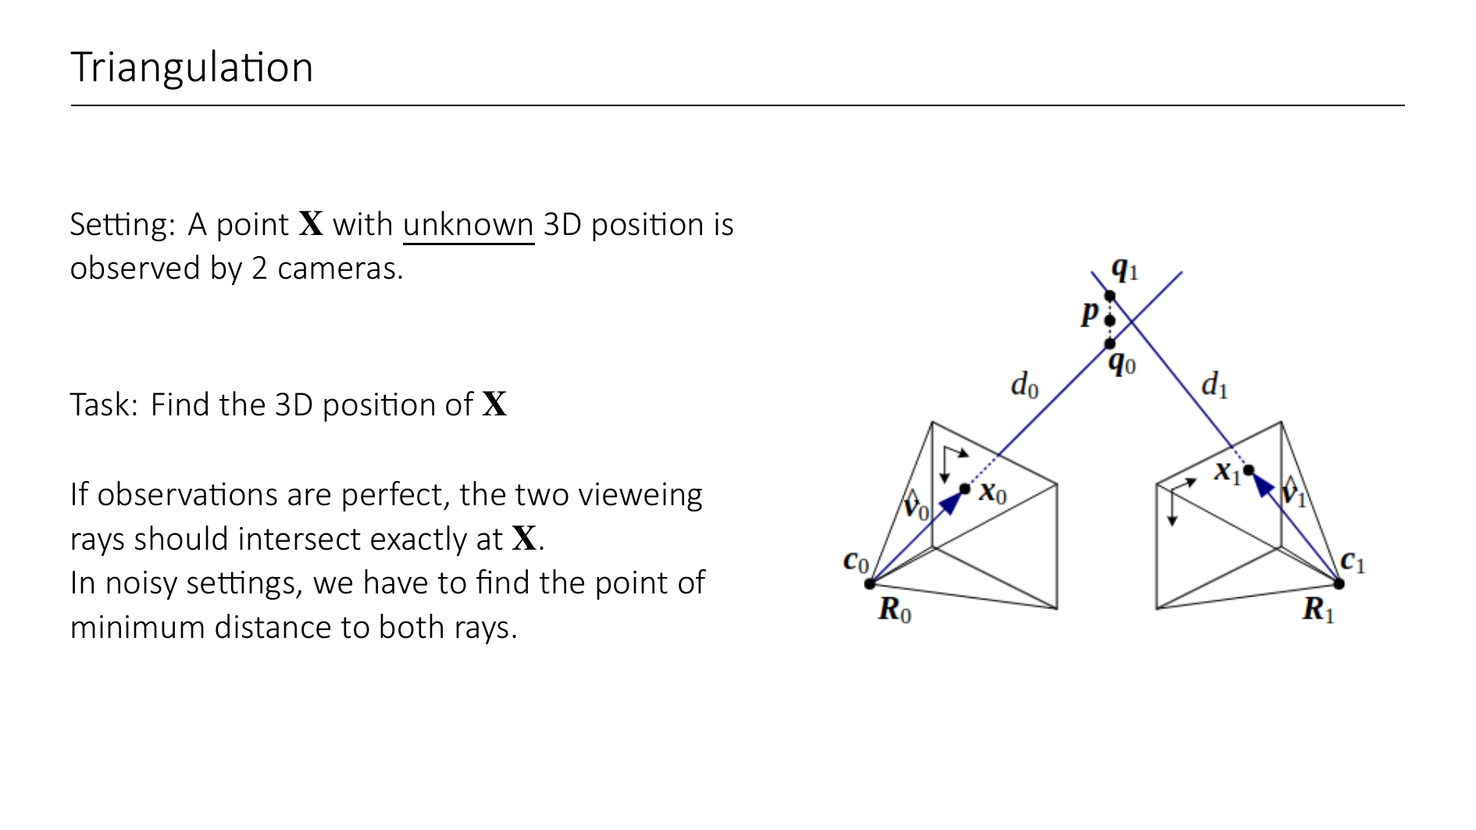

Slide 17
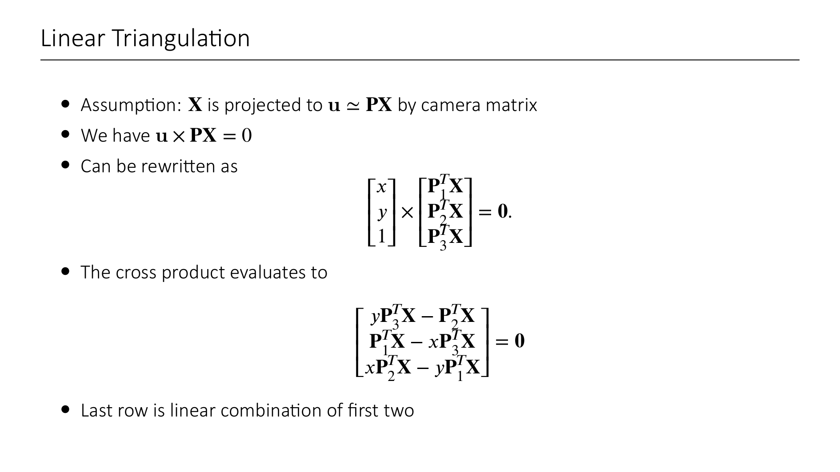
Notes:
u x PX to get rid of Z in homogeneous coordinates
lambda u = PX → parallel vectors

Slide 18
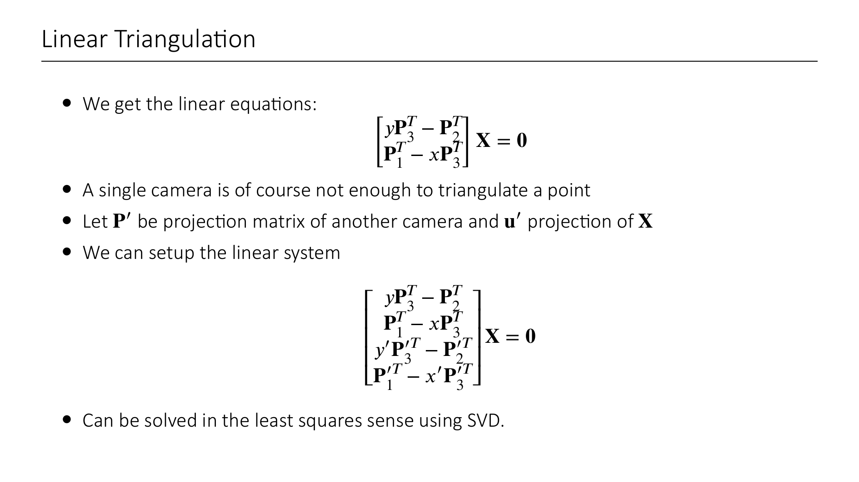

Slide 19


Slide 20
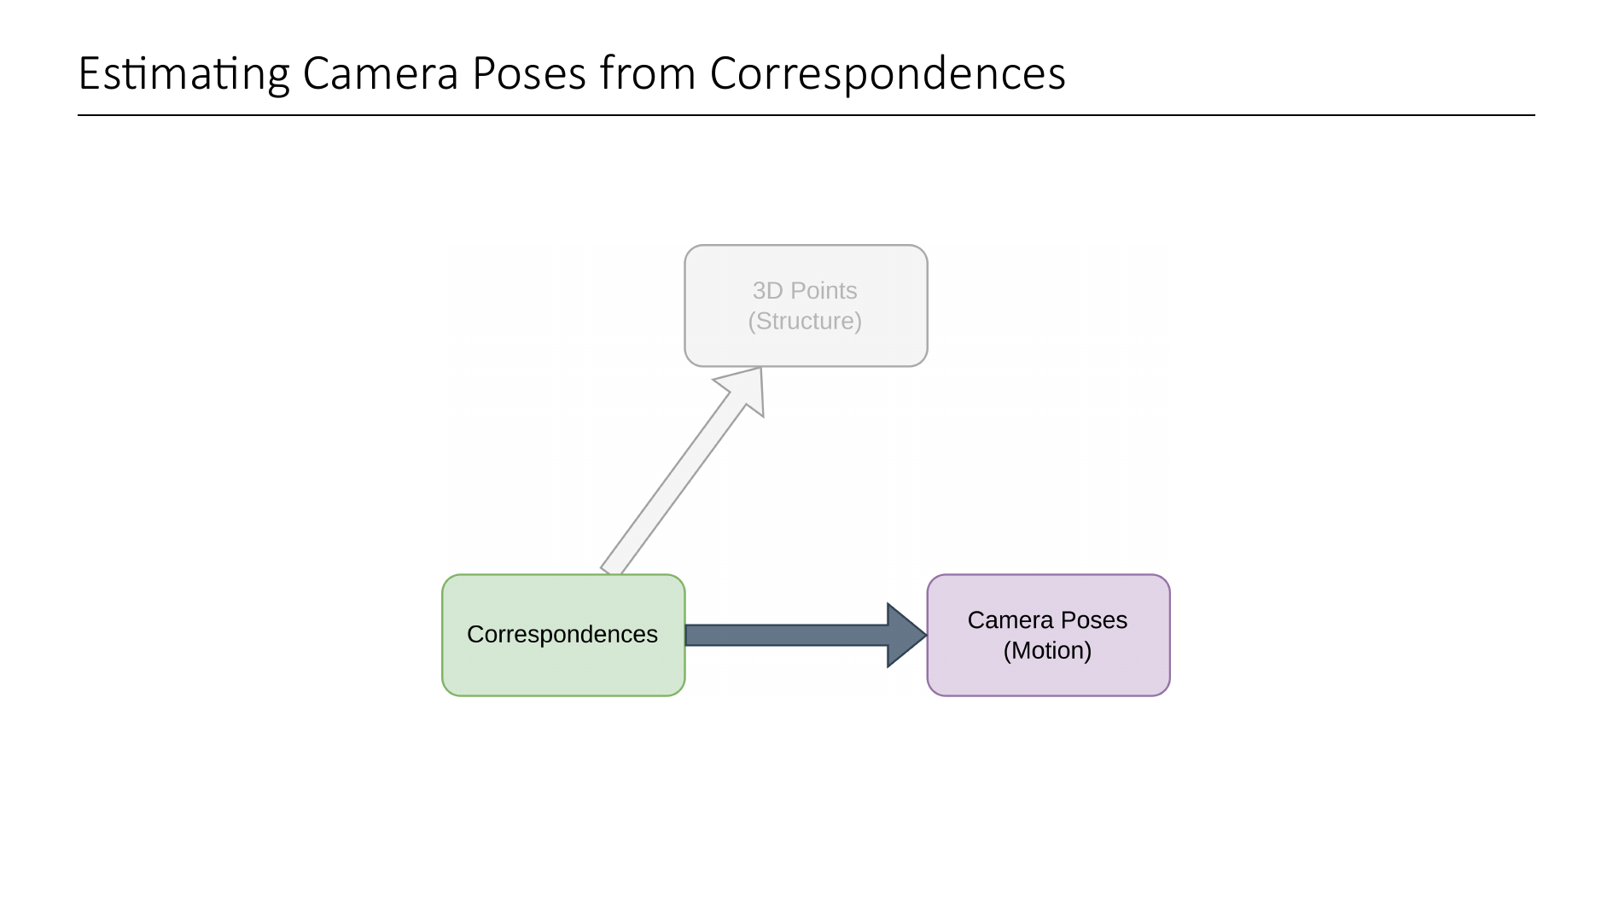
Notes:
As mentioned before, usually SfM works by first estimating the motion (i.e. camera poses) just from the 2D-2D correpsondences, and then reconstructing the 3D points from this. So in this first part, we will see how to estimate camera poses only from 2D-2D correspondences. And we will start with the simplest case, where there are only 2 cameras. But first, we need to understand a bit about the geometry of two such cameras.

Slide 21
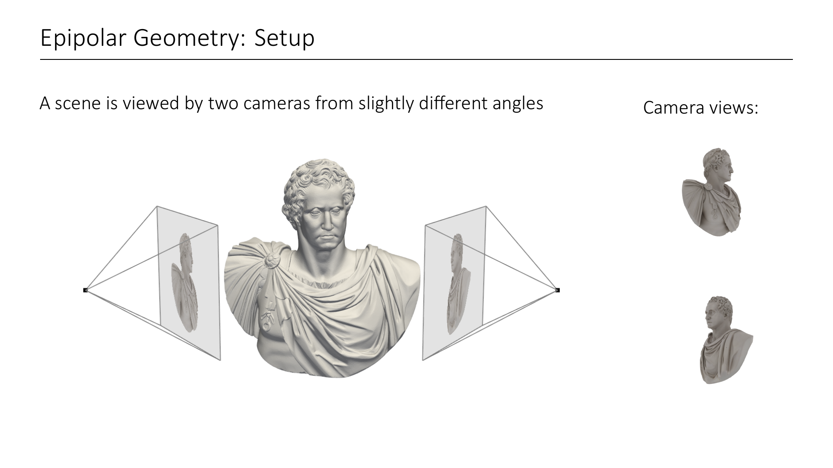

Slide 22
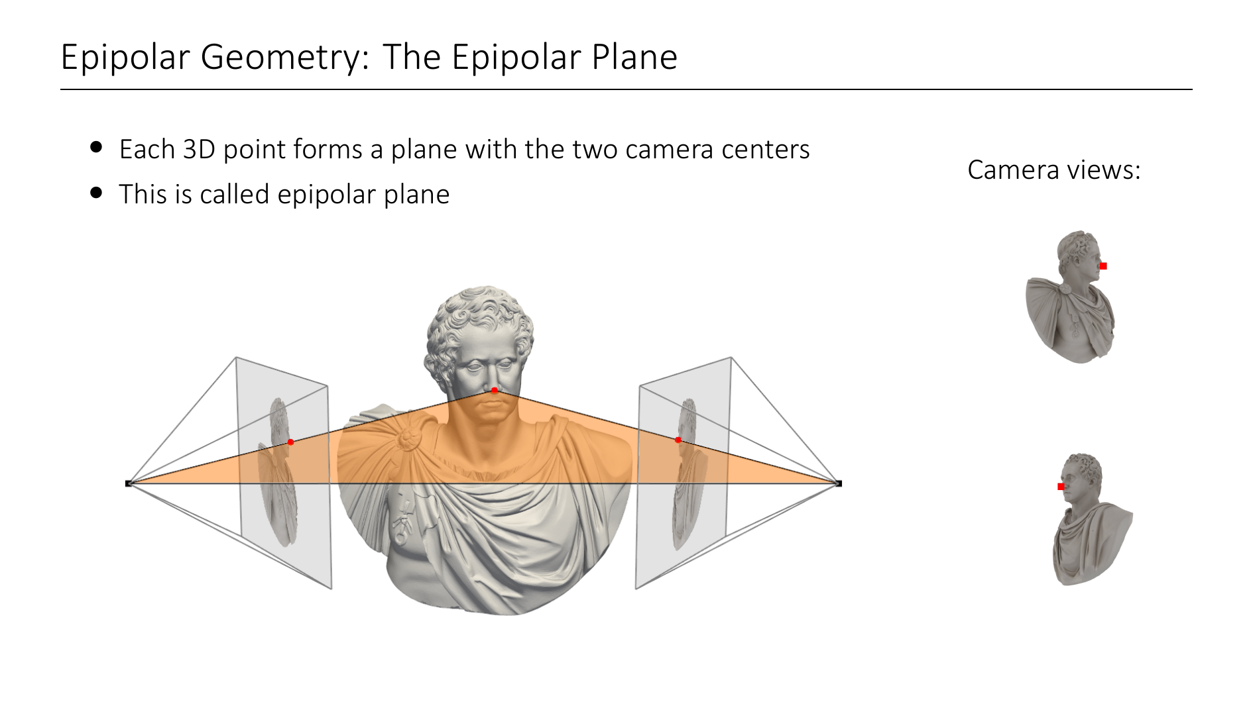

Slide 23
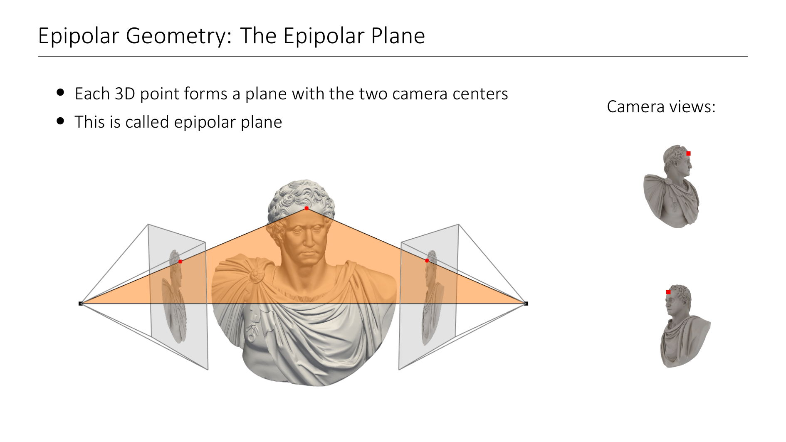

Slide 24
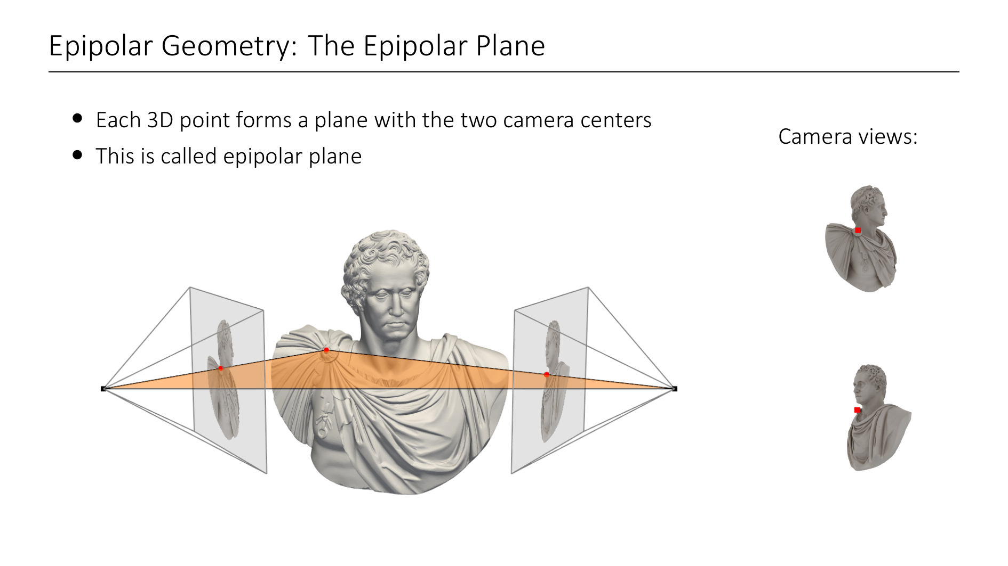

Slide 25
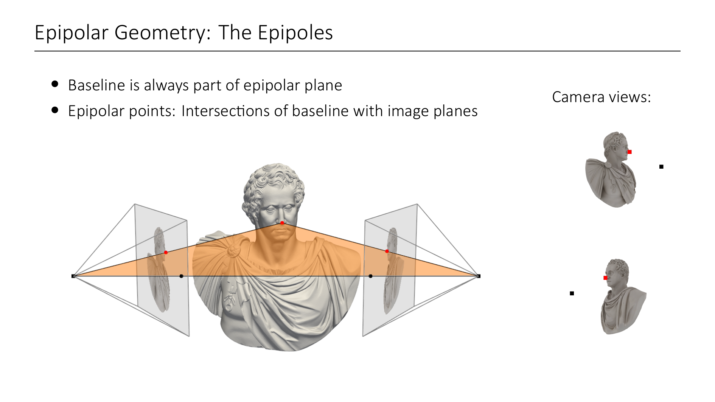
Notes:
So the epipolar plane is different for different 3D points. However, since both camera centers are always part of it, so is the line connecting them. This is called the baseline.
As a consequence, the points of intersection of the baseline with the image planes (black) also always lie on the epipolar plane.

Slide 26
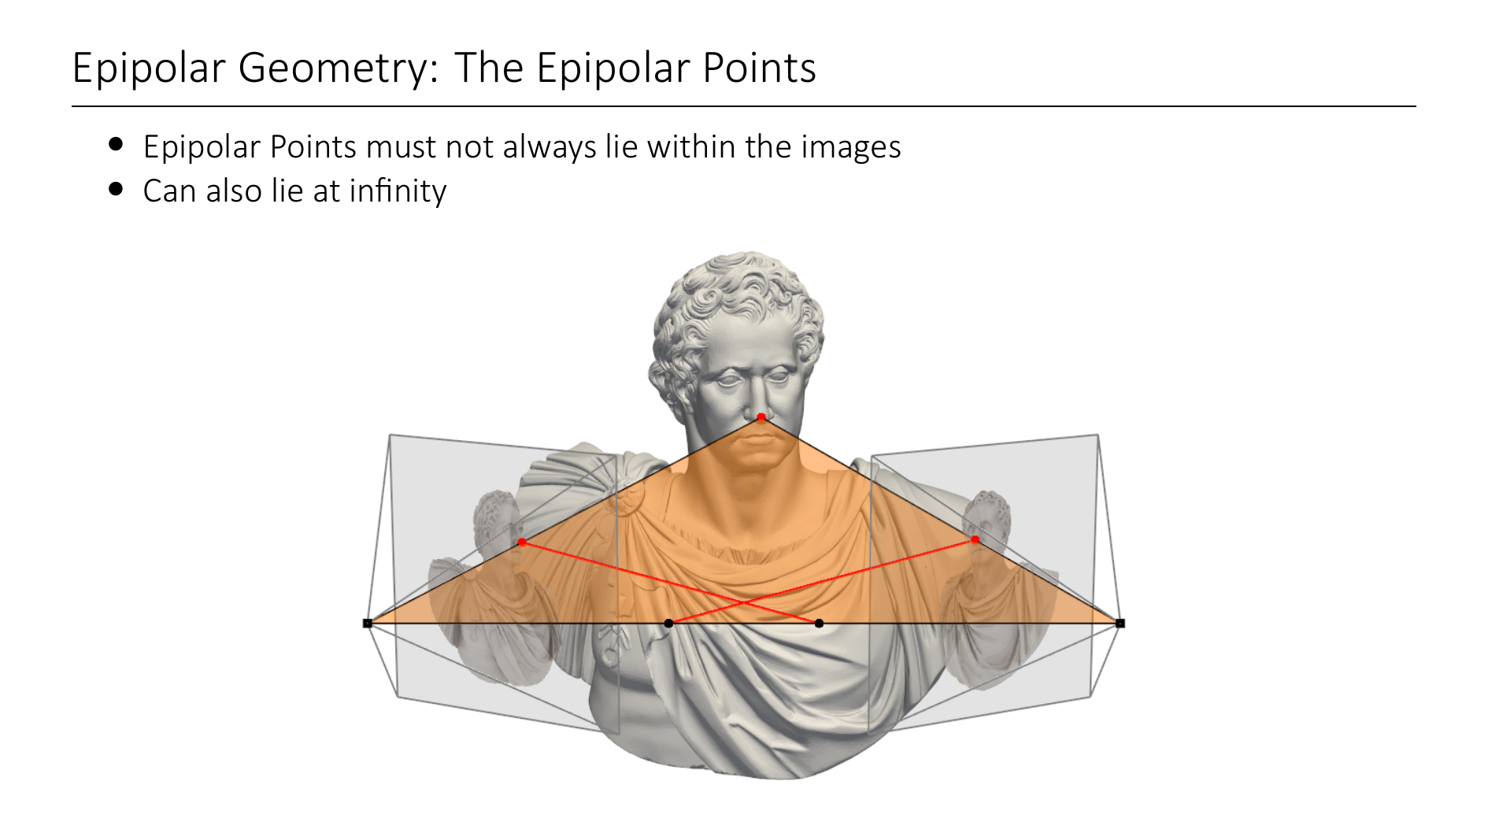
Notes:
The epipoles can of course lie outside of the images windows, depending on the relative orientation of the cameras, the camera intrinsics (like focal lengths) and the image planes' widths and heights. Namely, the epipole is not on the image plane, if the cameras cannot see each other.
It can even be the case that the epipoles are at infinity. Can you see when this is the case? (Answer: when the two viewing directions are parallel).

Slide 27

Notes:
Now we can define the so-called epipolar lines as the intersections of the image planes with the epipolar plane. What does this mean concretely?
The epipolar line on image line 1 (right) corresponds to the projection of the viewing ray of camera 0 (left) into the image plane (1), and vice versa.
This means, that the epipolar lines connect the observed point and the epipolar points in image space.

Slide 28
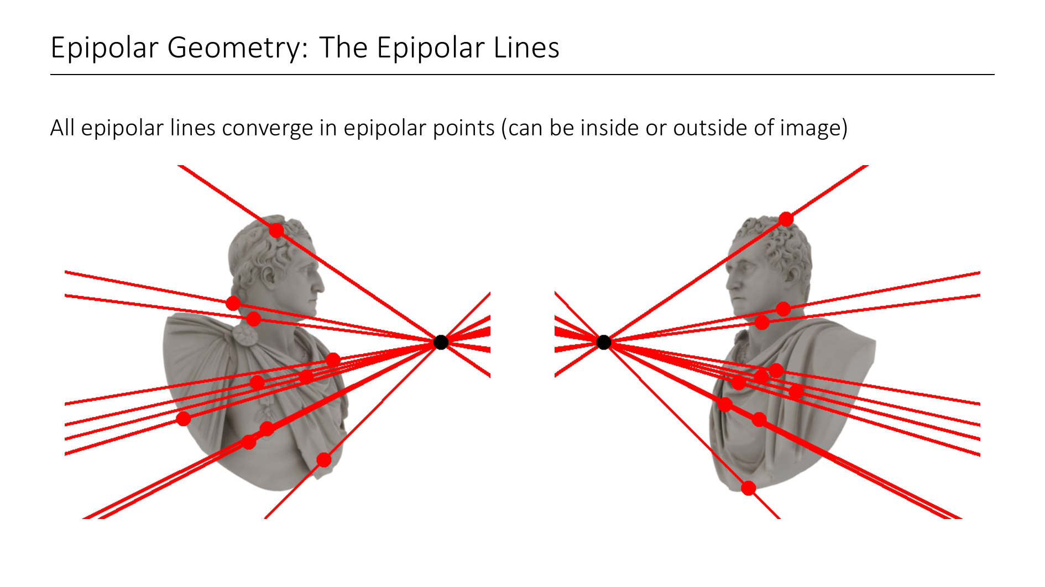
Notes:
Notice that all epipolar lines on an image must converge to the epipolar point. In this case it is inside the image.

Slide 29
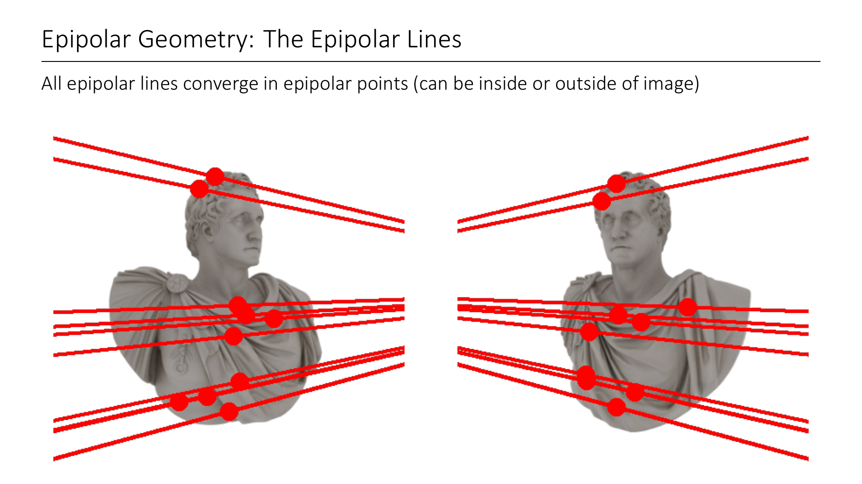
Notes:
in this case it is outside

Slide 30
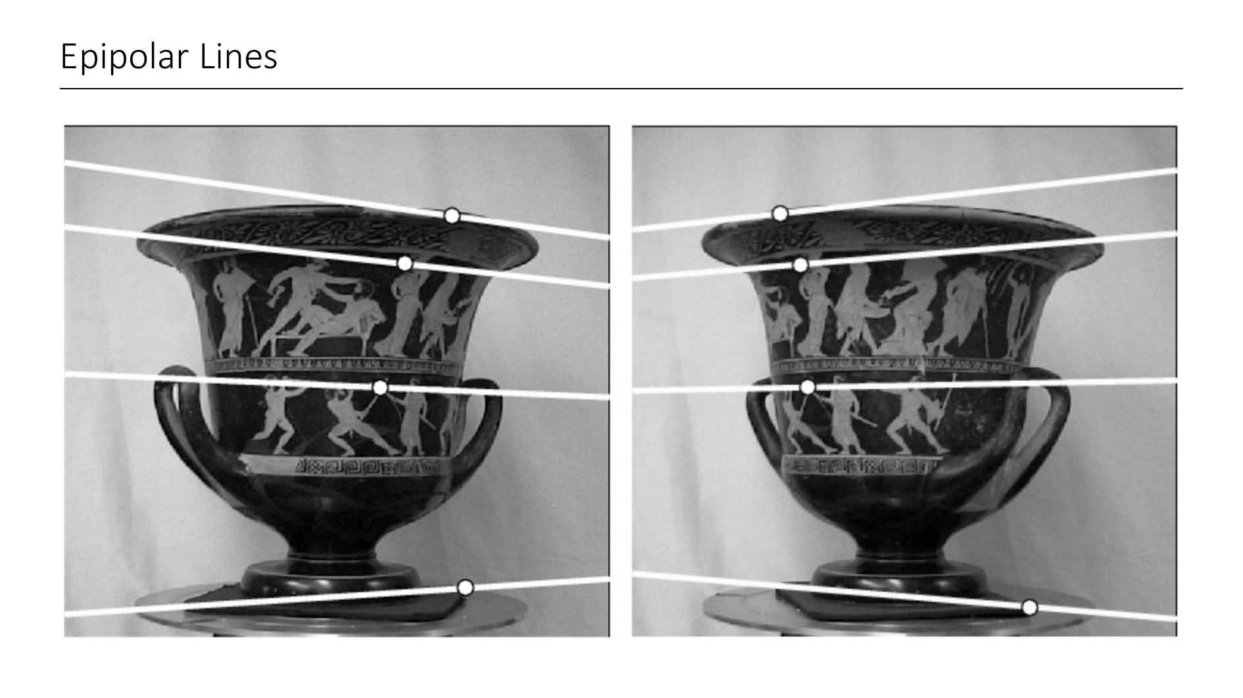
Notes:
Another example where the epipoles are not within the image window

Slide 31
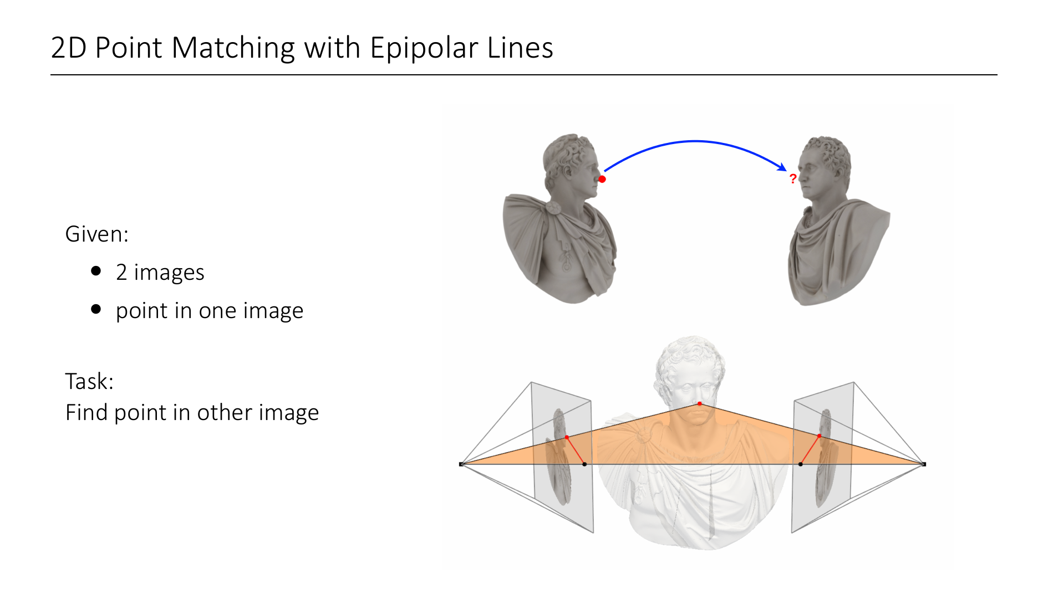
Notes:
So what are epipolar lines useful for?
Let me give you the following scenario. You are given 2 images of the same scene from different viewpoints, and I also specify one point in one image. Your task is to find the matching point in the other.
In a naive approach you would have to go over the entire image (2 dimensional search space) and look for matches.
How could the knowledge of epipolar lines help you here?

Slide 32
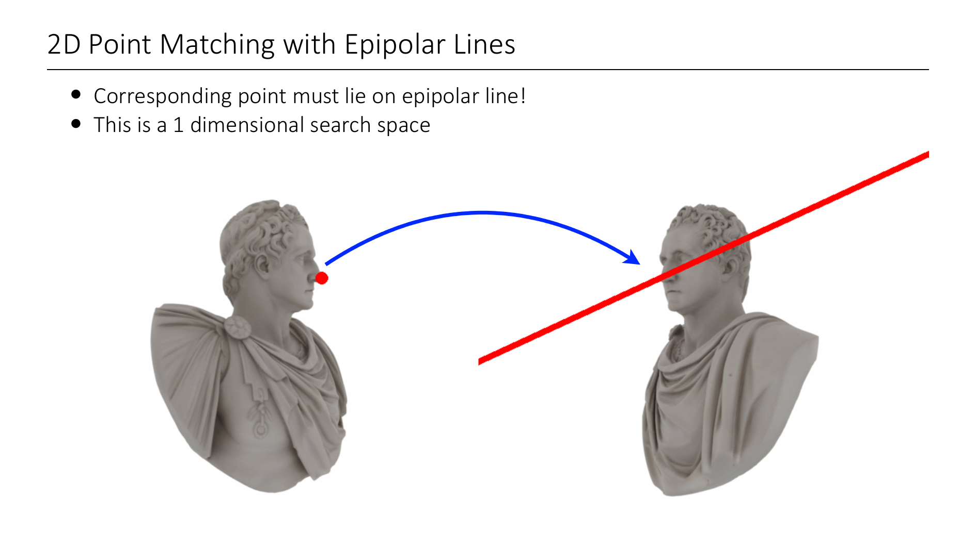
Notes:
However, now that you know about epipolar geometry, you know that the matching point must lie somewhere on the epipolar line of the point I gave you (i.e. the projection of the viewing ray onto the second image).
This is now a 1 dimensional search space!
Of course, for this to work, you must know where the epipolar line is. We will see in a second how this can be done.

Slide 33
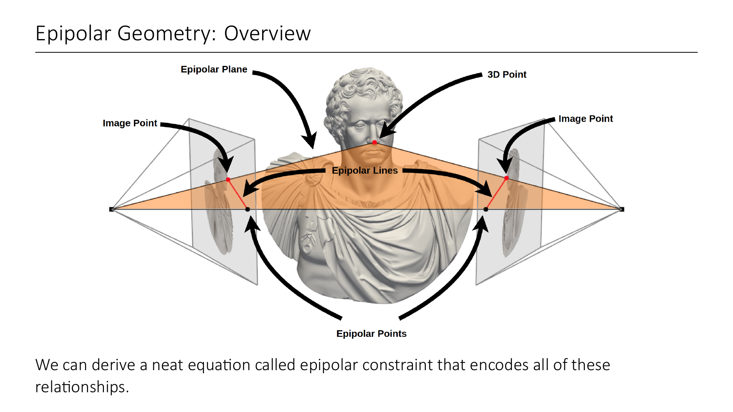
Notes:
Let us take a moment to recapitulate. We have a 3D point, image points, epipolar points. And it is clear that all of these must lie on the 3D epipolar plane, or in image space: the epipolar lines.
Epipolar geometry essentially encodes all of these relationships into a single neat equation called epipolar constraint, which we will now derive mathematically. We will then later see that from this epipolar constraint we can extract relative camera poses.

Slide 34
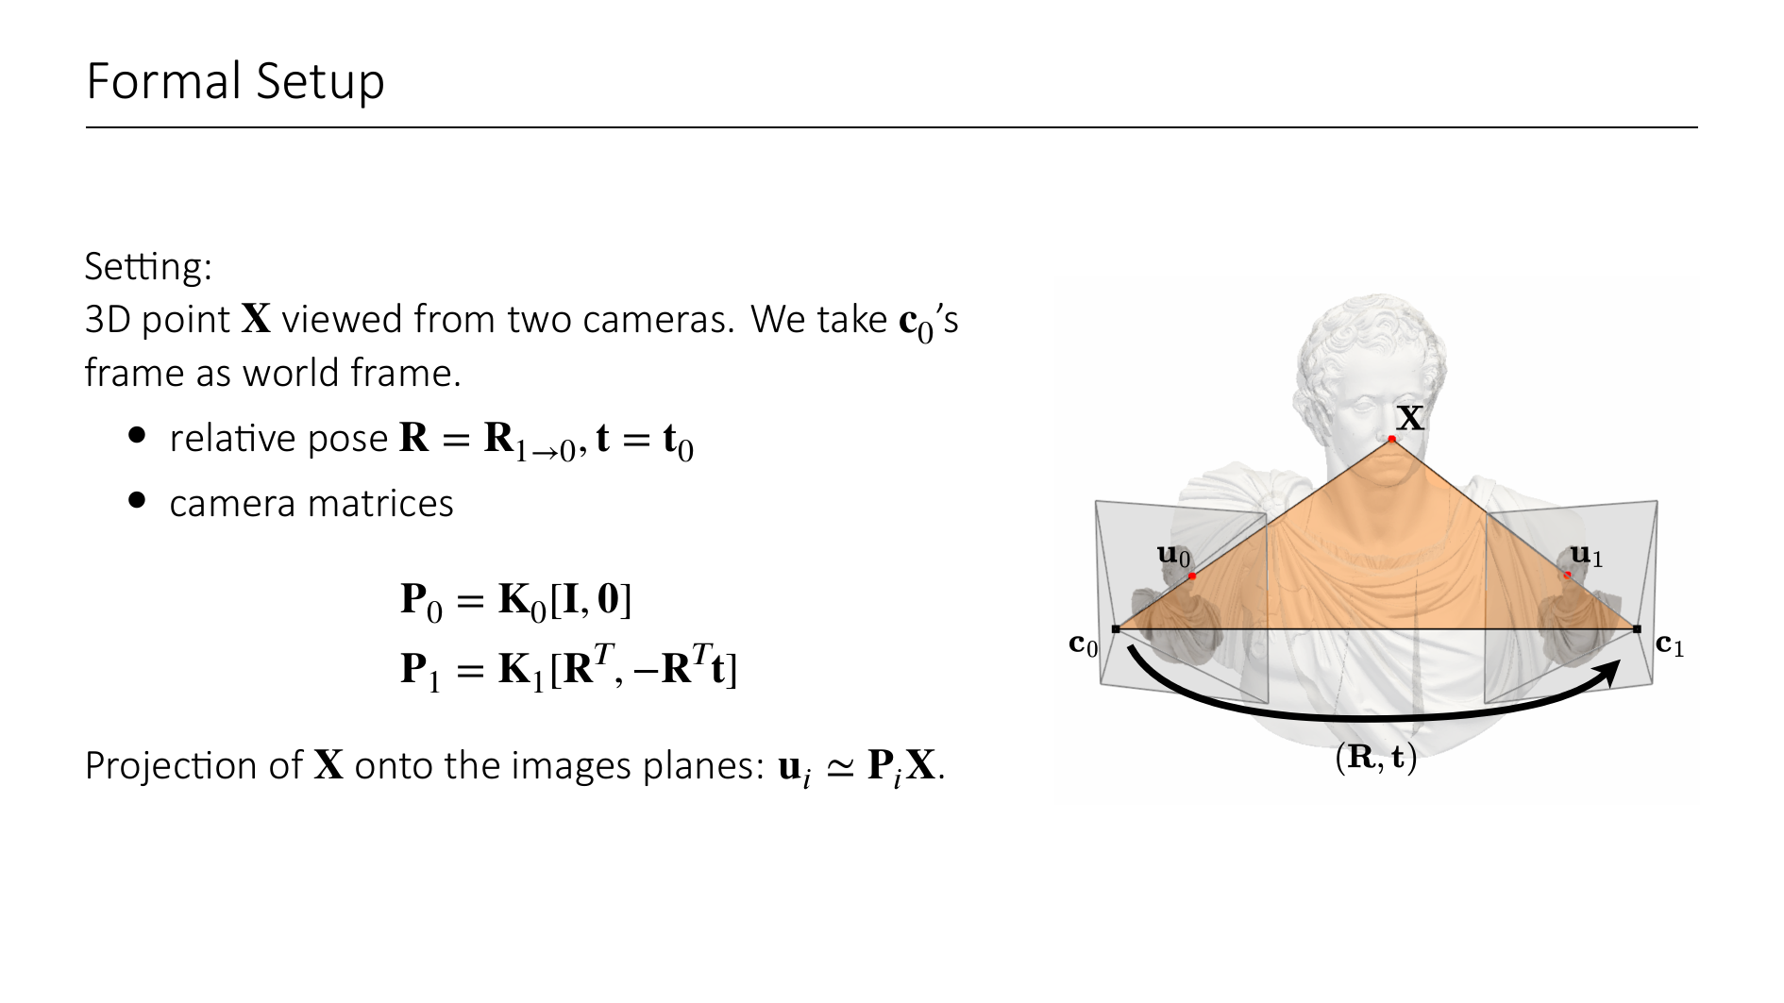
Notes:
For now we assume that we know all the information about the cameras (intrinsics and extrinsics), and we want to derive certain geometric relationships.
In the simplest case, the two cameras both observe a single 3D point X.
We don't really know or care about the "true" world coordinate system, so we assume that it aligns with camera 0's coordinate system.
R is the rotation matrix from camera 1's frame to camera 0's frame.
t is camera 1's center, expressed in camera 0's frame (i.e. world frame).
Also, if we know the relative rotation and translation of the two cameras, we can express the camera matrix P_1 as K_1 [R^T, -R^Tt].
From last lecture we know that the point X gets projected onto the two images at pixel coordinates u_i = P_i X. (We use homogeneous coordinates without introducing new notation, so keep an eye on the dimensions of the matrices and vectors)

Slide 35
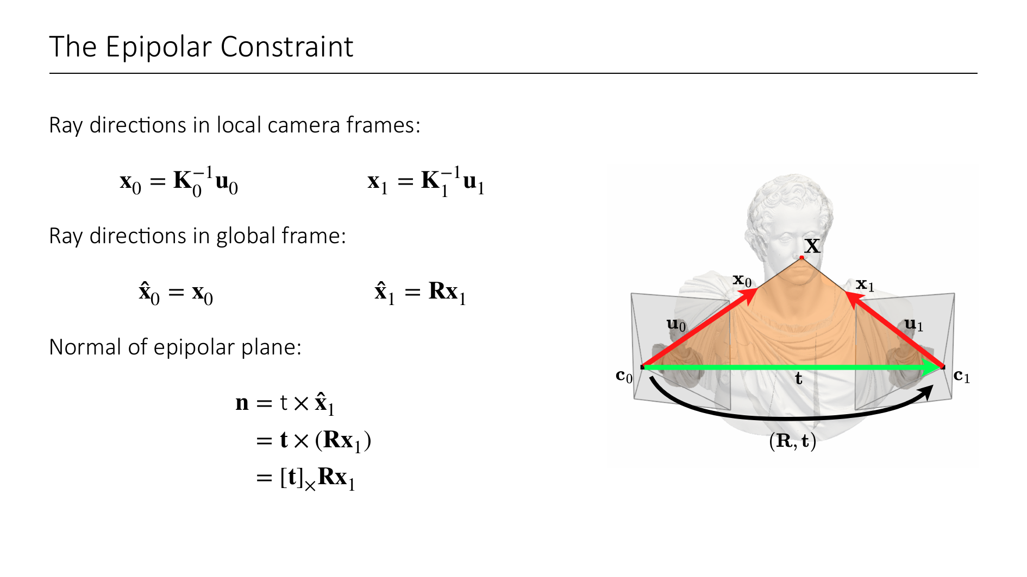
Notes:
Let us start by finding the epipolar plane. For this, we take two vectors that lie within the plane and take their cross product, to get the normal of the epipolar plane. We will choose t (green), and the direction vector from c_1 to u_1 (x_1 in red in image).
Note: u_1, u_2 are in pixel coordinates, i.e. we first have to derive the corresponding ray directions in 3D space.
For each individual camera, we can derive the ray directions in LOCAL frames by left mutiplying the inverse of the calibration matrix.
These direction vectors are local within the camera frames. We want to bring them into the world coordinate system (denoted by hat).
Since camera 0's frame coincides with the world frame, x_0 is already global
to get u_1 in global frame, we have to rotate it.
Now the normal of the epipolar plane is t cross (Rx_1).
We can rewrite the cross product as a matrix multiplication via the skew-symmetric matrix [t]_x

Slide 36
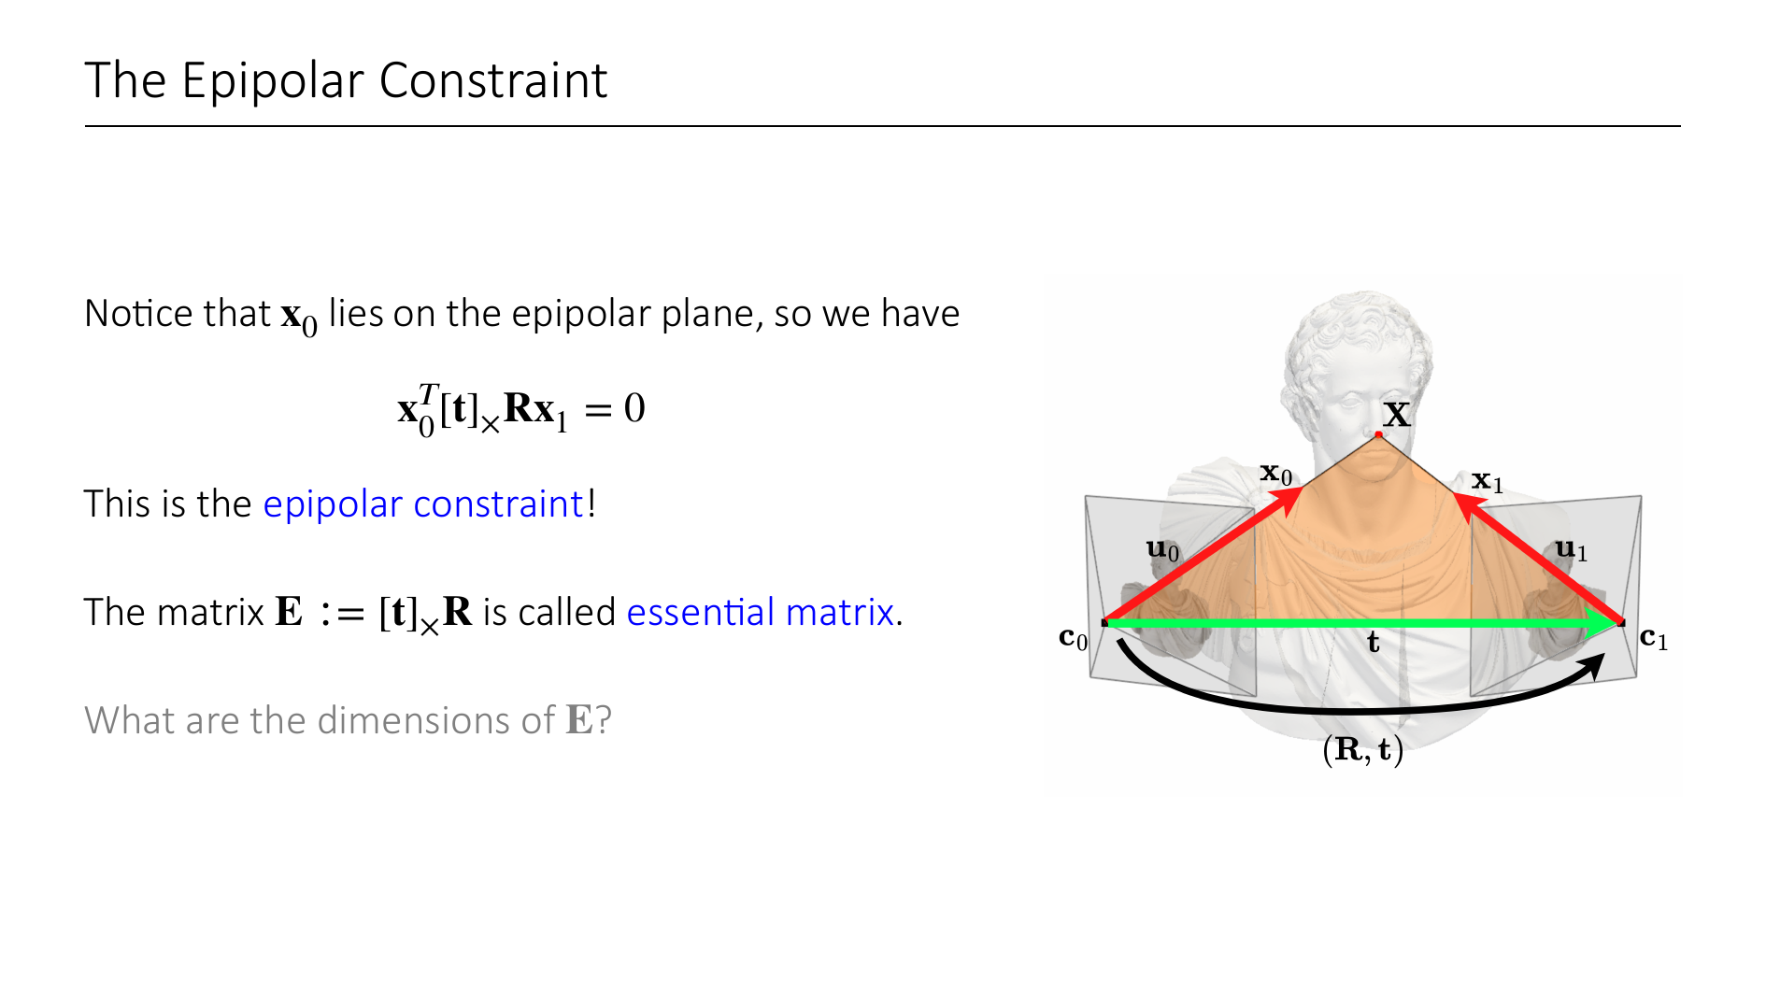
Notes:
Now of course x_0 also lies on the epipolar plane.
It follows that <x_0, n> has to be zero, i.e. x_0^T[t]_xRx_1 = 0.
This is known as the eipolar constraint, and the matrix in the middle is called essential matrix.
What are the dimensions of E? (ans: 3x3)
Let us recap for a second.
What we have derived is a simple equation of the form x_{0}^T E x_1 = 0. What does this tell us?
The essential matrix effectively captures the relative camera poses, and x_0, x_1 are the calibrated observations of the point X in the two images. Two 2D points on the image planes that correspond to the same 3D point must always satisfy this epipolar constraint.

Slide 37
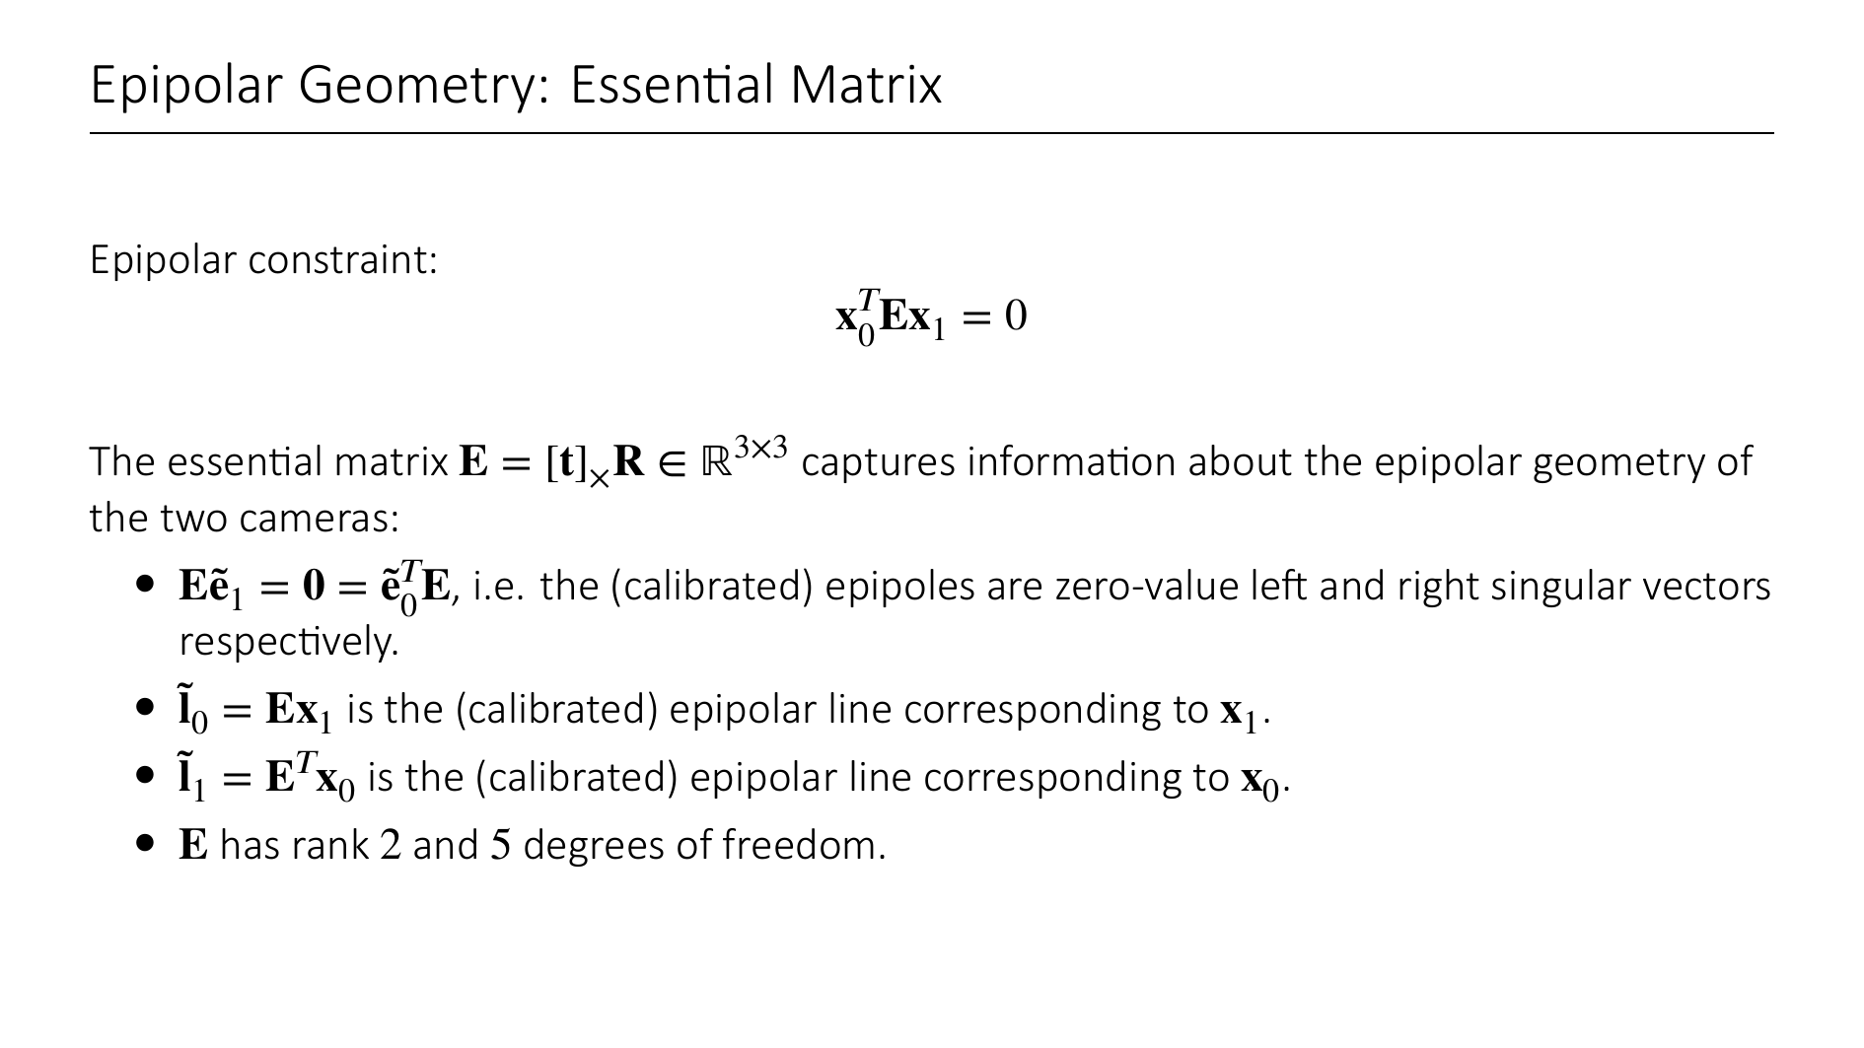
Notes:
So we can write the epipolar constraint simply as ...
It is important to note that the essential matrix DOES NOT depend on the 3D point that was chosen. It only depends on the relative camera poses.
It turns out that from the essential matrix we can derive pretty much all the geometric relationships we saw before.
The epipoles (epipolar points) correspond to the left and right 0-singular vectors of E.
The epipolar lines are parameterized by the vectors you get from left- or right multiplication of x_0^T or x_1 to E.
E has rank 2 (why?) and 5 degrees of freedom (why?)
Rank is clear because epipoles are in kernel of E. Alternatively, this becomes clear when you notice that [t]_x has rank 2.
Dof: 6 for rotation + translation - 1 because it is a projective mapping and scale-ambiguous.
Note that all of these are only calibrated (i.e. in a canonicalized camera frame) and not in image space. This is because we have previously calibrated the points (we used x_i, instead of u_i)
But of course now nothing stops us from going back to the uncalibrated case.

Slide 38
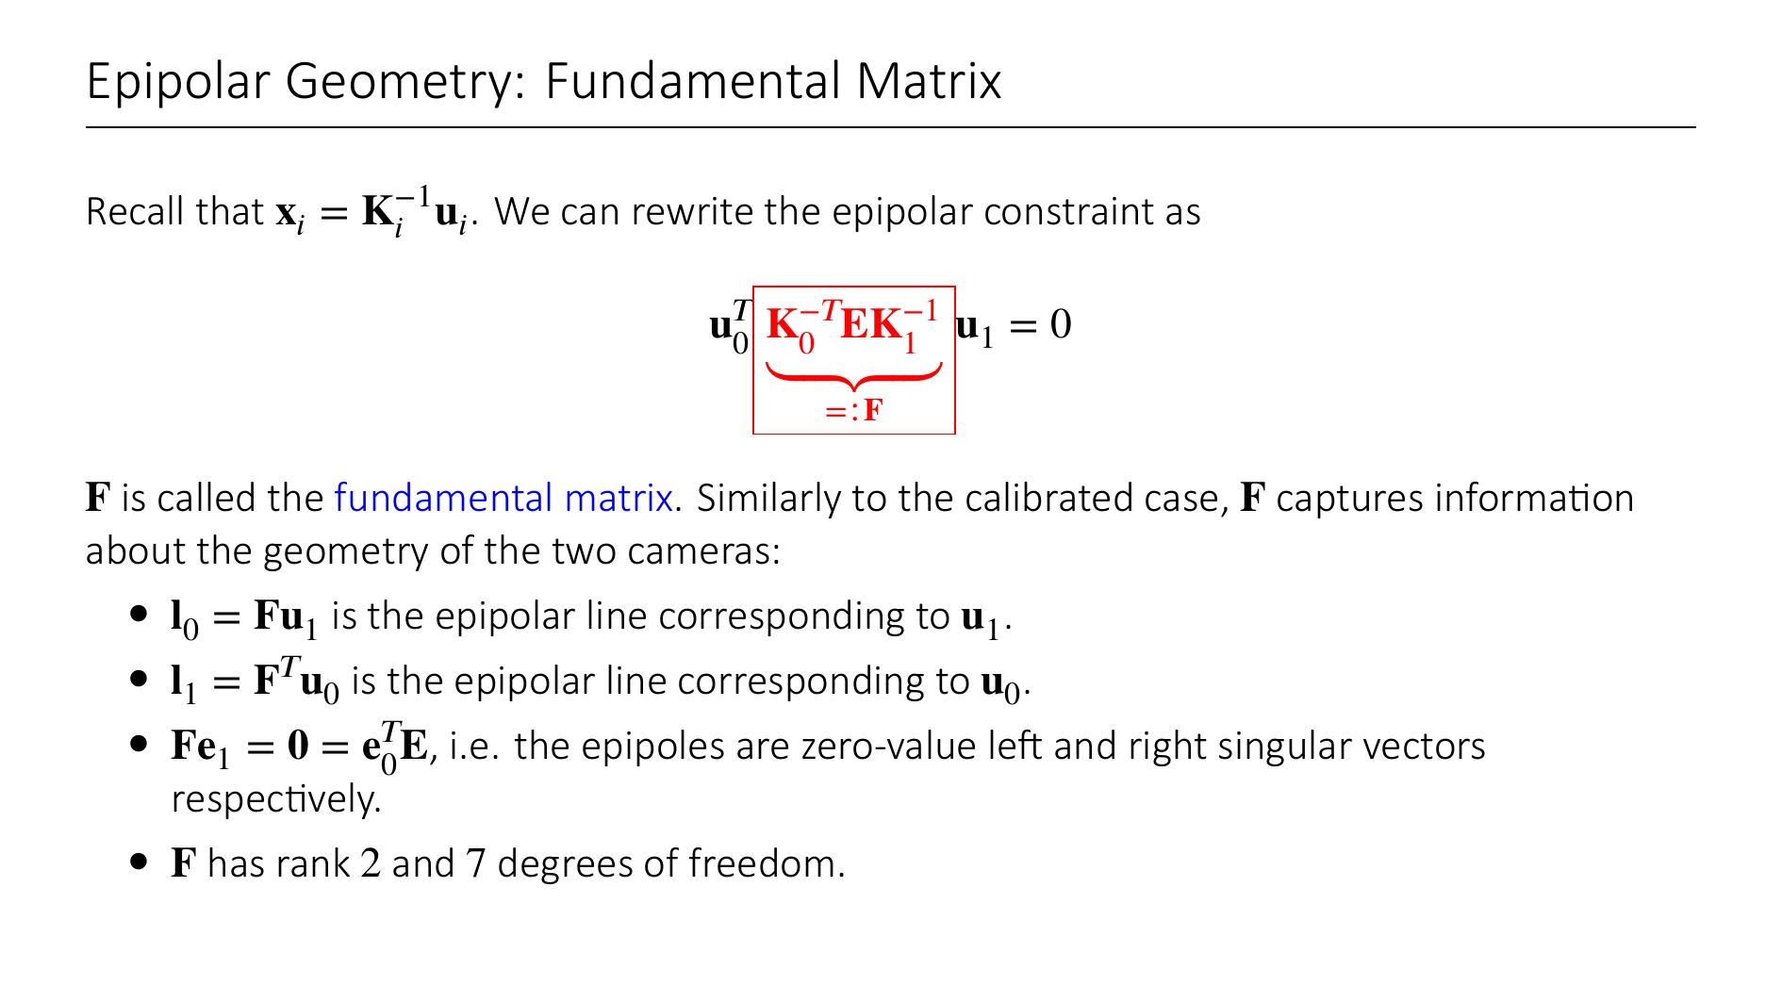
Notes:
For the calibration of the image points, we used the equation x_i = K_i^{-1}u_i.
We can simply rewrite the epipolar constraint in terms of u_0 and u_1 (the image points in image space!).
For the fundamental matrix, essentially all the same geometric things hold. We can now extract the epipoles and epipolar lines as before.
F still has rank 2 because E has and the K_calibration matrices have full rank.
For the degrees of freedom, we get 7 as follows: 9 entries in the matrix -1 for scale ambiguity -1 for det F = 0 constraint.
Why does the rank 2 constraint reduce the degrees of freedom by 1 for the fundamental matrix (here), but not for the essential matrix (prev slide)?
Answer: Here we started from an arbitrary 3x3 matrix. For the fundamental matrix we started from R and t, and the rank 2 constraint follows from the fact that [t]_x has rank 2. So there is no new constraint.
A note on notation:
K_0^{-T} is defined as (K_0^{-1})^T or (K_0^T)^{-1}. The order of inverting and transposing does not matter.

Slide 39
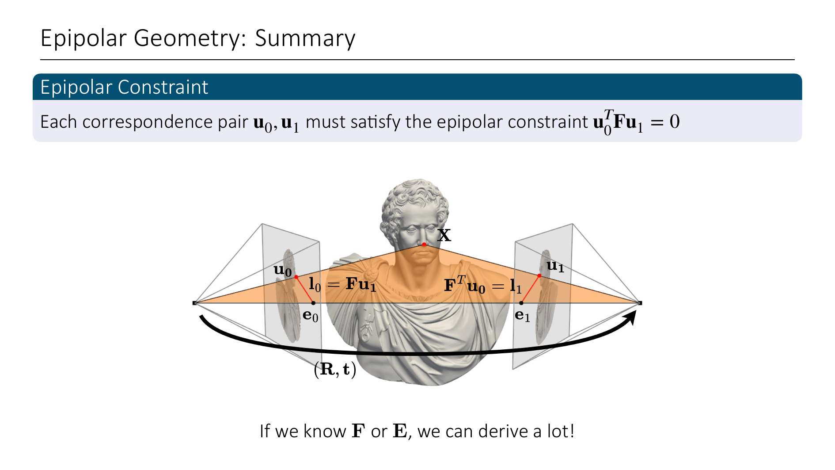
Notes:
The key takeaways here are the following:
The epipolar constraint is a central equation capturing the geometry of two views.
It is either expressed in terms of the fundamental matrix F (uncalibrated case), or the essential matrix E (calibrated case).
If we know F or E, we can derive a lot of useful information, such as epipoles, epipolar lines, etc.

Slide 40
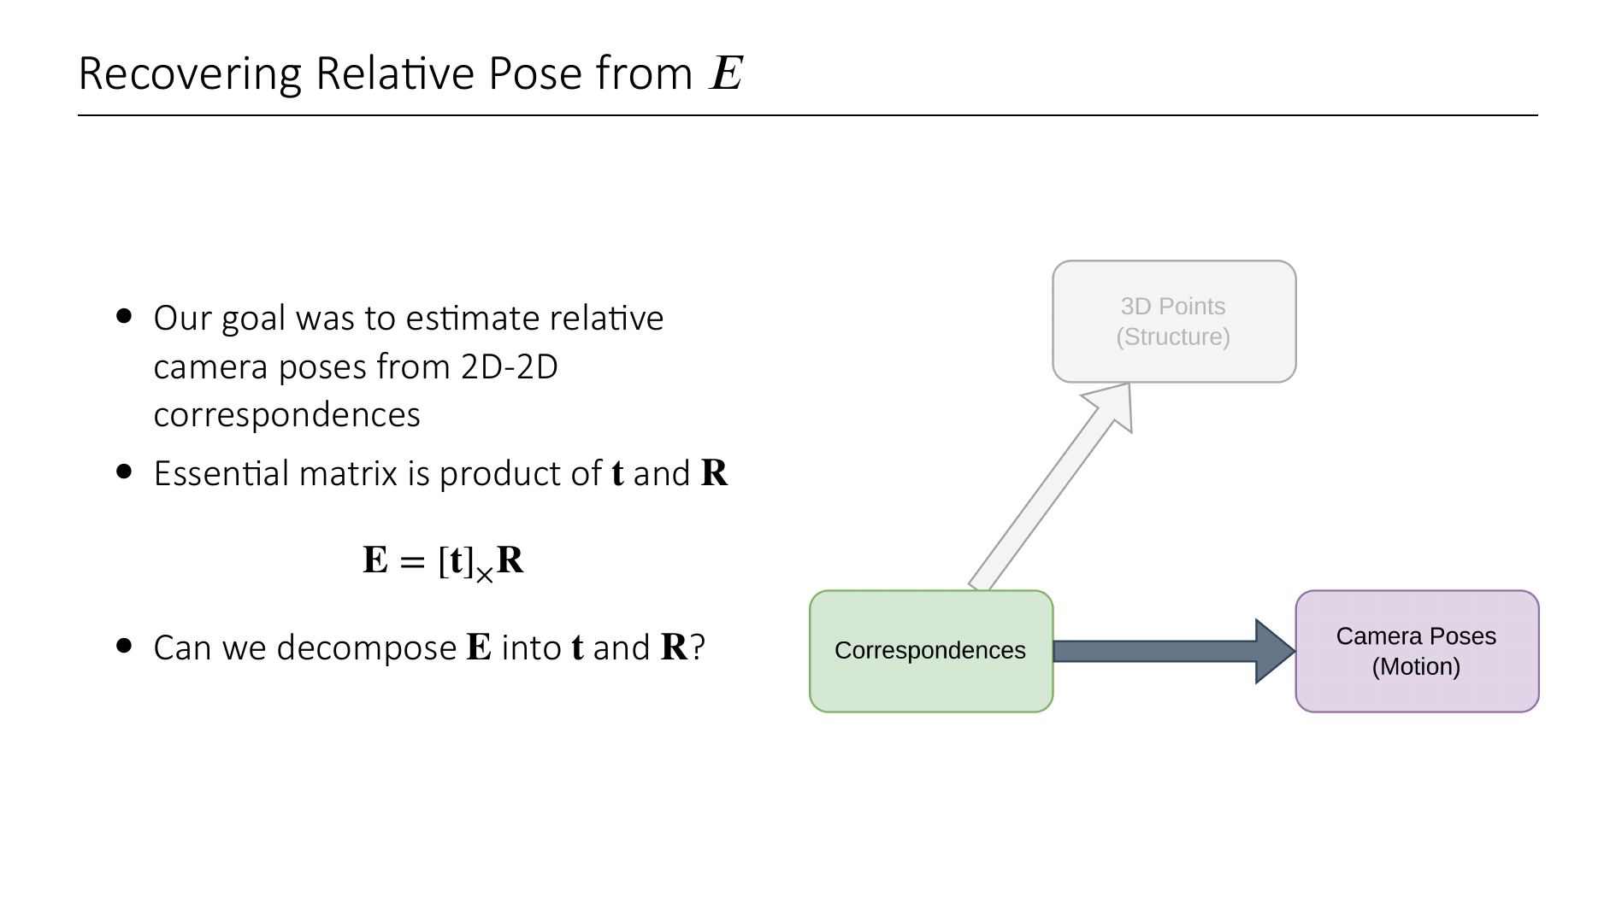
Notes:
Recall that we are actually interested in estimating the relative pose of two cameras just from known 2D correspondences.
Also, the essential matrix is by definition just a product of [t]_x and the rotation matrix.
Is there a way to recover t and R from E, if the essential matrix is known?

Slide 41
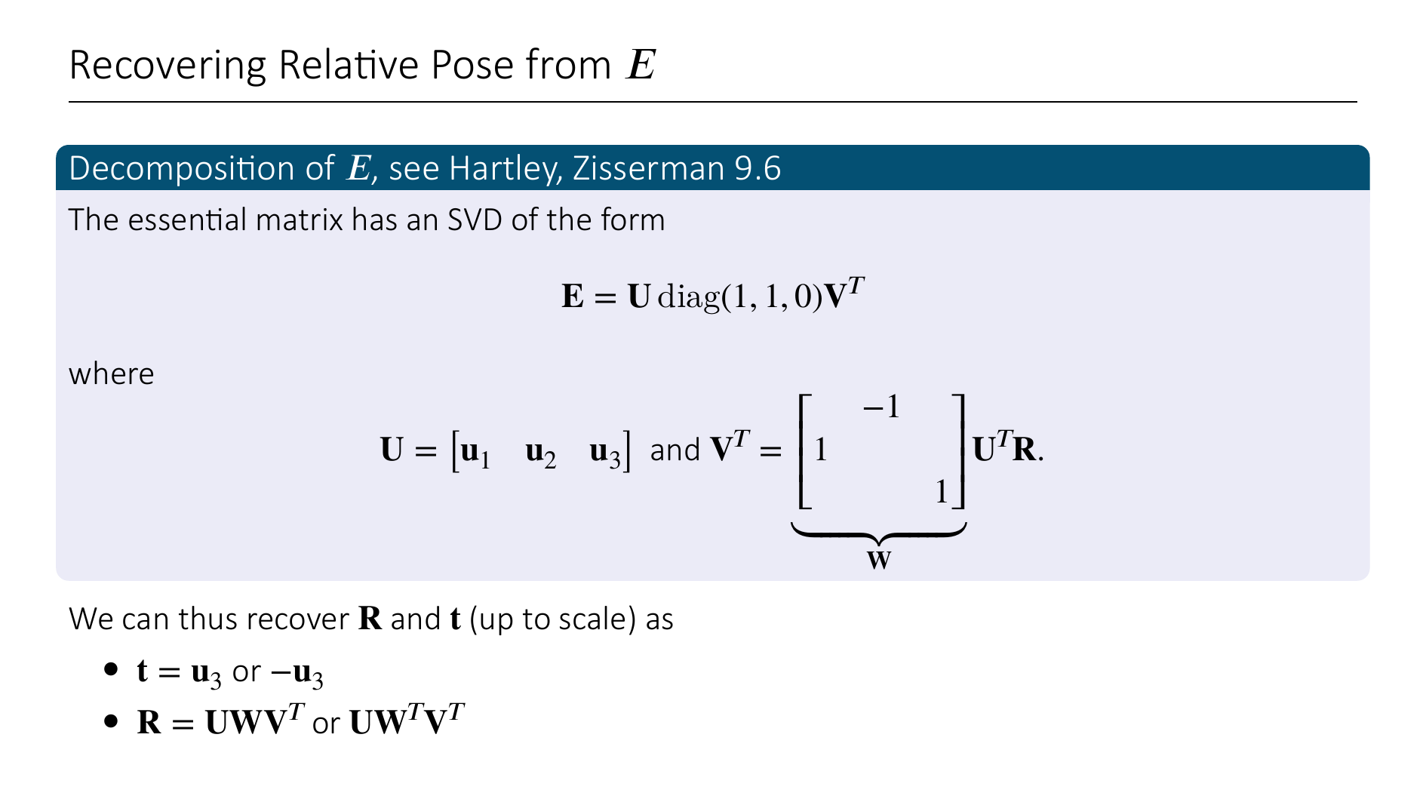
Notes:
Yes, we can recover the relative rotation and translation (R, t) (up to scale) from the essential matrix.
This is based on a decomposition theorem you can read up in Hartley Zisserman. Essentially, it states that the SVD of the essential matrix has a very special form (up to scale!).
Then t will be +/- the third column of U
And R will be UWV^T or UW^TV^T

Slide 42
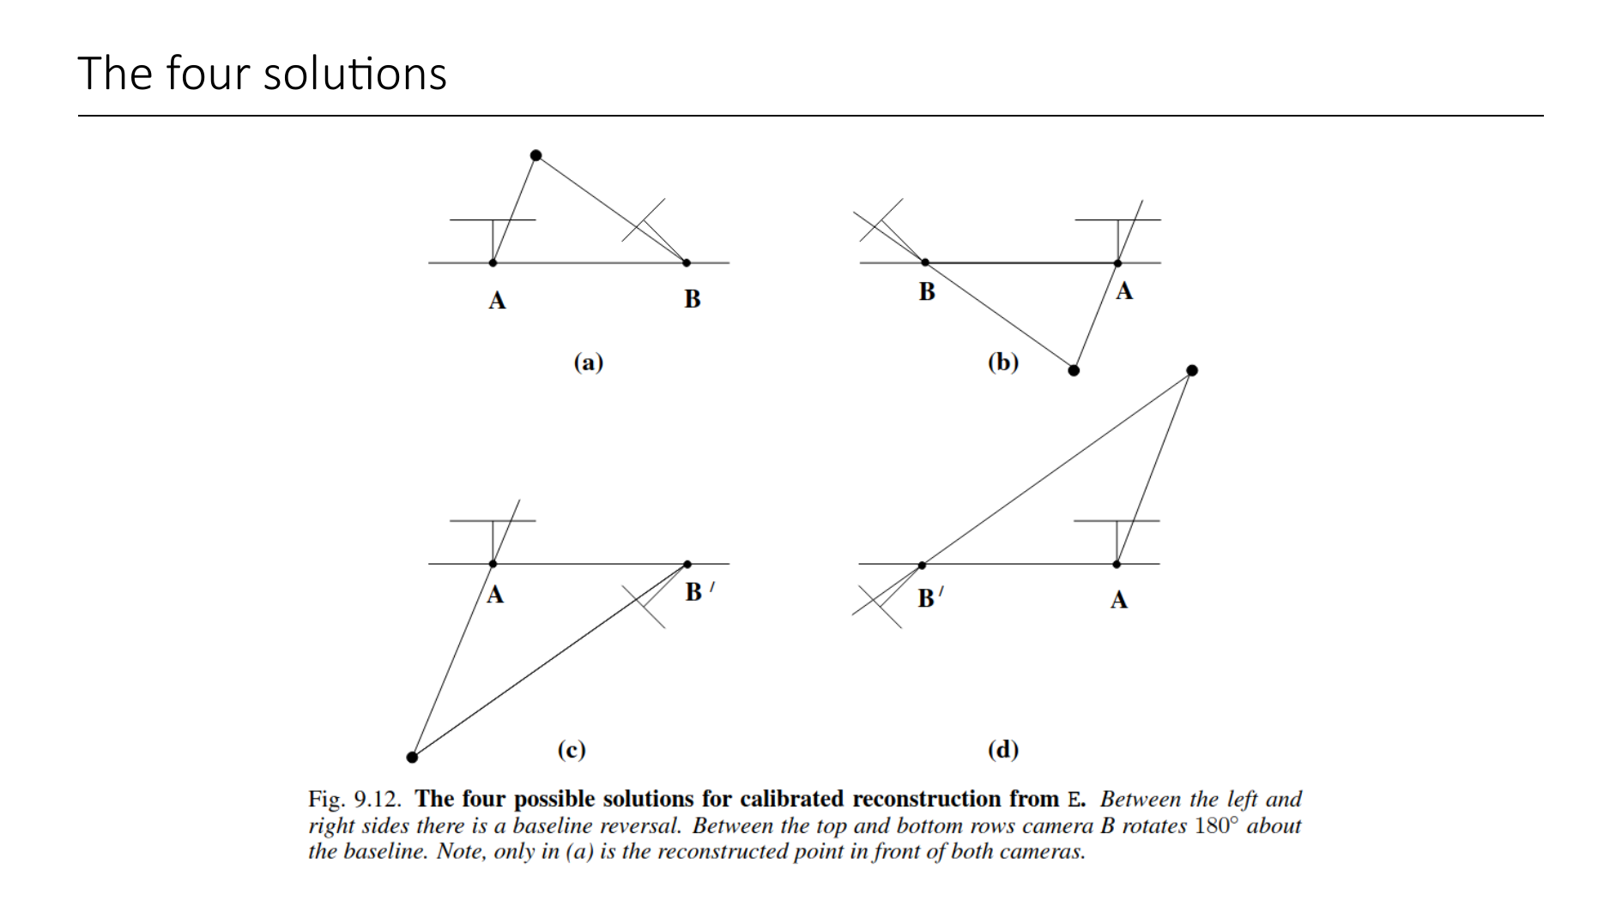
Notes:
So there are 4 different potential solutions for the relative orientation of the two cameras
The geometry is depicted in this figure from Hartley Zisserman
How do we find the correct configuration?
By testing for a single point to determine if it is in front of both cameras.

Slide 43
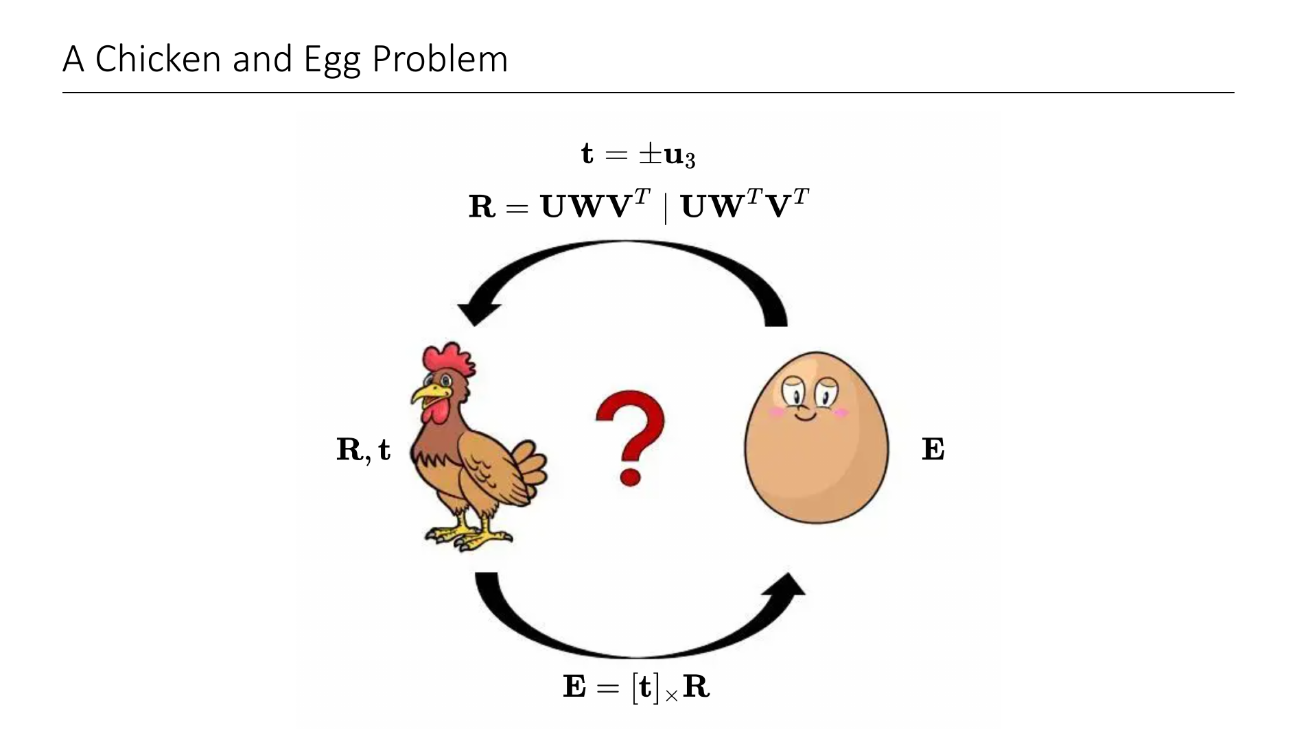
Notes:
Quick summary:
- We know that given the relative pose of the two cameras, we can compute the essential matrix as this matrix product.
- Secondly, we have just seen that given the essential matrix, we can recover the rotation and translation (up to scale, because E is projective mapping)
Notice that this is a classical chicken-egg problem! We defined E in terms of t and R, and we can recover t and R from E. But how do we get E without t and R?
We will next see how to estimate E from just 2D-2D correspondences.

Slide 44
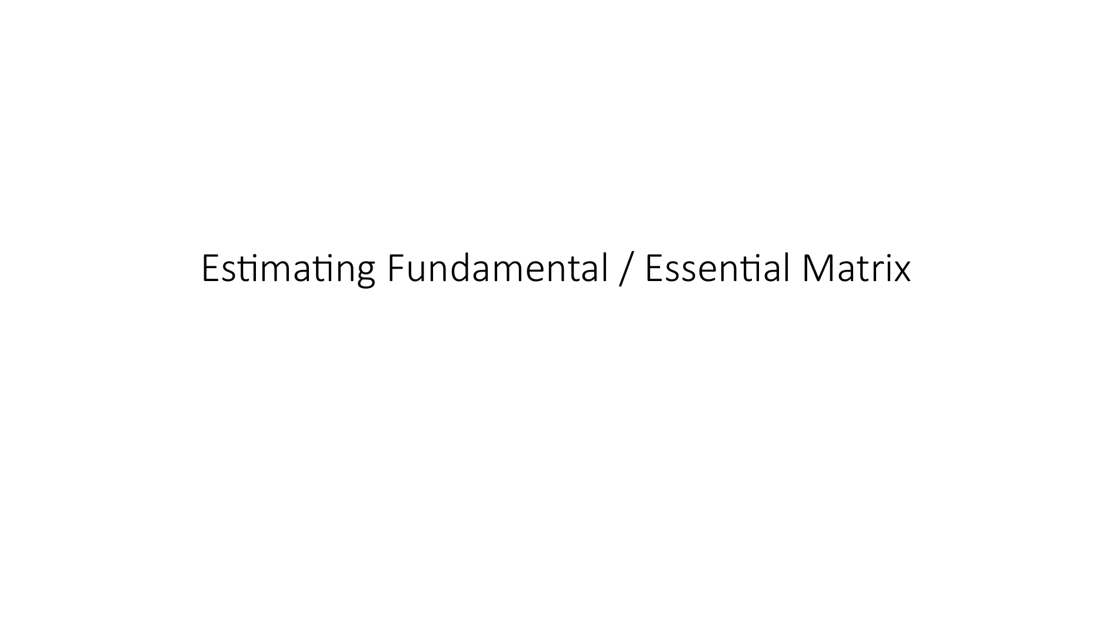

Slide 45
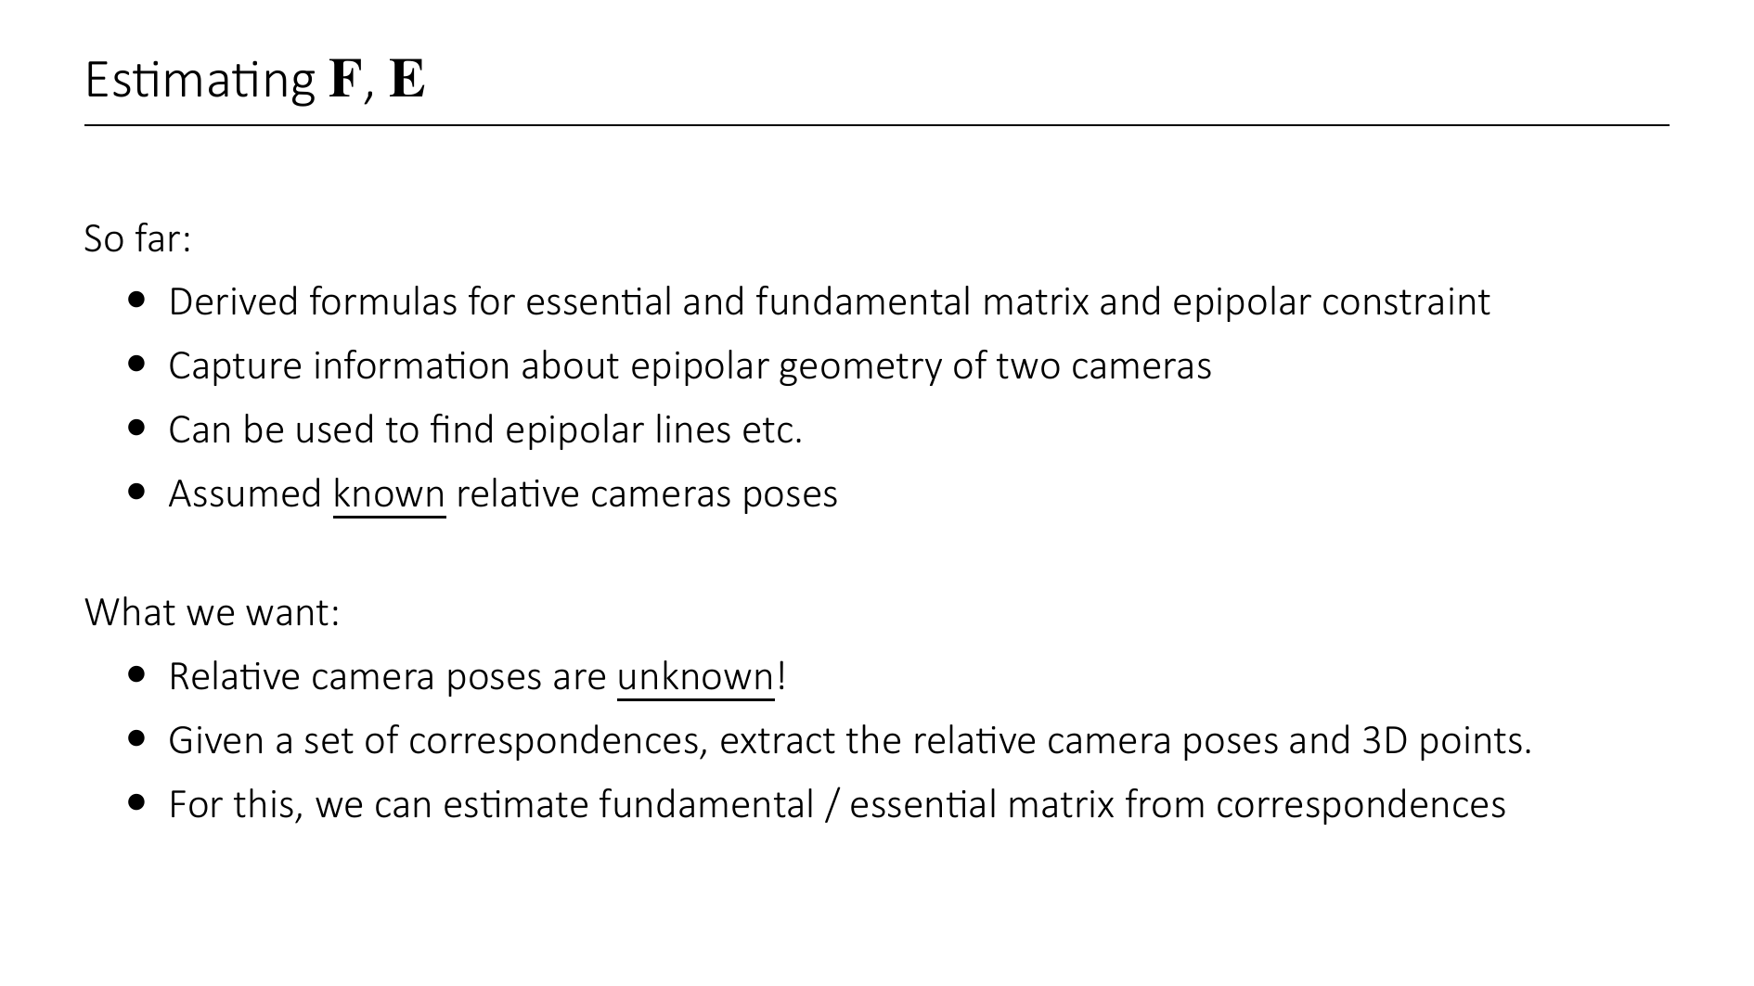

Slide 46
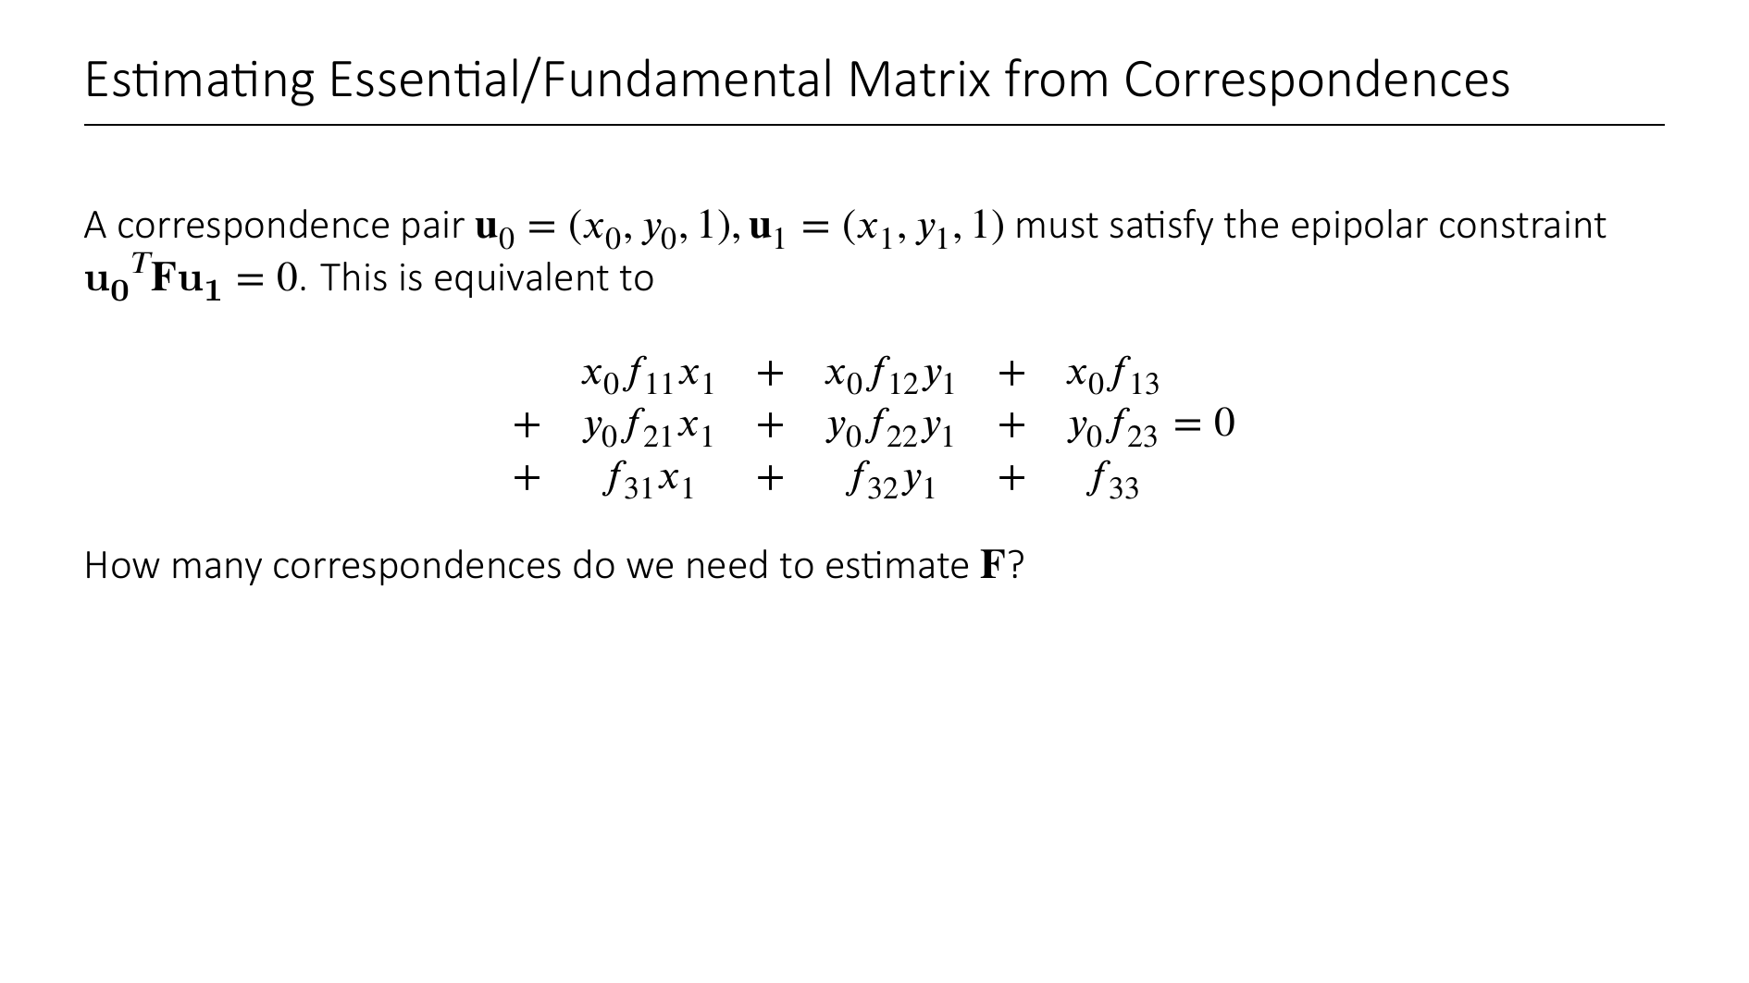

Slide 47
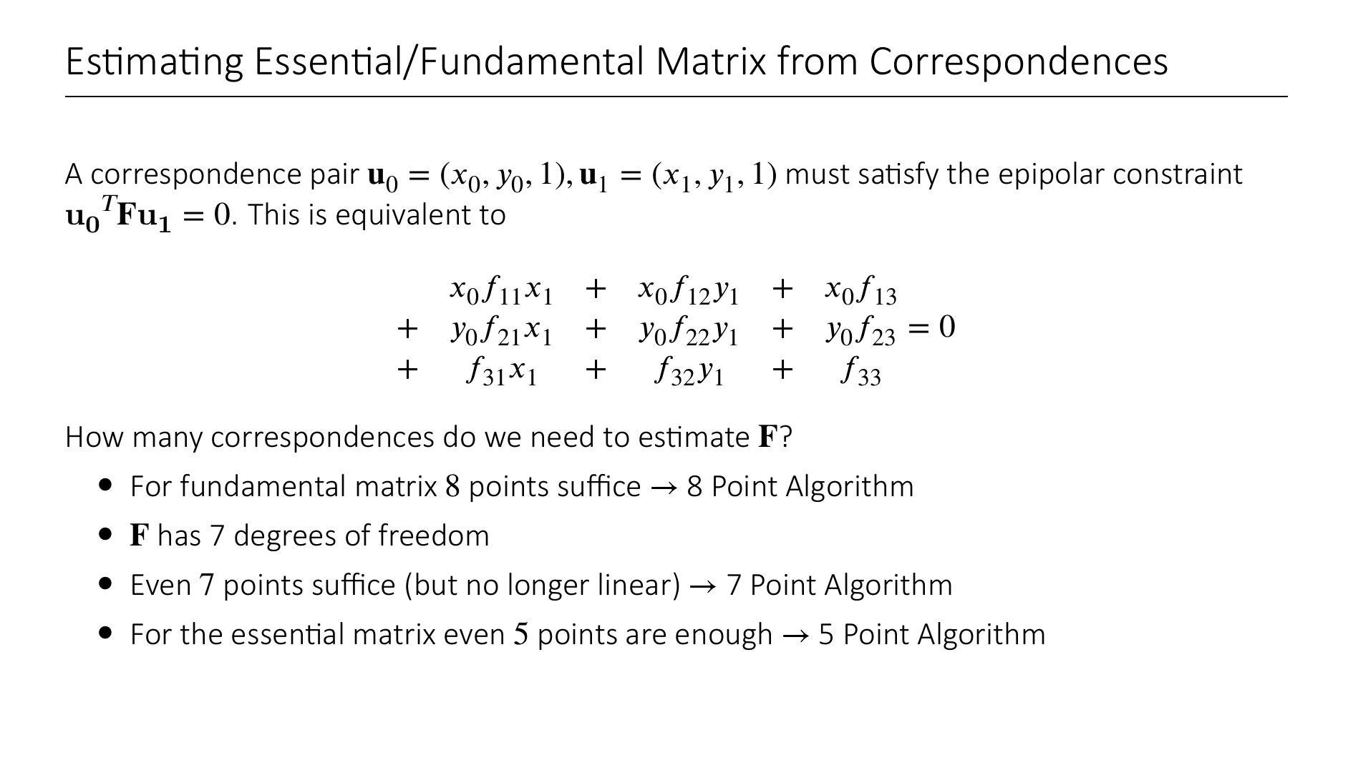

Slide 48
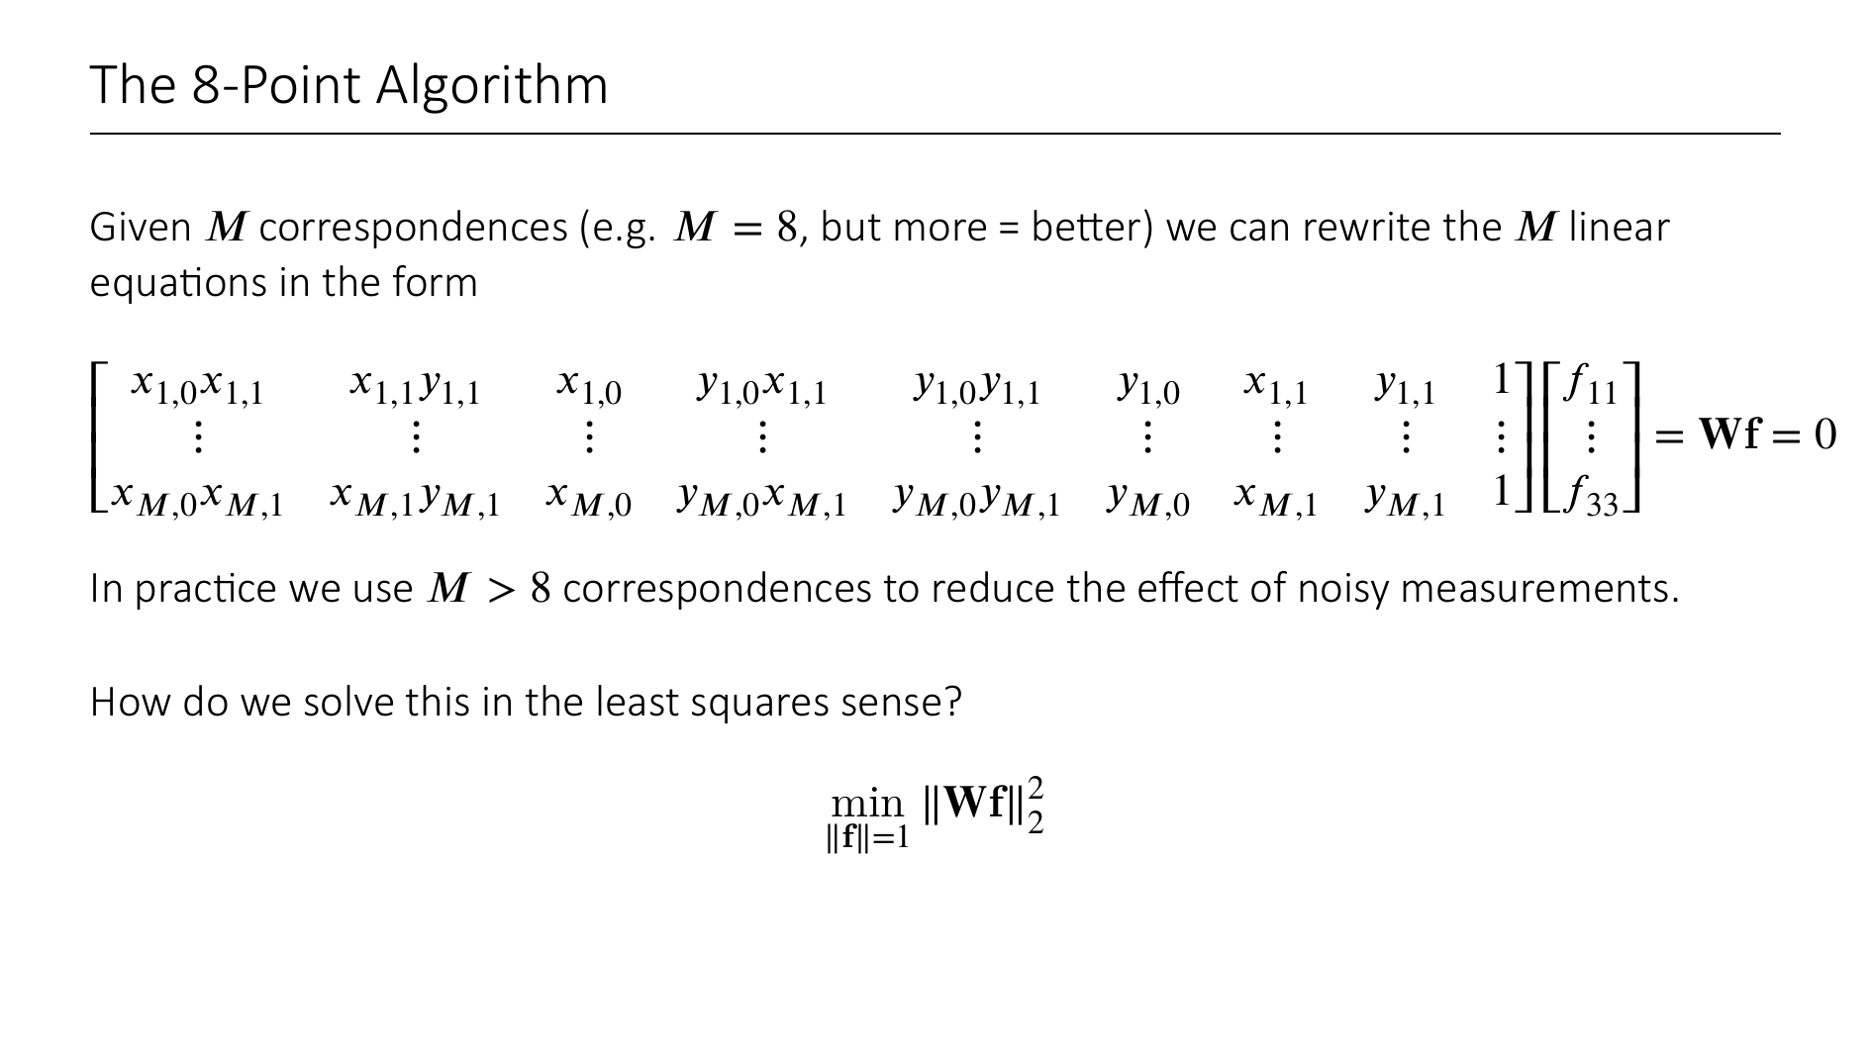

Slide 49
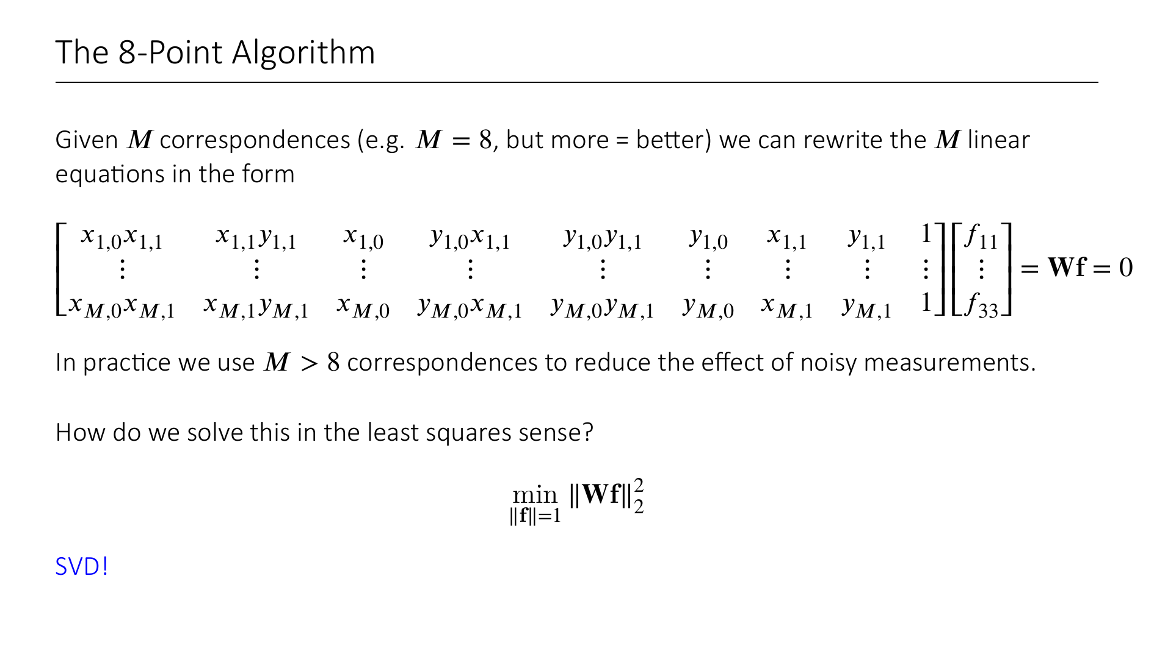

Slide 50
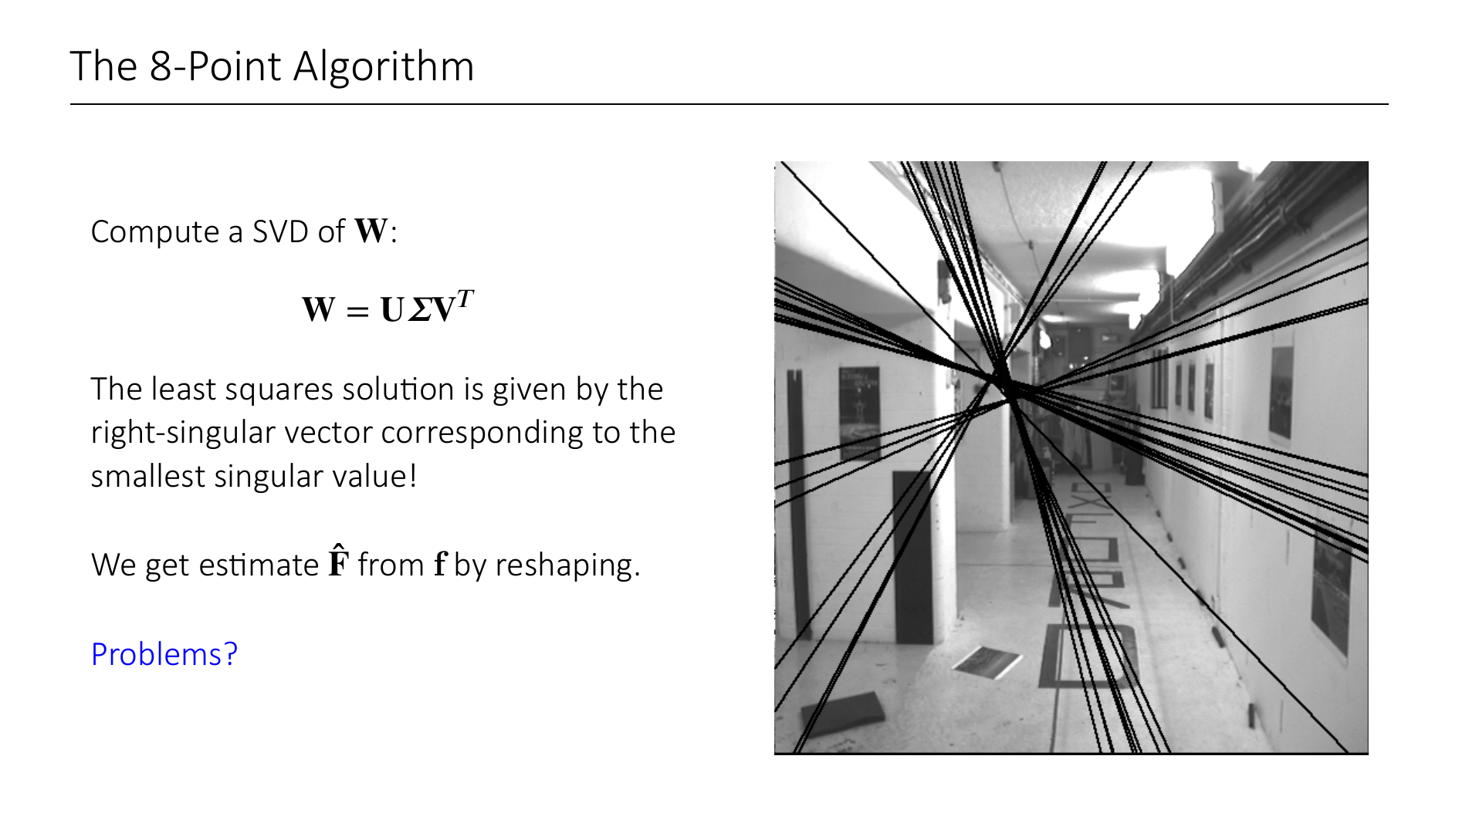
Notes:
Solving a linear least squares problem is routine. You also do / did this in the exercise.
To solve such a problem, you take the right-singular vector correpsonding to the smallest singular value of W.
Can you see any problems? Look at the picture on the right. You see the "epipolar lines" that we get from estimating a fundamental matrix that way. What is wrong?
The epipolar lines are not converging in a single epipole.
What is the problem? The estimate has full rank (recall that epipoles are in left- and right- nullspace of the fundamental matrix)
So we must enforce this constraint that rank(F) = 2...
Any idea how to solve this? Think of SVD again.

Slide 51
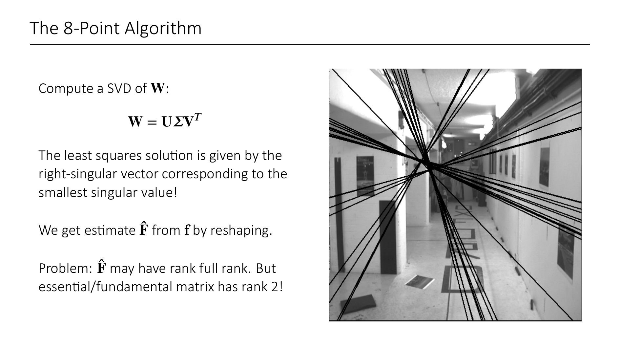

Slide 52
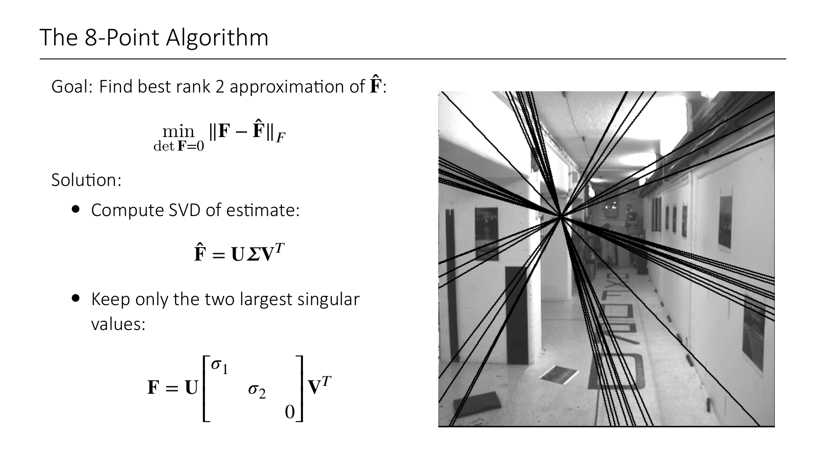
Notes:
The solution is to compute the best rank 2 approximation of the estimate.
This is done by computing another SVD and setting the last singular value to 0.
On the right you see the new epipolar lines after we have enforced the rank 2 constraint. You can clearly see that the lines are all intersecting in a point.

Slide 53
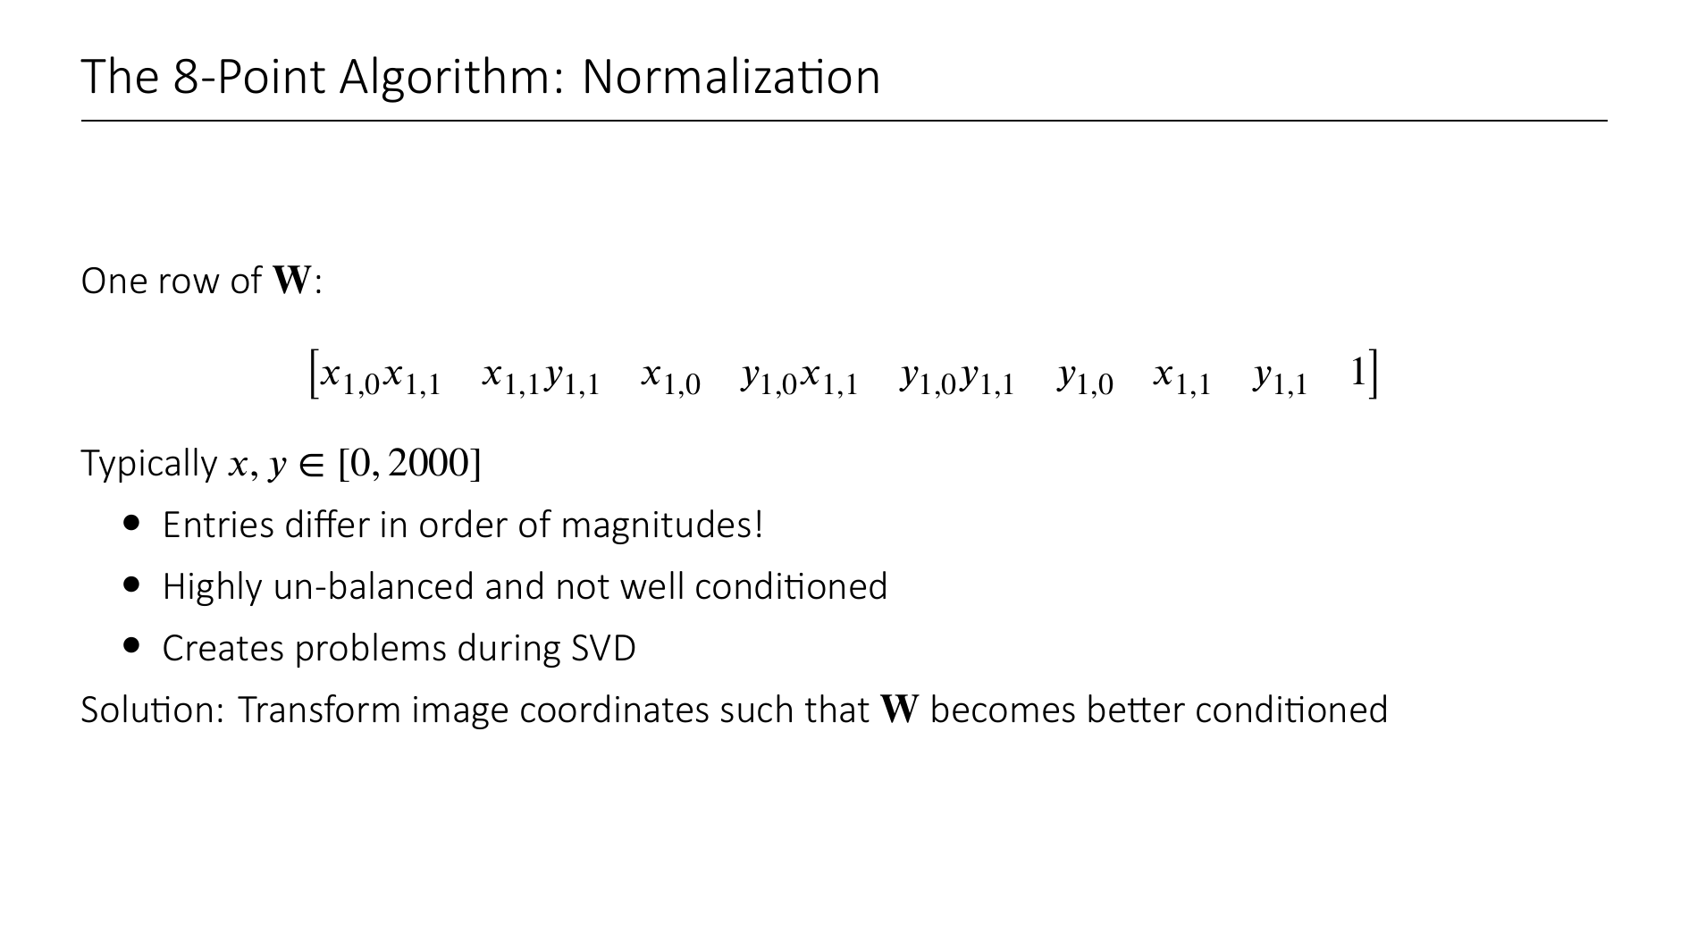

Slide 54


Slide 55


Slide 56


Slide 57

Notes:
One very important theme in 3D reconstruction pipelines that use 2D-correspondences is the robustness to wrong correspondonces.
In this example, you can see that some points are matched to false points, because they locally look similar.
So a lot of work has been put into making methods robust to outliers.
Here we will introduce a very general paradigm known as RANSAC that deals with outliers.

Slide 58

Notes:
Let's think about another simple problem for a second. Imagine I give you a bunch of 2D points and your task is to find a line that best explains these datapoints.
You probably all know the least squares line fitting algorithm, but this is not at all robust to outliers. The opposite is even the case, because of the squared distance terms, high deviations are punished more heavily.
You can see here in this example that the least squares fit does not fit the intuitively clear best line.
The "best" line here seems to be the one with the most "inliers"

Slide 59


Slide 60


Slide 61

Notes:
In the bigger picture, we follow the following pipeline:
Estimate F via (normalized) 8-Point algorithm (+RANSAC)
Use known (or estimated) intrinsic matrices to recover essential matrix
Scale E such that the first two singular values are 1
Then we can apply the theorem from before to recover relative rotation and translation from the essential matrix (the slide with the 4 possibilities)
This is the way to estimate relative camera poses from only 2D-2D correspondences

Slide 62


Slide 63

Notes:
What we have seen so far is how to go from 2D-2D correspondences on two images to the relative camera poses
Then we can triangulate the 3D points that can be observed in both images to get some structure.
There are ways to generalize this to 3 or 4 views (trifocal, quadrifocal tensors), but things get quite complicated there.
Instead, most SfM pipelines use different approaches to integrate multiple images into a 3D model.
Most prominently, so-called "incremental" SfM pipelines start from 2 images and in each step add an additional image into the already registered model.
One key ingredient here is "bundle adjustment", a strategy that tries to simultaneously optimize already registered camera poses and the 3D points.

Slide 64

Notes:
Bundle adjustment tries to minimize the total reprojection error by updating both the 3D model (X) and the camera matrices (P).
What does this mean?
Let us consider one 3D point X_j and a single camera i. The camera observes the point at position u_{i,j} (this is the actual observation in image space, not the reprojection using P_i!)
If the estimated camera matrix is P_i, then we can reproject the point onto the image plane using this matrix (pi(P_i, X_j)) and look how far away it is from the actually observed position u_{i,j}.
This is known as the reprojection error ("how much does the reprojection with the current estimates deviate from the actual observation?")
Of course, this only works for point-camera pairs that are actually visible. Hence, we have to introduce the indicator w_{I,j} that specifies whether point j is visible in camera i.

Slide 65

Notes:
Typically, BA is solved using Gauß-Newton or Levenberg-Marquardt optimization algorithms. For large systems, open source tools exist that efficiently converge to local minima.
Additionally, in the context of SfM problems, these solvers can take advantage of the sparse structure (eg. Only relatively sparse point clouds are reconstructed)
It seems that Bundle Adjustment kind of already does what we are trying to do, right?
Given a bunch of 2D image points, we want to find the underlying 3D structure and camera matrices that produce these images.
So why can't we just solve the SfM problem using BA?
The runtime of the algorithms is cubic in the number of cameras. For very large scale problems (think reconstructions of entire cities) this is not feasible at all
Also, BA is very sensitive to initialization, and only finds local minima
For these reasons, BA is predominantly used as a refinement step in SfM pipeline.
There are also variants where only camera matrices are optimized, while points are kept fixed and vice versa to reduce time complexity.

Slide 66

Notes:
With BA in our toolbox, we can start looking at how 3D Reconstruction Pipelines are actually built.
Here is an overview of the high level steps:
As input we get a collection of unstructured images
In a first step, the so-called scene graph is built. It encodes all the relative geometry between the images and is estimated using 2D correspondnces and the methods we saw in epipolar geometry. This step is also called Data Association.
Given this scene graph we solve the SfM problem to get a sprase model.
If we want a Dense Model, we can performs MVS (next lecture)

Slide 67

Notes:
So let us look into the first step "Data Association"
The first step is to find correspondences between the images. For this, we first identify keypoints and extract local features using methods like SIFT etc.
2. These features must then be matched to find 2D-2D correspondences between images. The naïve approach would be to compare every feature in each image with each feature in each other image (pairwise), but there are more approaches that tacke the problem of scalable and efficient matching.
3. Since this matching is done purely on appearance similarity and without spacial reasoning, we can assume that there are lots of incorrectly matched features. A third step, called "Geometric Verification", tries to estimate the two-view geometry using epipolar geometry (this is what we saw before​: estimating essential matrix and recovering relative poses, …) If a sufficient number of matched features is geometrically consistent with the estimated relative geometry, we say the two views are "geometrically verified" and connected in the scene graph by an edge.

Slide 68

Notes:
So after the Data Association Step, we can constrct the scene graph that tells us somewhat reliably which images have overlap, and gives us first estimates on the relative camera poses.

Slide 69

Notes:
Now in the next high level step, the SfM step, we use this scene graph to estimate the 3D Points and camera matrices.
Most SfM pipelines can be put into one of these three categories.
Incremental SfM pipelines start from two views, and in each step add an additional view.
Global SfM processes all views simultaneously
Hierarchical SfM pipelines are a mixture of both that partition the scene graph is clusters that are reconstructed individually and then stitched together

Slide 70


Notes:
What you see here is an example of COLMAP in action. COLMAP is the most popular incremental structure from motion pipeline
You can see that it is incremental by how it adds one camera after the other, and adding newly observed 3D points.

Slide 71

Notes:
This is the method overview figure from COLMAP.
We have already seen the Correspondence Search Part (Data Association)
We go through the initialization and incremental reconstruction steps of the pipeline.

Slide 72


Slide 73


Slide 74


Slide 75


Slide 76


Slide 77


Slide 78


Slide 79


Notes:
This is a demo from GLOMAP, a global structure from motion pipeline from ECCV'24
You can see how all cameras and points are optimized simulatineously, as opposed to the incremental pipeline, where the cameras and 3D points were added one after the other.

Slide 80

Notes:
One central problem of global SfM is the so-called rotation- and translation-averaging
From (pairwise) 2-View-Geometry, we can estimte the relative rotations and translations between all pairwise cameras that view a common region.
We will get some view-graph like this, where the {R,t}_{ij} are the relative pose estimates between camera i and j.
Of course, these are all somewhat noisy estimates that may suffer from wrong correspondences, inaccurate intrinsic estimates etc, so we cannot simply "add" the relative poses up to get consistent global poses.
Each cycle in this view-graph will potentially lead to a clash in global poses.
The problem to deal with this is known as "rotation" averaging.
The task is, to find the global orientations of the cameras (R_i) that minimize the error to the estimated relative rotations.

Slide 81

Notes:
This can be formulated as follows:
Hat R contains all global rotations, that we want to optimize for
The R_ij are the local relative rotations that we estimated from epipolar geometry
In terms of global rotations, R_ij can be expressed as the product of R_j with R_i^T (back and forth)
We want to find the global rotations that minimize the relative rotation error.

Slide 82

Notes:
Now rotation matrices are not really great for solving rotation estimation problems because they have 9 entries, while a rotation only has 3 dof.
So what we will do instead is to switch to axis angle representation.

Slide 83

Notes:
This matrix [… -I … I …] is a 3xC matrix (C = num of cameras) that has the identity matrix at the position of omega_j, and negative identity matrix at position of omega_i.
So we get 3 linear equations for each edge in the view graph
If we stack these on top of each other, we get a linear system A omega_glob = omega_rel
Here omega_glob is the axis angle representation of hat R, we want to optimize for, and omega_rel are the axis angles of the estimated relative rotations
A is a block matrix containing a lot of identity matrices
Solving such a problem in the least squares sense can again be done via SVD (compute the pseudo-inverse A+)
This way we get omega_glob which we can then back-translate to rotation matrices hat R.

Slide 84

Notes:
A problem is, that omega_{ij} = omega_j – omega_I is only an approximation
But we apply our linear solver repeatedly and end up with the following algorithm.

Slide 85


Slide 86

Notes:
Now that we have estimated global rotations of the cameras, we can do a similar thing for translations.
Translation averaging can be expressed as the following optimization problem.
Why do we normalize the distsance estimates?
Because we can only recover the t_{ij}'s up to scale! So we assume them to be normalized, and hence have to reflect this in the optimization.
Again, we filter out outliers.

Slide 87

Notes:
A global SfM pipeline then could look like this.
This is a recent paper GLOMAP from ECCV'24 which revisists global SfM after COLMAP (incremental) has been the goto method over the last years.
Notice that there is no loop in this pipeline, i.e. no incremental view adding, but a global alignment followed by bundle adjustment.
GLOMAP is a much more efficient and scalable pipeline than COLMAP. According to the authors, it is typically up to 1-2 orders of magnitude faster than COLMAP while achieving similar or superior reconstruction quality.
A note: GLOMAP does not perform translation averaging, but instead introduces a new method called global positioning. This step simultanenously estimates camera translations and 3D points, as opposed to translation averaging followed by triangulation.

Slide 88

Notes:
Hierarchical SfM is like a mixture of global and incremental SfM
The scene graph gets partitioned into clusters which get reconstruced individually

Slide 89


Slide 90


Slide 91


Slide 92


Slide 93


Slide 94


Slide 95


Slide 96


Slide 97


