Slide 1
Hands on AI based 3D Vision
Summer Semester 25
Lecture 2 – Image Formation
Prof. Dr.-Ing. Gerard Pons-Moll
University of Tübingen / MPI-Informatics
Notes:
Hello, wellcome to the second lecture on virtual humans. The topic of today is Image formation.

Slide 2
Overview
Part1. Image formation – Introduction
Part2. Image formation – Projection Matrix
Notes:
This lecture is divided in two parts. An introduction to image formation and then we will formalize the process mathematically. In particular we will see how 3D objects can be projected onto pixel coordinates via the projection matrix

Slide 3
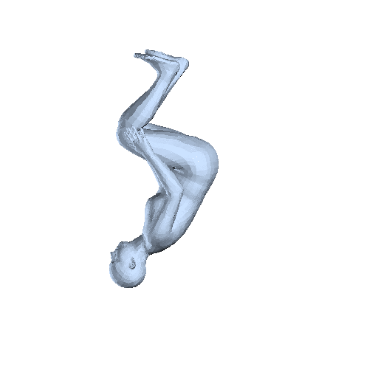
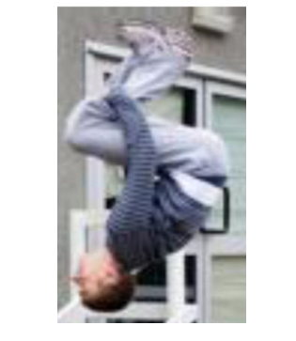
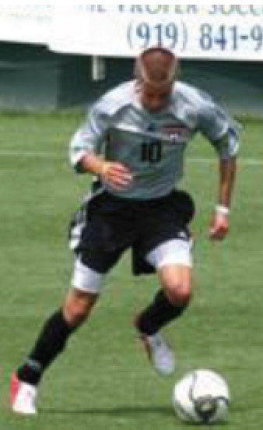
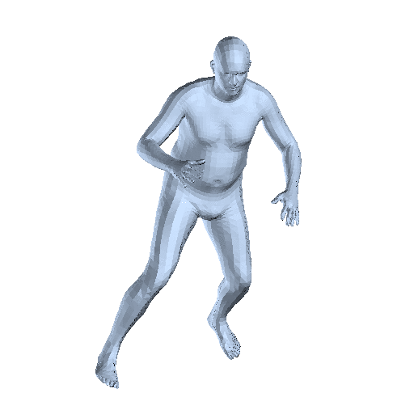
Computer Vision goal: Predict 3D human mesh from a single image
Input (2D)
Output (3D)
Notes:
One goal is to understand what people are doing in videos and images. For example, we might be interested in recovering the 3D mesh of a human characterizing the human pose and shape of the person.
This is a classical computer vision problem where we need to invert the image formation process.

Slide 4
Computer Graphics goal: Render photorealistic avatars
Input (2D)
Output (3D)
Notes:
Analogously, we are also interested the reverse problem. Given some controls of the human characteristics, such as the shape, pose and clothing, we would like to easily generate realistic images of humans.
This is a classical computer graphics problem.
By the end of the lecture it will be clear that the boundaries between computer graphics and computer vision problems are everytime more and more blurred. That is we often need to solve both problems simultaneously.
For both types of problems, generating realistic images and inverting the image formation process, we need to understand the image formation process first.

Slide 5
For both problems we need to understand first image formation models
Notes:
For both problems, we need to first understand how images are formed. What is the physical process to capture the light emited by a 3D scene in the world to produce an image. This will be the goal of this lecture.

Slide 6
Notes:
Let‘s start with the basics. The laws of perspective.
Light arriving at an object travels in straight lines.
These lines converge to a point in the eye.
Already Euclid discovered natural perspective. He realized that more ditstand objects subtend smaller visual angles

Slide 7
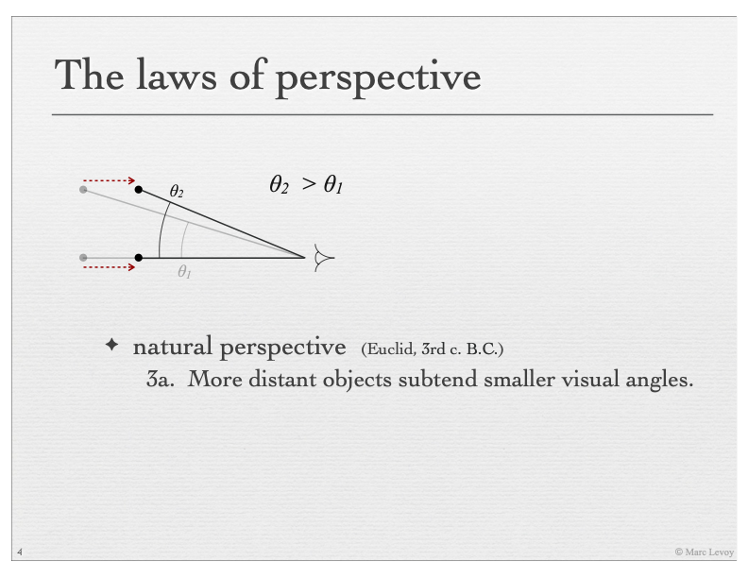
Notes:
What does it mean? Consider an object determined by the two black dots. If the object gets closer to the observer‘s eye, the angle \theta_2 will become larger.

Slide 8

Notes:
Look at the following paintings. What is wrong? In the drawing in hte left, further away objects appear indeed smaller. However, the proportions are not quite correct, making it look off.
They look rather flat because natural perspecive is not sufficient.
They requires linear perspective

Slide 9
Notes:
Linear perspective. A perspective image is formed by the intersection of these lines with a picture plane „a canvas“

Slide 10
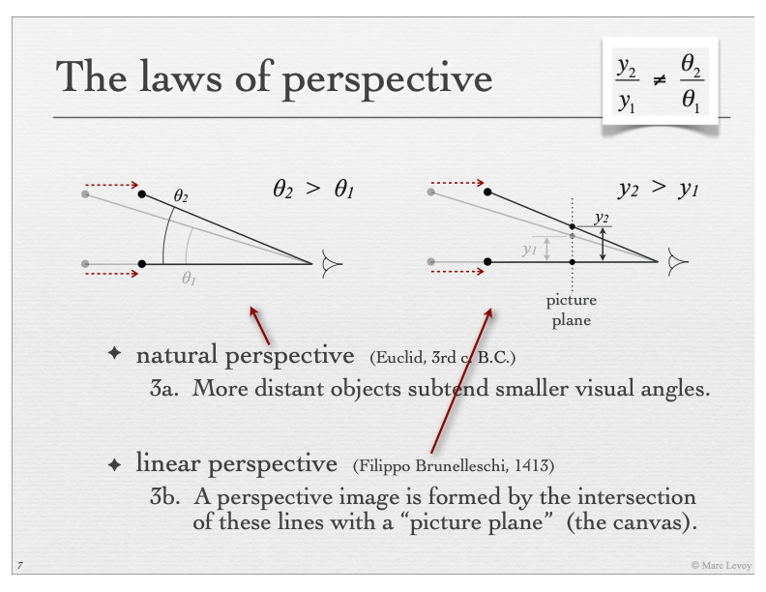
Notes:
Natural perspective subtends smaller vsual angles.
In lnear perspective, the 3D object in the wolrd, the two black dots, are projected by intersecting the straight line from the 3D point to the observer with the picture plane.
Hence, when the object gets closer, the height of the object gets larger. That is y_2 is larger than y_1.
This proportion, or how much larger the object appears in the image, is different than natural perspective, so the ratio between theta_2 and \theta_1 is different than the ratio between y2_and y_1.
These are different perspectives.

Slide 11
Notes:
In linear perspective it is straight forward to derive the intersection points with the image plane. Imagine we want to project P onto the image plane. That is we want to find y.
By similar triangles we have that h/z equals y/f. where f is the focal lenght or the distance from the viewpoint and the mage plane. From this we can derive that y=fh/Z.
Notice that the mapping requires division by Z, so it is a non-linear projection. Division by Z means that if I am twice as far, I will appear in the image half as big.
If I am twice as far, I appear half as big in the camera

Slide 12
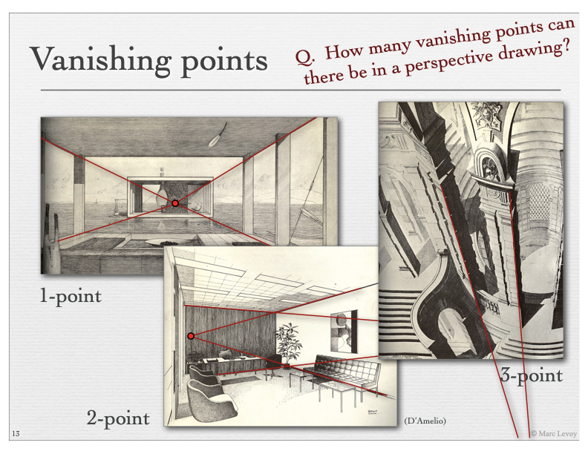
Notes:
In linear perspective straight lines remain straight. However, parallel lines in the 3D world will not remain parallel. Since objects appear smaller and smaller as we get further away from the camera.
Parallel lines will converge to a so called vanishing points. You can observe this effect in the columns of the drawng in the top left.
So a vanishing point is the point where paralel lines converge in the linear perspecive.
So one question. How many vanishing ponts can there be in a perspective drawing? 3?
There can be infitely many vanishing points. In fact, every pair of parallel lines will converge to the a vanishing point.

Slide 13
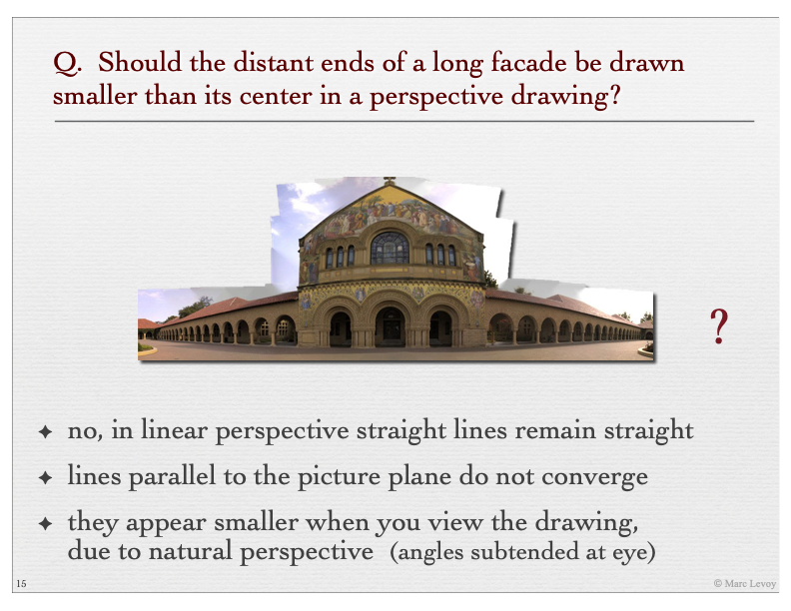
Pause the video and think
Notes:
Another question.
Imagine we are stadning in front of a very long faceade and we want to draw it. Should the dstant ends of the facade be drawn smaller than ist center in a perspective drawing?

Slide 14
Should it look like this picture?

Slide 15
Notes:
If the drawing is very very large, the far ends will appear smaller due to natural perspective

Slide 16
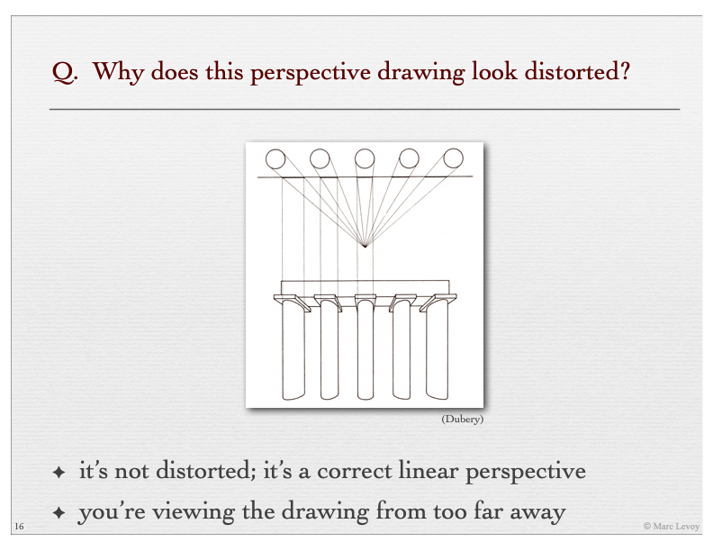
Notes:
Any ideas?

Slide 17
Notes:
It’s actually not distorted.
To see it undistorted we would have to stand really really close to the picture.

Slide 18
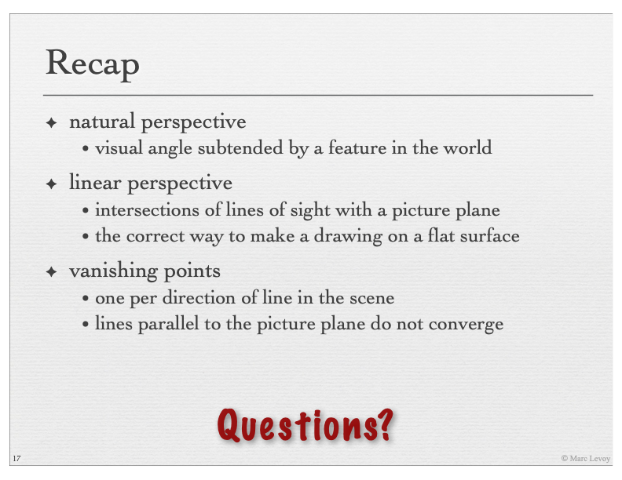

Slide 19
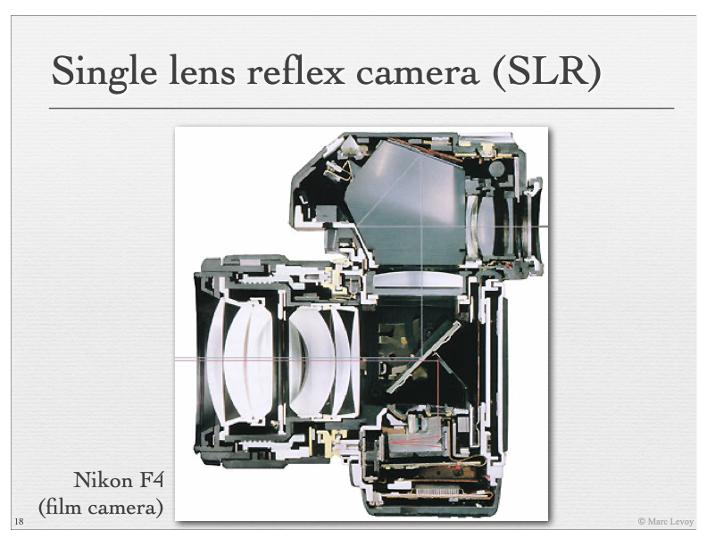
Notes:
This a picture of the internals of a camera. Have a look at all this glass here. These are the lenses. A nautral question is do cameras need lenses? Can we just put a sensor?

Slide 20
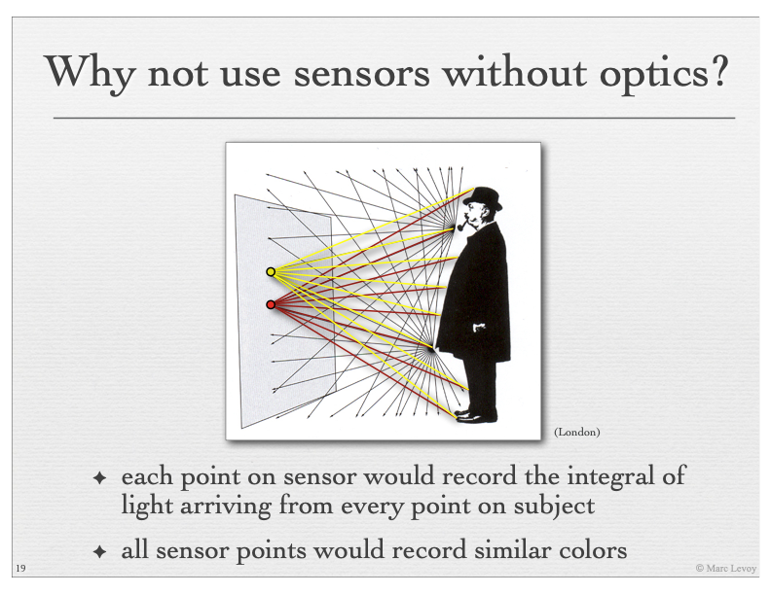
Notes:
Why not just put a sensor? What image would the sensor produce?
It would be an average. Every location in the image, would receive an integral of rays coming from many different places. Nearby image locations would produce almost the same color, and the whole image would be blurred

Slide 21
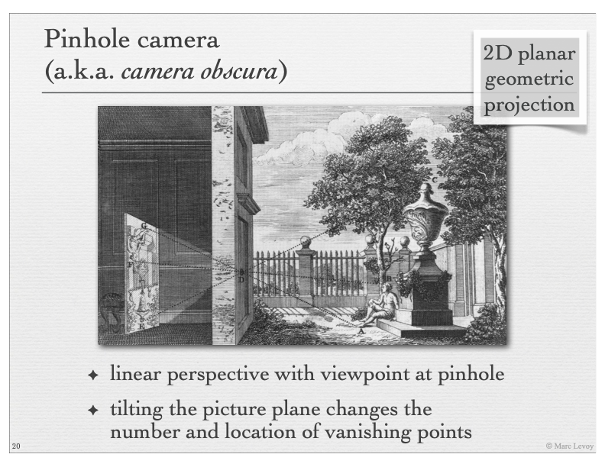
Notes:
Since ages it has been known that you can make a hole on a wall and put a sensor or a white wall on the other side. This is called a Pinhole camera or camera obscura.
With this we will obtain an image with linear perspective.
Everything is in focus. Because every point in the image is recorded. Notice, that the image will be inverted. Take this ray for example, which is the high part of the scene, it will land on the bottom of the image, and viceversa.

Slide 22
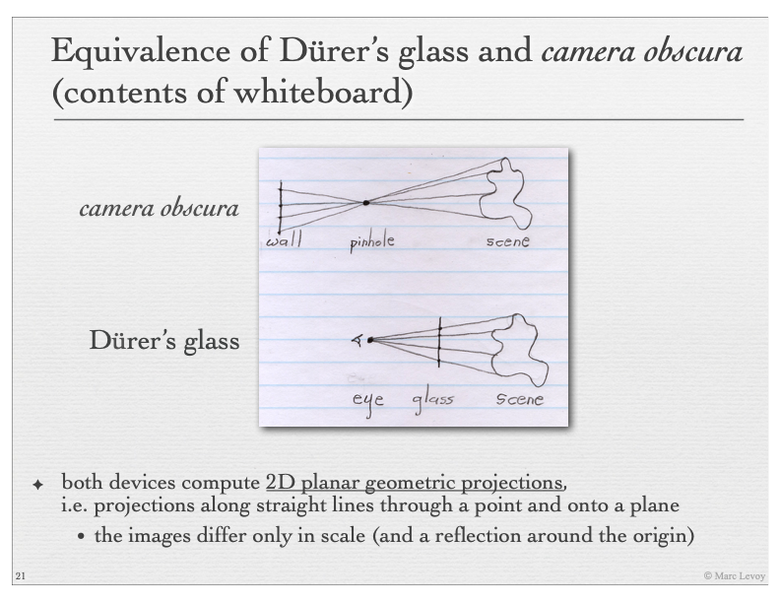
Notes:
The model of the pinhole is as follows. The pinhoile is in the middle, and the image is produced behind the pinhole.
A completely equivalent model is to consider the image produced in front of the pinhole. This makes the math to figure out proportions by similar triangles even easier.

Slide 23
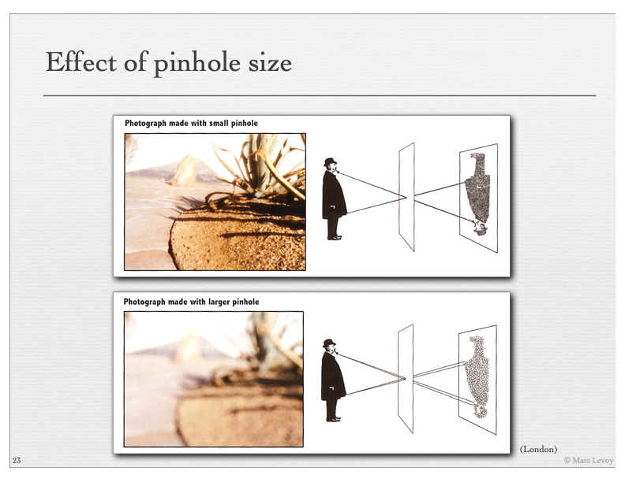
Notes:
Problem. What do you think is a potential problem with the pinhole?
A pinhole does not let enough light through. Solution make the pinhole larger. But what is going to happen?

Slide 24
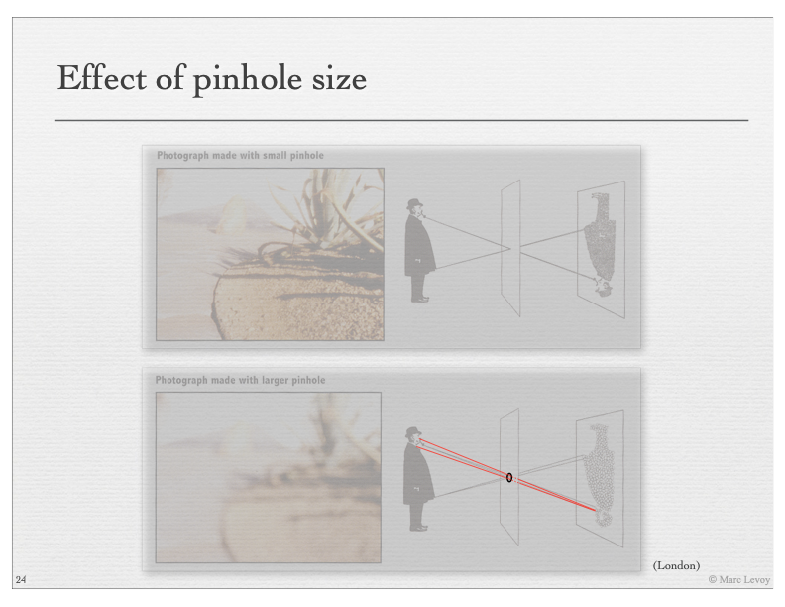
Notes:
If we look at all rays that arrive at a given location or pixel, we obtain a cone. Every „pixel“ will be the integral over a region on the scene.
Hence, the image look blurry. Even for small pinholes. That is why we do not use pinholes.

Slide 25
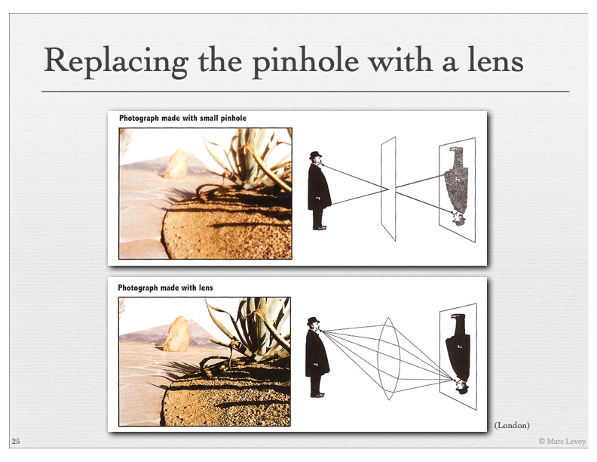
Notes:
Luckily, a Lens does the same thing. Takes all the rays leaving one point, and brings them back to a single point. It is still a linear perspective.

Slide 26
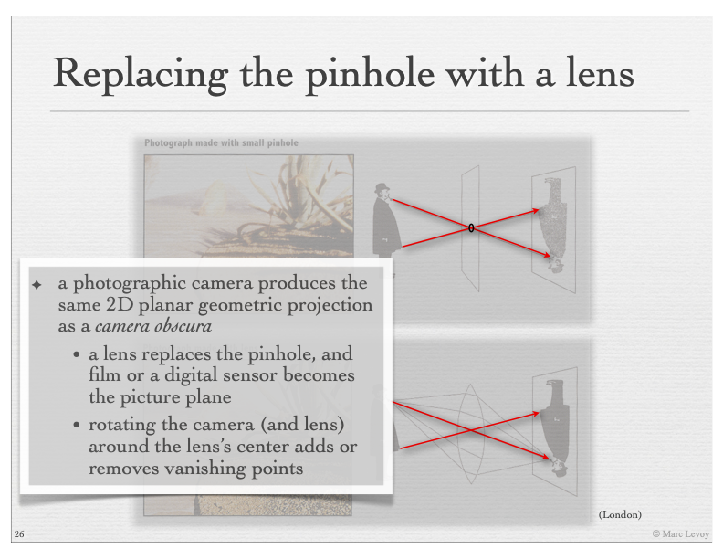
Notes:
In a pinhole the straight rays define the viewpoint. In a lens the effective linear perspective rays coincide with the straight rays passing through the middle of the lens.
Hence the lens produce a linear perspecive image, and the effective pinhole is right in the middle of the lens.

Slide 27
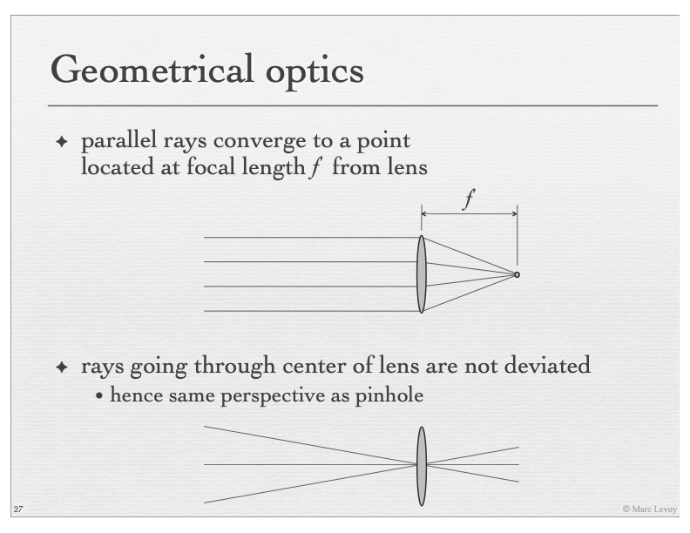
Notes:
Let’s see a little bit of geometrical optics to understand how a lens works.
There are two principles, from which we can derive pretty much everything.
First, straight rays are bent to converge at a single point located at a length f from lens
Rays going through the center are not deviated.

Slide 28
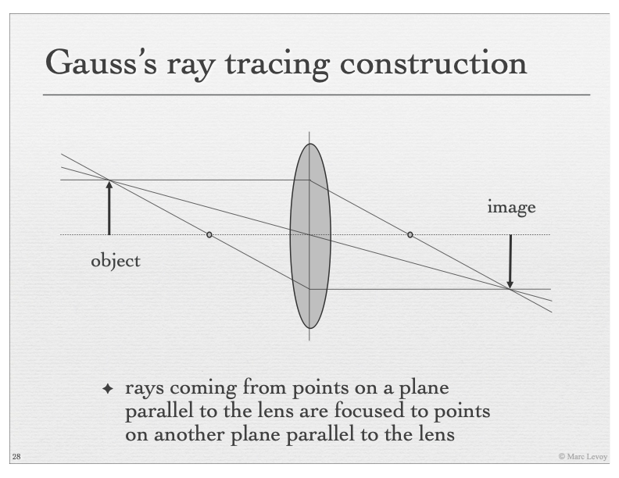
Notes:
A natural consequence is that points on a plane parallel to the lens are focused to points on another plane parallel to the lens.
Take the top ray. TI will be bent to pass throught he focal point, and will intersect the image plane at a given height. Consider now the ray on the bottom. By symmetry, the straight ray, will be bent exactly to pass through the focal length at the front of the lens, and pass throught the exact same point.
If we take another point in the object plane, it will produces an image point at a different height.

Slide 29
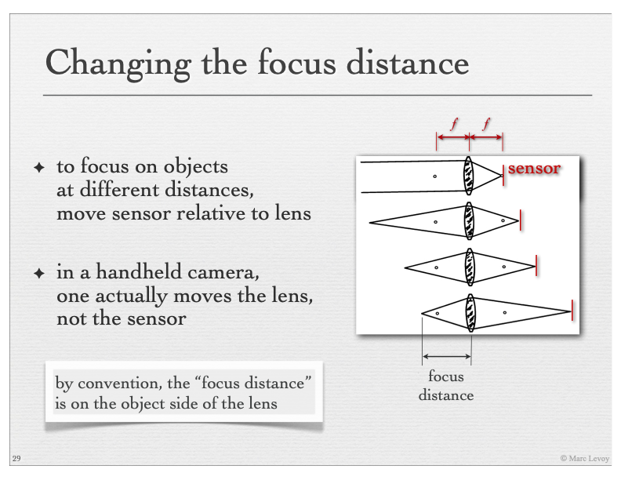
Notes:
In lenses focal lenght is the point where paralel rays converge. Paralel rays come from objects at the infitie
If we move the sensor relative to the focal point what starts to happen is that non paralel rays are focused in a single point. This means objects at fixed distances get in focus.
That is how focusing can work, by changing the sensor distance to the lens, or viceversa. This is what happens when the lens moves.

Slide 30
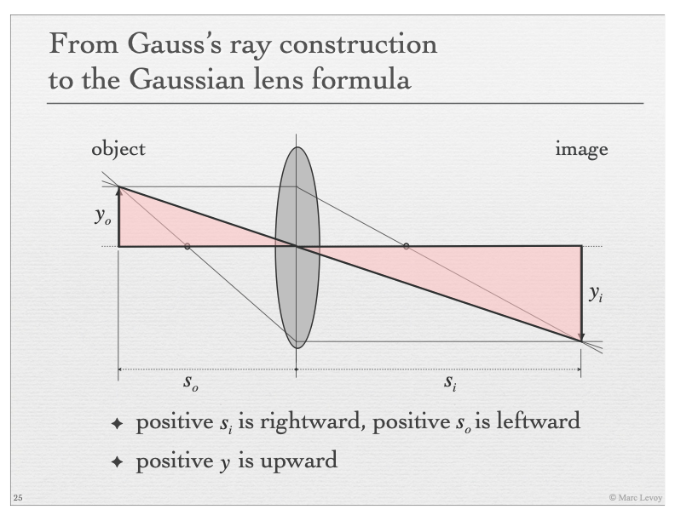

Slide 31
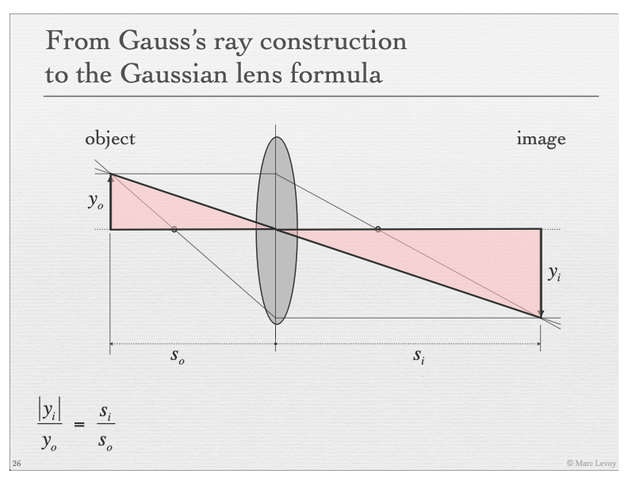
Notes:
By similar triangles, we have that yi/y_o is equal to si over s0

Slide 32
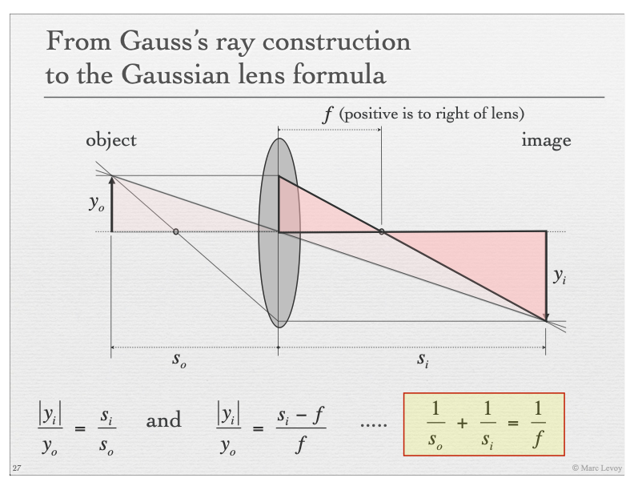
Notes:
By using the triangle on the left, we also have that si-f is to f as yi is to yo.
So we ogtain the following relationship, which is probably the most important formula that we know for lenses.

Slide 33
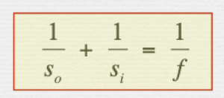
Notes:
Now that we have Gauss lens formula under our belt, we now how to focus objects at a given distance s_o. For a fixed lenses with focal lenght f, the formula tells us how much I have to move
The sensor away from the lenses. Or how muhc I have to change the focal lenght.

Slide 34
Pinhole camera model
Image height
Object height
Depth
Lens camera model
Distance from sensor to lens
Notes:
In a Pinhole camera model f is teh focal length and equals the distance from the sensor to the image plane.
In a lens camera model, focal length is a physical property of the lenses, which does not depend on the distance of the sensor.
Notice that the linear perspective is determined by the distance from the sensor to the lens
y/h = si/z
So the focal lenght in a pinhole refers to the distance to the pinhole. When we talk about lenses, the focal lenght refers to a physical property of the lenses. It is the distnace fromt he lens at which parallel rays converge.
In computer vision, we typically work with pinhole camera models and we do not think about lenses, unless we need to undistort images.

Slide 35
Lens camera vs Pinhole camera
For the lens camera model, we derived
As the depth goes to infinity we obtain That is, lens with focal length is equivalent to pinhole at distance
Notes:
A few more remarks.
Note that as z goes to infiinity, si converges to f. The lens with focal lenght
\frac{1}{z}+\frac{1}{z_i}=\frac{1}{f}

Slide 36
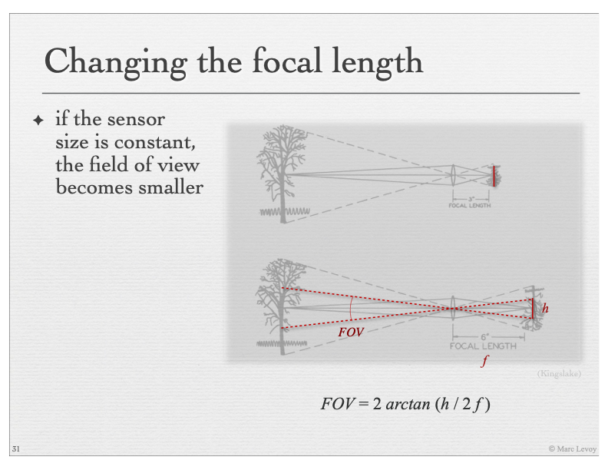
Notes:
The field of view is two times the angle of half triangle. That is artang h/2/f. times 2.
So the larger focal length, the smaller the field of view. That is why when we zoom, we have a narrower field of view.

Slide 37
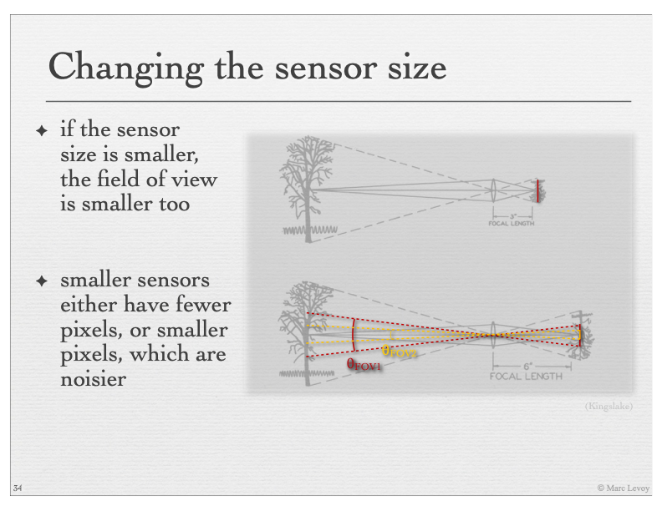

Slide 38
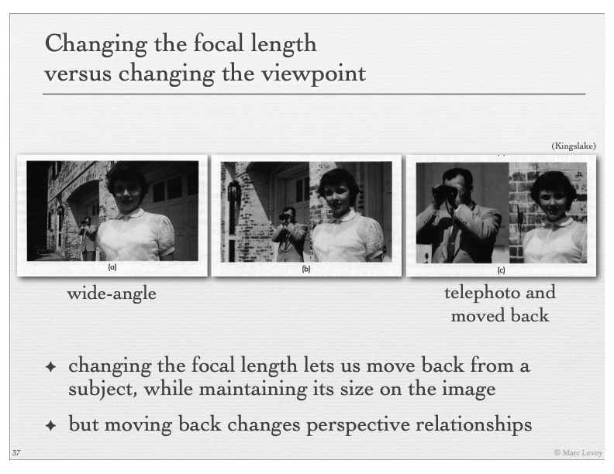
Notes:
Changing the focal length lets us move back from ….
Moving back changes perspective relationships. Look at these pictures. The front subject is of the same size. However, the subject on the back appears bigger relative to the front subject when taken with a telephoto.
That is because the focal length is very large, and the difference in depths becomes less important in the difference in image size.

Slide 39
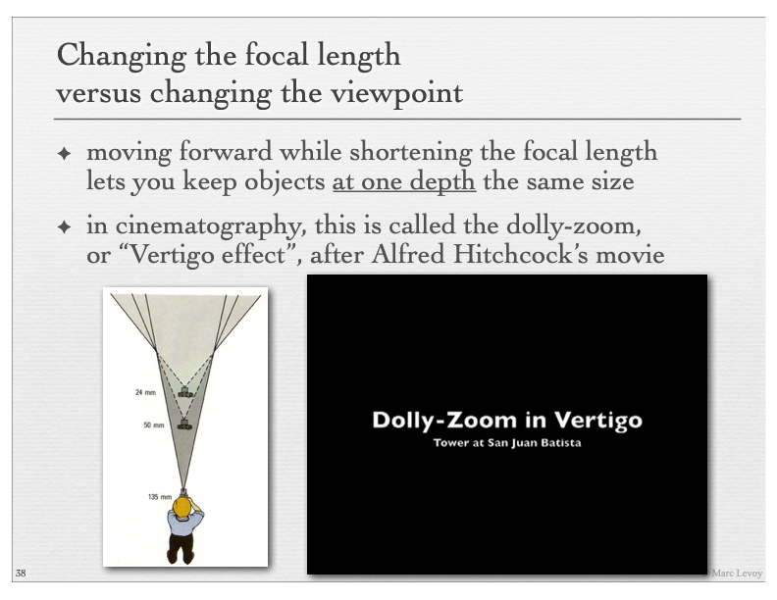
Notes:
Moving back while shorteining….

Slide 40
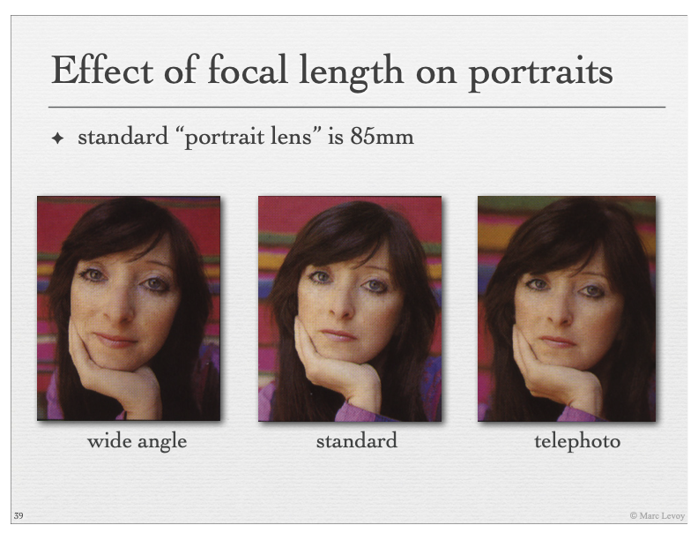
Notes:
When taking portraints these effects are really important. If we are capturing faces, this effect is very important. The closer we are to the camera the more perspective effets. Remember, we have a division by depth in the projection.
This makes the depth differences very important when we are close to the camera. When we are far, a slight difference in depth (e.g. the nose vs the eyes) is practically neglectable.

Slide 41
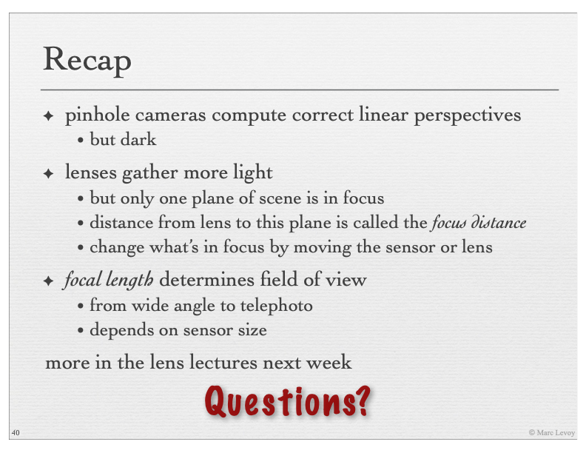

Slide 42
Let‘s formalize mathematically…
The goal now is to express the image formation process using a single Projection Matrix

Slide 43
Notes:
Consider an object of interest in a world coordinate system, which might be different form the camera coordinate system.

Slide 44
Notes:
The camera coordinate system, by convention, is always such that the Z axis aligns with the optic axis of the camera. As we have seen the image plane will be located at f units out al0ng the the optic axis

Slide 45
Notes:
As we have seen, an equivalent model is to localte the image plane in fron of the focal point (origin). With this, the image gets generated by a linear perspective first.

Slide 46
Notes:
And then this image is digitized into pixel coordinates, u,v

Slide 47
Notes:
So there are 3 effective transformations involved.
1 from wold coordinates to camera coordinates
2) From camera coordinates to image or film coordinates (these units are still in centimenters)
3) From film coordinates to pixel coordinates. Units are pixels.

Slide 48
Notes:
In this diagram we have the following transformations. We now want to describe this sequence of transformations by a matrix equation.
If we can express the transformation by a matrix, what kind of mapping we have? Linear right? Well, not quite, but we will do a trick to express as this projection as a linear mapping;.

Slide 49
Notes:
Note that much of computer vison consists in inverting the process. That is recovering the world structure form images alone. For example, with stereo algorithms by triangulations, or with learning methods exploiting learned priors and the 3D world structure.
But first, we need to understand the forward process. That is the computer graphics problem.

Slide 51
Notes:
Basically points are projected to the image film by a linear perspective. This is easily obtained by similar triangles.

Slide 52
Notes:
For the x dimension the coordinate in the image, small x, is obtained as follows. W have the big X is to big Z as small x is to f. Hence, x is obtained as the formula fX/Z.

Slide 53
Notes:
For the Y direction it is derived exactly the same way

Slide 54
Notes:
So how do we express this as a matrix equation? The division by Z means the mapping is actually non linear. Hence we need to introduce homogenous coordinates.

Slide 55
Notes:
In case you have not seen this. In hogenous coordinates, a 2D point is represented by a 3D point by adding a ficticious third coordinate. By convention we specify x,y,z prime such that the pojnt can be recovered as
Note that if we scale the point by any scalar z, we obtain example the same representation.

Slide 56
Notes:
With such change of coordinates the mapping is linear and can be expressed via the following matrix.

Slide 57
Notes:
Let’s look at the first transformation. From world to camera coordinates. This is a a simple change of coordinates.

Slide 58
Notes:
If I want to express a point P in camera coordinates. First I need to translate the point to the origin of the camera coordinate system, hence I need to subtract C.
Then I need to rotate by R

Slide 59
Notes:
R is a matrix whose columns are the axis of the source coordinate frame expressed in terms of the target coordinate frame.
So r11,r21,r31 is the X axis of the world frame in the coordinates of the camera frame. Which what will this column vector be, if the camera and world coordinae frames are aligned? 1 0 0,
1 times the x axis plus 0 times the y and z axis.

Slide 60
Notes:
Another example.
The world axes is aligned with the left camera

Slide 61
Notes:
The trainsformation from world to left camera is therefore the identity

Slide 62
Notes:
For the right camera, since axis are aligned we have the identity rotation matrix, but the origin is translated. So the translation is –Tx. The translation is the center of the camera in world coordinates which is Tx

Slide 64
Notes:
When thinking about rotations, you do not need to think about translation. Rotation is a property of the axis alone and not the translation

Slide 65
Notes:
If we know that the world x axis corresponds to the camera coordinates a,b,c, then we can write. Which follows immediately that the columns are the axis of the source in coordinates of the target

Slide 66
Notes:
We can do the reverse, and transpose the matrix

Slide 73
Notes:
Projected image by linear perspective and the pixel array. This depends on the actual hardware of the sensor. How large the pixels are, what shape they have etc

Slide 74
Notes:
In principle the center of the sensor is the principle point. Hence to transform to pixel coordinates we need to translate by 0_x,o_y

Slide 75
Notes:
Sometimes one or more coordinate axis are flipped, e.g. the y coordimate and x coordnates correspond to –u and –v.
This is a common bug. If have written a renderer and the image appears flipped or cropped, typically it is a problem with the axis

Slide 76
Notes:
The sensor captures light. Of course the resolution will be determined by the actual physical array of sensors. This will capture an analog signal which will be resampled to obtain a pixel array. This a discretization step.
This determines how many rows and columns the image has, -- the resolution.
At the same scanning resolution, if the sensor is bigger, I will obtain a higher resolution.

Slide 77
Notes:
This translates in having a scale to transform from film coordinates to pixel coordinates. And note that we might have different scale factors in x and y, we do not’ have necessarily squared pixels.

Slide 78
Notes:
So the final transformation is obtained by the following matrix. This is typically known as the intrinsic camera matrix. And depends on the hardware properties of the camera, and not on the location of the camera relative the wolrd coordinate frame

Slide 80
Notes:
We can think of the conversion as separate affine transformations. One for projection and one for transforming from film coordinates to pixel coordinates

Slide 81
Notes:
This is the perspective camera model and is often the most commonly used camera projection model in computer vision and graphics

Slide 82
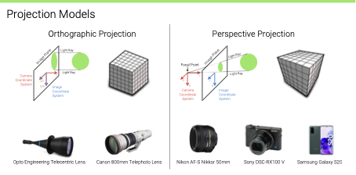
Notes:
Sometimes it is useful to use an even simpler camera model. This is the so called orthographic projection model, which completely ignores the linear perspective effects.
Basically, orthographic projection means removing the Z axis. That’s it. Film coordinates will be the X and Y coordinates in 3D camera coordinates. This is a good model for telecentic and telephoto cameras. Remember that for such camereas ince the object is far away and the zoom is very large, the perspective effects can be ignored.

Slide 83
Notes:
Showing the perspective effects disappear when we increase focal lenght

Slide 86
Slide Credits
Marc Levoy – Digital photography course at Stanford
Robert Collins – Computer Vision at Penn. State University
Andreas Geiger – Computer Vision at University of Tübingen

