Slide 1
Hands-on AI based 3D Vision– Summer 25
Lecture 6_2 – Point Cloud Processing
Prof. Dr.-Ing. Gerard Pons-Moll
University of Tübingen / MPI-Informatics

Slide 2
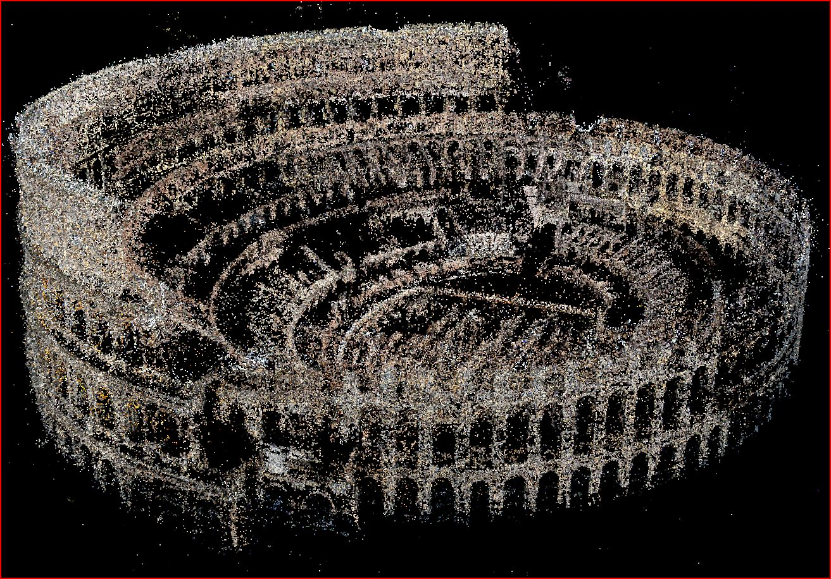
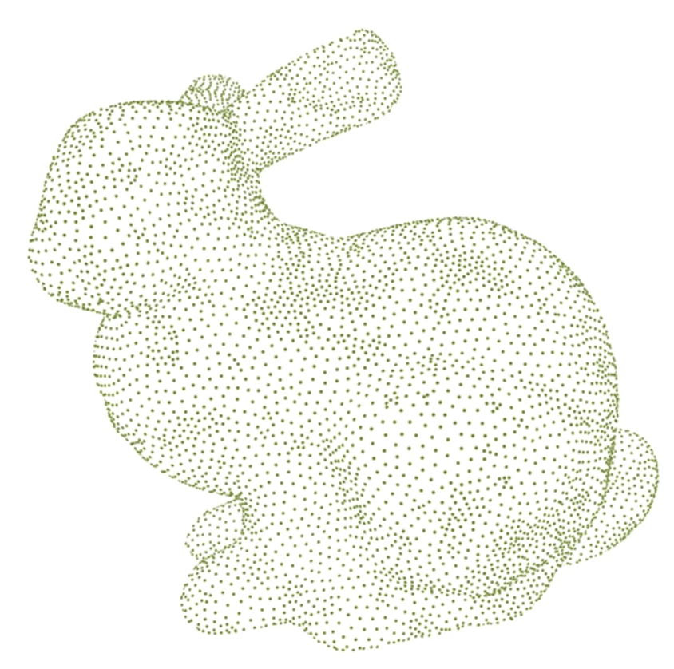
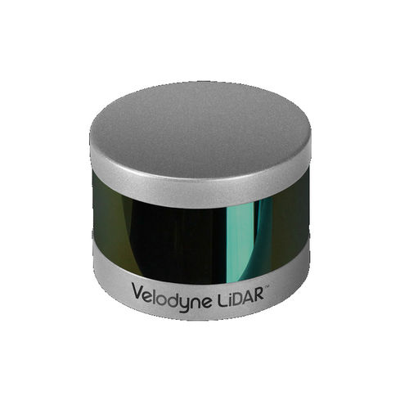
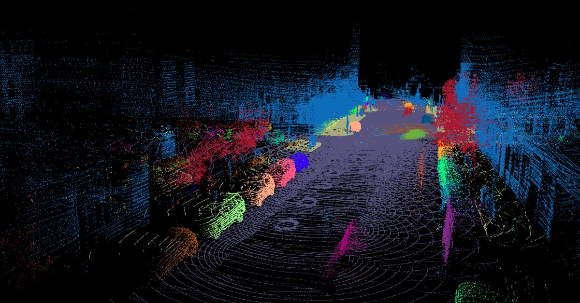
Recap: Point Clouds
Unordered sets of points in 3D space
Often represented as (Nx3) array (implicit order)
No explicit connectivity
Often captured in an image-like manner from sensors
Uneven density
Incomplete

Slide 3
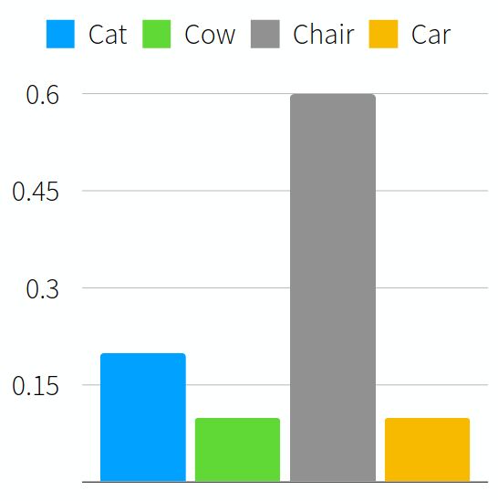
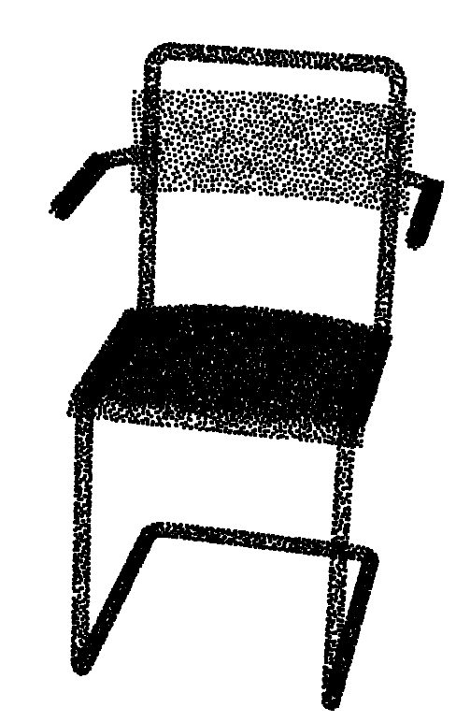
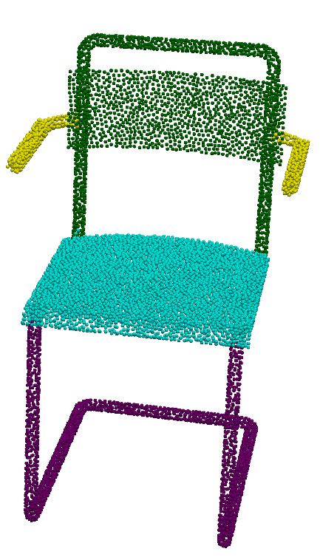
3D Vision Tasks on Point Clouds
Classification
Segmentation

Slide 4
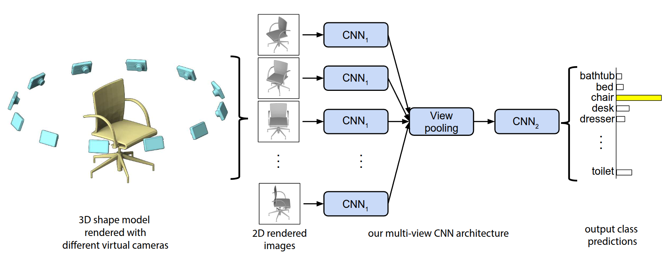
Projection-Based Approaches
Render point cloud from multiple views
Use 2D CNNs for feature extraction
Multi-View Convolutional Neural Networks for 3D Shape Recognition, Su et al. ICCV '15
Rotationnet, Kanezaki et al. CVPR '18
Notes:
One popular approach is to leverage 2D image models like CNNs.
For this, the point cloud is rendered from multiple viewpoints
The resulting images are then fed into 2D CNNs that extract features
These are then pooled over all the different views and finally a class is extracted

Slide 5
Projection-Based Approaches
Render point cloud from multiple views
Use 2D CNNs for feature extraction
Geometric information inside point clouds is collapsed
Underutilize sparsity of point clouds
Choice of views heavily influences performance
Multi-View Convolutional Neural Networks for 3D Shape Recognition, Su et al. ICCV '15
Rotationnet, Kanezaki et al. CVPR '18

Slide 6
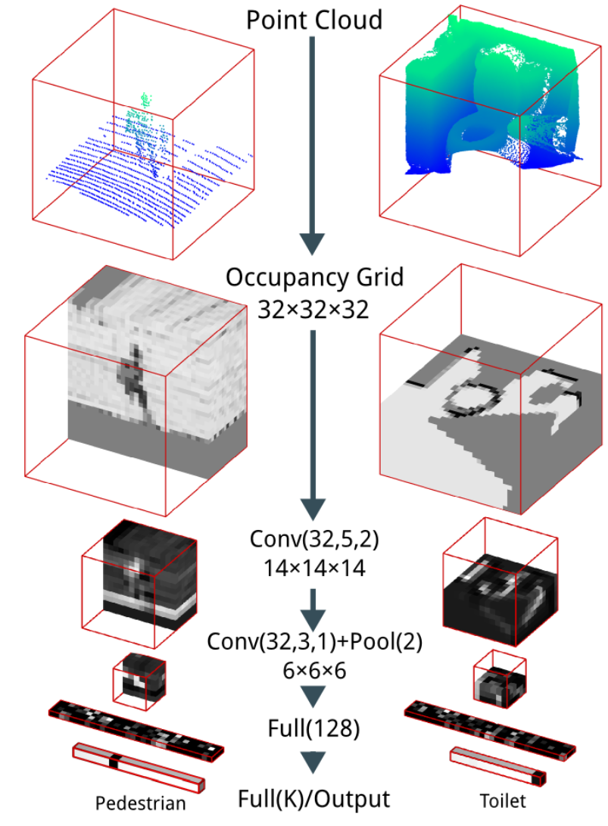
Voxel-Based Approaches
Discretize point cloud into occupancy voxel grid
Perform 3D convolutions
Octrees for better memory management
Sparse convolutions
VoxNet, Maturana et al. IROS '15
OctNet, Riegler et al. CVPR '17
Notes:
Another popular approach is to discretize the point cloud into an occupancy voxel grid and perform 3D convolutions there
We know that voxel grids are very memory inefficient and not scalable, so there are also variants that use octrees for better memory management
You can also make use of the fact that the voxels are only sparsely occupied. There are sparse convolution methods that are only evaluated at occupied voxels which can further reduce computation and memory requirements

Slide 7
Voxel-Based Approaches
Discretize point cloud into occupancy voxel grid
Perform 3D convolutions
Octrees for better memory management
Sparse convolutions
Loss of geometric details due to quantization
VoxNet, Maturana et al. IROS '15
OctNet, Riegler et al. CVPR '17
Notes:
The main problem is, however, the loss of geometric details due to the discretization
Unless the voxel-grid-resolution is very high (which leads to higher memory requirements again), you will lose information about local geometry

Slide 8
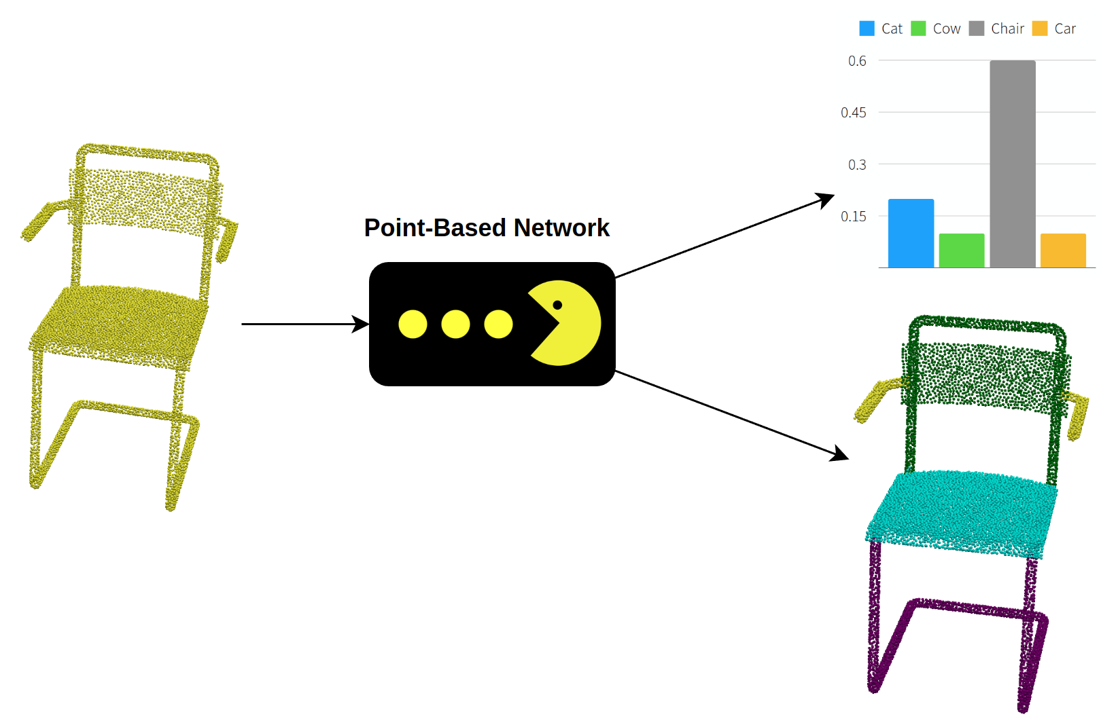
Point-Based Networks
Network that directly consumes points
Desired Properties:
Permutation-invariance
Variable number of points
Locality-aware
Notes:
A third approach, and the one we will be focusing on in this lecture are Point-based networks
It is not trivial to design a network that directly consumes point clouds, because we must make sure it
Is permutation invariant,
Works for variable number of points
Is locality aware, i.e. can reason about local neighborhoods of points

Slide 9
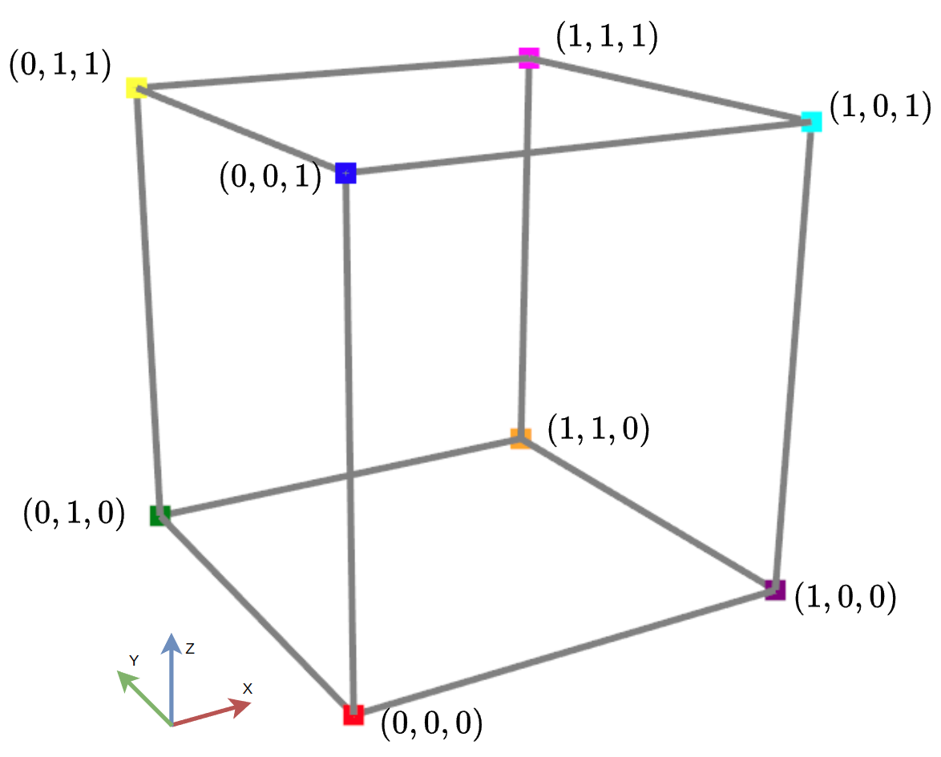
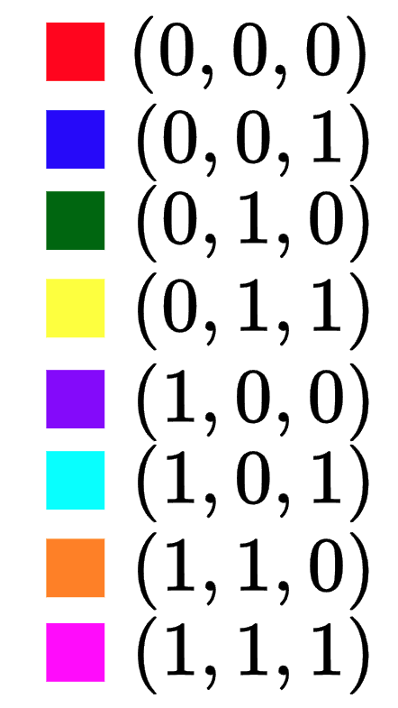
Permutation Invariance by Ordering
Notes:
Can you achieve Permutation Invariance by ordering the points in some canonical order, based on their coordinates?
E.g. you could try something like lexicographic ordering
Can you see any problems?

Slide 10
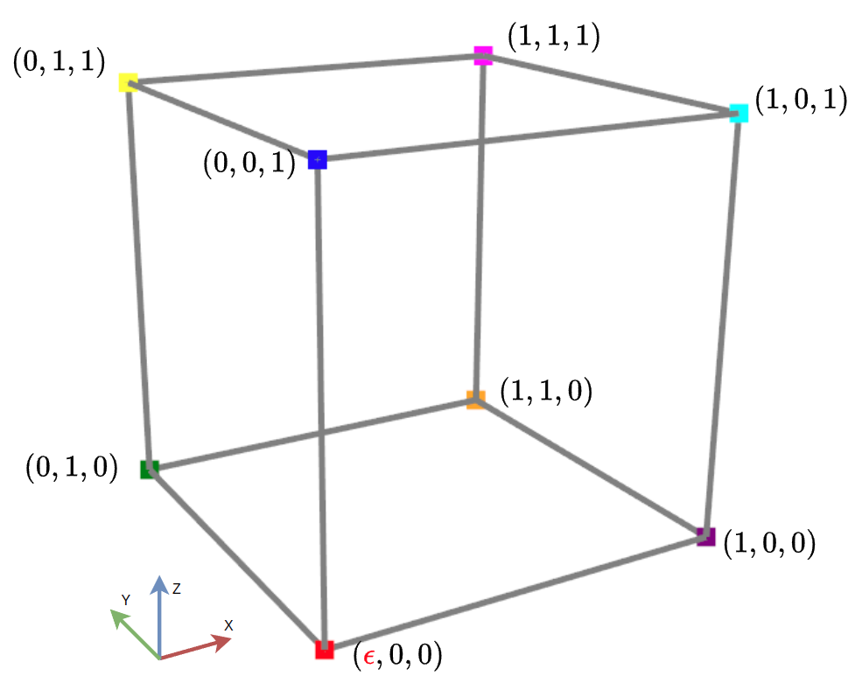
Permutation Invariance by Ordering
Tiny Perturbation
Drastically Different Order
Notes:
Slight perturbations lead to drastically different orderings!
In fact in can be shown that in high dimensional space there exists no ordering that is stable w.r.t. point perturbations in the general sense.
If you have a network that takes ordered points as input, this network will be very sensitive to even the slightest perturbations of single points, which we do not want

Slide 11
Permutation-Invariant (Symmetric) Functions
Can you think of a symmetric function

Slide 12
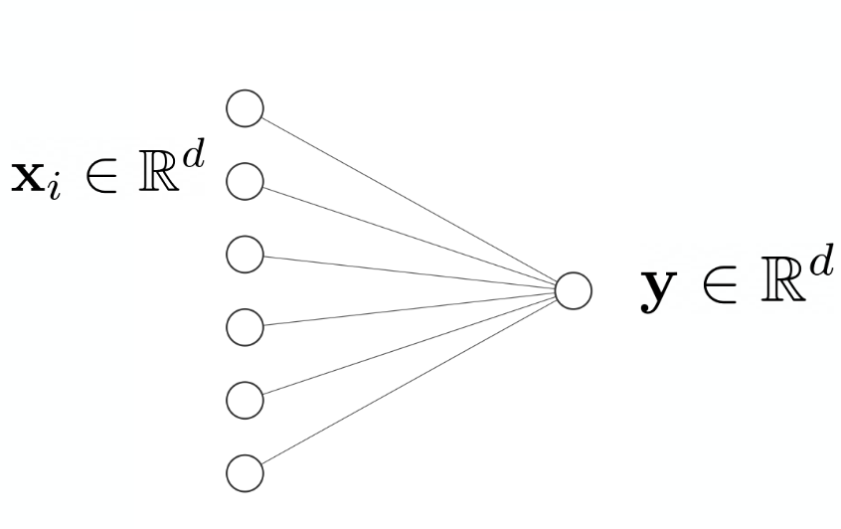
Permutation-Invariant (Symmetric) Functions
Can you think of a symmetric function
Pooling:
Note: This also allows variable number of input points
Notes:
Min, max, mean are all symmetric
They also allow variable number of input points

Slide 13
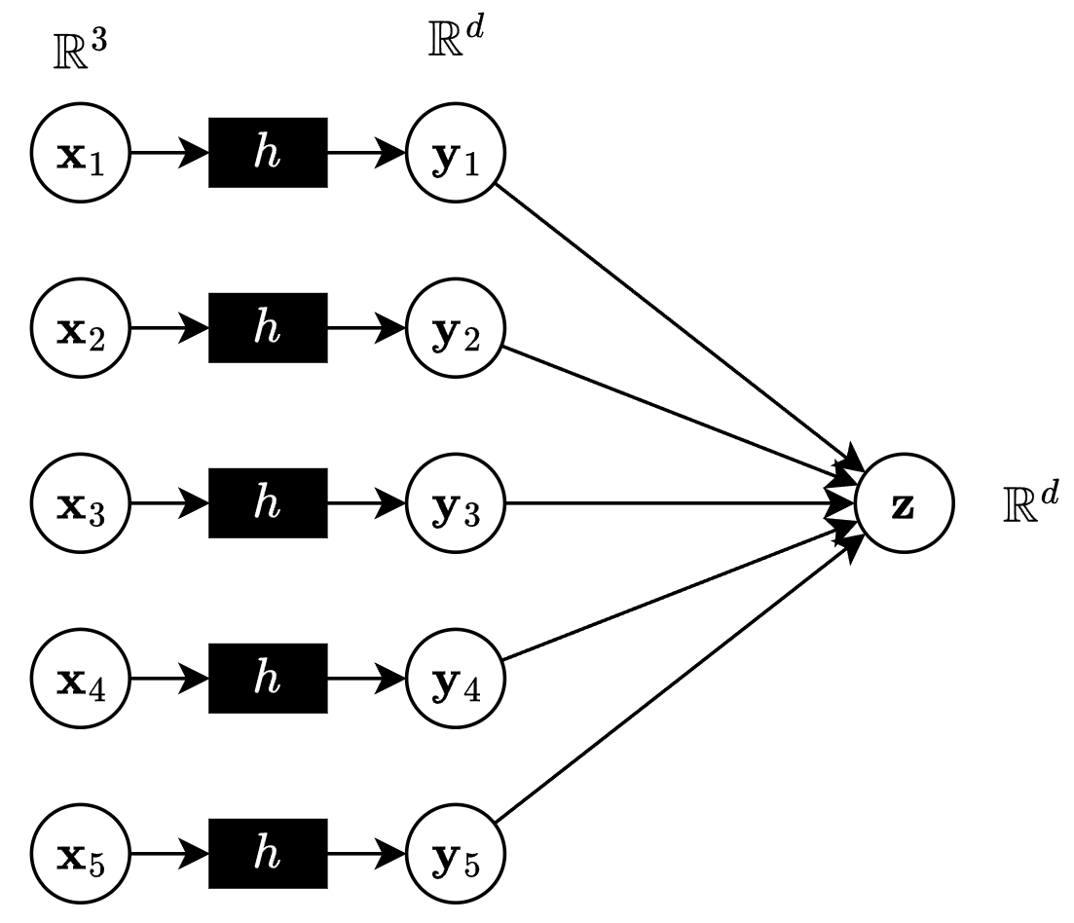
Per-Point Transformations
If g is symmetric, then so is
Applying the same function h to each point is permutation- equivariant
Not really expressive enough yet

Slide 14
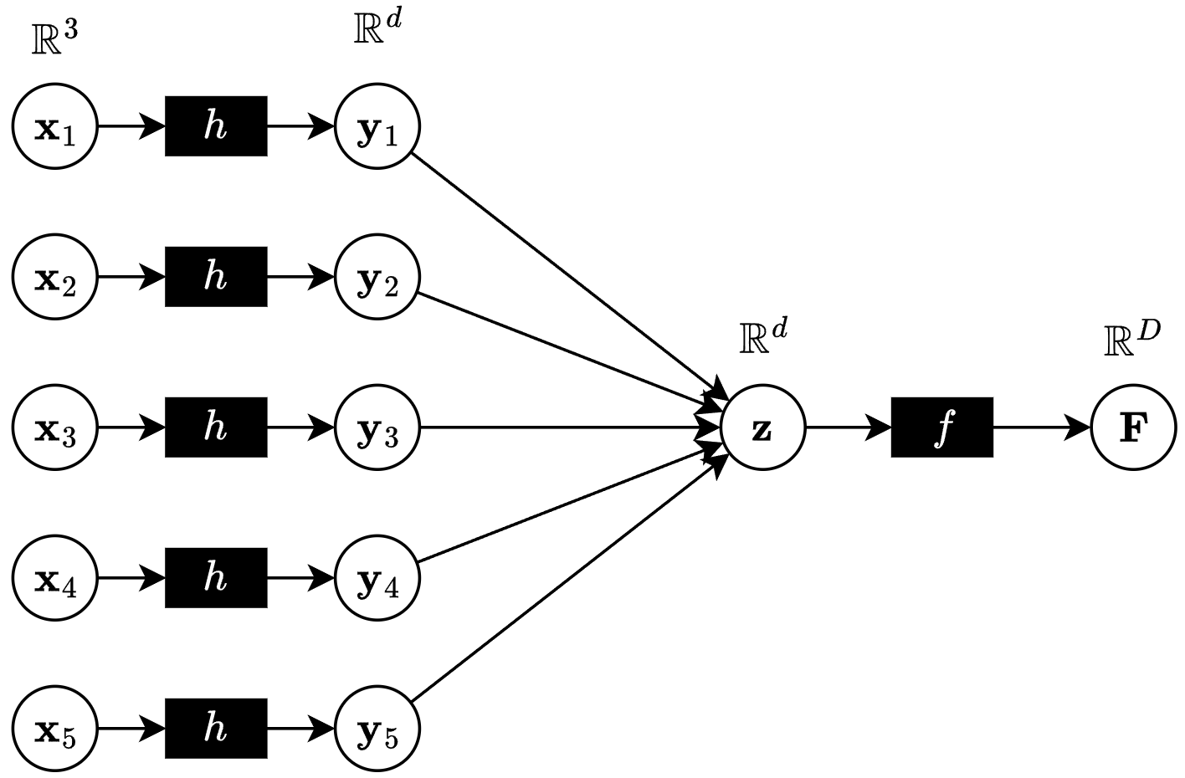
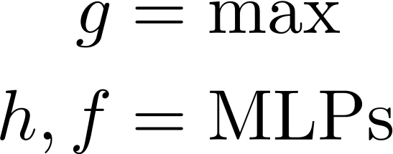
Feature Transformations
If g is symmetric, then so is
If we let we get vanilla PointNet architecture

Slide 15
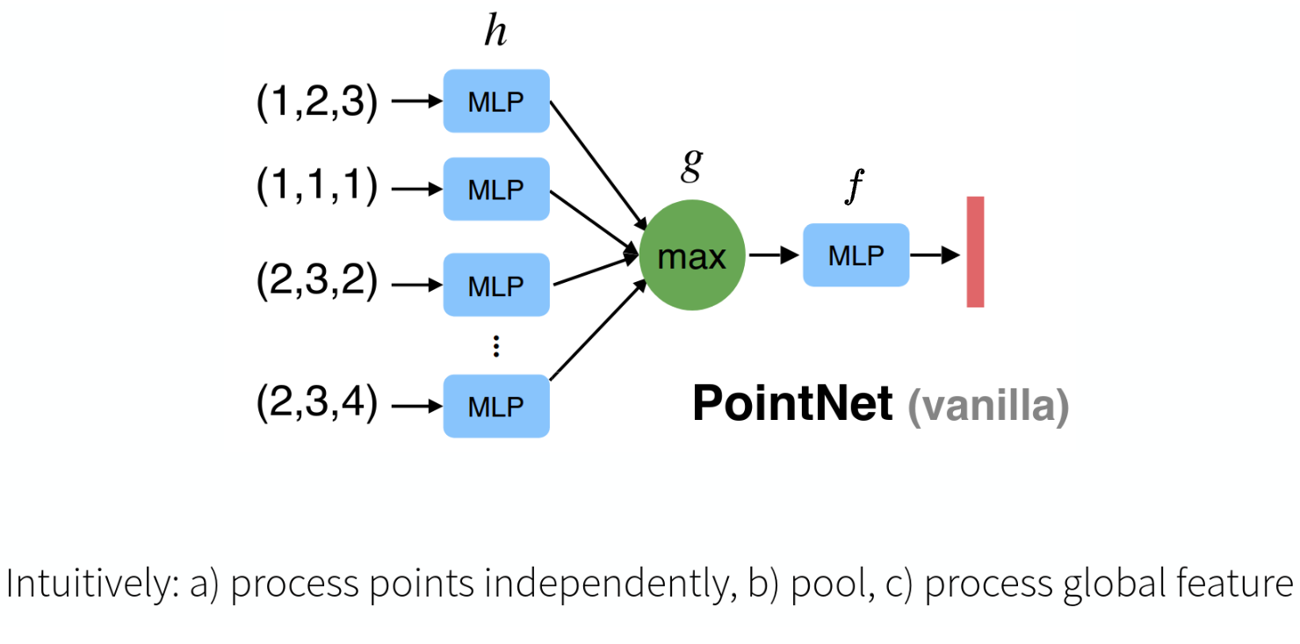
Vanilla PointNet

Slide 16
Vanilla Classification PointNet
Hidden layer sizes
PointNet, Qi et al. CVPR '17
Notes:
The MLPs on the left (before max pooling) are *shared* between all points, i.e. every point gets processed by the same mlps with the same weights and biases etc.
The numbers correspond to the sizes of the hidden layers (input layer sizes are omitted)
We start with n x 3 point cloud
Each point gets mapped by the first MLP to a 64-dim vector, i.e. we end up with a n x 64 feature cloud
These features are processed further by another MLP with hidden layer sizes (64, 128, 1024), again pointwise.
We end up with a n x 1024 feature matrix, one feature vector per point
These are aggregated using max pooling to get a single global feature vector, followed by a simple mlp to predict output scores (e.g. for a specific class in case of classification)
Question: Isn't there then just one single point which is relevant for the global feature vector, since we use max-pooling?
Ans: No, because max pooling is done channel-wise. EXPLAIN
The “64×64 MLP” in PointNet is really two layers:
3→64 (weight shape 3×64)
64→64 (weight shape 64×64)
You apply both layers independently to each of the N points. Hence, you go from N×3 → N×64 (after layer 1) → N×64 (after layer 2). There is no dimension mismatch, because the very first layer accepts 3-dim input per point.

Slide 17
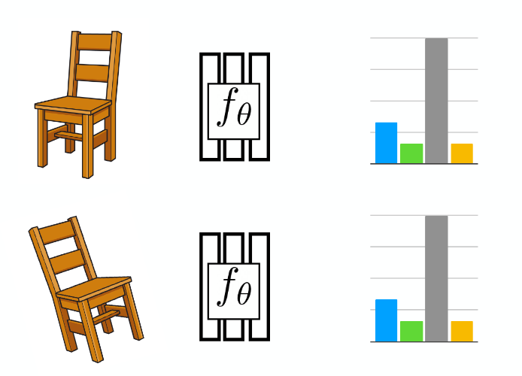
Rotation Invariance
If we rotate the object, we expect the same output from the network

Slide 18
Rotation Invariance in PointNet
Mini-PointNets (T-Nets) predict 3x3 and 64x64 transformations
Help overcome rotation dependence by "undoing" rotations
Regularization:

Slide 19
Local and Global Features
PointNet produces point-wise local features and global features
For tasks like segmentation you need both!
Local features & global features

Slide 20
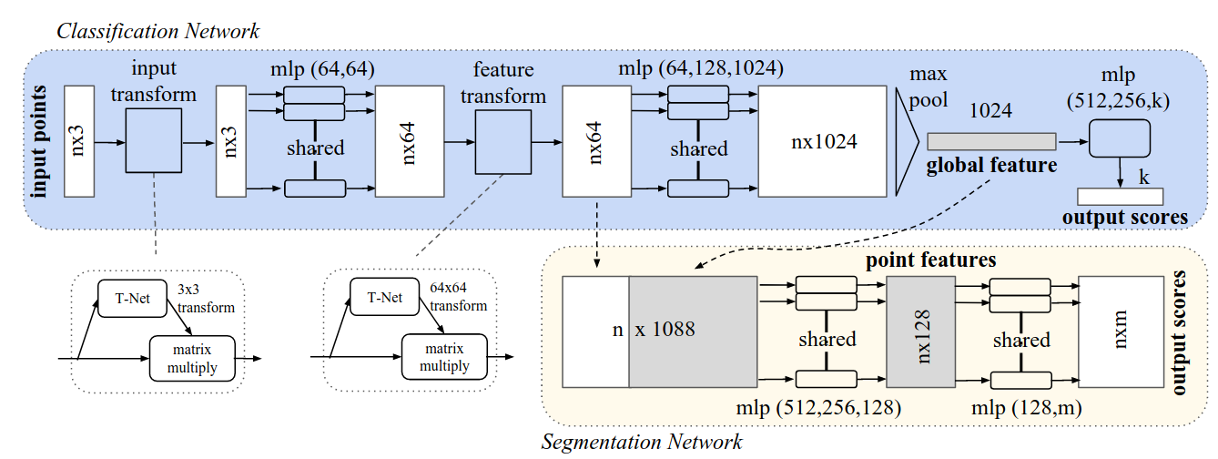
PointNet Segmentation Network
Concatenate local and global features and process point-wise to obtain segmentation classes

Slide 21
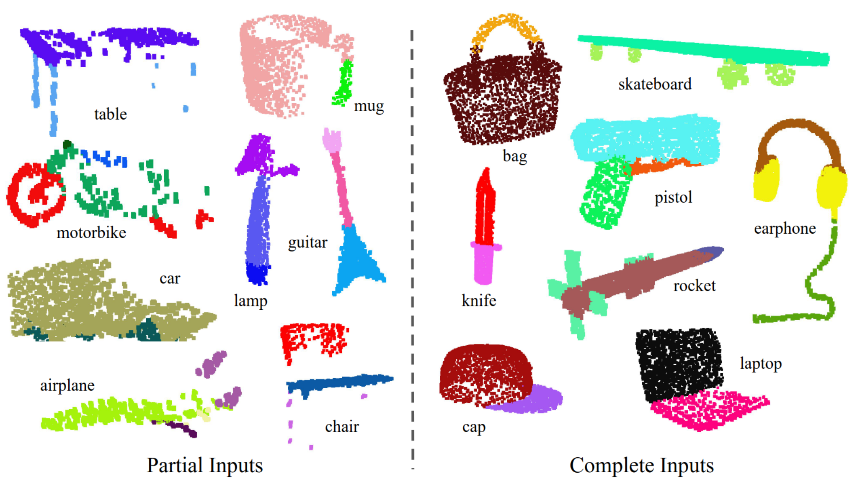
Part Segmentation

Slide 22
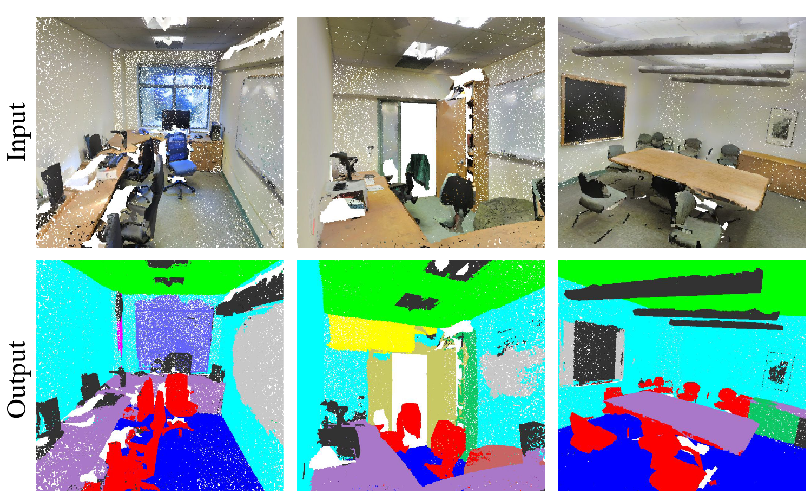
Semantic Segmentation
We can also attach additional features (like color) to points
Notes:
Here the input points are 9 dimensional:
(x,y,z) (3)
RGB (3)
Normalized location as to the room (in range [0,1])

Slide 23
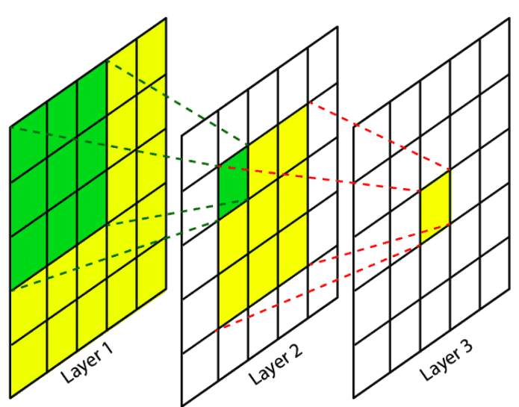
CNN vs PointNet - Locality
PointNet
Per Point Features
Global Feature
No notion of locality
CNN
Progressively captures features at increasingly large scales
Multi-resolution hierarchy with increasing receptive fields

Slide 24
PointNet++
Hierarchical network exploiting locality and PointNet as basic block
PointNet++, Qi et al. NeurIPS '17

Slide 25
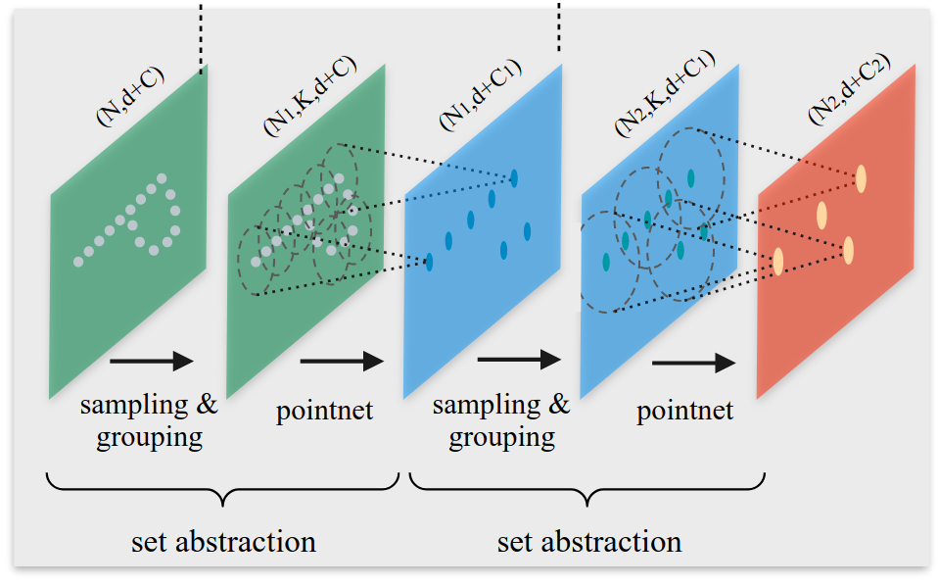
Hierarchical Point Set Feature Learning
Notes:
Composed of multiple set-abstraction levels
At each level a set of points is processed and abstracted to produce a new set with fewer elements but additional features about the local information of the points from the previous level
d=3 is the dimension of the original space (3 for us)

Slide 26
Hierarchical Point Set Feature Learning
Sample centroids using iterative farthest point sampling
Form (potentially overlapping) groups of close points around centroids
Process each group in local frame with a PointNet
Notes:
Iterative farthest point seems to be better than random choice
Receptive fields are data-dependend, as opposed to CNNs
Groups may overlap
The group scales may vary from one layer to the other
Each group is processed individually: First each point is translated into local frame relative to the centroid. Then PointNet is applied

Slide 27
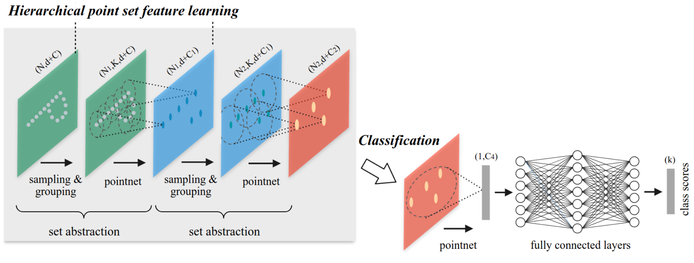
PointNet++ Classification
Process final abstraction layer's points + features by a PointNet

Slide 28
PointNet++ Segmentation
Problem:
Original point set is subsampled but we want per-point label
We have features for subsampled points
We want a label for each original point

Slide 29
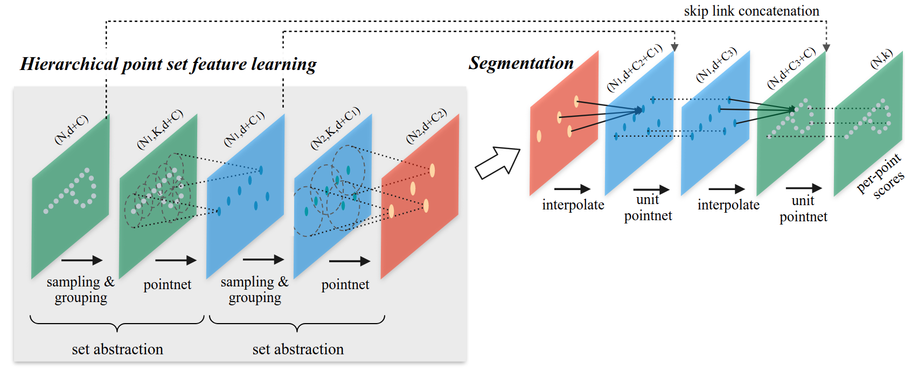
PointNet++ Segmentation
Feature propagation via interpolation
Notes:
We adopt a hierarchical propagation strategy with distance based interpolation and across level skip links (as shown in Fig. 2). In a feature propagation level, we propagate point features from Nl × (d + C) points to Nl−1 points where Nl−1 and Nl (with Nl ≤ Nl−1) are point set size of input and output of set abstraction level l. We achieve feature propagation by interpolating feature values f of Nl points at coordinates of the Nl−1 points. Among the many choices for interpolation, we use inverse distance weighted average based on k nearest neighbors (as in Eq. 2, in default we use p = 2, k = 3). The interpolated features on Nl−1 points are then concatenated with skip linked point features from the set abstraction level. Then the concatenated features are passed through a “unit pointnet”, which is similar to one-by-one convolution in CNNs. A few shared fully connected and ReLU layers are applied to update each point’s feature vector. The process is repeated until we have propagated features to the original set of points.

Slide 30
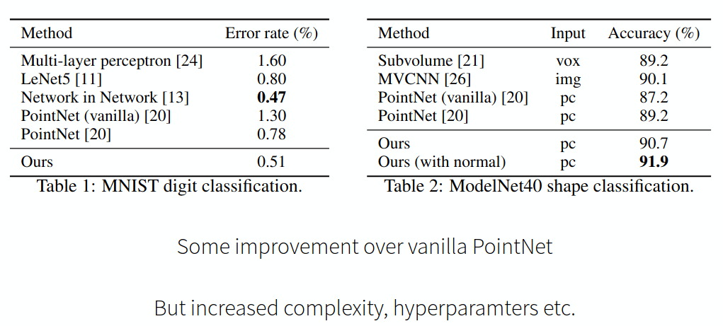
PointNet++ Summary

Slide 31
Transformers for Point Cloud Processing

Slide 32
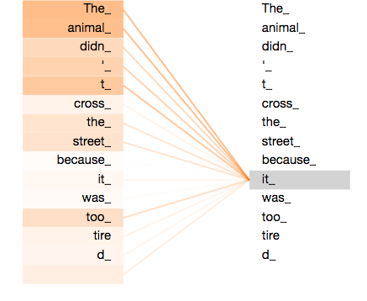
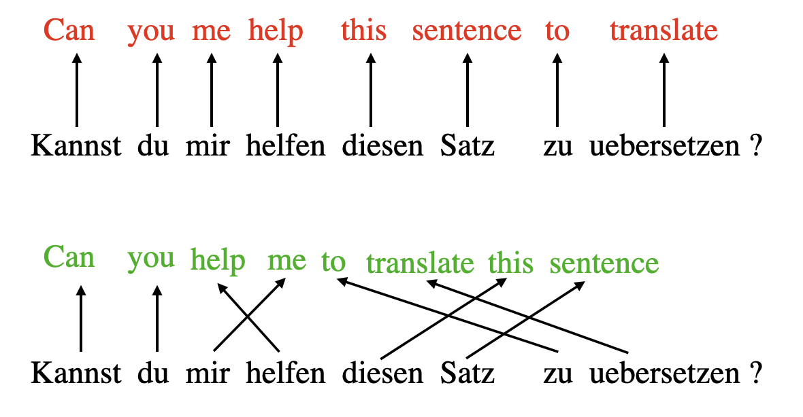
Refresher: Attention

Slide 33
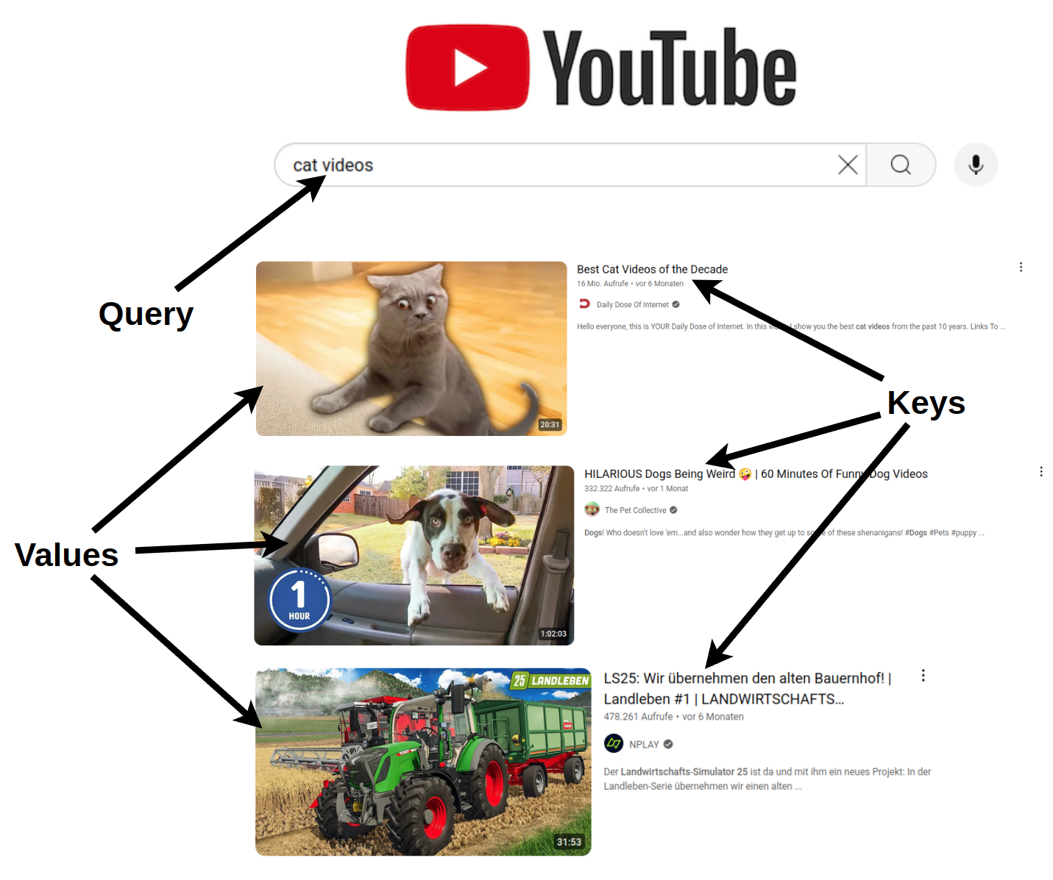
Query-Key-Value Formalism
Query: Search query
Keys: Video titles
Values: Videos
Compare query against keys and return values of best matches
Notes:
At the heart of the attention mechanism lies the query-key-value formalism.
This is inspired by retrieval systems.
E.g. youtube video search

Slide 34
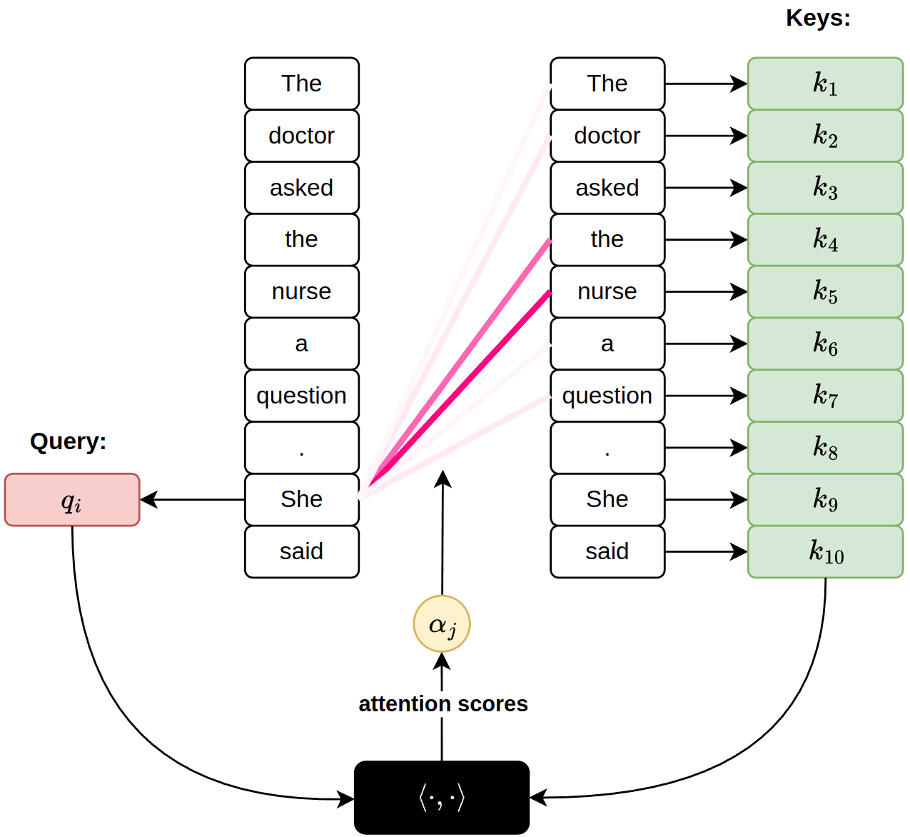
Attention Scores
What is "She" referring to?
Query: Things I am looking for
Keys: Things I have
Compare query against
keys to get attention weights

Slide 35
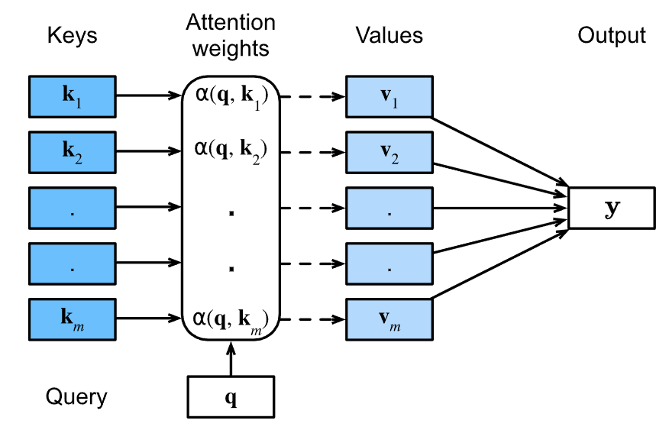
Value Aggregation
Query: Things I am looking for
Keys: Things I have
Values: Things I want to communicate
Compare query against
keys to get attention weights.
Aggregate values proportional to attention weights

Slide 36
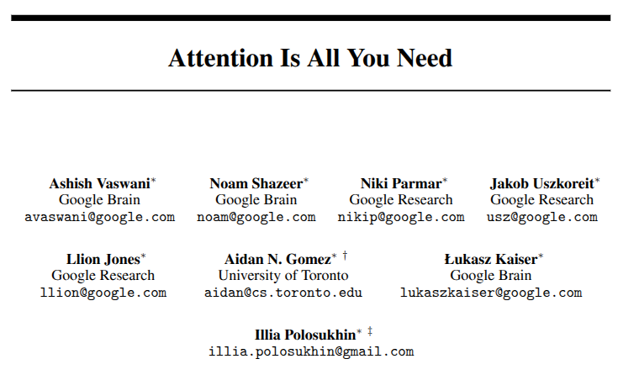
Attention is all you need

Slide 37
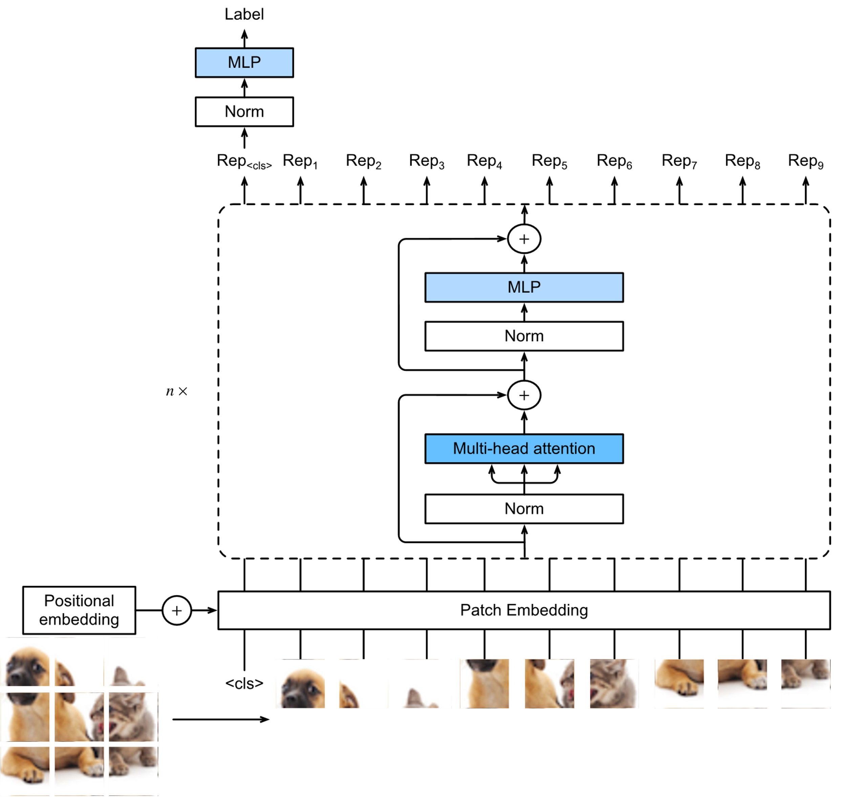
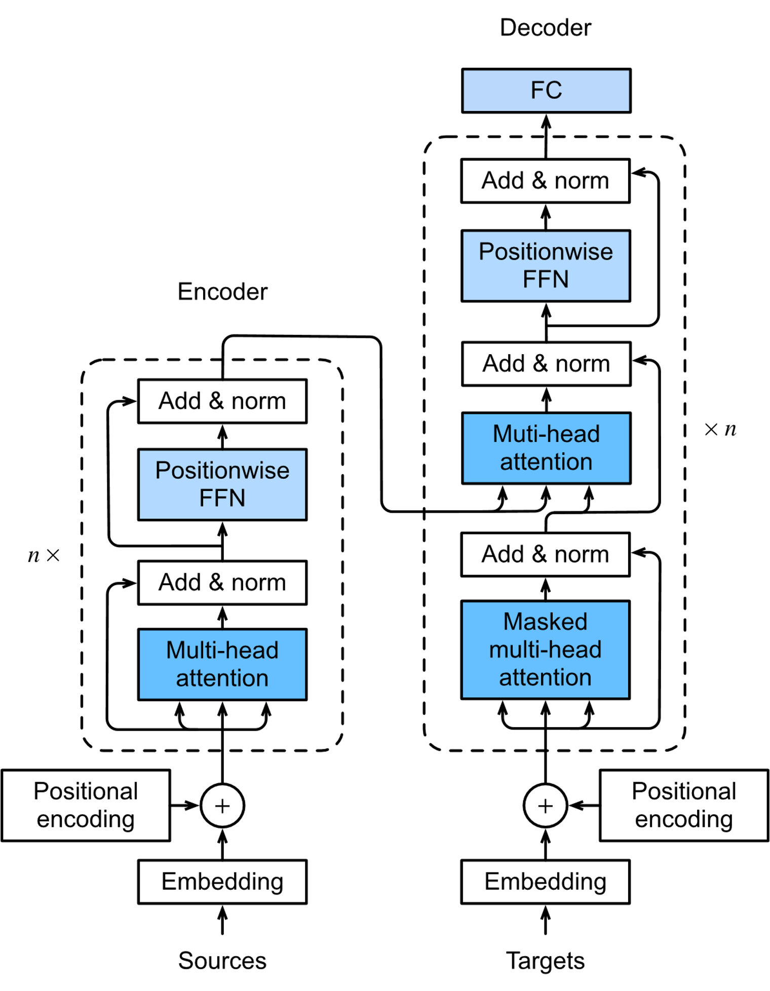
Transformer Architectures
Notes:
Explain Transformer and Vision Transformer basic ideas
Explain why we need positional encoding for nlp and vision tasks
Positional encoding add numbers to tokens to indicate the position of tokens in a sentence

Slide 38
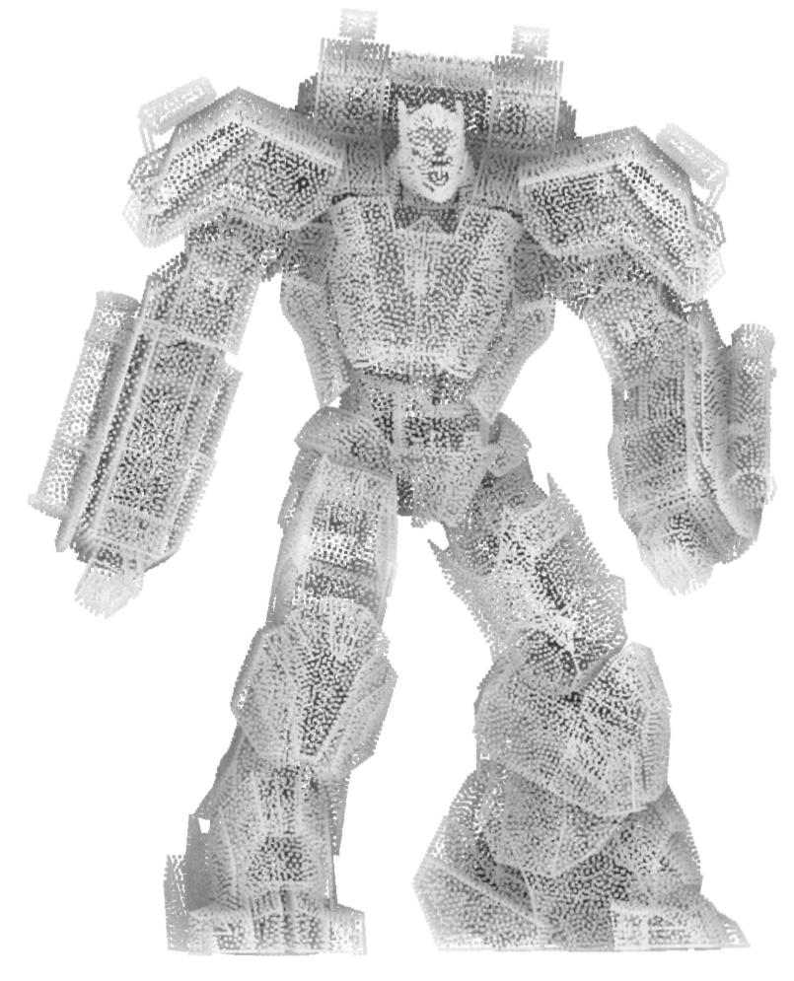
Transformer for Point Cloud Processing
Extremely powerful for NLP and 2D vision tasks
Naturally permutation-invariant
Can process sequences of variable length
Ideal choice for point cloud processing
Notes:
Transformers seem to be the ideal choice for point cloud processing, because they have some of the desired properties like permutation invariance and variable input length right out of the box
There are many works that use transformer based architectures for point cloud processing.
In this lecture we will take a look at one specific architecture, called Point Transformer

Slide 39
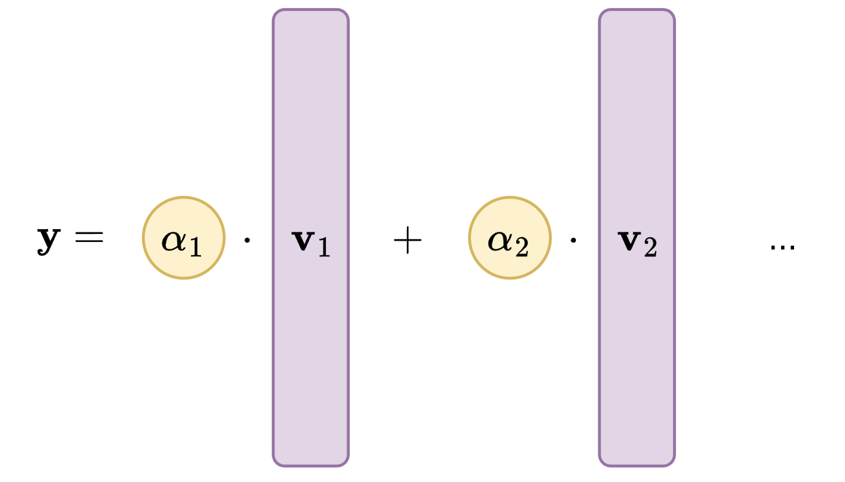
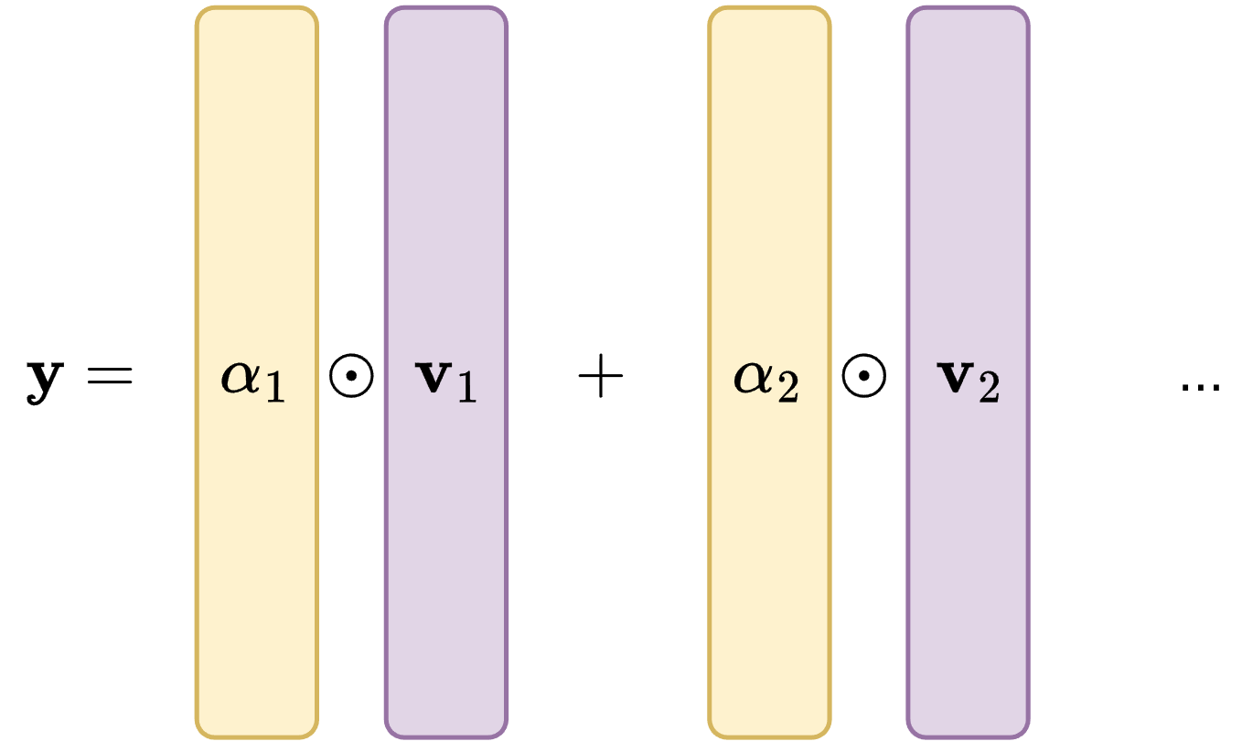
Scalar Attention
Vs.
Vector Attention
Per channel
Multipl.
Scalar attention weights
Feature is aggregated as linear combination of value vectors
All channels have same weight
Vector attention weights
Same dimension as value vector
Channel-wise attention
Notes:
Vector attention allows to have chanelwise attention, so I can attend for the same point differently to different channels. With scalar attention same weight for every pair of points.

Slide 40
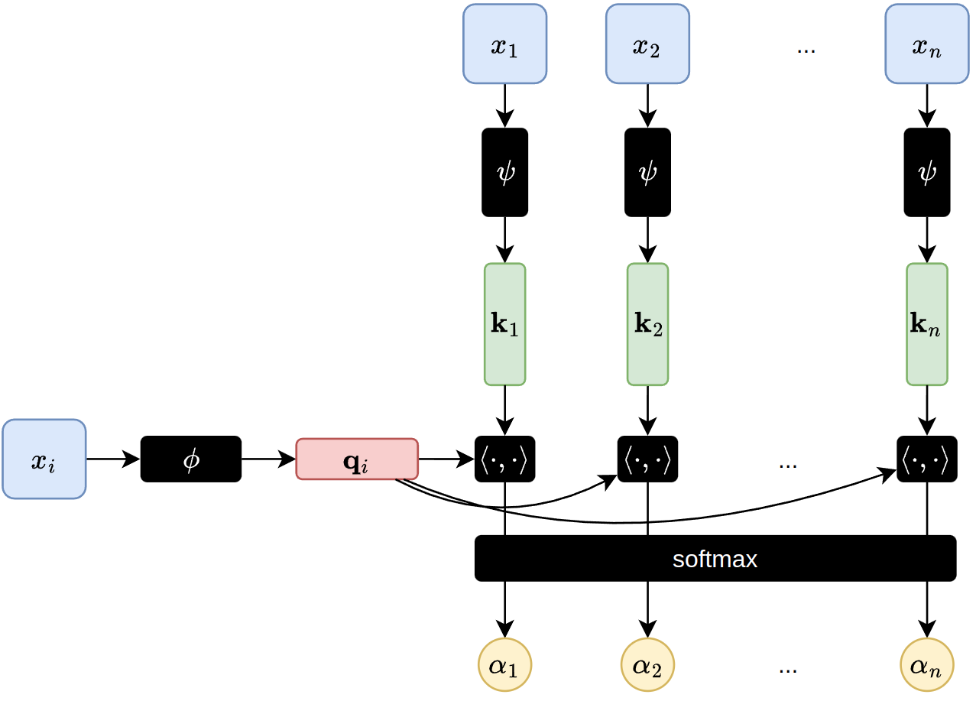
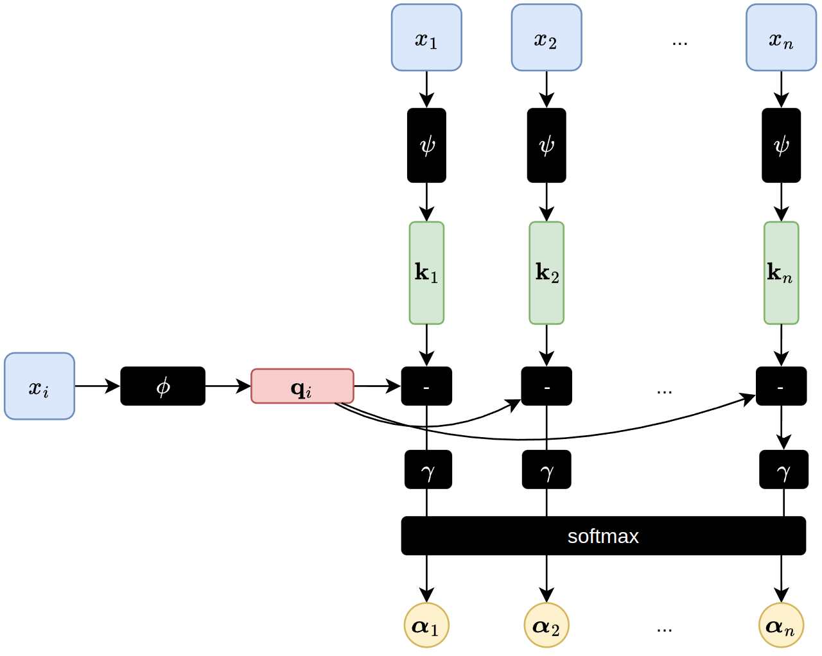
Scalar Attention vs Vector Attention
Scalars
Vectors
Notes:
complexity N^2, every x_i can be a query.
Point transformer makes use of a slightly different attention formulation.
What we have seen so far is known as scalar attention, because the attention weights (alpha) are scalars.
The feature y_I is linear combination of value vectors, where the weights are simple scalars computed from the dot product of key and value. (We ignore normalization by sqrt(d) here for simplicity)
Phi and psi are the linear mappings that map an input token to its query and key respectively.
This means that each channel of the values is weighted the same.
The intuition: Different channels in the value vectors may need to be aggregated differently which is impossible with scalar attention.
This can be achieved by vector attention where the weights are no longer scalars but vectors.
Here the weight computation does not collapse the channel dimension and allows the feature aggregation to adapt to each channel.
In point transformer this is done by replacing the dot product by a simple difference (-) to compute similarity of query and keys. This difference is further processed by some mapping gamma (mlp mapping vector to vector).
The result is a weight vector for each key which are combined by component wise multiplication with the values

Slide 41
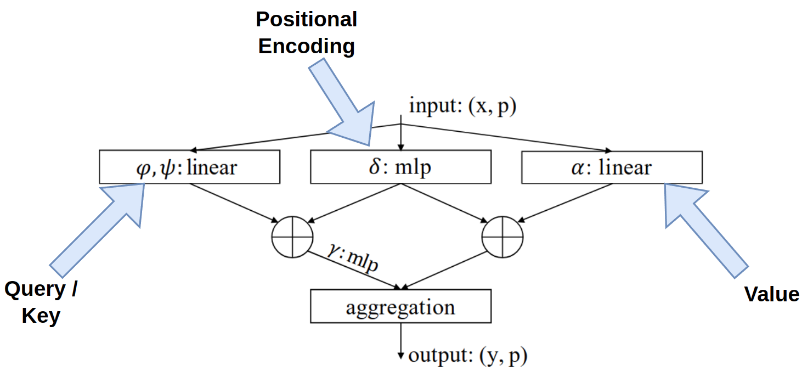
Point Transformer Layer
Key design choices:
Vector attention
Self-attention over neighborhoods (NN)
Relative positional encoding via small MLP
Point Transformer, Zhao et al. ICCV '21
Notes:
Point Transformer applies this vector attention for point cloud processing.
Input is a Point Cloud with features attached to each point. (x,p) is feature vector with point position
In NLP we ​need positional encoding because the word tokens themselves carry no information about their position in the sentence
Here, the input is a 3D point p with a feature vector x attached to it, so there is already positional encoding
The authors found it beneficial to add relative positional encoding of the points to their neighbors
Note that this positional encoding is not added to the tokens like in NLP, but both to the value vector and attention vector

Slide 42
The building blocks
Downsample
Upsample
Notes:
Point Transformer block: Main building block. Takes a point cloud with features, and maps to the same number of points with new features by attending points to their neighborhoods.
Transition Down: Similar to PointNet++ set abstraction. Downsamples point cloud and aggregates their features
Transition Up: Similar to PointNet++ for upsampling back to the original point cloud. This is necessary for segmentation task

Slide 43
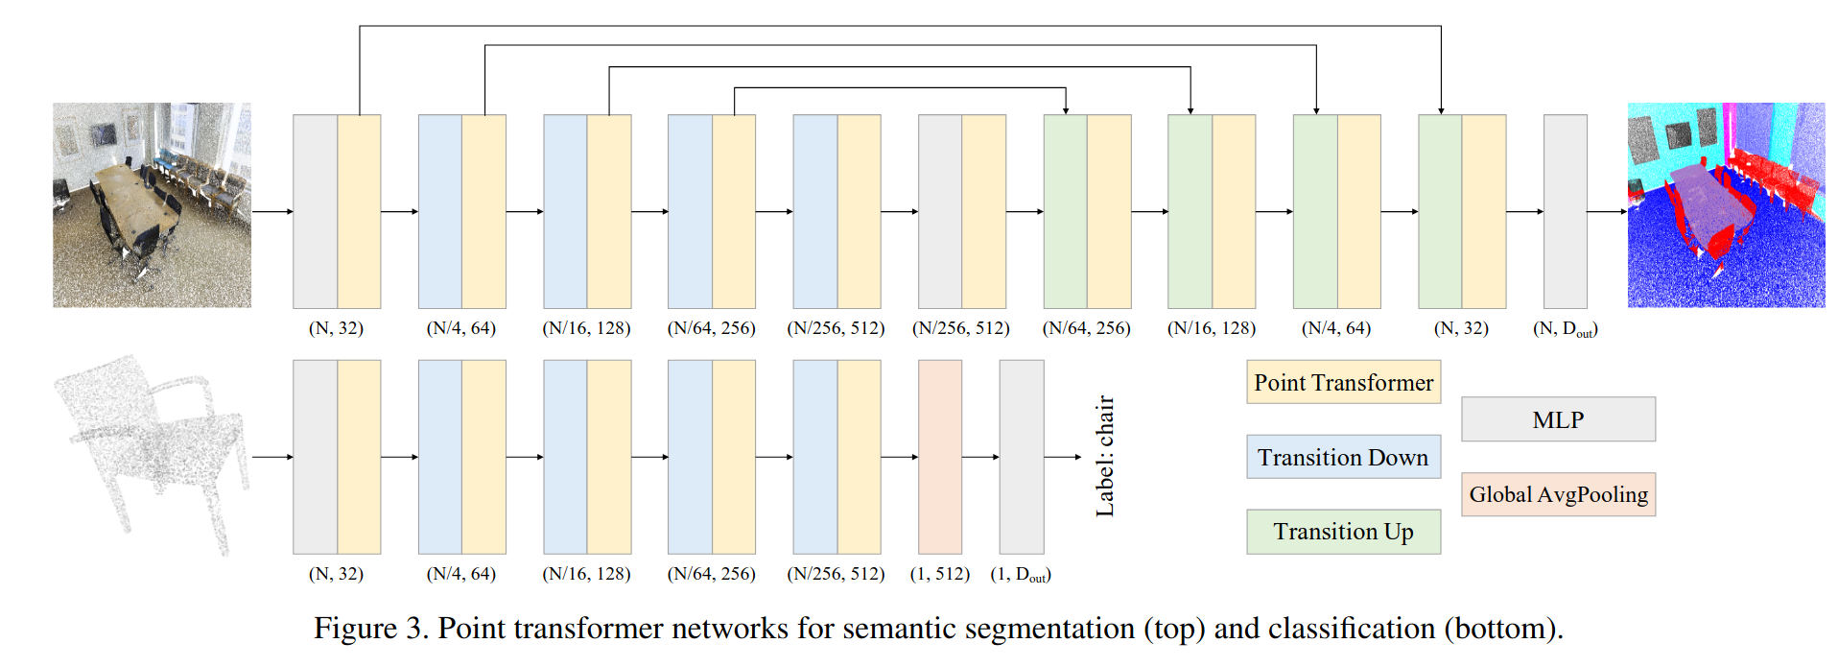
Point Transformer Networks
Notes:
Segmentation network is like a U-Net with encoder (transition down) and decoder (transition up) part.

Slide 44
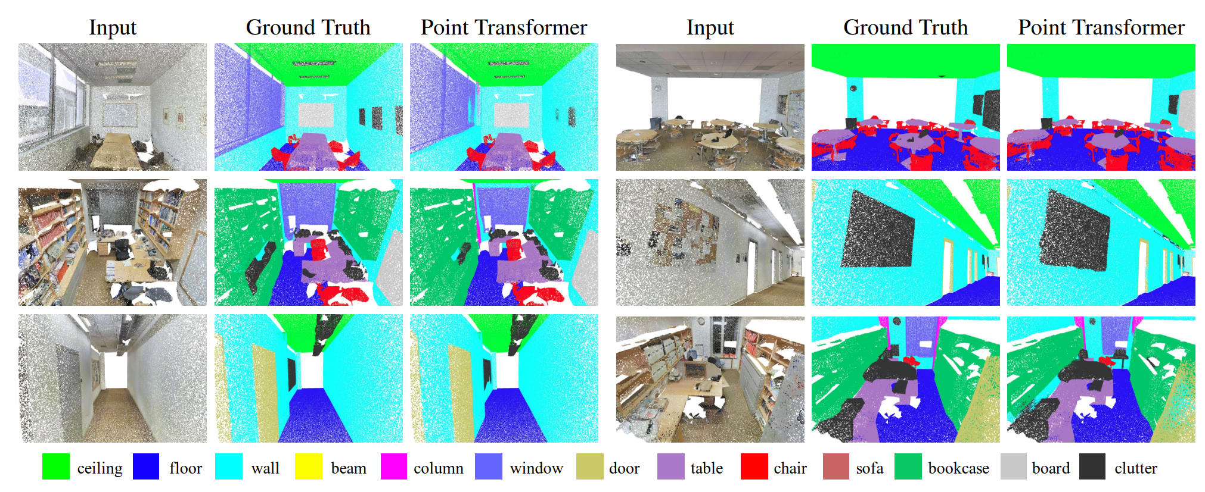
Results
Notes:
Semantic segmentation task results of Point Transformer

Slide 45
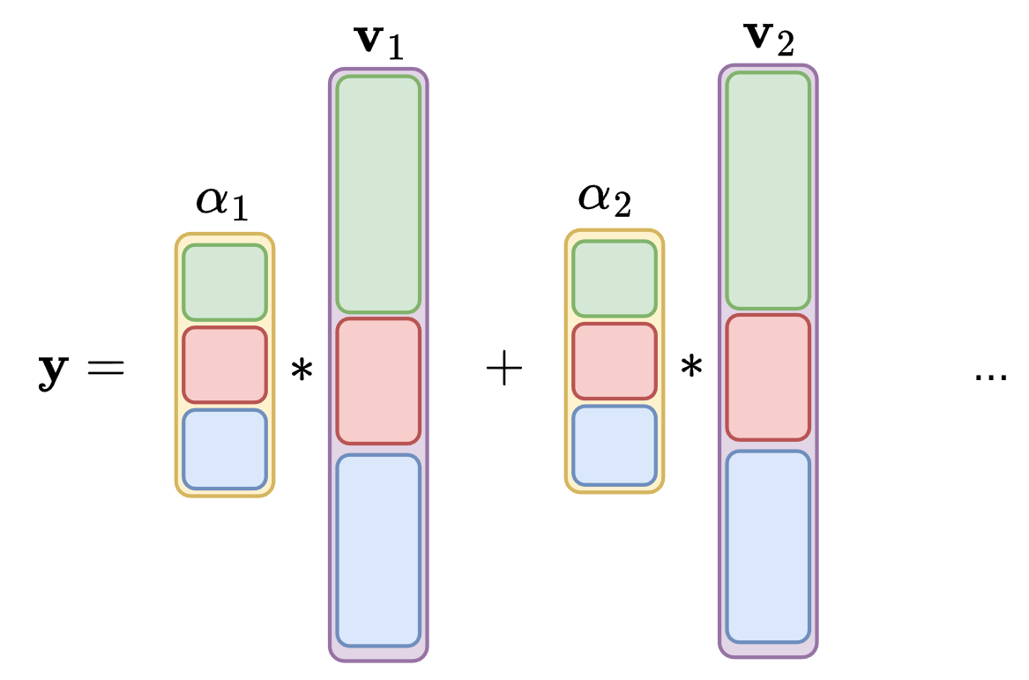
Extensions
Point Transformer v2
Point Transformer v3
Vector attention
Grouped vector attention
PTv1: Large number of parameters for weight encoding layer
Grouped vector attention with shared weights over channel groups
Modifications to pooling for increased efficiency
Serialize points via space-filling curves
Group points into contiguous "patches" for attention
No costly k-NN search
Point Transformer v2, Wu et al. NeurIPS '22
Point Transformer v3, Wu et al. CVPR'24
Notes:
Point Transfomer v2:
In vector attention, as the network goes deeper and there are more feature encoding channels, the
number of parameters for the weight encoding layer increases drastically. The large parameter size
restricts the efficiency and generalization ability of the model.
Introduce grouped vector attention where the weights are not per chanel, but grouped over multiple chanels
This leads to increased efficiency and prevents overfitting
Point Transformer v3:
Replace costly k-NN search by grouping points into contiguous patches for attention
This is done by serializing the point cloud using space-filling curves, which we will not go into detail about

Slide 46
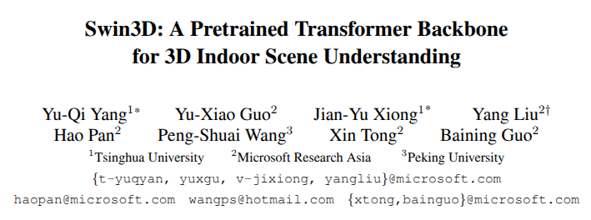
And many more transformer-based works...
Notes:
Due to the natural fit of transformers to point cloud processing, there are lots of other works with similar ideas
We only described one of these works, but there are more to discover

Slide 47
Summary
PointNet: Permutation Invariance
PointNet++: Locality
Point Transformer

Slide 48
Slides credit and resources
This Blog on Attention
https://d2l.ai/ for transformer figures
Learning for 3D Vision, Ioannis Gkioulekas, Shubham Tulsiani, CMU
48
Notes:
Pop re

