Slide 1
Hands-on AI based 3D Vision– Summer 25
Lecture 6_1 – Neural Fields
Prof. Dr.-Ing. Gerard Pons-Moll
University of Tübingen / MPI-Informatics

Slide 2
What is a good representation for 3D data?
2
Notes:
Let's start with why do we need implicit representation and what are other representations are out there, which might be useful for human/clothing modeling

Slide 3
What is a good representation for 3D data?
Compatible with neural networks.
Flexible
High fidelity
3
Notes:
We need a representation that works well with neural network, is flexible and can model high frequency details. Let's look at some of the representation which has been used widely.

Slide 4
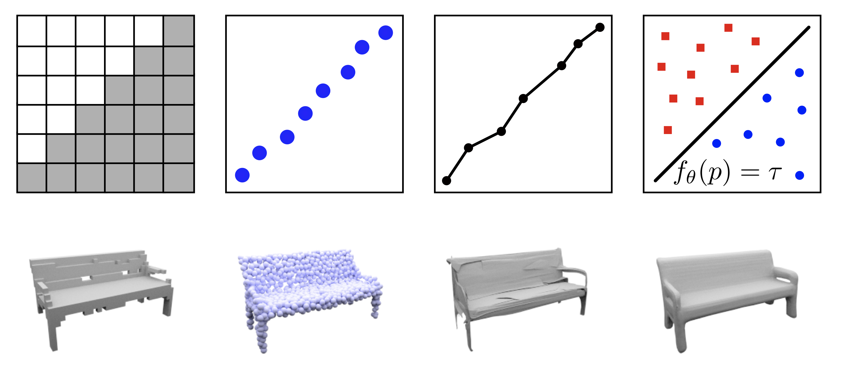
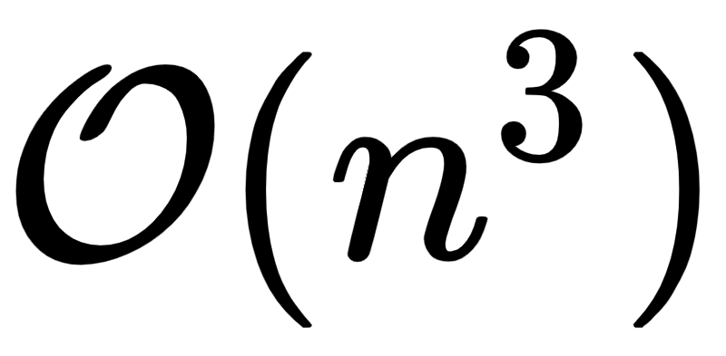
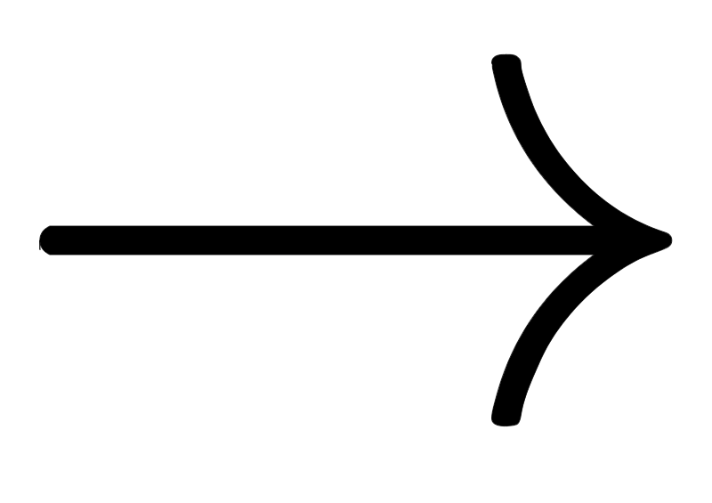
Voxels
Discretization of 3D space into grid.
Easy to process with neural networks.
Cubic memory limited resolution.
[Liao et al. CVPR’18]
[Chov et al. ECCV’16]
4
Image credit: Mescheder et al. CVPR‘19
Notes:
\mathcal{O}(n^3)
First is voxel based representation, which is just the extension of image grids/pixels to 3D
Explain problems

Slide 5
Pointclouds
Discretization of 3D space into 3D points.
Does not model connectivity/topology.
Limited number of points.
[Liao et al. CVPR’18]
[Chov et al. ECCV’16]
5
Image credit: Mescheder et al. CVPR‘19
Notes:
Pointcloud is collection of unordered 3d points in the space, and these points belong to the surface of object.
We can add more information to each point such as colors, normals

Slide 6
Meshes
Discretization into vertices and faces.
Limited number of vertices/granularity.
Requires class specific template.
Leads to self-intersections.
[Wang et al. ECCV’18]
6
Image credit: Mescheder et al. CVPR‘19
Notes:
Now mesh, which has been covered mostly in our lectures. Meshes consists of vertices and its connectivity given by edges and/or faces. Most commonly we use traingulated meshes for representing meshes, i.e. each face represents a triangle. You can also possible use quads for meshes. But we will not go there.
When we use mesh based representation, we need to define connectivity I.e. edges and faces. In order to define different shapes with meshes, we either need to define new mesh templates for each object or we can just deform a given mesh template to explain different geometeries. In first case, it is not practical to create new mesh for every object and in second case, there are limitations e.g. limited resolution, limited topology. As we have already seen in mesh based clothing models.

Slide 7
Implicit representation
Implicit representation No discretization.
Arbitrary topology and resolution.
Low memory footprint.
Not restricted to specific class.
[Mescheder et al. CVPR’19]
[Chen et al. CVPR’19]
[Park et al. CVPR’19
7
Image credit: Mescheder et al. CVPR‘19
Notes:
Today we will focus on implicit representation, which resolves some of the limitations of previous representations such as: limited resoltuon, limited topology.

Slide 8
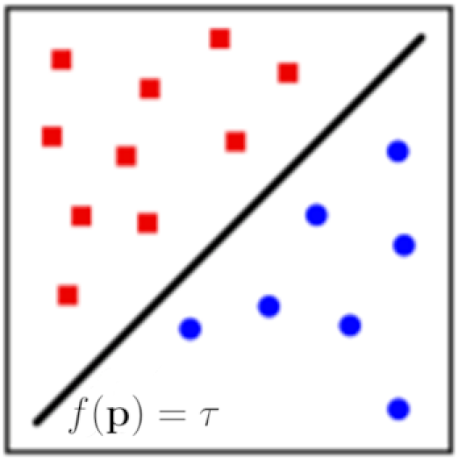

Surfaces as an Implicit Function
A function tells us whether a point is inside or outside an object
If the function is continuous, a levelset of it defines a surface
8
Notes:
Explain implicits
f(\mathbf{p}) = \begin{cases}
0, & \mbox{if} \quad \mathbf{p} \in \mathrm{outside} \\
1, & \mbox{if } \quad \mathbf{p} \in \mathrm{inside}
\end{cases}
\mathcal{S} = \{\mathbf{p},\ f(\mathbf{p}) = \tau \}

Slide 9


Surfaces as an Implicit Function
With implicit functions, Topology changes only require changing
Mesh based representations would struggle
9
Notes:
f(\mathbf{p}) = \begin{cases}
0, & \mbox{if} \quad \mathbf{p} \in \mathrm{outside} \\
1, & \mbox{if } \quad \mathbf{p} \in \mathrm{inside}
\end{cases}
\mathcal{S} = \{\mathbf{p},\ f(\mathbf{p}) = \tau \}

Slide 10
Neural Fields
10
Notes:
In this lecture we will talk about neural fields. Very general concept that can be applied to all kinds of data (not only 3D) but we will mainly focus on neural fields for 3D computer vision / graphics

Slide 11

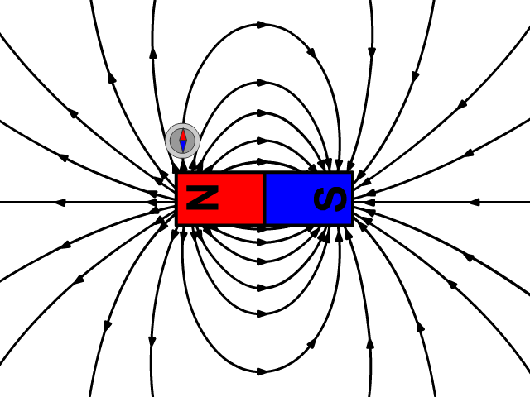
What is a Field? (Physics)
A Field is a mapping associating a scalar or vector quantity to each point in space
Notes:
The name field originates from physics

Slide 12
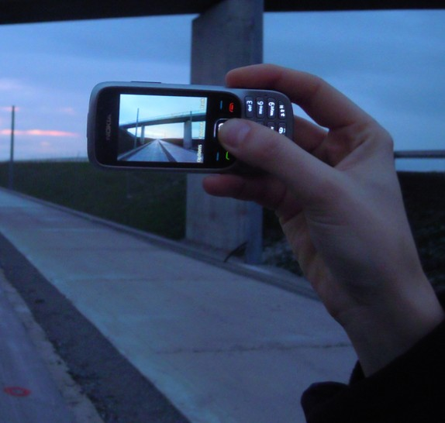
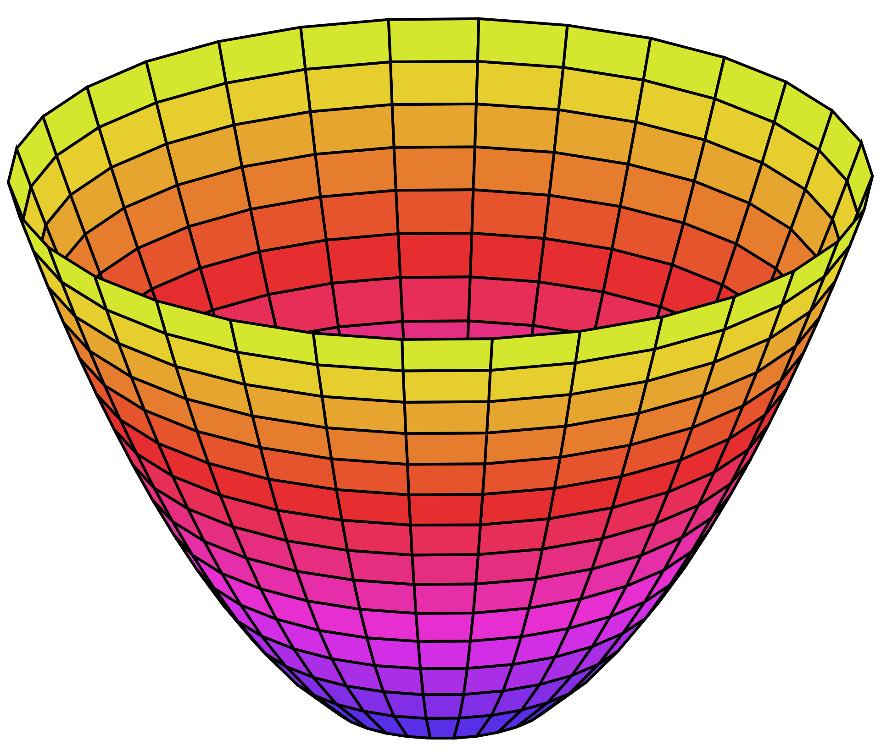
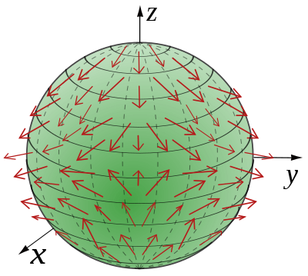
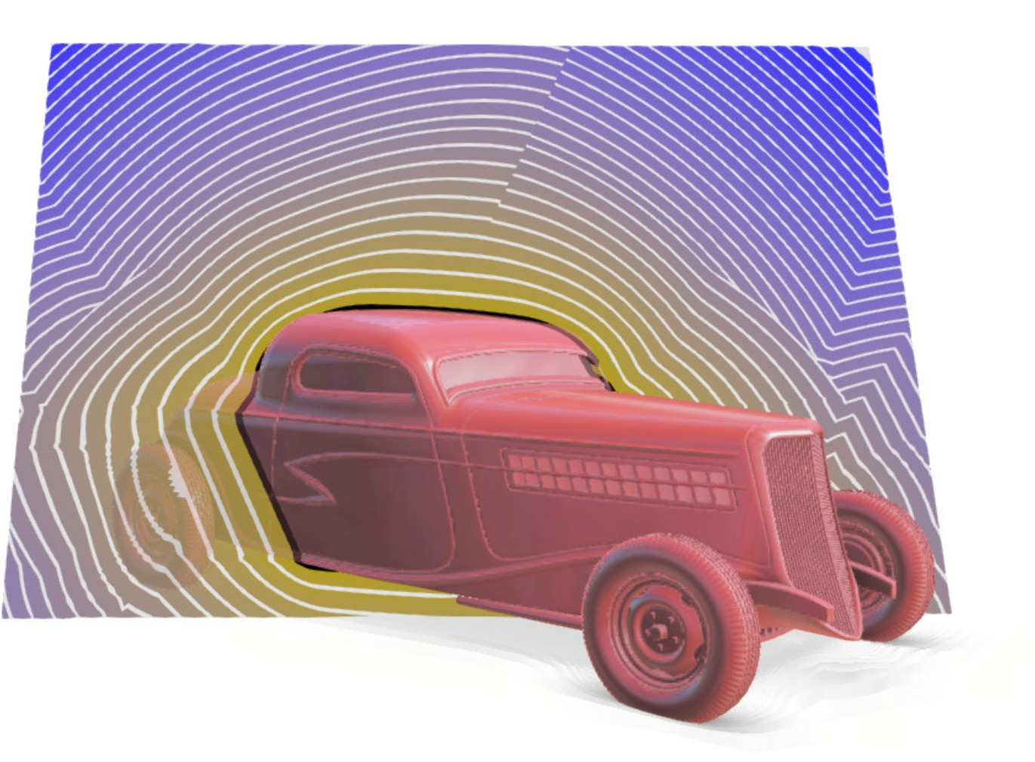
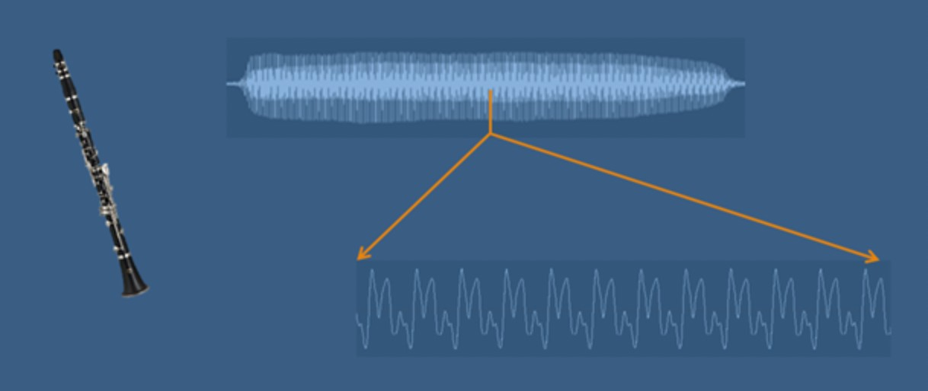
3D Parabola
(Explicit Surface)
Image
Vector Field
3D Signed Distance Fields
(Implicit Surface)
Fields
Audio

Slide 13
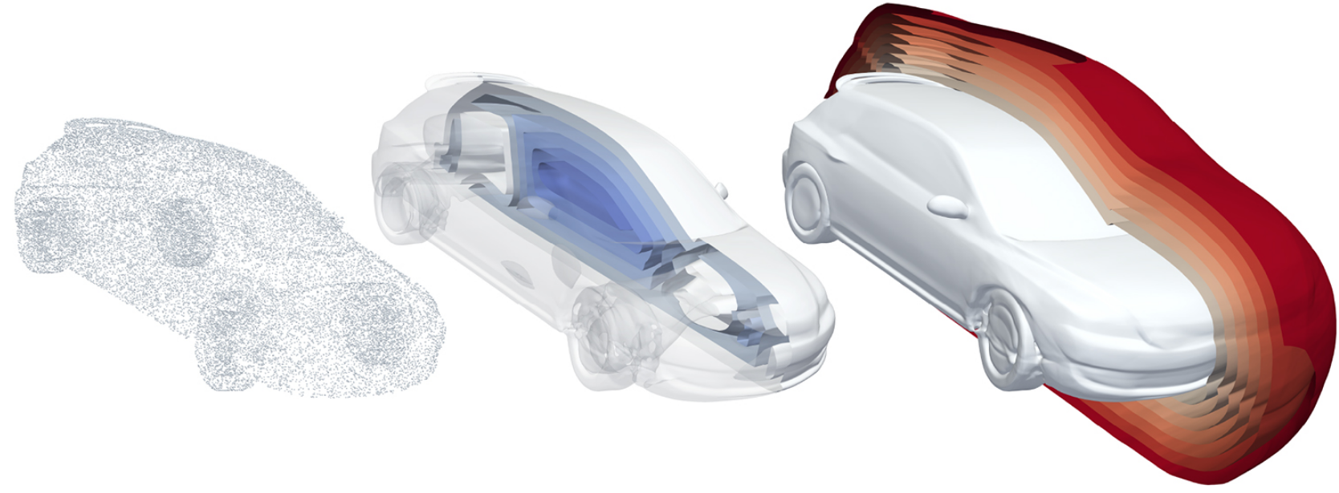
You have already seen fields!
Implicit Geometric Regularization for Learning Shapes. Gropp et al.

Slide 14
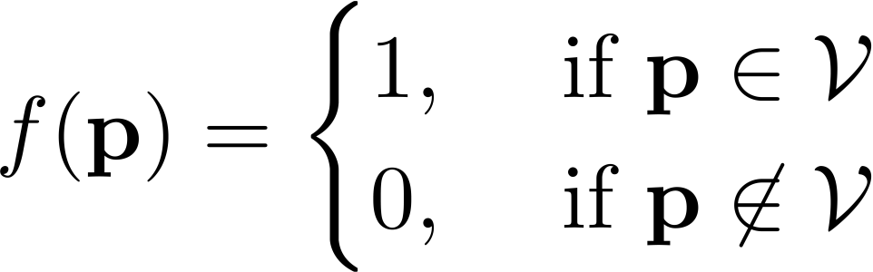

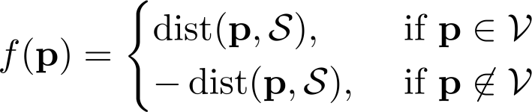
You have already seen fields!
Occupancy Fields:
Unsigned Distance Fields:
Signed Distance Fields:

Slide 15
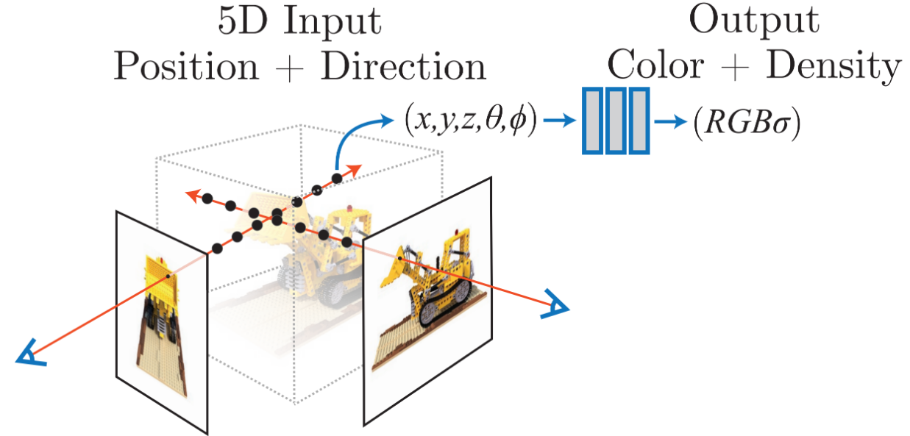
Fields can be anything
Nerf: Representing scenes as neural radiance fields for view synthesis. Mildenhall et al.
Notes:
Briefly tease Neural Radiance Fields as fields where each 3D point (with viewing angle) is mapped to color + density
Next lecture will cover NeRFs in more detail. For now, it suffices to know that it models a field.

Slide 16
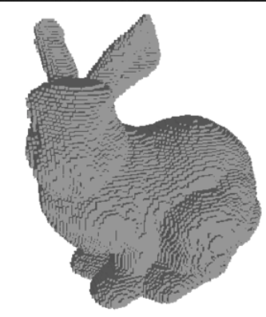
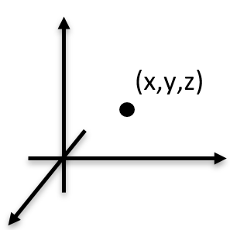
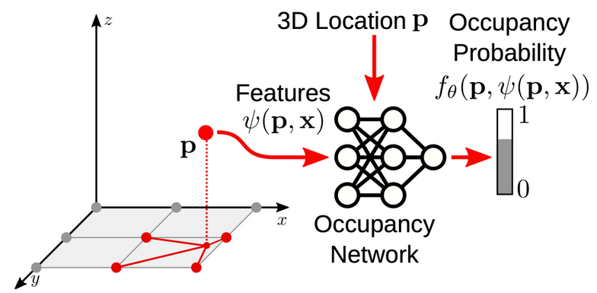
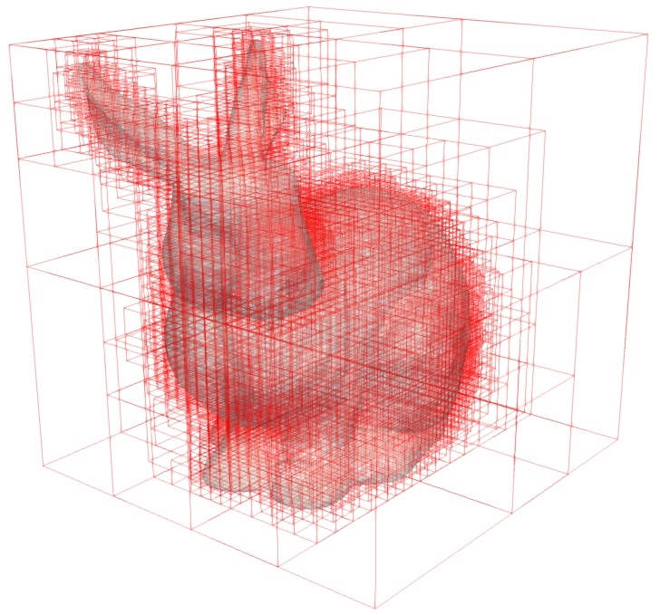
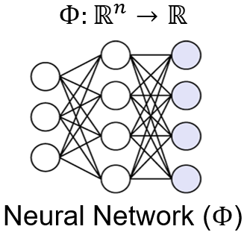
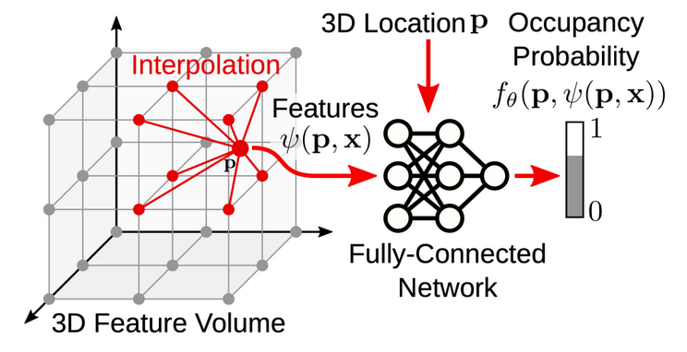
Parameterizing Fields
Discrete
Neural
Hybrid
Notes:
Usually the field mapping f is way too complicated to be written down explicitly.
So we somehow have to parameterize fields.
There are discrete methods like voxel grids and octrees where you essentially evaluate the field at specified control points and simply store those values. Then you can use them to approximate the field at arbitrary points in space.
Of course, one could also try to parameterize a field by a neural network. In the case of SDF, you would have a Neural Network that gets as input some query point (x,y,z) and produces the signed distance of this point to a surface. These neural fields are inherently continuous and we know that theoretically, they can approximate any field to arbitrary precision.
Finally, there are hybrid parameterizations that use the best of both worlds.

Slide 17
Parameterizing Fields
Discrete
Neural
Hybrid
Notes:
The general idea of discrete parametriziation of fields is to store the field value for some control points in 3D space and use those values to approximate the function for arbitrary points.

Slide 18
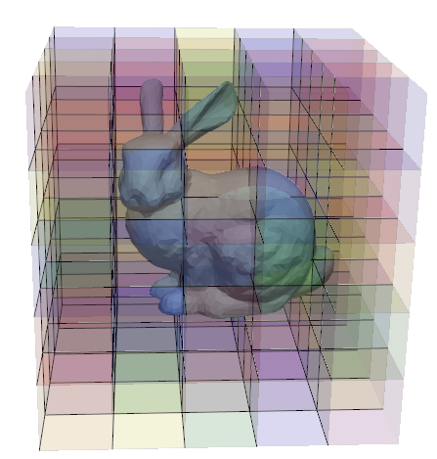
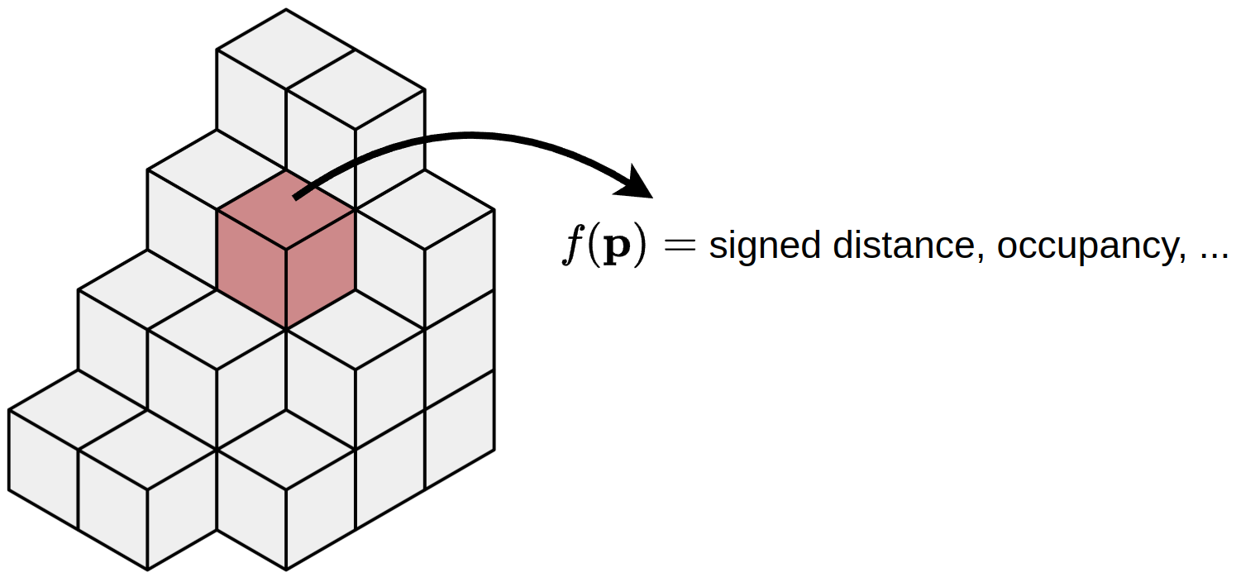
Voxel Grid
Subdivide 3D space into voxel grid of equal sized bins
For each voxel store field value

Slide 19
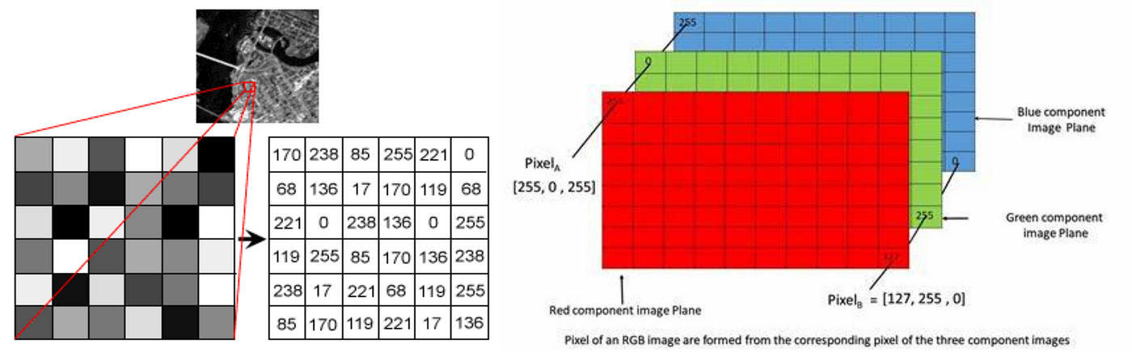
Images are 2D Voxel Grids

Slide 20
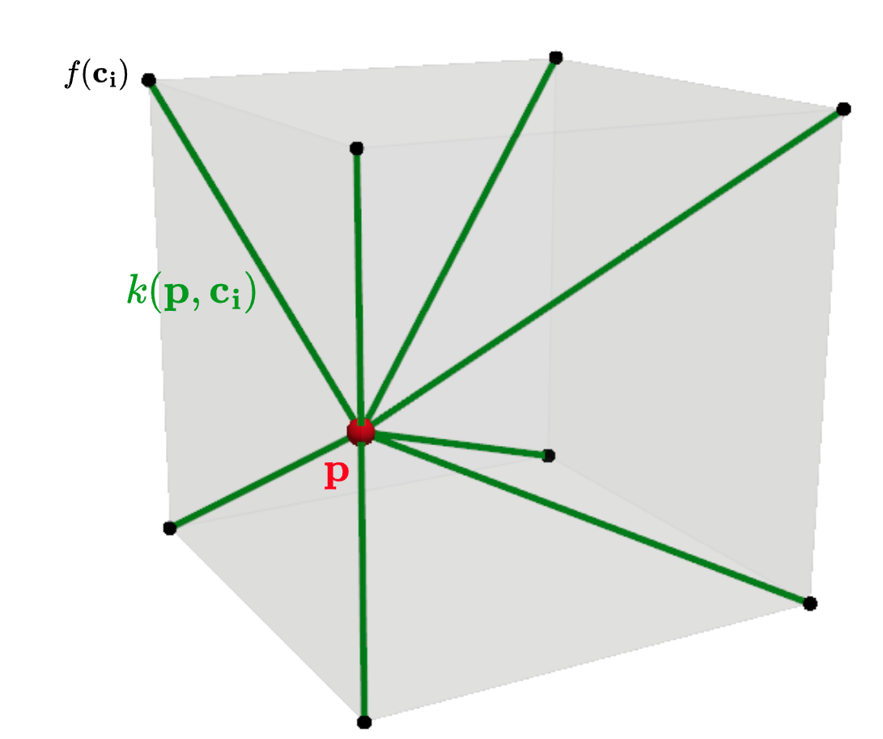

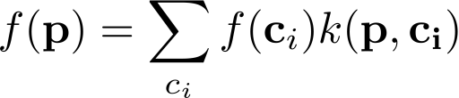
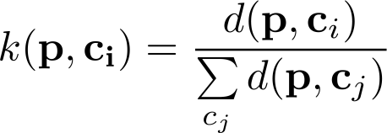
Continuous Fields with Voxels
Values can also be stored at corners of the voxels
For a query point interpolate via
Stored value at corner
Kernel function
E.g.
Notes:
Voxel grids are discrete representations of fields
You can make them continuous via trilinear interpolation

Slide 21

Properties of Voxel Grids
For d input dimensions, and n bins per dimension the memory required is
Intractable in higher dimensions
For 3D scenes: Lots of voxels store no useful information
Retains locality information
Easy to extend CNNs to 3D convolutions

Slide 22
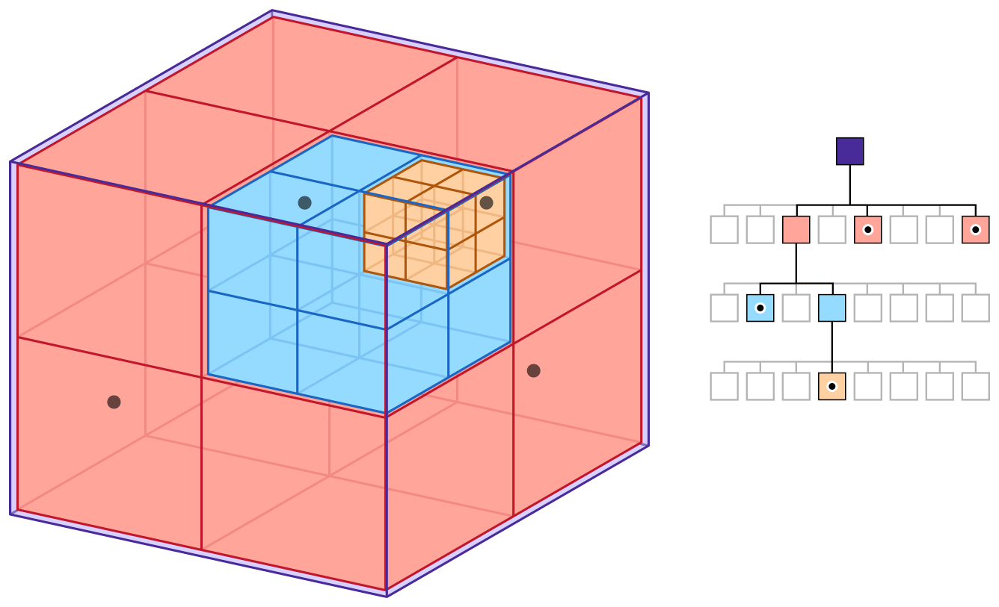
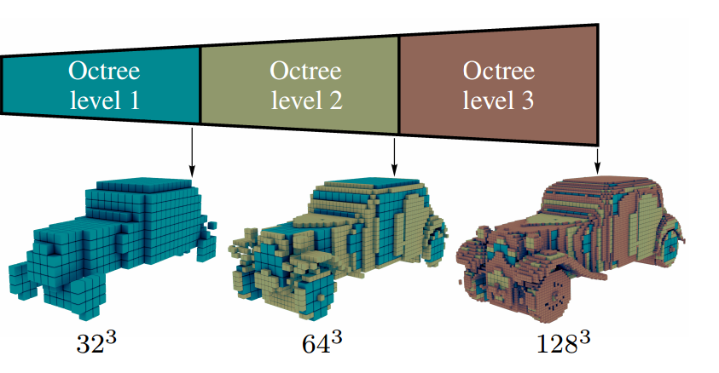
Octrees
Divide voxels into 8 subvoxels if it has more than N points in it
Depth of octree depends on desired resolution
https://dulalsaurab.github.io/assets/img/octree.png
https://lmb.informatik.uni-freiburg.de/people/tatarchm/ogn/

Slide 23
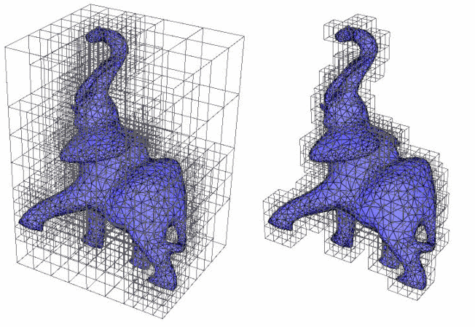
Discussion of Octrees
Reduces memory wasted by empty space
Still memory extensive (depending on desired resolution)
More expensive to construct
Sub-division is not differentiable
To sample a point, have to traverse hierarchy
https://doc.cgal.org/latest/Orthtree/index.html

Slide 24
Parameterizing Fields
Discrete
Neural
Hybrid

Slide 25
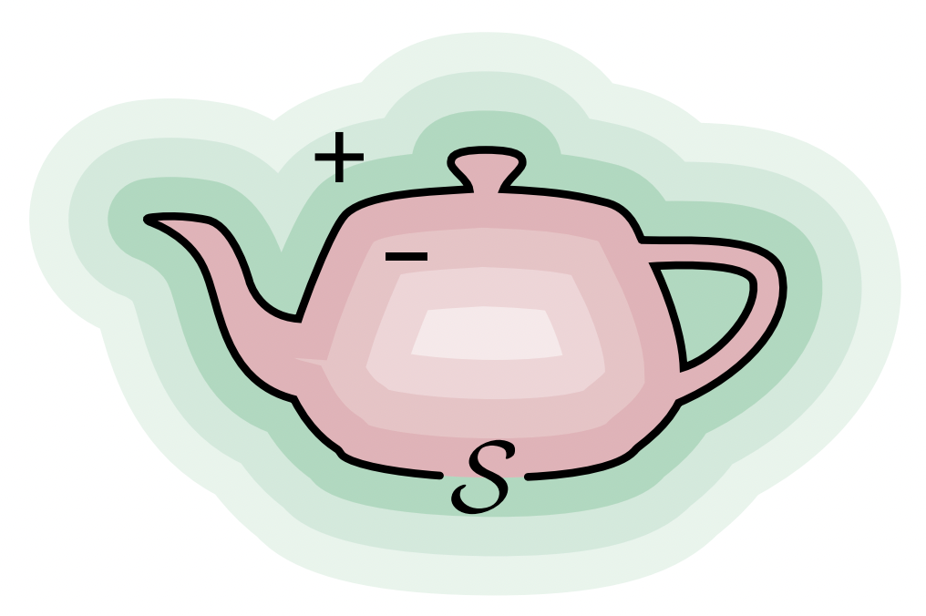
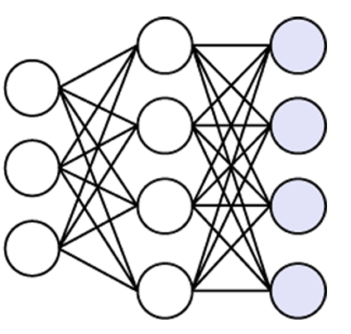

Neural Fields
$$Φ:ℝ^{n}→ℝ$$
(x,y,z)
Signed Distance Function (SDF)
Notes:
The core idea of neural fields is to simply represent the field by a neural network that can be queried for points in space / time
Example: Neural Signed Distance Field

Slide 26
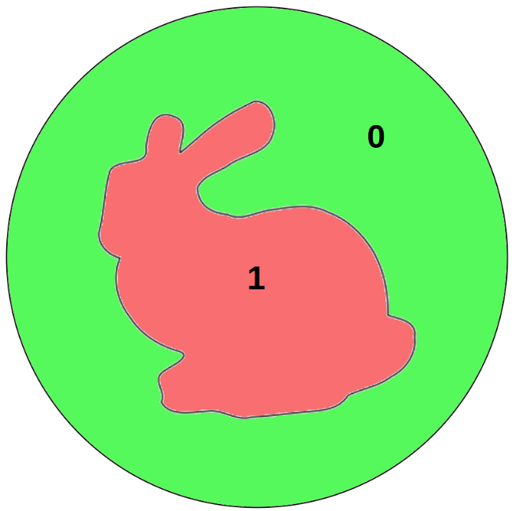
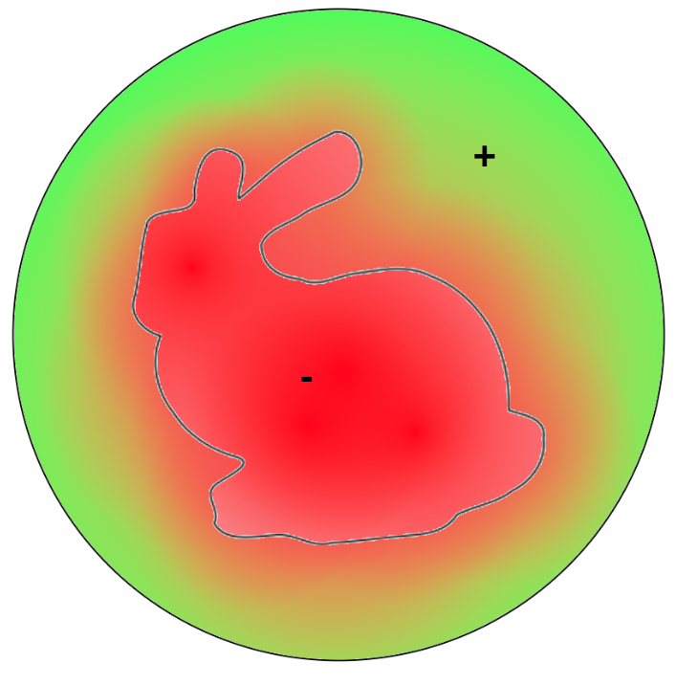
Neural Fields for 3D Scenes
$$Φ:ℝ^{n}→ℝ$$
Occupancy Field
(x,y,z)
Signed Distance Function (SDF)
Occupancy Networks, Mescheder et al. CVPR‘19
IM-NET, Chen et al. CVPR'19
DeepSDF, Park et al. CVPR'19
Notes:
In 2019 there were 3 works that essentially had the same idea.
These are also called Neural Implicits because they are neural representations of implicit functions like SDF, UDF, Occupancy that describe the 3D object

Slide 27
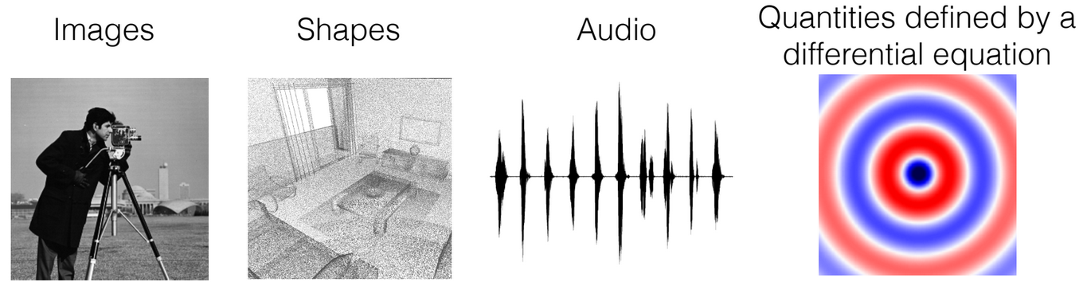
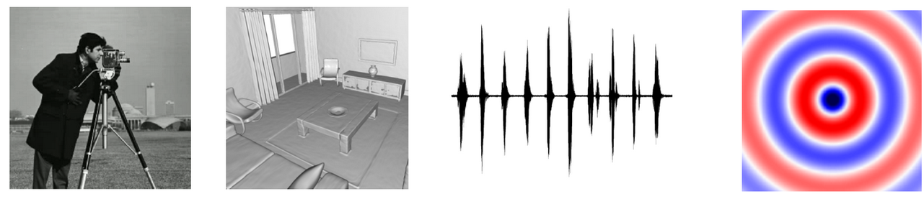
Neural Fields For Other Data
SIREN, Sitzmann et al. NeurIPS '20
Notes:
In theory, neural fields can represent any kind of signal
Images, 3D distance/occupancy functions, audio signals, ...

Slide 28
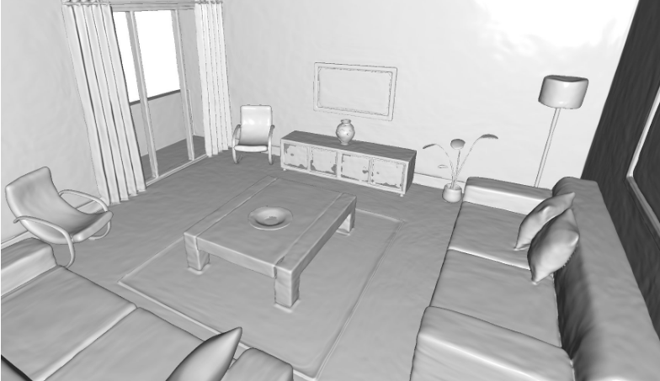
Memory
~1MB memory
Mesh: 110MB
SIREN, Sitzmann et al. NeurIPS '20

Slide 29
Discussion of Neural Fields
Storage memory does not grow with spatial resolution or number of spatial dimensions
Resolution chosen at test time
Adaptive resolution: Assigns more compute to higher frequency areas
Work for arbitary dimensions
Slow training and sampling
Does not expose locality
Inconvenient processing: Cannot run convolutions
Editing is hard
Notes:
It is important to note that neural fields are nothing "smart"
They are just neural networks overfit to a specific scene
They store the scene in their weights
Intuitively, the network automatically assigns "more weights" to parts of the signal with high frequency detail

Slide 30

Comparison
 | Memory | Speed | Locality | Resolution
Discrete
Neural
Hybrid Parametrizations: Best of both worlds

Slide 31
Parameterizing Fields
Discrete
Neural
Hybrid
Notes:
Neural Fields parameterized by fully connected neural networks, can be costly to train and evaluate. Therefore, there are an abundance of strategies that try to reduce this cost by combining discrete and neural approaches.
At the core of these hybrid approaches, a small(!) neural network is augmented by some discrete representation of trainable feature vectors whose values are jointly otimized.
This way, the network does no longer have to do all the heavy lifting, but is aided by some discrete structure that captures spatial features of the signal.

Slide 32
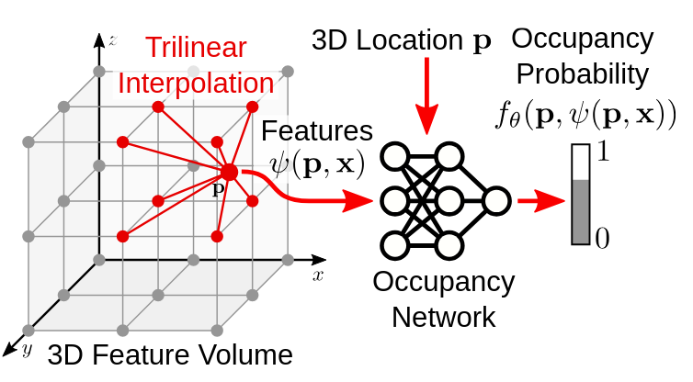
Voxel-Features + Neural Field
IF-Nets, Chibane et al. CVPR '20
Convolutional Occupancy Networks, Peng et al. ECCV '20
Neural Sparse Voxel Fields, Liu et al. NeurIPS '20
Notes:
idea: Store some learnable features in a voxel grid
Smaller neural network takes 3D point p together with the trilinear interpolated feature of that point as input and produces occupancy / distance function / …
There are many works that do something similar, one of them is from our group and we will discuss in more detail later

Slide 33
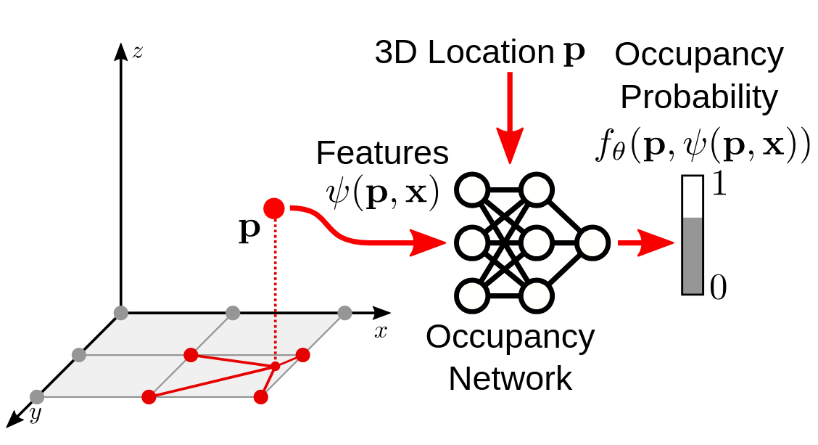
Orthographic Projection onto Feature Plane
Convolutional Occupancy Networks, Peng et al. ECCV '20
Notes:
You can of course also use something different than a 3D voxel grid to store your learnable features
E.g. a feature plane + orthographic projection of p onto that plane

Slide 34
Triplane Representation
Convolutional Occupancy Networks, Peng et al. ECCV '20
EG3D, Chan et al. CVPR '22
Notes:
Trilinear representation maps onto three axis aligned planes, adds the features and passes them through a shallow MLP

Slide 35
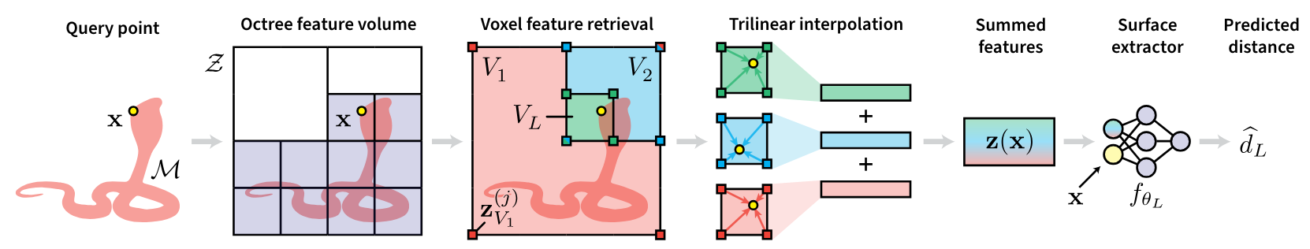
Octree-Feature Volumes
NGLOD, Takikawa et al. CVPR '21
Notes:
We can also, again, replace the voxel grid by an octree. This way we can vary the level of detail
Each cell in the octree now has a feature vector attached to it
We encode our neural SDF using a sparse voxel octree (SVO) which holds a collection of features Z. The levels of
the SVO define levels of detail (LODs) and the voxel corners contain feature vectors defining local surface segments. Given query point x and LOD L, we
find corresponding voxels V1:L, trilinearly interpolate their corners z(j)
V up to L and sum to obtain a feature vector z(x). Together with x,
this feature is fed into a small MLP fθL to obtain a signed distancê dL. We jointly optimize MLP parameters θ and features Z end-to-end

Slide 36
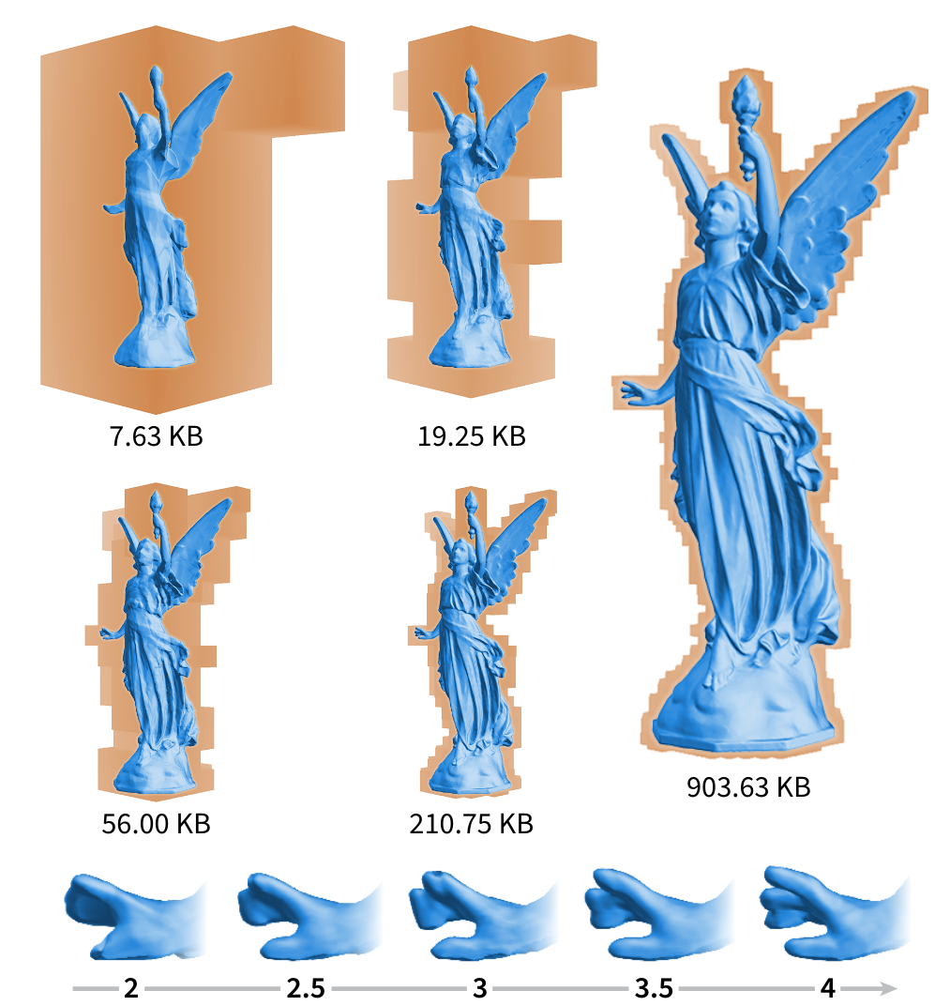
Octree-Feature Volumes
NGLOD, Takikawa et al. CVPR '21
Notes:
Reconstructions at different levels of detail

Slide 37
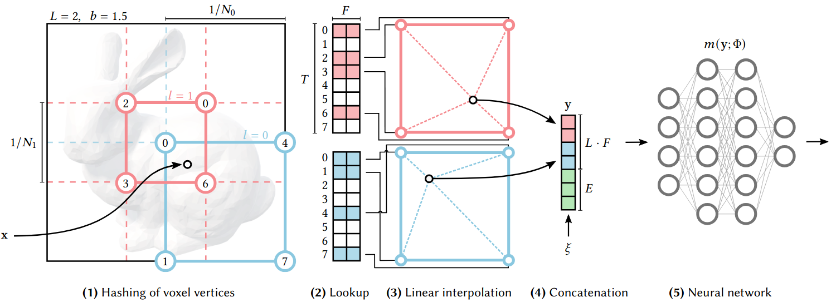
Multi-Scale Voxel Grid + Hash Encoding
Instant Neural Graphics Primitives with a Multiresolution Hash Encoding, Müller et al. SIGGRAPH '22
Notes:
(1) for a given input coordinate x, we find the surrounding voxels at 𝐿 resolution levels and
assign indices to their corners by hashing their integer coordinates. (2) for all resulting corner indices, we look up the corresponding 𝐹 -dimensional feature
vectors from the hash tables 𝜃𝑙 and (3) linearly interpolate them according to the relative position of x within the respective 𝑙-th voxel. (4) we concatenate the
result of each level, as well as auxiliary inputs 𝜉 , producing the encoded MLP input 𝑦 , which (5) is evaluated last. To train the encoding, loss
gradients are backpropagated through the MLP (5), the concatenation (4), the linear interpolation (3), and then accumulated in the looked-up feature vectors.
The multiresolution structure allows the network to disambiguate hash collisions.
This achieves a combined speedup of several orders of magnitude, enabling
training of high-quality neural graphics primitives in a matter of seconds

Slide 38
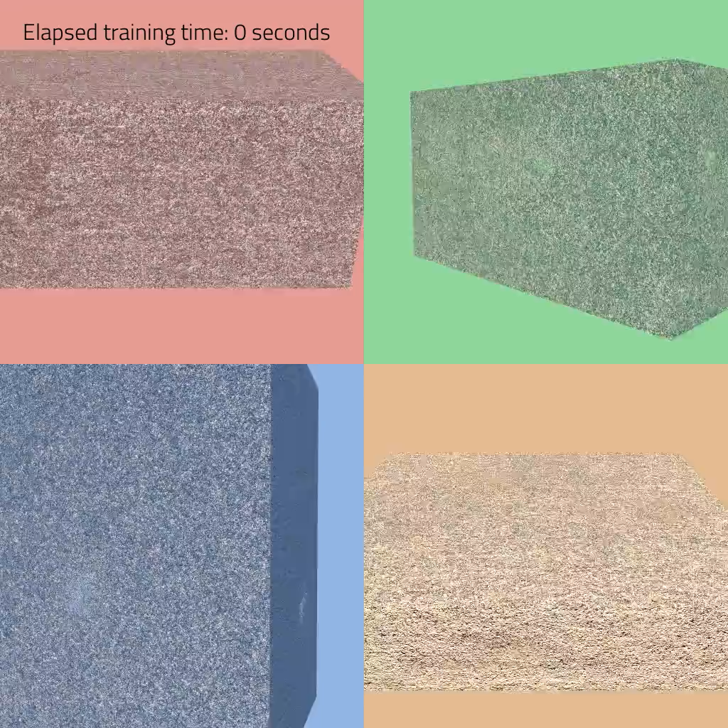
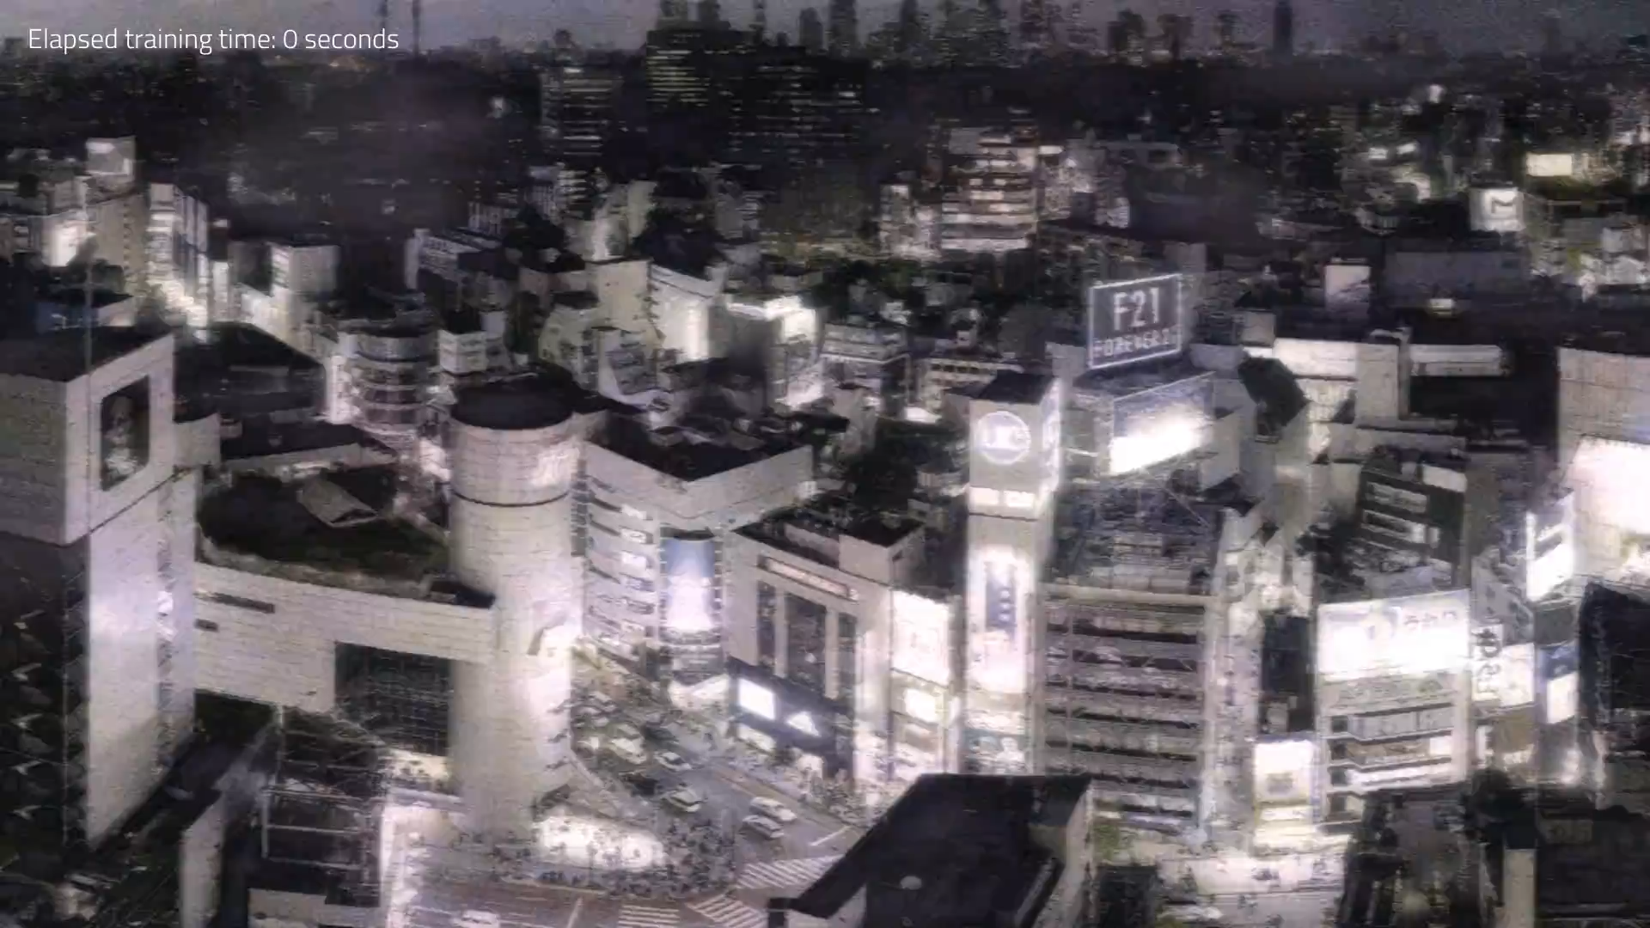
Mult-Scale Voxel Grid + Hash Encoding
Instant Neural Graphics Primitives with a Multiresolution Hash Encoding, Müller et al. SIGGRAPH '22
Notes:
Left: Real-time training progress on the image task where the neural network learns the mapping from 2D coordinates to RGB colors of a high-resolution image. Note that in this video, the network is trained from scratch—but converges so quickly you may miss it if you blink!
Right: Real-time training progress on various SDF datsets. Training data is generated on the fly from the ground-truth mesh

Slide 39
Hybrid Representations
Trade-off between memory and speed
Best of both worlds
Neural network can locally "super-resolve" discrete representation
Notes:
Summary

Slide 40
Neural Fields for 3D Reconstruction
40
Notes:
In this lecture we will talk about neural fields. Very general concept that can be applied to all kinds of data (not only 3D) but we will mainly focus on neural fields for 3D computer vision / graphics

Slide 41
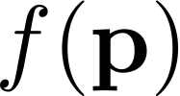
Neural Implicits for 3D Reconstruction
Decoder
41
Notes:
So far we have only looked at the general idea behind neural fields, where we learn some network that represents an implicit representation of scene geometry (e.g. SDF, Occupancy,…)
This is done by overfitting a network to a single scene.
Storing a single shape/scene in a neural network has its usecases, but is not that useful. More sueful is to generalize to different shapes and objects.
We will revisit this in the next lecture on neural radiance fields, but today we want to see how neural fields can be used for 3D reconstruction tasks.

Slide 42
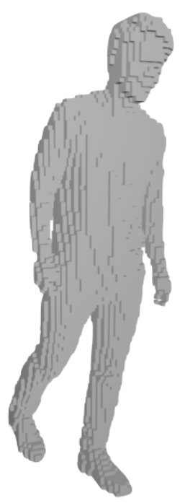
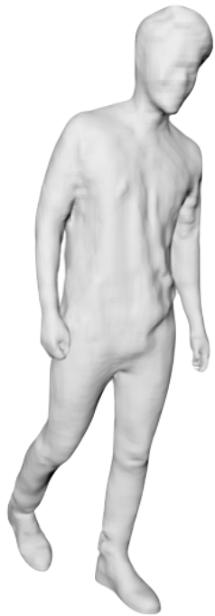
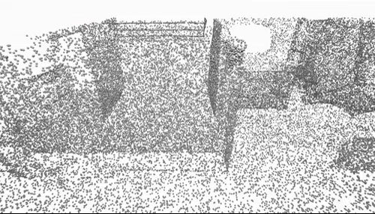
3D Reconstruction Tasks
Voxel Super-Resolution
Point Cloud Completion
Notes:
We might be interested in tasks like voxel super resolution, point cloud completion etc.
In such tasks the input is a deficient 3D geometry, and the goal is to reconstruct the high frequency details, missing parts etc

Slide 43
Previous Implicit Function Learning Architecture
is a shape observation:
Sparse point-cloud
Partial point-cloud
Low-res voxels
Encoder
Decoder
[Mescheder et al. CVPR’19
Chen et al. CVPR’19
Park et al. CVPR’19]
43
Notes:
These three concurrent works from 2019 all followed the same principle.
An input is encoded into a shape code z, and then given a continuous point, the occupancy of the shape is decoded, in this case green inside and white is outside
Write F(x,y,z)

Slide 44
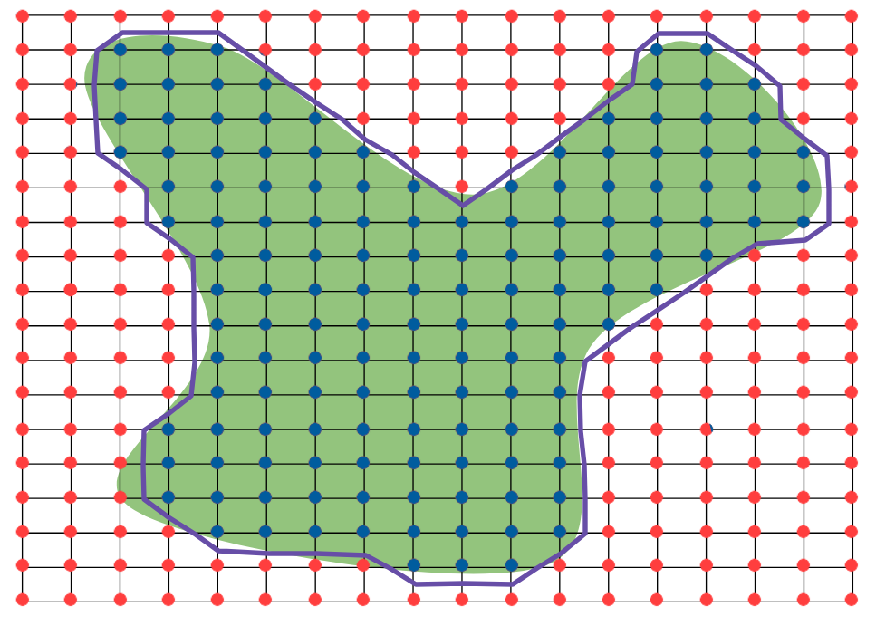
Previous Implicit Function Learning Architecture
is a shape observation:
Sparse point-cloud
Partial point-cloud
Low-res voxels
Encoder
Decoder
[Mescheder et al. CVPR’19
Chen et al. CVPR’19
Park et al. CVPR’19]
44
Notes:
An input is encoded into a shape code z, and then given a continuous point, the occupancy of the shape is decoded, in this case green inside and white is outside
Write F(x,y,z)

Slide 45
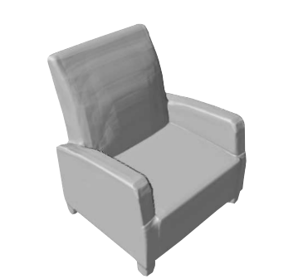
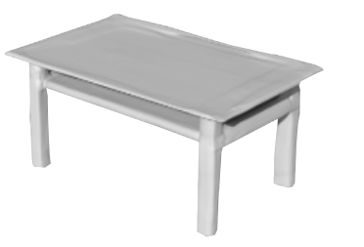

Neural Implicits for common objects
Work well for rigid objects:
Continuous
Multiple topologies
[Park et al. CVPR’19]
[Chen et al. CVPR’19]
[Mescheder et al. CVPR’19]
45

Slide 46






Problem with Previous Work
Reconstruct Articulations
Retain Details
[Chen et al. CVPR’19]
[Mescheder et al. CVPR’19]
[Chen et al. CVPR’19]
[Mescheder et al. CVPR’19]
46
Notes:
We tried to represent humans, and it failed. It also could not retain high-frequency detail in the input and the local input details

Slide 47

Implicit Functions in Feature Space for 3D Shape Reconstruction and Completion
Julian Chibane^{1,2}, Thiemo Alldieck^{1,3}, Gerard Pons-Moll¹
CVPR 2020
47
Notes:
WE propose a solution to this problem in this paper ……

Slide 48

Problems with previous work
1) Loss of 3D structure
Encoder
Decoder
2) Point coordinates carry no information about local shape
[Mescheder et al. CVPR’19
Chen et al. CVPR’19]
48

Slide 49

Implicit Feature Networks (IF-Nets)
3D Grid
Chibane et al. IF-Nets CVPR’20
49

Slide 50
Implicit Feature Networks (IF-Nets)
3D Grid
Chibane et al. IF-Nets CVPR’20
50

Slide 51
Representation of IF-Nets
Previous:
Ours:
Chibane et al. IF-Nets CVPR’20
51
Notes:
f(\mathbf{z},\mathbf{p}) \mapsto [0,1]
\mathbf{F}_1,\hdots ,\mathbf{F}_n, \quad \mathbf{F} \in \mathcal{F}^{K\times{k}\times{k}}
f(\mathbf{F}_1(\mathbf{p}),\hdots ,\mathbf{F}_n(\mathbf{p})) \mapsto [0,1]
\mathbf{F}_1,\hdots ,\mathbf{F}_n, \quad \mathbf{F} \in \mathcal{F}^{K\times{K}\times{K}}
K Error

Slide 52





IF-Nets for 3D Shape Reconstruction and Completion
Reconstruct Articulations
Retain Details
Complete Shape
52

Slide 53


IF-Nets for Texture completion
ECCV SHARP CHALLENGE
Input Prediction GT
Input Prediction GT
[Chibane and Pons-Moll, IF-Nets for texture. SHARP 2020
Chibane et al. IF-Nets CVPR’20]
Notes:
We see: Very incomplete data, currupting legs, feet,…
Surprisingly, IF-Nets are generating feet, in the abcense of local data.
Little evidence for leg is enough to predict near ground truth shape.
IF-Nets learns human shape charactarisitca, I imagend to necessitate a body model. – no body model involved.

Slide 54

Remaining Problem
Surfaces that do not divide the space in two regions can not be represented.
We need a different output representation.
We changed the input representation
SDF:
0
1
Only water-tight surfaces
Open surfaces and manifolds
Functions
Complex shapes
54
Notes:
What is the problem with previous representaiton?

Slide 55

Neural Unsigned Distance Fields for Implicit Function Learning
Julian Chibane, Aymen Mir, Gerard Pons-Moll
NeurIPS 2020
Chibane et al. NDF, NeurIPS 2020
55

Slide 56
Our Solution
Change the output representation
Unsigned distance:
0
1
Only water-tight surfaces
Open surfaces and manifolds
Functions
Complex shapes
Chibane et al. NDF, NeurIPS 2020
56
Notes:
You need to close the surfaces, it is a mess
f(\mathbf{F}_1(\mathbf{p}),\hdots ,\mathbf{F}_n(\mathbf{p})) = \min_{\mathbf{q} \in \mathcal{S}} \|\mathbf{p}-\mathbf{q}\|

Slide 57

Neural Distance Fields
Chibane et al. NDF, NeurIPS 2020
Chibane et al. NDF, NeurIPS 2020
57
Notes:
f(\mathbf{p}) = \min_{\mathbf{q} \in \mathcal{S}} \|\mathbf{p}-\mathbf{q}\|
\mathbf{q} = \mathbf{p} - f(\mathbf{p}) \nabla_\mathbf{p} f(\mathbf{p})
\mathcal{S} = \{\mathbf{p}\in \mathbb{R}^d\,\, | \,\, f(\mathbf{p}) = 0 \}

Slide 58
Neural processing of arbitrary surfaces
Next, we illustrate the capabilities of NDF to neurally process arbitrary surfaces, not representable by prior learned implicit work:
  Mathematical Functions and Manifolds – We train a single NDF on a dataset consisting of 1000 functions per type: linear function, parabola, sinusoids and spirals.
  Garments – Open Surfaces, without thickness. Training on ~300 garments of five types from [Bhatnagar et al. ICCV‘19].
  Scenes – Open surfaces with holes and no thickness. Training on 34 real world scenes captured by RGBD Sensors from [Xia et al. CVPR‘18].
Chibane et al. NDF, NeurIPS 2020
58

Slide 59


NDF results
1) Comparison with IF-Nets
IF-Net (cut)
Ours (cut)
IF-Net (Transparent)
Ours (Transparent)
GT Mesh
Input
Direct Rendering (Front View)
Direct Rendering
(Side View)
Output 1Mio. PC
2) Garment reconstruction
Open surface
Chibane et al. NDF, NeurIPS 2020
59

Slide 60

Direct Rendering of NDF
Input
Depth
Sphere
marching
Normals
Shaded
Back
Chibane et al. NDF, NeurIPS 2020
60

Slide 61

Representation and Regression of Functions
Linear
Quadratic
Sinusoids
Spiral
Quadratic
Regression
Classical regression using NDFs and an adapted sphere tracing (ray tracing method)
Chibane et al. NDF, NeurIPS 2020
61
Notes:
We start with computer vision, graphics
Reconstruction is percveived as a computer graphics and computer vision problem, while regression, interpolation and manifold learning is more a learning problem .
Here
y = h(x_1,\hdots,x_n)
f(x_1,\hdots,x_n,y) = 0
\mathbf{p}(\lambda) = (x_1, \hdots ,x_n,0) + \lambda (0,\hdots, 1)

Slide 62



Representation and Completion of Scenes
Input
Output
Ground Truth
Chibane et al. NDF, NeurIPS 2020
62

Slide 63





Meshes vs Implicits
1) Parametric Meshes
2) Implicit Functions
 | Control /Meaning | Topology | Details
1)
2)
General objects and humans
[Alldieck et al. CVPR’18
Bhatnagar et al. ICCV’19, ECCV’20
Tiwari et al. ECCV’20]
[Chibane et al. CVPR’20
Chibane et al. NeurIPS’20]
2) Compatible with learning
63
Notes:
We have seen that implicit representation can be used for objects and also for humans and even for meshes with open holes such as garments, but if we see their applicabilty in human and clothing modleing, they are limited
As they don't have any control.

Slide 64
More works on Human modeling using Neural Implicits
SCANimate, Saito et al. CVPR'21
LEAP, Mihajlovic et al. CVPR'21
imGHUM, Alldieck et al. ICCV'21
MetaAvatar, Weng et al. NeurIPS'21
ICON, Xiu et al. CVPR'22
PINA, Dong et al. CVPR'22
AutoAvatar, Bai et al. ECCV'22
And Many more.....
NeuralFields
https://neuralfields.cs.brown.edu/
64

Slide 65
Meshes vs Implicits vs PointClouds
 | Control /Meaning | Topology | Details | Speed | Continuous
Meshes
2) Implicits
3) PointClouds
65
Notes:
Traditional pointclouds are not

Slide 66
Slides credit and resources
Thanks to
Julian Chibane, Enric Corona and Qianli Ma
for providing materials.
Parts of the slides were inspired by the course Inverse Graphics by Vincent Sitzmann
TUM AI Lecture Series - Neural Implicit Representations for 3D Vision
(talk by Prof. Pons-Moll)
66
Notes:
Pop re

