Slide 1
Hands-on AI based 3D Vision Summer 25
Lecture 1_0 – Organization
Prof. Dr.-Ing Gerard Pons-Moll
University of Tübingen / MPI-Informatics
Notes:
Wellcome to virtual humans lecture!
In this first lecture I want to talk a bit about the organization of the lecture, and how it is going to be evaluated.

Slide 2
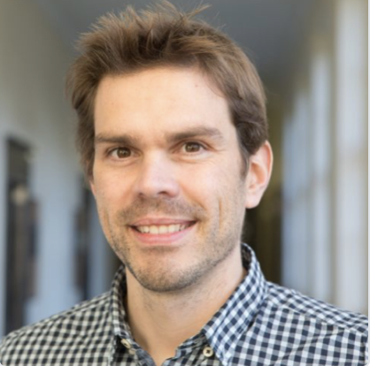
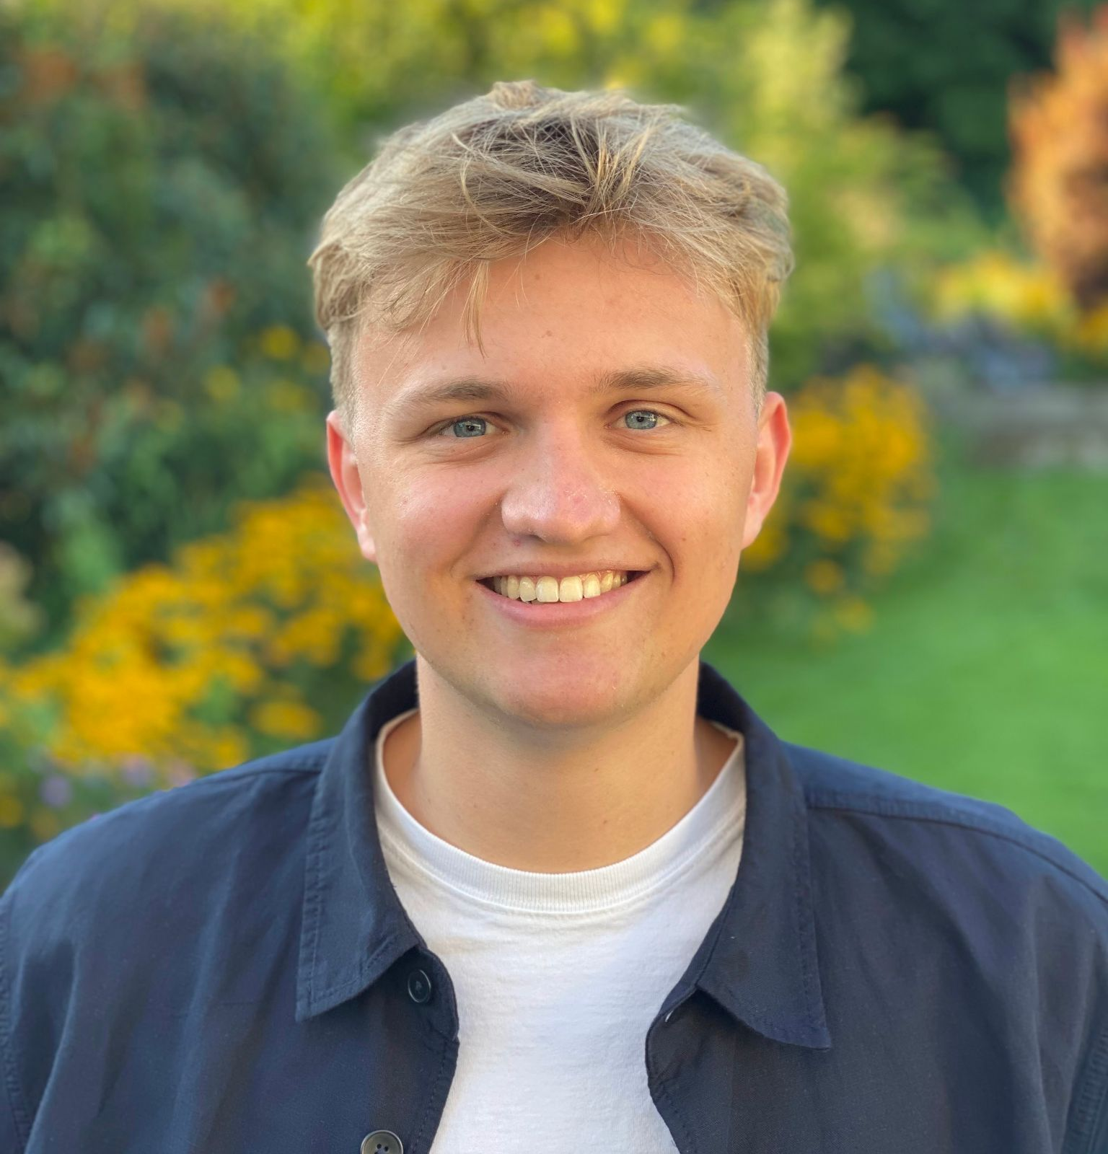
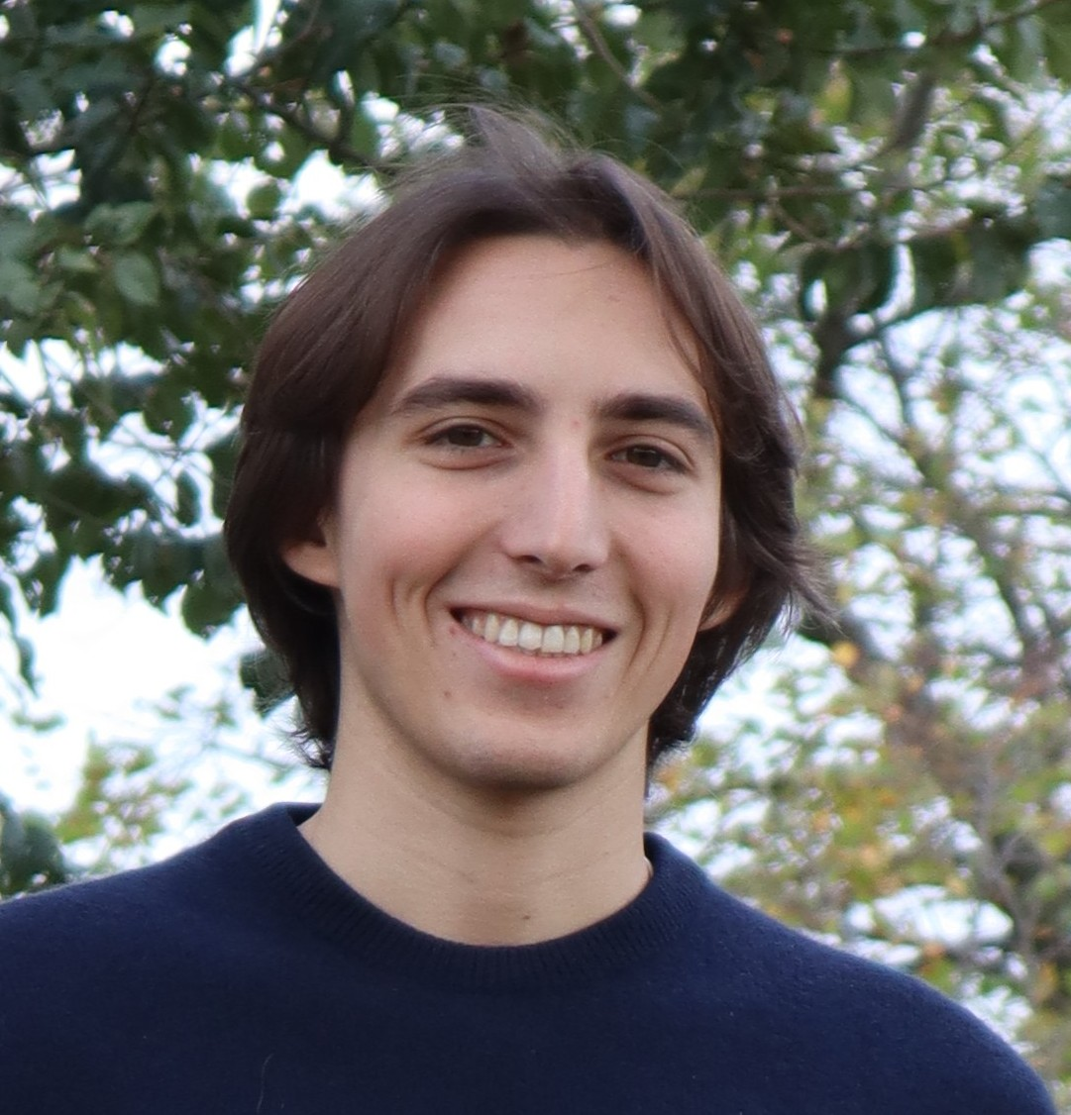
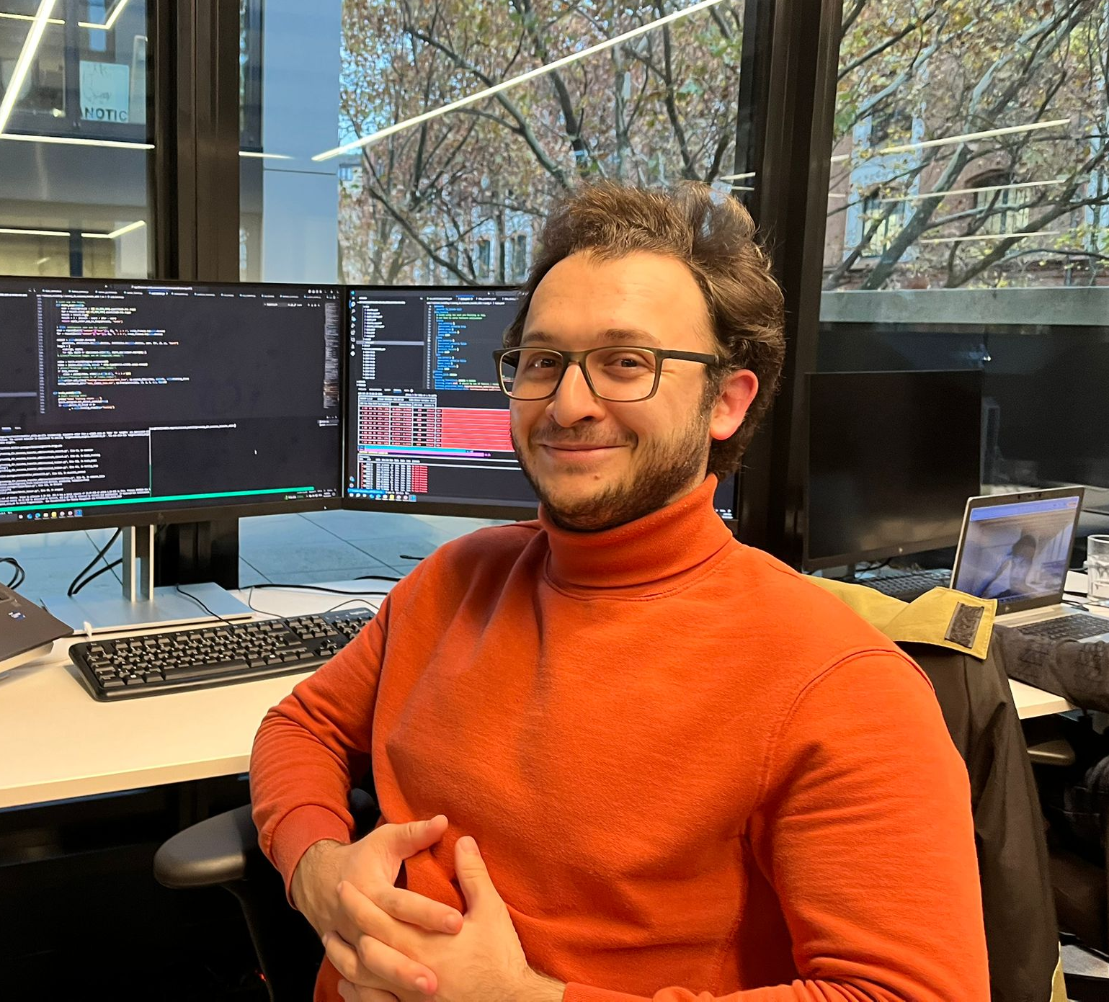
Team
Lecturer
Teaching assistants
Niklas Berndt
2nd floor MvL 6, room A14
Andrea Sanchietti
2nd floor MvL 6, room A12
Eyvaz Najafli
Prof. Dr.-Ing. Gerard Pons-Moll
2nd floor Mvl 6, room A19
Notes:
I am Gerard Pons-Moll. I am professor in computer science....
MVL6 building second floor.
Teaching assistants PhD studetns in my group

Slide 3
Team
Lecturer
I am a Professor in Computer Science at the University of Tübingen and the Tübingen AI center
My group focuses on 3D computer vision and graphics
Special focus on Virtual Humans – making machines human-like
I want to teach machines to see, perceive and act on the 3D world like humans do
Prof. Dr.-Ing. Gerard Pons-Moll
2nd floor Mvl 6, room A19
Notes:
I am Gerard Pons-Moll. I am professor in computer science....
MVL6 building second floor.
Teaching assistants PhD studetns in my group

Slide 4
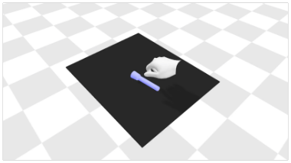
Team
Teaching assistant
I am a first year PhD student supervised by Prof. Dr. Pons-Moll
Studied computer science and mathematics at RWTH Aachen
Interested in analysis and synthesis of realistic and plausible human-object interactions
Niklas Berndt
2nd floor MvL 6, room A14
Notes:
I am Gerard Pons-Moll. I am professor in computer science....
MVL6 building second floor.
Teaching assistants PhD studetns in my group

Slide 5
Team
Teaching assistant
I am a first year PhD student in the Real Virtual Humans group
Studied Computer Science at University of Rome La Sapienza
My research topic concernes garment representation and reconstruction
Andrea Sanchietti
2nd floor MvL 6, room A12
Notes:
I am Gerard Pons-Moll. I am professor in computer science....
MVL6 building second floor.
Teaching assistants PhD studetns in my group

Slide 6
Team
Teaching assistant
Graduated from Master of Science in Machine Learning at the University of Tübingen
Starting Ph.D. student in RVH
Intersted in 4D reconstruction & generation
Eyvaz Najafli
Notes:
I am Gerard Pons-Moll. I am professor in computer science....
MVL6 building second floor.
Teaching assistants PhD studetns in my group

Slide 7
Organization
Course webpage:
https://virtualhumans.mpi-inf.mpg.de/3DVision25/
Lecture
Tuesday 12-14, Sand
Tutorials on Tuesday 14-16, Sand
The course is 6 ECTS
Grade:
50% exam, 20% exercises, 30% project
ILIAS and Website
Announcements, discussion forum on ILIAS
Exercises will be made available on ILIAS
Slides will be available from the course webpage
Work in teams
Form teams up to 2 people
Add your team names on google docs (link)
Deadline: April 21th 23:59PM CET.
Exercises: Only 1 report per team

Slide 8
About Lectures and Tutorials
Lectures and Tutorials will be in presence.
It is really important that you participate in class. Any question is welcome. For example, ‘’I didn’t understand slide XX” or “I’d like to know more about these type of models” etc.
Classes will not be recorded.

Slide 9
Tutorial / Exercises
The exercises will consist of theoretical questions and also programming exercises
The final exercise (project) will consist of a mini research project
You can complete the exercises in teams of 2 people
Form a “team” until next week Apr 21 23:59PM CET.
Add your team names on this google doc.
We will remove you from the course if your name is not there to leave slots for waiting list students.

Slide 10
Evaluation criteria
Exam (Oral or written) 50 %:
Depending on the number of students exam will be oral or written
You need to pass the exam to pass the course
Exercises (20%) + project (30%):
Exercises:
Evaluation of theoretical exercises is based on correctness and clarity
Project (mini-research project ~6 weeks) – we will evaluate
Completeness of the report, including motivation, prior work, methodology, evaluation, and limitations/discussion.
Whether the developed methods are substantial (not a small addition).
Robustness of the final result in the scale and scope it was developed.
We will have different TAs read the reports so that grading is unbiased.
To pass the course, you need to pass the exercises, project and exam

Slide 11
Goal
After this course, students should be able to:
Understand research papers related to 3D vision and be able to assess how they fit within the state of the art
Develop classical and modern algorithms
camera parameters estimation, Structure-from-Motion, pointcloud processing, Neural Rendering techniques, Generative models
Requirements:
Master course. Knowledge of linear algebra, probability theory and programming skills are required.

Slide 12
Lectures & Tutorials Schedule
Location:
Lectures: A104, Sand
Tutorials: A104, Sand
Lecture | Lecture Date & Time | Tutorial Date & Time | Lecture Title
Lecture 01 | April 15, 12-14PM | April 15, 14-16PM | Introduction to 3D Computer Vision
Lecture 02 | April 29, 12-14PM | April 29, 14-16PM | Camera Models and Coordinate Systems + First exercise
Lecture 03 | May 06, 12-14PM | May 06, 14-16PM | Classical 3D Reconstruction Techniques
Lecture 04 | May 13, 12-14PM | May 13, 14-16PM | Stereo Vision and Depth Estimation + Second exercise
Lecture 05 | May 20, 12-14PM | May 20, 14-16PM | Surface reconstruction and Procrustes alignment
Lecture 06 | May 27, 12-14PM | May 27, 14-16PM | Neural Fields and Point Based Representations + Third exercise
Lecture 07 | June 03, 12-14PM | June 03, 14-16PM | Neural Radiance Fields (NeRF)
Lecture 08 | June 10, 12-14PM | June 10, 14-16PM | Gaussian Splatting and Point Clouds + project proposal
Lecture 09 | June 17, 12-14PM | June 17, 14-16PM | Advanced Methods in Learning-Based 3D Reconstruction
Lecture 10 | June 24, 12-14PM | June 24, 14-16PM | Generative models
Lecture 11 | July 01, 12-14PM | July 01, 14-16PM | SDS based methods
Lecture 12 | July 15, 12-14PM | July 15, 14-16PM | Recap of concepts
Lecture 13 | July 22, 12-14PM |  | Project Presentation. DEADLINE July 22 00:00 CET

